Slide 1
BIOMARKERS AND TOXICITY MECHANISMS
10 – BIOMARKERS
Introduction
Luděk Bláha, PřF MU, RECETOX
www.recetox.cz

Slide 2
Definition and applications
- markers in biological systems with a sufficently long half-life which allow location where in the biological system change occur and to quantify the change.
Various definitions and applications of „biomarkers“
  – Ecology / Geology
  Human health and diseases
  Toxicology (special focus in this class)

Slide 3
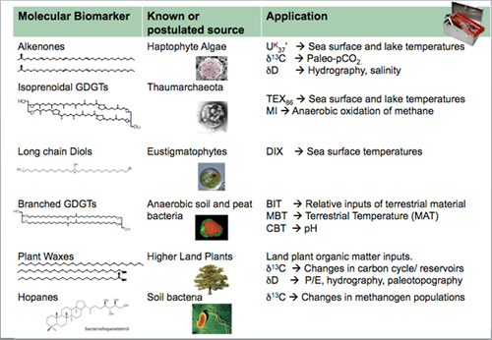
Biomarkers in ECOLOGY / GEOLOGY

Slide 4
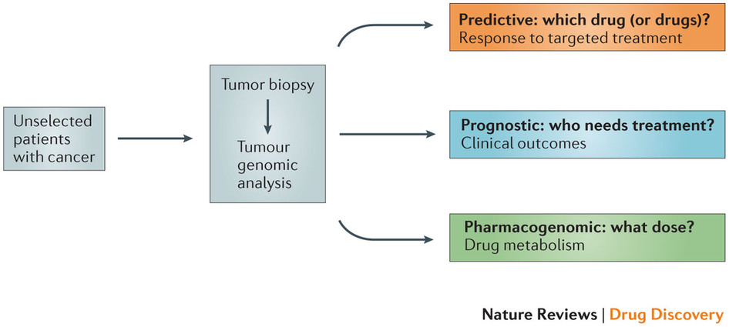
Biomarkers in HUMAN HEALTH
Examples of biomarker
applications
in human health:

Slide 5
Biomarkers in TOXICOLOGY
Identification of markers that inform/predict about long-term risks
  Human: chronic health –e.g. early stages of liver steatosis, carcinogenesis
  Ecotoxicology: early markers of ecotoxic effects
BIOMARKER
  change which occurs as a response to "stressors“ (xenobiotics, disease, temperature...) extending the adaptive response beyond the normal range
In vivo biomarkers:
  changes measured in stressed organisms, i.e. in vivo ("classical biomarkers“ in toxicological research)
In vitro biomarkers
  in vitro testing characterizing potencies of xenobiotic to induce specific biological activity (or toxicity mechanism)
    = biological potencies (markers of potential hazards)

Slide 6
Biomarkers - classification
Categorization by US National Academy of Sciences
- Biomarkers of exposure
- Biomarkers of response or effect
- Biomarkers of susceptibility
Continuum exists among biomarkers
Example: adducts of a toxicant bound to nucleotide
? biomarker of exposure (proof of toxicant)
? biomarker of response or effect (modified nucleotide = effect)

Slide 7
Various biomarker types
Specific (selective) in vivo biomarkers
  Biomarkers selectively reflecting specific types (mechanisms) of toxicity
    E.g. inhibition of AcCholE :
    exposure = organophosphates; effect = neurotoxicity
+ provides specific information
- multiple biomarkers need to be measured in parallel when searching for a cause of intoxication
Non-specific (non-selective) in vivo biomarkers
  Biomarkers of general stress
    E.g. induction of Heat Shock Proteins (hsp)
+ general information about stress
- sensitive to many "stressors" (chemicals, temperature, salinity ...)

Slide 8
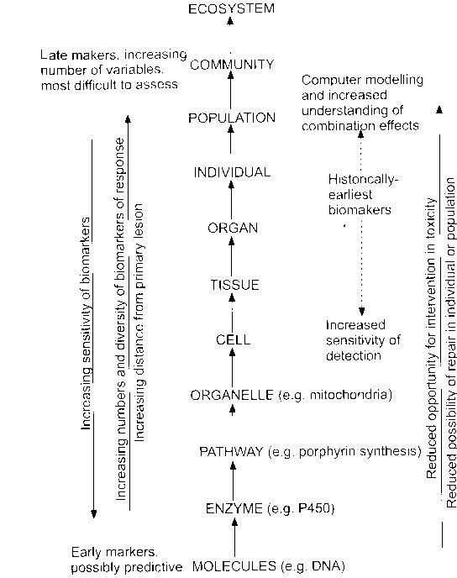
Biomarkers at different levels of biological organisation
These
BMs
are
mainly
covered
in our
lecture

Slide 9
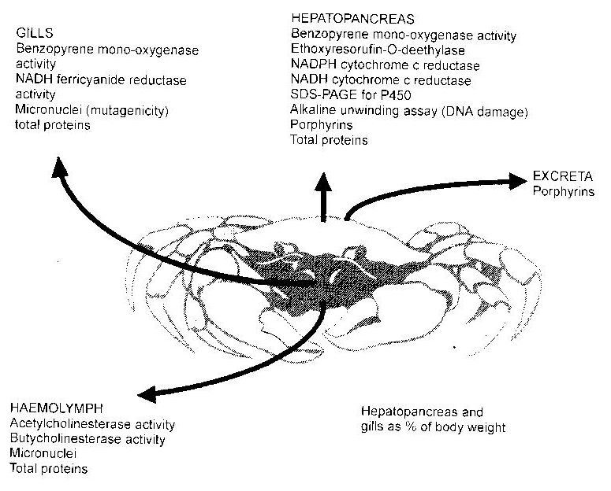
Sampling biological materials for biomarker analyses
Non-destructive (non-invasive)
  blood / haemolymph collection & analyses
  skin, feather, hair, urine …
  (life of the organism not affected)
Destructive (invasive)
  whole animal
  → research should follow 3R principles (Replacement, Reduction and Refinement)
  → maximum use of the biological material
  multiple biomarker evaluation

Slide 10
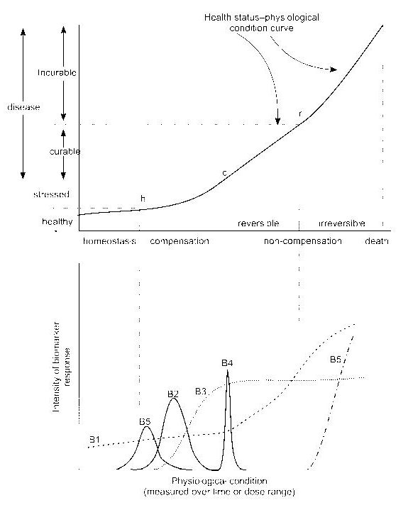
Biomarkers
& Exposure
Health effect intensity
h: homeostatic conditions
c: reversible stage
r: irreversible effects of pollutants
Various biomarker profiles
- temporal changes–B2; B4
- repeated occurrence (B5)
- continuous increase (B1)
- increase with maximum (B3)
: B1 + B3 are candidate biomarkers !
Stressor / time
Biomarker intensity
Stressor / time

Slide 11
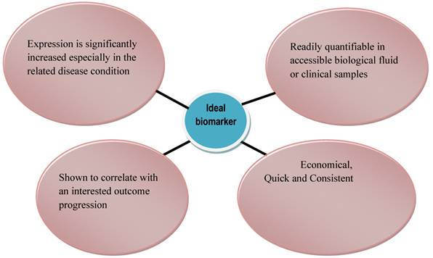
Ideal biomarker

Slide 12
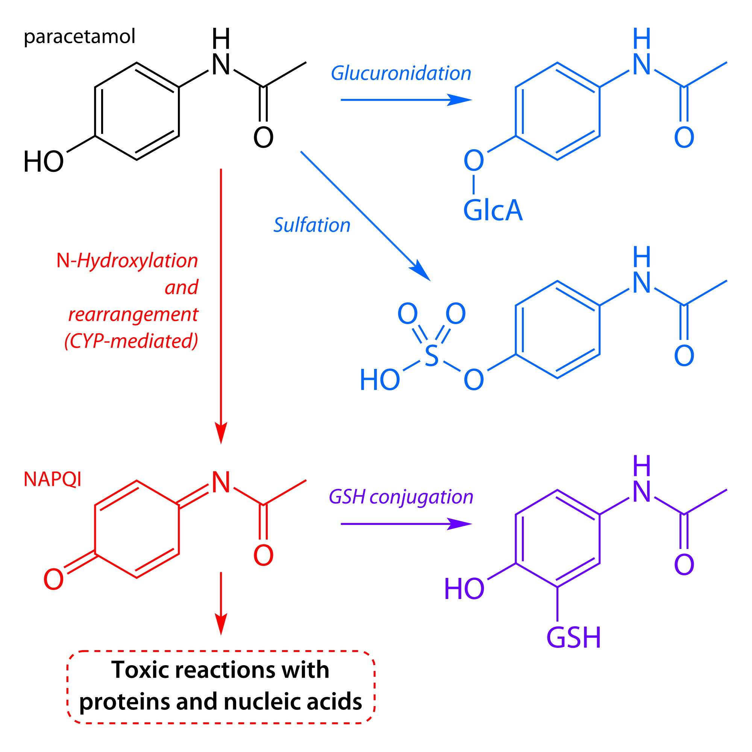
EXAMPLE
- Paracetamol

Slide 13
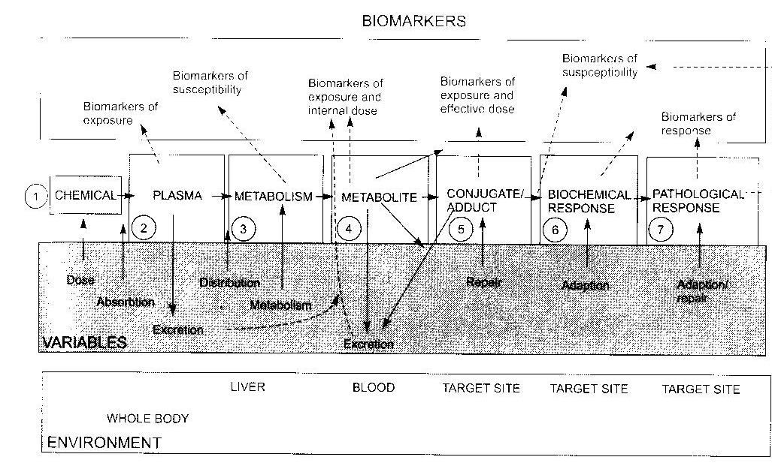
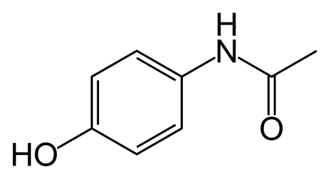
EXAMPLE
- Paracetamol
paracetamol
parent compound measurement - biomarker of exposure
activation to reactive metabolite (N-ac-p-benzoquinone, NAPQI) by CYP
→ reaction with GSH / measurement – levels of CYPs; levels of GSH – susceptibility
GSH-NAPQI conjugate – exposure, susceptibility
NAPQI-protein adducts → toxicity: exposure, effective dose
adaptations: GSH depletion, inhibition of protein synthesis – biomarkers of response
protein alkylation → degeneration of hepatocytes: necrosis
→ increase concentrations of bilirubin in plasma + inflammation - response / effect

Slide 14
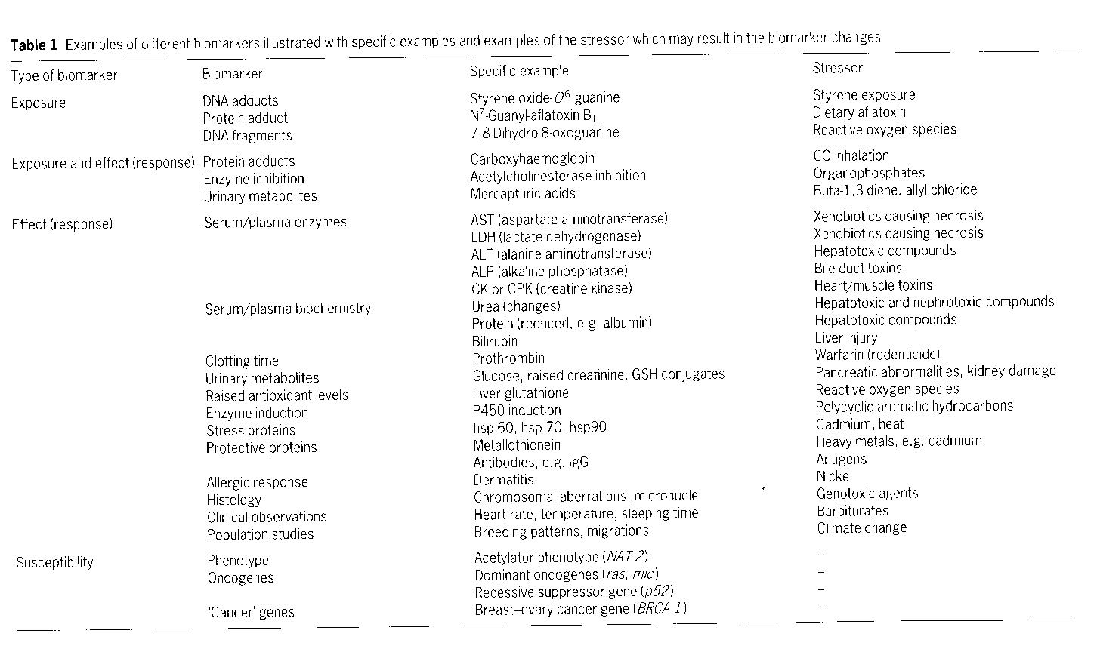
Biomarkers in toxicology – examples / overview
(some are discussed in detail in following lectures)

