Slide 1

INTRODUCTION TO EPIDEMIOLOGY AND ENVIRONMENTAL HEALTH
E2040 – Lecture
E2041 – Practice

Slide 2
WHAT IS THIS COURSE ALL ABOUT?
Course rules and expectations
  Syllabus, class content, and the course instructors
Introduction to the topic
  Definition of epidemiology and public health
  The tasks of epidemiology
  The role of the environment in human health

Slide 3
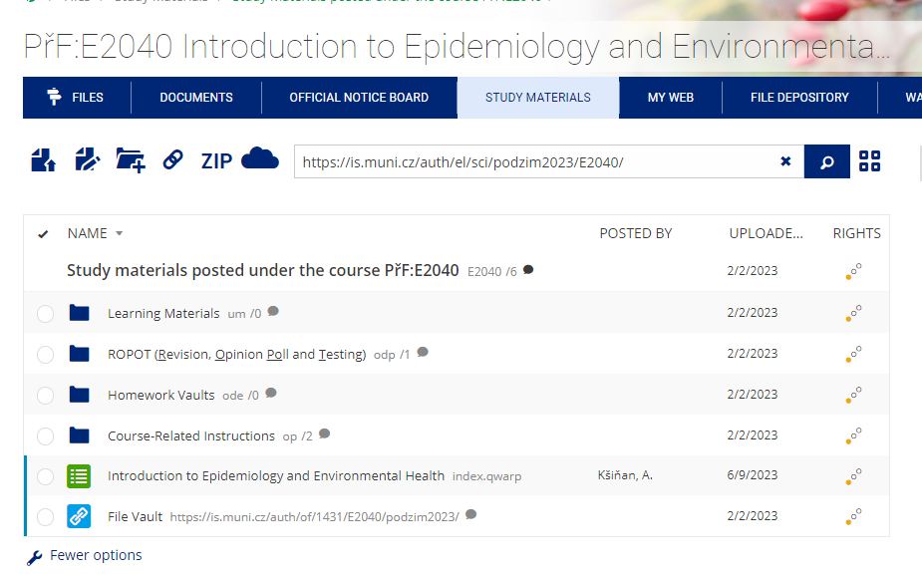
SYLLABUS HIGHLIGHTS
Study materials will be available in IS.MU before each lecture
2 exams (midterm and final during examination period)
Mandatory attendance at the practice sessions
2 assignments that require preparation at home
Read the syllabus!

Slide 4
CLASS CONTENT
Essential concepts in epidemiology and environmental health
Disease occurrence and determinants in populations
Measures of disease frequency, defining cases
The basics of quantitative methodology
Introduction to data analysis, sources of data
Measures of association and effect
Study designs in epidemiology
Confounding, effect modification, and bias in epidemiology studies
Critical evaluation of research studies
Ethical considerations in epidemiology research and practice
Translating science into practice

Slide 5
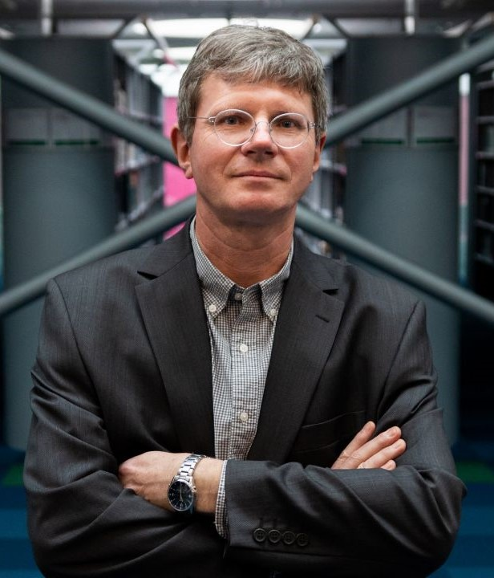



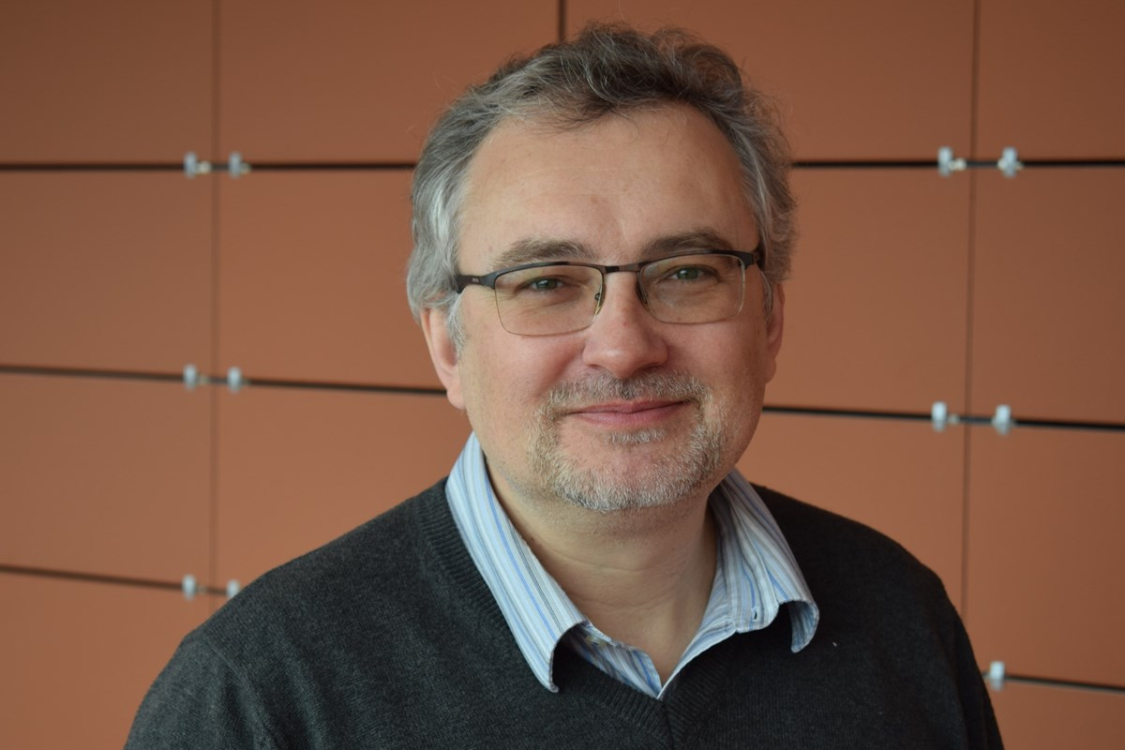

INSTRUCTORS
Martin Bobák
Anna Bartošková
Daniel Szabó
Albert Kšiňan
Andrea Dalecká
Hynek Pikhart

Slide 6
WHAT IS EPIDEMIOLOGY?
WHAT DOES AN EPIDEMIOLOGIST DO?
Write down first three things that come to your mind
1 idea = 1 sticky note
Put your sticky notes on the whiteboard
Notes:
- discuss how many ideas were related to infectious diseases

Slide 7

WHAT IS EPIDEMIOLOGY?
Study of health and disease
Their patterns
Their causes
In defined populations
To inform policy decisions, prevention, and evidence-based medicine = public health
Notes:
Public health: Organized community efforts to prevent disease and promote health, efforts accomplished through a combination of programs, services, and policies that protect and promote the health of entire communities

Slide 8

BRANCHES OF EPIDEMIOLOGY
Infectious Disease Epidemiology
Environmental Epidemiology
Social Epidemiology
Nutritional Epidemiology
Occupational Epidemiology
Epidemiology of specific diseases (e.g., cardiovascular)
Etc…

Slide 9
POPULATION VS CLINICAL APPROACH
Public Health Model
Medical Model
Focus on population
Prevention and health promotion of the community
Interventions aimed at the environment, lifestyle, and human behavior
Focus on individual
Diagnosis and treatment of the patient
Emphasis on medical care

Slide 10
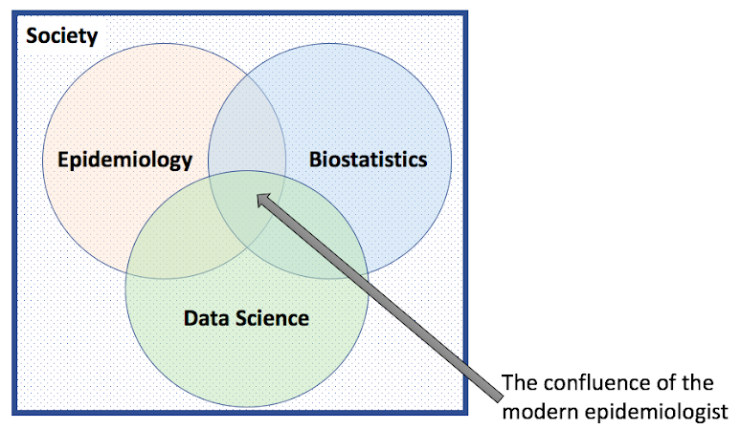
TASKS OF EPIDEMIOLOGY
Research, surveillance, and evaluation
  Focus on data
  Quantitative analysis
Translating science into practice
  Evidence-based medicine
  WHO recommendations: Intrapartum care for a positive childbirth experience https://apps.who.int/iris/bitstream/handle/10665/272447/WHO-RHR-18.12-eng.pdf
  Policy development
  Chlorpyrifos ban in the US https://www.epa.gov/ingredients-used-pesticide-products/frequent-questions-about-chlorpyrifos-2021-final-rule
Notes:
"[The modern day epidemiology] is competent in statistics but not a statistician; has a grasp of concrete biomedical reality without being a clinician responsible for the medical care of individuals, is able to comprehend the basic elements of society and social structure without being a sociologist or anthropologist, and can also work with large amounts of electronic data and program complex analytic models without being a computer scientist.” (https://www.goldsteinepi.com/blog/should-all-epidemiologists-be-data-scientists/index.html)

Slide 11
RESEARCH IN EPIDEMIOLOGY
Write down two questions that epidemiologists may be interested in answering
1 idea = 1 sticky note
Put your sticky notes on the whiteboard

Slide 12




A PUBLIC HEALTH APPROACH
Defining the problem/surveillance
Risk and protective factor identification
Developing and testing prevention strategies
Implementation and adoption of the strategies

Slide 13
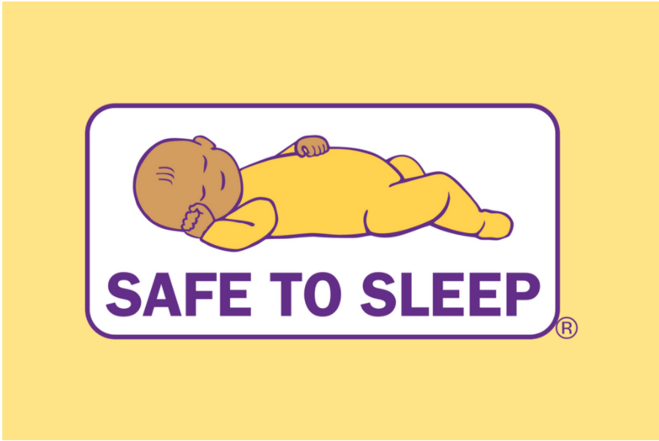
EXAMPLE OF SAFE TO SLEEP CAMPAIGN
SIDS risk factors:
Sex of the baby
Ethnicity and SES of the family
Prematurity
Family history
But also:
Stomach sleeping
Bed-sharing
Exposure to secondhand smoke
Risk factors modifiable by an intervention

Slide 14
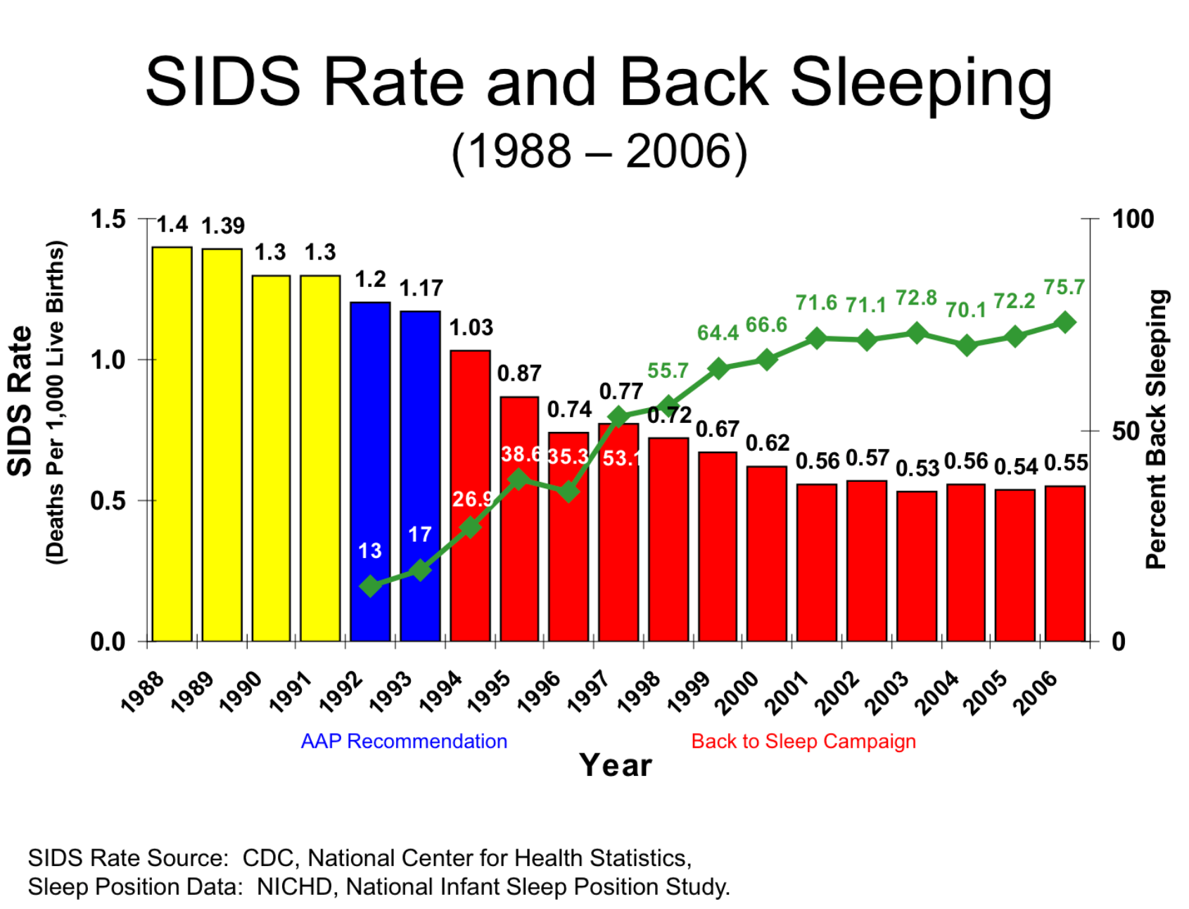

Slide 15
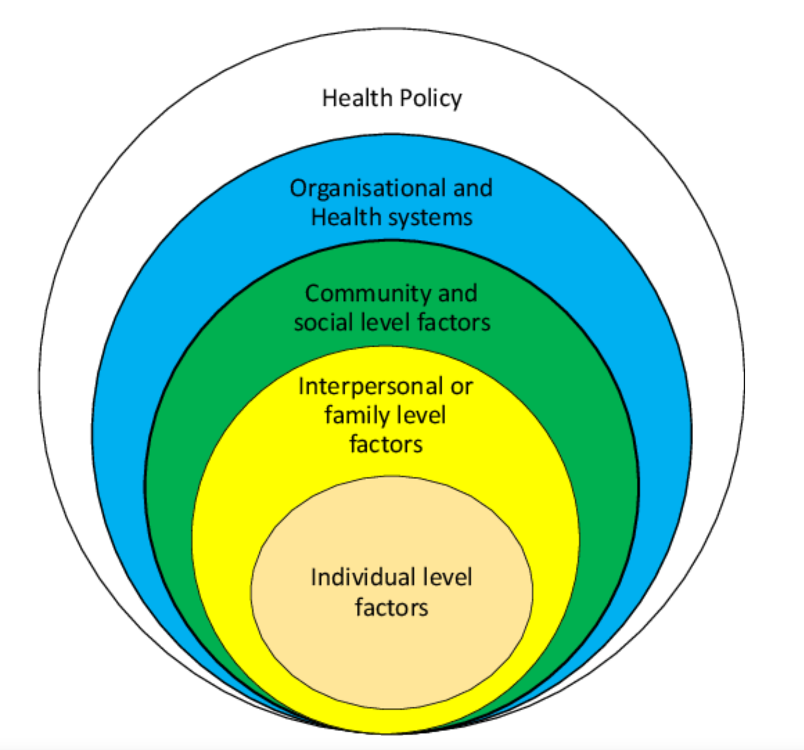
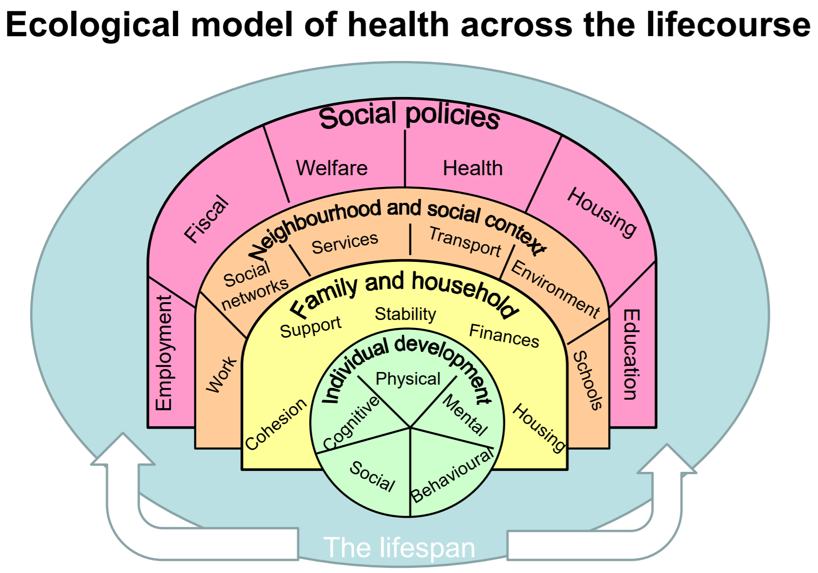
MULTILEVEL INTERVENTIONS

Slide 16
Implementation of Safe to Sleep at different levels of influence
Including safe sleep guidelines to education of nursing students
Addressing cultural practices related to infant sleep (e.g. bed-sharing)
Educating parents on safe infant sleep

Slide 17




RESEARCH AND EVALUATION
Data and understanding data is essential!
…and many more
Notes:
Major part of this course will be focused on data and their understanding

Slide 18





PREVENTION AND POLICY
The ultimate goal of the field is improving population health

Slide 19
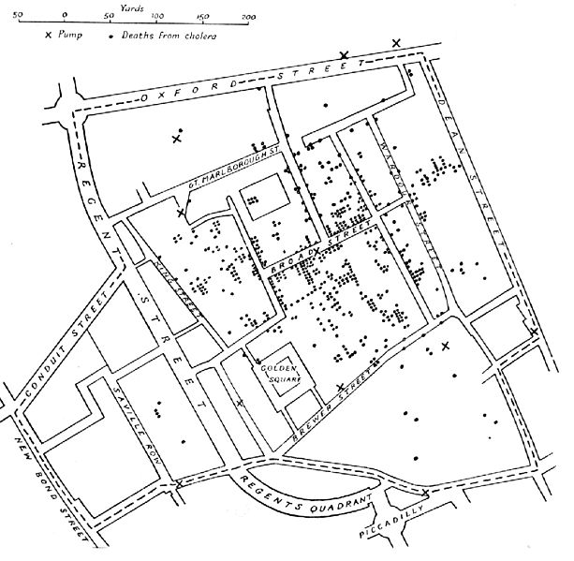
HISTORY OF EPIDEMIOLOGY
John Snow
Investigation into the causes of the 19th-century cholera epidemics in London
Identification of the Broad Street pump as the cause
Snow removed the pump handle – this probably ended the outbreak
Notes:
Picture: https://en.wikipedia.org/wiki/Epidemiology

Slide 20
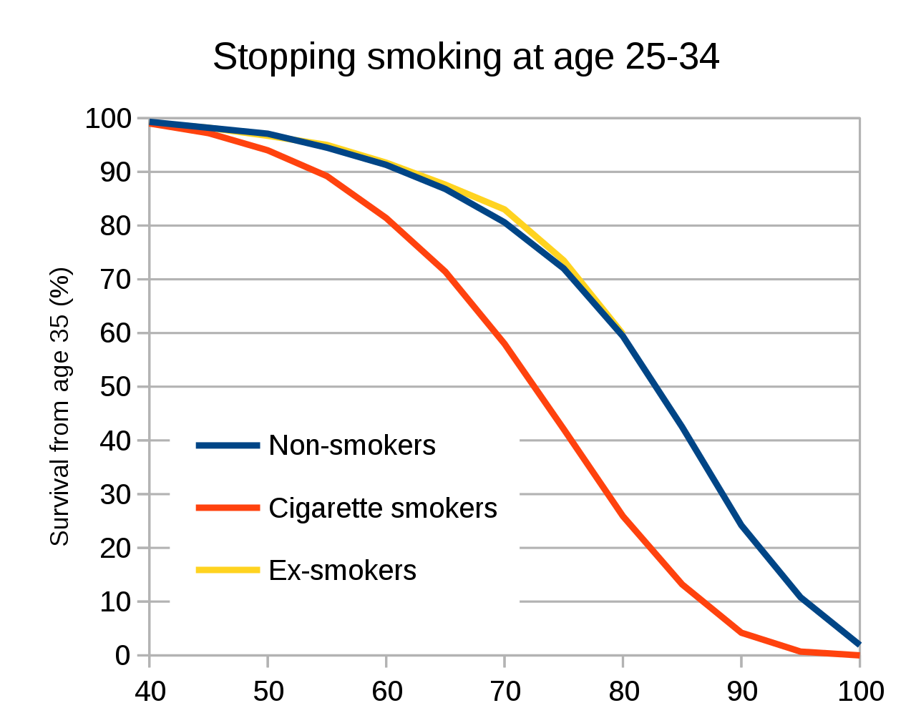
HISTORY OF EPIDEMIOLOGY
British Doctors' Study
A prospective cohort study starting in 1950s
First statistical evidence that tobacco smoking increased the risk of lung cancer
Notes:
Picture: https://en.wikipedia.org/wiki/British_Doctors_Study

Slide 21

EPIDEMIOLOGICAL TRANSITION

Slide 22
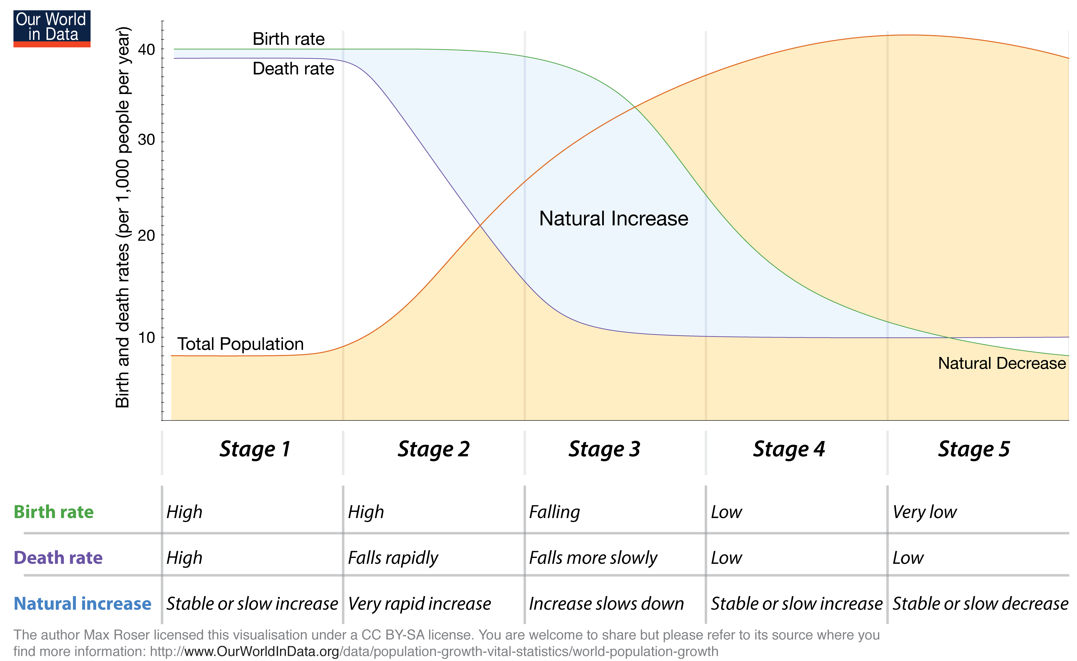

Slide 23
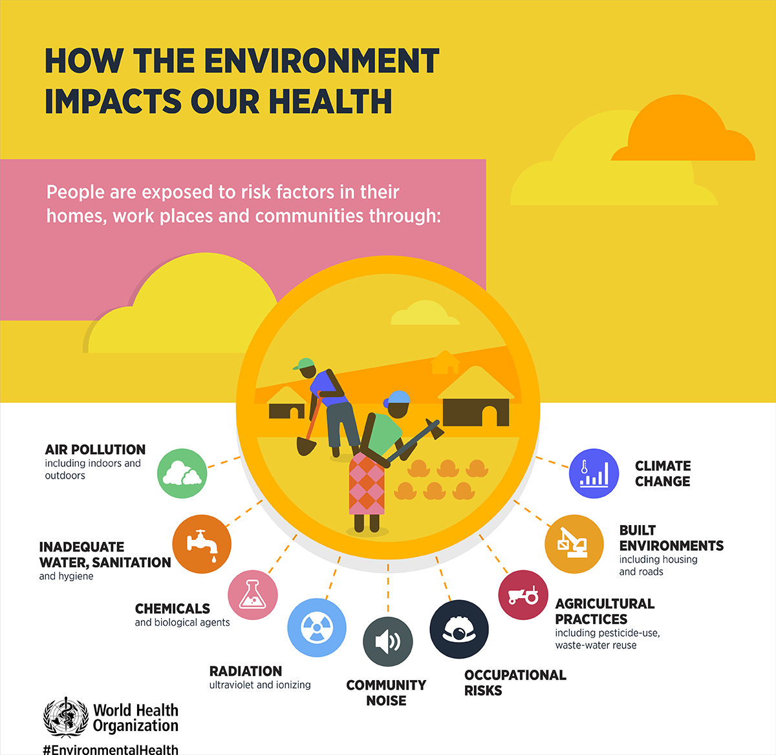
THE ROLE OF THE ENVIRONMENT
Environmental epidemiology is the study of the effect on human health of physical, biologic, and chemical factors in the external environment, broadly conceived.

Slide 24
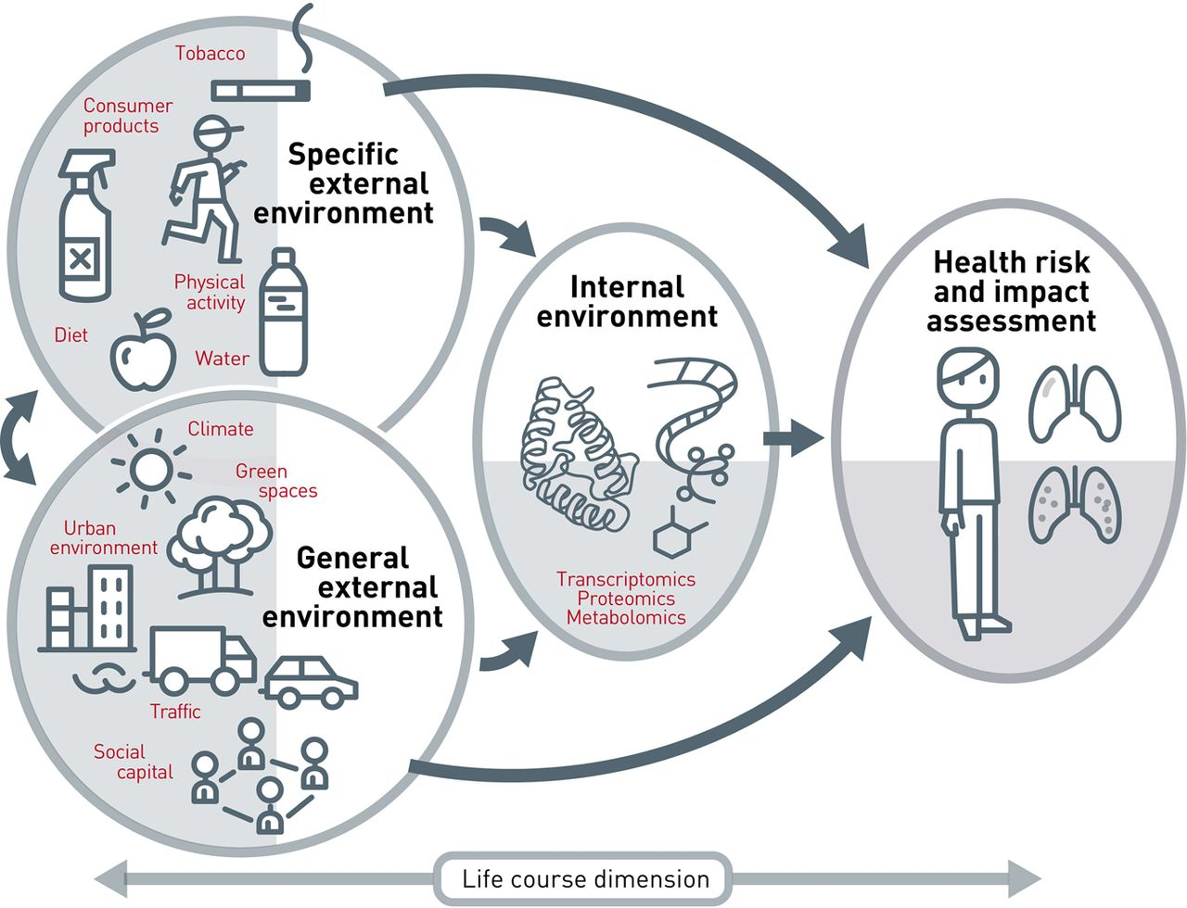
EXPOSOME CONCEPT
The totality of human environmental (meaning all non-genetic) exposures from conception onwards
Source: Vrijheid, M. (2014). The exposome: A new paradigm to study the impact of environment on health. Thorax;69:876–878. doi:10.1136/thoraxjnl-2013-204949

Slide 25
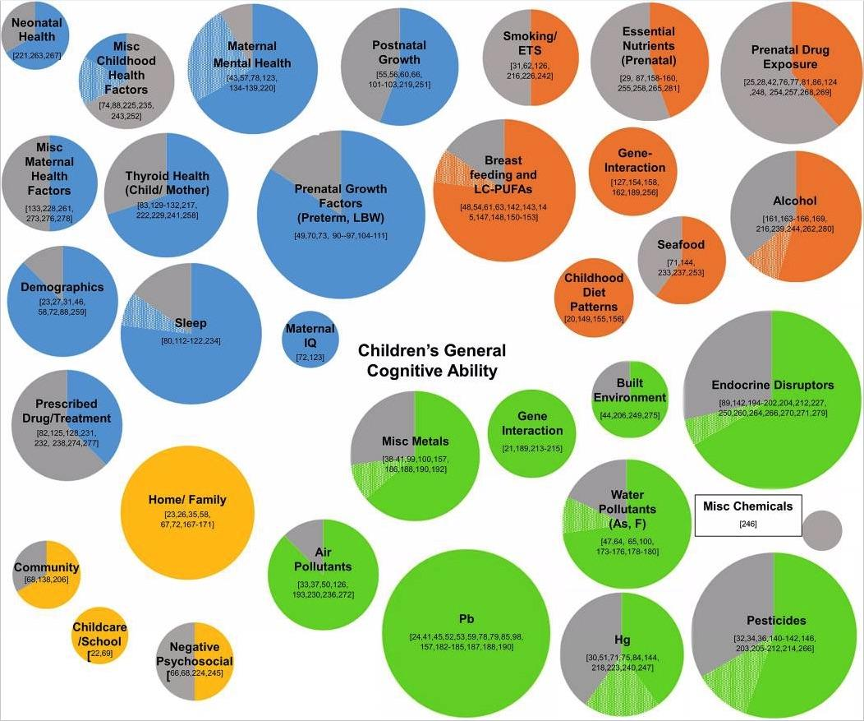
Large number of environmental factors identified as having effects on child development
Ruiz Jdel et al. Contributions of a child’s built, natural, and social environments to their general cognitive ability: a systematic scoping review. PLoS One 2016; 11: e0147741.
Slide courtesy of Dr. Katarzyna Kordas

Slide 26
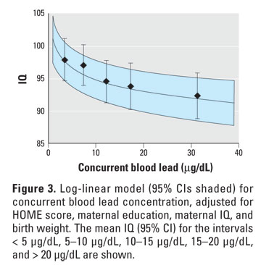
EXAMPLE OF LEAD EXPOSURE
Lead exposure (even low-level) is associated with poor outcomes (particularly IQ loss)
Slide courtesy of Dr. Katarzyna Kordas

Slide 27
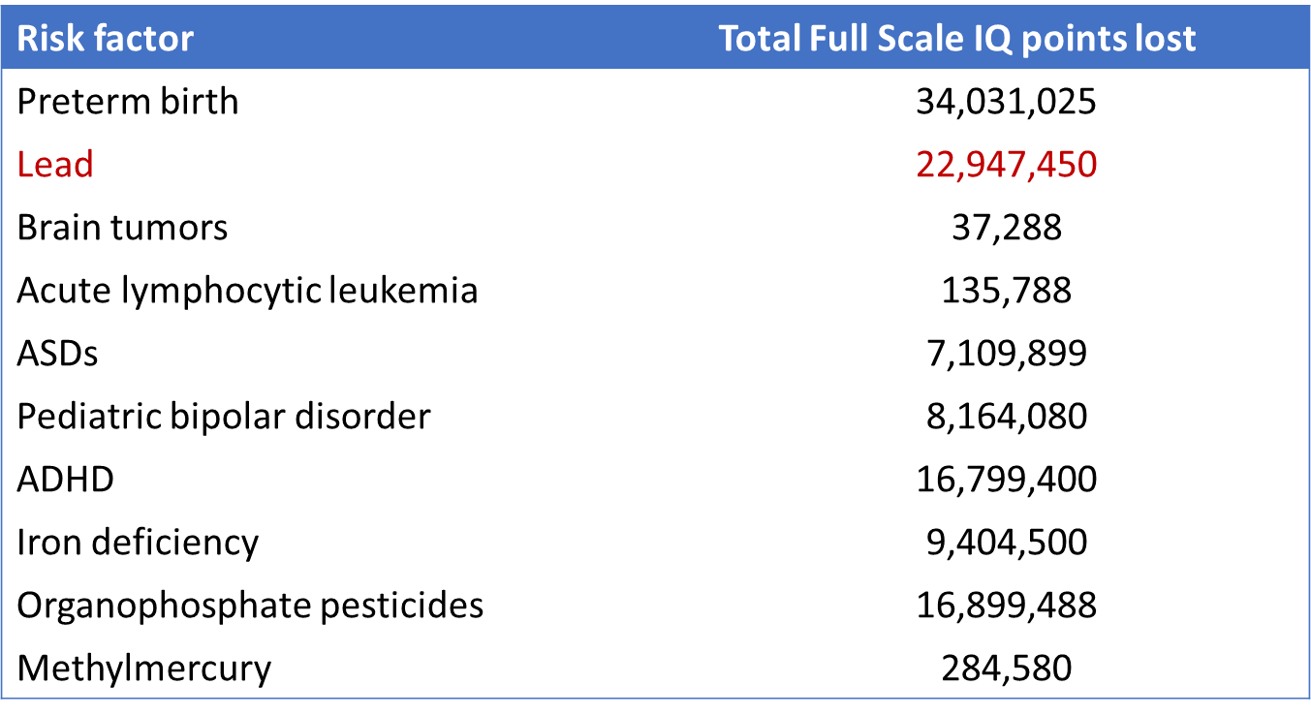
EXAMPLE OF LEAD EXPOSURE
How do you understand the table?
What does it mean?
Bellinger DC. A strategy for comparing the contributions of environmental chemicals and other risk factors to neurodevelopment of children. Environ Health Perspect 2012; 120: 501-507.
Slide courtesy of Dr. Katarzyna Kordas

Slide 28
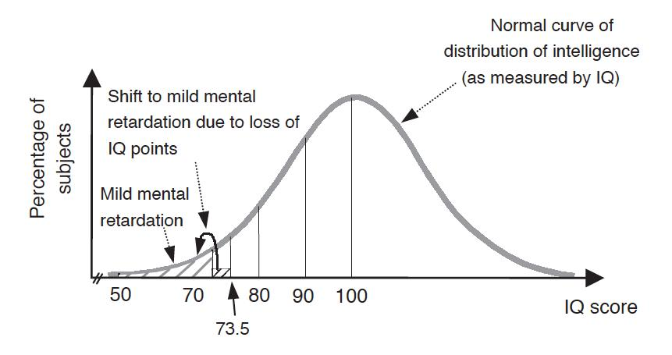
EXAMPLE OF LEAD EXPOSURE
Even with low-level chemical exposures, we worry about shifting the IQ distribution
Pruss-Ustun et al. (2004) Lead exposure. In: Ezzati M et al., eds. Comparative quantification of health risks: global and regional burden of disease attributable to selected major risk factors. Geneva, WHO: 1495-1542.
Slide courtesy of Dr. Katarzyna Kordas

Slide 29
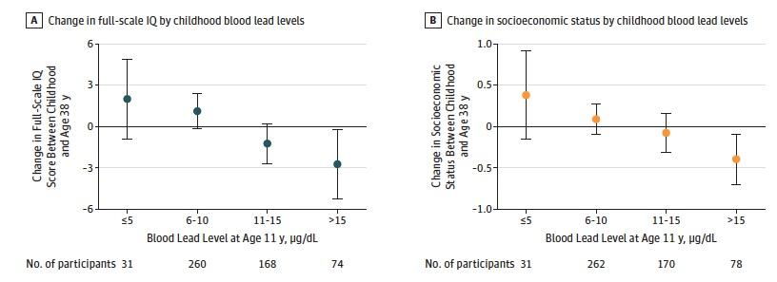
LEAD EFFECTS BEYOND CHILDHOOD
Reuben A, Caspi A, Belsky DW, Broadbent J, Harrington H, Sugden K, Houts RM, Ramrakha S, Poulton R, Moffitt TE. Association of childhood blood lead levels with cognitive function and socioeconomic status at age 38 and with IQ change and socioeconomic mobility between childhood and adulthood. JAMA 2017; 317: 1244-51.
Slide courtesy of Dr. Katarzyna Kordas

Slide 30
PROJECTIONS FOR GLOBAL LEAD EXPOSURE (𝜇G/DL) AMONG CHILDREN, 2010-30
Pruss-Ustun et al. (2004) Lead exposure. In: Ezzati M et al., eds. Comparative quantification of health risks: global and regional burden of disease attributable to selected major risk factors. Geneva, WHO: 1495-1542.
Slide courtesy of Dr. Katarzyna Kordas
Notes:
WPRO—western pacific region
EMRO—Eastern Mediterranean region
SEARO—South East Asia
https://eridirect.com/blog/2016/02/5-hard-facts-about-lead-in-e-waste/#:~:text=E%2Dwaste%20exposed%20areas%20are,is%20mounting%20with%20each%20finding

Slide 31
RECAPITULATION
Write down three take home messages from the lecture
1 take home message = 1 sticky note
Put your sticky notes on the whiteboard

Slide 32

QUESTIONS?

