Slide 1
Routine data
MD. Consuelo Quispe-Haro

Slide 2
Definition
Regularly collected data on health indicators used to track health trends and inform public health interventions.
Vital statistics
Administrative data systems
Compulsory notifiable diseases
Specific disease registries (population based, or hospital based) e.g. Cancer registration, Congenital malformations
Continuous or repeated surveys of representative samples of the population
Routinely collected data can be:
Individually identifiable (personal ID in registers)
Can be linked across different sources / registers
No individual identification
Can be “linked” at aggregate level (e.g. regional)
Ecological studies

Slide 3
Data sources – Czech Republic
Routine statistical data (ČSÚ)
Administrative data series - census, etc.
Specific disease registries (ÚZIS) – available in aggregated form
Repeated population health survey on a representative sample of the population
Birth
Death
Abortions
Marriages
Divorces
Moving
https://csu.gov.cz/pohyb-obyvatelstva-metodika

Slide 4
National Registry of Newborns
Device identification
Newborn registration number
Birth number of the mother
Frequency of pregnancy - sequence of pregnancies
Place of residence – municipality number, ORP, region, district
Newborn – citizenship
Mode of delivery
Fetal position
Date of birth
Vitality
Weight (g)
Gestational age
Treatment in the ward - mandatory, if the birth was not at home or outside the ZZ
Apgar score (optional for birth outside ZZ)
Treatment at the Department of Selected Diseases and Complications
Screening performed
Congenital defect (in a live birth)
Date and time of termination of ZN
Reason for termination of ZN incl. IČA during translation
Death

Slide 5
Mortality
Certificate of examination of the deceased
Age
Gender
Marital status
Education
Citizenship and country of birth
Place of death (in hospital, at home, etc.)
The underlying cause of death (WHO defined as (a) the disease or injury that initiated the chain of medical conditions directly leading to death, or (b) the circumstances of the accident or violence which caused the fatal injury).
Causes of death are coded according to the International Statistical Classification of Diseases and Associated Health Problems (ICD - latest version ICD-11)

Slide 6
National health registers in the Czech Republic
National Cancer Registry
National register of hospitalized patients
National Reproductive Health Registry
National Registry of Cardiovascular
Operations and Interventions
National register of joint replacements
National register of occupational diseases
National registry for treatment of drug users
National register of injuries
National register of autopsies and toxicological examinations
National diabetes register
National register of intensive care

Slide 7
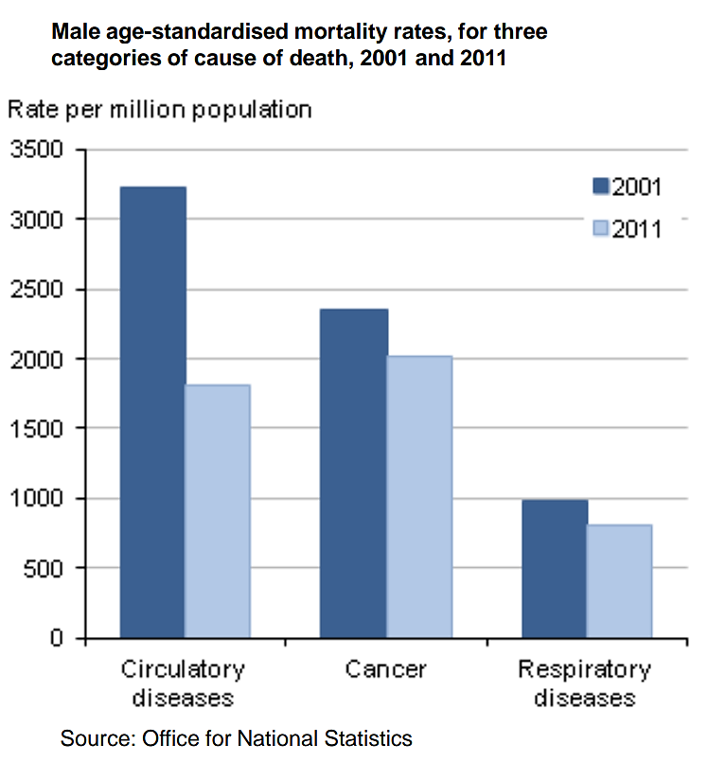
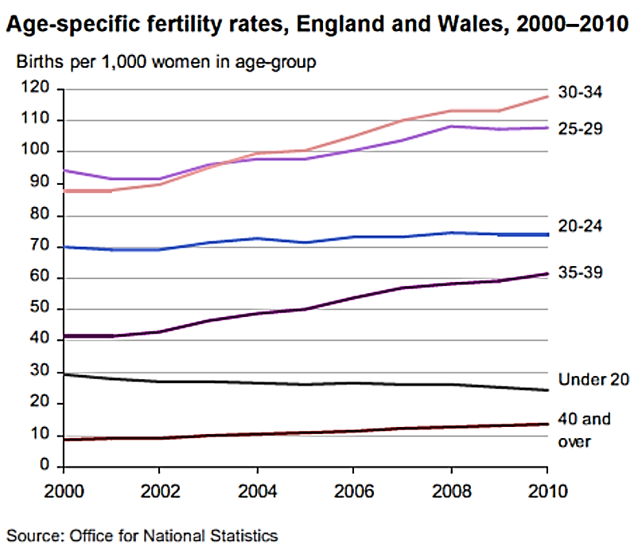
Why it is important

Slide 8
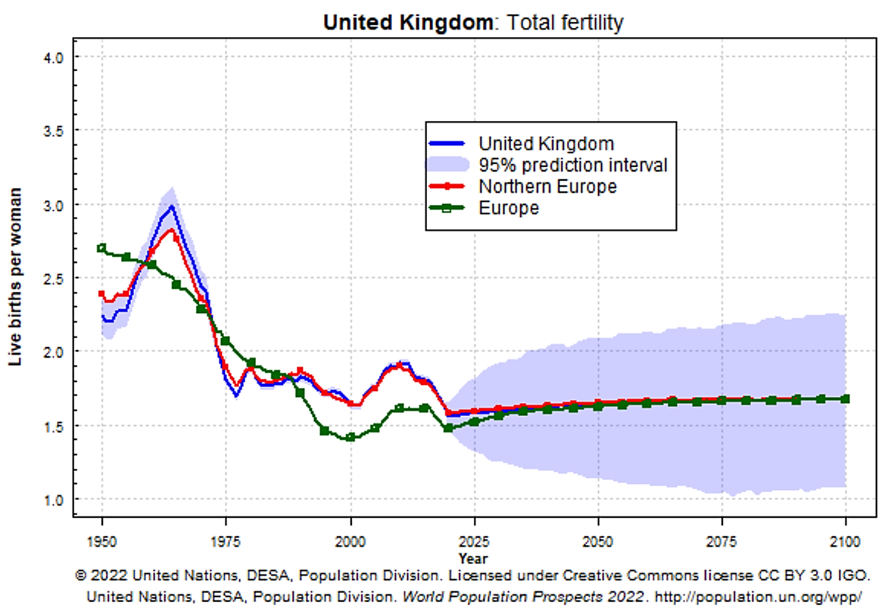

Slide 9
Global Burden of Diseases, Injuries, and Risk Factors (GBD)
“global descriptive epidemiology”
https://www.healthdata.org/research-analysis/gbd
Systematic, scientific effort to quantify the comparative magnitude of health loss due to diseases, injuries, and risk factors by:
age
sex
geographies
specific points in time
Compare the effects of different diseases that kill people prematurely and cause ill health and disability
GBD was established by WHO, WB and Harvard in 1996, currently led by the Institute for Health Metrics and Evaluation (IHME), University of Washington

Slide 10
GBD metrics
OUTCOMES
All-cause mortality
Deaths by cause
Years of life lost (YLLs)
Years lived with disability (YLDs)
Disability adjusted life years (DALYs)
PREDICTORS
291 causes of diseases and injuries
67 risk factors

Slide 11
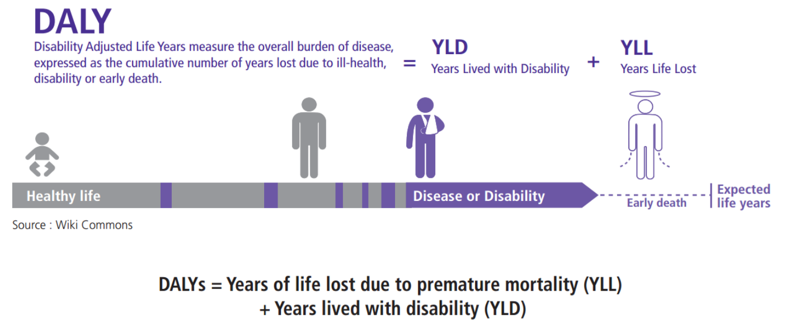
BLOG - The value of administrative data: DALYs and the Scottish Burden of Disease study | SCADR

Slide 12
Practical part 1
Go to:
https://vizhub.healthdata.org/gbd-compare/

Slide 13
Questions and answers
What causes contribute more to DALYs globally up to 2021: Chronic diseases, infectious and neonatal diseases, or injuries?
What causes contribute more to YLDs globally up to 2021: Chronic diseases, infectious and neonatal diseases, or injuries?
In which sex COVID19 caused more deaths?
What was the main cause of death in Czechia in 2021?
Compared with high socio-demographic index (SDI) countries, what was the difference in death rate in Czechia in 2021
What are the categories of risk factors in GBD webpage?
High systolic blood pressure is a risk factor for multiple diseases. Identify all the diseases that can benefit of blood pressure control and write the respective attributable risk percentage.

Slide 14
Break time

Slide 15
Advantages and disadvantages of routine data
Advantages
Data already collected
Large number of observations
Objective observations
Disadvantages
Quality of sources may differ
Sometimes only aggregated data is available (only suitable for ecological studies)
Limited information: No information on socioeconomic status or other useful variables

Slide 16
What to measure
Mortality
Incidence and prevalence
Others: admission rate, outpatients visits, immunization coverage
Vital statistics registers
Disease specific register
Healthcare utilization registers

Slide 17
Data quality
Quality: Accuracy, completeness, timeliness
Issues: underreporting, data duplication, incomplete records:
Validation and quality control: cross-referencing sources, regular audits

Slide 18
Applications
Disease surveillance for outbreaks detection
Health program evaluation
Trends analysis and policy making

Slide 19
Health surveys
Often designed to be nationally representative
Often repeated to allow comparisons over time
Often open access data
Much more information than routine data
Often limited by low response rates (so not strictly nationally representative)

Slide 20
Health surveys – examples
The Health Survey for England (HSE)
Scottish Health Surveys (SHeS)
European Health Interview Survey (EHIS) - Eurostat
European Health Examination Survey (EHES) – planned
US National Health and Nutrition Examination Survey (NHANES)
Study of Health, Ageing and Retirement in Europe (SHARE)
English Longitudinal study of Ageing (ELSA)

Slide 21
The Health Survey for England (HSE)
Provide annual data from nationally representative samples to monitor trends in the nation’s health
Estimate the proportion of people in England who have specified health conditions
Estimate the prevalence of certain risk factors associated with these conditions
Examine differences between subgroups of the population (for example by age, sex or income) in their likelihood of having specified conditions or risk factors
Assess the frequency with which particular combinations of risk factors are found, and in which groups these combinations most commonly occur
Monitor progress towards selected health targets
Since 1995: measure the height of children at different ages, replacing the National Study of Health and Growth
Since 1995: monitor the prevalence of overweight and obesity in children

Slide 22
Data linkages
Various types of routine data can be linked
  Register with register(s)
  Survey with register(s)
  Survey with survey(s)
Only possible if
  Individuals have personal ID (for individual linkage)
  Individual have known location (for geographical linkage)
  Ethical approval is available (may require informed consent)

Slide 23

Are people diagnosed with mental health disorders at higher risk of mortality in Czechia?
Comparison group
General population – people not hospitalized for mental health disorders
Data sources
Registry of inpatients discharges
Cause of death registry

Slide 24
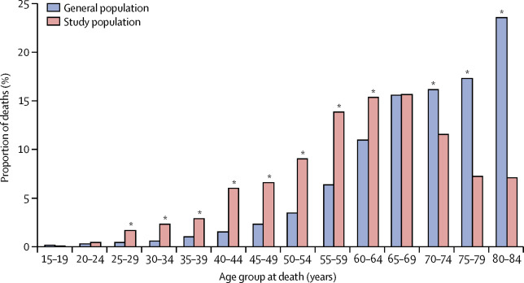

Slide 25
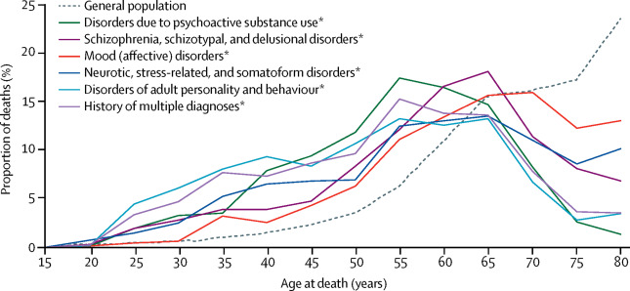

Slide 26
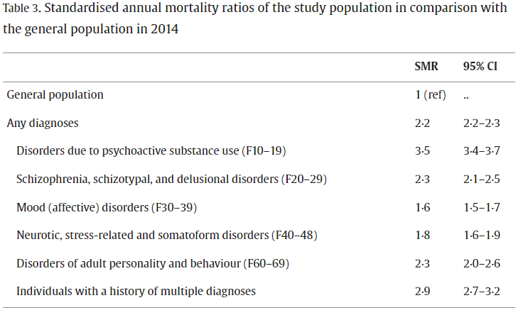
Mortality in people with mental disorders in the Czech Republic: a nationwide, register-based cohort study - ScienceDirect

Slide 27

Does conditional cash transfers reduce maternal mortality in Brazil?
Outcome
Maternal mortality
Predictors
Duration of CCT (years)
Coverage of CCT (%)
https://link.springer.com/article/10.1186/s12916-021-01994-7#Tab2

Slide 28
Data sources
Mortality Information System for maternal and under-5 deaths, Primary Care Information System for FHP coverage, Live Births Information System and Outpatient Information System for hospital admissions
The Ministry of Social Development databases were used to calculate BFP coverage
Brazilian Institute of Geography and Statistics (IBGE) was used for socioeconomic variables. From the 2000 and 2010 IBGE National Censuses (income per person, poverty rate, illiteracy, households with piped water

Slide 29
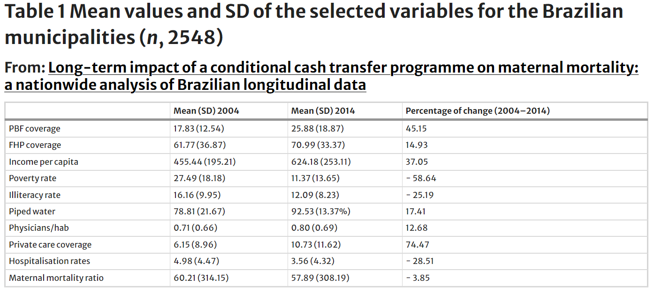
Notes:
BFP:Bolsa Familia Programme
CCT:Conditional cash transfer
FE:Fixed effects
FHP:Family Health Programme

Slide 30
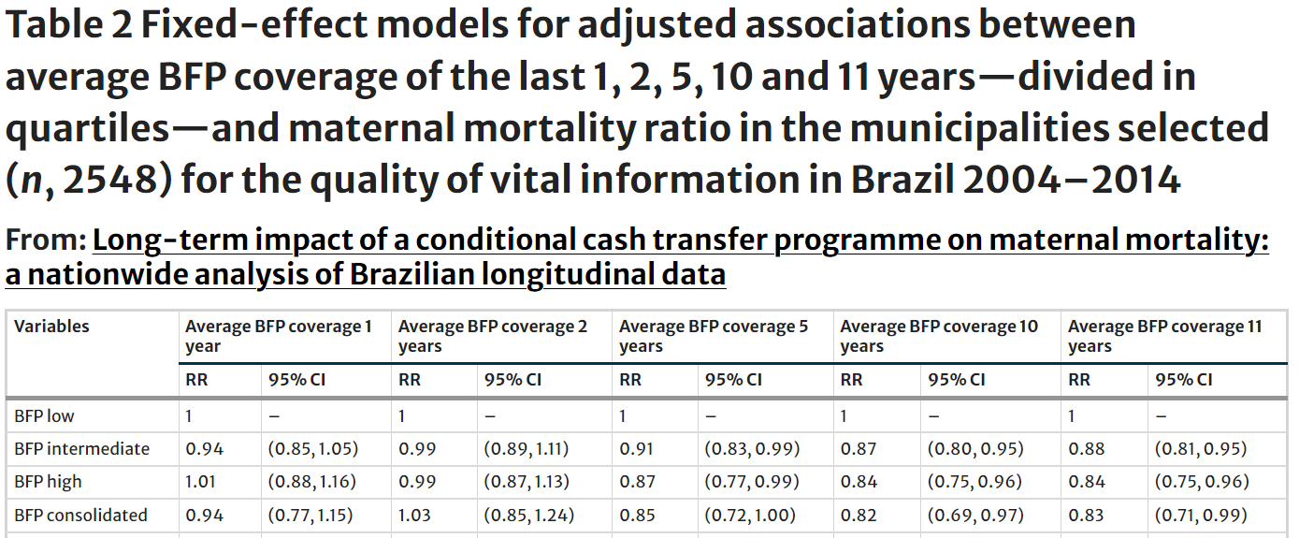
Notes:
BFP:Bolsa Familia Programme
CCT:Conditional cash transfer
FE:Fixed effects
FHP:Family Health Programme

Slide 31
Questions?

Slide 32
Codebook Practical
Year: year of survey
Country:
1: Czechia
2: Slovakia
ID: Identification Number
Female:
0: Male
1: Female
Age_group:
1: 20-45 years
2: 46-70 years
3: >70 years
Employed:
1: Yes
0: No
Sick_3mon: Have you been sick in the last 3 months?
1: Yes
0: No
Heath_sta: How you rate your health in the last 3 months?
0: Poor
1: Good/Excellent
Status: Dead or alive in 2024
0: Alive
1: Dead
Cause: Cause of death
1: Heart attack
2: Cancer
3: Other
Year_dead: Year of Death

