Slide 1
Ethics in Epidemiology
E2040
Albert Kšiňan

Slide 2
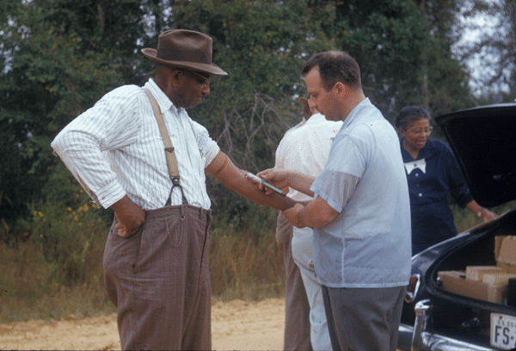
Tuskegee Syphilis Study (1932-1972)
To observe the effect of untreated syphilis
600 poor African Americans enrolled (399 cases, 201 controls)
  Never informed about the purpose of the study
  Deception – “treated for bad blood”
No treatment offered (penicillin available since 1943)
1972: study was stopped after media coverage
  28 died directly from s., 100 from complications due to s.
  40 wives infected with s., 19 children born with s.

Slide 3
The Belmont Report (1978)
Reaction to ethical problems in research, especially the Tuskegee Study
It defined basic ethical principles and guidelines for human subject research

Slide 4
Declaration of Helsinki (1964)
Developed by World Medical Association
Revised 7 times since
Ethical principles for medical research involving human subjects
Respect for individual, their right of self-determination, their right to make informed decisions, their welfare

Slide 5

Basic ethical principles by the BR
Respect for persons
  Autonomy of individuals should be respected
  Extra protection for children, people with illness or mental disability
Beneficence
  Protecting subjects from harm
  Maximizing possible benefits and minimizing possible harms
Justice
  Fair treatment and fair distribution of risk and benefits of research

Slide 6
Informed consent
  Necessary part of every study with human subjects
  Information – ensure that all information is provided to participants
  Comprehension – ensure that participants can fully understand the information
  Voluntariness – ensure that participation is voluntary

Slide 7

Institutional Review Board (IRB) or Ethics Committee
Every research institution needs to have a board for evaluating research with regards to ethics
Every study needs to be approved by the committee before conducted
The submission to IRB/EC needs to describe the study, the benefits and risks for participants, how informed consent is obtained, what steps are taken to protect subjects from harm etc.

Slide 8
Research ethics more broadly
Conducting research
  Respect, Beneficence, Justice
  Confidentiality and Privacy
Research integrity
  Data accuracy
  No fabrication or falsification of data
  Transparent reporting of results
  Avoiding bias
Ethics in Publishing
  Authorship
  Conflict of Interst
  Plagiarism
  Peer review

