Slide 1
Basics of quantitative methodology
E2040 Week 4
2024

Slide 2
Study objectives
At the end of this lesson, student will be able to:
Understand the basics of quantitative methodology
List basic types of variables
Know basic types of data visualization
Know basic types of summary statistics

Slide 3
Types of variables
Categorical
Nominal
Continuous
Binary/dichotomous
Ordinal

Slide 4
Categorical variables
Nominal – qualitative values, no ordering
sex, ethnicity, birth month
Binary/dichotomous – two categories
No/yes, dead/alive, case/control
Ordinal – have several ordered categories
Level of education (elementary, high school, college), Likert scale ([1]strongly disagree – strongly agree[5])

Slide 5
Continuous variables
Can take any value within a range
Theoretically infinite values
Examples: blood pressure, height, temperature, liquid volume

Slide 6
KvIS 1

Slide 7
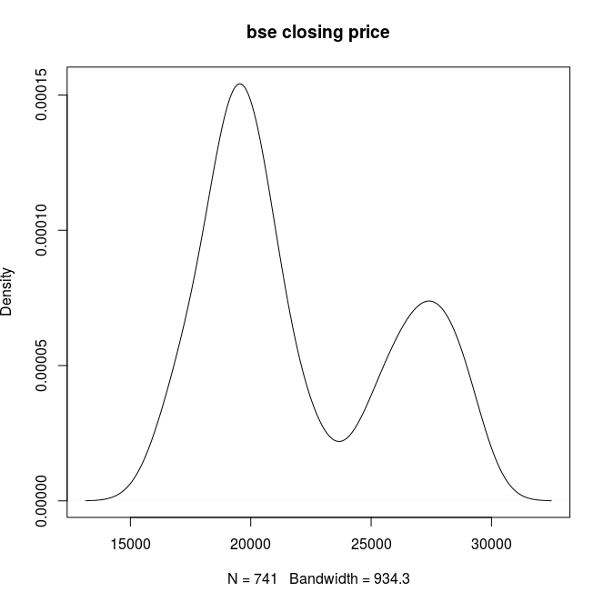
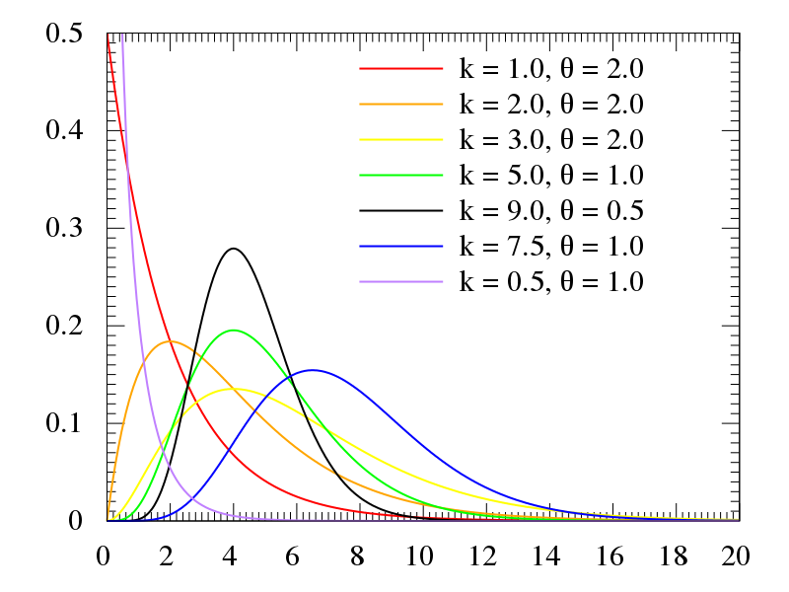
Distribution
How data values are spread across different values
Normal distribution – Gaussian, symmetrical
Skewed distribution
Positively skewed (right-skewed), negatively skewed (left-skewed)
Bimodal distribution

Slide 8
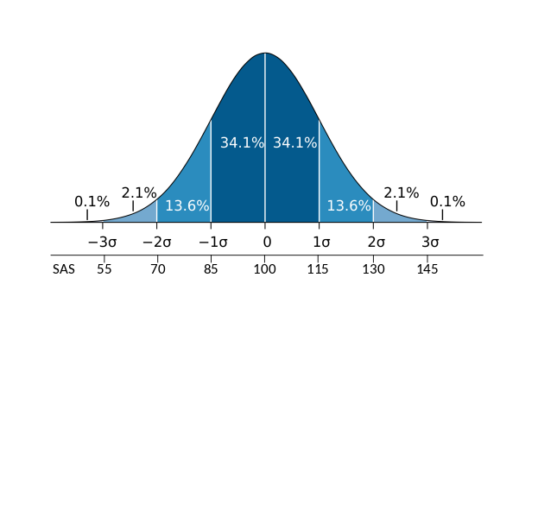
Normal/Gaussian distribution

Slide 9
Galton board and the laws of nature
Notes:
https://www.edumedia-sciences.com/en/media/905-galton-board

Slide 10
Measures of central tendency
Mean – the average value (sum of values / number of values)
Median – the value in the middle of distribution (50th percentile)
Mode – the most frequent value

Slide 11
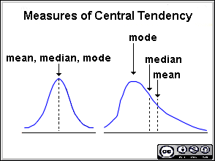
Measures of central tendency

Slide 12
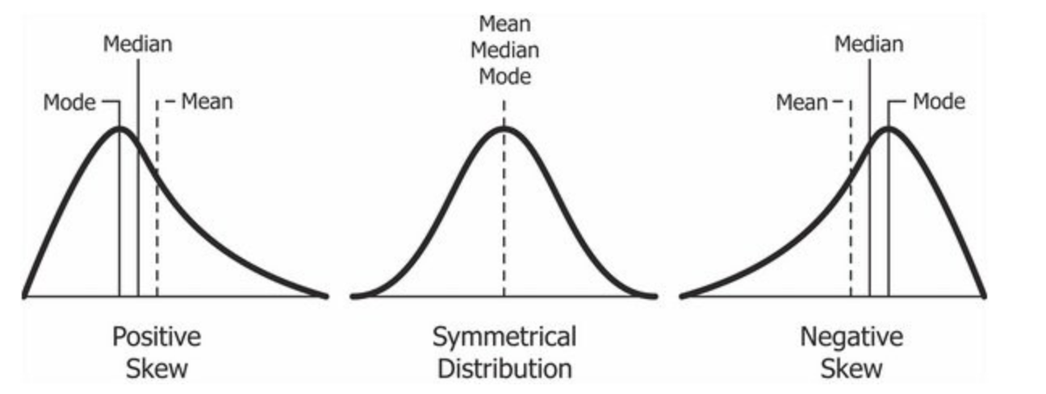
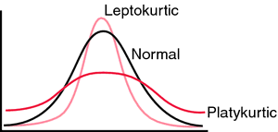
Non-normal distributions
Skewness
Kurtosis

Slide 13
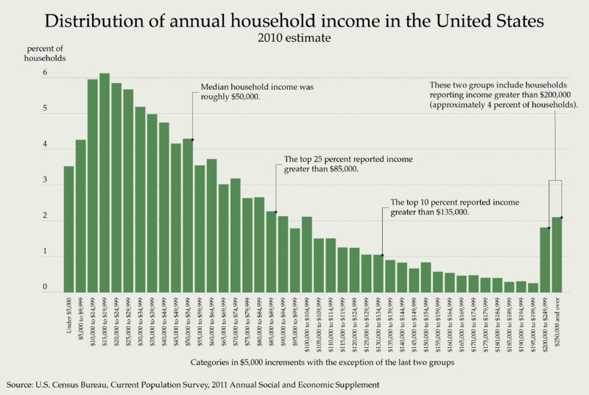

Slide 14
KvIS 2

Slide 15
Measures of spread
How spread our data are around the central tendency
The lower the spread, the more representative the measures of central tendency are of the data
High spread = large variability

Slide 16
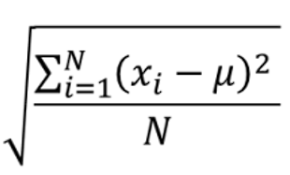
Standard deviation (SD)
Amount of variation of the values from the mean
High SD = high variability
(population SD): square root of the mean of squared differences of individual values from the mean = variance
Sample SD = using n-1 instead of N

Slide 18
Basic descriptive terms
Sum – adding values together
Mean (M) – sum of values divided by their count
Mode – most frequently occurring value
Median – value at the 50% (“in the middle”)
Standard deviation (SD) – distance of a value from a sample mean
Variance – squared SD
Quantile – cut point dividing the range of the distribution into intervals with equal probabilities
Minimum – the smallest value
Maximum – the largest value

Slide 19
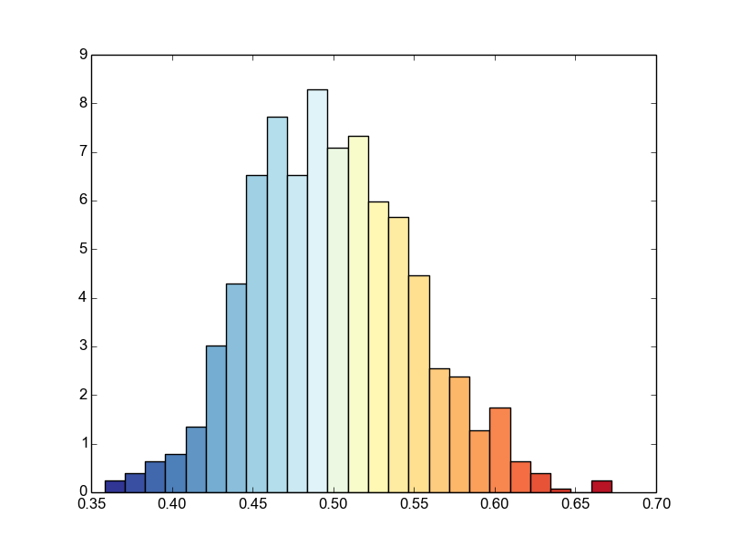
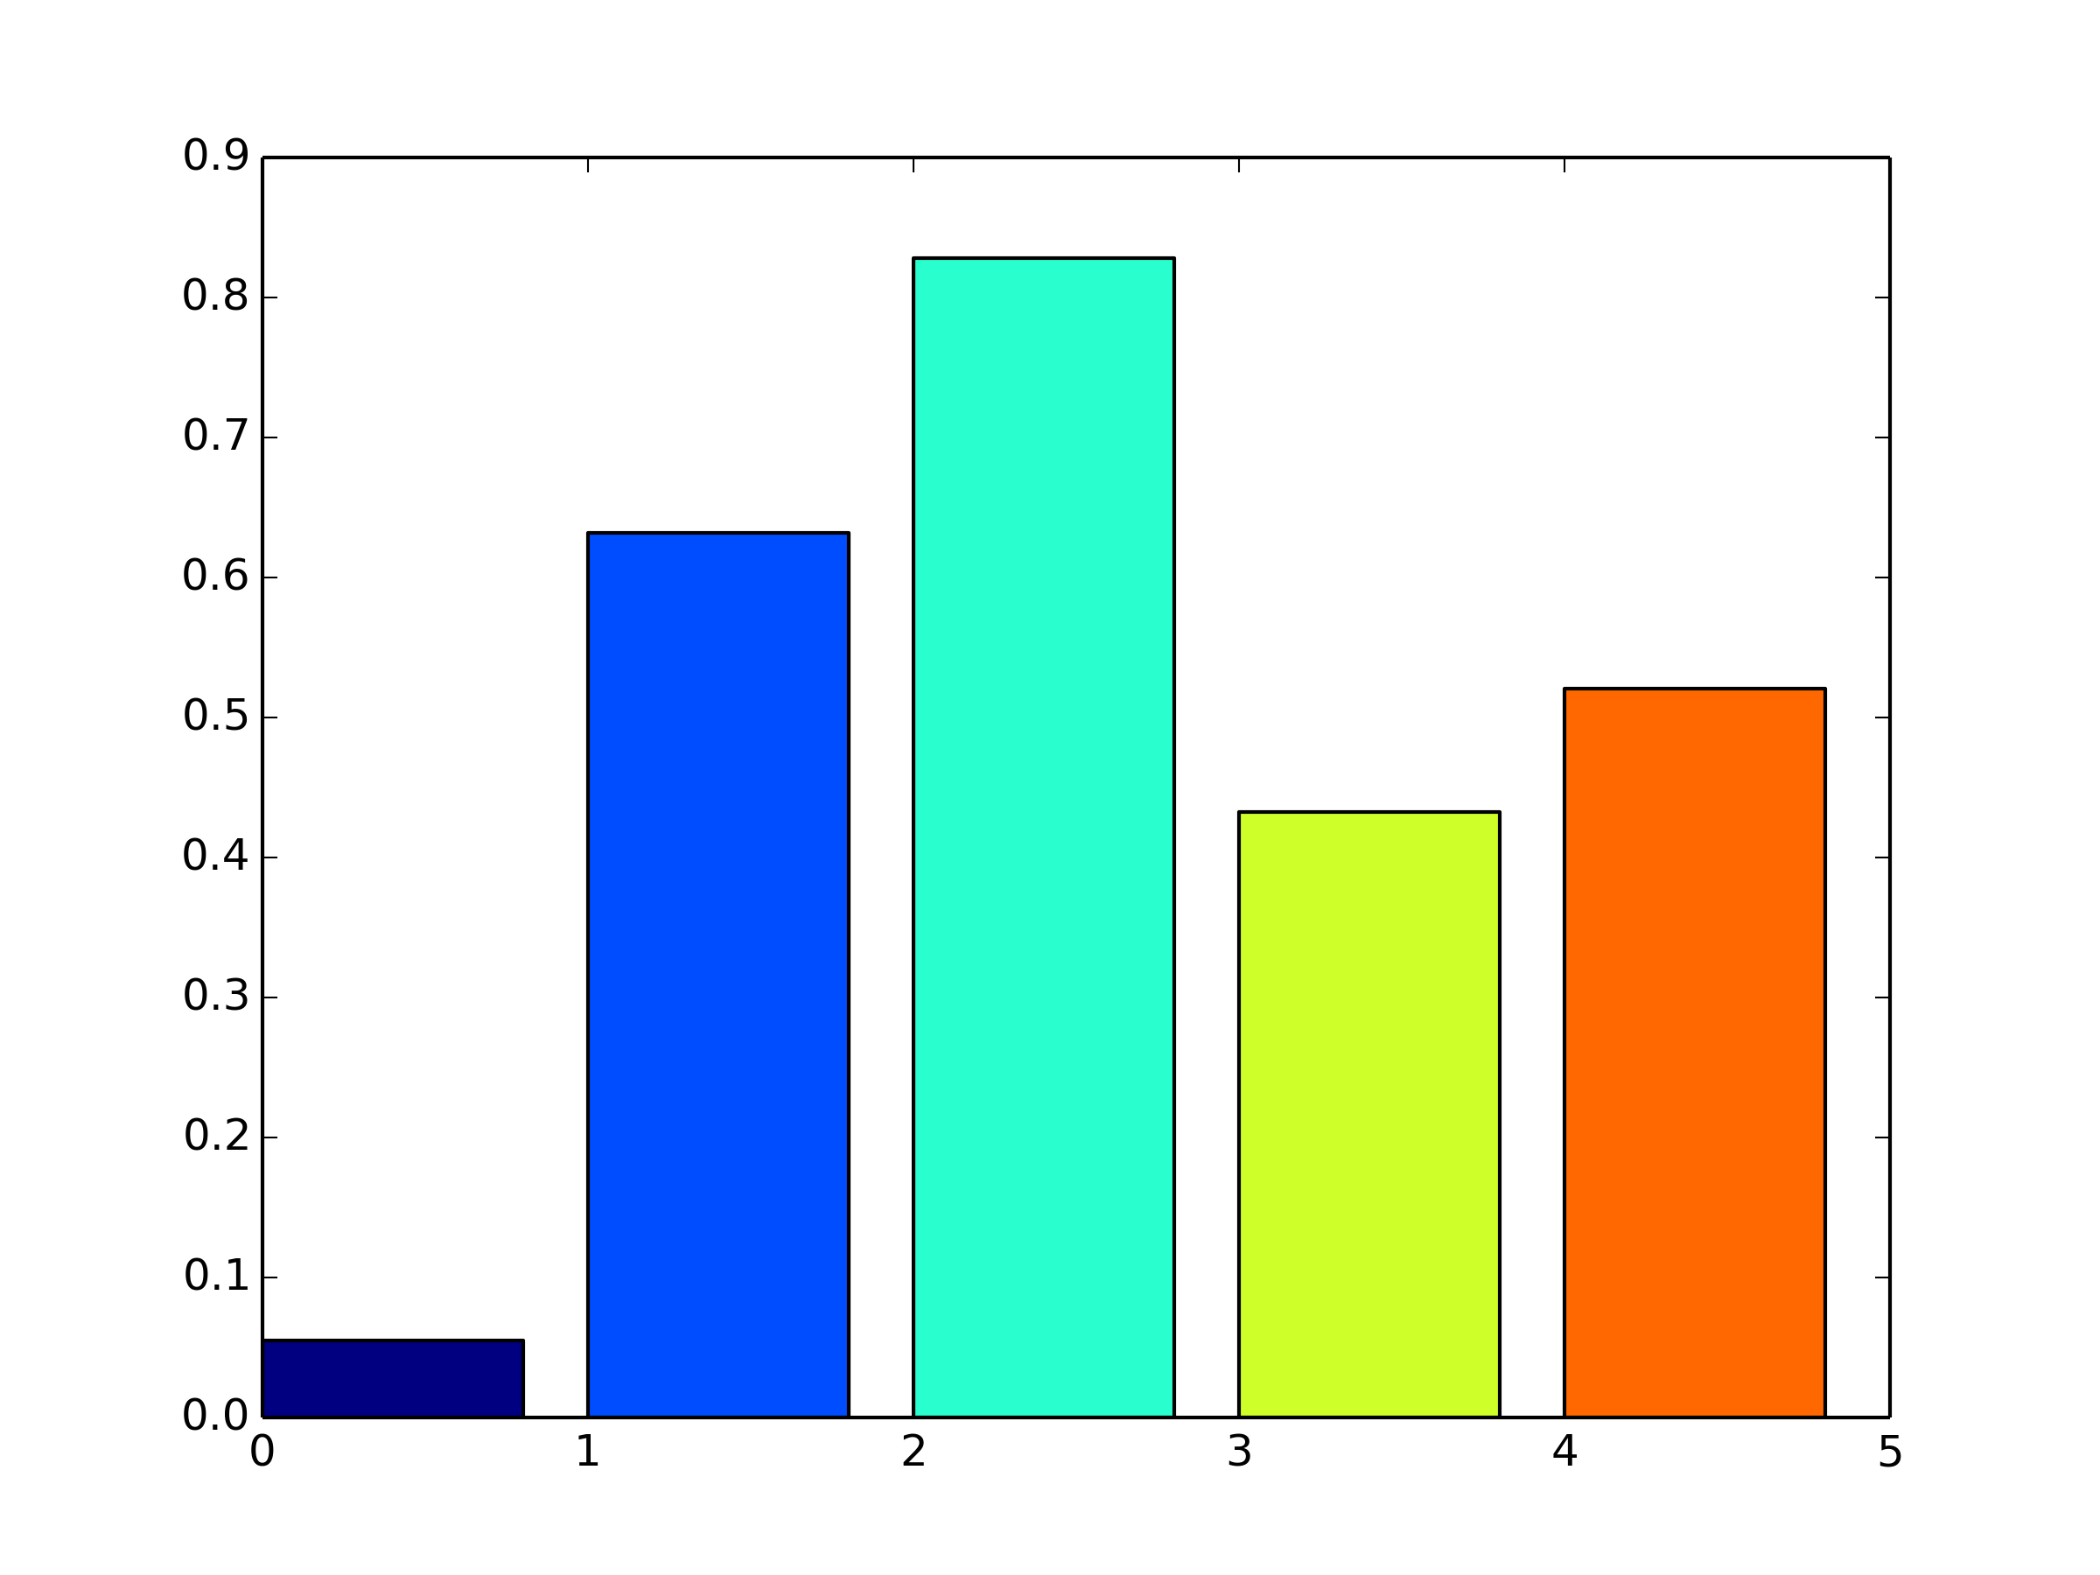
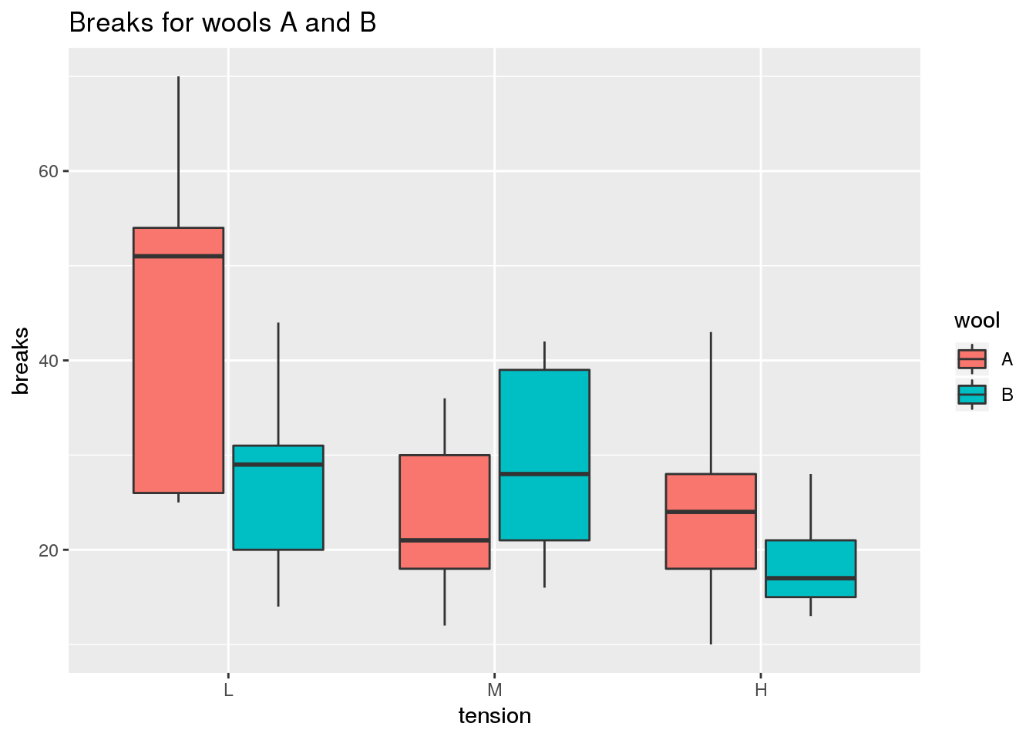
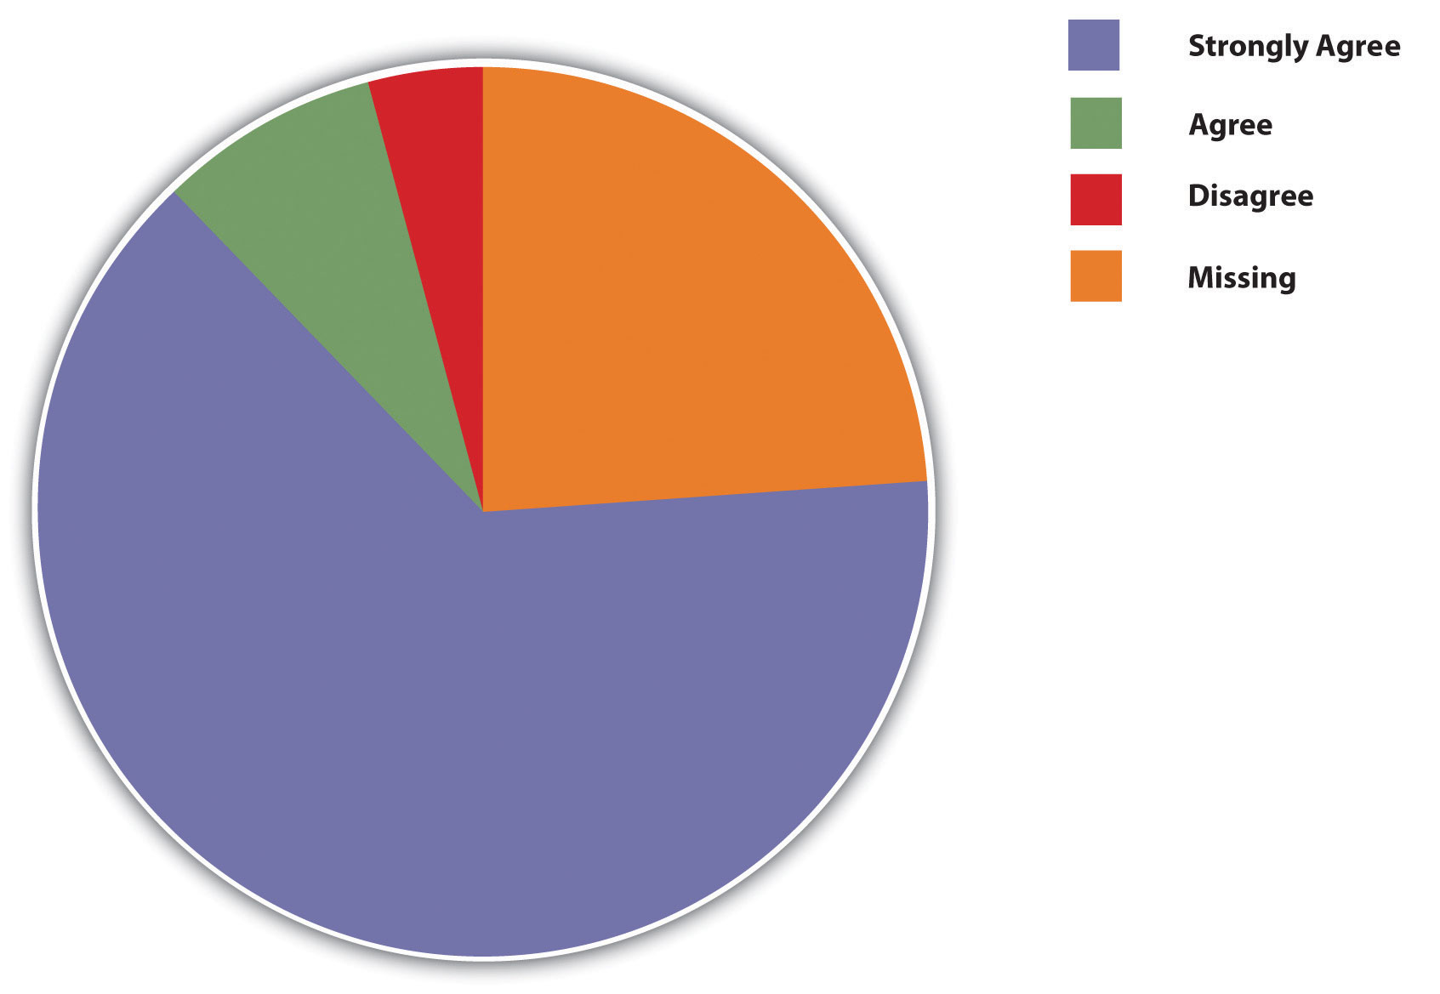
Visualizing the distribution

Slide 20
Pie chart
Categorical variables
Visualizing the proportions of values
Typically as a percentage

Slide 21
Bar chart
Categorical variables
Frequency of values for each category

Slide 22
Boxplot
Continuous variables
Illustrates the spread of values
Median, percentiles, min/max
Outliers

Slide 23
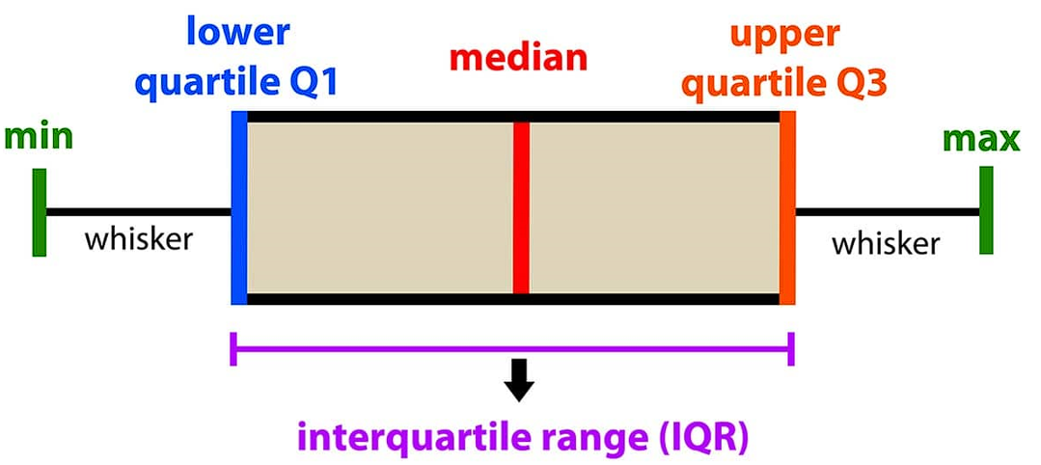

Slide 24
Histogram
Continuous variables
Values are divided into bins = range of values
Visualizing the density
Bars in histogram vs bars in bar chart
Different range of values vs different categories

Slide 25
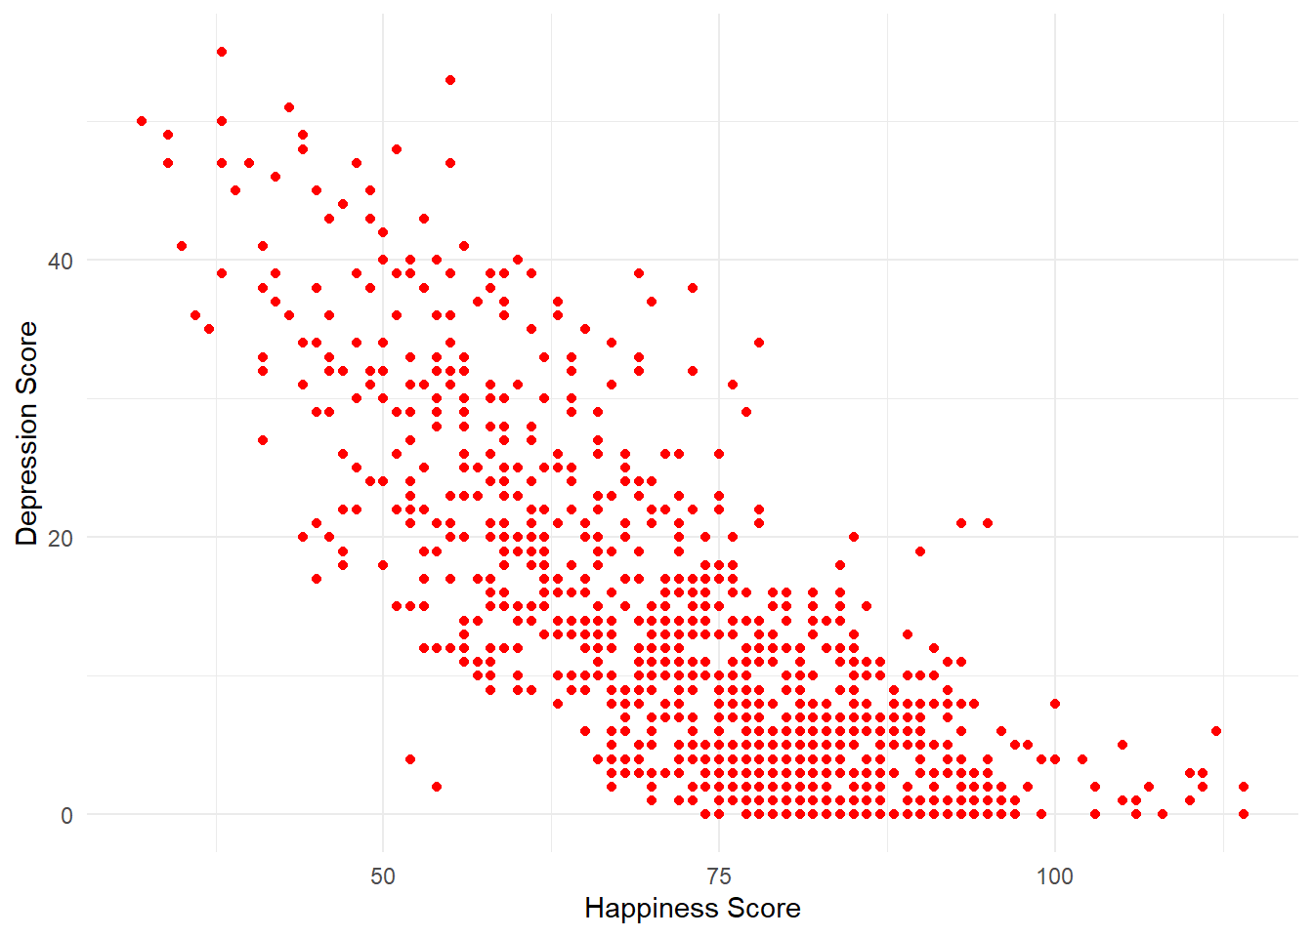
Scatterplot
Two continuous variables
Bivariate distribution

Slide 26
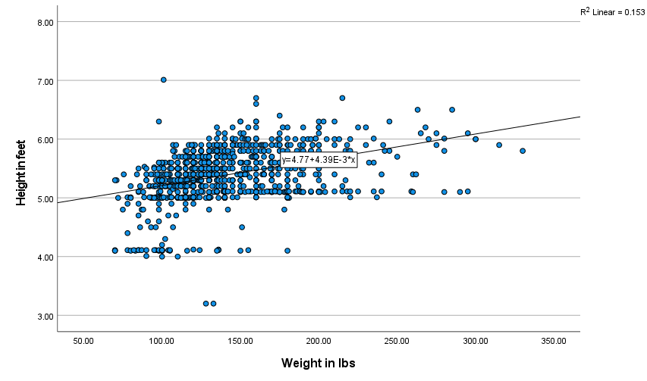

Slide 27
KvIS 3

Slide 28
Data cleaning
Data often contain errors, missing values, outliers
This might be due to
Contamination (biological samples)
Error in data entry
Just a really atypical case (with regards to outliers)

Slide 29
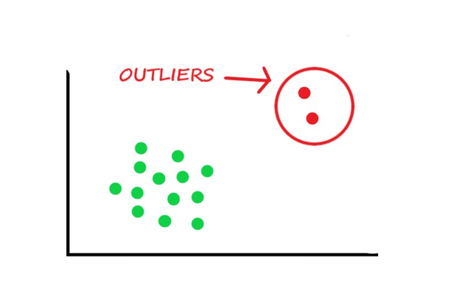
Outliers
atypical data point with regards to sample values
Example
Erasmus students in class – 10 students
With outlier:
M = 25.8
SD = 15.9
Median = 21
Without outlier:
M = 20.8
SD = 0.83
Median = 21
# | age
1 | 20
2 | 21
3 | 20
4 | 22
5 | 21
6 | 20
7 | 22
8 | 20
9 | 71
10 | 21

Slide 30
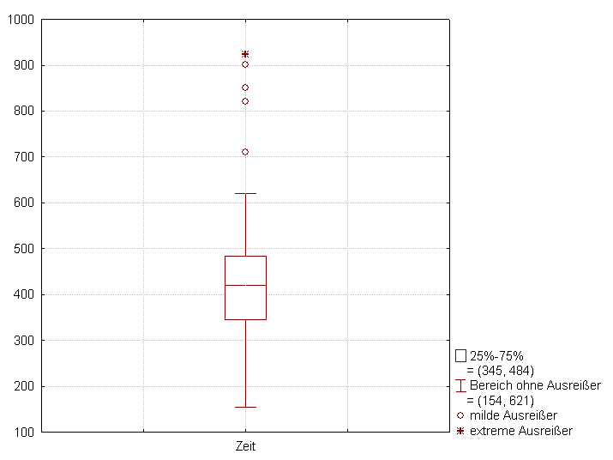
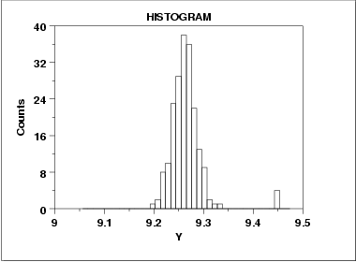
Identifying outliers – graphs
Box plot with 1.5 IQR = everything beyond that is outlier

Slide 31
Outliers – what should we do?
Errors in data entry – need to fix
Extreme values
Remove?
Keep in?
Substitute?
Transform?
Depends on the type of data

Slide 32
Outliers?
Yang, S., Puggioni, G., Harlow, L. L., & Redding, C. A. (2017). A Comparison of Different Methods of Zero-Inflated Data Analysis and an Application in Health Surveys. JMASM Editors, 16(1), 518-543.

Slide 33
Missing data
Missing data – no response for some or all of variables for an individual
Missing data can lead to biased results
Handling missing data
Poor handling:
Listwise deletion
Pairwise deletion
Mean/median imputation
Good handling:
Multiple imputation
Full information maximum likelihood

Slide 34
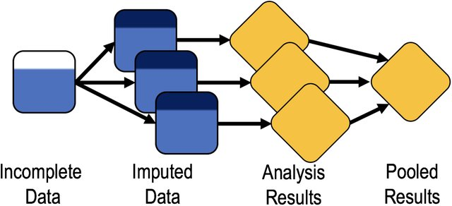
Multiple imputation
Nissen, J., Donatello, R., & Van Dusen, B. (2019). Missing data and bias in physics education research: A case for using multiple imputation. Physical Review Physics Education Research, 15(2), 020106.

