Slide 1
Study designs in epidemiology II
E2040
Albert Kšiňan

Slide 2
Studies by “level of evidence”
Case study/case series
Ecological
Cross-sectional
Case-control
Cohort
Randomized controlled trial
Quasi-experiment
Systematic review & meta-analysis
Weakest
we are here
Strongest

Slide 3
Cohort studies

Slide 4
Cohort study
Cohort - group of subjects sharing a defining characteristic
typically birth – subjects are of same/similar age
Longitudinal
Exposure to risk factors throughout lifecourse
Compare the risk of disease in groups over time
Development of disease
Explore a wide range of outcomes

Slide 5
Types of cohort studies
Prospective cohort study
Starts with exposure data before development of the outcome
The cohort sample is then followed across time
Repeated measures
Retrospective cohort study
The outcome prevalence is known, looking to the past for exposures
Using historical data, medical records etc.

Slide 6
Cohort study

Slide 7
ELSPAC
The European Longitudinal Study of Pregnancy and Childhood (ELSPAC)
prospective study that was initiated in 1980s by the World Health Organization (WHO) in six European countries
the Czech ELSPAC study has followed up 5,738 children born in Brno and 1,851 children born in Znojmo since their birth to their adulthood
All followed-up children were born in 1991 or 1992
Collected data enable researchers to understand better the influence of biological, psychological, social, economic and environmental factors (including their combinations) on the health of children and adolescents

Slide 8
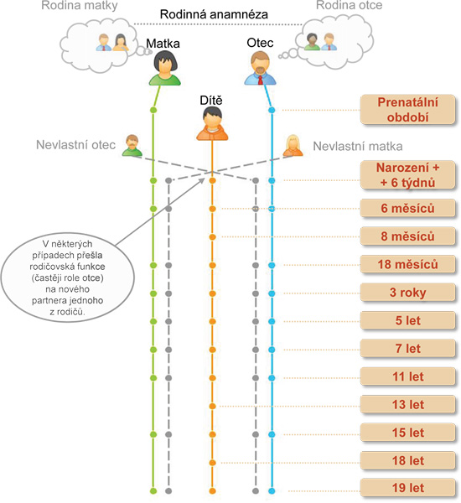
ELSPAC overview

Slide 9
Examples of cohort studies

Slide 10
Cohort studies
British Birth Cohorts
Millennium Cohort Study
1970 British Cohort Study (BCS70)
1958 National Child Development Study
1946 National Survey of Health and Development
Studies of specific diseases (e.g. cardiovascular disease):
Whitehall II study
Framingham Study
HAPIEE (Health, Alcohol and Psychosocial Indicators in Eastern Europe)
Studies of specific exposures/groups of population
War veterans
Nurses Health Study

Slide 11
Open vs closed cohorts
Open
Participants enter and leave the study
Closed
No one enters, only sample attrition

Slide 12
Representativeness in cohort studies
How representative of a studied population the sample is
Selection of sample and response rate
Measurement of exposure
Sample attrition – main issue in cohort studies
If the sample attrition is non-random, it affects representativeness of the study

Slide 13
Sample attrition
Characteristics of people more likely to drop out of study:
Lower education
Lower SES
Men
Living on their own
Worse physical health
Why do people drop out?
Time consuming, too much effort, repetitive, too intrusive

Slide 14
Incidence rate (IR)
Frequency with which a disease or other incident occurs over a specified time period
Person time as denominator (person-months, person-years)
Example:
5 people out of 1,000 develop cancer during 5 years
IR = 1 case per 1,000 person-years (5 / 5,000 person-years)

Slide 15
Advantages of cohort studies
Temporality (exposure followed by outcome)
Less prone to reverse causality
Can compute disease incidence
Can compute absolute and relative rates of disease
Many exposures, many outcomes
Less possibility for bias compared to case-control study

Slide 16
Disadvantages of cohort studies
Exposure can change over time
High costs (large sample, long duration)
High demand on participants
Sample attrition
The findings might not be relevant at the end of the study

Slide 17
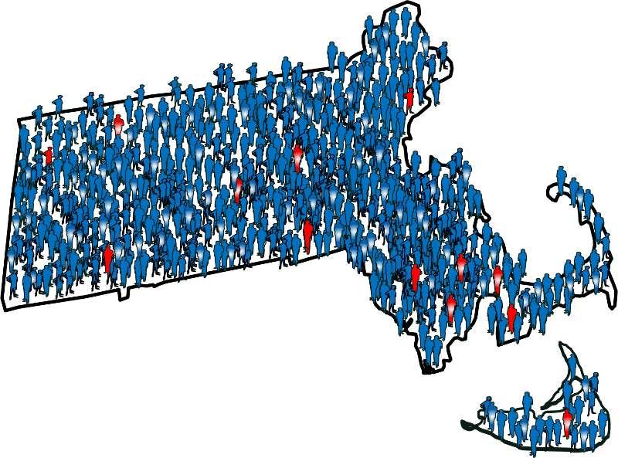
Case-control studies
Image from Introduction to Epidemiology, Boston University

Slide 18
Start
Cohort
All healthy
Follow-up (wait)
Disease assessment
Exposed
Unexposed
Case-Control
Start
Cases
Look back
Controls

Slide 19
Case-control study
Measurement of exposure
Comparing frequency of exposure in cases and controls
“Now”
Cases
Controls
Time

Slide 20
Case-control vs retrospective cohort study
Similarities
Both are observational
Both are retrospective
Both compare exposed and unexposed groups

Slide 21
Case-control vs retrospective cohort study
Differences
Design
Case-control study – the outcome is known (cases and controls), we look back in time for exposures
Retrospective cohort study – we know the exposures (exposed-unexposed), we look back in time to see their outcomes
Objective
Case-control study –identifying the association between exposure and outcome, suitable for studying rare outcomes or diseases
Retrospective cohort study – assessing the risk of developing an outcome in exposed versus unexposed groups, particularly for common exposures
Sampling
Case-control study – cases selected based on the presence of outcome, controls w/o outcome
Retrospective cohort study – exposed and unexposed groups based on exposure history

Slide 22
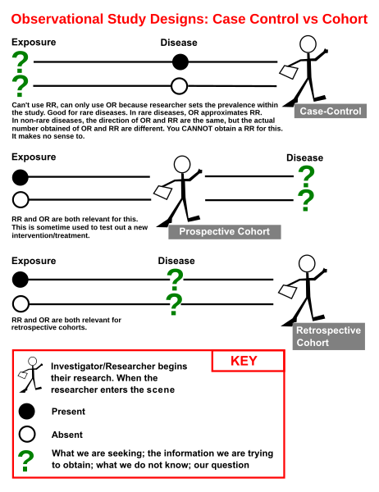
Wikipedia: Case-control study, by Jmarchn.

Slide 23
Case-control study
Cases
having a certain disease (based on dg, symptoms)
selection: hospitals, clinics
Controls
Subjects without the condition
Hospital controls
patients from the same hospital as cases
cheaper, accessible
might differ from general population in exposure levels - selection bias
Community controls
Potential reduction in selection bias
More expensive and time-consuming
Recall bias

Slide 24
Relative risk vs Odds ratio I
Odds ratio (OR)
ratio of the odds of an event in the Treatment group to the odds of an event in the control group
OR = (a/c) / (b/d)
(40/20) / (10/30) = 2 / 0.333 = 6 ($this is the same mathematically as ad/bc)$
 |  | Event
 |  | Dating (Y+) | Not dating (Y-) | Total
Treatment | Socks with sandals (X+) | 40 (a) | 20 (c) | 60
 | No socks with sandals (X-) | 10 (b) | 30 (d) | 40
 | Total | 50 | 50 | 100

Slide 25
Relative risk vs Odds ratio II
Relative risk (RR)
ratio of the risk in the Treatment group to the risk of an event in the control group
RR = (a/(a+c)) / (b/(b+d))
(40/40+20)) / (10/(10+30)) = 0.66 / 0.25 = 2.667
 |  | Event
 |  | Dating (Y+) | Not dating (Y-) | Total
Treatment | Socks with sandals (X+) | 40 (a) | 20 (c) | 60
 | No socks with sandals (X-) | 10 (b) | 30 (d) | 40
 | Total | 50 | 50 | 100

Slide 26
Relative risk vs Odds ratio III
risk = chance of the outcome of interest/all possible outcomes
odds = probability of the occurrence of an event / probability of the event not occurring
In retrospective (case-control) studies, where the total number of exposed people is not available, RR cannot be calculated and OR is used as a measure of the strength of association between exposure and outcome. By contrast, in prospective studies (cohort studies), where the number at risk (number exposed) is available, either RR or OR can be calculated.
Ranganathan, P., Aggarwal, R., & Pramesh, C. S. (2015). Common pitfalls in statistical analysis: Odds versus risk. Perspectives in clinical research, 6(4), 222.

Slide 27
Relative risk vs Odds ratio IV
If the disease is rare (<10%), the estimates of OR and RR will be close
If the disease is more common, OR will exaggerate the association between outcome and exposure
 | Disease + | Disease -
Exposed | 20 | 980 | 1000
Not Exposed | 10 | 990 | 1000
Relative risk = [20/1000] / [10/1000] = 2.00
Odds ratio = [20/980] / [10/990] = 2.02

Slide 28
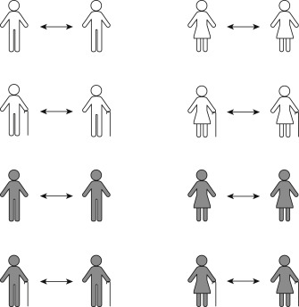
Matched case-control studies
Cases and controls often differ in important aspects (age, sex, ethnicity, behaviours...)
These can confound the study
One way to eliminate such differences is matching controls to cases on these factors
More than 1 control per case can be used
Image from Dey, T., Mukherjee, A., & Chakraborty, S. (2020). A practical overview of case-control studies in clinical practice. Chest, 158(1), S57-S64.

Slide 29
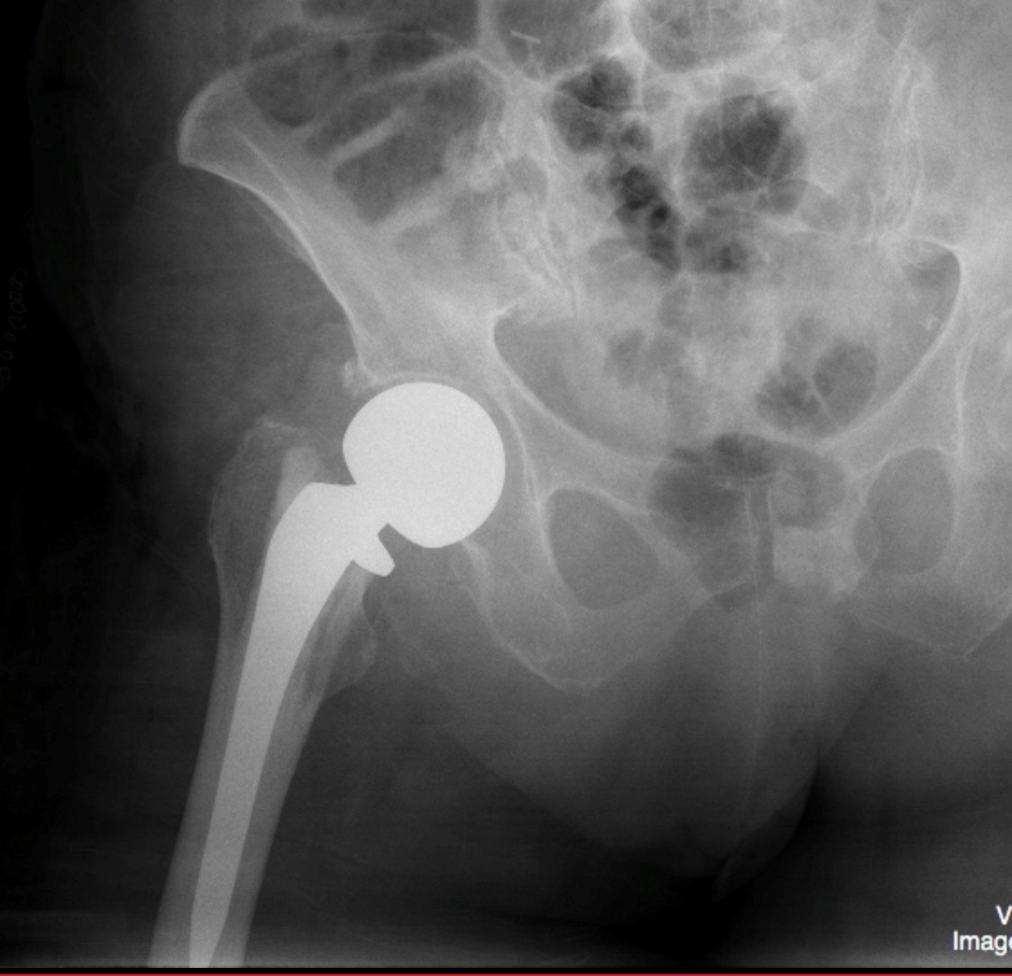
Example: matching in the study of hip fracture
Risk of hip fracture depends on age and sex; men and older people are more likely to suffer; these factors have to be controlled for
Matching cases and controls on age and sex will eliminate the confounding by these factors
For each case [male; age 74] recruit one or more controls [male; age 74]
For each case [female; age 81] recruit one or more controls [female; age 81] etc

Slide 30
Other ways to control confounding
Matching may be impractical (if there are many strata, it is difficult to find controls)
Adjustment in analysis
stratified analysis (eg within drinkers and non-drinkers)
multi-variable analysis (“adjusted” odds ratios)

Slide 31
Nested case-control study
Using an existing cohort study
Cases: subjects who developed the disease
Controls: a random sample of subjects who did not develop the disease
Rationale: to reduce cost with lab measurements
Advantage: no reporting / measurement bias

Slide 32
Case-control study - advantages
Useful for studying rare diseases
Cheap (not necessary to examine large number of people)
Quick (cases already exist)
Can examine many exposures

Slide 33
Case-control study - disadvantages
Not suitable for rare exposure
Cannot calculate incidence risk or death rates
Prone to selection bias
Prone to misclassification of exposure
Prone to reverse causation (people with disease may have changed their behaviour)

