Slide 1
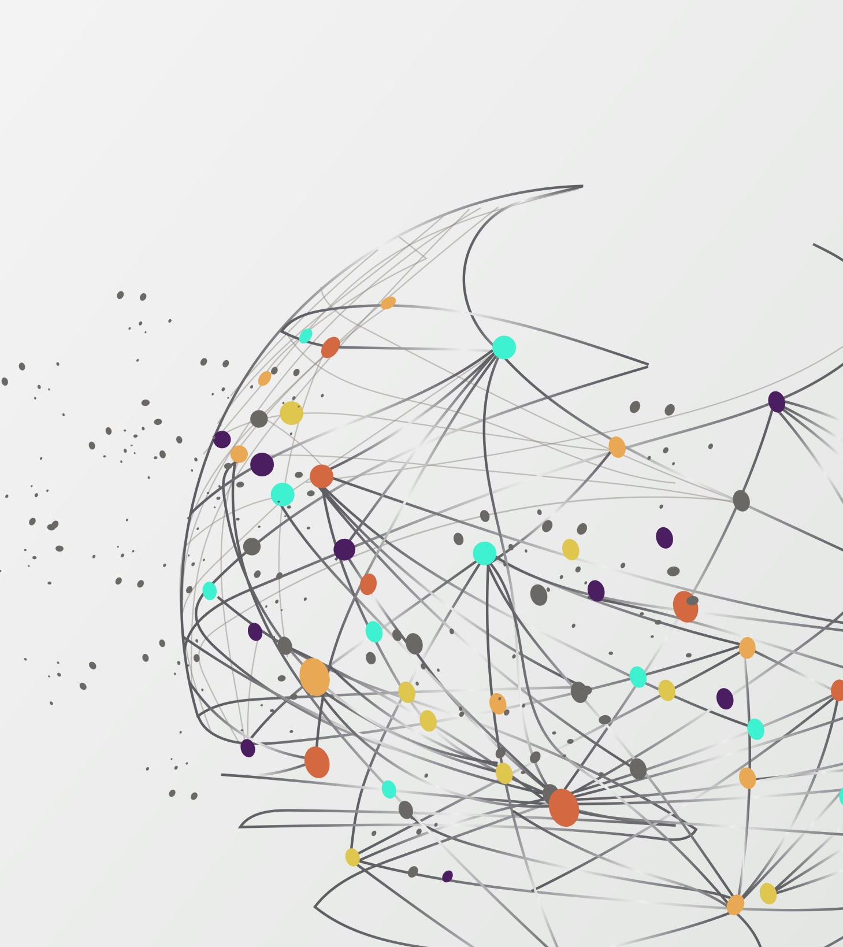
Epidemiological study designs, 3
E2040: Introduction to Epidemiology and Environmental Health
Andrea Dalecká, PhD
Kasia Kordas, PhD

Slide 2
Today’s learning objectives
Describe the features of intervention studies
Describe the reason for and process of randomization in intervention studies
Discuss advantages and disadvantages of intervention studies
Explain what problems with epi studies randomization addresses

Slide 3
But first, a bit of review

Slide 4
Posit a hypothesis
Define study population
Select sub-sample
Collect data
Measure association
Epidemiology allows us to quantify the association between exposure/factor and outcome
Data for this comes from epidemiological studies
Epidemiological study

Slide 5
Different epi designs are appropriate for different purposes and types of questions
Case study/case series
Ecological
Cross-sectional
Case-control
Cohort
Randomized controlled trial
Quasi experimental
Systematic review & meta-analysis
We are here today

Slide 6
Study designs can be grouped by type
Case study/case series
Ecological
Cross-sectional
Case-control
Cohort
Randomized controlled trial
Quasi-experiment
Descriptive
Observational
Analytic
Intervention

Slide 7
And a few words about bias

Slide 8
What is bias in epi?
Bias: systematic, rather than random, error
It's caused by something, like a design feature, mistake, or ignoring confounding factors
Epidemiologic bias is error that systematically affects one group in our study more than another
If an error systematically affects my epidemiologic study, I’ll make an error in calculating my measure of association: I’ll come to the wrong conclusion about the X/Y relationship
We spend a lot of time in epi studies trying to prevent or reduce bias and trying to predict how bias influences our study results.

Slide 9
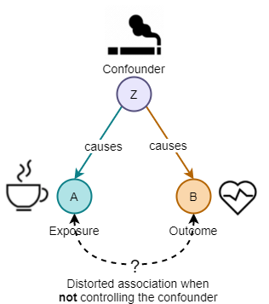
Three categories of bias
Information bias: when how we measure something in a study is related to both X and Y
Selection bias: how people are selected into the study is related to both X and Y
Confounding: when a third variable Z is related to both X and Y

Slide 10
Finally, to intervention studies…

Slide 11

Goal of public health
Modify
In clinical practice and public health, the objective is to modify the natural history of a disease (prevent or delay death or disability) and to improve the health of the patient or the population.
Select
The challenge is to select the best available preventive or therapeutic measures to achieve this goal.
Benefit/risk
Trials can help us determine the value of a measure we have selected (benefit/risk).

Slide 12
What is an intervention study?
Intervention studies are research designs where researchers actively assign participants to receive specific interventions to assess their effects on health outcomes.
These studies are distinct from observational studies, where researchers simply observe and record outcomes without manipulating any variables.
Investigator intervenes; controls what the exposure is; chooses which participants are exposed and not exposed
Intervention studies evaluate both, the benefits and the risks of new forms of intervention (medications, exercise, vaccination… etc.)
Also known as randomized controlled trials (RCT).

Slide 13



There are different types of RCT…

Slide 14
There are different types of RCT…
Clinical trials
Test new medical, surgical, or diagnostic interventions in human patients.
They are primarily designed to determine the safety and efficacy of these interventions.
Successful clinical trials can lead to the development of new therapies for various diseases
Non-clinical trials
Oriented on public health and behavioral changes.
Examples:
Water fluoridation,
grain fortification with folate,
workplace exercise program, diet,
wearing a step counter,
school-based health clinic...
Treatment Trials: Focus on testing new treatments or drugs.
Prevention Trials: Aim to find ways to prevent diseases (e.g. Vaccination).
Diagnostic Trials: Evaluate new tests for diagnosing diseases.

Slide 15
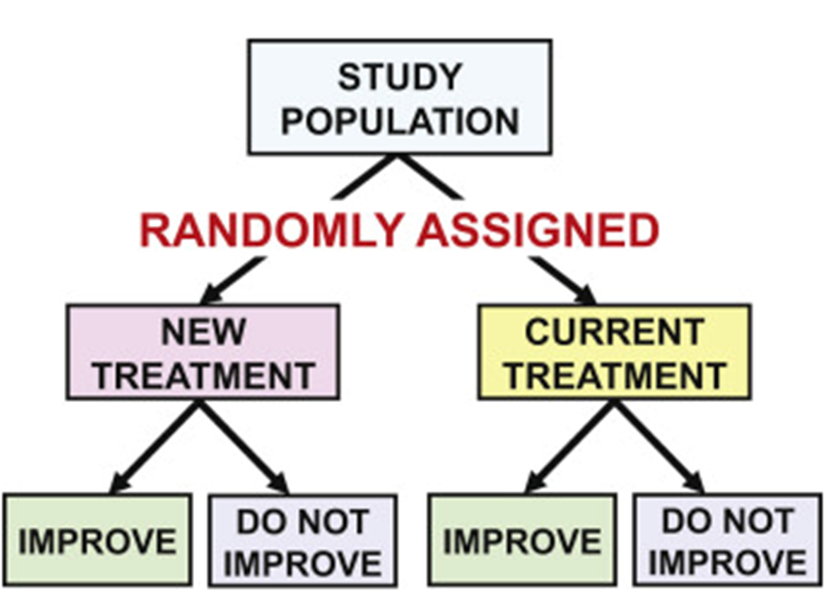
What happens in a randomized trial?
Define the population to study
Sample people from that population
Randomly assign the exposure/intervention (X) or the control
  Inactive treatment (placebo)
  Active treatment (standard of care)
  It is “randomized” because exposure is assigned randomly
Follow up for the outcome (Y)
  How many in each group have developed disease? How many have improved?
Compare outcome between exposed and unexposed. We can calculate:
  Risk (rate) ratio of outcome in exposed compared to unexposed
  Risk difference
We’re measuring incident (new) outcomes here, so we can measure risk!

Slide 16
How are subjects selected?
Based on eligibility criteria (also called inclusion and exclusion criteria)
Characteristics that define the individuals you want to participate in the study
Inclusion criteria:
  Participants with the potential to benefit from the intervention and a high probability of developing the outcomes of interest
Exclusion criteria:
  Higher risk of unwanted events (allergic reactions, pregnant women, children)
  Risk of not complying with the study protocol
Must be explicitly specified in a study protocol, before the study begins. Why?
    Allows clear selection of the sample
    Allows homogeneity of the sample
    Allows others to reproduce the study, assess if the sample was appropriate for the research question
    Identifies the individuals to whom findings apply

Slide 17
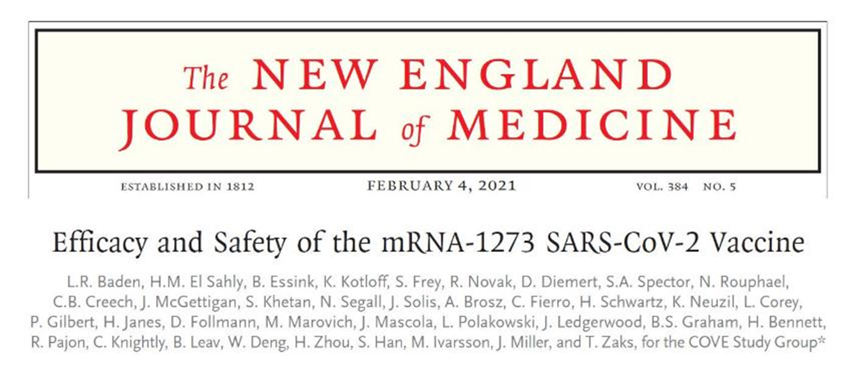
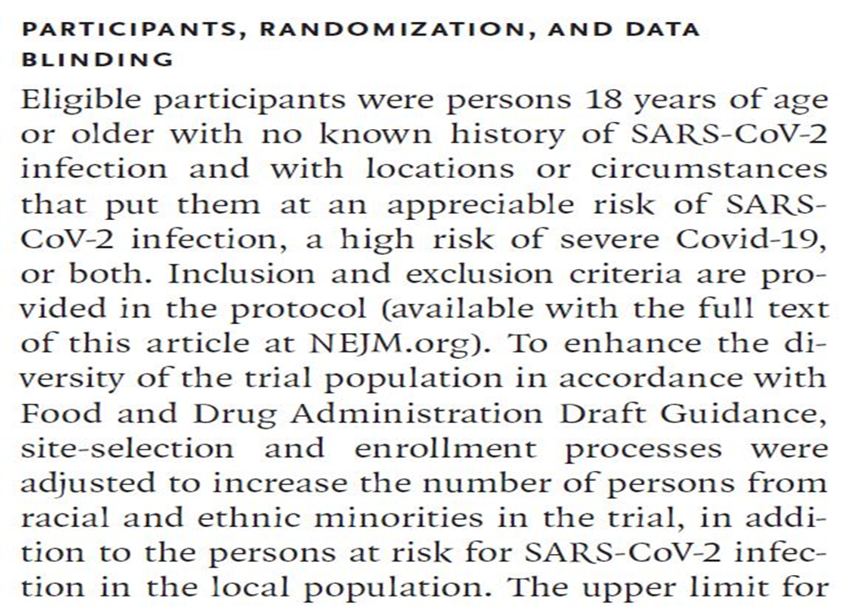

Example

Slide 18






Why randomize?
Different people participate in randomized trials
  Older vs. younger
  Men vs. women
  Sicker vs. healthier
  Better vs. poorer: SES, physical activity, mental health, sleep, diet
Different people respond differently to experimental condition/treatment
  Possibly due to genetic traits
  Possibly due to above characteristics

Slide 19






Purpose of randomization
Condition A
Condition B
Who will tend to do better?

Slide 20
Purpose of randomization
Condition A
Condition B
If there are enough participants, we hope that randomization will increase the likelihood that the groups will be comparable on characteristics about which we may be concerned (such as sex, age, race, and severity of disease).
Randomization does not guarantee comparability – by chance, groups could differ. If groups that are being randomized are large enough and the randomization procedure is free of bias, they will tend to be similar.

Slide 21
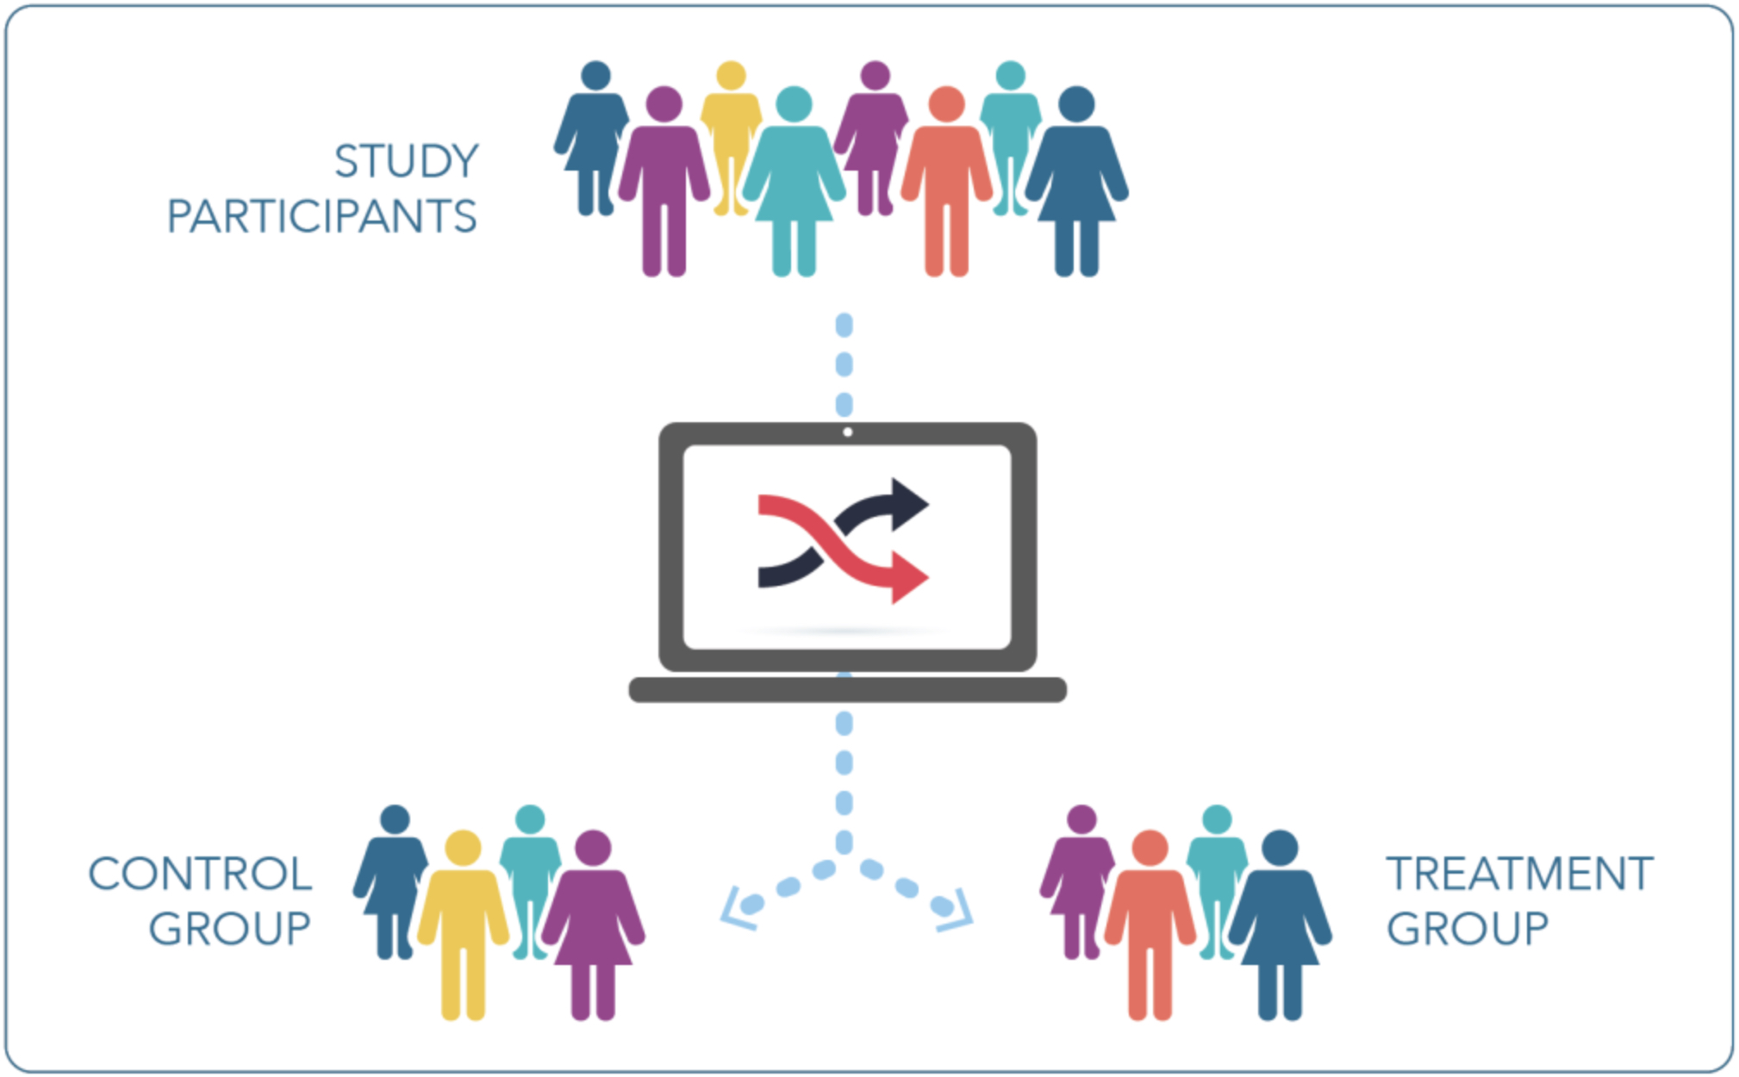

The critical element of randomization is the unpredictability of the next assignment
https://mrctcenter.org/clinical-research-glossary/glossary-words/randomization/

Slide 22
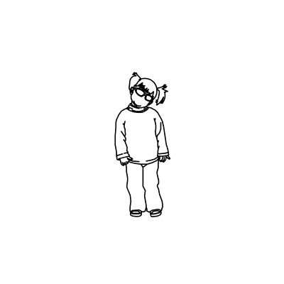


There are different types/levels of randomization
Individual – each person is randomized to an experimental/treatment group and the individual is the unit of analysis
Cluster – a group of people is randomized and the cluster is the unit of analysis
Condition A
Condition B
Condition A
Condition B

Slide 23







Example clusters for randomization

Slide 24
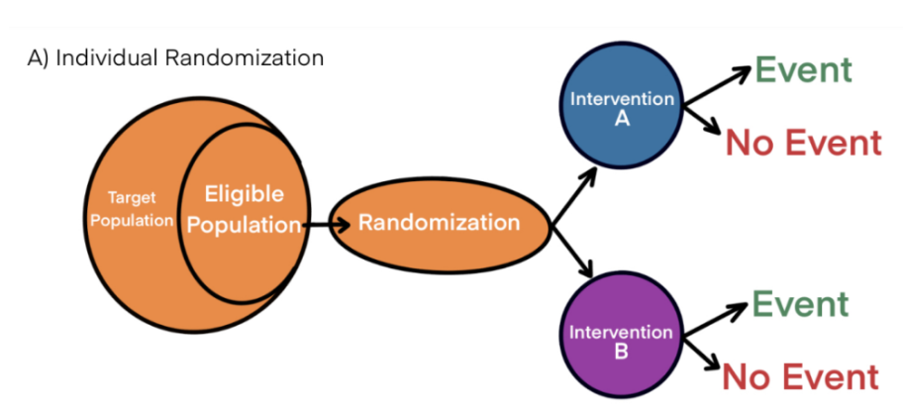
Individual vs cluster RCT

Slide 25
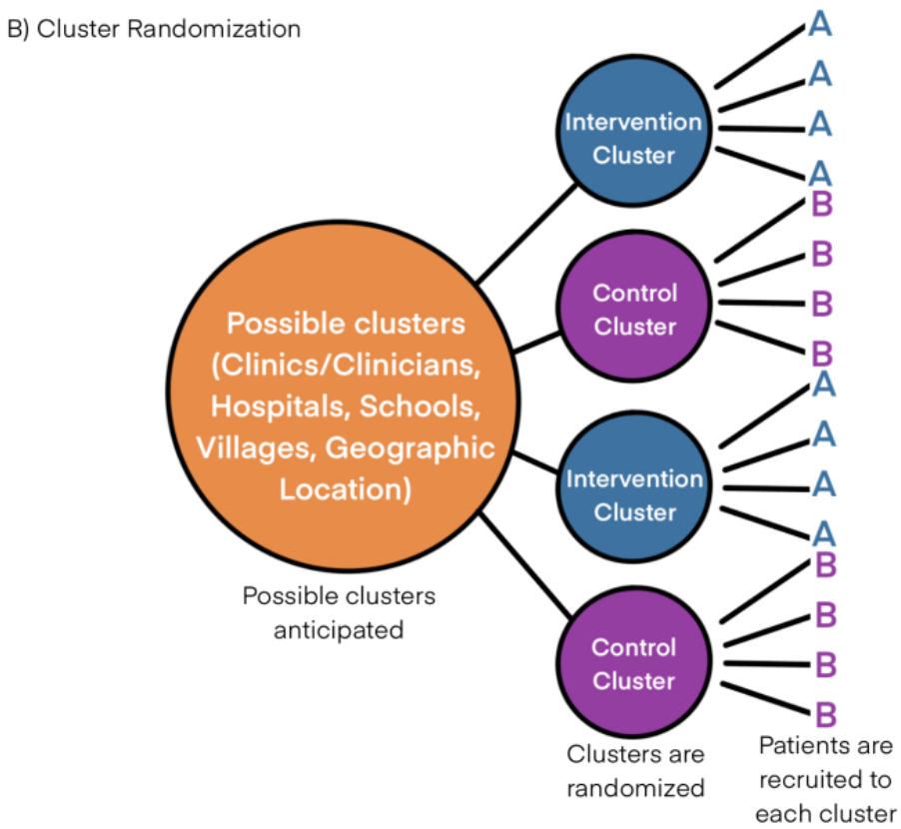
Individual vs cluster RCT
Why would you wish to cluster-randomize?
Unethical to assign individuals (ex., breastfeeding promotion in baby-friendly hospital)
Difficult to implement experiment on individuals (ex., children in daycare)
Difficult to mask assignments.

Slide 26
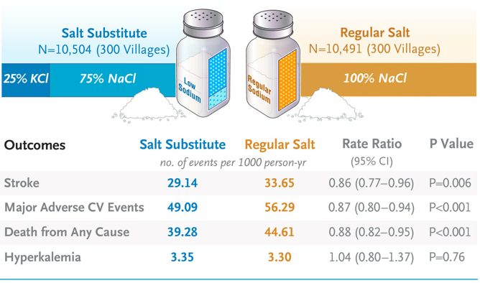
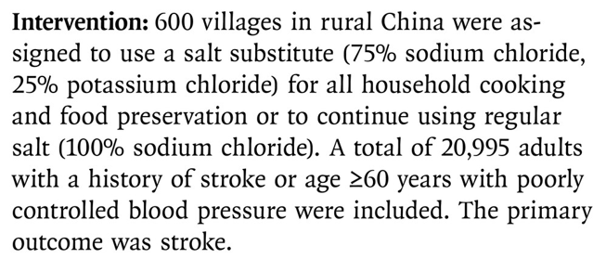
Example cluster-randomized trial
Notes:
Mentor mothers in the video intervention arm provided standard-of-care counseling plus the MOVIE intervention; mentor mothers in the control arm provided standard of care only. The video intervention mentor mothers were tasked with delivering the video intervention during their regular perinatal home visits, which typically include counseling on infant feeding methods.

Slide 27
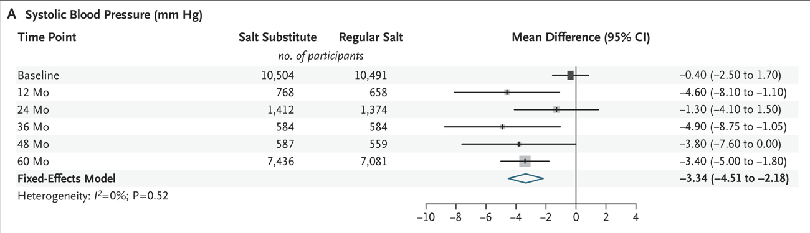
Example cluster-randomized trial

Slide 28







Stratified randomization
Concern about comparability of the groups in terms of one or a few important characteristics that may influence response to intervention/experiment (Sex, classroom, city, etc.)
Randomization does not 100% ensure comparability
  Randomization within strata can help increase the likelihood of comparability of the study groups.
We first stratify our study population by each variable that we consider important and then randomize participants to treatment groups within each stratum.
Older ages
Younger ages
Older ages
Younger ages
Condition A
Condition B
Condition A
Condition B
Condition A
Condition B
Condition A
Condition B

Slide 29

Let’s review randomized trials

Slide 30
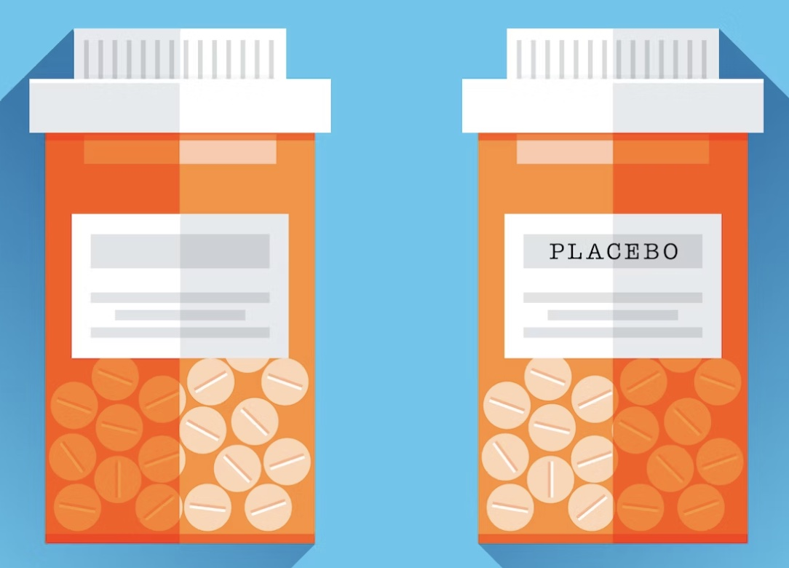
Blinding
Blinding refers to the concealment (masking) of group allocation from one or more individuals involved in a RCT.
Blinding is particularly important when:
  The outcome is a subjective measure, such as pain
  The intervention may affect the participant‘s behaviour (measured as exposure)
How can subjects be masked?
  Using a placebo (an inert substance that looks, tastes, and smells like the active agent)
Use of a placebo does not automatically guarantee that the patients are masked
  Some participants may try to determine whether they are taking the placebo or active drug
https://nautil.us/sugar-pill-nation-294292/

Slide 31
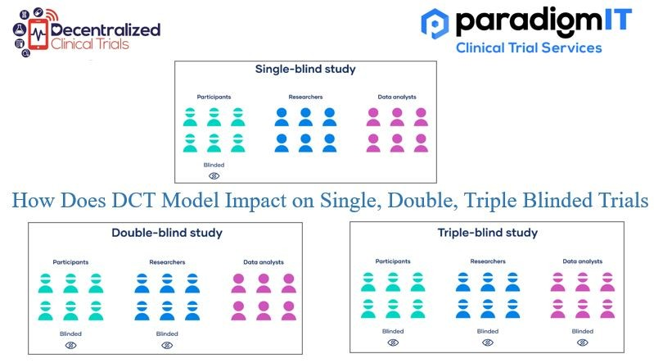
Types of blinding
Participants are not aware whether receiving treatment or placebo.
Neither the subject nor the researcher is aware of the participant's current treatment.
The intervention being studied is concealed from the participants, the individuals administering the treatment, and the evaluators of the results

Slide 32
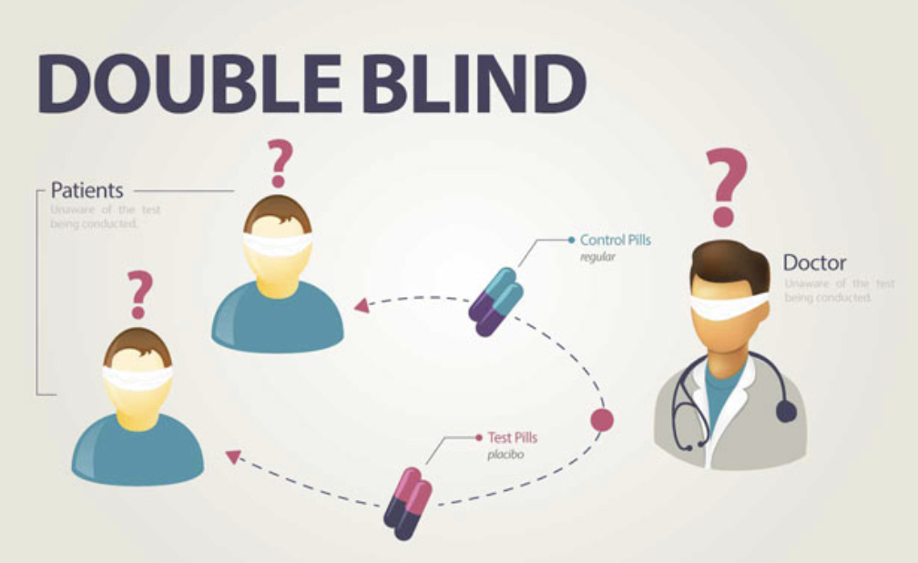
Why do we double- or triple- blind the RCTs?
Observers who think the intervention is effective may probe the subjects who are taking the intervention differently (Observer bias)
Clinicians who know the subject is taking the placebo may give extra care to compensate not receiving an active treatment
(Co-intervention bias)
https://www.covid19recovery.net/blog/understanding-clinical-trials

Slide 33



What if blinding is not possible?
Happens in behavioral, educational, or clinical care interventions
Cross-over trials
  Participants serve as their own controls
Wait-list control
  Everyone gets the intervention, but some people randomized to wait before they get it
No intervention
Control
Intervention
Wait
Control
Intervention

Slide 34
Factorial design
You can test two interventions at once! How convenient!
Ex., Harvard Women’s Health study. Randomized women to both vitamin E and low-dose aspirin (LDA):
Neither drug had strong effects on cardiovascular disease or cancer. There were some weak effects on specific outcomes like stroke.
Factorial designs also allow testing of effect modification: ex., is the effect of vitamin E and aspirin taken together stronger than the sum of their individual effects?
 | Vitamin E: yes | Vitamin E: no
Low dose aspirin: yes | Vit E and LDA | LDA only
Low dose aspirin: no | Vit E only | Neither (placebo)

Slide 35
Possible issues during the RCTs

Slide 36
Data collection: Information bias
We want comparable measurement between intervention and control groups: this reduces information bias
To prevent information bias, you need to measure outcome equivalently for intervention and control groups
Example, exercise frequency and intensity:
In a study of online video intervention to increase exercise, the intervention group may report it more accurately because they’re more attentive to it
One way to solve this: not rely on self-reports. Maybe look at activity time or steps on a smartwatch. There are privacy and feasibility concerns, though.
Information bias can affect randomized trials. Randomization doesn’t solve information bias!
  Randomization doesn't improve how we collect information

Slide 37
Drop-ins
People in one group may unintentionally take the agent assigned to the other group.
For example:
    In a trial of aspirin vs placebo, participants in the placebo group may take aspirin as an over-the-counter medication
Two steps were taken to address this problem:
      (1) controls were provided with lists of aspirin-containing preparations that they should avoid,
      (2) urine tests for salicylates were carried out both in the aspirin group and in the controls.

Slide 38
Non-compliance
Noncompliance arises when participants do not receive the treatment or intervention to which they were randomly allocated.
For example, some participants invited to go through a screening program may not attend.
Noncompliance may be overt or covert: people may overtly articulate their refusal to comply or may stop participating in the study (non-compliers are also called dropouts from the study).
People may just stop taking the agent assigned without admitting this to the investigator or the study staff.
  Whenever possible, checks on potential noncompliance are built into the study (for example, urine tests for the agent being tested or for one of its metabolites)
Consequences:
  The treatment group will include some who did not receive the therapy, and the no-treatment group may include some who received the treatment.
  The experimental groups are less different.
  Noncompliance may be differential (related to specific characteristic)→ bias.

Slide 39
Recruitment and retention of participants
Recruitment of sufficient numbers of eligible and willing volunteers is major challenge in randomized trials
  Especially if treatment is long or difficult (has side effects, many tests or procedures).
Failure to recruit enough volunteers can leave a well-designed trial without enough participants to produce statistically valid results.
Within the limits of a randomized trial, participants must be fully informed of the risks and what arrangements have been made for their compensation if untoward effects occur.
A related problem is retaining volunteers for the full duration of the study
  Participants may lose interest in the study over time, or find participation too inconvenient, long.
Investigators understand why participants often drop out of studies and develop appropriate measures to prevent losses to follow-up.

Slide 40
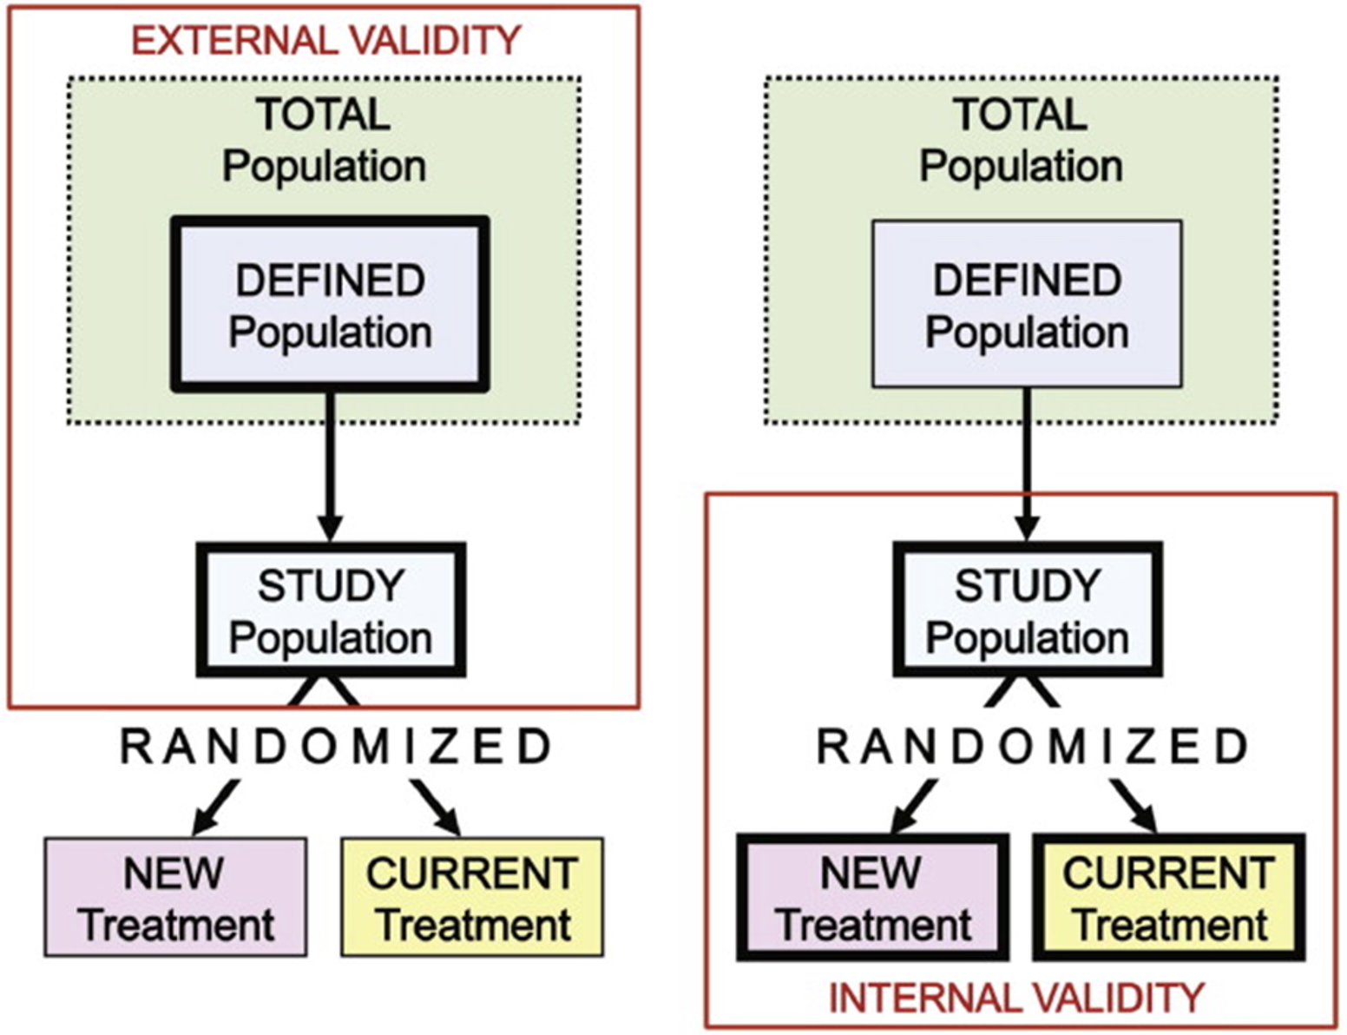
External vs. internal validity
Main objective is to generalize the results of a trial beyond the study population itself.
Our ability to apply the results to a broader population is called the generalizability, or external validity, of the study.
External validity should be distinguished from internal validity.
A randomized trial is internally valid if the randomization has been properly done and the study is free of other biases and is without any of the major methodologic problems that have been discussed.
It should be ideally concluded that the observed differences in the outcomes in the two groups being compared are attributed to the hypothesized exposure under study, aside from sampling errors.

Slide 41

Let’s wrap this up
X = Exposure
Y = Outcome
Does randomization fix these problems?
Confounding: yes! It ensures that nothing but random chance is related to X
Selection bias:
  yes if it’s due to selection into the study! It ensures that nothing but random chance is related to X
  no if it’s due to loss to follow-up! Because reasons people drop out can still be related to X and Y
Generalizability: no! People who join the trial may still be different than people who don’t join
Information bias: no! There can still be measurement inaccuracies in X or Y

Slide 42

How to express results from a randomized trial?
The number needed to treat (NTT)
$$\frac{1}{(rate in placebo group −rate in treated group)}$$
Efficacy
$$\frac{(rate in placebo group −rate in treated group)}{rate in placebo group}$$

Slide 43
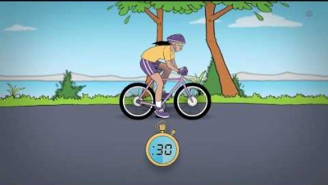

A trial for a new drug shows that 30% of patients in the treatment group and 50% in the control group experienced an adverse event.
In clinical trials (like in any epi study), we also need to consider whether the result is clinically significant. What is that?
The number needed to treat (NTT)
$\frac{1}{(50\%−30\%)}$ = $\frac{1}{20\%}\text{= }\frac{1}{0.2}$ = $5$
We need to treat 5 patients to save 1 from adverse event.
Efficacy
$\frac{(50\%−30\%)}{50\%}$ = $\frac{20\%}{50\%}\text{ = 0.4 ∗ 100 = 40}$%
The treatment is 40% efficacious

Slide 44
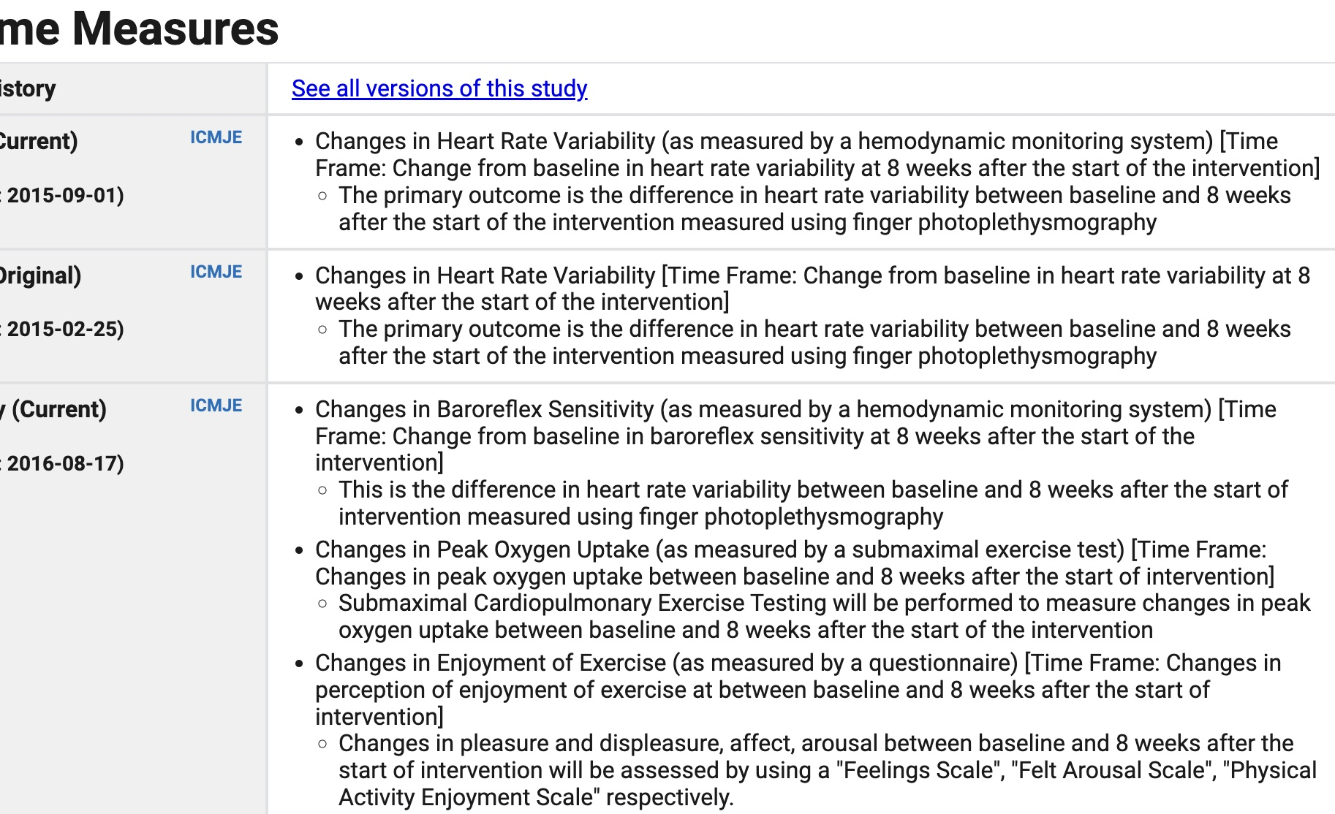
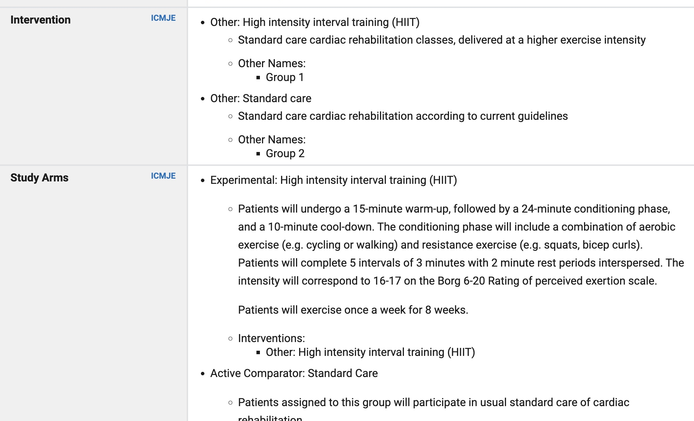
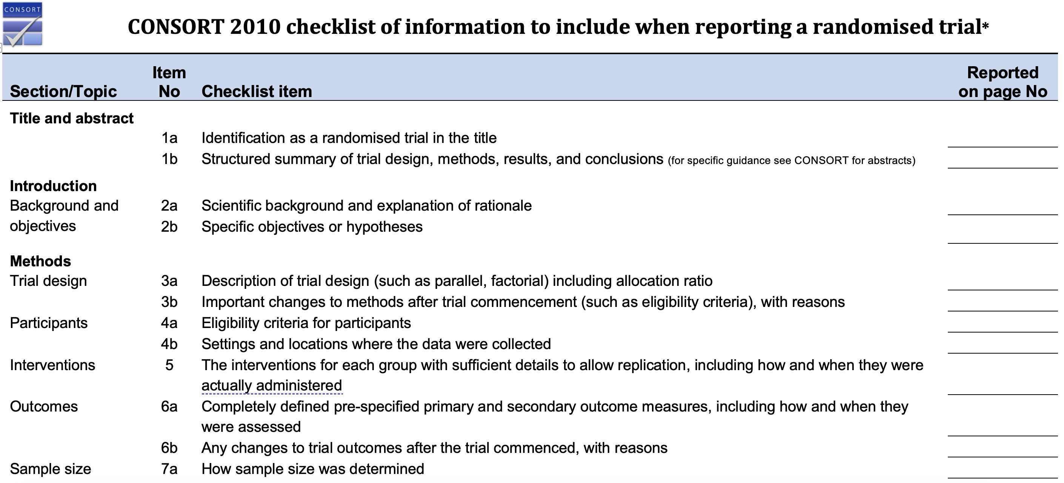
Clinical trial registration & reporting
To avoid selective reporting, the International Committee of Medical Journal Editors adopted a policy, which became effective in 2005, that all clinical trials must be registered in a public registry before any participants are enrolled in the study.
www.Clinicaltrials.gov
Clinical trial reporting must follow established guidelines

Slide 45
Is using a placebo ethical?
Placebo-controlled trials
  Use of an active treatment comparator in a clinical trial of a new therapy is generally the appropriate trial design when an established effective therapy exists
Placebo can be ok in some circumstances:
    No established therapy
    Existing evidence raises significant doubt by medical experts regarding benefit of existing therapy
    Patients are resistant to existing therapy due to previous history

Slide 46

Questions?
Andrea Dalecká andrea.dalecka@recetox.muni.cz

