Slide 1

Ecotoxicology
Part 1 - Introduction
Ludek Blaha + ecotox colleagues

Slide 2
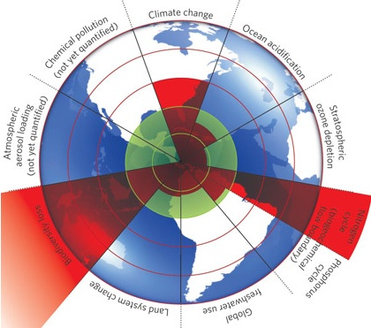
Global anthropogenic threats ?
A safe operating space for humanity
& the nine planetary boundaries
Rockstrom et al. 2009
(Ecology and Society 14(2): 32; Nature 461, 472-475)

Slide 3
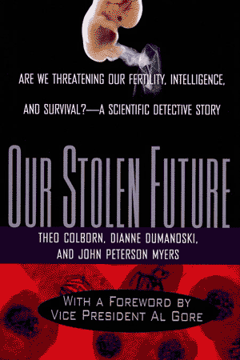
1996 - Chemicals in the environment
Do you believe that chemicals in products sold to consumers have been proven safe?
Think again
most chemicals in modern use have simply not been tested for their impacts on
human, even very basic effects.
… what about the effects in nature, then ?
How we stand almost 30 years later?

Slide 4
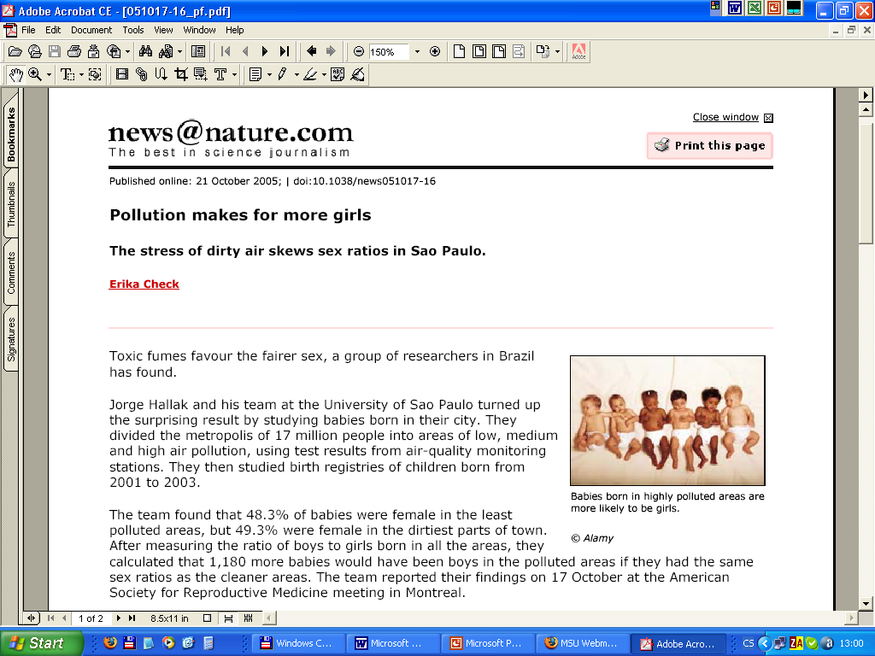

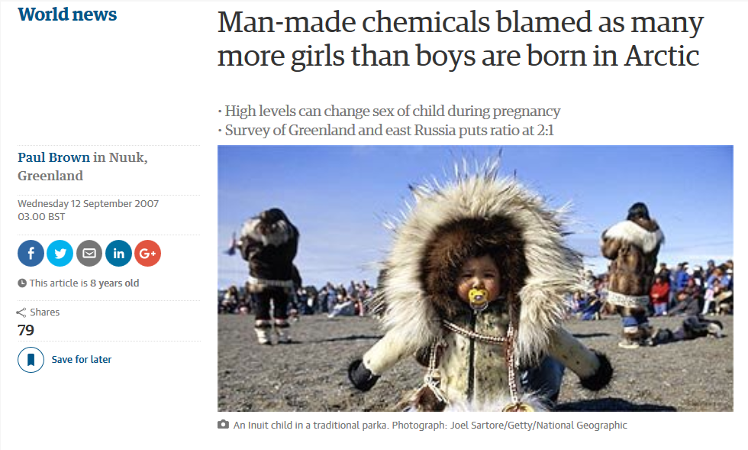

Slide 5
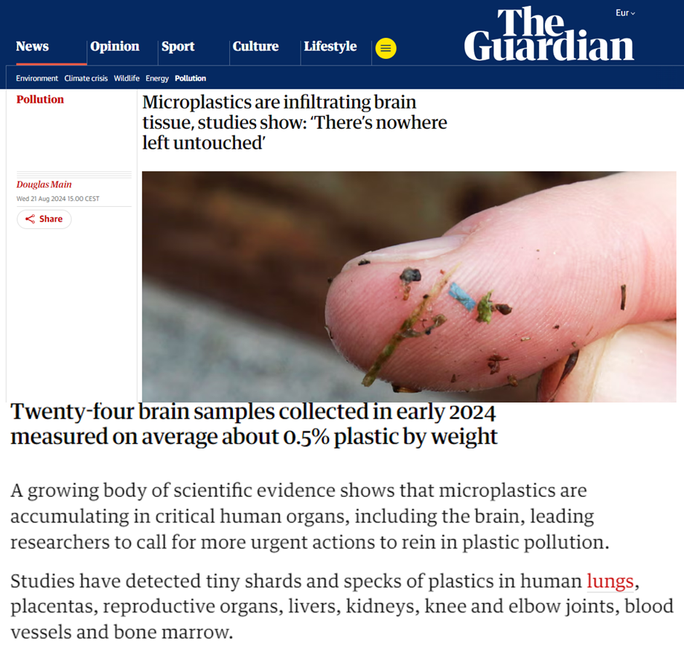
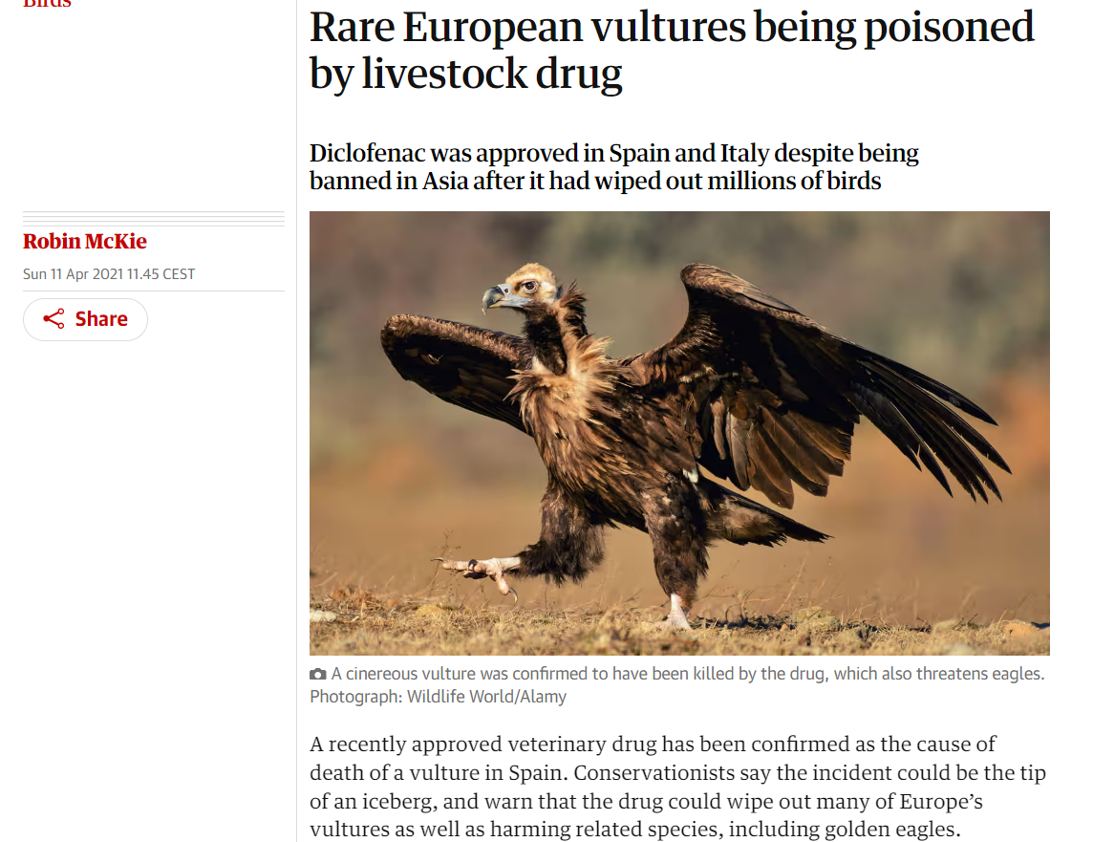

Slide 6
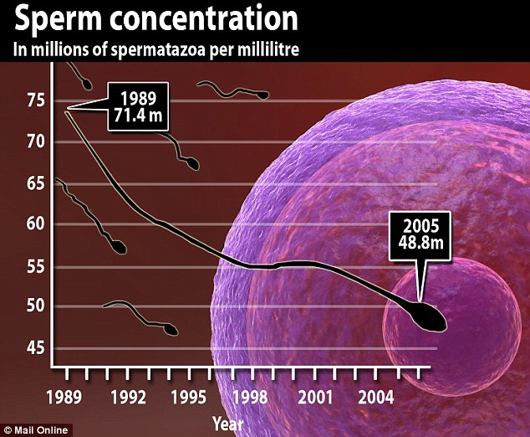
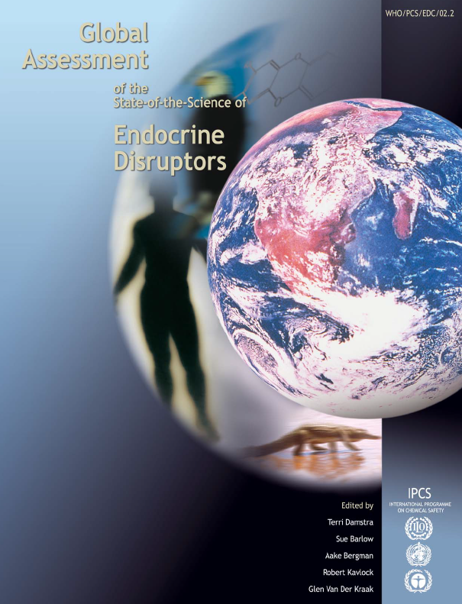
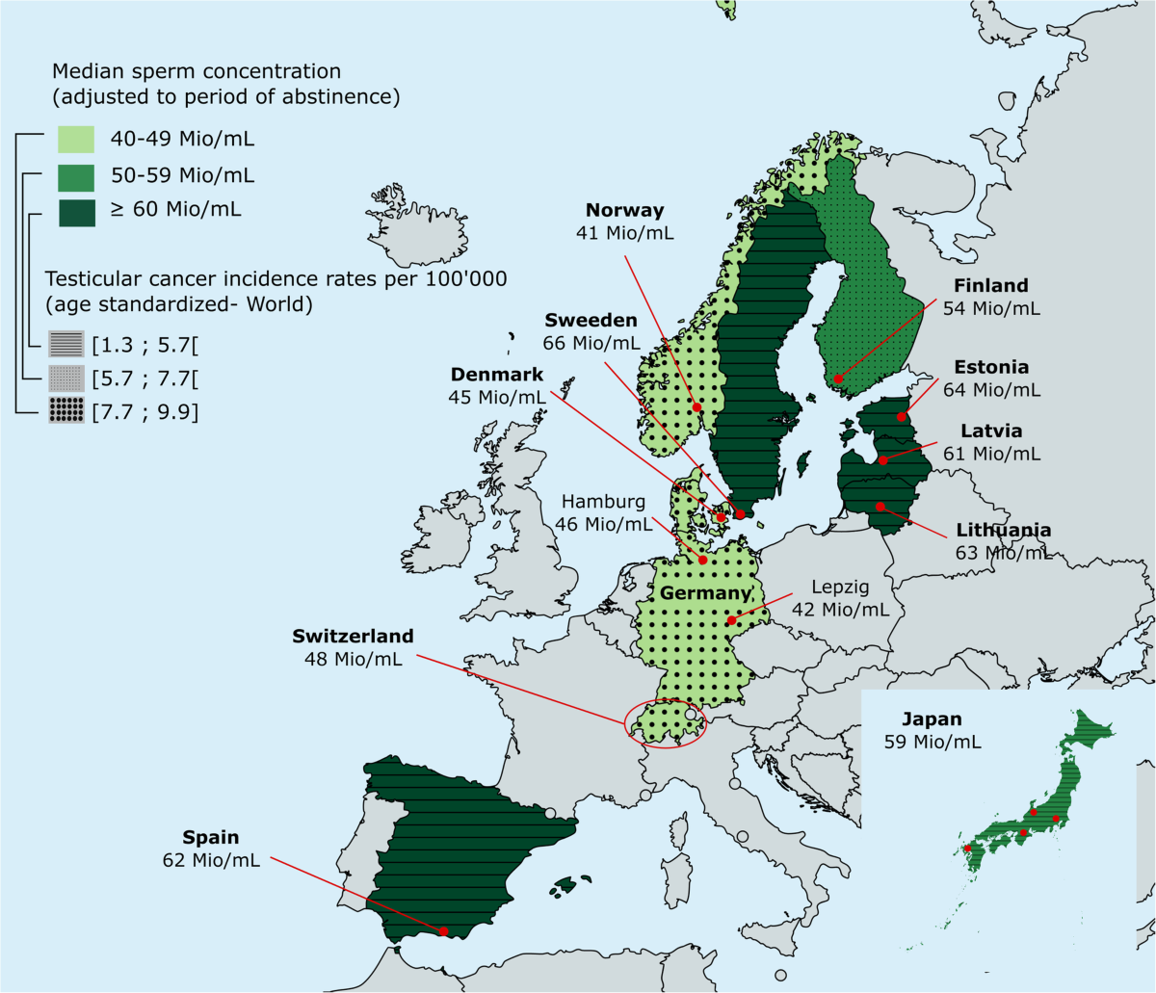
https://www.who.int/teams/environment-climate-change-and-health/settings-and-populations/children/endocrine-disrupters
https://bacandrology.biomedcentral.com/articles/10.1186/s12610-020-00114-4

Slide 7
Environmental pollution
Examples and ecological cosequences

Slide 8
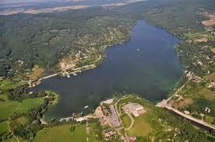
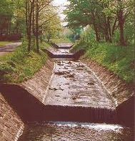
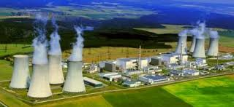
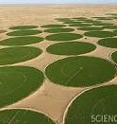
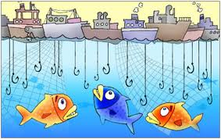
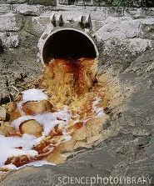
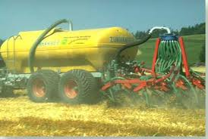
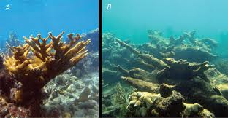
Major anthropogenic threats – example: waters
Direct
Impacts
Indirect

Slide 9
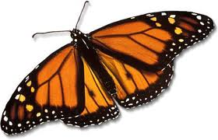
Major impacts
Loss of biodiversity

Slide 10
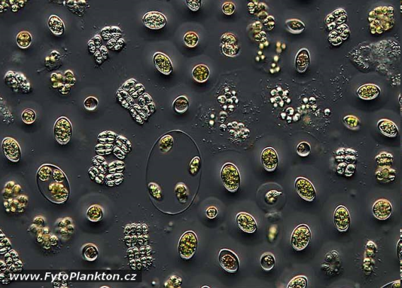
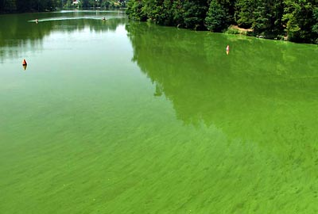
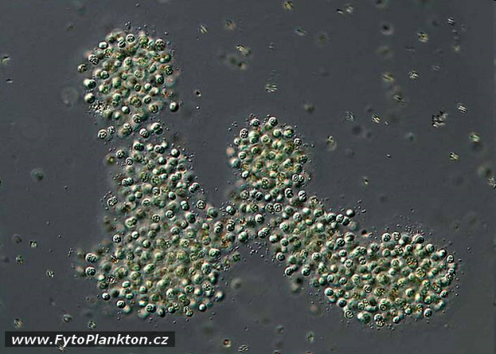
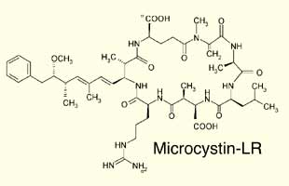
Changes in biodiversity

Slide 11
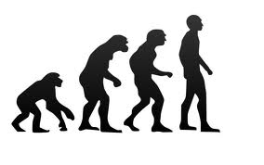
Major impacts
Loss of biodiversity
Impairment of ecosystem services
  Unbalanced water cycles
    Water scarcity
    Draughts/floods
  Impaired water quality
    Drinking waters
    Bathing waters
    Toxicants in food chain
  Shrinking of food supplies
    Direct → lowering fish amounts
    Indirect → crop yield

Slide 12
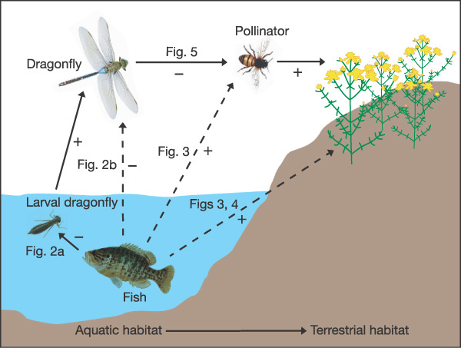
Impacts on fish → decreased crop yields
NATURE (2005) 437: 880

Slide 13
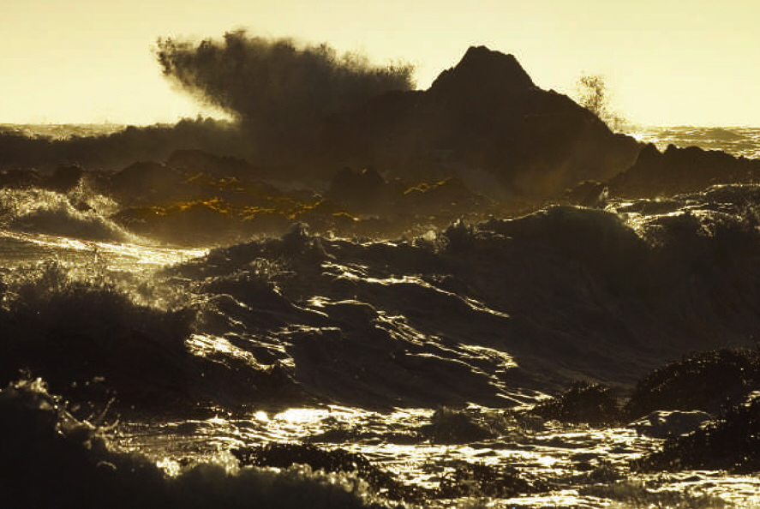
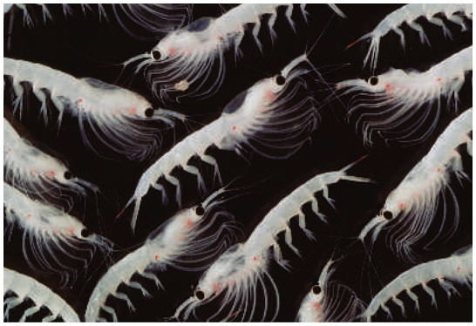
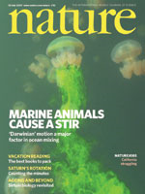
Impacts on biota → global effects
Mixing oceans
→ cooling the atmosphere
[Nature 447, p.522, May 31, 2007]
Marine life supplies up to 50% of the mechanical energy required worldwide to mix waters from the surface to deeper cool layers
[Dewar, Marine Res 64:541 (2006)]
[Katija a Dabiri, Nature 460:624 (2009)]

Slide 14
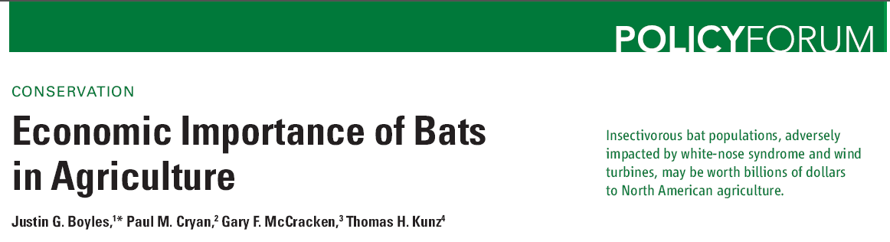

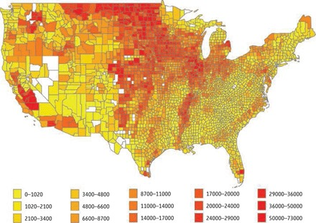
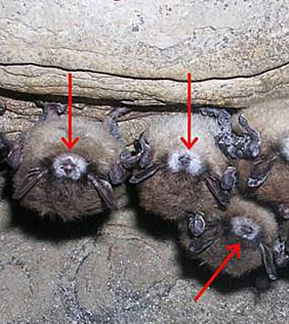
Boyles et al. (2011) Science 332 (60251) 41-42

Slide 15
Ecotoxicology
assessment of hazards
and risks of chemicals in ecosystems

Slide 16

Protection of environment / nature
Is and must be primary aim of sustainably developing society
why?
How to protect ?
Policy
Legislation
Research
Education
Ecotoxicology – offers knowledge and tools useful for the effective and reasonable environmental protection

Slide 17
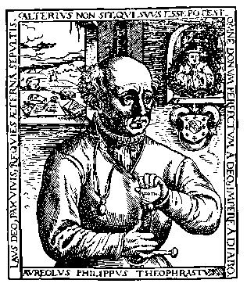
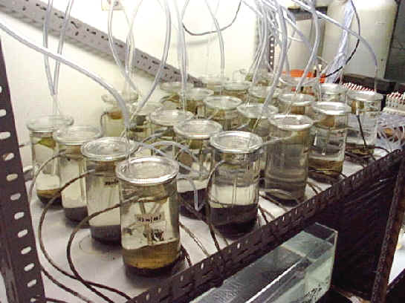
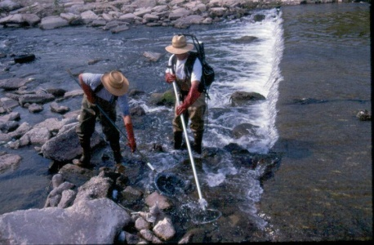
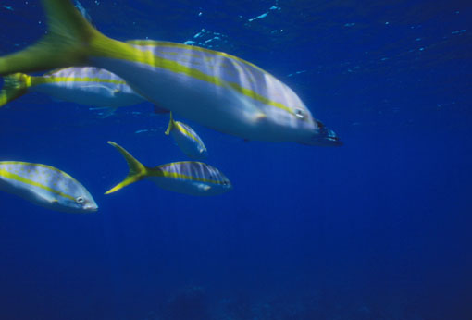
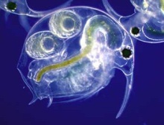
Cause → Effect (Causality)
Dose → Response
Risk assessment
Exposure
(concentration >> dose)
Effect
(What exposure causes effects?)
Atmospheric
Deposition
WWTP
Erosion
& Runoff
Ecotoxicologica bioassays,
field studies, biomonitoring…
Untreated discharges

Slide 18
What is hazardous? What is toxic?
How to define toxicity?

Slide 19

What is hazardous? What is toxic?
How to define toxicity?
Is this thing toxic?

Slide 20
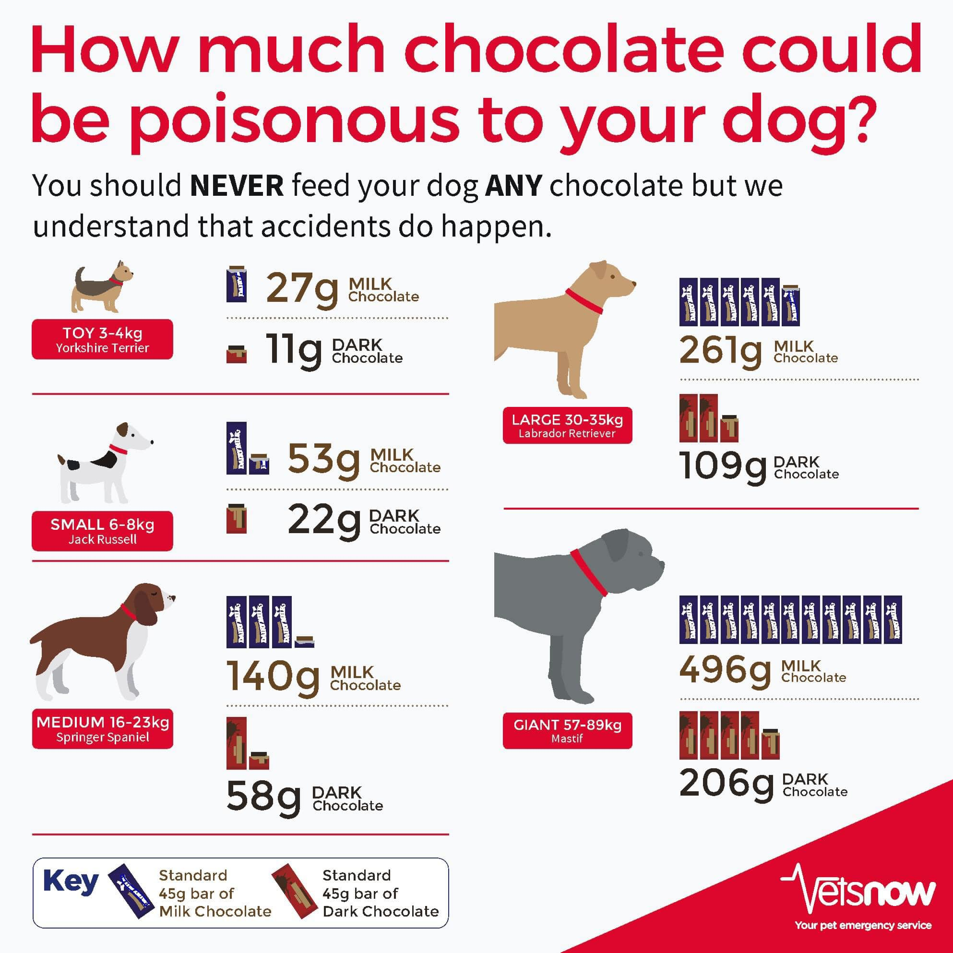
What is hazardous? What is toxic?
How to define toxicity?
Is 11g a lot … or is it just negligible amount?

Slide 21
What is hazardous? What is toxic?
How to define toxicity?

Slide 22

Paracelsus (1493 - 1541)
‘What is there which is not a poison?
All things are poison and nothing without poison.
Solely the dose determines that a thing is not a poison.

Slide 23

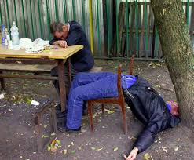
(Eco)toxicology – ultimate goal ?
To identify (or predict)
safe vs hazardous levels

Slide 24
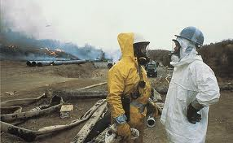
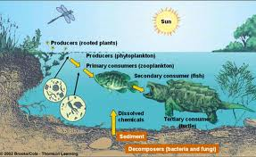
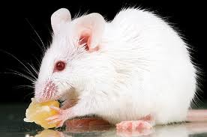
Assessment of one of the hazards (i.e. toxicity) to different targets
…to…
Humans Other organisms
(TOXICOLOGY) (ECOtoxicology)

Slide 25
ECOTOXICOLOGY by definition
Aim: to maintain the natural structure and function of ecosystems
Definitions:
  ecotoxicology is concerned with the toxic effects of chemical and physical agents on living organisms, especially on populations and communities within defined ecosystems; it includes the transfer pathways and their interactions with the environment
  science of contaminants in the biosphere and their effect on constituents of the biosphere, including humans’ (Newman & Unger, 2002)
  science that provides critical information on effects of toxic compounds on living organisms which SERVE various practical aims (environmental protection)

Slide 26
ECOTOXICOLOGY

Slide 27
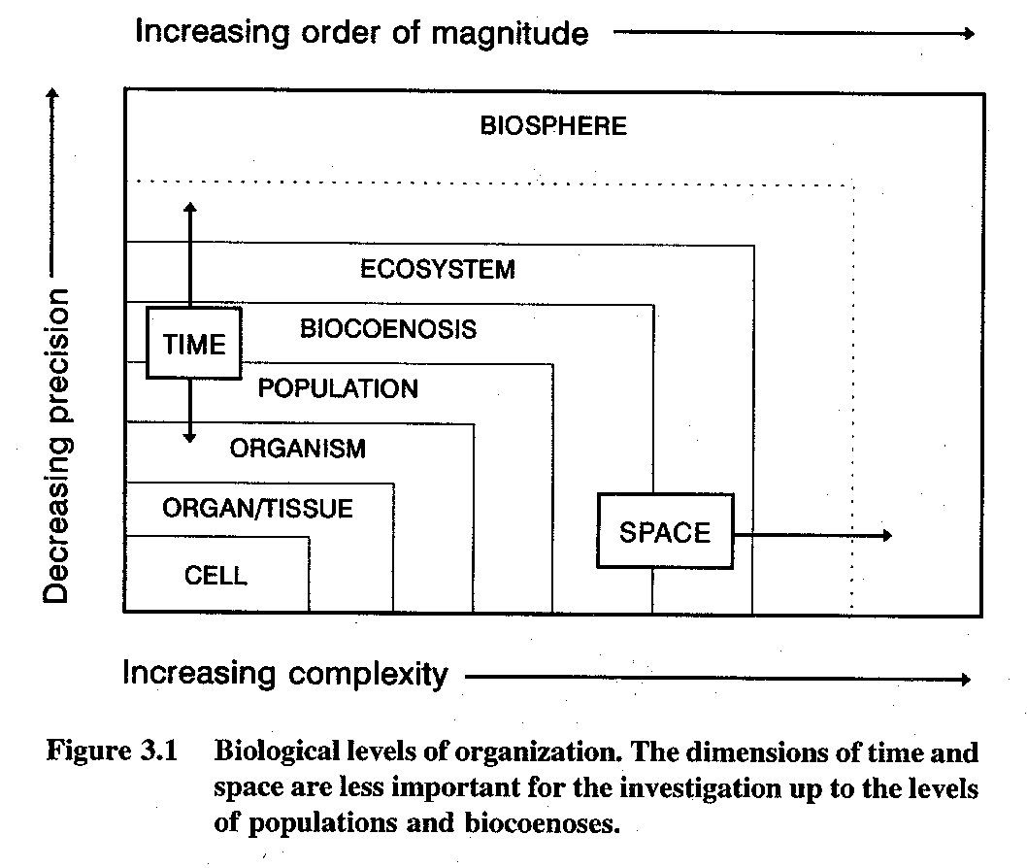
Ecotoxicology - from molecules to ecosystems
… and backwards

Slide 28
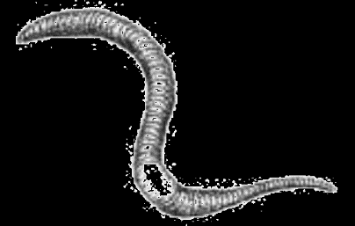
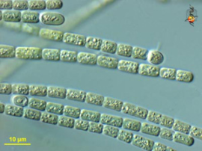
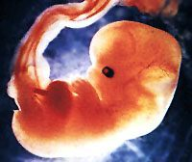
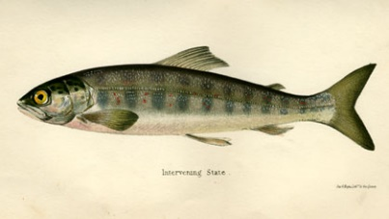
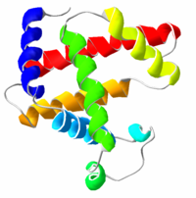
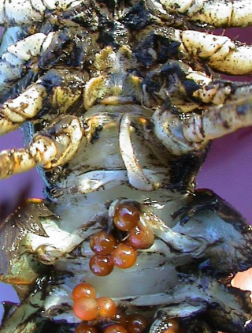
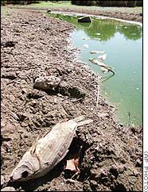

CHEMICAL ENTERS THE ENVIRONMENT
CHEMICAL ENTERS THE ORGANISM
biomonitoring
LEVELS, FATE, PROCESSES
Toxicokinetics
biotransformation
bioactivation
excretion / sequestration
Bioavailable fraction
Target site
“EFFECT”
toxicodynamics
“EXPOSURE”
acute
chronic

Slide 29
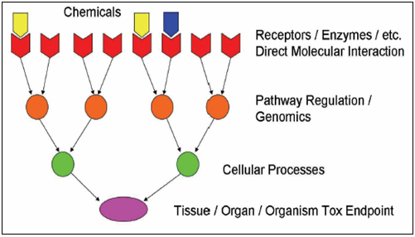
From molecules to individuals → to populations
MECHANISMS OF TOXICITY

Slide 30
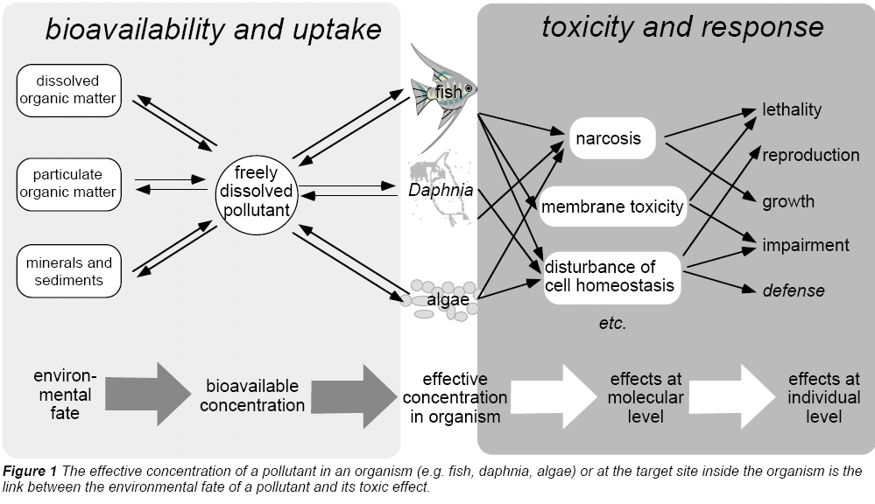
Ecotoxic effects
Escher, B. I., Behra, R., Eggen, R. I. L., Fent, K. (1997), "Molecular mechanisms in ecotoxicology:
an interplay between environmental chemistry and biology", Chimia, 51, 915-921.

Slide 31

From molecules to individuals → to populations
ADVERSE OUTCOME PATHWAYS

Slide 32
From ecosystems
→
down the mechanisms
OR
?
From mechanisms (molecules)
→
up to effects and ecosystems

Slide 33





1962
© Patuxent Wildlife
Refuge, MA, USA
http://www2.ucsc.edu/scpbrg/

Slide 34




Bitman et al. Science 1970, 168(3931): 594
Biochemistry
bird carbonate dehydratase
In situ: bioaccumulation
-> bird population decline
In vivo: shell thinning

Slide 35

AOP Example: Activation of ER - estrogen receptor (e.g. by EE2) leads to reproductive disorders and population decline in fish
Ethinylestradiol (EE2)
Binds to
ESTROGEN
RECEPTOR
Target genes
Proliferation/Apoptosis (sexual organs)
Synthesis of egg yolk (fish, amphibia)
Effects
Females: reproduction regulation
Males: feminization
(+ e.g. cancer promotion, development,
immunomodulation)

Slide 36




Kidd, K.A. et al. 2007. Collapse of a fish population following exposure to a synthetic estrogen. Proceedings of the National Academy of Sciences 104(21):8897-8901
5 ng/L (!)
7 years
Controls +Ethinylestradiol

Slide 37
WRAP UP … take home message
Ecotoxicology as a science with close links to practical environmental protection
  Understand the importance and links between
  ECOTOXICITY --- BIODIVERSITY --- ECOSYSTEM SERVICES
From molecular events to higher levels
  Be aware of different biological levels - from molecules to communities
  Know example(s) of „Adverse Outcome Pathway(s)“

