Slide 1
Ecotoxic effects
- Cellular and organisms levels -
Luděk Bláha, PřF MU

Slide 2
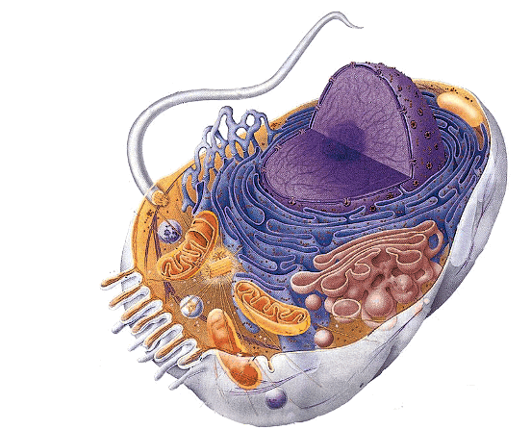
Toxicity at cellular level
Molecular mechanisms
(effects on proteins, membranes, DNA) manifest at cellular level

Slide 3
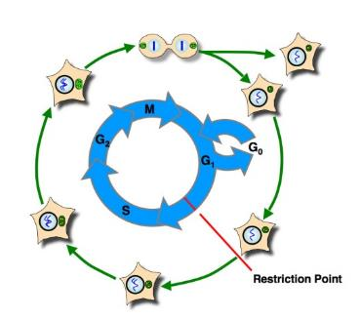
Life trajectories of the cell
Regular pathways of cell life
  Cycling (cell cycle, proliferation)
  Due to limited proliferation → senescence or
  or terminal differentiation
  or cell death (controlled) – apoptosis
Homeostasis assured through careful check of key processes, i.e.
Cell membrane integrity
Aerobic respiration (mitochondria)
Proteosynthesis (ribozomes)
DNA integrity
…. Effects on these processes → toxicity

Slide 4
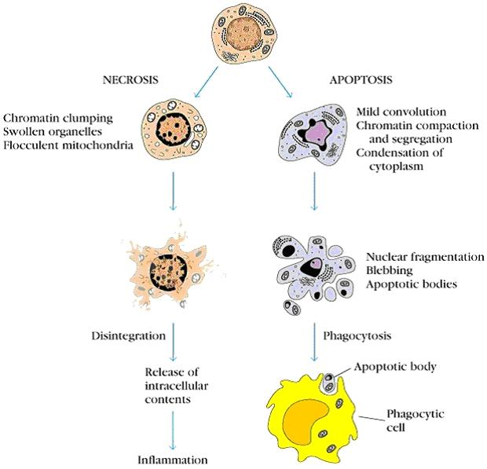

Slide 5
IMPACTS and manifestation of toxicity at cell level
Disruption of cell proliferation
Tumors, cancer
Immune system disruption (proliferation in many processes)
Disruptions of differentiation
Important for early development (embryotoxicity, teratogenicity)
Tumors (cells often NOT differentiated)
Immune systém
Disruptions of apoptosis
Tumors (cells escape apoptosis)
Effects on immune system
  (TCDD induced activation of AhR → apoptosis in thymus → loss of functional immune reactions

Slide 6
Oxidative stress
Important general mechanism of celluar toxicity

Slide 7
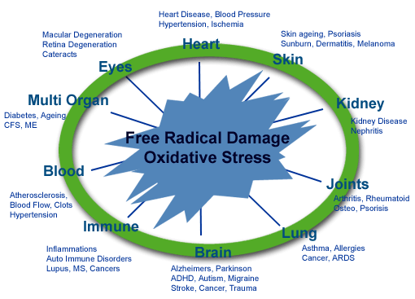
Importance of redox (oxido-reduction) homeostasis
Redox homeostasis
  natural homeostatic levels of prooxidants and antioxidants
  keeping cell metabolism and signalling balanced
Disruptions of homeostasis
  → depletion of oxygen
    Change in metabolism, acidosis in tissues, signalling (e.g. TUMORS)
    Less studied – new field – REDOX SIGNALLING
  overproduction of prooxidants = oxidative stress
    GENERAL MECHANISM OF TOXICITY AND AGING

Slide 8
Pro oxidants
Oxygen (O2)
  principal molecule in living organisms
    terminal acceptor of electones
  highly reactive molecule
    formation of reactive derivatives → ROS → toxicity
Other reactive molecules and ROS sources
    production in mitochondria (byproducts of metabolism)
    oxidations in detoxification mediated via MFOs (CYPs)
    Fenton-reaction (toxic metals)
    Depletion of antioxidants … caused by presence of all kinds of reactive chemicals
    Redox-cycling (quinones of xenobiotics)
    and others

Slide 9
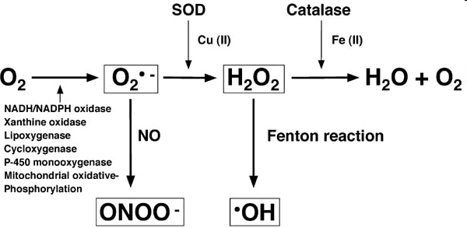
Key Reactive Oxygen Species (ROS)
SOD = Superoxide dismutase

Slide 10
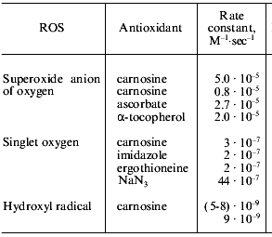
Reactivity of ROS (short rate → instability = reactivity)

Slide 11
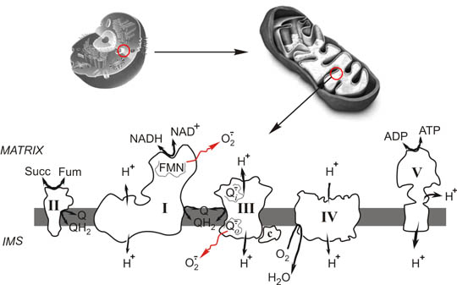
Mitochondria (= metabolism!)
Unwanted (side effect) production os O2*- (superoxide) during ATP synthesis = during oxidative respiration

Slide 12
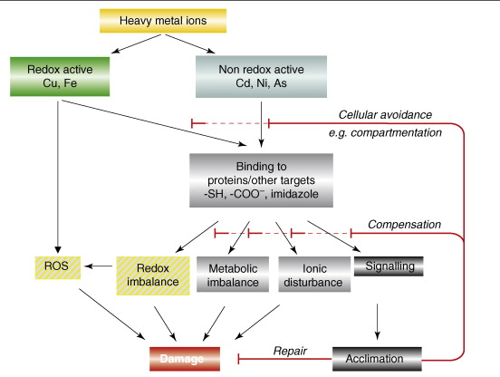
Metals and impacts on redox homeostasis
(* direct ROS production / * binding to proteins)
, Cr
+ H₂O₂
(Fenton reaction)

Slide 13
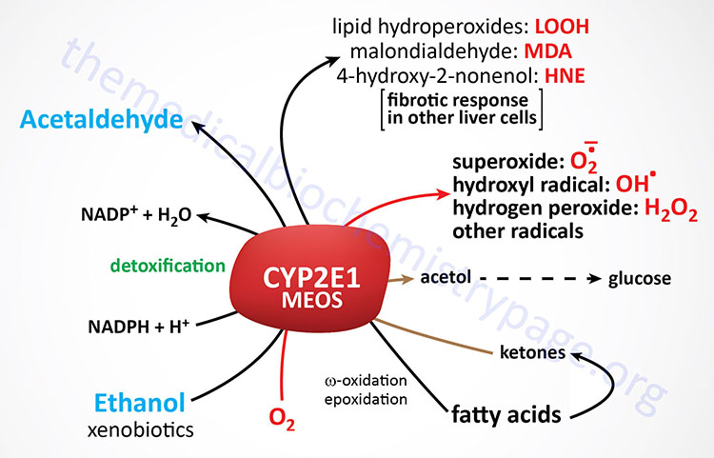
CYP450 as ROS source
(example CYP2E1, MEOS – microsomal ethanol oxidising system)

Slide 14
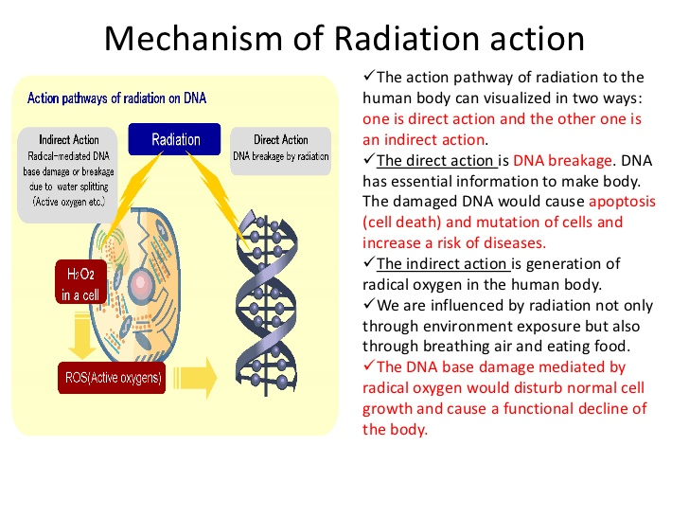
Irradiation as a source of ROS and oxidative damage
(reminder – check lectures on toxicity towards DNA)
ROS

Slide 15
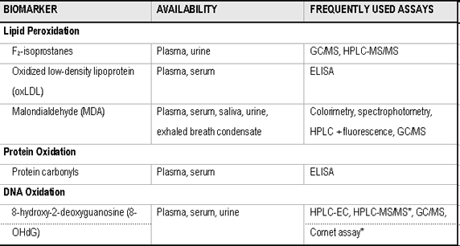
Oxidative damage to cellular components
& biomarkers of oxidative damage

Slide 16
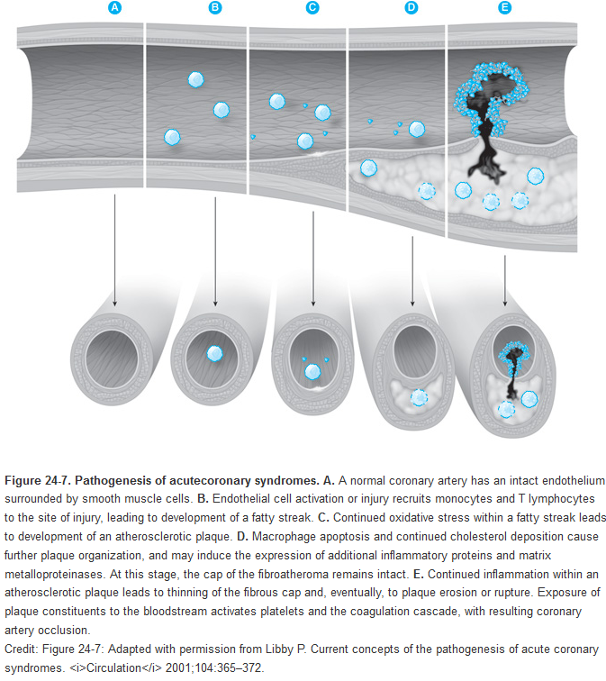
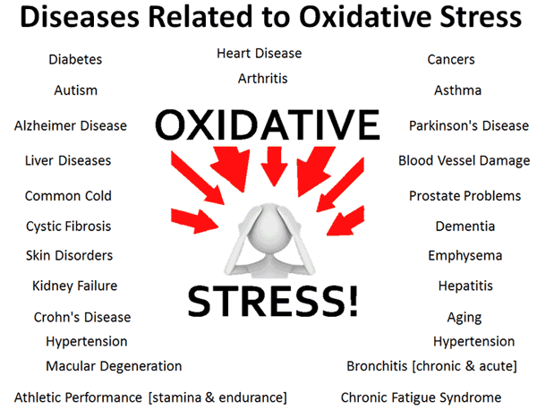
Effects of oxidative stress … multiple
e.g. acute coronary syndrome (ACS) → myocardial infarction

Slide 17
The cellular effects further propate
→ level of the ORGANISM

Slide 18
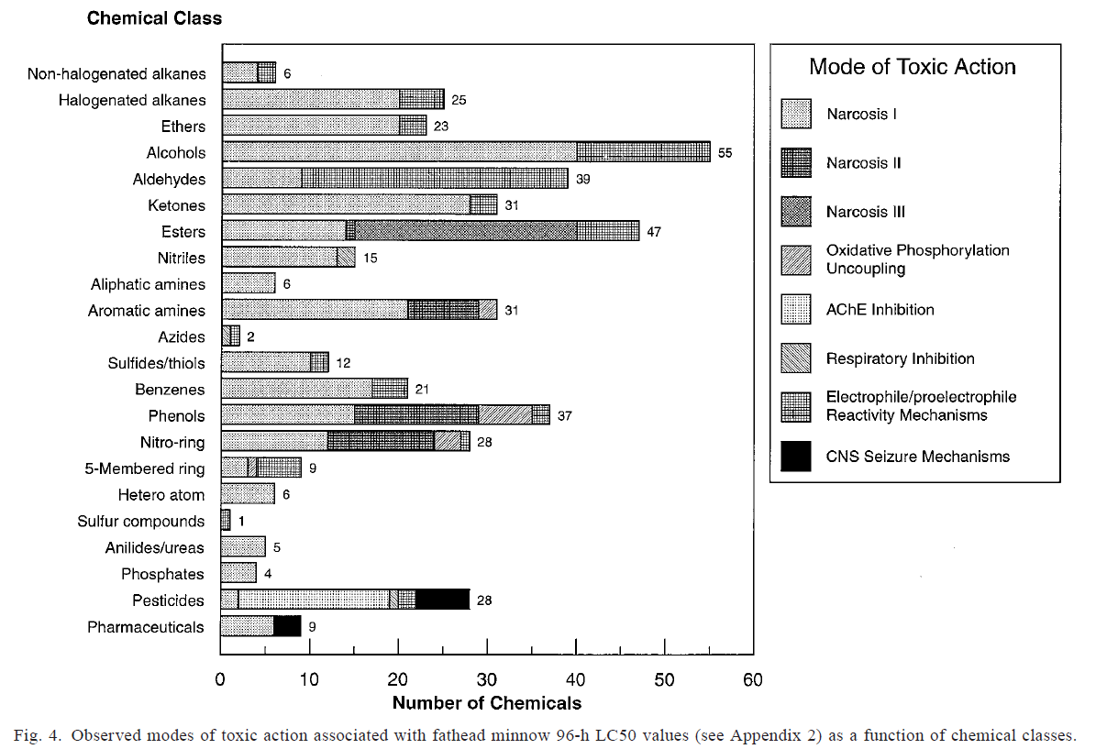
Acute lethal toxicity (fish) & relevant toxicity mechanisms
Russom et al. Environmental Toxicology and Chemistry, Vol. 16, No. 5, pp. 948–967, 1997

Slide 19
CHRONIC and DELAYED TOXICITY
„Chronic“ mechanisms less explored
  Usually not tested in ecotoxicity assays
  Slow manifestation and effects in ecosystems
Various effects:
  growth inhibition (~ lower food uptake)
  diseases such as carcinogenicity
  teratogenicity and embryotoxicity,
  developmental toxicity
  Reproduction toxicity
  Organ-specific types of toxicity
  → Imunotoxicity
    Neurotoxicity
    Nefrotoxicity etc.
„Systemic“
effects

Slide 20
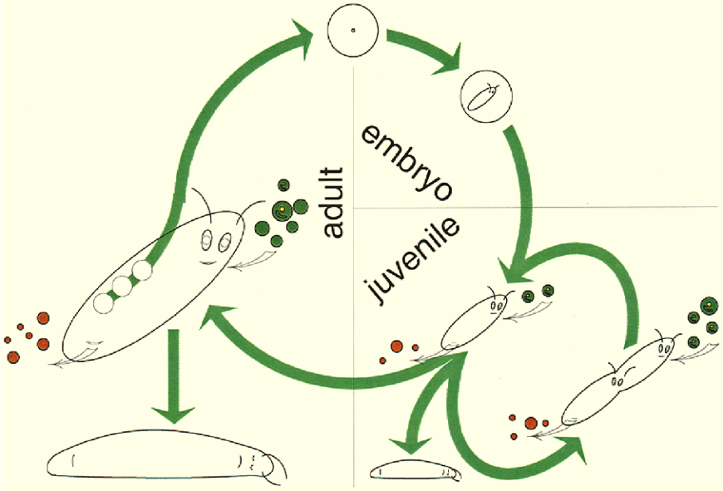
Effects at different levels - ORGANISM
Organism level – important in ecotoxicology (see Bioassays)
  Effects on structure
  Effects on metabolism (maintenance)
  Effects on regulation
    Changes in functions (e.g. Ethinylestradiol)
    Repair, survival, growth
    Death (lethality)
    Proliferation = Reproduction
3 key apical endpoints
(reflected e.g. in regulations)

Slide 21
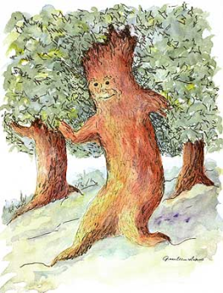


REMINDER: Energy & Life
Chemical stress
+ ... another stress
(food scarcity)
Energy
hv
food
Losses
heat
faeces
Life
(maintenance)
Metabolism
Control,
Interactions
with environment
Defence
against pathogens
predators …
Defence against
toxicants
Growth
to sexual
maturity
Reproduction
Chemical
stress

Slide 22
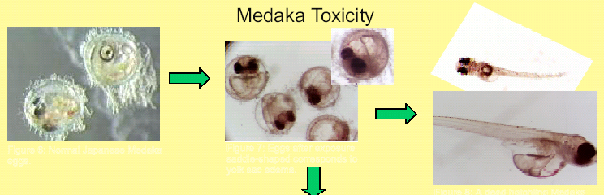
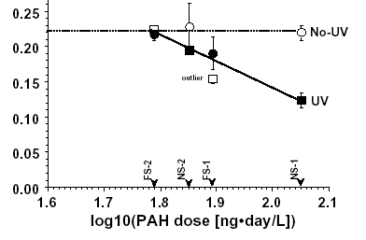
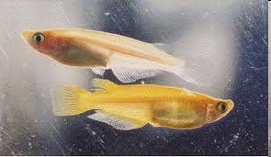
Example - GROWTH inhibition in fish
Exposures to PAHs +/- UV (phototoxicity)
Model fish = Japanese medaka
Growth is proportional to food/feed consumption
(measuring of food consumption answers how toxicant affects the growth)

Slide 23
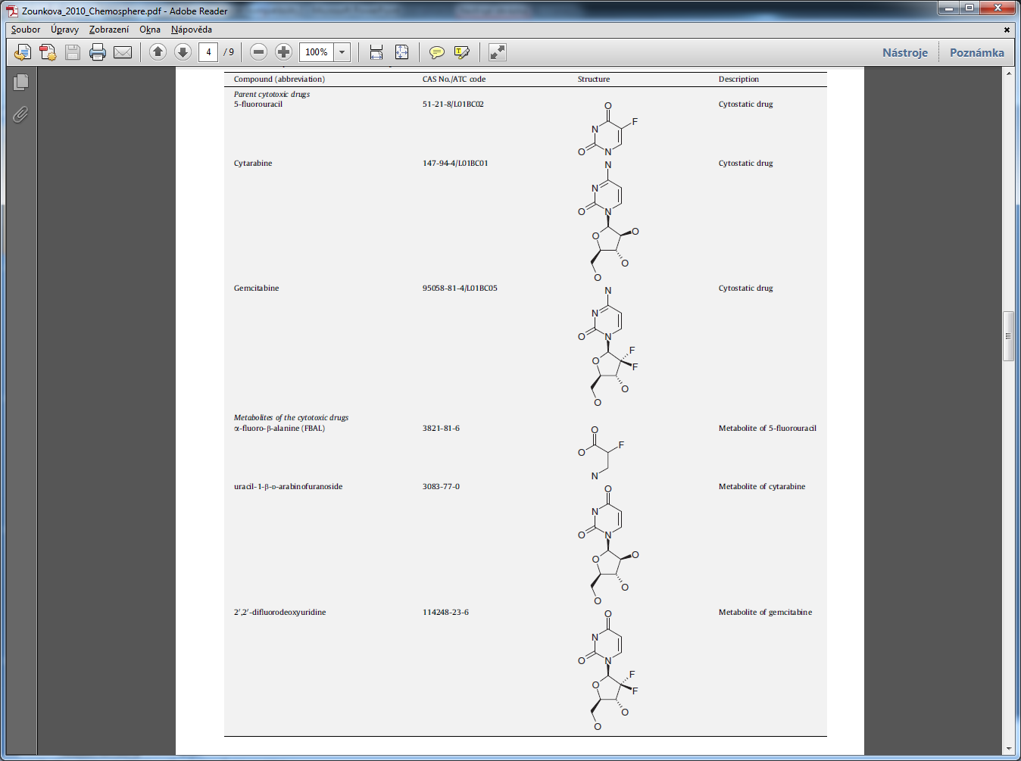
Example – ecotoxicity of cytostatic drugs and their metabolites
(Zounková et al. 2010 Chemosphere 81:253-260)
5-Fluorouracil
Cytarabin
Gemcitabin
Metabolity

Slide 24
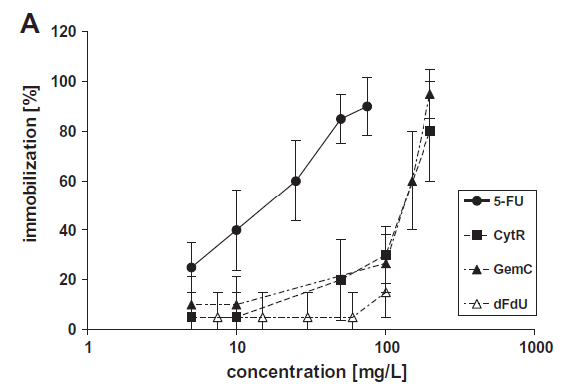
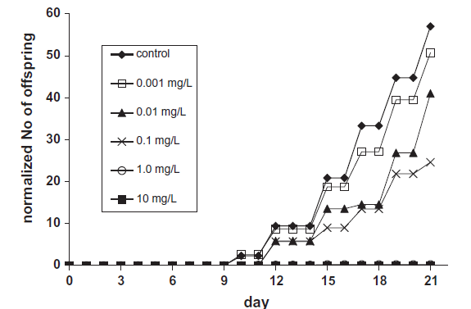
Example – aquatic ecotoxicity of cytostatic drugs
(Zounková et al. 2010 Chemosphere 81:253-260)
Reproduction toxicity 5-FU
Acute toxicity – D. magna
Fig. 1. Ecotoxicity (concentration–response curves) of the studied cytostatic drugs
and their metabolites. (A) Daphnia magna acute immobilization test.
Fig. 2. Effects of 5-fluorouracil (5-FU) on the reproduction of Daphnia magna (numbers of offsprings) in the 21-d chronic test.

Slide 25
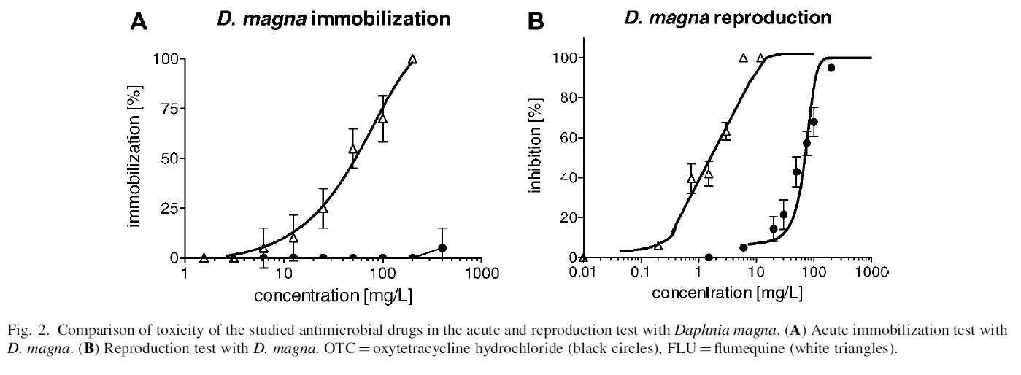
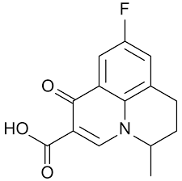
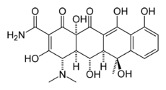
Example – aquatic ecotoxicity of cytostatic drugs
Zounkova, R., Z. Kliemesova, L. Nepejchalova, K. Hilscherova and L. Blaha (2011). "Complex Evaluation of Ecotoxicity and Genotoxicity of Antimicrobials Oxytetracycline and Flumequine Used in Aquaculture." Environmental Toxicology and Chemistry 30(5): 1184-1189.

Slide 26
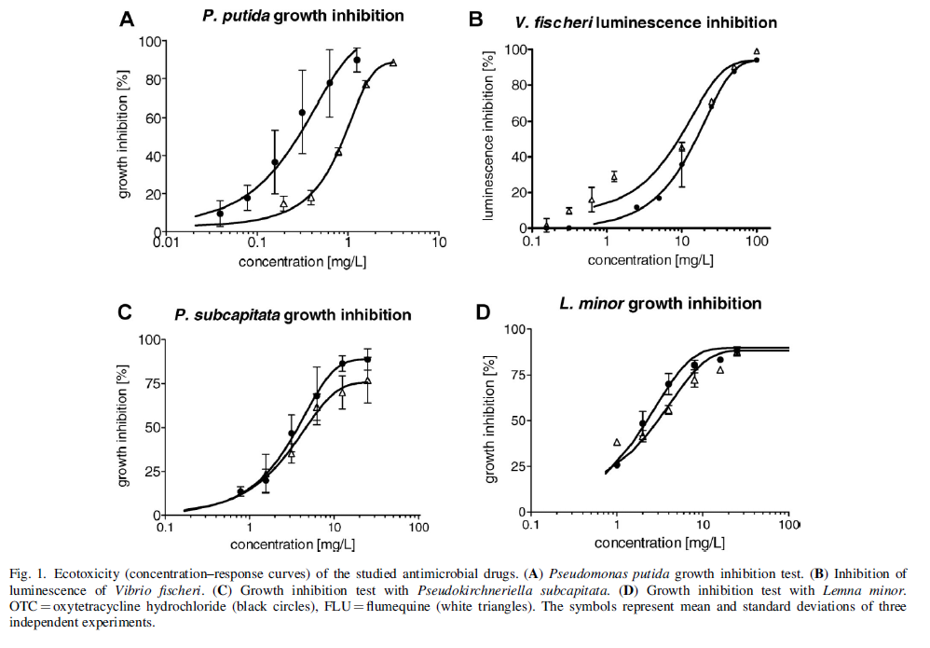
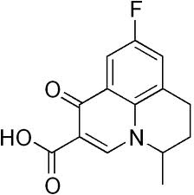
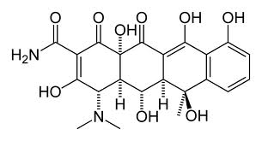
Zounkova, R., Z. Klimesova, L. Nepejchalova, K. Hilscherova and L. Blaha (2011). "Complex Evaluation of Ecotoxicity and Genotoxicity of Antimicrobials Oxytetracycline and Flumequine Used in Aquaculture." Environmental Toxicology and Chemistry 30(5): 1184-1189.0
Flumequine
OTC

Slide 27
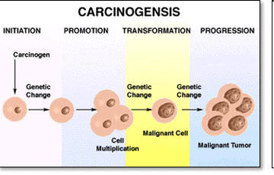
Carcinogenicity
Complex process with four main phases/steps:
initiation (DNA changes) = mutagenesis
promotion (changes fixed in genome, cell proliferation etc)
- transformation (formation of malignant cells)
- progression (neoplasia, metastasing)
RELEVANT mostly
for HUMAN
toxicology but
tumors observed
also in wild
biota

Slide 28
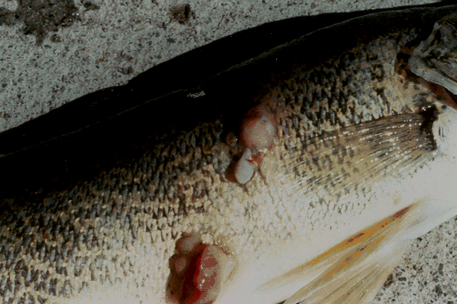
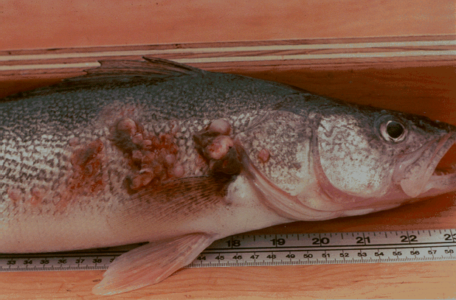
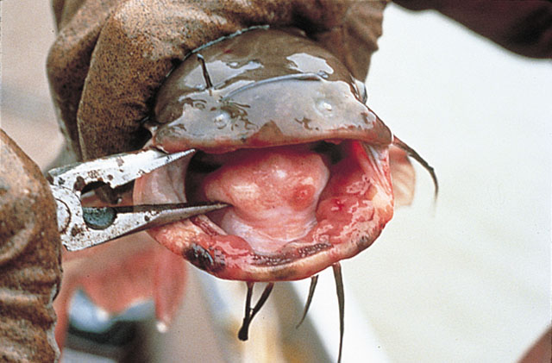

Slide 29
Reproduction toxicity, developmental toxicity, embryotoxicity and teratogenicity

Slide 30
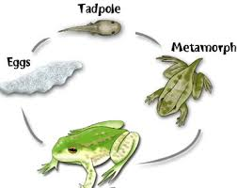
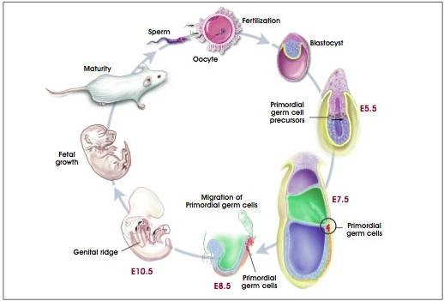
Reproduction and development are closely related
Reprod
Reprod

Slide 31
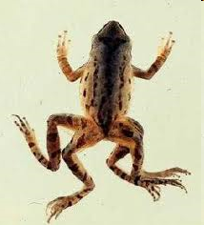
DEVELOPMENTAL TOXICITY
Embryotoxicity
= general term – toxicity to embryo
Teratogenicity
= morphological developmental effects
  Malformations, missing organs etc.
well characterized in aquatic vertebrates
  ecotoxicity tests - Danio rerio, Xenopus laevis

Slide 32
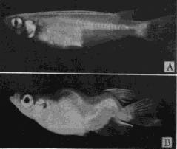
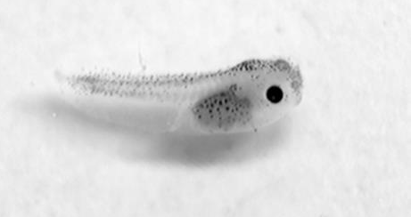
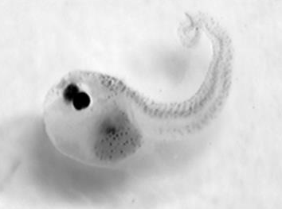
Teratogenicity effects
Examples of teratogens
- organochlorine compounds (DDT, DDE)
- new types of pesticides ATRAZIN
- PCBs and compounds with dioxin-like mechanims
- toxic metals
- natural toxins (e.g. From cyanobacteria)
Japanese medaka
teratogenicity of PCBs
Embryos of frogs X. laevis
Controls exposure to cyanotoxins

Slide 33
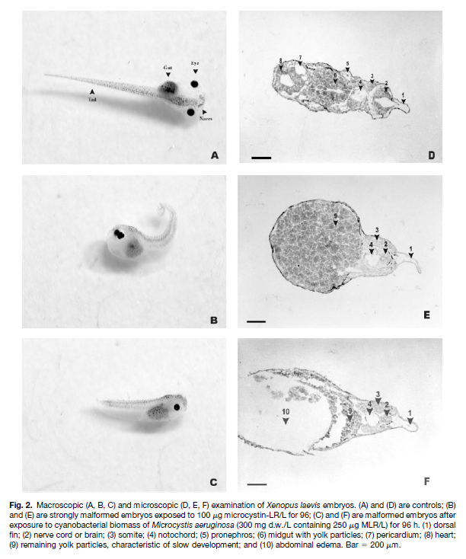
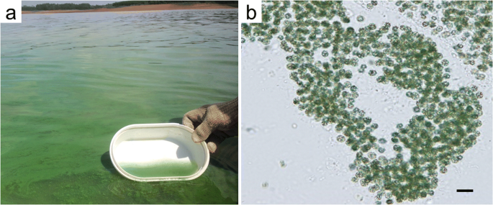
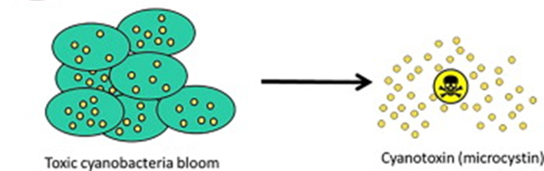
Dvořáková, D., K. Dvořáková, L. Bláha, B. Maršálek and Z. Knotková (2002). "Effects of cyanobacterial biomass and purified microcystins on malformations in Xenopus laevis: teratogenesis assay (FETAX)." Environmental Toxicology 17(6): 547-555.

Slide 34
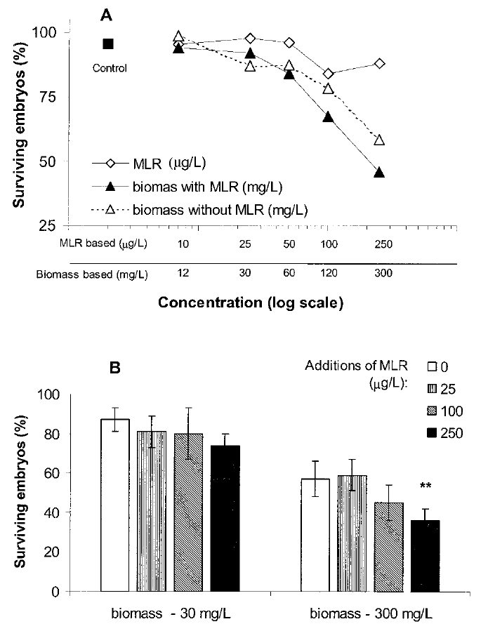
Fig. 1. Mortality in the 96-h FETAX test after exposure to purified microcystin-LR (MLR) and the biomass of cyanobacterial
water blooms:
(A) Dose–response curves of purified MLR (scale in g/L on X axis), biomass containing natural microcystins (bloom dominated by Microcystis
aeruginosa), and biomass with no detectable microcystins (bloom dominated by M. wesenbergii; scale milligrams of
biomas d.w. per liter on X axis). Concentrations of purified MLR and the M. aeruginosa biomass are proportional (e.g.,
12 mg of the biomass d.w. contained 10 g of MLR).
(B) Toxic effects of externally added MLR (25–250 g/L) to the cyanobacterial biomass with no natural microcystins.
Asterisks
(**) indicate statistically significant difference from the effect of the biomass (300 g/L) with no MLR addition
(Pearson’s chi-square, p 0.01). Bars represent means standard error of the mean of two independent experiments
each performed in two parallels.

Slide 35
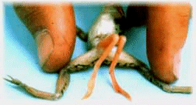
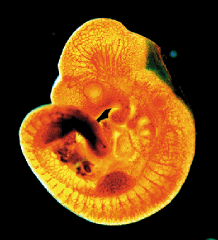
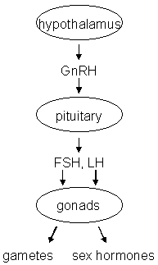
Endocrine disruption
Interference of xenobiotics with normal functioning of hormonal system
Known consequences
→ Disruption of homeostasis, reproduction, development, and/or behavior (and other hormone-controlled processes), such as
  Shift in sex ratio, defective sexual development
  Low fecundity/fertility
  Hypo-immunity, carcinogenesis
  Developmental processes - malformations
  etc.

Slide 36
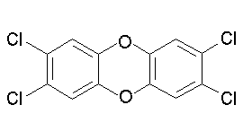
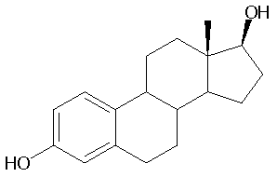
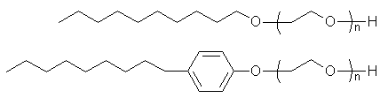
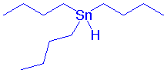
Endocrine disrupters in the environment?
2,3,7,8-TCDD
EDCs...
  Persistent Organic Compounds
  (POPs and their metabolites)
  steroid hormones and their
  derivatives from contraception pills
  alkylphenols
  organometallics (butyltins)
  pharmaceuticals
  Pesticides
  + number of unknowns …
estradiol
alkylphenols
Tributyl-tin

Slide 37
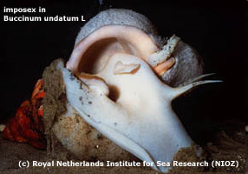


Effects of EDs in
invertebrates
(molluscs)
One of the first EDC effects: = imposex
Development of male sexual characteristic in
females
Effects of alkyltins (e.g. Tributyl tin)
– anti-fouling agents
BIOFOULING

Slide 38




Female estrogens and contraception pills
Feminization
Intersex
Female eggs (oocytes) formed in male testes
Reproduction
disruption
Decline in fish populations

Slide 39




Kidd, K.A. et al. 2007. Collapse of a fish population following exposure to a synthetic estrogen. PNAS 104(21):8897-8901
Control lake lake with EE2
EE2 - 5 ng/L (!)

Slide 40
Organ-specific ecotoxic effects

Slide 41

IMMUNOTOXIC EFFECTS OF ECOTOXICANTS
Examples
- Mortalities of seals, dolfins – morbillivirus infections / PCBs, PCDDs
- Elevated skin lesions (fungi, bacteria) in fish from contaminated sites
- Arsenic → direct toxicity to natural killer cells in immune system (responsible for removal of tumors → increased carcinogenicity)
- Prenatal exposures to DIOXINS → complete „apoptosis“ (convolusion) of thymus → not immune system in offsprings (no T-cells)

Slide 42

NEUROTOXIC EFFECTS (e.g. Insecticides)
1] Acute toxicity
- spasms, effects on CNS, suffocation, death
2] Chronic effects
→ effects on behaviour, learning etc..
  Behavioral changes – critical for survival of individuals and populations
  - male-female attraction / reproduction, foraging, hiding from predators
Loss of synchronization in release of gametes
(aquatic invertebrates and vertebrates)
- Complex reproduction behaviour (birds and mammals)
- Slower burrying of molluscs into sediments ← fast predation
→ lower fitness and lower reproduction success

Slide 43




NEFROTOXICITY IN VULTURES
- Damaging effects of veterinary pharmaceuticals on vulture populations
- primary effect → kidney in vultures = nephrotoxicity

Slide 44


TOXIC EFFECTS TO PRODUCERS (plants, algae)
Unique process of PHOTOSYNTHESIS
Target to many herbicidies – e.g. Diuron (DCMU) and Paraquat

Slide 45






Acute effects in producers
Damage to photosynthetic pigments
cell and plant death
Example:
Effects of metals on chlorophyll-a
content in algae

Slide 46
Example – ecotoxicity of cytostatic drugs and their metabolites
(Zounková et al. 2010 Chemosphere 81:253-260)
5-Fluorouracil
Cytarabin
Gemcitabin
Metabolity

Slide 47

Effects of cytostatics on ALGAL GROWTH
(Zounková et al. 2010 Chemosphere 81:253-260)

Slide 48

Toxicity of PAHs & their N-derivatives to plants
(Pašková et al. 2006 Environmental Chemistry and Ecotoxicology 25:3238–3245)

Slide 49

Toxicity of PAHs & their N-derivatives to plants
(Pašková et al. 2006 Environmental Chemistry and Ecotoxicology 25:3238–3245)

Slide 50

Toxicity of PAHs & their N-derivatives to plants
(Pašková et al. 2006 Environmental Chemistry and Ecotoxicology 25:3238–3245)

Slide 51


EFFECTS on DECOMPOSERS
bacteria, microorganisms
Key component for global GEO-BIO-CHEMICAL CYCLES

Slide 52

Specific notes on ecotoxicity to microorganisms
1) Unicellular (or small in general)
large specific surface – easy uptake of chemicals
2) Relativelly good protection (cell wall)
3) Fast division and proliferation
  generally good ADAPTATION of populations
  (antimicrobial resistencies)

Slide 53


Slide 54

Therapeutic antibiotics … and resistance

Slide 55


Spread of ARG
(antibiotic resistence genes)
… also at waste
water treatment plants

Slide 57

WHO Report:
The Review of Antimicrobial Resistance, Chaired by Jim O’Neil, UK, 2014

Slide 58

Total 10 million deaths per year

