Slide 1
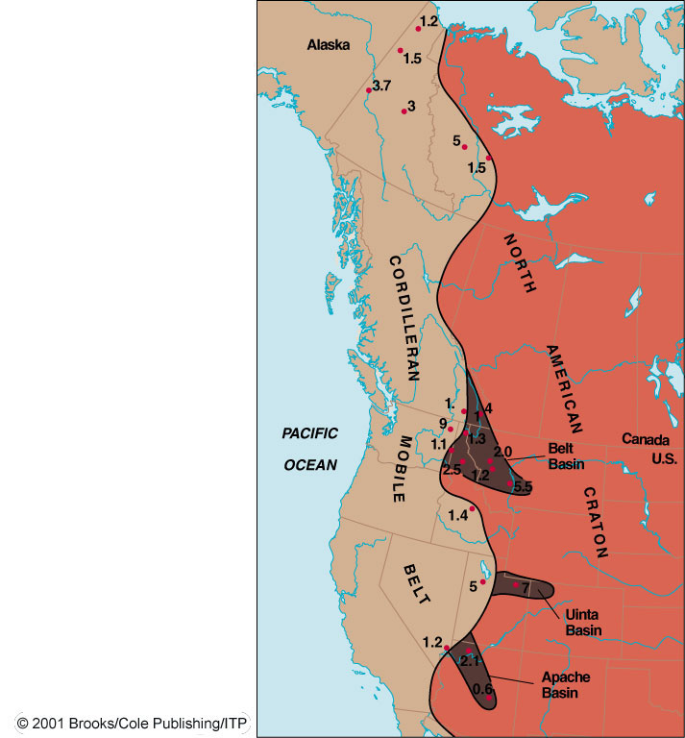



Slide 2
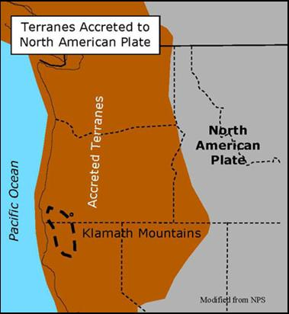

Slide 3
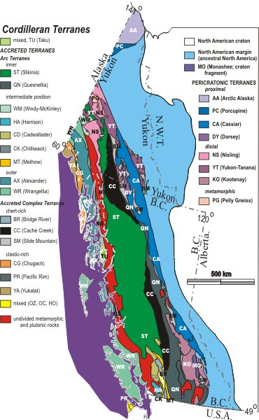
What is a Tectonostratigraphic Terrane?
Terranes can be:
Native – showing shared traits with North American crust, indicating an origin adjacent to North America.
Exotic – Far-traveled, not born adjacent to North America
Superterranes – amalgamated with other terranes before accretion to the continental margin.

Slide 4
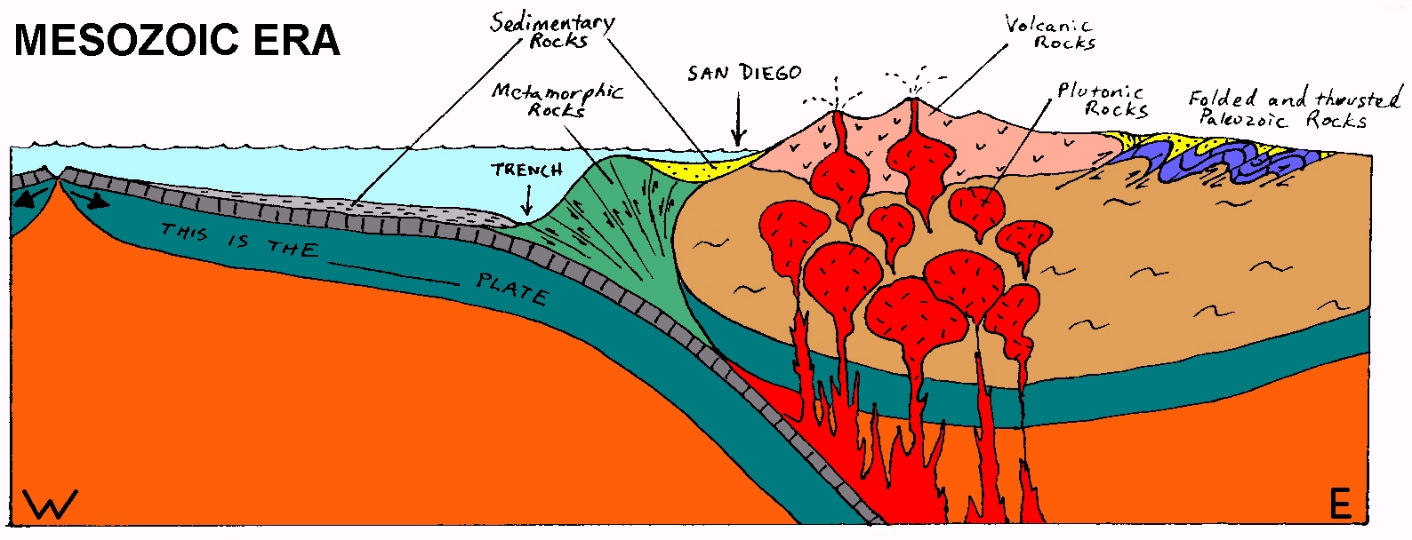
Notes:
During the Mesozoic, subduction of the Farallon Plate formed a volcanic arc and the associated compression folded and thrust-faulted the Paleozoic sediments. Note the overall thickening of the continent, which will produce the gravitational potential energy which will help extend this region once compressional forces relax.

Slide 5
The Western Collage
Cordillera an collage of microplates and arcs
  accreted during the Paleozoic and Mesozoic
  terrains have different rock types and fossil assemblages that cannot be correlated
  suspect terrains--fault-bounded regions that cannot be correlated
  exotic terrains--clearly from somewhere else

Slide 6
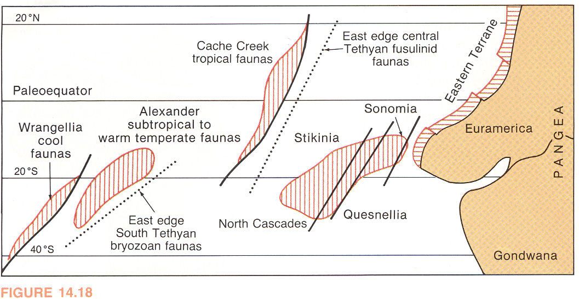
Accreted or “suspect” terranes
Dott & Prothero

Slide 7
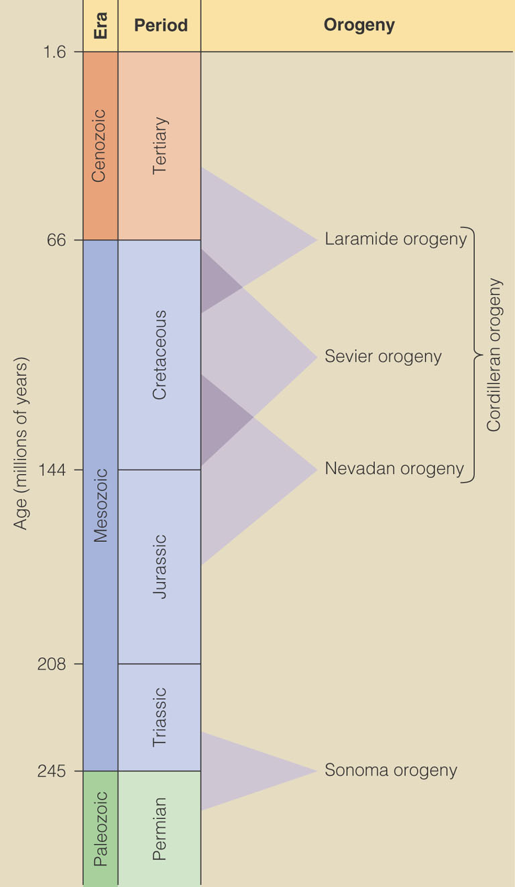
KORDILERY
Basin and Range extension
KORDILERY
Active margin
Antler Orogeny in Devonian-Carb.
Passive margin

Slide 8
Paleozoic Passive Margin
• Existed in Late Precambrian and Paleozoic
• Craton and cratonic basin deposits
• Miogeocline continental shelf deposits
Antler Orogeny
(300 (300-375 Ma) 375 Ma)
• Late Devonian - Mississippian
• Collision of the arc with a passive margin
• Roberts Mountain Allochton thrust over the
passive margin
• A series of foreland basins formed in
eastern Nevada

Slide 9
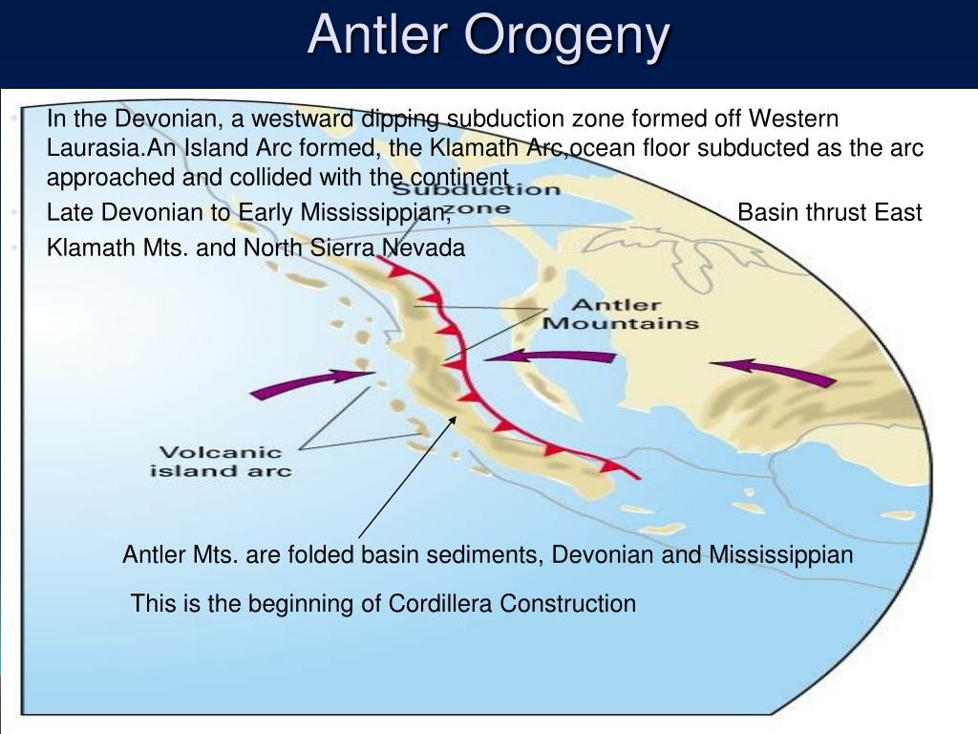

Slide 10
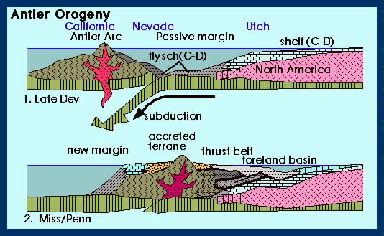
Orogeneze: antlerská, kolize klamathského ostrovního oblouku v devonu a spodním karbonu

Slide 11
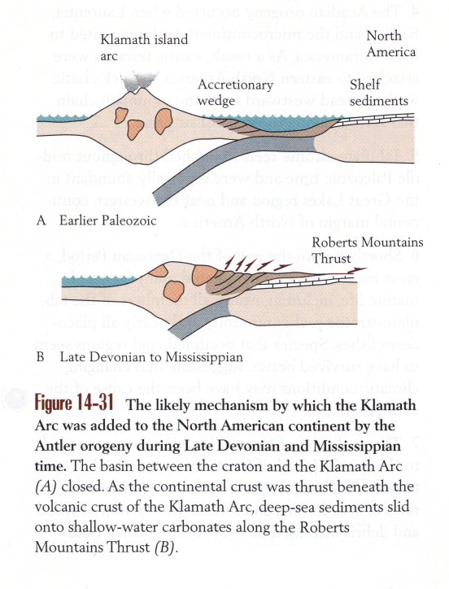

Slide 12
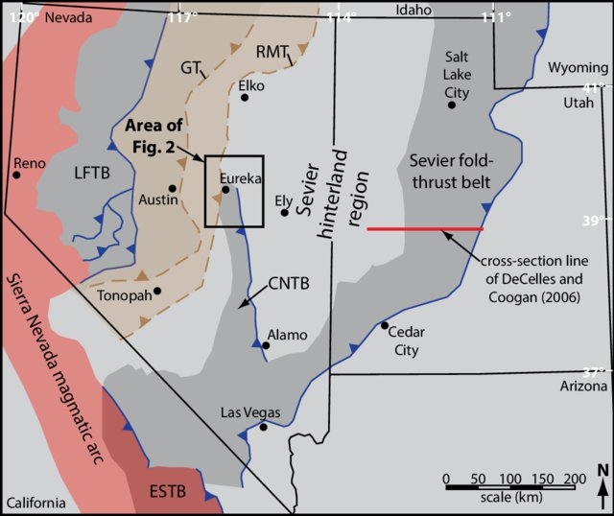

Slide 13
Mesozoic

Slide 14
Active margin
Passive margin

Slide 15
Sonoma Orogeny (200-280 Ma)
• Permo -Triassic
• Collision of Arc With a Passive Margin
• Island Arc Terrains Were Accreted
• golconda allochthon
Thrust Partly Over Roberts Mountain
Allochthon

Slide 16
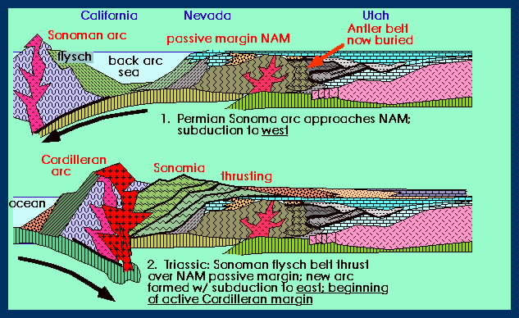
sonomská, kolize dalšího ostrovníhp oblouku na konci paleozoika

Slide 17
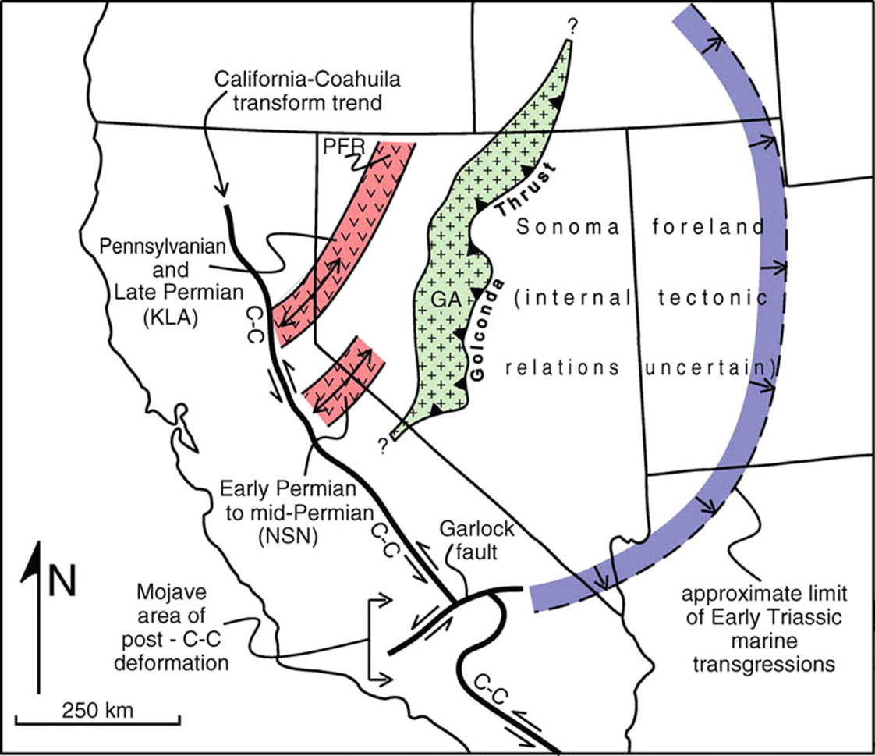
A hick oceanic sequence of Mississippian through Permian chert, limestone, conglomerate, siltstone, shale, lava flows and pyroclastics accumulated in a trough west of the Antler orogenic belt. This tectonic assemblage was emplaced along the Golconda thrust, at least 60 miles (100 km) eastward or inboard of the new continental margin, during the Late Permian through Early Triassic Sonoma Orogeny (Speed, 1983).

Slide 18
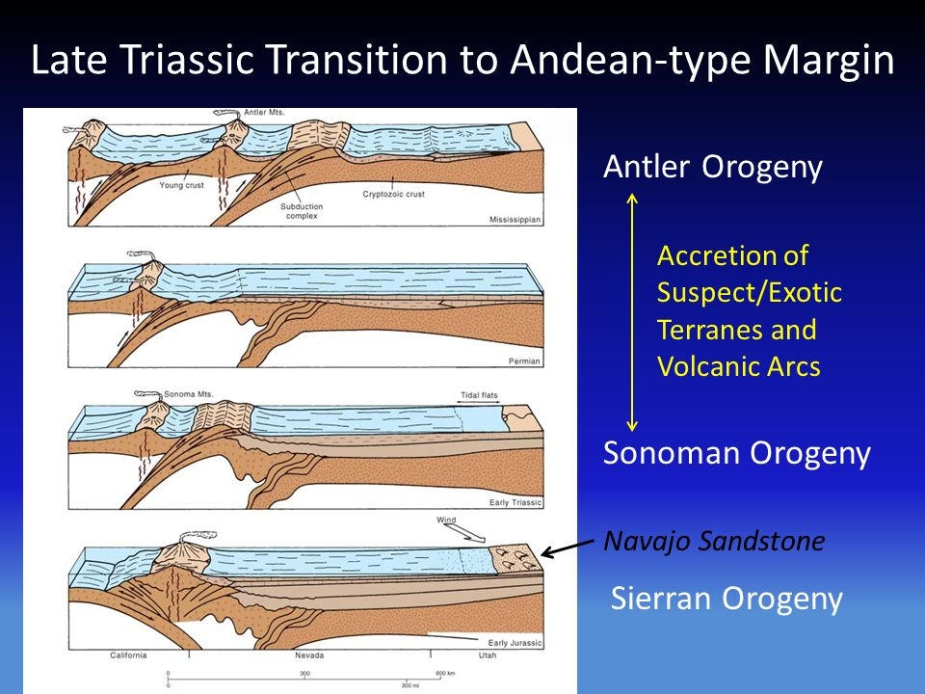

Slide 19
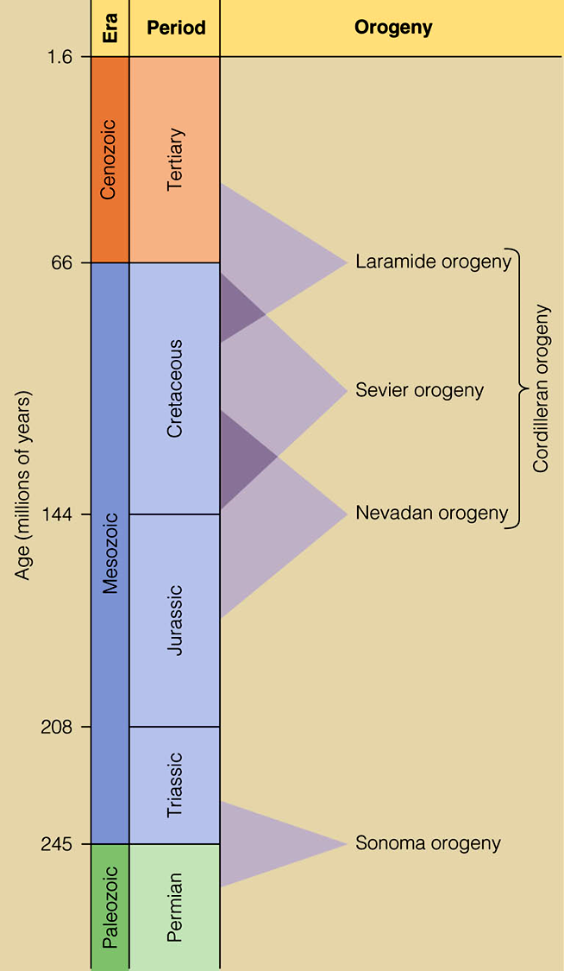
Cordilleran orogeny

Slide 20
Cordilleran Orogeny components – Jurassic – Tertiary Periods
Nevadan – emplacements of large granite batholiths, Sierra Nevada, Idaho, S. California, Coast Ranges.
Sevier – Shallower sub-duction angle = igneous activity moves eastward.
Laramide – “Rocky Mts.” – east of Sevier Orogeny –Cretaceous – Tertiary Periods
Active margin
Passive margin

Slide 21
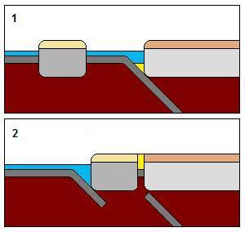
"Cordilleran" style of arc terrane accretion onto a continental land mass. Continued subduction transports the arc terrane to the margin of the continent where it is too buoyant to be subducted so it gets accreted to the continent

Slide 23
The Nevadan Orogeny
• Several Upper Jurassic Arcs Collided
•Cretaceous Franciscan Fm in the accretionary prism
• Sierra Nevada was the root zone of the arc
The Nevadan Orogeny was a major mountain building event that took place along the western edge of ancient North America between the Mid to Late Jurassic (between about 155 and 145 million years ago). In comparison with other orogenic events, it appears that the Nevadan Orogeny occurred rather quickly (10 million years). During the early stages of orogenesis an "Andean type" continental magmatic arc developed due to subduction of the Farallon oceanic plate beneath the North American Plate. The latter stages of orogenesis, in contrast, saw multiple oceanic arc terranes accreted onto the western margin of North America in a "Cordilleran type" accretionary orogen. Deformation related to the accretion of these volcanic arc terranes is mostly limited to the western regions of the resulting mountain ranges (Klamath Mountain range and Sierra Nevada) and is absent from the eastern regions. The massive series of exposed batholiths that currently make up most of the high Sierra Nevada was formed during this event. Due to the steep angle of the subducted plate, these were located relatively close to continent's edge.

Slide 24
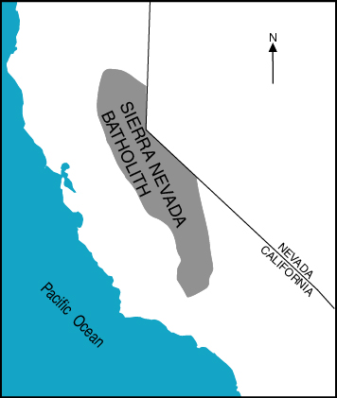
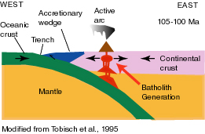

Slide 25
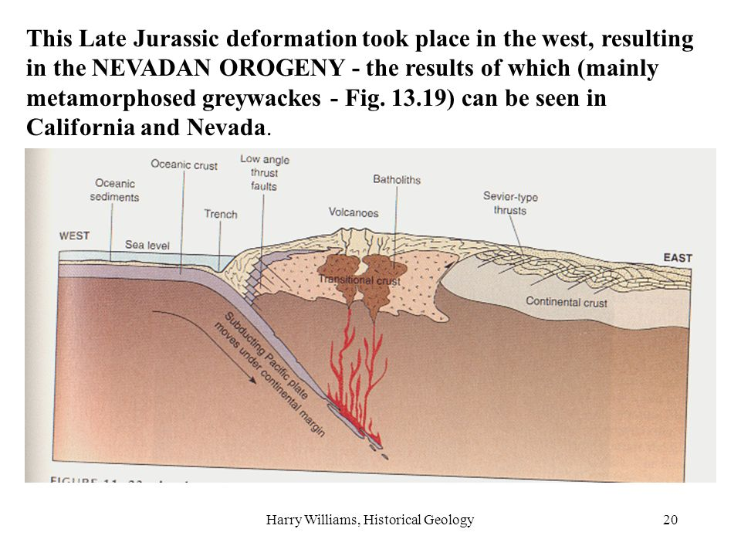

Slide 26
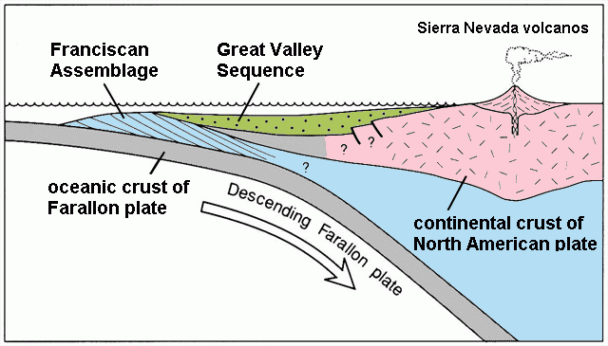
The Franciscan Complex is an assemblage of metamorphosed and deformed sediments and ophiolites, associated with east-dipping subduction zone. Although most of the Franciscan is Early/Late Jurassic through Cretaceous in age (150-66 Ma),[ some Franciscan rocks are as old as early Jurassic (180-190 Ma) age and as young as Miocene (15 Ma). As oceanic crust descended beneath the continent, ocean floor basalt and sediments were subducted and then tectonically underplated to the upper plate.[10] This resulted in widespread deformation with the generation of thrust faults and folding, and caused high pressure-low temperature regional metamorphism. In the Miocene, the Farallon-Pacific spreading center reached the Franciscan trench and the relative motion between Pacific-North America caused the initiation of the San Andreas Fault.

Slide 27
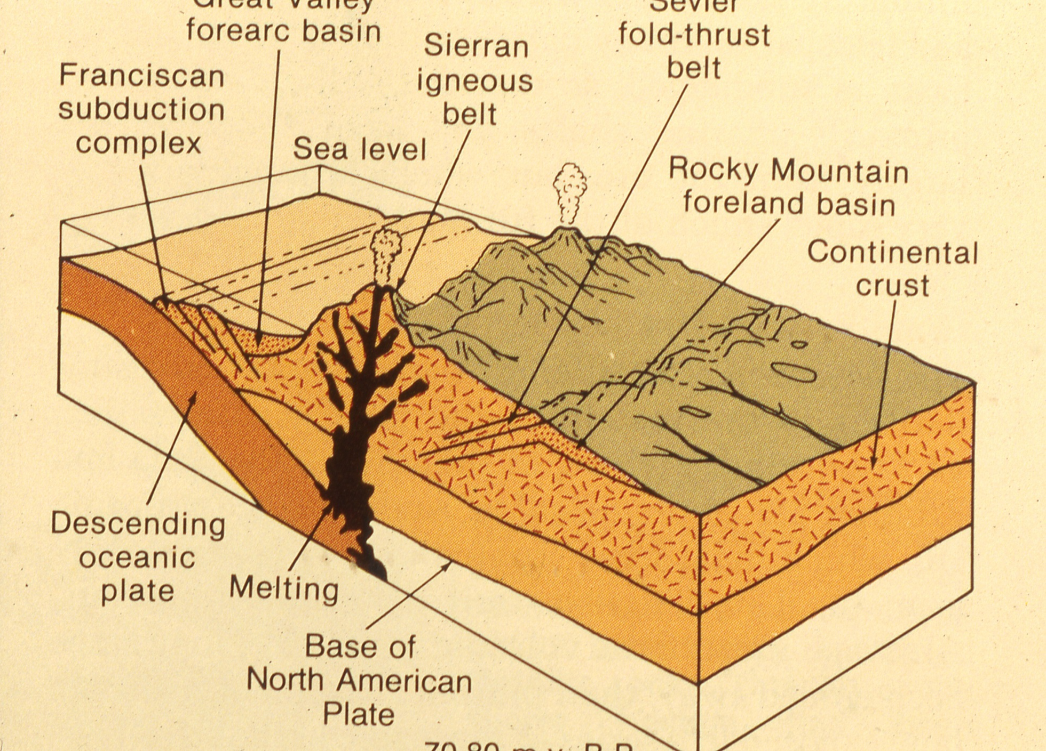

Slide 28
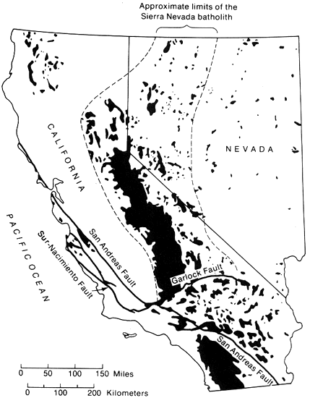
Evidence for the Nevadan orogeny includes the formation of vast Late Jurassic and Early Cretaceous batholiths (large bodies of igneous rock that formed underground) in southern California, the Sierra Nevada, the Coast Ranges, Idaho, and British Columbia. The name is derived from the changes that occurred in the Sierra Nevada range of eastern California.

Slide 29
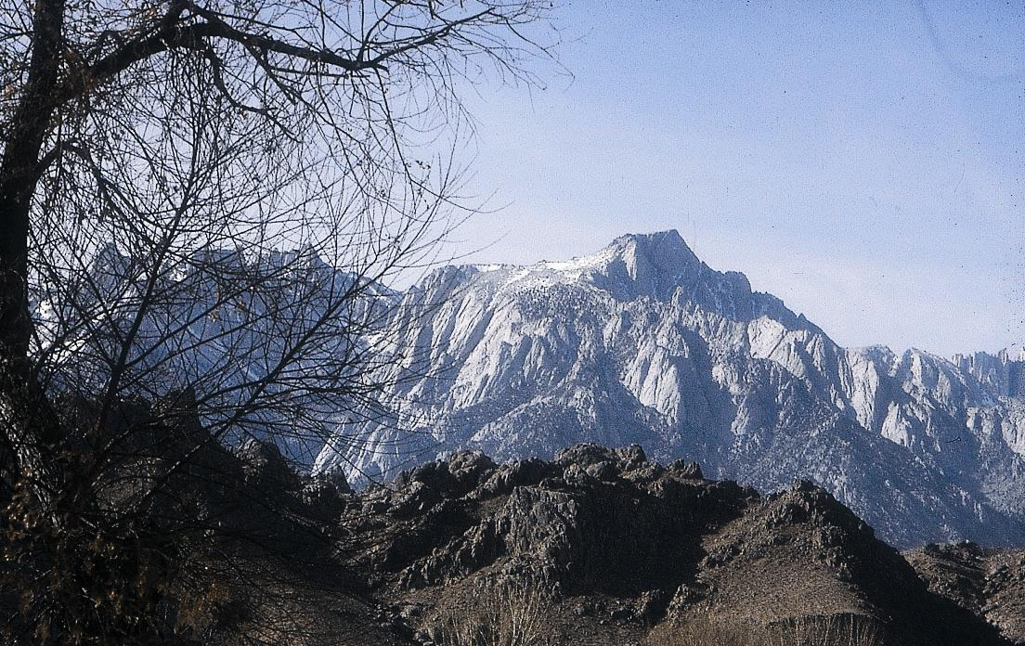
Sierra Nevada Mountains
Nevadan Orogeny:
Subduction formed batholith cores of continental volcanic arc, once as tall as Andes

Slide 30
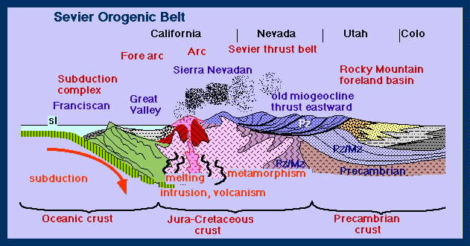
Sevier Orogen (80 Sevier Orogen (50- 130 Ma)
• Fold-thrust belt behind the arc
• Eastward directed thin skinned thrusts
• Franciscan complex and Great Valley fore arc basins
• Cretaceous
• Batholithic intrusions

Slide 31
Fig. 5 Schematic Late Cretaceous cross-section of the Central Cordillera, showing the relationship between the Sevier fold-and-thrust belt and Cordilleran foreland basin on the east, metamorphic and igneous rocks of the hinterland, Sierra Nevada batholith, Great Valley forearc basin, and Franciscan accretionary complex on the west.

Slide 32
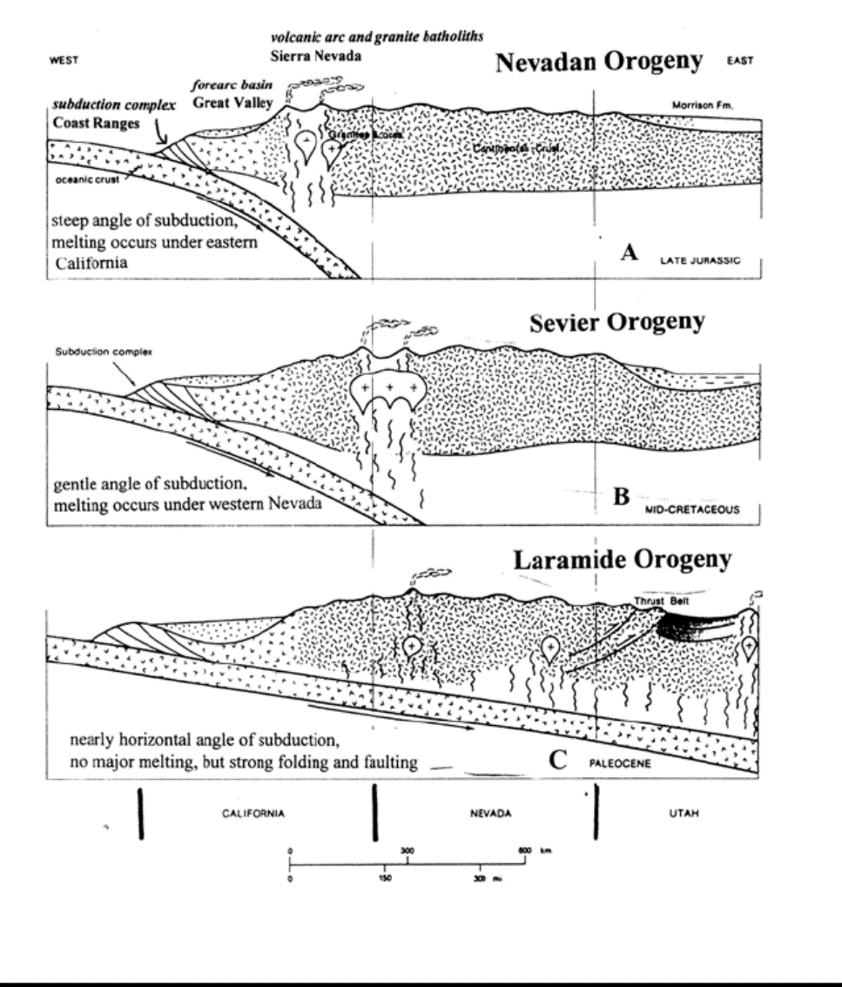

Slide 33
The Sevier orogeny was the result of convergent boundary tectonic activity, and deformation occurred from approximately 160 million years (Ma) ago to around 50 Ma. This orogeny was caused by the subduction of the oceanic Farallon Plate underneath the continental North American Plate.
The Sevier orogeny partially overlapped in time and space with the Laramide orogeny. There is evidence that suggests late Sevier faults were active during the early Laramide. Sevier thrusts may have remained active until the Eocene while Laramide deformation began in the Late Cretaceous
In general the Sevier orogeny defines compressional event that took advantage of weak bedding planes in overlying Paleozoic and Mesozoic sedimentary rock. As the crust was shortened, pressure was transferred eastward along the weak sedimentary layers, producing “thin-skinned” thrust faults that generally get younger to the east. In contrast, the Laramide orogeny produced “basement-cored” uplifts that often took advantage of pre-existing faults that formed during rifting in the late Precambrian during the breakup of the supercontinent Rodinia or during the Ancestral Rocky Mountains orogeny

Slide 34
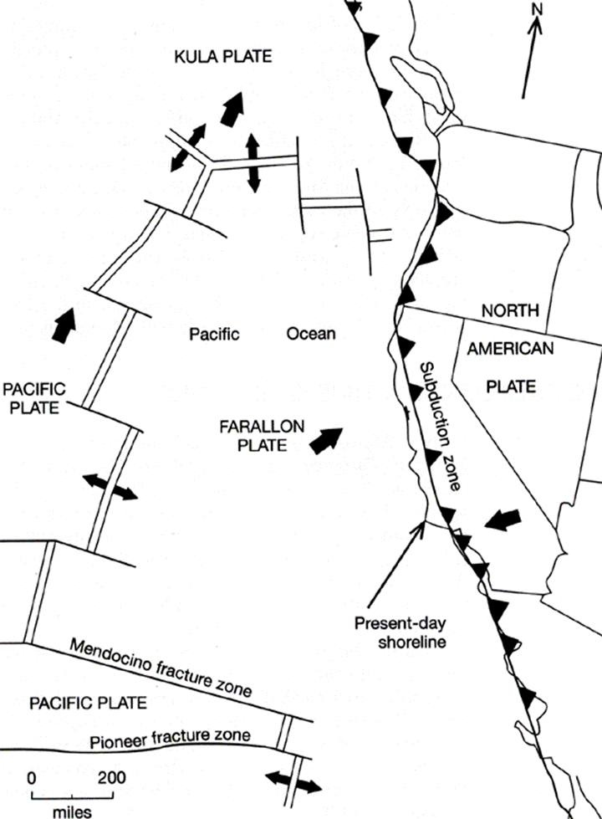

Slide 35
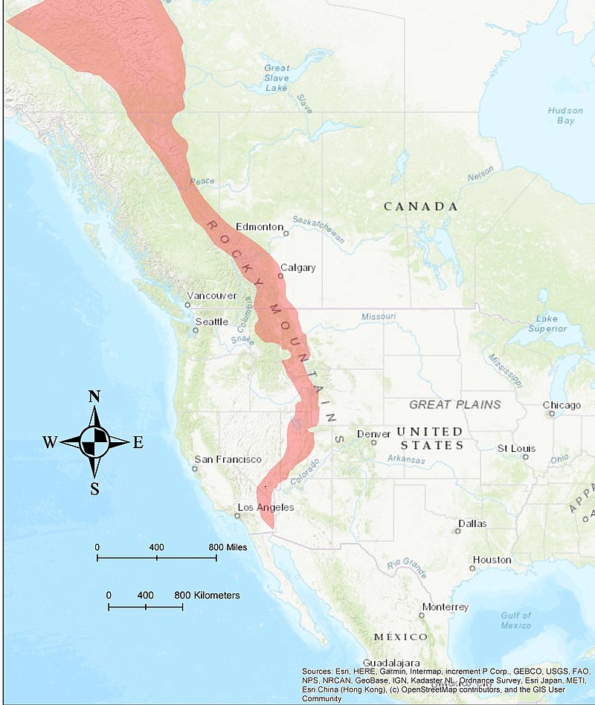
The Sevier Fold and Thrust Belt extends from southern California near the Mexican border to Canada
Location of the Sevier Fold and Thrust Belt (highlighted in red). After Yonkee and Weil (2015)

Slide 36
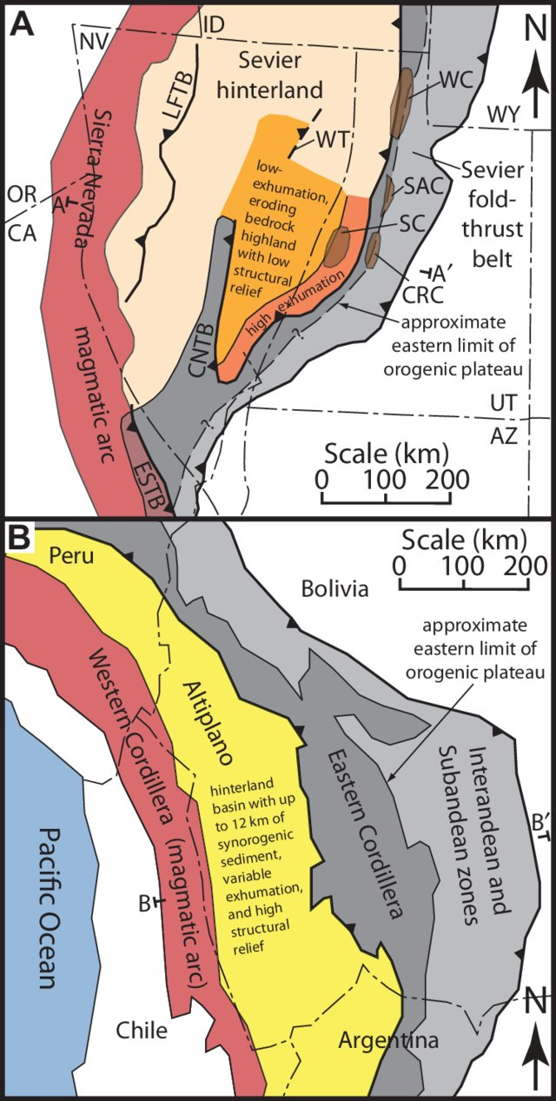
Figure 3. (A) Generalized geologic map of the Sevier orogenic belt, approximately restored for Cenozoic extension (base map modifi ed from DeCelles, 2004). Mesozoic thrust systems: LFTB—Luning-Fencemaker thrust belt, CNTB—central Nevada thrust belt, ESTB—eastern Sierra thrust belt, WT—Windermere thrust. Structural culminations in Utah: SC— Sevier culmination, CRC—Canyon Range culmination, SAC—Santaquin culmination, WC—Wasatch culmination. Approximate eastern limit of orogenic plateau based on position of Wasatch hingeline and positions of culminations (queried where unknown) (e.g., DeCelles, 1994, 2004; DeCelles and Coogan, 2006). Line A–A′ delineates approximate crosssection line of Figure 4A. Note that exhumation magnitudes outside of the map area in this study are not quantifi ed.
Luning-Fencemaker fold and thrust belt was active from the Middle or Late Jurassic through the. Early Cretaceous – Nevadan orogeny

Slide 37
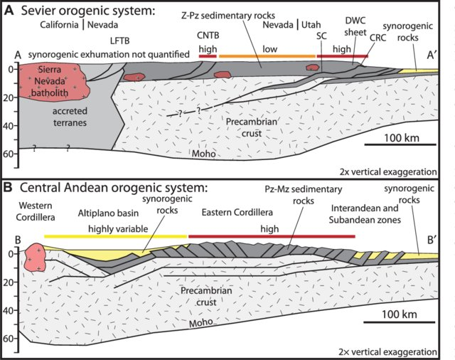
Figure 4. Schematic cross sections comparing deformation geometries and exhumation patterns between the Sevier and central Andean orogenic systems. Approximate cross-section lines are shown in Figure 3. (A) Schematic preextensional geometry of the Sevier orogenic system, modifi ed from Allmendinger et al. (1987) and Best et al. (2009). Placements of individual structures and plutons are largely schematic, and are meant to show only general locations. Eastern limit of high topography is placed above the Canyon Range culmination (DeCelles and Coogan, 2006). Generalized exhumation magnitudes are shown by red and orange bars. LFTB—Luning-Fencemaker thrust belt, CNTB—central Nevada thrust belt, SC—Sevier culmination, CRC—Canyon Range culmination, DWC—Delamar–Wah Wah– Canyon Range, Z–Pz—Neoproterozoic–Paleozoic. (B) Schematic present-day geometry of the central Andean orogenic system (modifi ed from Leier et al., 2010). Generalized exhumation magnitudes are shown by red and yellow bars. Pz–Mz—Paleozoic–Mesozoic.

Slide 38
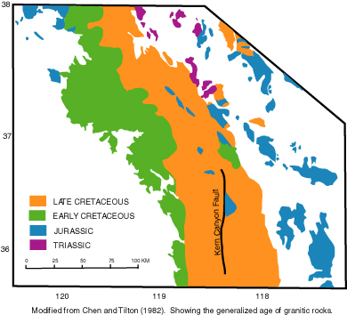
~210 Ma on the east side of the batholith in a single, extensive Triassic sequence
186-155 Ma on both east and west margins of the batholith
125-88 Ma granitoids, which young eastward, in the axial part of the batholith

Slide 39
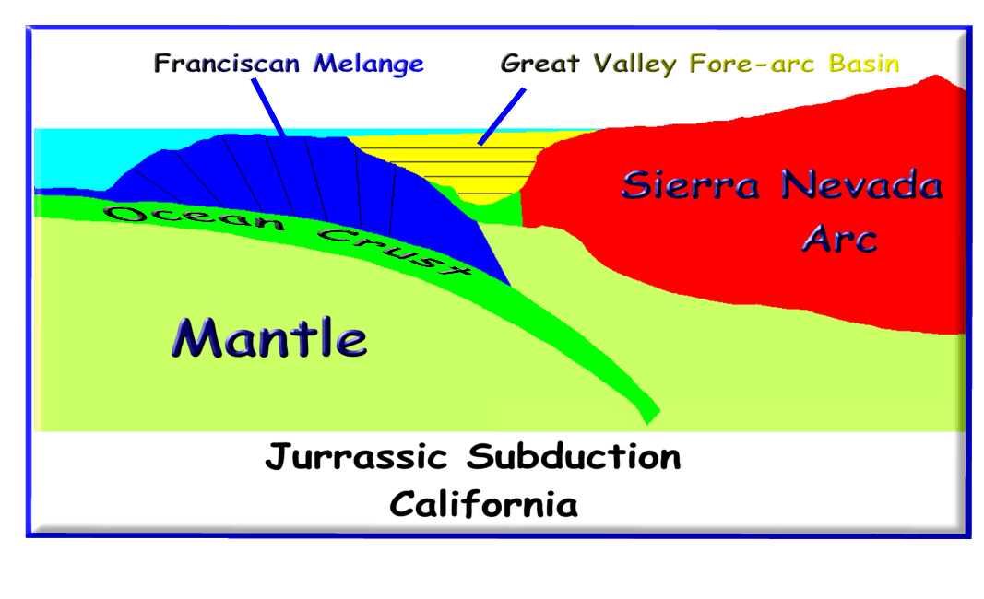

Slide 40
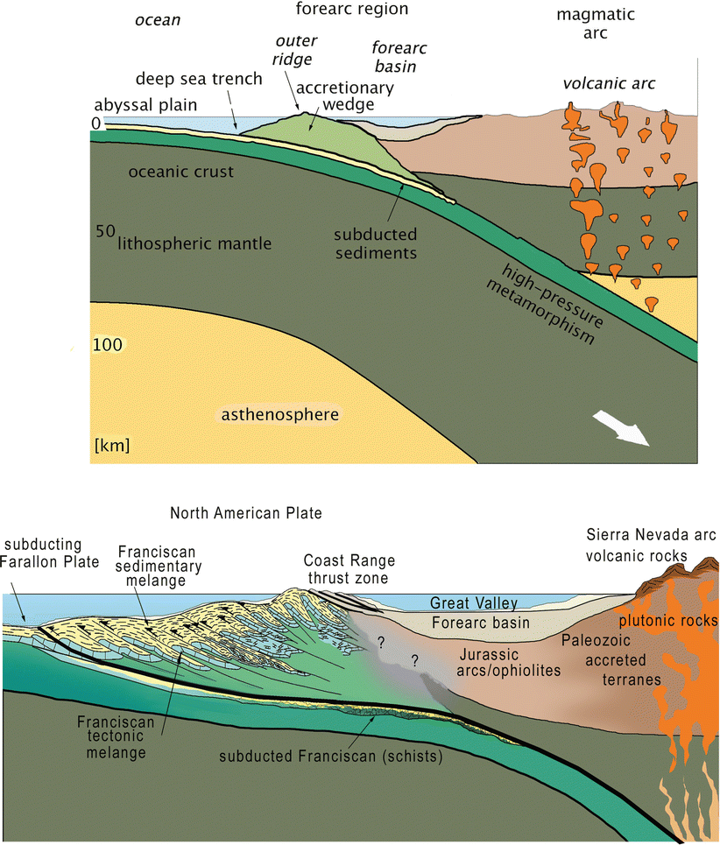
Fig. 8.5 Cross sections of the forearc region. Upper: general cross
section of typical Cordilleran margin showing tectonic and sedimentary elements and geomorphic settings. Lower: details of forearc setting typical of the Late Jurassic through Paleocene of Central California
showing tectonic and sedimentary setting of Franciscan and Great
Valley sedimentary rocks. Light tan shows zones of active sedimentation. Note that most Franciscan deposits are bathyal to abyssal and that
Great Valley deposits range from shoreline to abyssal. The contact
between Franciscan and Great Valley rocks is everywhere tectonic –
usually the Coast Range Fault zone. Queried areas have uncertain relations. Over long periods of geologic time, the entire forearc region
became new continental crust added to western North America;
Cenozoic sedimentary basins and associated volcanic rocks were
developed across the forearc region during the ensuing compressional,
transpressional, and transform tectonic regimes (Modified after
Frisch et al. 2011)

Slide 41
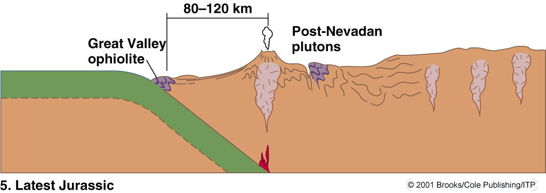
Franciscan complex – a Late Jurassic/Early Cretaceous chaotic mixture of graywacke, volcanic breccia, siltstone, black shale, chert, pillow-basalt, and blueschist (a low temperature, high pressure metamorphic rock) resulting from the “scraping-off” of continental shelf, cont. slope, and deep sea sediments from the Farallon Plate.

Slide 42
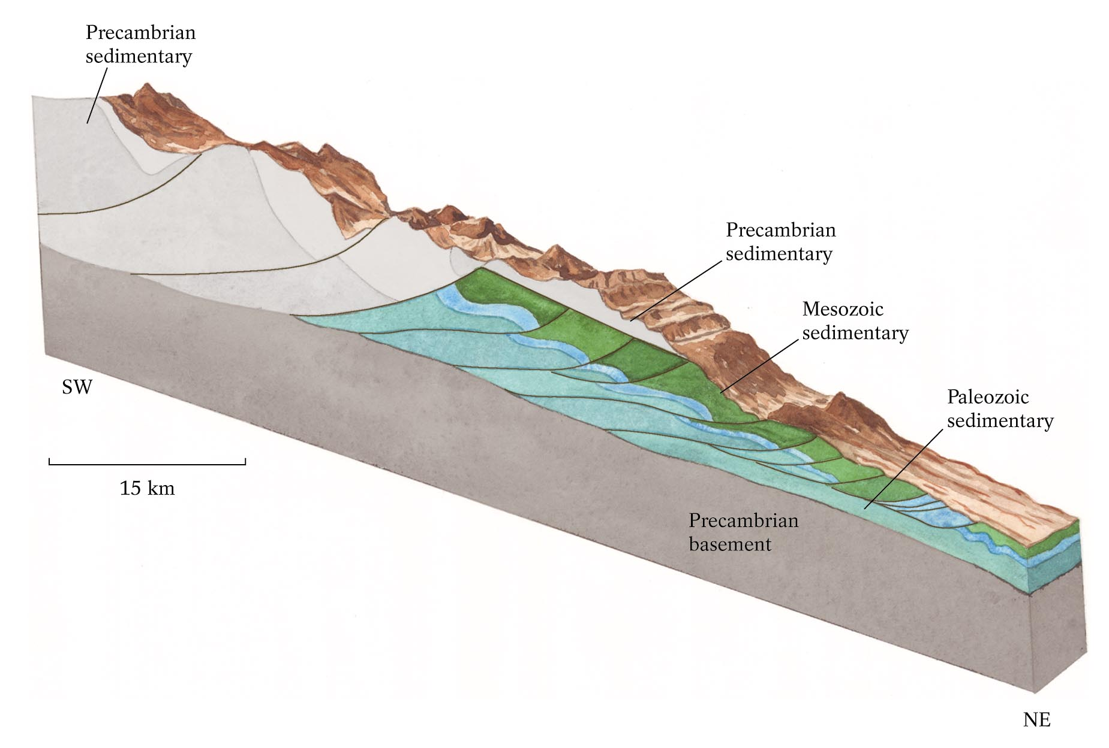
Sevier thin-skinned deformation

Slide 43
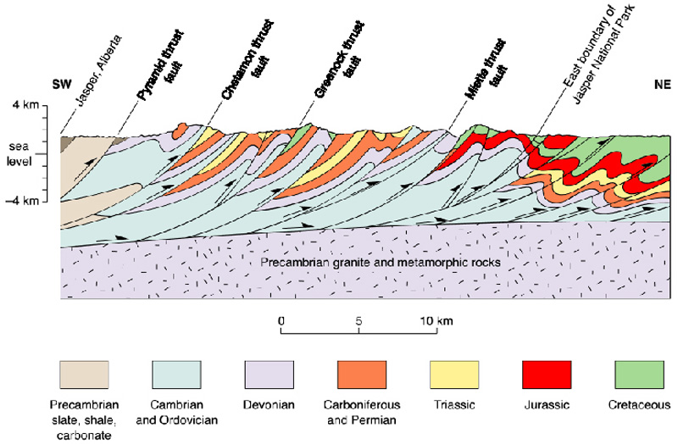
Competent (resistant to flow)

Slide 44
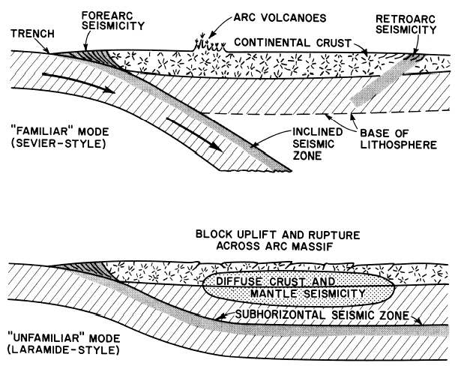
~50 Ma: End of subduction
In the Cenozoic, the slab became completely horizontal, probably due to progressive decrease in age of the subducting Farallon Plate as the ridge approached the trench. Results include end of calc-alkaline volcanism, major compressive orogeny far inland (Laramide orogeny of the Rocky Mountains) and emplacement of Pelona and related schists under Southern California
44

Slide 46
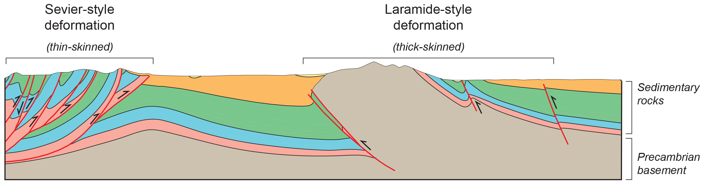

Slide 47
Laramide Orogeny (50- 80 Ma)
Late Cretaceous - Early Eocene
Deformation shifted eastward following
Magmatism – Coast Range Arc
Thick-skinned tectonics
The Laramide orogeny occurred in a series of pulses, with quiescent phases intervening. The major feature that was created by this orogeny was deep-seated, thick-skinned deformation, with evidence of this orogeny found from Canada to northern Mexico. Most hypotheses propose that the angle of subduction became shallow. The Laramide Orogeny lasted about 30 million years during which the Rocky Mountain foreland ranges were pushed up. The area affected by the Laramide Orogeny includes the central and southern Rockies and the Colorado Plateau.
Magmatism associated with subduction occurred not near the plate edges (as in the volcanic arc of the Andes, for example), but far to the east, called the Coast Range Arc. Coast Range Arc is the largest granitic outcropping in North America, which then it is usually referred to as the Coast Plutonic Complex or the Coast Mountains Batholith

Slide 48
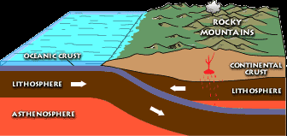
The Laramide orogeny was caused by subduction of a plate at a shallow angle. The Laramide Orogeny lasted about 30 million years during which the Rocky Mountain foreland ranges were pushed up. The area affected by the Laramide Orogeny includes the central and southern Rockies and the Colorado Plateau.

Slide 49
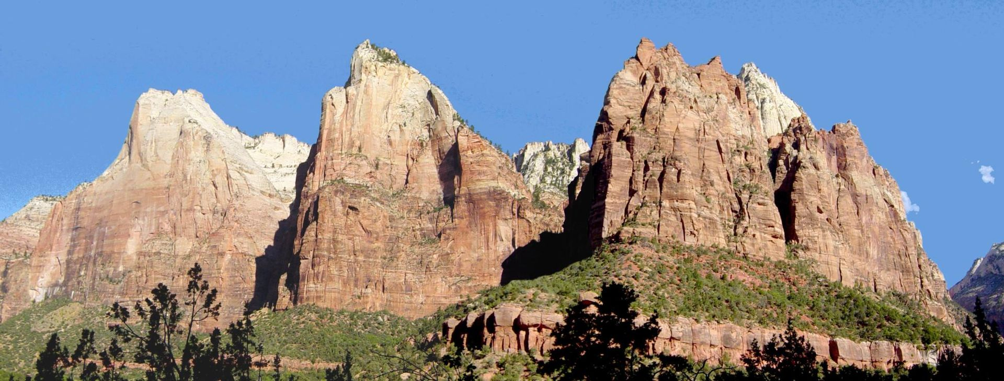
The Three Patriarchs in Zion Canyon are made of Navajo Sandstone. It may originate from the Late Triassic but is at least as young as the Early Jurassic stages Pliensbachian and Toarcian

Slide 50
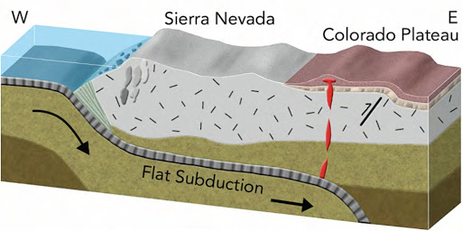
deformation landward of the relatively undeformed Colo- rado Plateau

Slide 52
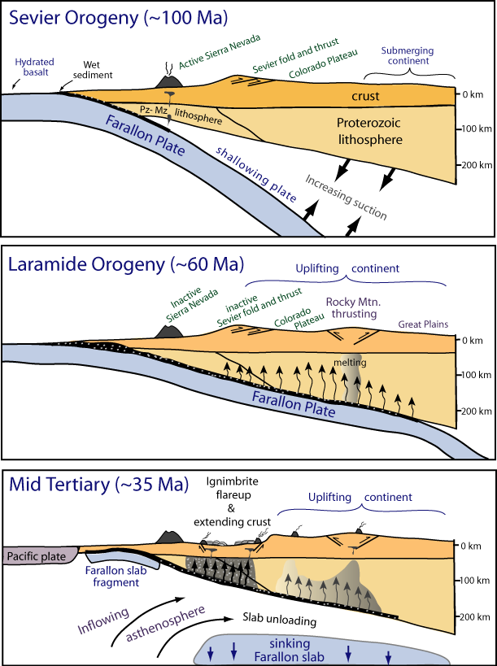
Humphreys et al., 2003

Slide 54
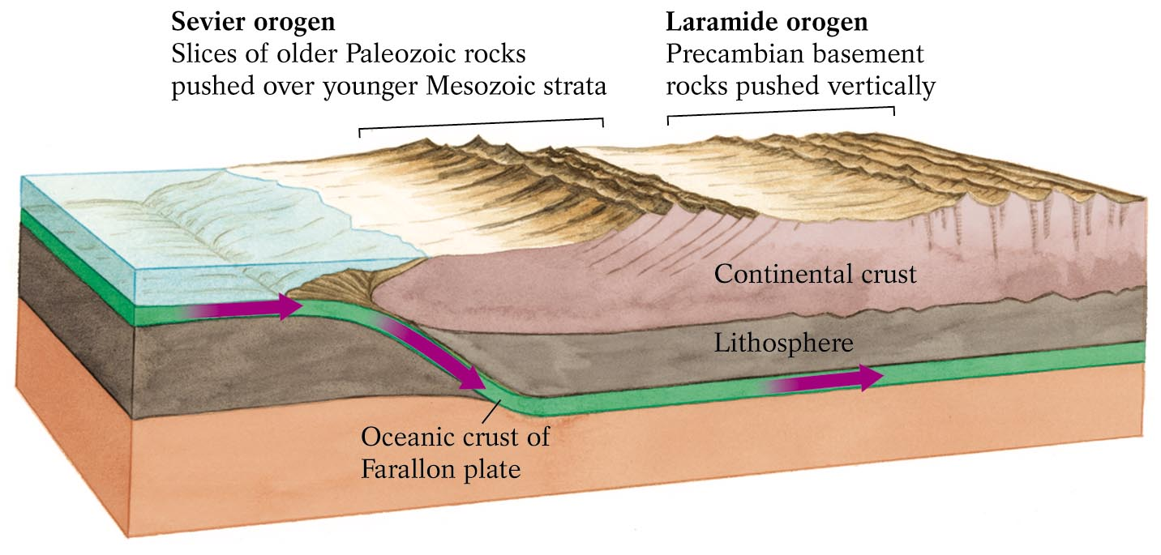
Buoyant Subduction Laramide Orogeny
Vertical block uplift
Normal, thin-skinned
Now we understand weird looking Tetons
Approaching Continent pushes
accretionary wedge sediments
into forearc sediments

Slide 55
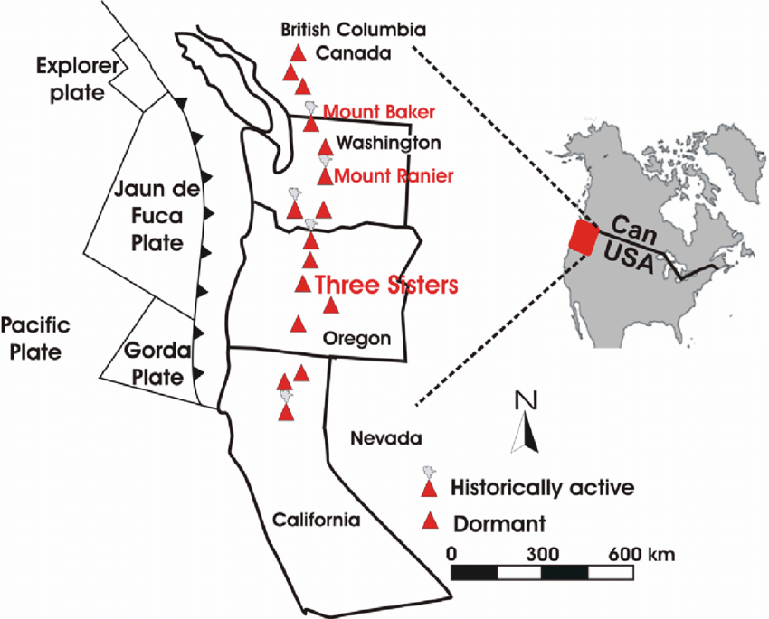
The Coast Range Arc formed as a result of subduction of the Juan de Fuca, Kula and pre-existing Farallon Plates. It is most famous for being the largest granitic outcropping in North America, which then it is usually referred to as the Coast Plutonic Complex or the Coast Mountains Batholith. Although taking its name from the Coast Mountains, this term is a geologic grouping rather than a geographic one, and the Coast Range Arc extended south into the High Cascades of the Cascade Range, past the Fraser River which is the northward limit of the Cascade Range proper.

Slide 56
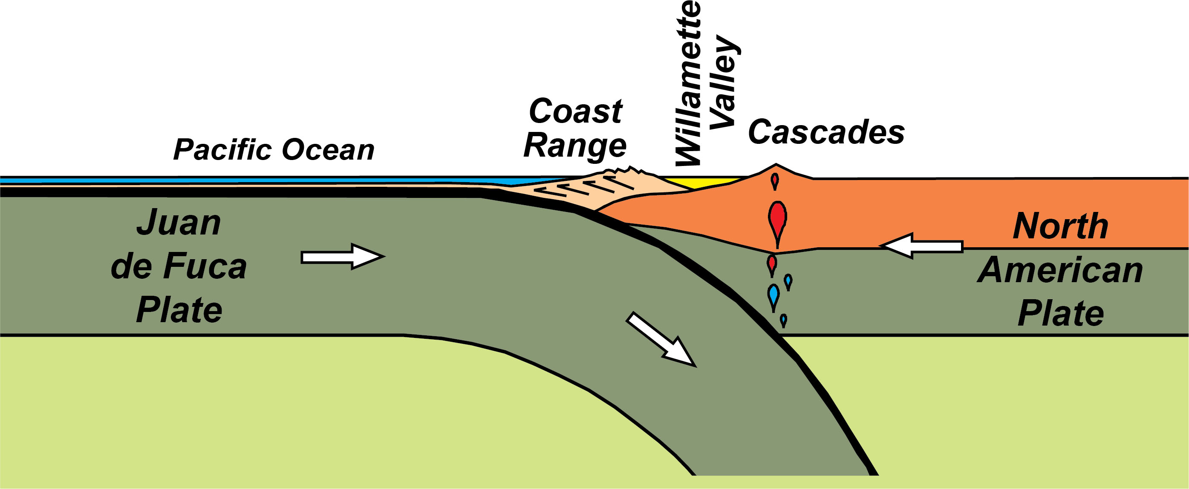

Slide 57
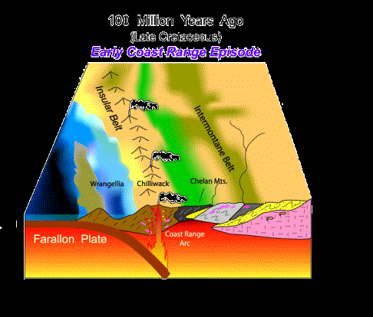
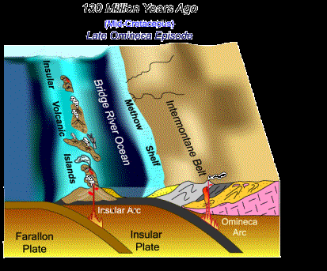
As the Insular Volcanic Islands collided with the Pacific Northwest, the old subduction zone of the Insular Plate jammed and shut down entirely. The descending Farallon Plate took over as the active subduction zone. As molten rock from the Farallon Plate rose upward through the accreted Insular Belt, the Coast Range Arc intruded molten granitic rocks to form the Coast Range Mountains from Washington to Alaska.

Slide 58
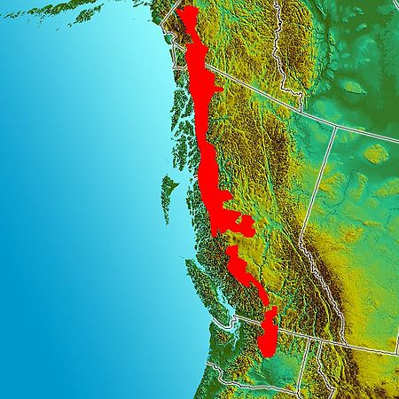
Image of the Pacific Northwest. Red indicates the inferred boundaries of the Coast Range Arc.

Slide 59
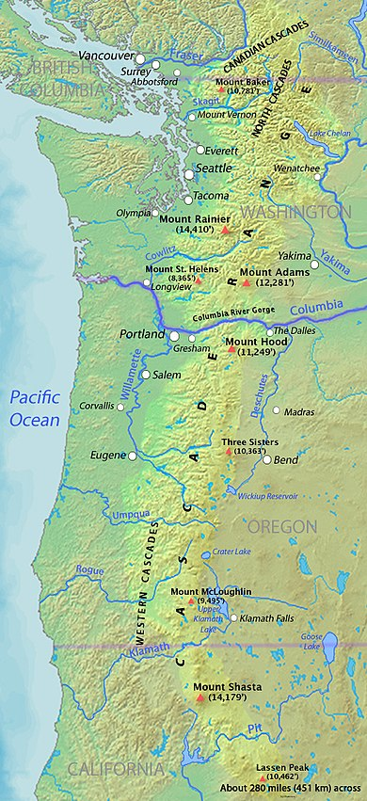
The Cascade Range or Cascades is a major mountain range of western North America, extending from southern British Columbia through Washington and Oregon to Northern California. It includes both non-volcanic mountains, such as the North Cascades, and the notable volcanoes known as the High Cascades. The highest peak in the range is Mount Rainier in Washington at 14,411 feet (4,392 m).

Slide 60
Tertiary Postlaramide evolution
Faralon plate subducted
Tangential motion and expansion replaced convergent motion as the North American plate began interacting with the Pacific plate.
The San Andreas Fault system was formed
Widespread magmatism and volcanism
Basin and Range extension

Slide 61
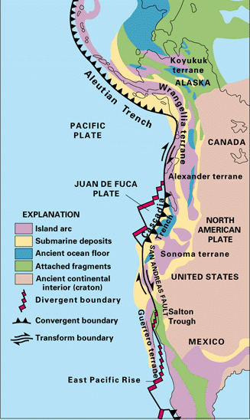

Slide 62
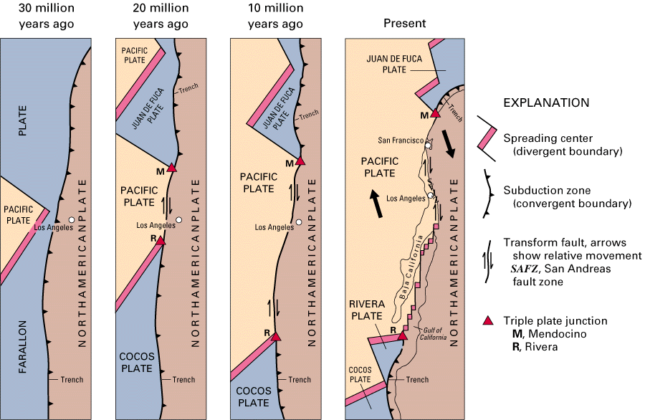

Slide 63
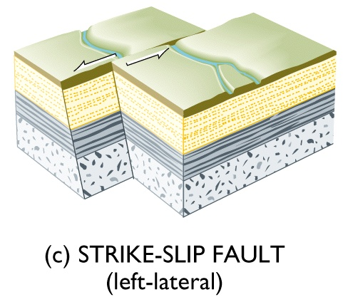

Modern California: Strike-Slip tectonics
On the other hand, California is also a transform plate boundary zone, which is accommodated be a series of strike-slip faults.
There is evidence of strike-slip motion across the surface rupture of the 1872 Lone Pine earthquake. This air-photo of the San Andreas Fault shows a somewhat clearer offset drainage.
63

Slide 64

The Basin and Range Province is a vast physiographic region covering much of the inland Western United States and northwestern Mexico. It is defined by unique basin and range topography, characterized by abrupt changes in elevation, alternating between narrow faulted mountain chains and flat arid valleys or basins. The physiography of the province is the result of tectonic extension that began around 17 million years ago in the early Miocene epoch. This province is literally being split apart by tension connected with magmatism along the Nevada–Columbia Basin magmatic belt which was generated above an elongated sublithospheric melt zone associated with arrival of the Yellowstone mantle plume- —a region of the mantle that is hot but still solid and that is buoyantly upwelling

Slide 65

The Nevada–Columbia Basin magmatic belt, a linear zone of dikes and basaltic volcanic centers that extends for >1000 km, from southern Nevada to the Columbia Basin of eastern Washington.

Slide 67

Figure 5. Cross section of the Basin and Range Province. The gray rectanglar outline represents the area traversed by the Virgin River Gorge. Thin curved black lines represent faults. Modified from USGS cross section.
This province is literally being split apart by tension resulting from a source of heat energy that exists below the region. Evidence for that heat is provided by numerous volcanoes and lava flows scattered throughout this province. The term “Basin and Range” comes from the generally parallel north-trending mountains (the ranges) separated by valleys (the basins). Rocks in each of these mountain ranges are tilted and bounded by faults and are thus described as fault block mountains.

Slide 68


Slide 69


Slide 70

Yellowstone National Park
Grand Prismatic Spring
Old Faithful
Nachází se zde velké množství horkých pramenů, bublajících bahnitých jam, horských jezer, kaňonů, erodovaných lávových proudů a gejzírů. Nejznámějším gejzírem je Old Faithful, jenž tryská průměrně po 64,5 minutách do výšky 40 m, maximálně pak až do výšky 56 m. Takto vytryskuje asi 120 let.

Slide 72

Franklinsko – inuitská orogeneze
Při severním okraji severoamerického kratonu probíhala ve spodním paleozoiku ellesmerská a inuitská orogeneze.
Dostupné údaje zatím neumožňují jjeich jednoznačnou interpretaci.

