Slide 1
Chemical properties, structure and interactions of nucleic acids
DNA structure – basics, Watson-Crick and Hoogsteen base pairing, double helix, alternative structures, DNA superhelicity
Chemical reactivity of DNA, DNA damage, chemical modification of DNA as a tool for structure/interactions studies
Non-covalent interactions of DNA, outer-sphere electrostatic interactions, groove binding, intercalation, fundamentals of DNA-protein interactions
Enzymatic processing of nucleic acids, application of enzymes in structure/interactions studies
Molecular principles of epigenetic regulations.
Optical spectroscopic methods - general introduction
Principles of circular dichroic (CD) spectroscopy
Advantages and drawbacks of the use of CD spectroscopy to proteins and nucleic acids studies
Characteristic CD spectra of particular nucleic acids types
Structural properties of nucleic acids - fresh findings
Electrochemistry of nucleic acids, electrochemical methods – general introduction, electrochemical activity of DNA, DNA structure at electrically charged surfaces, electrochemical sensing of DNA damage, modification and nucleotide sequences.
Electrochemistry of proteins – basics and applications

Slide 2
You and chemistry? ☺

Slide 3
Some basic terms
hydrogen bond
ionic interactions
hydrophobic interactions, stacking
ester bond
N-glycosidic bonds
condensation, hydrolysis
oxidation, reduction
electrophile, nucleophile
tautomers, enol-keto, amino-imino

Slide 4
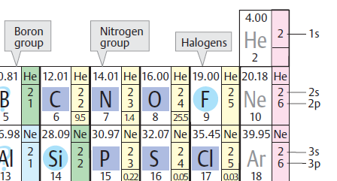
Hydrogen bond
δ−
δ+
δ−
electronegative atom (O, N)
electronegative atom with lone electron pair (O, N)

Slide 5
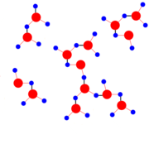
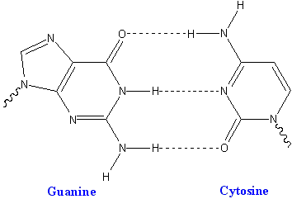
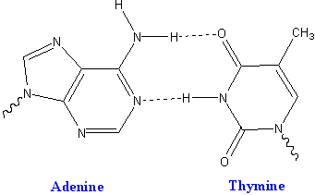
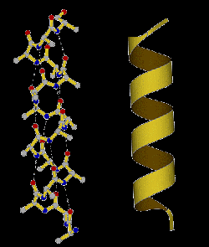
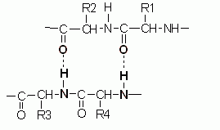
Hydrogen bond
crucial importance for biology
properties of water
nucleobase pairing
protein structures
protein-DNA interactions
many others

Slide 6
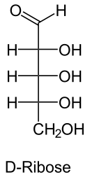
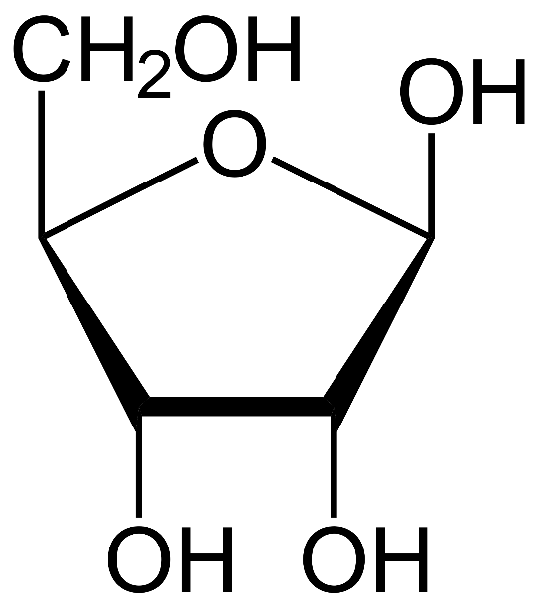
N-glycosidic bond
anomers:
α (hemiacetal hydroxyl „down“) β („up“ as here)
hemiacetal
(more exactly: in β anomer the hemiacetal hydroxyl is on the same side of the furanose ring as the -CH₂OH group)
β-D-ribofuranose

Slide 7
N-glycosidic bond
HO-R
O-glycosides
substitution of hemiacetal OH
(condensation reaction)
N-glycosides
- H₂O
β-D-ribofuranose

Slide 8
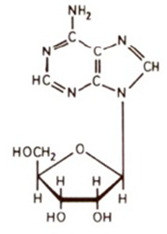
N-glycosidic bond
nucleoside formation
- H₂O
β-D-ribofuranose
nucleoside

Slide 9

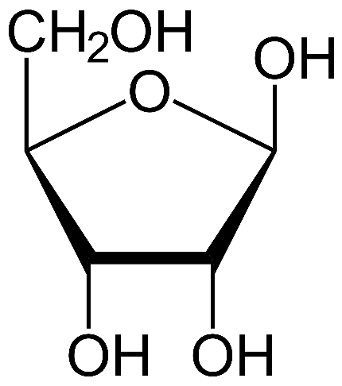
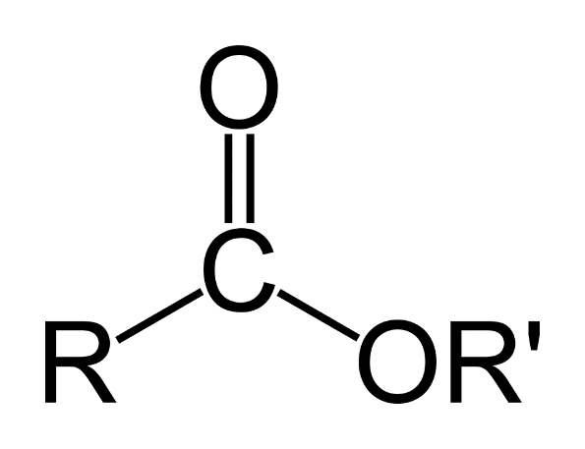
Ester bonds
H
H
esters: products of condensation of acids with alcohols
substitution of –OH of the acid with –OR
phosphoric acid (dihydrogen phosphate)
- H₂O
phosphodiester
carboxy ester
- H₂O
-OH
H-

Slide 10
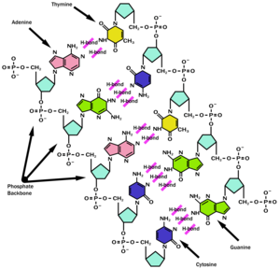

Slide 11
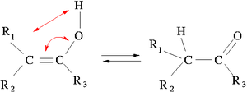
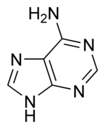
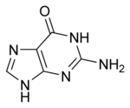
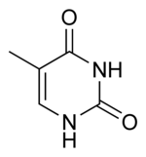
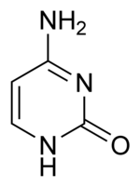
Tautomers
isomers enol-keto, amino-imino
double bond switch plus hydrogen/proton migration
in nucleobases: critical effect on pairing properties
6-substituents in purines + 4-substituents in pyrimidines: oxygenous=keto, nitrogenous=amino
hydrogen yes or not on the neighboring ring nitrogen
relation to chemical mutagenesis
6
4

Slide 12

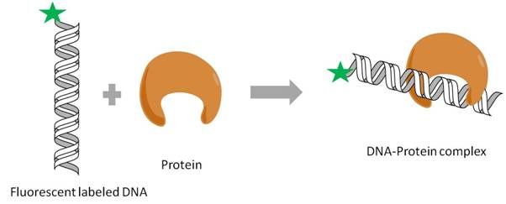
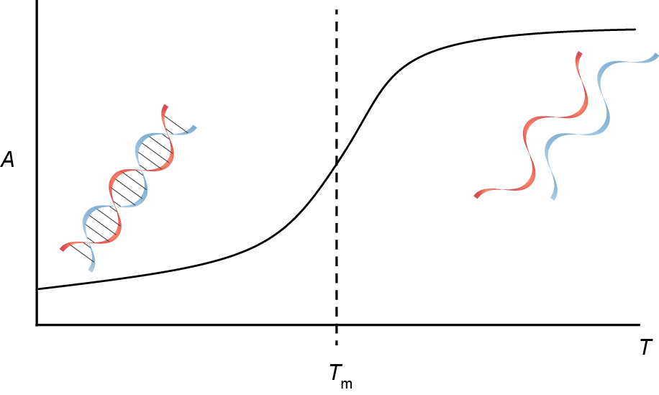
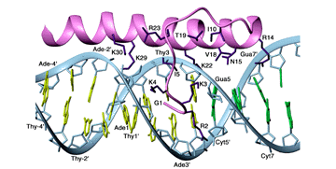
Energetics of interactions (including structure)
absolute temperature
<0
less ordered
ordered
Gibbs energy
enthalpy
(reaction heat)
entropy
(disorder)
hydrogen bonds
stacking
(heat released)
bonds broken (consumes heat)
ordered
disordered
network of „weak“ bonds– released heat
(H-bonds, electrostatic...)

Slide 13
DNA structure

Slide 14
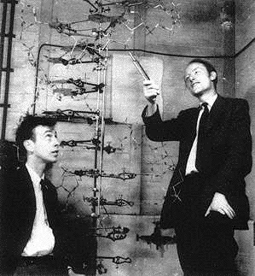
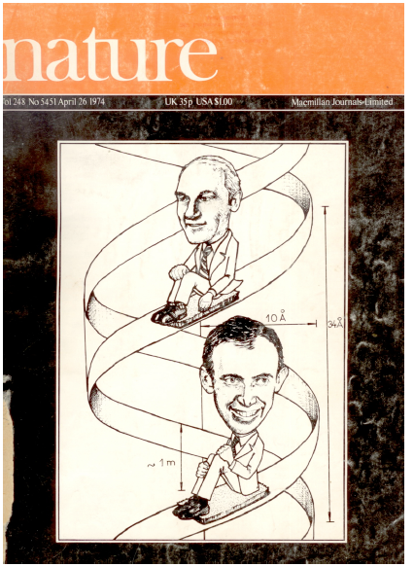
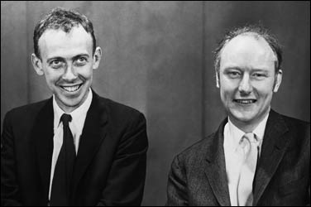
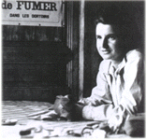
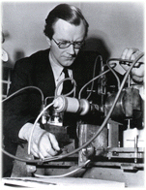
1953: James Watson, Francis Crick, Rosalind Franklin, Maurice Wilkins: the DNA double helix
1962: Nobel Prize (JW, FC, MW)
basic principle of the preservation, transfer and expression of genetic information explained

Slide 15
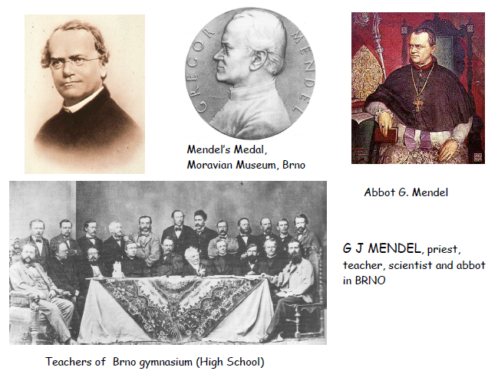
Mendel 1864: „elements of heredity“, Mendel laws

Slide 16
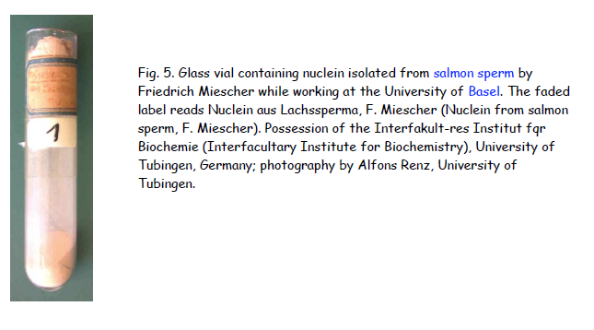
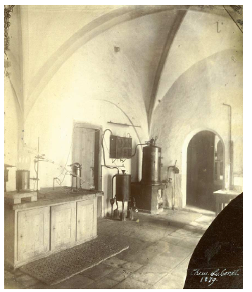
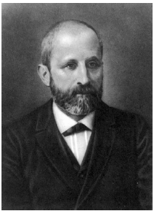
Miescher 1871: discovered „nuclein“, a substance occuring in cell nuclei

Slide 17
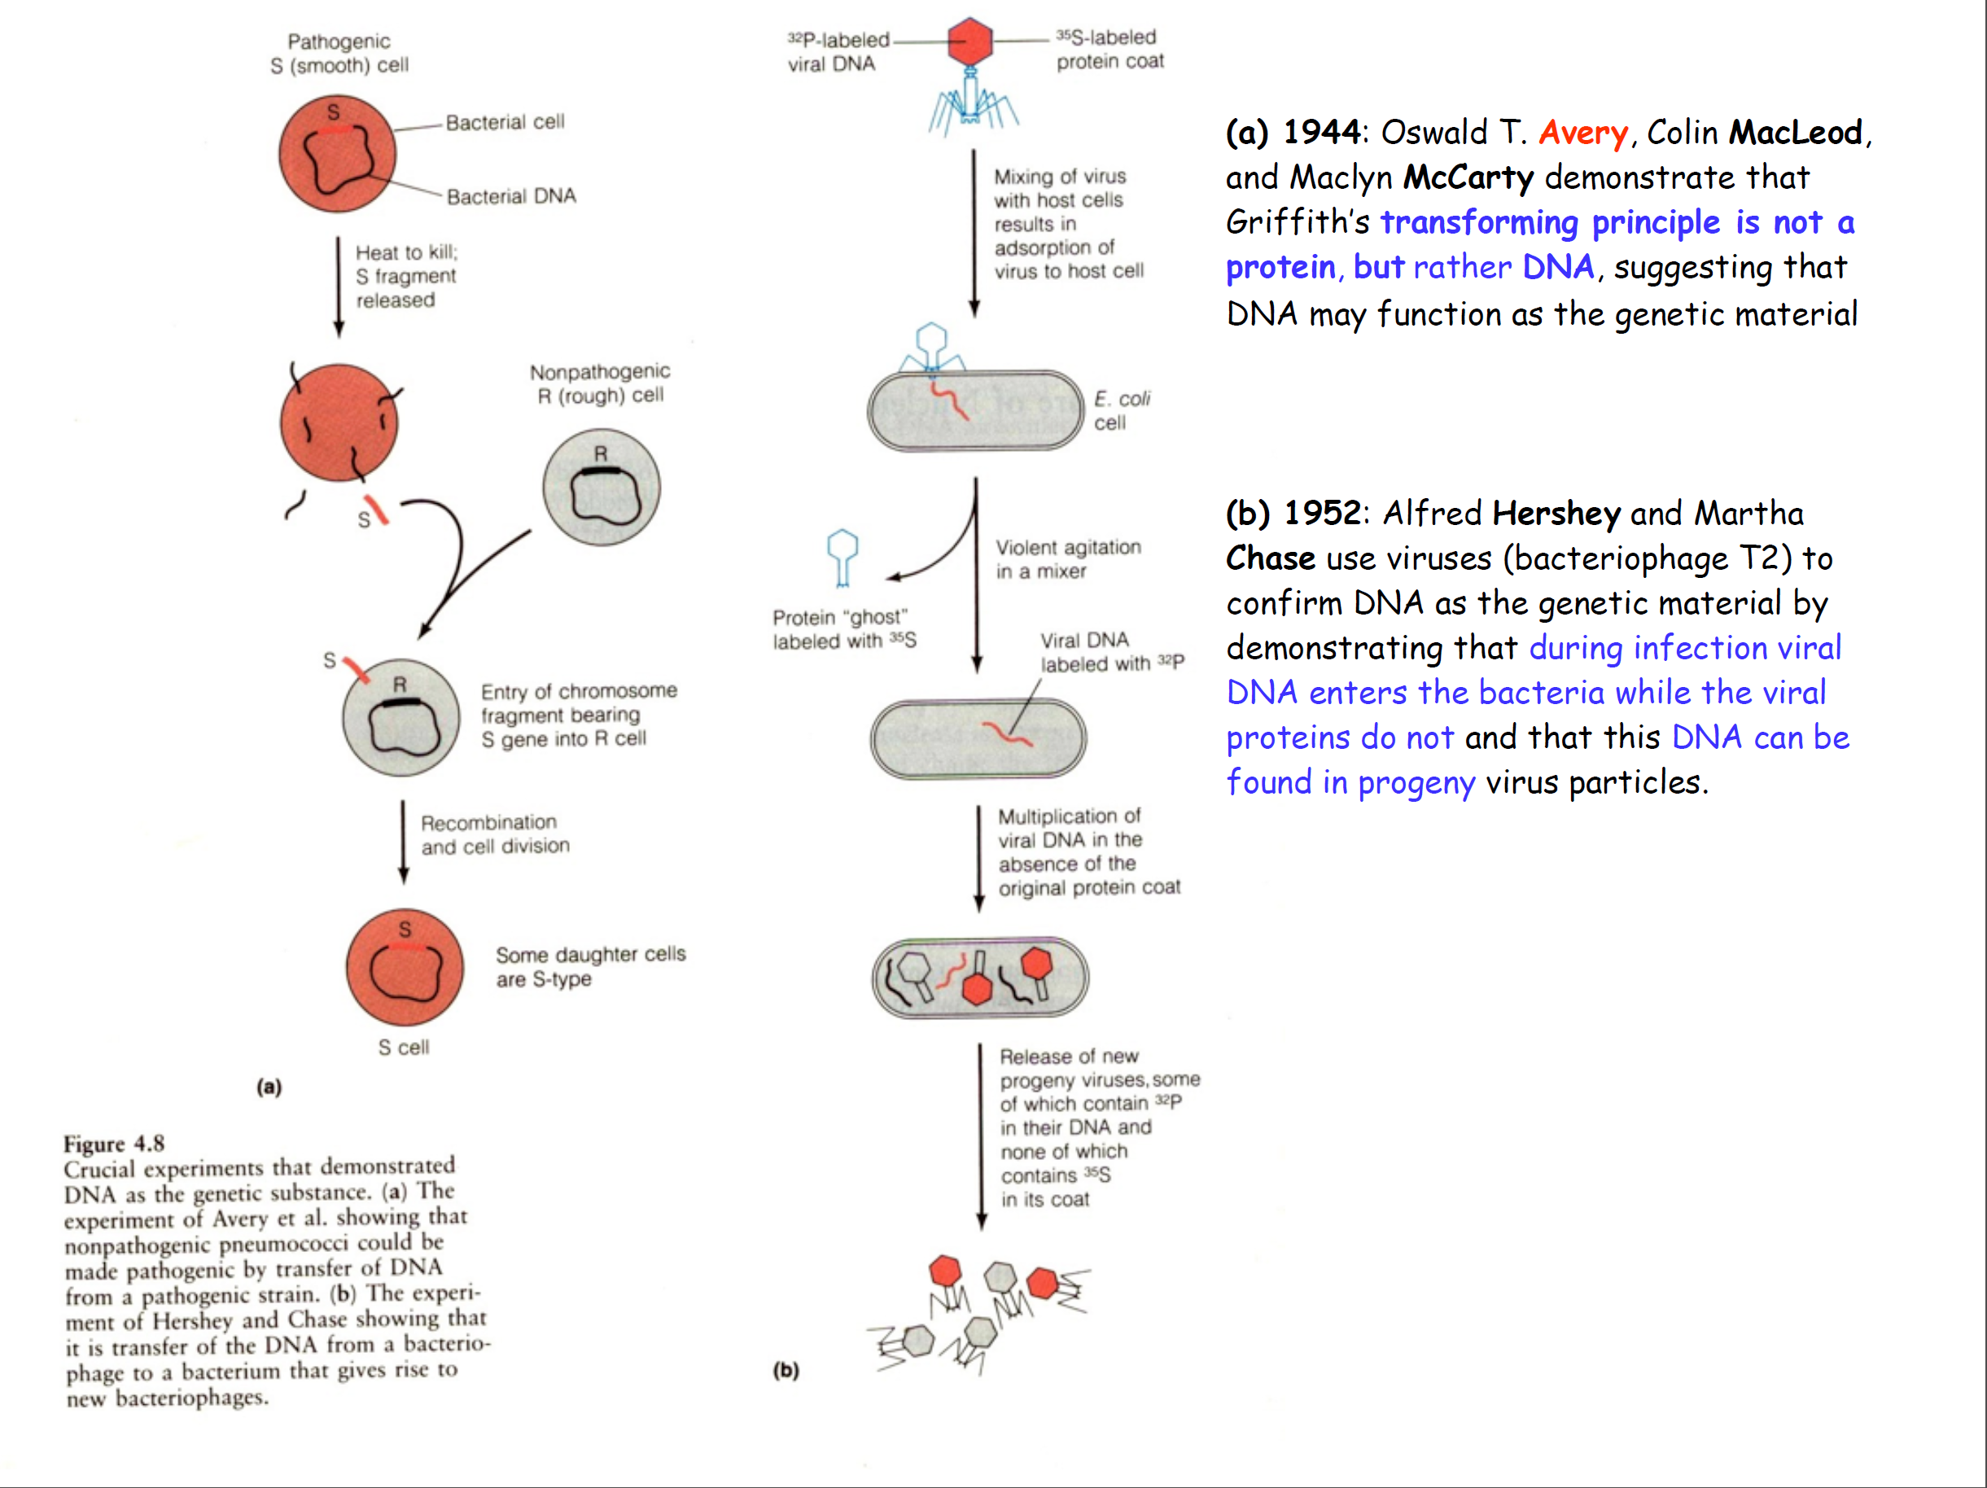
DNA is the genetic material (1944 Avery, 1952 Hershey)

Slide 18
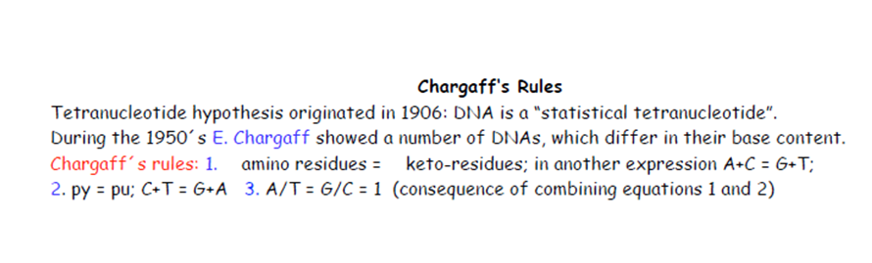
amino pairs with keto
purine pairs with pyrimidine
consequently, A pairs with T and G with C
nitrogen in the ring: donor or acceptor of H bond

Slide 19
Tautomers
isomers enol-keto, amino-imino
double bond switch plus hydrogen/proton migration
in nucleobases: critical effect on pairing properties
6-substituents in purines + 4-substituents in pyrimidines: oxygenous=keto, nitrogenous=amino
hydrogen yes or not on the neighboring ring nitrogen
6
4

Slide 20
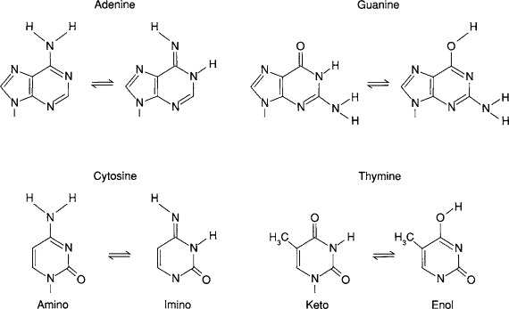
Tautomers
imino behaves as keto
enol behaves as amino

Slide 22
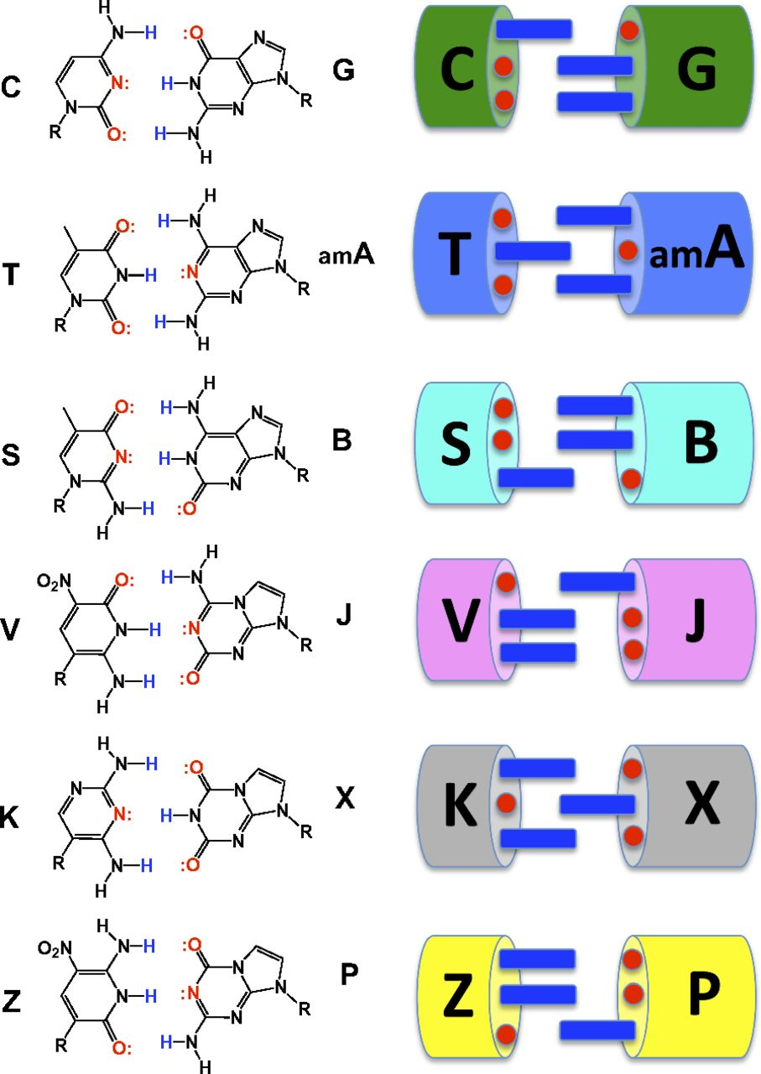
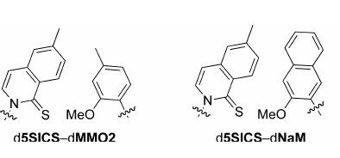
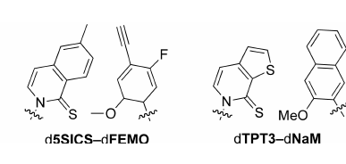
Unnatural base pairs to expand genetic code
F. Romesberg
hydrophobic base pairs
no hydrogen bonding!
shape complementarity only
S. Benner: „AEGIS“ (Artificially Expanded Genetic Information System)
nucleobase analogues with permutated hydrogen bonding donor/akceptor features

Slide 23
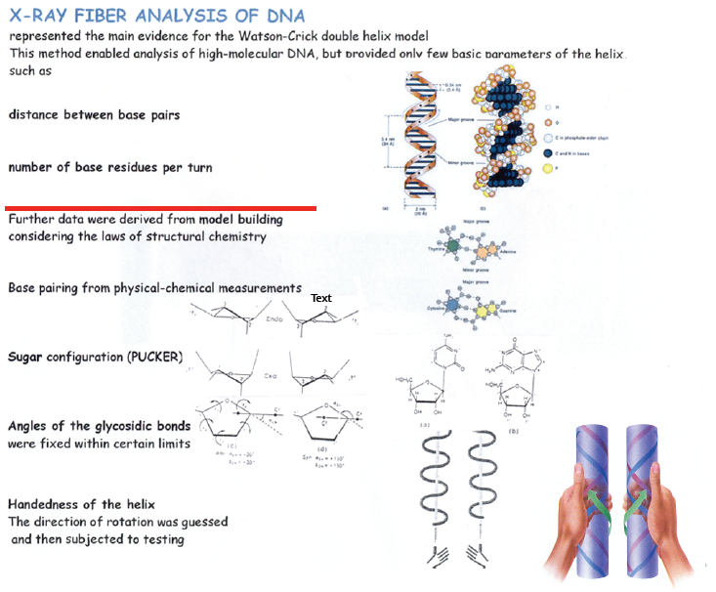
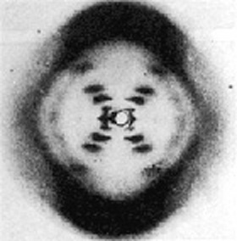

Slide 24
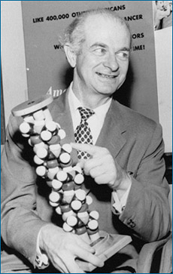
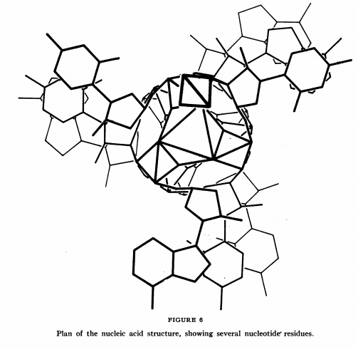
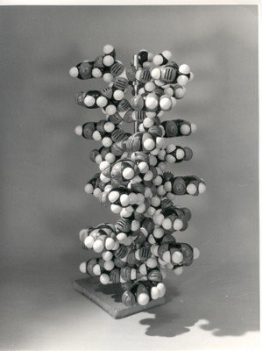
Linus Pauling – suggested triple helix structure with bases outside - INCORRECT
Other concepts: ladder (not interwound) structure (to overcome topological problems with unwinding the double helix)

Slide 25
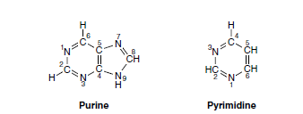
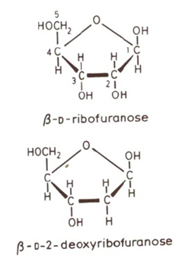
Building blocks of nucleic acids: bases and pentoses
RNA
Sugar numbeering in nucleosides: 1‘, 2‘....5‘
DNA

Slide 26
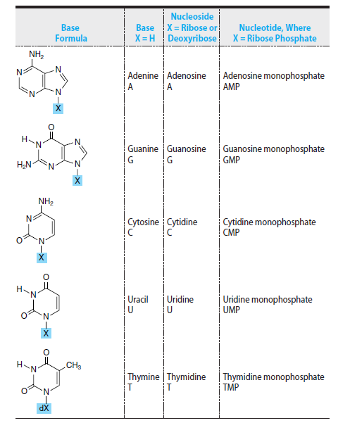
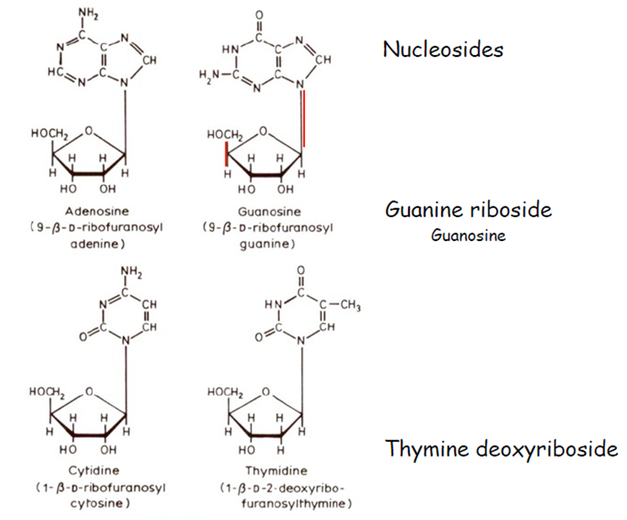
always β anomer

Slide 27
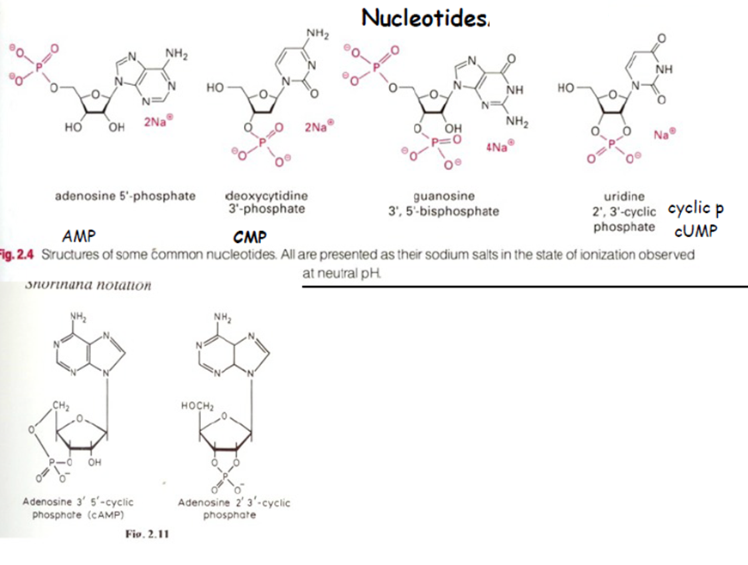




Slide 28
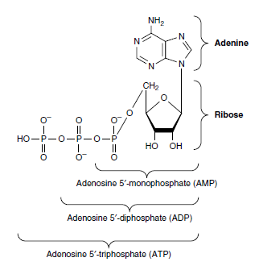
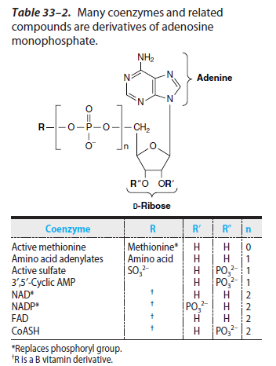
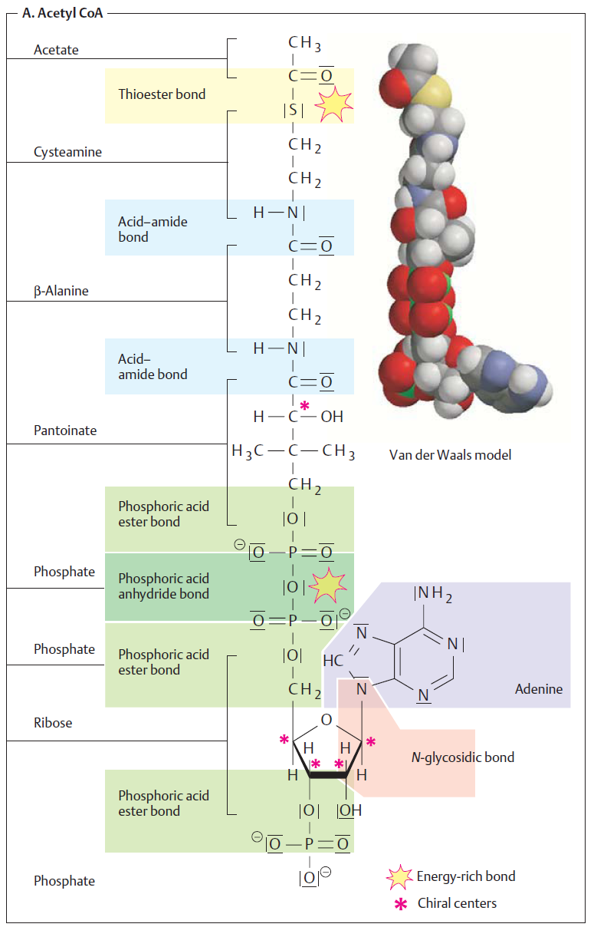
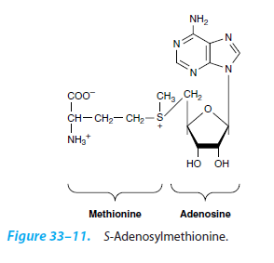
ATP
methyl donor
for methylation reactions

Slide 29
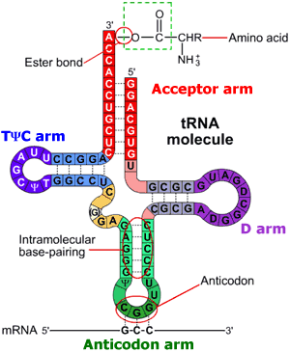




Unusual bases and nucleosides
5
in archeae
dihydrodouridine
archaeosine
pseudouridine
in tRNA
tRNA^{Phe}
adenine demethylation
guanine demethylation
catabolism of purines
nucleoside=inosine (I)

Slide 30



Watson-Crick base pairs
(„canonical“)
wobble pairs (examples)
(in fact canonical)

Slide 31



Slide 32




Slide 33


Slide 34
Multistranded DNA structures
triplexes
tetraplexes (quadruplexes)

Slide 35

Hoogsteen base pairs (triads)
cytosine protonation

Slide 36


Triplex DNA
(homopurine·homopyrimidine stretch of suitable sequence)
e.g. TTTTTTTTTTTTTTTTTTTTTTTTTTTTTTTTTTTTTTTT
AAAAAAAAAAAAAAAAAAAAAAAAAAAAAAAAAAAAAAAA
TTTTTTTTTTTTTTTTTTTTTTTTTTTTTTTTTTTTTTTT
(intermolecular triplex)

Slide 37





Guanine tetrad
Guanine tetraplex
tetramolecular
parallel
bimolecular
antiparallel
intramolecular
parallel
intramolecular
antiparallel

Slide 38


cytosine tetraplex (i-motif)
metal ion-mediated pairing
(non-physiological)
hemiprotonated C⁺•C pair

Slide 39
Chemical reactivity of DNA

Slide 40
Chemical reactivity of DNA
DNA chemistry is derived from chemistry of its costituents
phosphodiester bonds
N-glycosidic bonds
deoxyribose
nitrogenous bases
2-deoxyribose
phosphate

Slide 41
Chemical modification of DNA:
damage to the genetic material
analytical use

Slide 42

DNA hydrolysis
both phosphodiester and N-glycosidic bonds susceptible to acid hydrolysis
N-glycosidic bond more stable toward hydrolysis in pyrimidine than in purine nucleosides (and more in ribo- than in deoxynucleosides)
stable in alkali (unlike RNA)
alkali-labile sites: upon DNA damage
enzymatic hydrolysis (N-glycosylases, nucleases, phosphodiesterases)

Slide 43



Oxidation
two main sites susceptible to oxidation attacks:
  C8 of purines (ROS)
  C5-C6 of pyrimidines
+

Slide 44

reactions with nucleophiles
C4 and C6 are centres of electron deficit in pyrimidine moieties (electrophile centres)
reaction with hydrazine: pyrazole derivative and urea residue bound to the sugar
with T the reaction is disfavored in high salt: Maxam-Gilbert sequencing technique

Slide 45


reactions with nucleophiles
hydroxylamine: cytosine modification
the products‘ preferred tautomer pairs with adenine →mutagenic
bisulphite: cytosine modification inducing its deamination to uracil →mutagenic
5-methyl cytosine does not give this reaction: genomic sequencing
of 5^{m}C

Slide 46


reactions with electrophiles
attacking N and/or O atoms
nitrous acid (HNO₂) causes base deamination (C→U, A→I) – affecting base pairing, mutagenic
aldehydes: reactions with primary amino groups
formaldehyde: two step reaction

Slide 47


DNA alkylation
hard or soft alkylating agents
hard ones attack both N and O atoms, soft only N
dimethyl sulfate: typical soft alkylating agent
N-alkyl-N-nitroso urea: typical hard alkylating agent
modifies all N + O in bases as well as phosphate groups (forming phosphotriesters)
analytical use (sequencing, foorprinting)

Slide 48

Biological consequences of base alkylation
N-alkylation: the primary site = N7 of guanine (accessible in both ss and dsDNA)
  does not change base pairing; easily repairable
N3 of adenine or guanine: located in minor groove
  cytotoxic modification (DNA/RNA polymerization blocked)
N1 of guanine: interferes with base pairing
O-alkylation (G-O6, T-O6) the bases „locked“ in enol forms → improper base pairing → mutagenic

Slide 49



Tautomerization, base pairing and chemical mutagenesis
similarly uracil is deamination product of cytosine

Slide 50





chloro- (bromo-) acetaldehyde: two reactive centres (aldehyde and alkylhalogenide)
reaction with C or A
chemical probes (react only with unpaired bases)
diethyl pyrocarbonate: acylation of purines (primarily A) or C
modification leads to opening of the imidazole ring
chemical DNA probing

Slide 51
Metabolically activated carcinogens
some substances became toxic after their metabolic conversion
detoxifying machinery of the organism acts here as a bad fellow
microsomal hydroxylase complex, cytochrome P450
the role of this system is to introduce suitable reactive groups into xenobiotics enabling their conjugation with other molecules followed by removal from the organism
but….

Slide 52

Metabolically activated carcinogens
aromatic nitrogenous compounds (amines, nitro- or azo- compounds):
aromatic amines are converted into either (safe) phenols, or (dangerous) hydroxylamine derivatives
azo- compounds: „cleaved“ into amines
nitro- compounds: reduced into hydroxylamines

Slide 53


Metabolically activated carcinogens
polycyclic aromatic hydrocarbons like benzo[α]pyrene: three-step activation
  P450 introduces epoxy group
  epoxide hydrolase opens the epoxide circle
  P450 introduces second epoxy group
DNA adduct formation (primarily -NH₂ of guanine, then G-N7, G-O6 and A-N6)
similar pathway of
aflatoxin activation
bay region

Slide 54




anticancer drugs
some types of antineoplastic agents act via formation of DNA adducts
metallodrugs: mainly platinum complexes
(ineffective)

Slide 55
cisplatin: reaction with DNA in certain sequence motifs
some adduct types preferred (and/or more stable than others)
1,2-GG and 1,2-AG IACs = the main cytotoxic lesions

Slide 56


other platinum complexes tested as cytostatics

Slide 57


Photochemical DNA modifications
mainly pyrimidines
excitation at 240-280 nm: reactive singlet state
water addition at C5-C6
excitation at 260-280 nm: photodimerization of pyrimidines
photoproducts of C can deaminate to U (mutagenic effects)

Slide 58

effects of ionizing radiation
mostly indirect – through water radiolysis
each 1,000 eV produces ~27 •OH radicals that attack DNA
sugar damage:abstraction of hydrogen atoms from C-H bonds
a series of steps resulting
in strand breakage

Slide 59


effects of ionizing radiation
base damage: hydroxylation and/or (under aerobic conditions) peroxylation
pyrimidine products
purine products (mainly C8 hydroxylation or opening of the imidazole ring)

Slide 60

chemical nucleases
species containing redox active metal ions mediating production of hydroxyl radicals (or othe reactive oxygen species) via Fenton and/or Haber-Weiss processes
Me^{n} + H₂O₂ → Me^{n+1} + •OH + OH⁻
iron/EDTA complex
Cu(phen)₂ complex
Fe or Cu
bleomycine

Slide 61
Chemical approaches in DNA studies
(several examples)

Slide 62
Maxam and Gilbert method of DNA sequencing

Slide 63
G
DMS
(preferential methylation of G at N7; spontaneous depurination)
HCOOH
(acid depurination)
A
T
hydrazine (modification
&breakdown of the pyrimidine ring)
C
hydrazine+NaCl
(selective modification of cytosine)
at sites of base modification (removal) the sugar-phosphate backobone is labile towards alkali
treatment with hot piperidine → cleavage at such sites

Slide 64
DNA fragment is end-labeled (radionuclide, fluorophore)
the sample is divided into four reactions (HCOOH, DMS, hydrazine, hydrazine + NaCl)
the conditions are chosen to reach only one modification event per DNA molecule

Slide 65
G
G
G
G
A
A
A
A
T
T
T
T
T
C
HCOOH
C
C
C
C
or
or
or
G
G
G
G
A
A
A
A
T
T
T
T
T
C
C
C
C
C

Slide 66
G
G
A
A
T
T
C
C
piperidine
A
T
A
C
T
C
only the „subfragment“ bearing the label is „visible“ in the following detection step

Slide 67
G
A
A
autoradiography
T
piperidine
T
T
HCOOH
PAGE
C
C
C
G
G
or
G
or
or
A
A
A
A
T
T
T
T
T
C
C
C
C
C

Slide 68
Hydrazine
+NaCl
hydrazine
HCOOH
DMS
G
A
T
C
G
A
T
C

Slide 69


Slide 70
DNA „footprinting“: determination of binding sites of other molecules (e.g. proteins)
at the DNA sequence level

Slide 71
complex
free DNA
DMS (guanine) piperidine
DNaseI
UO₂ UV
Cu(phen)₂
OH radicals

Slide 72
single strand-selective chemical probes

Slide 73


Open local structures in negatively supercoiled DNA
relaxed circular DNA
negatively supercoiled DNA (linking deficit)
stress related to the negative superhelicity (the linking deficit) can be absorbed in local open structures

Slide 74



Open local structures in negatively supercoiled DNA
DNA segments of specific sequence can adopt „alternative“ local structures
cruciform DNA (inverted repeat)
unpaired bases

Slide 75
Open local structures in negatively supercoiled DNA
Triplex DNA
(homopurine·homopyrimidine stretch with mirror symmetry)
e.g. TTTTTTTTTTTTTTTTTTTTTTTTTTTTTTTTTTTTTTTT
AAAAAAAAAAAAAAAAAAAAAAAAAAAAAAAAAAAAAAAA
TTTTTTTTTTTTTTTTTTTTTTTTTTTTTTTTTTTTTTTT
(intermolecular triplex)

Slide 76


Otevřené lokální struktury v negativně nadšroubovicové (sc) DNA
Intramolecular triplex
(homoPu•homoPy segment within negatively supercoiled DNA)
T
T
A
T
A
A
A
A
A
A
T
T
T

Slide 77
Chemicals selectively reacting with unpaired bases:
osmium tetroxide complexes
(Os,L)
(T, more slowly C)
chloroacetaldehyde
(CAA)
(A, C)
diethyl pyrocarbonate
(DEPC)
(A, G)

Slide 78

carbodiimide
steric clash
steric clash
footprinting of CGC+ triplex by DMS
carbodiimide

Slide 79

Using the Maxam-Gilbert technique, it is possible to determine with a high preciseness which nucleotides are forming the local structure
modification of supercoiled DNA
restriction cleavage, radiactive labeling
hot piperidine
sequencing PAGE
the structure can be deduced from the modification pattern
TTTTTTTTTTTTTTTTTTTTTTTTTTTTTTTTTTTTTTTT
AAAAAAAAAAAAAAAAAAAAAAAAAAAAAAAAAAAAAAAA

