Slide 1
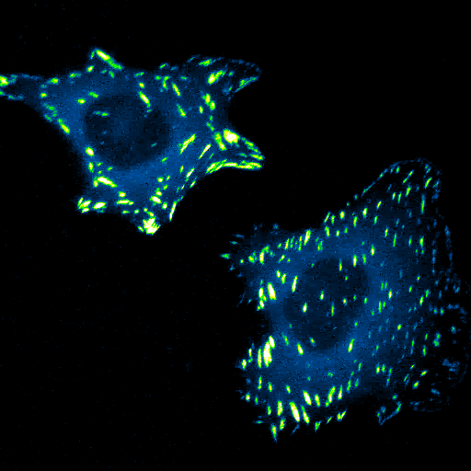
Emerging view of a cell
Live-cell imaging at Morgan lab, UK

Slide 2
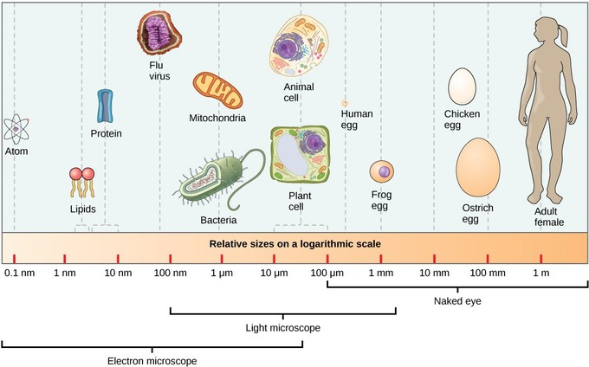
Cell size in context
Biology LibreTexts

Slide 3
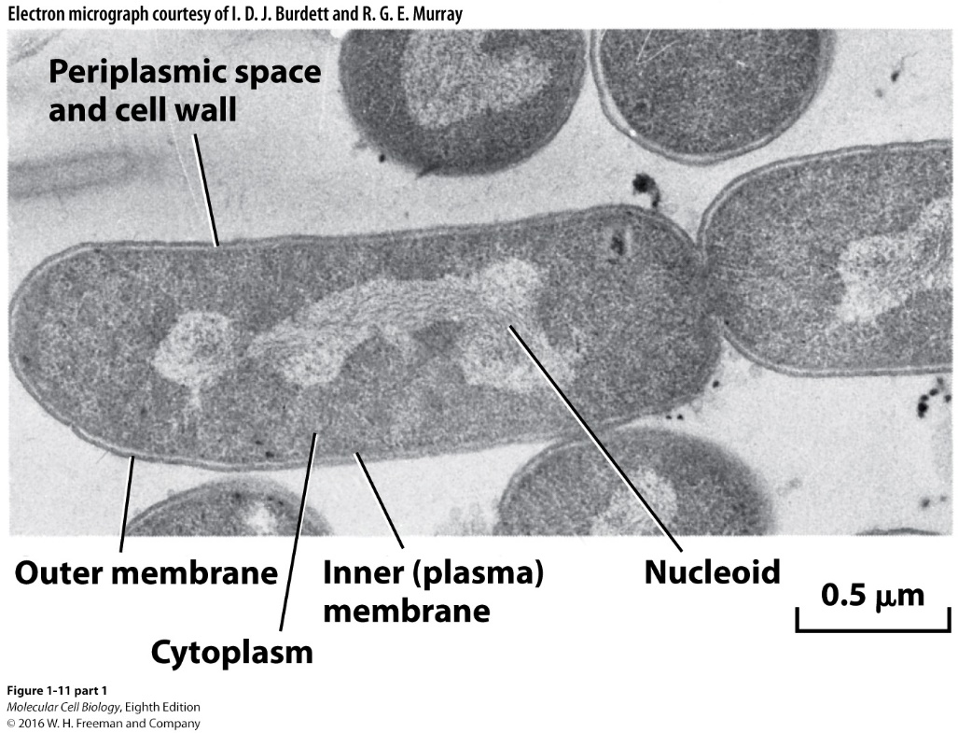
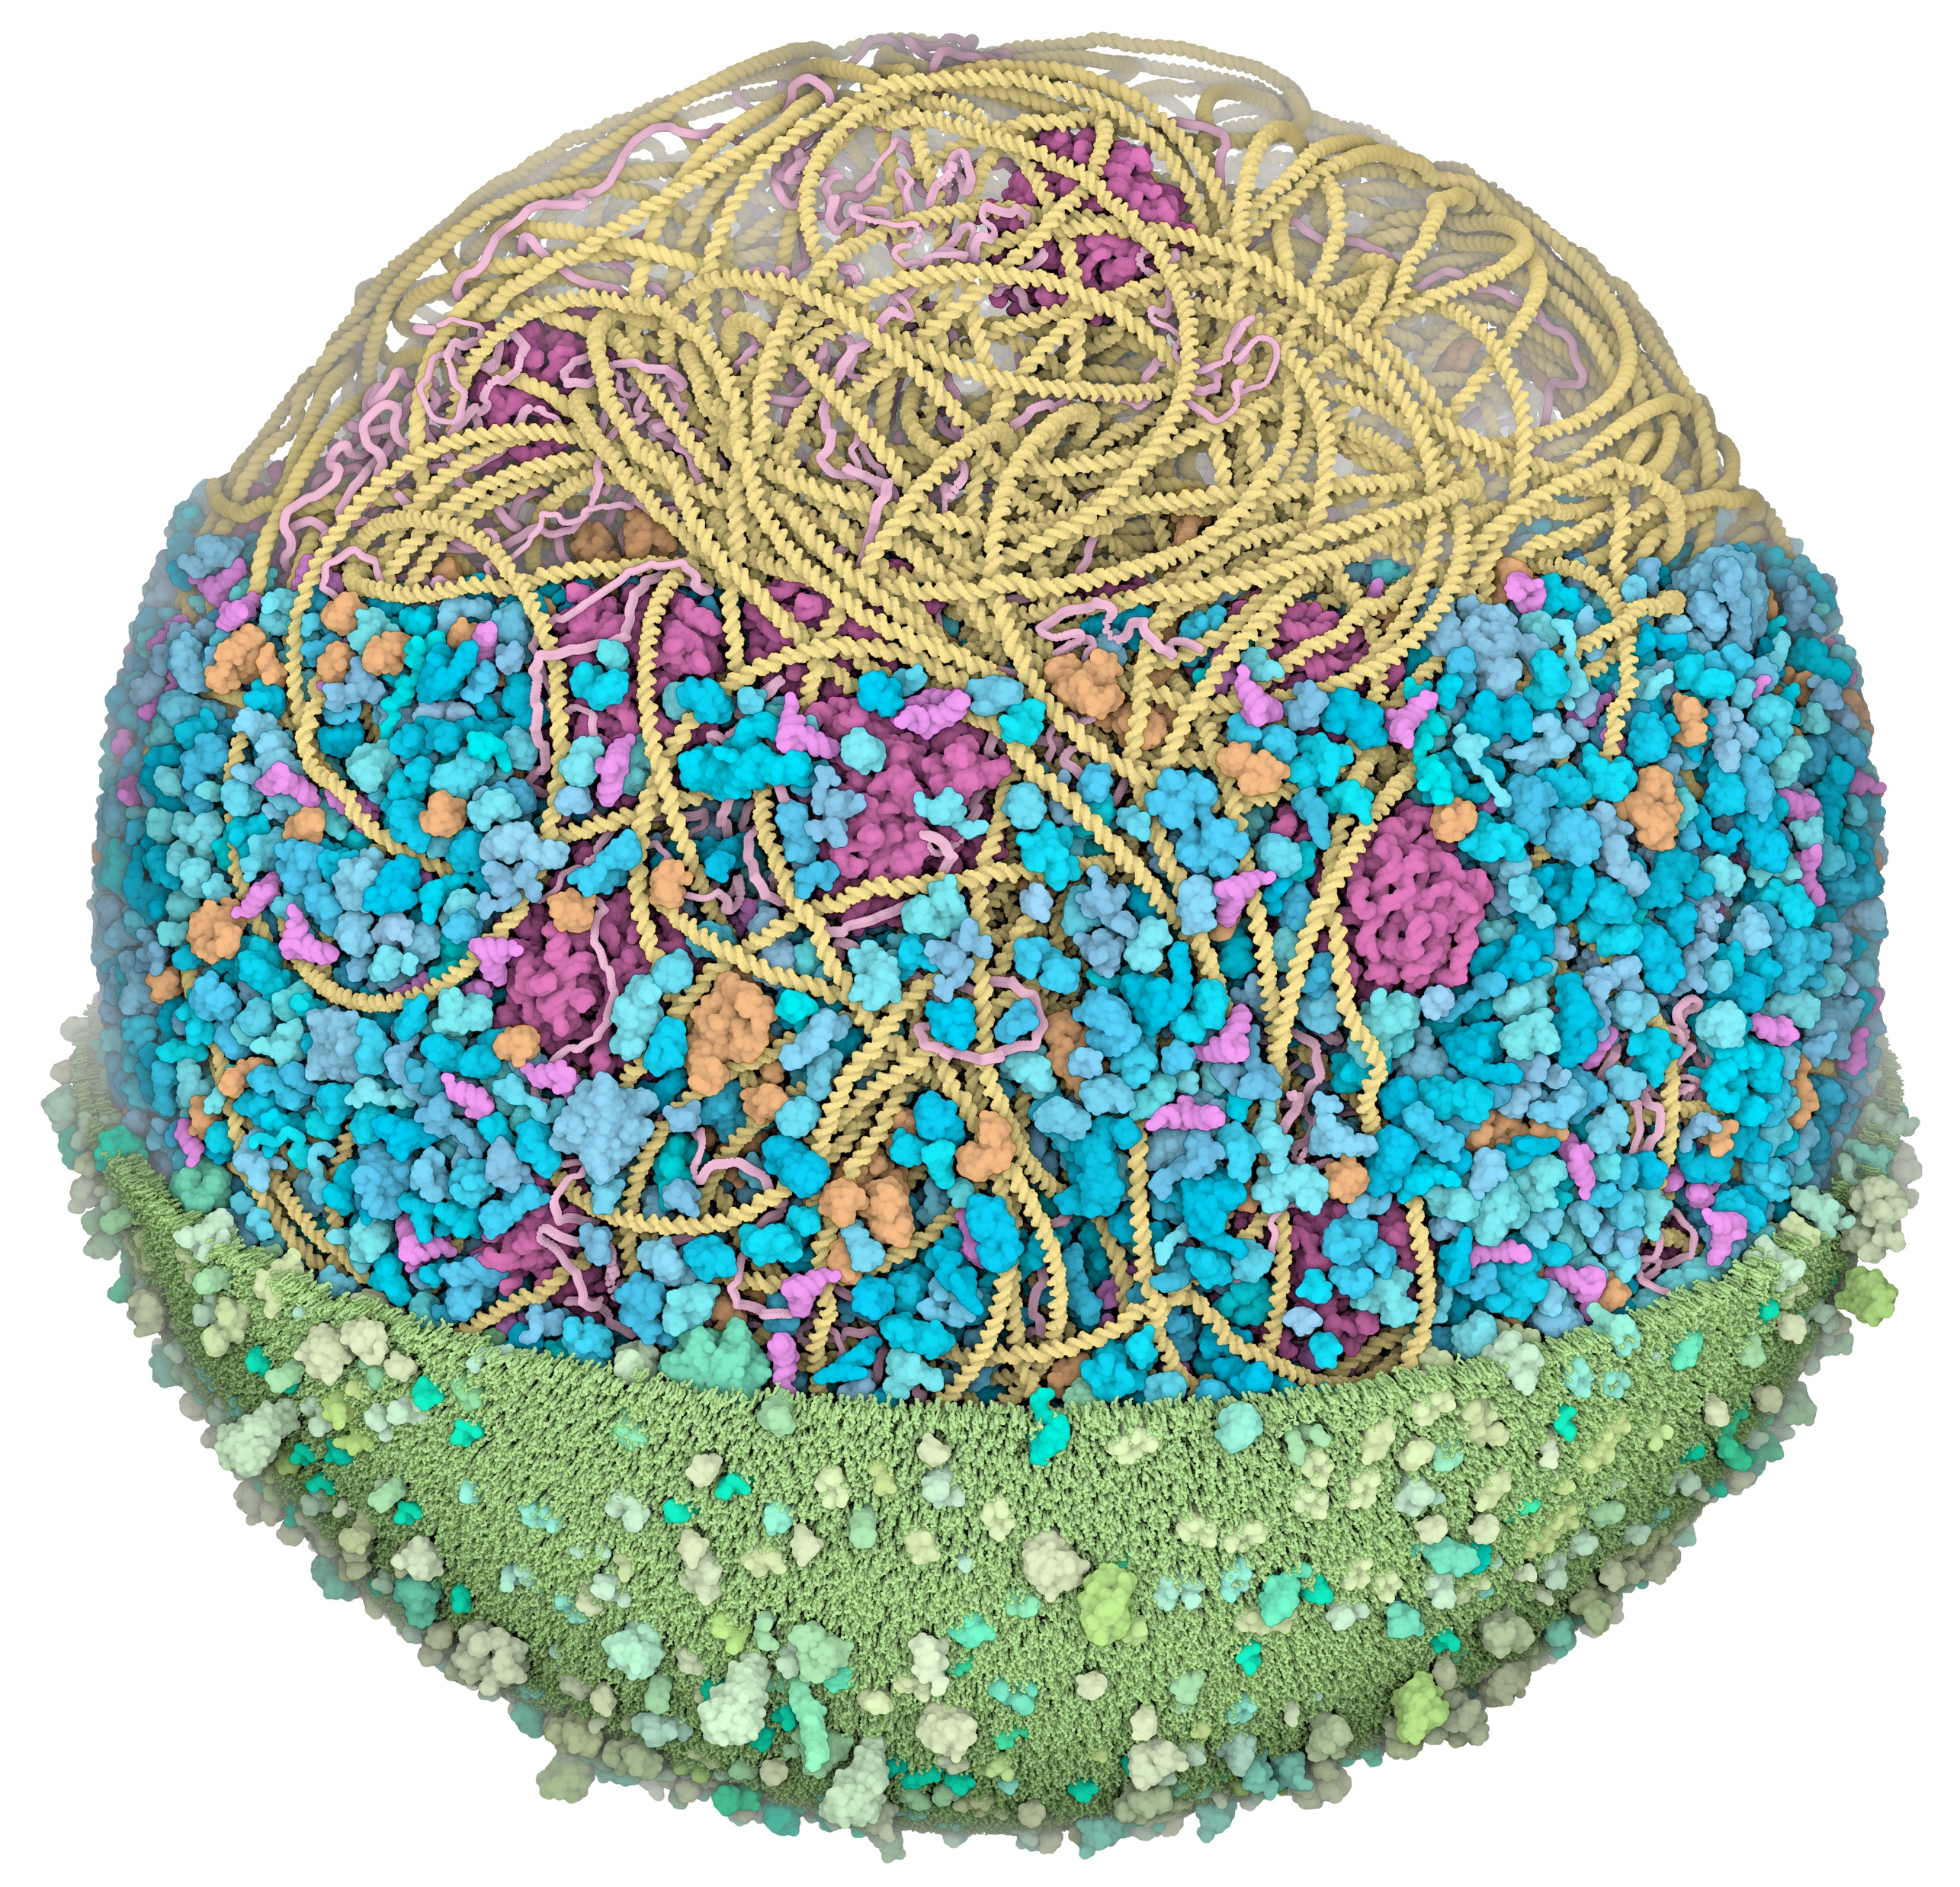
Bacterial cell
Mycoplasma mycoides illustration by David Goodsell

Slide 4
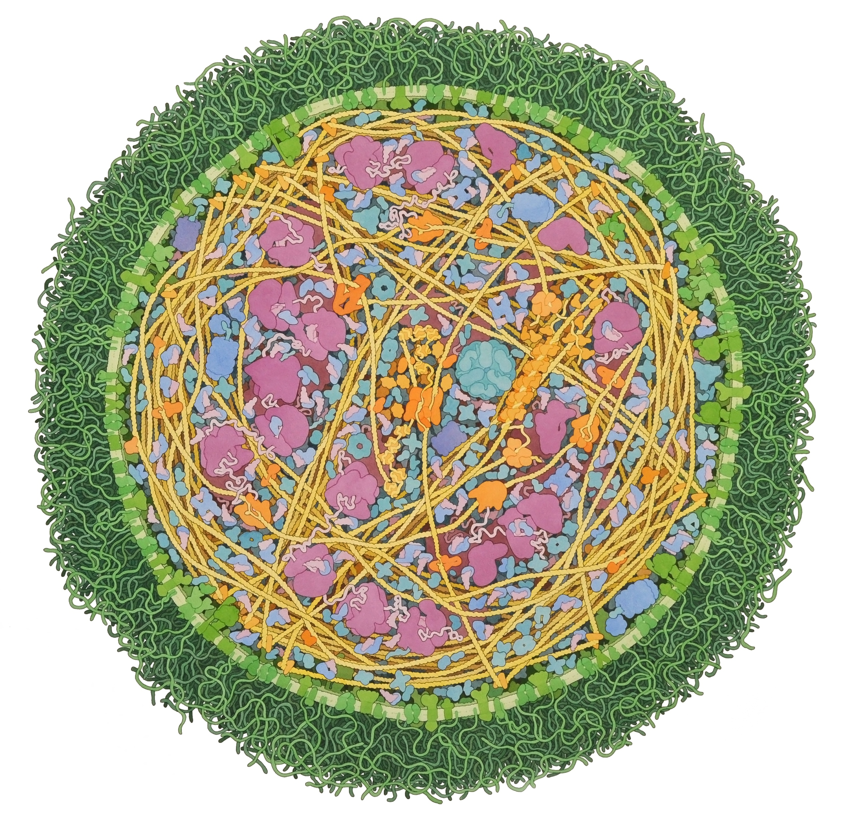
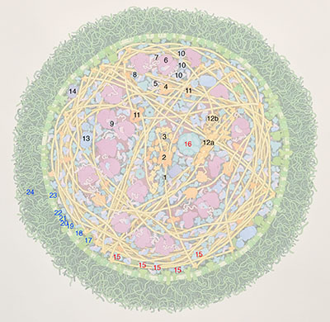
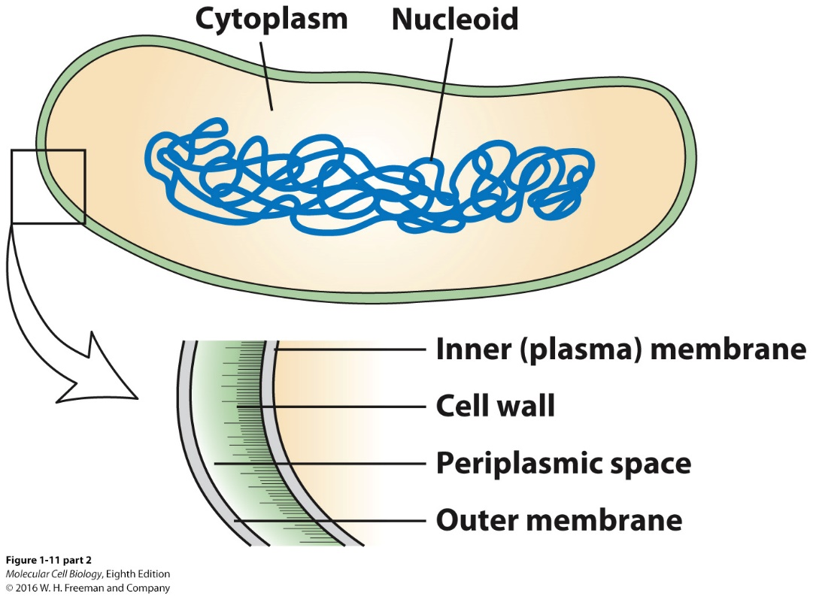
Inside a bacterial cell
Mycoplasma mycoides illustration by David Goodsell
Key for “Mycoplasma mycoides”
Protein synthesis (labels in black)
DNA
DNA polymerase
single-stranded-DNA binding protein (protects single-stranded portions during replication)
RNA polymerase
messenger RNA
ribosome
transfer RNA(in pink) and elongation factor Tu (in blue)
elongation factor Tu and Ts
elongation factor G
aminoacyl-tRNA synthetases
topoisomerases
Rec system for DNA repair: a) RecA, b) RecBC
chaperonin GroEL (helps folding of new proteins)
ClpA (destroys old proteins)
Enzymes for energy production (labels in red)glycolytic enymes
pyruvate dehydrogenase complex
Membrane proteins (labels in blue)ATP synthase
secretory proteins
sodium pump
zinc transporter
magnesium transporter
ABC transporter (different ABC transporters transport different types of molecules-ABC is short for "ATP-binding cassette")
magnesium transporter
lipoglycan (long carbohydrate chains connected to lipid in the membrane)

Slide 5
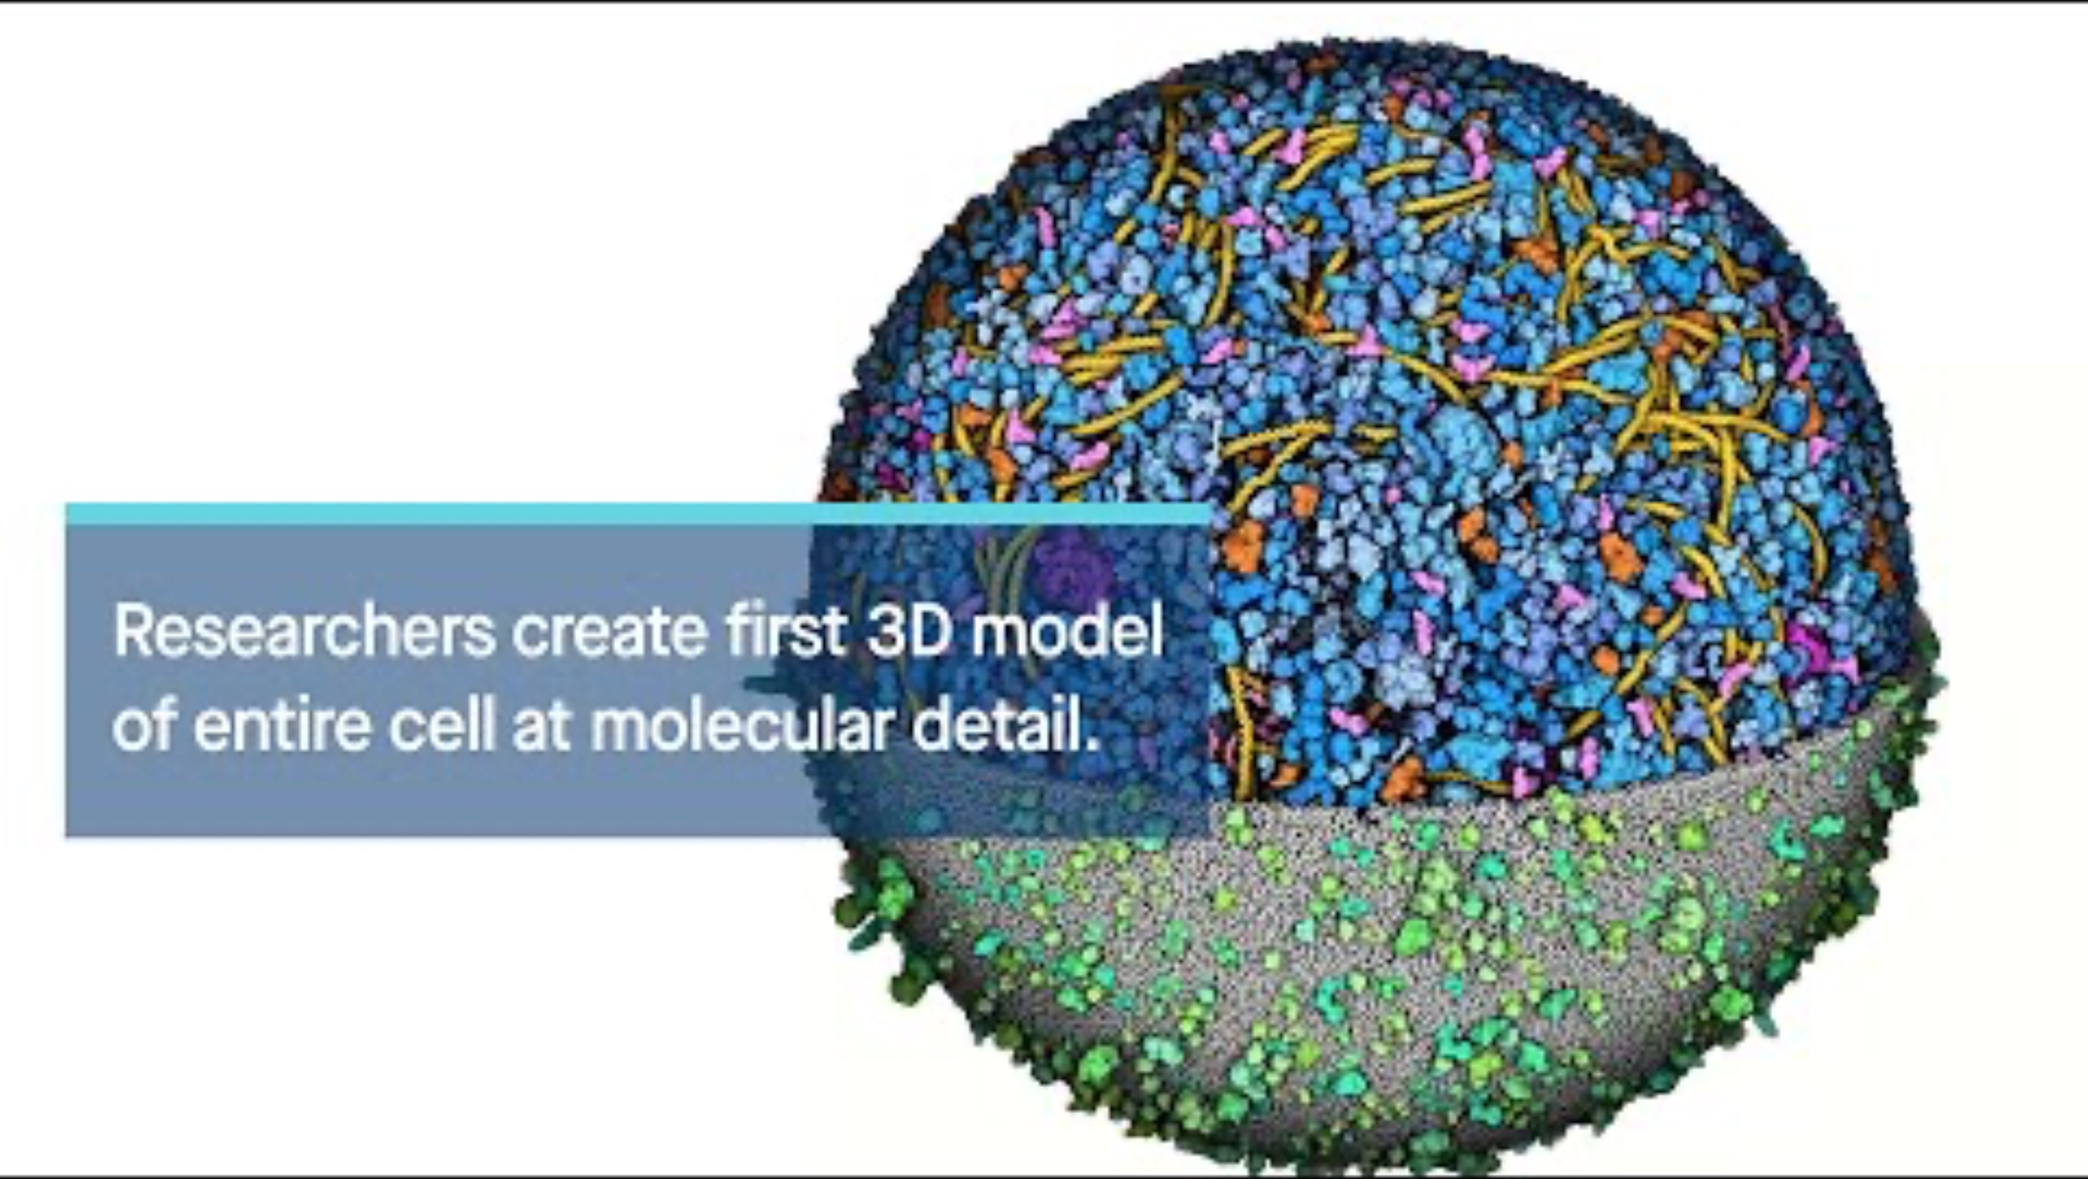
3D model of a bacterial cell

Slide 6
A virus infected bacterial cell
Bacteriophage T4 Infection, 2023 by David Goodsell

Slide 7
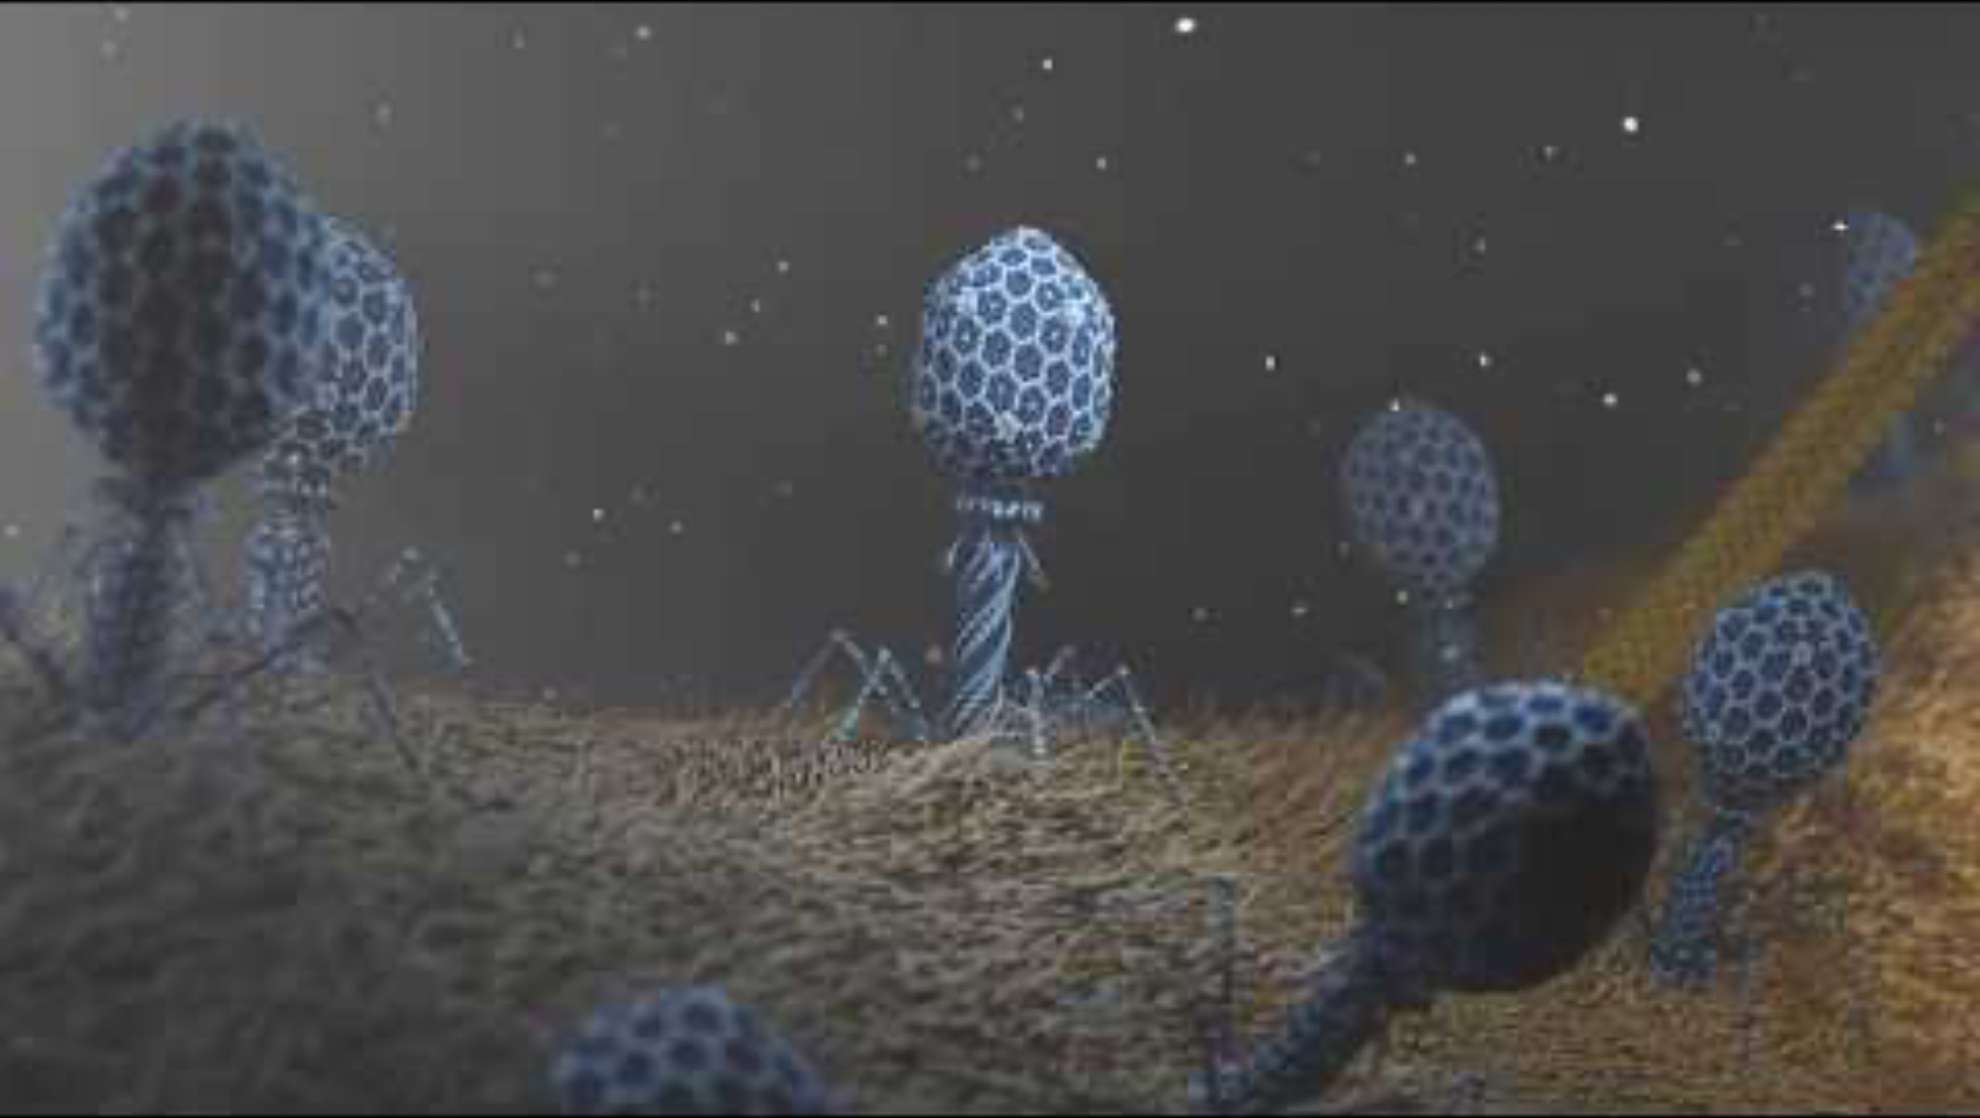
T4 Phage attacking E.coli

Slide 8
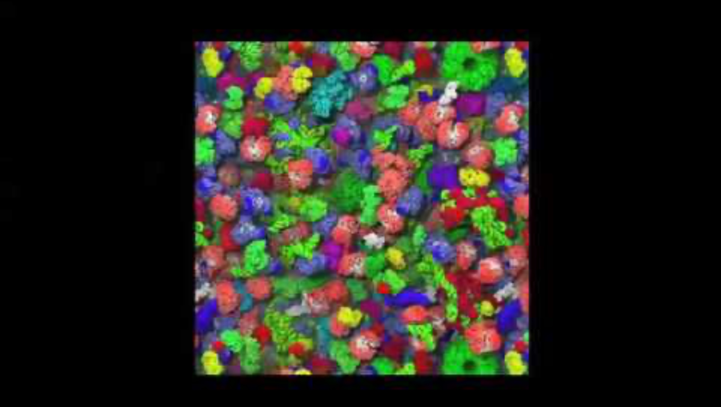
Molecular crowding in the cytoplasm

Slide 9
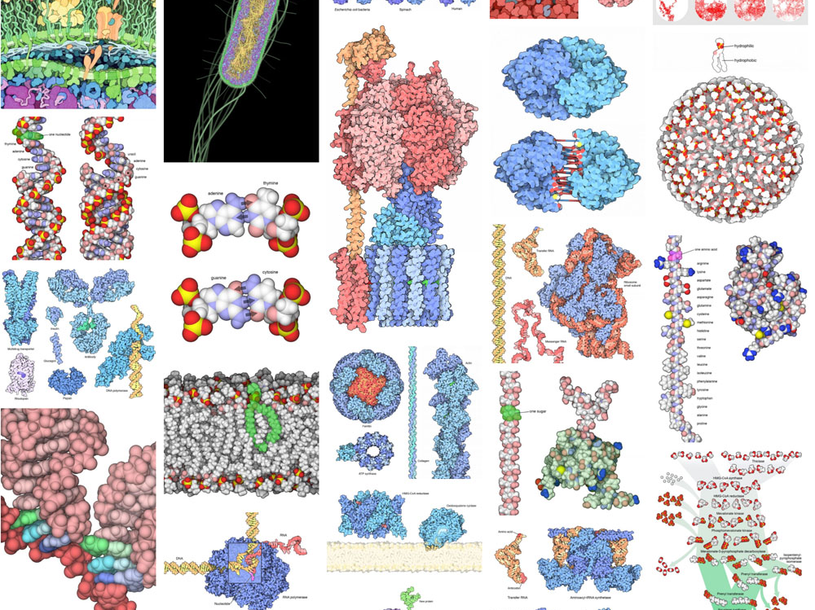
The machinery of life
by David Goodsell

Slide 10
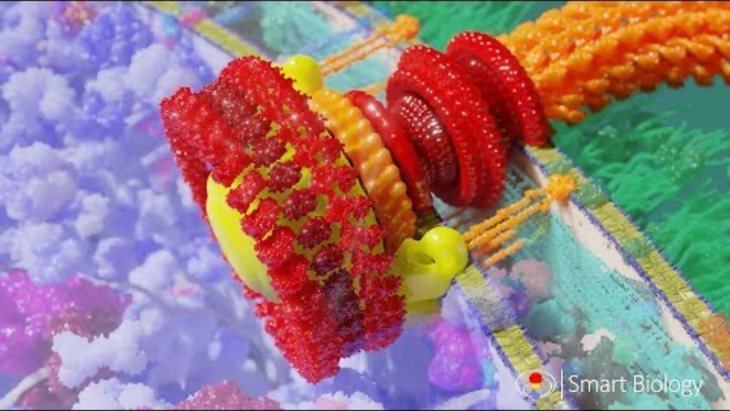
Bacterial flagellum

Slide 11
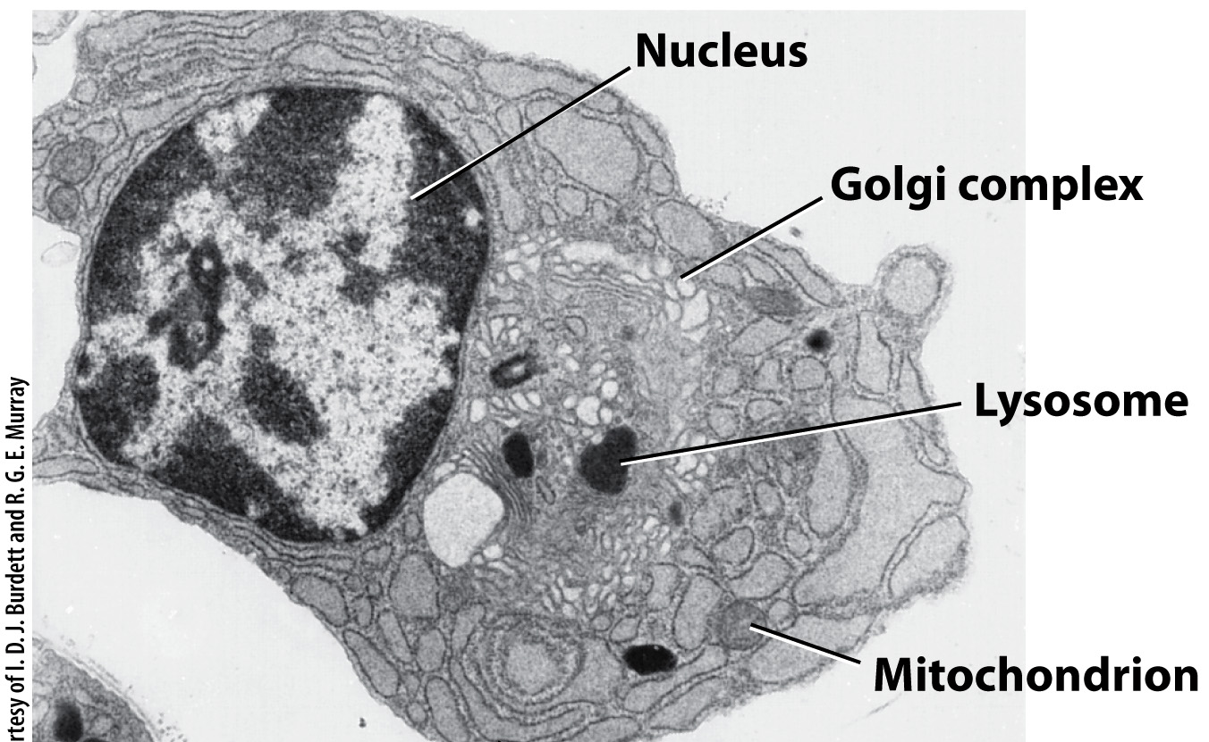
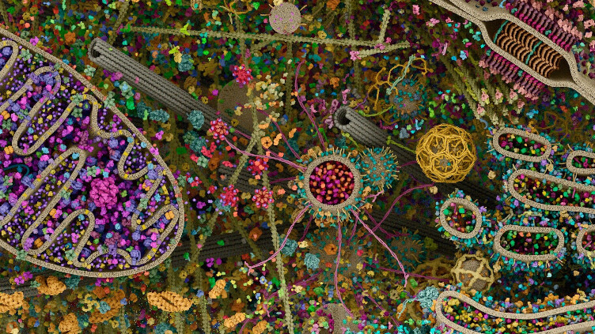
Eukaryotic cell
Scientific Illustration Shared as a Detailed Image of a Human Cell | Misbar

Slide 12
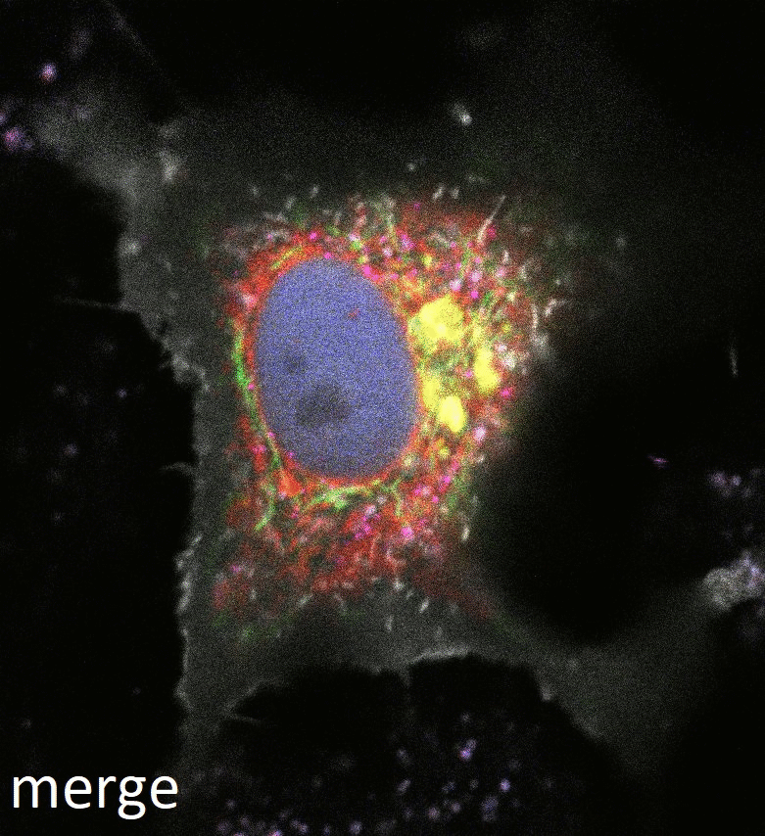
Organelles in the cell
RPE-1 human cell line from Wikimedia Commons

Slide 13
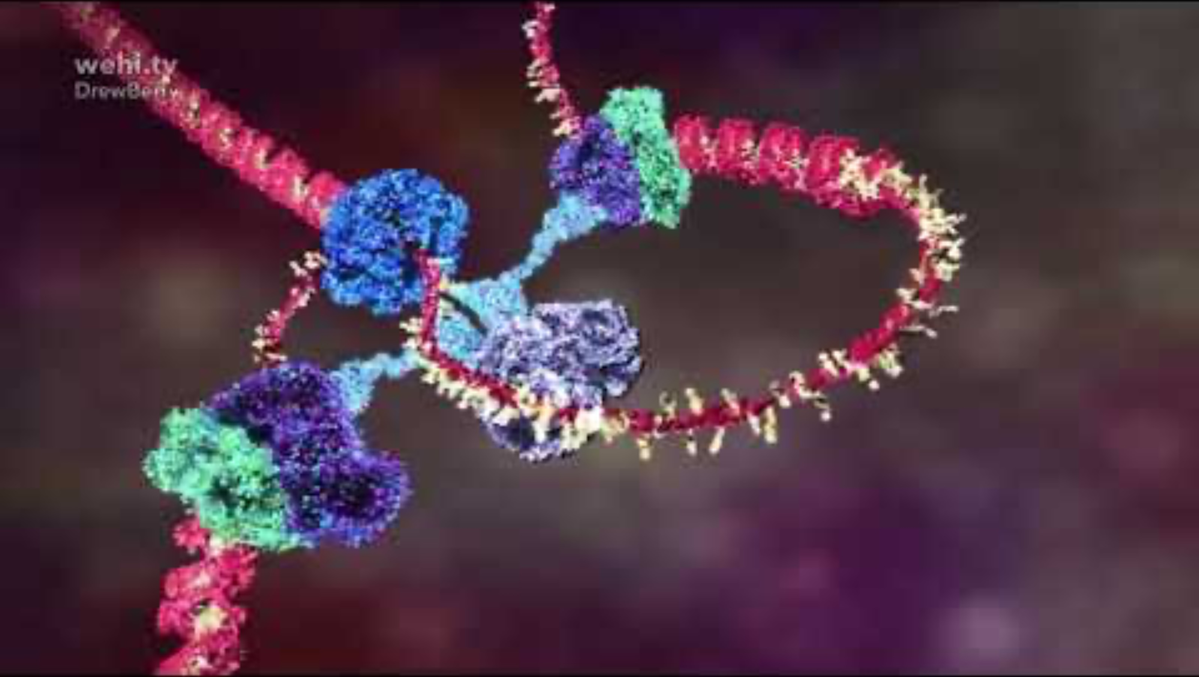
Inside a cell

Slide 14
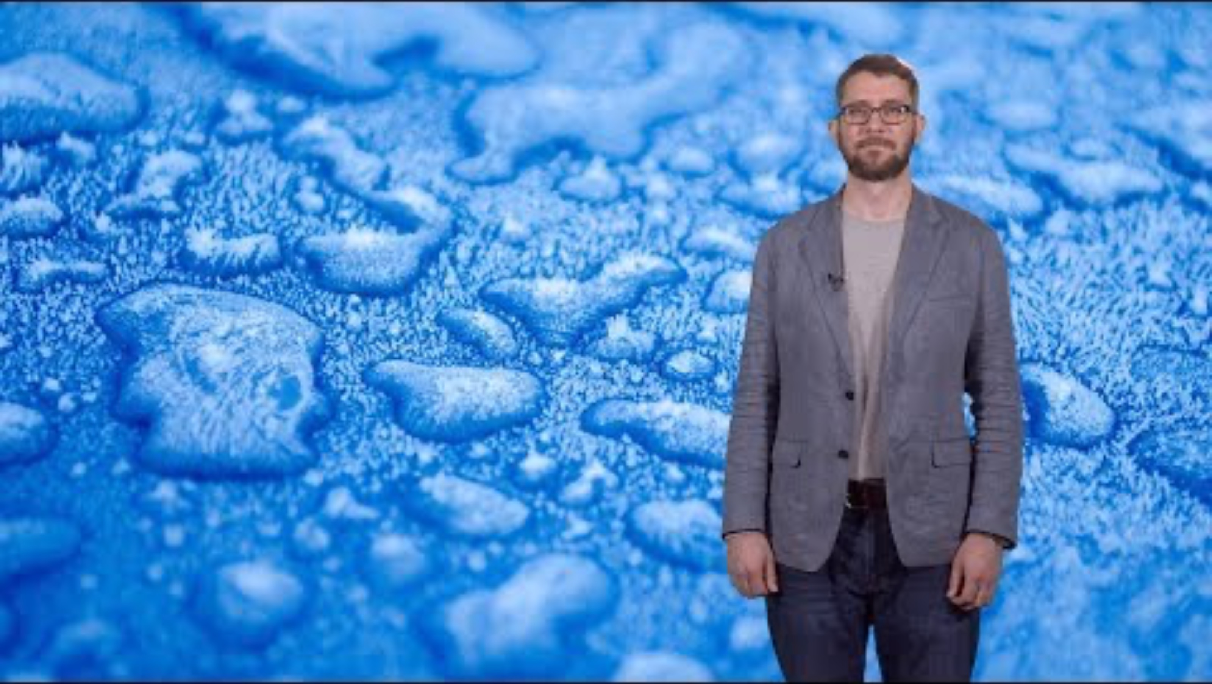
Biomolecular condensates

