Slide 1

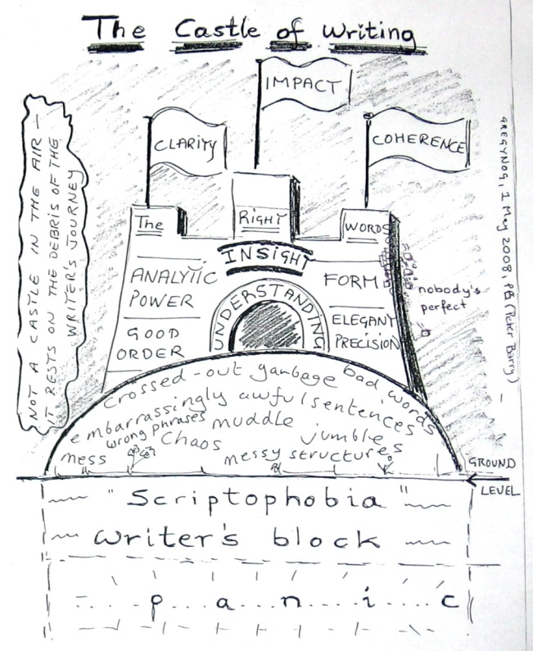
S4001
International Performance
Course

Slide 2
Academic Writing Introduction
  Why is the writing done?

Slide 3
expert scientific student general

Slide 4
expert scientific student general

Slide 5
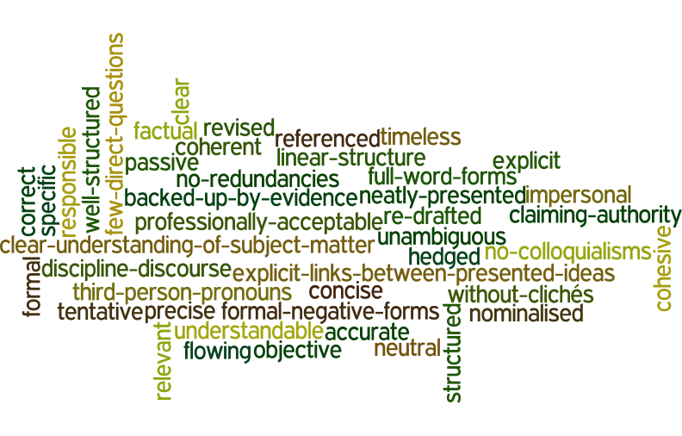

Slide 6
neatly presented cohesive with full forms of words
objective correct without redundancies
explicit factual with flowing structure
hedged unambiguous without clichés
frequent third person pronouns accurate responsible
well structured neutral backed up by evidence
professionally acceptable revised understandable
linear structure timeless specific
without colloquialisms re-drafted referenced
precise clear nominalised
claiming authority formal tentative
more frequent passive voice impersonal no negative forms
with explicit links between presented ideas coherent
with clear understanding of the subject matter concise
relevant within the discourse of your discipline

Slide 7
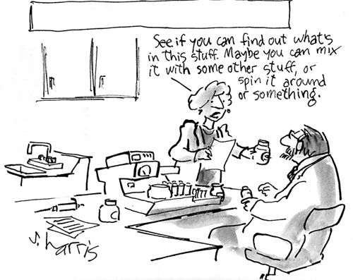
style
(Adapted from: http://www.chemistry-blog.com/category/fun/page/2/)

Slide 8
concise writing

Slide 9
concise writing
Concise writing presents information that is important to the reader. There are no unnecessary words, sentences or paragraphs. Redundant expressions and structures are eliminated or replaced wordy with more concise words or phrases that have the same meaning.
Adapted from: Cooper, P. (2011): Academic Writing and Czech Universities

Slide 10
Chromatography is an experimental technique used by chemists as a means to help them separate different compounds in experimental samples using the affinity of the compound for the mobile phase as well as the affinity of the compound for the stationary phase.
[42 words]

Slide 11
Chromatography is an experimental technique used by chemists as a means to help them separate different compounds in experimental samples using the affinity of the compound for the mobile phase as well as the affinity of the compound for the stationary phase.
[42 words]
Chromatography is an experimental technique used by chemists to separate compounds in experimental samples using the affinity of the compound for the mobile phase as well as the affinity of the compound for the stationary phase.
[36 words]

Slide 12
Chromatography is an experimental technique used by chemists as a means to help them separate different compounds in experimental samples using the affinity of the compound for the mobile phase as well as the affinity of the compound for the stationary phase.
[42 words]
Chromatography is an experimental technique used by chemists to separate compounds in experimental samples using the affinity of the compound for the mobile phase as well as the affinity of the compound for the stationary phase. [36 words]
Chromatography is used to separate compounds using the affinity of the compound for the mobile phase as well as the affinity of the compound for the stationary phase. [28 words]

Slide 13
[42 words]
Chromatography is an experimental technique used by chemists as a means to help them separate different compounds in experimental samples using the affinity of the compound for the mobile phase as well as the affinity of the compound for the stationary phase.
[42 words]
Chromatography is an experimental technique used by chemists to separate compounds in experimental samples using the affinity of the compound for the mobile phase as well as the affinity of the compound for the stationary phase. [36 words]
Chromatography is used to separate compounds using the affinity of the compound for the mobile phase as well as the affinity of the compound for the stationary phase. [28 words]
Chromatography separates compounds based on the affinity of the compound for the mobile phase relative to the stationary phase.
[19 words]

Slide 14
de-personalisation

Slide 15
On self-mention in academic articles: Frequency of self-mention forms per discipline (Ø per 10,000 words).
Discipline | Total | Citation | I | Me | My | We | Us | Our | Other
Physics | 64,6 | 8,7 | 0,0 | 0,1 | 0,0 | 39,3 | 0,6 | 14,4 | 1,4
Marketing | 61,3 | 6,9 | 1,6 | 0,0 | 0,7 | 31,0 | 1,1 | 18,9 | 0,6
Biology | 56,2 | 22,6 | 0,0 | 0,1 | 0,1 | 24,0 | 1,1 | 7,2 | 0,7
Philosophy | 52,7 | 3,1 | 35,6 | 2,5 | 7,7 | 1,4 | 0,2 | 0,6 | 0,0
Electronic eng. | 44,4 | 10,7 | 0,0 | 0,0 | 0,0 | 23,3 | 0,4 | 8,6 | 0,5
Mechanical eng. | 17,8 | 9,6 | 0,0 | 0,0 | 0,0 | 5,5 | 0,0 | 1,4 | 0,4
Overall | 50,5 | 8,3 | 11,2 | 0,8 | 2,4 | 17,8 | 0,8 | 8,3 | 1,1
Adapted from: K. Hyland/English for Specific Purposes 20 (2001) 207-226

Slide 16
All manuscripts must…be written in objective third person point of view throughout (Use "the authors" or "the researchers" NOT "I" or "we")…
(Adapted from: http://www.igi-global.com/publish/contributor-resources/before-you-write/)

Slide 17
passive vs active

Slide 18
Percentages of voice per section in the processes of three types of sciences
in 21 research articles.
 | Introduction |  | Method |  | Results |  | Discussion
 | A | P | A | P | A | P | A | P
Physical sciences | 63,0 | 37,0 | 26,0 | 74,0 | 72,0 | 28,0 | 71,0 | 29,0
Biological sciences | 74,0 | 26,0 | 38,0 | 61,05 | 68,0 | 32,0 | 79,0 | 21,0
Social sciences | 84,0 | 16,0 | 46,0 | 54,0 | 77,0 | 23,0 | 85,0 | 15,0
A=active, P=passive Source: I.A.Martinez/English for Specific Purposes 20 (2001) 227-247)
NOTE: To read more on passive: Lilita Rodman: The passive in technical and scientific
writing; http://www.jaconlinejournal.com/archives/vol2/rodman-passive.pdf

Slide 19
We should reject this conclusion for two reasons.
vs
This conclusion should be rejected for two reasons.
…
It is unclear at this time as to what extent cremophore is responsible for these side effects, but similar hypersensitivity reactions in dogs have been attributed to histamine release by cremophore EL.

Slide 20
Experts presented and discussed a total of ten
innovative papers during the two-day workshop sessions.
vs
A total of ten innovative papers
were presented and discussed
during the two-day workshop sessions.

Slide 21
To measure the number of gene copies the cellular DNA
is broken into small pieces, the double strands are denatured
(separated into single strands) by boiling, and a small amount of
the radioactively labeled complementary DNA is added
to the mixture under experimental conditions.

Slide 22
nominalisation

Slide 23
You can understand something better if it is repeated.

Slide 24
You can understand something better if it is repeated.
Comprehension is aided by repetition.

Slide 25
This can serve as a template,
thanks to which proteins can be synthesised.
This can serve as a template
for the synthesis of proteins.

Slide 26
The body temperature rose suddenly,
as a consequence, the invading pathogen
grew less quickly.
The sudden rise in body temperature may also have caused the inhibition of the growth
of the invading pathogen.

Slide 27
The body temperature rose suddenly,
as a consequence, the invading pathogen
grew less quickly.
The sudden rise in body temperature may also have caused the inhibition of the growth
of the invading pathogen.

Slide 28
Incomplete implementation of strategized
programmatics was designated to maximize acquisition
of awareness and utilization of communication skills pursuant to standardized review and assessment
of linguistic development.
Adapted from: http://stevenpinker.com/files/pinker/files/why_academics_stink_at_writing.pdf

Slide 29
Incomplete implementation of strategized
programmatics was designated to maximize acquisition
of awareness and utilization of communication skills pursuant to standardized review and assessment
of linguistic development.
Adapted from: http://stevenpinker.com/files/pinker/files/why_academics_stink_at_writing.pdf

Slide 30
coherence and cohesion

Slide 31
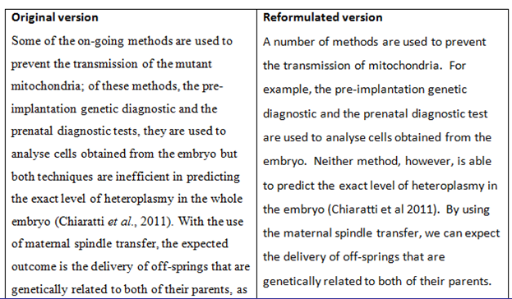
Reformulation (ii)
Adapted from: Ellwood, C.(2011)
Notes:
What did students notice? What they liked about this?

Slide 32
Reformulation (ii)
Adapted from: Ellwood, C.(2011)
Notes:
What did students notice? What they liked about this?

Slide 33
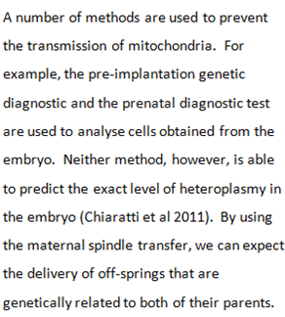

Slide 34
hedging language of caution tentative language
Academic writing might give the impression that it is factual, conveying precise, accurate and objective facts and information. “However, it is now recognised that an important feature of academic writing is the concept of cautious language, often called hedging.“ In other words, it is necessary to make decisions about your stance on a particular subject, or the strength of the claims you are making.”
Adapted from: Cooper, P. (2011): Academic Writing and Czech Universities

Slide 35
Hedge Class | Function
Shields Devices that take responsibility for the claim made away from the author. They function as a tool protecting the author from any criticism. The writer aims at not being on record with regard to the propositions expressed in the text. | Responsibility shifting e.g. …([1], [2], [3],)…, …it is shown in [3]…, Romanowska found…, …we refer reader to [3, 4]…, …see [10]…
 | Speaking facts The writer shields his/her claims through stating “the commonly accepted” view. e.g. Definition 1…, A map is…, …is defined to be…, …space is said to be…
Mitigators The author admits his/her responsibility for the claims made. The writer takes stance while using mitigators, but decides to weaken his/her propositions for various reasons. | Approximation e.g. …some…, …more…, Several, …similar…
 | Possibility e.g. …may…, …can…, …possible…
 | Understatement By using these devices, authors lessen the importance and the validity of their claims. e.g. …notions…, …concept…
 | Admitting incompleteness e.g. …briefly…, however,…

Slide 36
Introductory verbs | e.g. seem, tend, look like, appear to be, think, believe, doubt, be sure, indicate, suggest
Modal verbs | e.g. would, may, might, could
Frequency adverbs | e.g. often, sometimes, usually
Modal adverbs / adjectives | e.g. probably, possibly / probable, possible
Modal nouns | e.g. assumption, possibility, probability
“That” clauses | e.g. It could be the case that…. It might be suggested that…
“To”-clause + adjective | e.g. It may be possible to obtain

Slide 37
In addition, to the best of our knowledge,
there is no facile and practical method for the synthesis of this compound in the literature.

Slide 38
This system prevents attacks on both server and client sides.
According to simulation studies, under some circumstances this system may reduce certain types of attacks on both server and client sides.
It could be concluded that some evidence seems to suggest that this system might, under some circumstances, have the tendency to reduce at least certain types of attacks on both server
and client sides

Slide 39
The fluorescence lifetime measurement of the diol/carbonate pair will be complete in two months.
The fluorescence lifetime measurement of the diol/carbonate pair is expected to be complete in two months.
It is estimated that in the next fifty years the world’s population might again grow 40-50% and if we continuously used the amount of water that we are currently using the water supply may significantly diminish.
In the next fifty years the world’s population will again grow 40-50% and if we continuously use the amount of water that we are currently using the water supply will significantly diminish.
Adapted from: Robinson, M., Stoller,F. (2008): pp.594-596

Slide 40
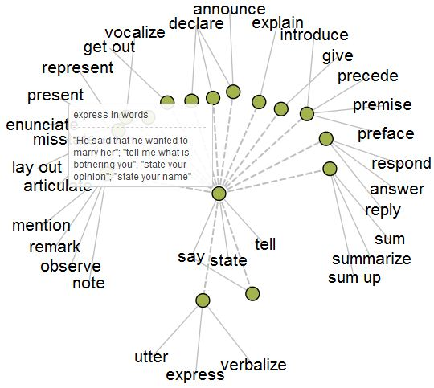
accuracy and precision

Slide 41
It is ….
certain
almost certain
very probable / highly likely probable / likely
possible
unlikely
very / highly unlikely
…that we will experience similar reactions when acids are used.
Adapted from: Štěpánek, L., deHaaff, J.(2011): Academic English, Grada, Praha, p.29

Slide 42
titles
A
B
C
D

Slide 43
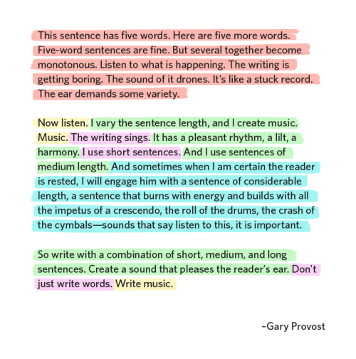
sentences

Slide 44
Since it was, as mentioned, a test, we did not try to achieve the best results, we just wanted to verify the idea of time characteristics.
The(Our) intention was to verify (its) time characteristics
(of…) by means of a (…) test.

Slide 45
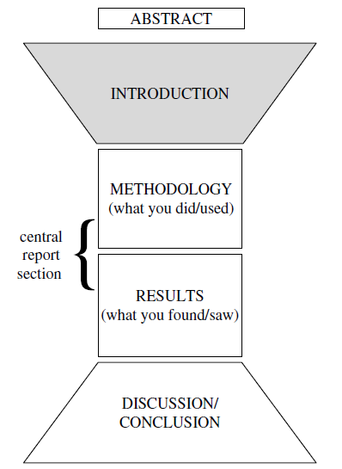

Slide 46
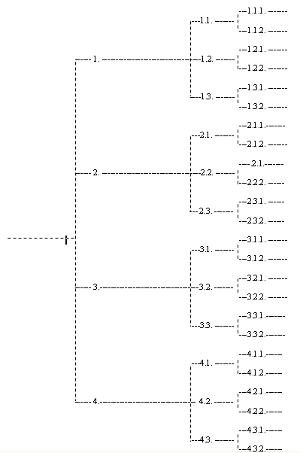

Slide 47
Academic Presentations

Slide 48

Preparation
TIME MANAGEMENT
AUDIENCE ANALYSIS
TOPIC
AIMS and OBJECTIVES
RESEARCH
DATA SELECTION
DRAFTS
AUDIO-VISUAL AIDS
NOTES
REHEARSAL

Slide 49
Indidvidual Parts
TITLE
INTRODUCTION
DELIVERY
Voice
Stance
Facial Expression
Eye contact
Gestures
Body Movement
MAIN BODY
CONCLUSION
QUESTIONS AND ANSWERS

Slide 50
Titles
Attractive
Brief
Clear
Descriptive
(AI for brainstorming)

Slide 51
Introductory Part
GREETING
POSITIVE COMMENTS
NAME + POSITION
TOPIC / TITLE / SUBJECT
PURPOSE
OUTLINE
TIME
AUDIO-VISUAL AIDS
QUESTIONS
goal
time
structure

Slide 52
Main Body Part
STRUCTURE
STYLE
AUDIO-VISUAL AIDS

Slide 53
Main Body Part
CONVERSATIONAL style (but not too familiar)
- SHORT sentences,
- CONCRETE language offering EXMAPLES,
- COHERENT ideas that follow each other NATURALLY while using effective transitions
TRANSITIONS TYPES: e.g. clear sign posting language, pausing, point-by-point, flashback, questions
FREQUENT TRANSITIONS ISSUES: no transitions, too short, one (the same) for the whole talk
AUDIO-VISUAL AIDS:
- less is more
- effective support of you as a speaker
- offer diverse means of communication

Slide 54
Final Part
SIGNAL TO END
SUMMARY
CONCLUSION
CLOSE
INVITATION FOR QUESTIONS

Slide 55
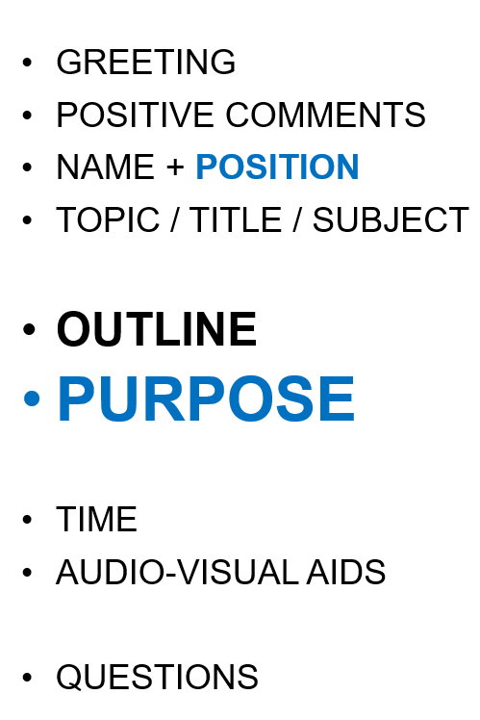
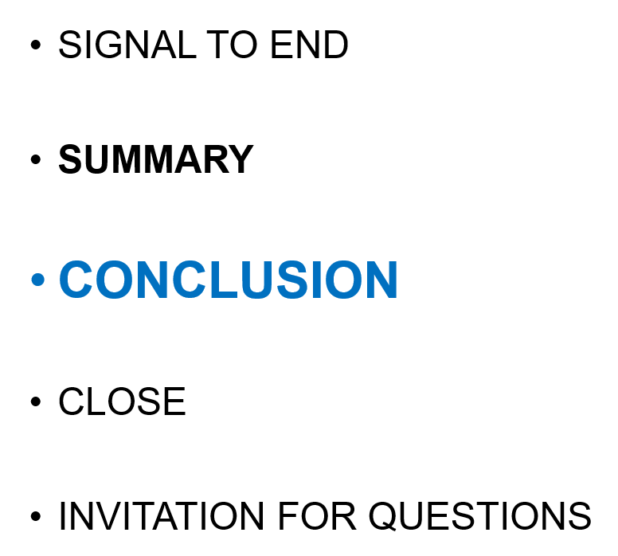
coherence
A
    A1
    A2
    A3
B
    B1
    B2
    B3
C
    C1
    C2
    C3

Slide 56
Questions and Answers Part
invite questions
listen carefully right to the end
welcome the question
repeat, paraphrase, or clarify if necessary
take time to think before answering
answer the question relevantly
check whether the questioner is satisfied
A) disagreement
B) compliment
C) questioning the accuracy of your sources
D) interrupting
E) clarification
F) irrelevant question
G) repetition
H) asking for proof
I) showing off
J) asking strings of questions

Slide 57
Delivery
voice
stance
facial expression
eye contact
gestures
body movement

Slide 58
Delivery
Note: The videos are not examples of applicable/good presentations for our purposes, they only include certain aspects (or content) that can be useful to notice and be aware of.
1) voice focus: https://www.youtube.com/watch?v=YlI-e4QJWG0
- minute: 3´30´´ on... .. a comment on an “ideal” intensity of a credible voice
- minute: 7´28´´ on... Margaret Thatcher example
- minute: 14´40´´ on... projecting a voice to express different emotions
Btw, the video is in Spanish with English subtitles on purpose, diverse research in different cultures/languages come to very similar results on how human beings perceive different uses of voice. In other words, ideas from this presentation can be applicable to your mother tongues as well.
2) rhythm / parallelism / repetition : https://www.ted.com/talks/rives_the_4_a_m_mystery?language=en
This video is a great example of work with rhythm, repetition and parallelism (repetition of grammatical structures or vocabulary). Rythm and repetition work in any language, however, there are specific characteristics in each language, which can change the impact; e.g. parallelism works differently in non-English languages, basically, does not work so well. ☺
It can be interesting to watch the whole talk (9 mins) and focus on the speaker´s work with rythm, repetition and parallel structures, or here are some examples: Please, ignore the content, it is pure enterntainment.
- minute: 0´47´´ - 1´50´´ ... “a time for ...” - parallelism (repetition –ideally 3x - for emphasis)
- minute: 1´50´´ - 5´11´´... notice how the presenter works with the rhythm of the speech (slow, fast, repetitions, rhythmic sequences)
- minute: 7´42´´... “way back ...” - parallelism (repetition –ideally 3x -for emphasis)
3) audio-visual / body language
https://www.ted.com/talks/beau_lotto_amy_o_toole_science_is_for_everyone_kids_included?language=en
minute: 0´10´´ - 3´00´´ - audio-visuals: compare the visuals of the first two minutes with those of the later minutes and think of effectiveness and relevance of the two types; and on the expectations set at the beginning.
minute: 1´30´´ - 2´00´´: body language + voice (the teacher) – compare with: 6´12´´- 7´00´´ (the student), you can even try and watch both bits without sound first, only than with the sound to get a better focus on the body language itself
minute 6´12´´ - 7´11´´ (focus on the body language of the teacher at the back) – compare with 7´58´´ - 9´20´´ (focus on
the body language of the teacher at the back)

Slide 59
Delivery
Note: The videos are not examples of applicable/good presentations for our purposes, they only include certain aspects (or content) that can be useful to notice and be aware of.
4) audio-visuals – when you need to be make sure your audience (general public in this cse) gets the point
You may know Hans Rosling and his lecture shows. Apart from enjoying the learning experience, it may be useful to notice how his use of audio-visuals is effective. What strategies does he use to make sure everybody understands what he shows?
https://www.youtube.com/watch?v=hVimVzgtD6w
https://www.youtube.com/watch?v=2LyzBoHo5EI&t=48s

