Slide 1
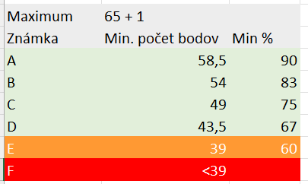

Slide 2
Geoserver
Cvičení 7
Webová kartografie – úvod
Podzim 2024
Filip Leitner

Slide 3
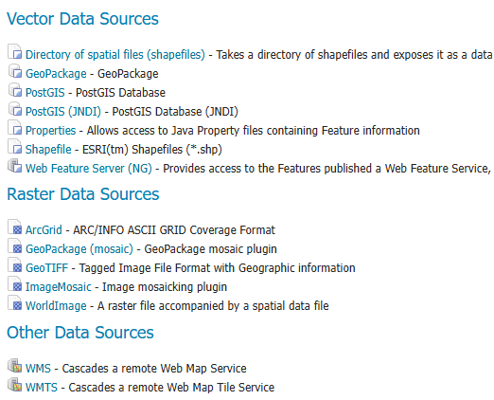

Geoserver
Publikace dat na webu
WMS, WMTS, WFS, …
rastry, vektory
SHP, PostGIS, GeoTIFF, …
Aplikace provozovaná na serveru

Slide 4
Geoserver
Pracovat budeme na:
http://zelda.sci.muni.cz:8080/geoserver/
login: student, heslo: student
Anonymný režim

Slide 5
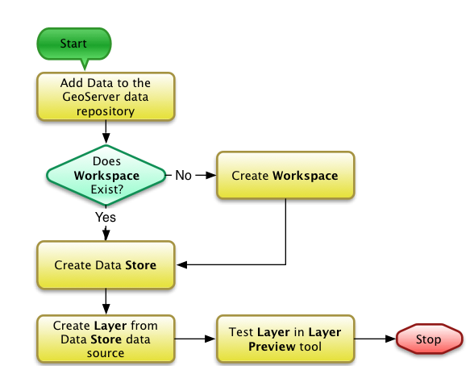
Geoserver
“Štruktúra“
Workspace
Store
Layer
http://kkb-classes.s3.amazonaws.com/2013/GEOGx85/web/2013-Spring-InternetMapping-011_slides.html#17

Slide 6
Další možnosti
MapServer Mapnik, TileStache
OpenMapTiles – vektorové dlaždice

Slide 7
SLD
Styled layer descriptor Založeno na XML Standard OGC
https://docs.geoserver.org/latest/en/user/ styling/index.html#styling
SLD Cookbook

Slide 8
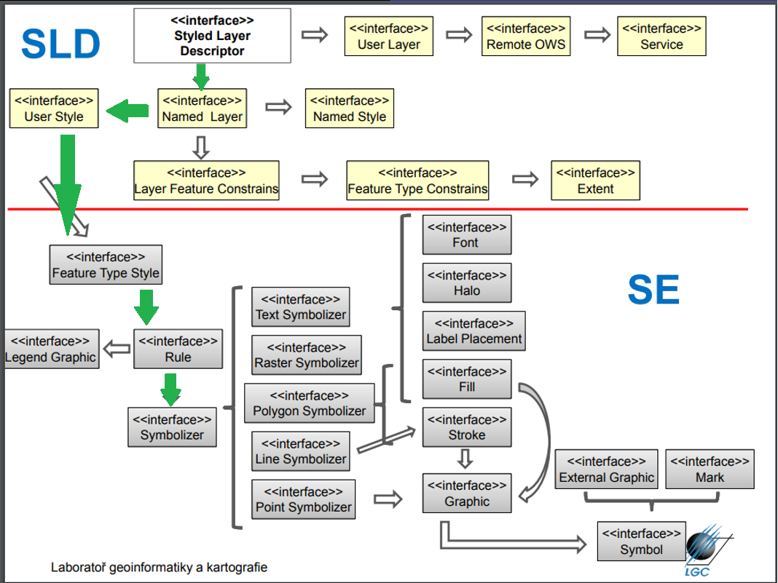

SLD
existujúci štýl
GeoServer supports the use of a StyledLayerDescriptor document containing a single <NamedLayer> element, which contains a single <UserStyle> element to specify the styling.

Slide 9
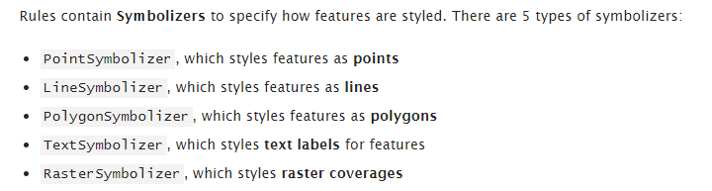
SLD symbolizers
Ako na to? Dokumentácia. Napr. https://docs.geoserver.org/latest/en/user/styling/sld/reference/linesymbolizer.html#syntax

Slide 10
Struktura SLD
<StyledLayerDescriptor>
<NamedLayer>
<UserStyle>
<FeatureTypeStyle>
<Rule>
<PointSymbolizer>
<LineSymbolizer>
<PolygonSymbolizer>
<TextSymbolizer>
…
</StyledLayerDescriptor>

Slide 11
CSS
CSS už znáte!
V Geoserveru dostupné jako rozšíření CSS → SLD
https://docs.geoserver.org/latest/en/user/ styling/css/tutorial.html

Slide 12
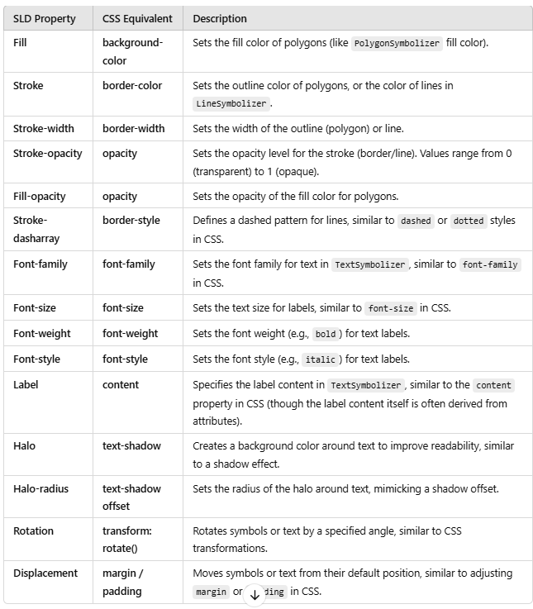

Slide 13
Body
<?xml version="1.0" encoding="ISO-8859-1"?>
<StyledLayerDescriptor version="1.0.0" xsi:schemaLocation="http://www.opengis.net/sld StyledLayerDescriptor.xsd" xmlns="http://www.opengis.net/sld"
xmlns:ogc="http://www.opengis.net/ogc"
xmlns:xlink="http://www.w3.org/1999/xlink" xmlns:xsi="http://www.w3.org/2001/XMLSchema-instance">
<NamedLayer>
<Name>Simple Point</Name>
<UserStyle>
<Title>SLD Cook Book: Simple Point</Title>
<FeatureTypeStyle>
<Rule>
<PointSymbolizer>
<Graphic>
<Mark>
<WellKnownName>circle</WellKnownName>
<Fill>
<CssParameter name="fill">#FF0000</CssParameter>
</Fill>
</Mark>
<Size>6</Size>
</Graphic>
</PointSymbolizer>
</Rule>
. . . . . . . . . . . . . . . .
. . . . . . . . . . . . . . . . .

Slide 14
Body
* {
mark: symbol('circle');
mark-size: 6;
}
:mark {
fill: #FF0000;
}

Slide 15
Linie
<?xml version="1.0" encoding="ISO-8859-1"?>
<StyledLayerDescriptor version="1.0.0" xsi:schemaLocation="http://www.opengis.net/sld StyledLayerDescriptor.xsd" xmlns="http://www.opengis.net/sld"
xmlns:ogc="http://www.opengis.net/ogc"
xmlns:xlink="http://www.w3.org/1999/xlink" xmlns:xsi="http://www.w3.org/2001/XMLSchema-instance">
<NamedLayer>
<Name>Simple Line</Name>
<UserStyle>
<Title>SLD Cook Book: Simple Line</Title>
<FeatureTypeStyle>
<Rule>
<LineSymbolizer>
<Stroke>
<CssParameter name="stroke">#000000</CssParameter>
<CssParameter name="stroke-width">3</CssParameter>
</Stroke>
</LineSymbolizer>
</Rule>
</FeatureTypeStyle>
</UserStyle>
</NamedLayer>
. . . . . . . . . . . . . . . .
. . . . . . . . . . . . . . . . .
</StyledLayerDescriptor>

Slide 16
Linie
* {
stroke: #000000;
stroke-width: 3;
}

Slide 17
Polygony
<?xml version="1.0" encoding="ISO-8859-1"?>
<StyledLayerDescriptor version="1.0.0" xsi:schemaLocation="http://www.opengis.net/sld StyledLayerDescriptor.xsd" xmlns="http://www.opengis.net/sld"
xmlns:ogc="http://www.opengis.net/ogc"
xmlns:xlink="http://www.w3.org/1999/xlink" xmlns:xsi="http://www.w3.org/2001/XMLSchema-instance">
<NamedLayer>
<Name>Simple polygon</Name>
<UserStyle>
<Title>SLD Cook Book: Simple polygon</Title>
<FeatureTypeStyle>
<Rule>
<PolygonSymbolizer>
<Fill>
<CssParameter name="fill">#000080</CssParameter>
</Fill>
</PolygonSymbolizer>
</Rule>
</FeatureTypeStyle>
</UserStyle>
</NamedLayer>
</StyledLayerDescriptor>
. . . . . . . . . . . . . . . .
. . . . . . . . . . . . . . . . .

Slide 18
Polygony
* {
fill: #000080;
}

Slide 19
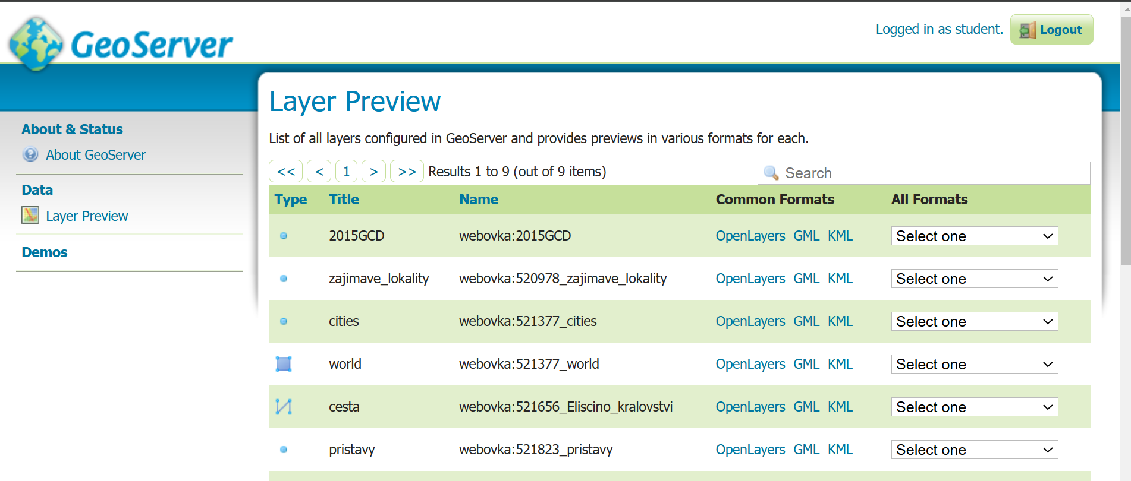
AKO NA LAYER PREVIEW

Slide 20
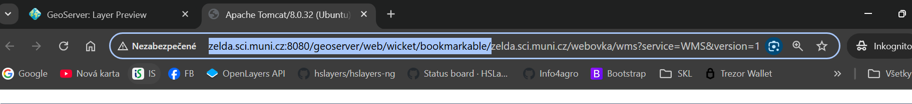
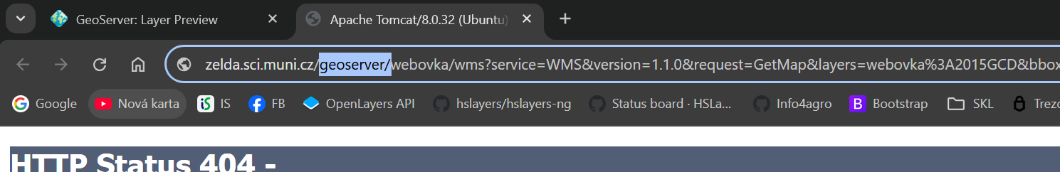
AKO NA LAYER PREVIEW
Vymazať začiatok vygenerovanej url až po „zelda“
Doplniť geoserver/

Slide 21
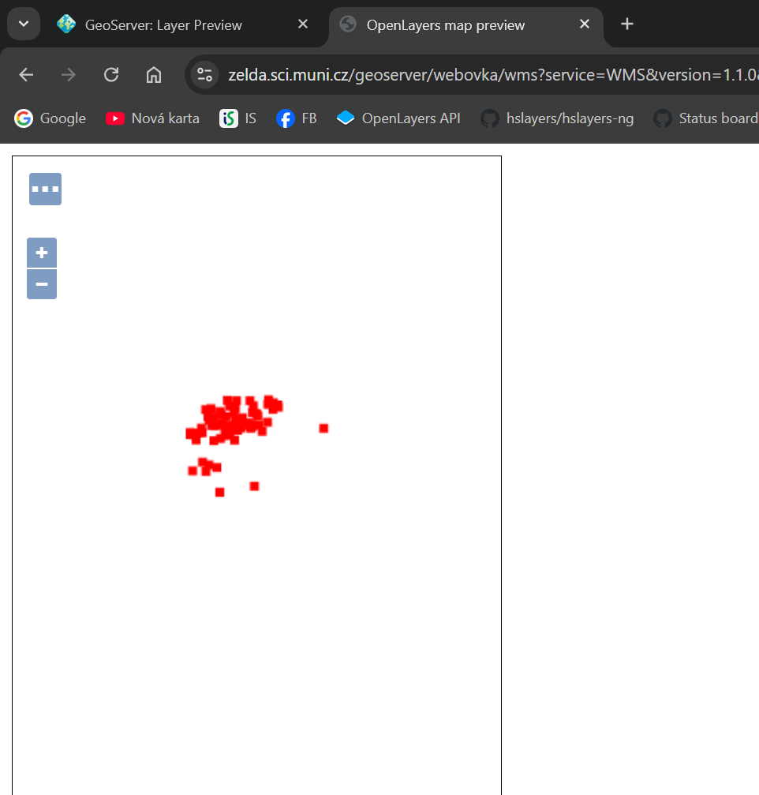

Slide 22
Jak dál?
Dokumentace Geoserver SLD Cookbook https://medium.com/
https://bost.ocks.org/mike/

Slide 23
Procvičování
Publikujte vrstvu ciest Nigérie (zložka 451242-Leitner_Filip/ )
  Nastavte východzí štýl WMS služby, ktorý bude pozostávať z
    Šírka línie = 5px
    Farba línie = #4934eb
    Typ línie = čiarkovaná (dash)
    Vzor čiarkovania 5px čiara, 2px medzera

Slide 24
Ptejte se
kdykoliv kdekoliv jakkoliv
co nejdřív …

