Slide 1
Theory and practice in human geography – introduction to the course
Pavel Doboš

Slide 2
What is going to happen in the course?
The course explores some of the ways in which geography has been positioned in relation to its various foundations: history; philosophy; science; and culture. During geography’s engagement with these diverse knowledge positions, it has become common to speak of geographical knowledges as “situated knowledges”: always partial, always provisional. We will explore how this change has come about, examine its implications, and see how it helps us to understand geography’s involvements in the shaping of today’s world. This course is going to make a series of “visits” to intellectual sites where human geographers have done some of their most characteristic work.

Slide 3
What is going to happen in the course?
In other words, we will examine some of the key concepts in contemporary geographical inquiry: ideas like “landscape”, “space”, “place”, “time”, “society”, “nature”, “culture”, “representation”, “relations”, “difference”, or “affect”. We will try to understand how they have developed and changed and how they are connected to ideas in other fields. We will explore how they have shaped various paradigmatic and epistemological positions in geographical thought. We will also consider their implications for the ways in which we represent other people and other places: in writing, in visual images and maps, and in numbers and statistics. None of these constructions is innocent. Our concepts are usually freighted with power.

Slide 4
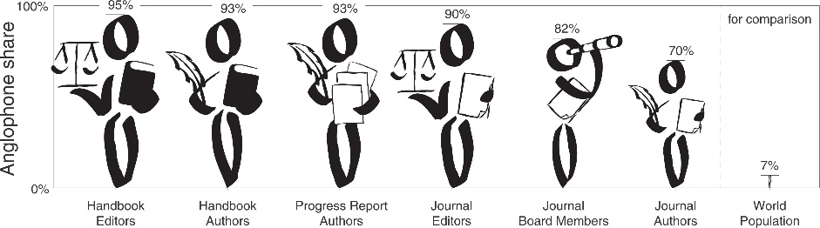
2. lecture (10th October)
Geographical traditions and their spatio-temporal origin
Anglofone (hegemonic) geography
Non-anglofone geographies
Post-socialist geographies
Post-colonial geographies

Slide 5
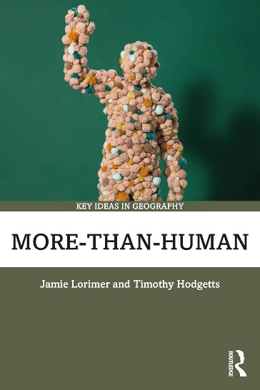
3. lecture (17th October)
From positivist to post-positivist approaches
Quantitative revolution and after
Birth of critical and humanistic geographies
Qualitative methods are coming to the forefront
Unifying geography again?
  More-than-human geographies

Slide 6
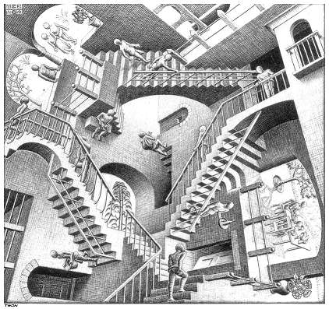
4. lecture (24th October)
Geography and modernism: from modern to post-modern thought
What is modernity and postmodernity?
Critical geographies of postmodernity
Postmodern geographies
Epistemological elevation of multiparadigmatism

Slide 7
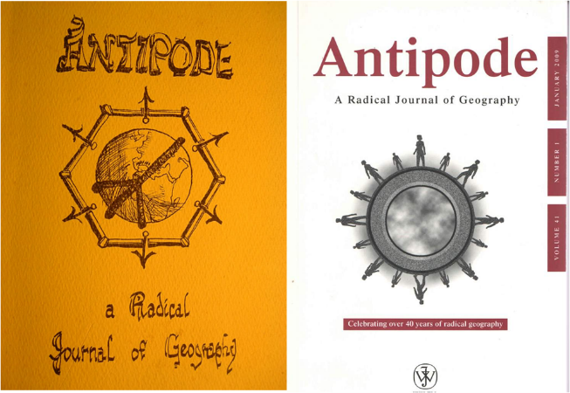
5. lecture (31st October)
Radical geographies and the criticism of global political economy
Critiques of global capitalism
  Unequal exchange
  Unequal divisons of labour
  Unequal distribution of profit and surplus value
Marxist geography, welfare geography, anarchist geography, …

Slide 8
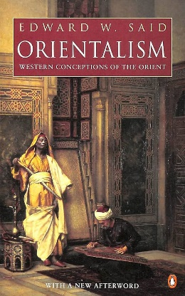
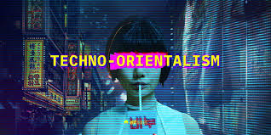
6. lecture (7th November)
Eurocentrism and Orientalism: postcolonial critiques and imaginative geographies
Postcolonial turn in (anglofone) geography
  The influence of postcolonial thinkers
What is postcolonial, decolonial, counter-colonial?
The problem of the dissemination of Orientalist imaginative geographies

Slide 9

7. lecture (14th November)
Landscape geography and the problem of representation
Problematizing the question of what landscape actually is
Landscape as perfomed
Critiques of ocularcentric representations in landscape studies

Slide 10
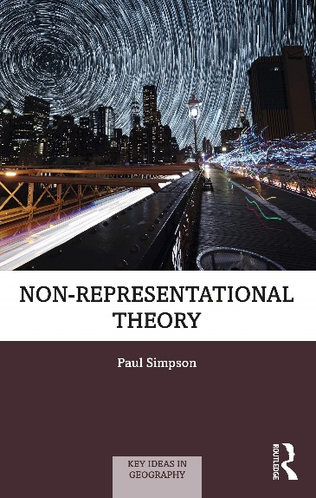
8. lecture (21st November)
Politics of performance and affect: the imperative of being non-representational
From representational to non-representational geographies
  From „dead“ to „living“ geographies
The concept of affect
Geographies as performing and affecting a life

Slide 11
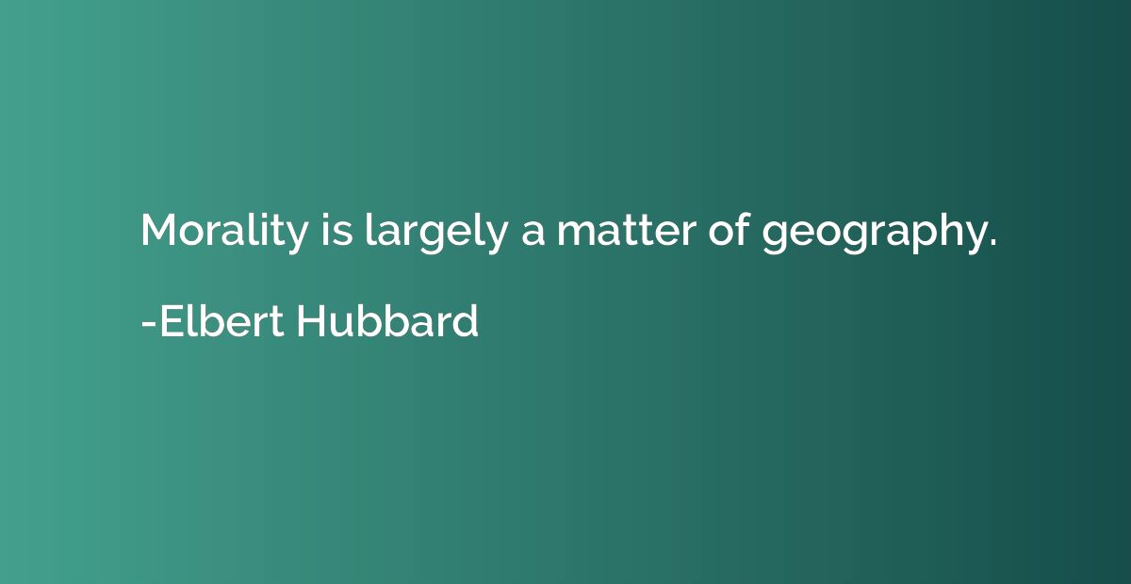
9. lecture (28th November)
Geography, morality, ethics
Moral and activist geographies
Descriptive and normative ethics
Commitments to humans, as well as non-human beings, and nature?
Spatial ideas of empathy, justice, emancipation, alleviation of suffering, …

Slide 12
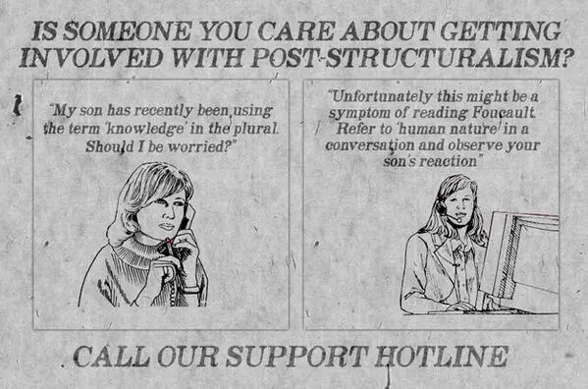
10. lecture (5th December)
Spatial opportunities that poststructuralism makes possible
Spatialities in writings of poststructuralist thinkers
Deconstruction, schizoanalysis, différends
The critique of pointillism
Space as a verb, rather than a noun -> spacing

Slide 13

11. lecture (12th December)
Geographies of virtual space, big data, and the problem of internet communication
Spatialities of internet platforms
Exclusions inside digital spaces
Affects of software
Ontegenesis of space via algorithms

Slide 14
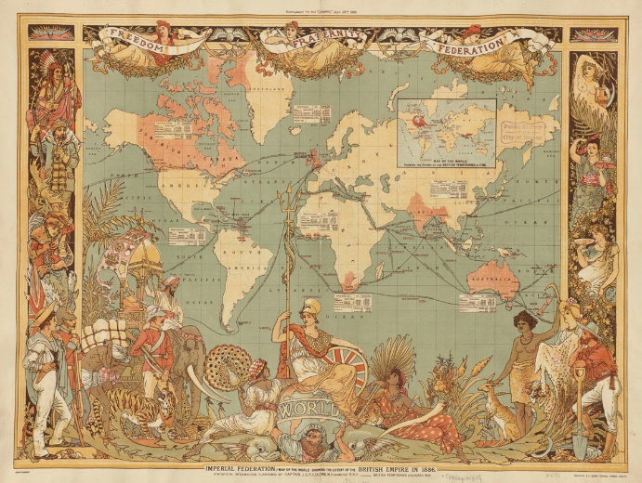
12. lecture (19th December)
Critical cartographies and the cartographic reason
The discursive critique of maps as ideological tools
The critique of cartographic reason
New maps as counter-hegemonic tools in critical and activist mappings
Post-representational cartography

