Slide 1
From positivist to post-positivist approaches Pavel Doboš

Slide 2
Before positivist geography
At first there was descriptive regional geography
prior to the 1950s, geography focused on detailed descriptions of specific regions.
geographers aimed to catalog the physical and human characteristics of different areas, emphasizing uniqueness and particularity
holistic approach, integrating physical geography (landforms, climate) with human geography (culture, economy)
atheoretical and primarily qualitative, relying on subjective interpretations and personal observations
Then Schaefer vs Hartshorne “debate“ came

Slide 3
Birth of positivist geography
Scientific revolution
advances in the natural sciences which emphasized empirical observation, measurement, and the scientific method
Critique of descriptive methods and adoption of quantitative methods
so-called “quantitative revolution“ in geography
Philosophy of empiricism and positivism
focus on observable, measurable phenomena
Technological advancements
enabled to handle large datasets, perform complex analyses, and create sophisticated spatial models

Slide 4
Characteristics of positivist geography
Searching for universal laws in spatial science
analyses of spatial patterns, relationships, and processes that govern the distribution of phenomena across space
Integration with other disciplines
statistics, economics, engineering, physics (gravity model)
Utilization of remote sensing to get data
Location theories
Examination of the optimal locations for economic activities and settlements
Foundation for modern geography

Slide 5
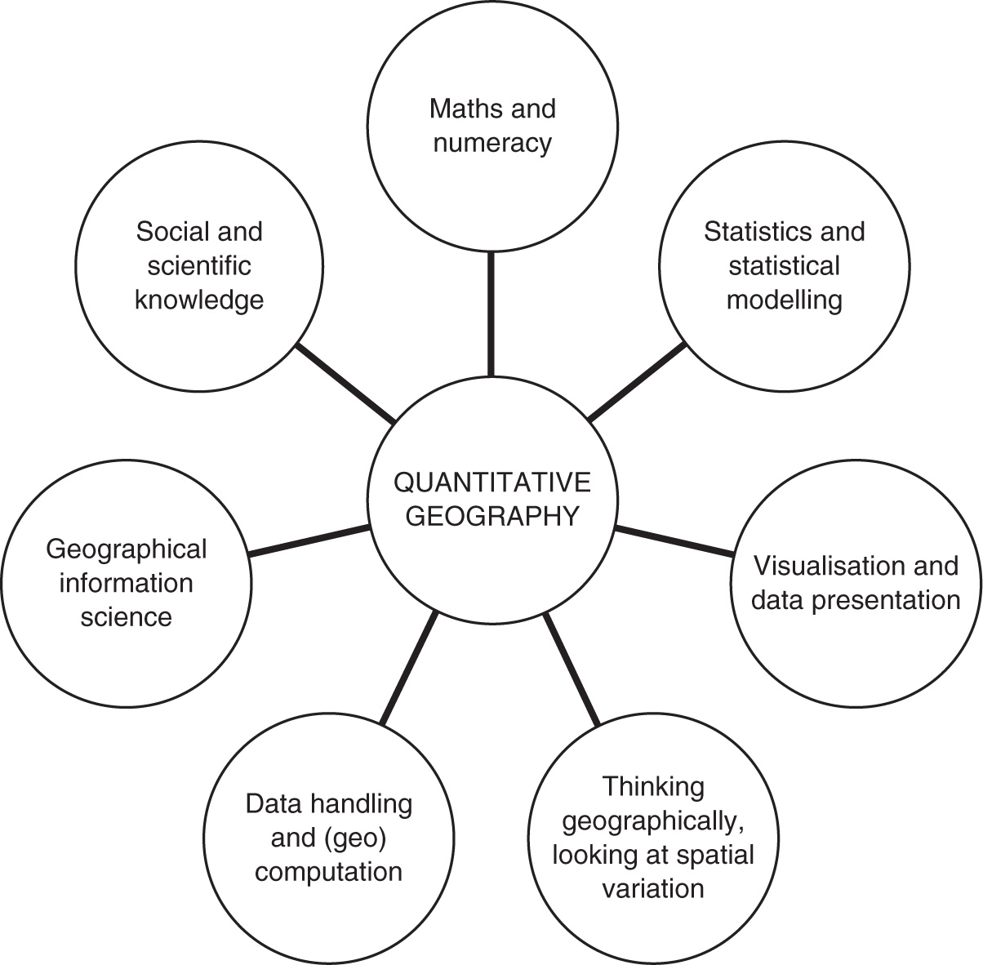

Slide 7
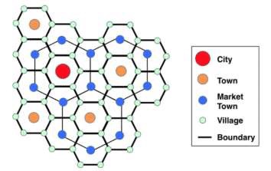
Example of an important gravity model theory: Walter Christaller‘s Central Place Theory
Central Place: A settlement that provides goods and services to its hinterland (the surrounding area).
Hinterland: The market area or service area surrounding a central place.
Threshold: The minimum population size needed to support a service or business.
Range: The maximum distance people are willing to travel to access a service.

Slide 8
Central Place Theory in geography
Assumptions of the Theory: isotropic plain, equal accessibility, rational economic behavior, even population distribution
Applications: urban planning, regional science and regional development
Limitations: simplistic assumptions, problems with advances in transportation and communication, dynamic nature of settlements

Slide 9
CPT in practice

Slide 10
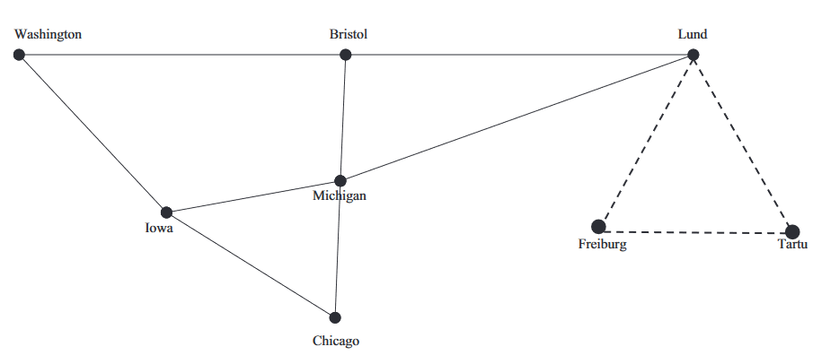
Diffusion of CPT in the 1950s and 1960s
From Germany to Estonia and Sweden
Edgar Kant, Torsten Hägerstand
Then to the Anglophone geography
Peter Haggett in UK, William Garrison and “space cadets“ in USA

Slide 11
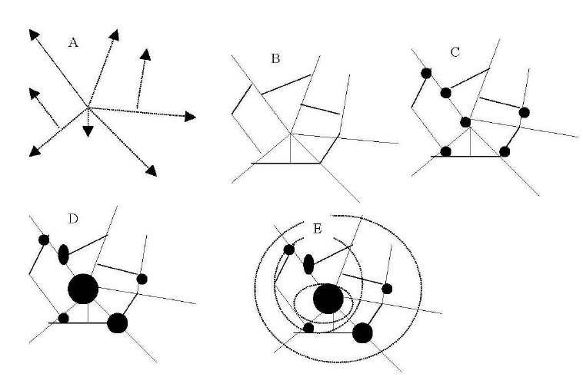
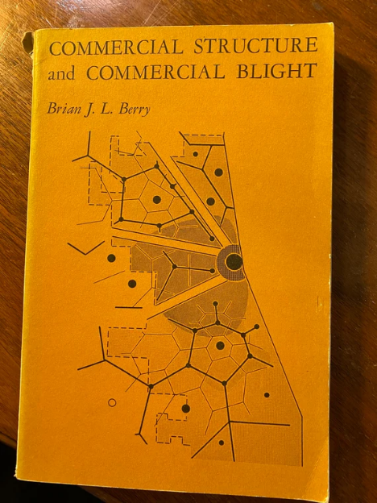
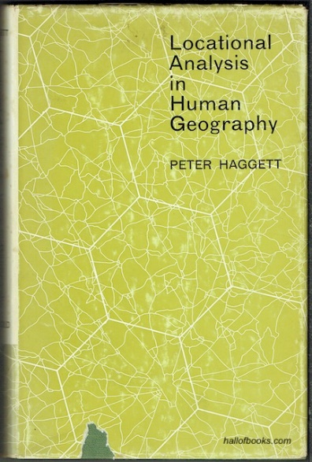
Fascination with the geometry on the face of the Earth

Slide 12
Critiques of positivist geography
Reduction and oversimplification
complex social and environmental phenomena reduced to simplistic quantitative models
Loss of context
broader social, historical, and cultural contexts neglected
No humans, or just as numbers in space
ignoring the subjective experiences, perceptions, and meanings that individuals and communities attach to places
Emphasis on universal laws and patterns
ignoring cultural differences and local specificities
Assumptions of objectivity and neutrality
Neglect of the perspective of researchers and how their own context influenced them

Slide 13
More critiques
Power dynamics overlooked
ignoring how power relations and social inequalities influence geographic phenomena (and the production of knowledge)
Inadequate for certain phenomena
Some phenomena are not easily quantifiable (justice, identity, cultural practices, …)
Rigid and inflexible
Statistics and geometrical models needed everywhere
Ethical problems
Pure technical and scientific rigor can lead to ethical oversights, such as the impacts of research on communities and the environment
Often non-relevance to pressing social Issues
detached from politics, failing to address problems such as poverty, inequality, or environmental degradation

Slide 14
The humanisation of geography
Focus on human experience and subjectivity is (also) needed
Inspirations in philosophies of humanism, existentialism, and phenomenology
Not how geographical objects and issues are (objectively), but how they are perceived by humans (subjectively)
Emphasis on the concept of place
The concept was downgraded by positivist geography
Sense of place very important
Even space no longer just abstract and geometrical, but experiental
sensory, emotional, and cognitive dimensions of spatial experience

Slide 15
Humanistic geography
Embracement of qualitative methods (again)
but not an atheoretical description of regions
interviews, ethnography, personal biography narratives
detailed case studies to explore specific places and the meanings they hold for people
Integration of insights from the humanities
Aesthetic and ethical considerations
the aesthetic appreciation of landscapes and places, as well as the ethical implications of human-environment interactions
Critique of technological determinism
overemphasis on technological solutions could lead to alienation from the natural and built environments

Slide 16
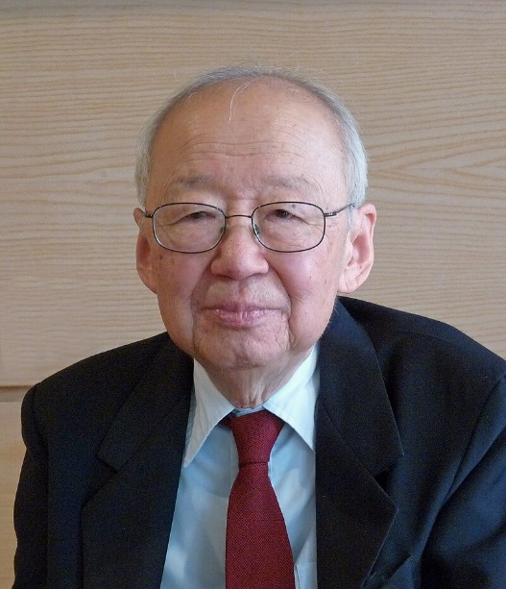
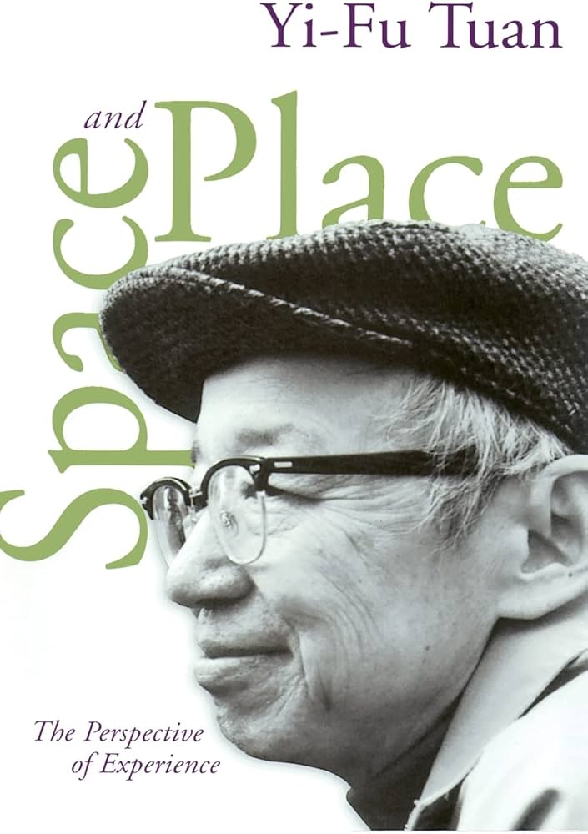
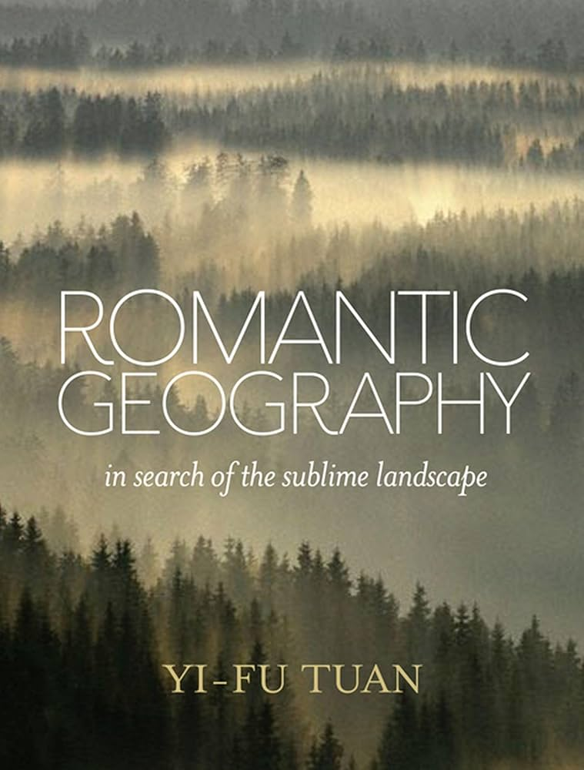
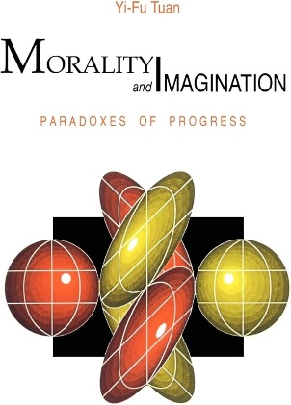
Key person: Yi-Fu Tuan
5th December 1930 (Tianjin, China) – 10th August 2022 (Madison, Wisconsin, USA)

Slide 17
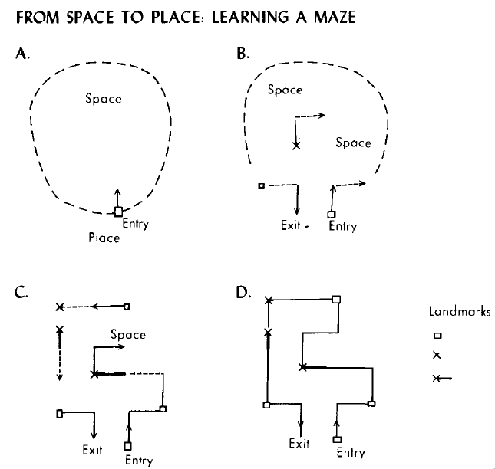
Places from and for people
How are meaningful places created out of vast space?

Slide 18
Geography and modernism: from modern to post-modern thought Pavel Doboš

Slide 19
What is modernism?
Cultural, intellectual, and artistic movement that emerged in the late 19th and early 20th centuries
belief in objective truths and universal principles
focus on linear progress and development
emphasis on order and structure
creates grand narratives about humanity
eurocentric

Slide 20
Modernism and positivist geography – interconnected issues
Emphasis on scientific rationality, objective knowledge, universal principles, and general laws
Systematic and structured approach
Technological optimism
Adoration of perfect geometric structures
Rational spatial (urban or regional) planning

Slide 21
Modernism, geography, and time
One universal linear timeline of progress
Evolutionary thinking toward greater complexity and improvement
evolution of spatial patterns and models, spatial diffusion, or regional development seek to predict future trends based on past and present data
Spatial patterns of societies evolve in a predictable manner from primitive to advanced
from underdeveloped to developed

Slide 22
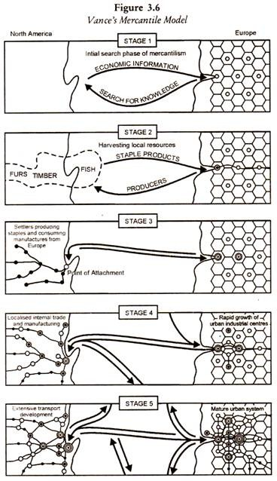

Slide 23
Modernist urban planning
The application of rationality, functionality, and spatial order to create efficient, healthy, and aesthetically pleasing environments
cities for a good future
to have a good city means to have a good geometry based on spatial data
functional zoning, i.e. separation of urban areas into distinct zones for residential, commercial, industrial, and recreational use
use of standardized designs and building practices to ensure consistency and efficiency
adoption of high-rise residential and office buildings to maximize space utilization

Slide 24
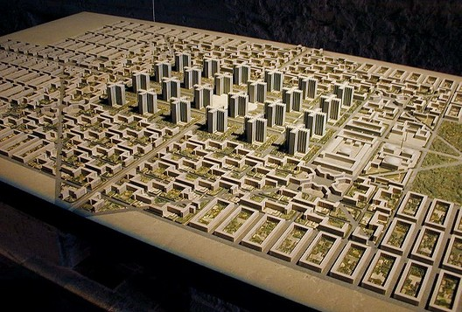
Le Corbusier: Radiant City (Ville Radieuse)

Slide 25
Oscar Niemeyer: Ideal futuristic city

Slide 26
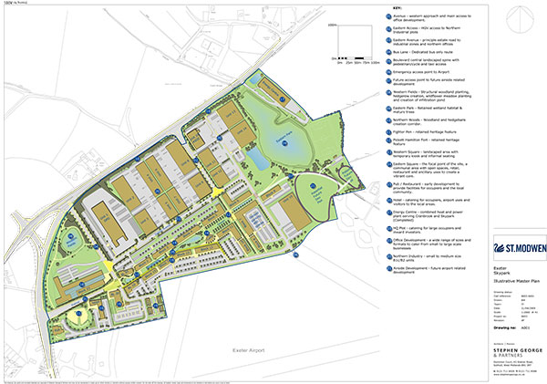
Peter Hall: Enterprise zone concept

Slide 27
Capitalist development as modernist: Modernization theory
Development theory that emerged in the mid-20th century, explaining how societies progress from traditional to modern states through a series of stages
emphasis on industrialization, technological advancement, and economic growth as indicators of modernization
inherent principles of capitalist political economy
shift from traditional values and social structures to more secular, rational, and bureaucratic systems
belief in „trickle-down effect“
optimism in human progress

Slide 28
Rostow’s Stages of Economic Growth

Slide 29
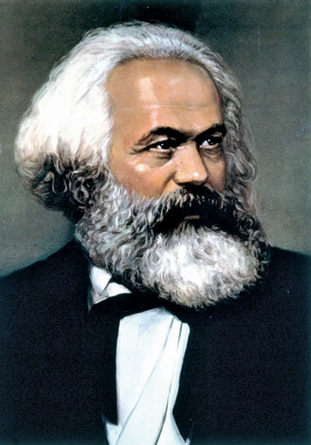
Marxism as modernist
Historical materialism
the idea that material conditions and economic factors shape society and history
The conflict between the bourgeoisie (capitalist class) and the proletariat (working class) as the driving force of historical change.
Revolutionary change needed to achieve a classless society.
View of history as a dialectical process leading to human emancipation

Slide 30
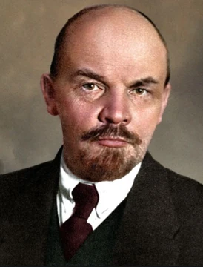
Geography in socialist countries
Centralization of government
Communist parties direct socio-spatial development to reach the final stage
Scientific Marxism and historico-materialist determinism
Analysis of spatial structures and patterns should lead to better spatial distribution
focus on prognoses that lead to the optimization of spatial structures of economy and society
regionalization of industrial complexes
movement of people to regions where work is needed

Slide 31
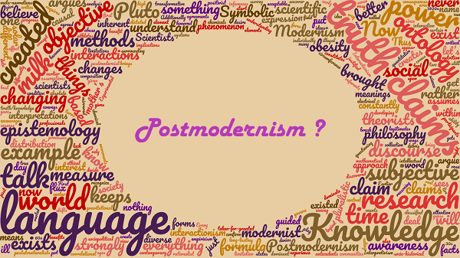

Slide 32
What is postmodernism?
Broad intellectual, cultural, and artistic movement that emerged in the mid-to-late 20th century as a reaction against modernism
Skepticism towards grand narratives that claim to explain all aspects of society, history, or human experience
The idea that truth is discursively constructed rather than absolute or universal (different perspectives can be equally valid)

Slide 33
Postmodernism and its risks
Embracement of relativism
celebration of diversity, multiplicity, and fragmentation in cultural expressions, identities, and viewpoints
focus on local, particular, and individual experiences
questioning established norms, conventions, and meanings
risk of moral and epistemological nihilism, i.e. approaching all beliefs and perspectives as equally valid can undermine efforts to establish objective truths or universal ethical standards
Focus on how language, symbols, and narratives shape social reality and power dynamics
risk of the neglect of material conditions, i.e. forgetting that people are (also) bodies inside the material world

Slide 34
Postmodernism and geography
No grand theories, the plurality of paradigms is needed
Uncertainty and false objectivity of representation
geographical representations (maps, texts, images) are linked to power relations and influence our understanding of space and place
they can reinforce dominant power relations and ideologies
Distrust towards perfect and precise geometries
Liveliness of the lived world cannot be deduced from geometrical patterns
No single universal timeline of progress
future changes are not easily predictable from synchronic analyses of spatial patterns and structures
plurality of temporalities

Slide 35
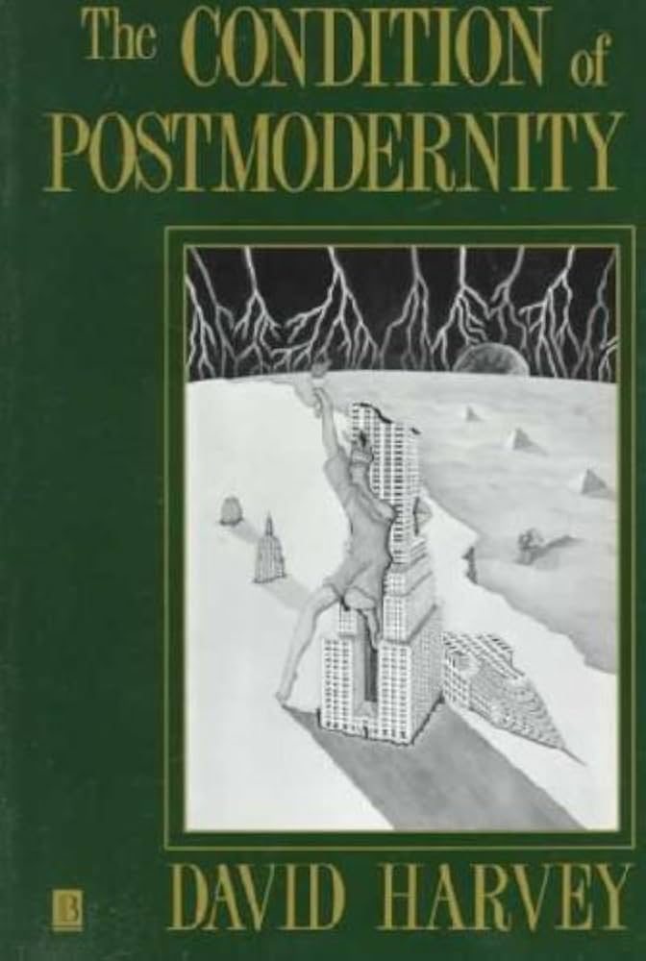
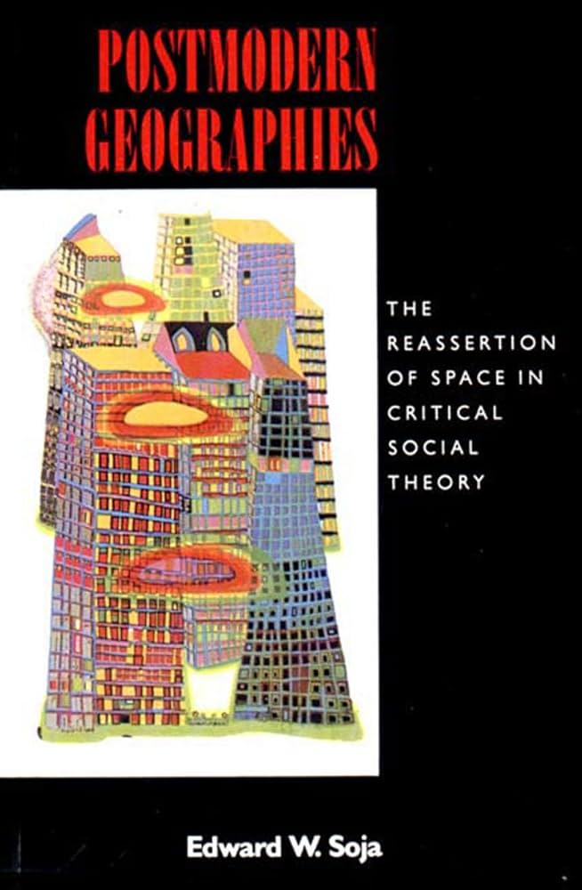
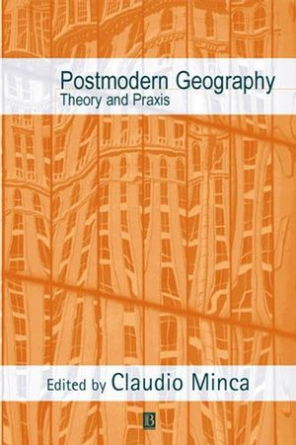
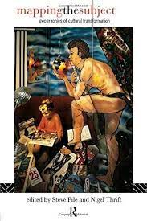
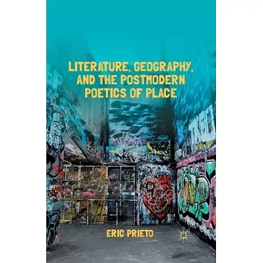

Slide 36
Space reconsidered
Not merely a physical container but produced and shaped by social relations and power dynamics
Not just a backstage for events, histories, becomings, or social processes
space itself recreates and reforms them in diverse ways
People interact with and create space through their daily practices
emphasizing the role of agency and local knowledge in shaping spatial realities

Slide 37
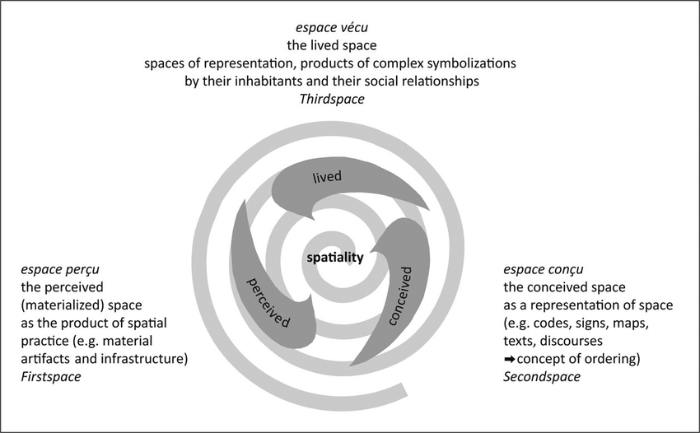

Slide 38
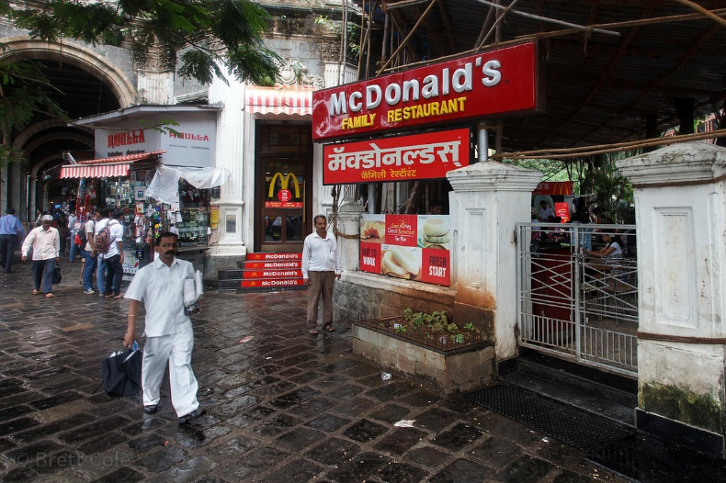
Place reconsidered
Places are socially constructed and imbued with multiple meanings
different groups may experience and interpret the same place in varying ways, depending on their cultural, social, and historical contexts
No fixity or stability inside places
they are seen as dynamic and constantly changing, influenced by social processes, cultural practices, and global flows

Slide 39
Spatial boundaries reconsidered
Hybrid, fluid, and dynamic spatialities challenge fixed and bounded notions of spatial identities, places, territories, or regions
focus on effects of globalization or transnationalism
focus on intersections of various identities (race, gender, sexuality, class, …) and how these influence people’s spatial experiences

