Slide 1
Radical geographies and the criticism of global political economy
Pavel Doboš

Slide 2
What is radical geography?
It challenges non-critical geographical approaches, mainly spatial-analytical science
  underlying social and economic inequalities must be addressed
  power dynamics and socioeconomic structures shape spatial arrangements
  inherently political and aligns itself with social justice movements
The ultimate goal is not just to explain or understand the world but to change it
  transformative spatial practices can lead to more equitable and sustainable spatial arrangements

Slide 3
Focus of radical geographers
Issues such as inequality, oppression, and environmental degradation through a geographical lens
  research on housing inequality, gentrification, environmental racism, access to resources, access to services, …
Concepts such as class struggle, exploitation, and the uneven development of different regions
The pursuit of social justice, seeking to understand and mitigate the spatial manifestations of injustice

Slide 4
Beginnigs: the context of 1970s
Civil rights movements and anti-war protests
Urban unrest
  often linked to racial and economic injustices
Crisis of Fordism
  mass industrial production and consumption model falters and gives rise to mass unemployment
Neoliberal policies start to expand
  deregulation, privatization, and austerity
  huge impact on lower classes and poor people
Environmental concerns
  pollution, resource depletion, and ecological degradation

Slide 5
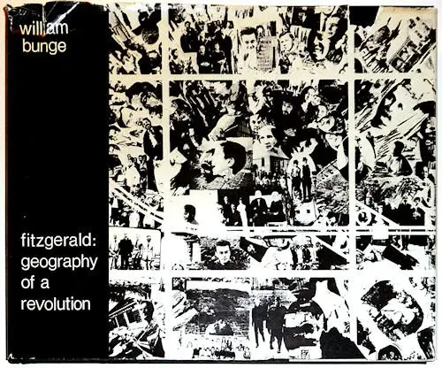
First radical attempt
Detroit Geographical Expedition by William Bunge in 1968
  rooted in the analysis of spatial patterns and participant observation
The goal was to discover inequalities and injustices in poor neighborhoods and then to find ways how to confront them in cooperation with the locals
  this involved policy lobbying, direct support to poor households, and analysis of urban problems

Slide 6
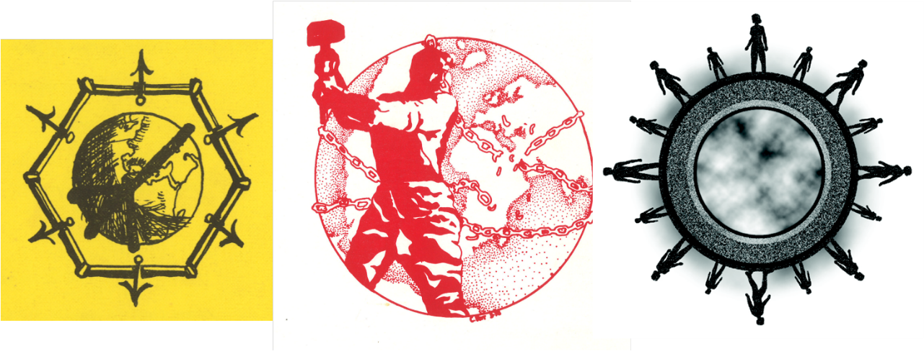
Institutionalization of RG
Clark University in 1969
  Antipode: A Radical Journal of Geography
  Union of Socialist Geographers
  James Blaut, Richard Peet
  at first a lot of different perspectives: anti-colonial, socialist, anti-racist, anarchist („re-discovery“ of geographical anarchist roots: Elisée Reclus, Peter Kropotkin)

Slide 7
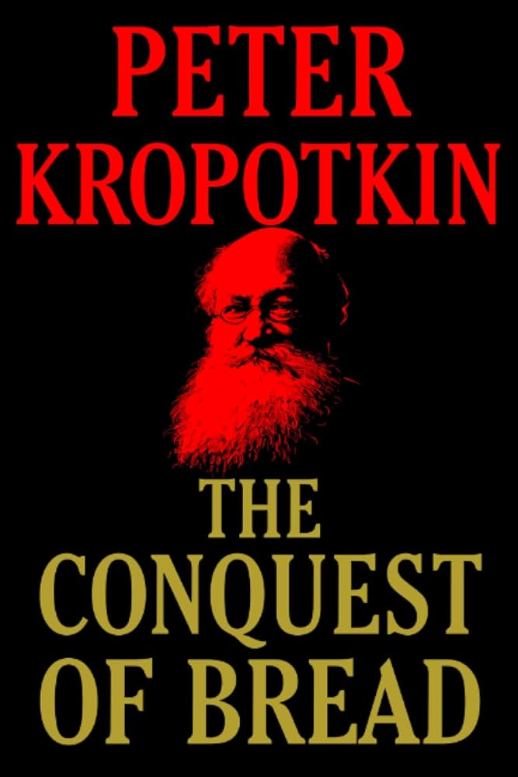
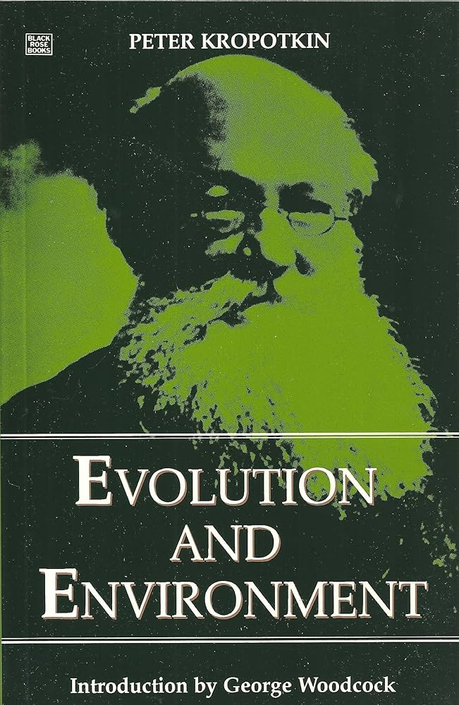
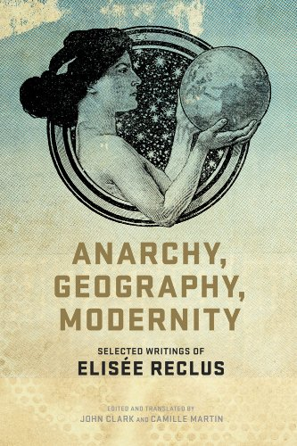


Early radical geographers

Slide 8
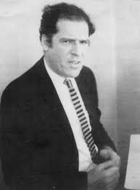
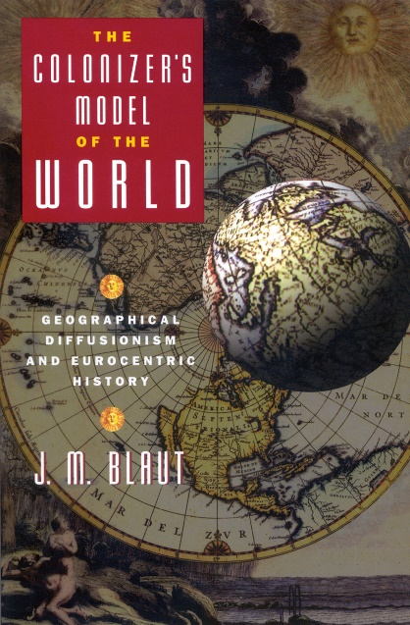
James M. Blaut (1927-2000)
Activist, radical, anti-colonial, anti-Eurocentric
Economic, political, cultural, historical geographer
  research on agricultural micro-geography (geographical activity of villagers), cultural ecology, theory of nationalism
Rejection of the "European Miracle"
Criticism of Eurocentric history and geographical diffusionism
  The National Question: Decolonising the Theory of Nationalism (1987)
  The Colonizer’s Model of the World (1993)
  Eight Eurocentric Historians (2000)

Slide 9
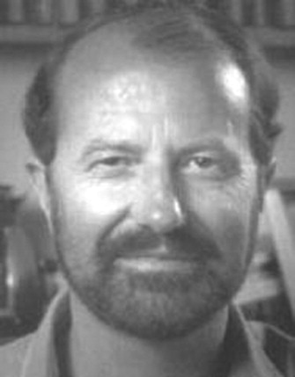
Richard Peet (1940 - ?)
Radical and Marxist, social justice advocate
Social and economic geographer
  research on the geography of power, political ecology, liberation ecology, development geography, critical policy studies
Critique of the inequities produced by capitalist development, highlighting how wealth and power are unevenly distributed across different regions
  capitalist exploitation leads to environmental degradation and disproportionately affects marginalized communities
  mainstream development theories and institutions perpetuate global inequalities

Slide 10
Domination of Marxist geography
Grounded in Marxist theory
  focus on concepts such as historical materialism, class struggle, dialectics of socioeconomic formations and spatial structures
Capitalism produces and transforms space, creating landscapes that reflect and reinforce social inequalities
  conflicts between different social classes influence the organization of space
  critique of the capitalist exploitation of natural resources
  studies of urbanization because cities are sites of capital accumulation and class struggle

Slide 11
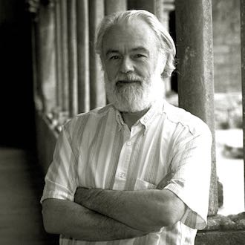

David Harvey (1935 - ?)
Social, economic and urban geographer
  research on cities and socio-economic inequalities, geographical reworking of historical materialism into historical-geographical materialism
Social Justice and the City (1973)
  inequalities are spatially manifested in cities: segregation, inadequate housing, uneven access to services
  criticism of the role of urban planning and policy in maintaining inequalities
  spatial justice: social justice cannot be achieved without considering the spatial organization of society
  capitalism exploits urban spaces for profit, leading to gentrification, displacement, and other forms of spatial injustice

Slide 12

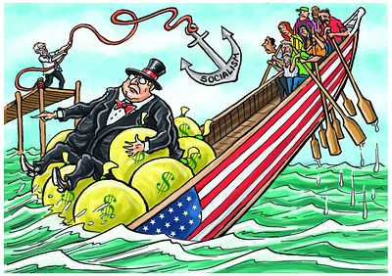
The Limits to Capital (1982)
  the tendency of capitalism is to produce crises of overaccumulation, where surplus capital cannot find profitable investment opportunities, leading to economic crises and forcing capital to seek new spaces for accumulation
  concept of the „spatial fix“: capital resolves crises by expanding into new geographical areas or restructuring existing spaces; it temporarily alleviates overaccumulation but often leads to new forms of spatial inequality and conflict
  financial markets and instruments become central to the accumulation process, leading to speculative bubbles and financial crises
  uneven geographical development is an inherent feature of capitalism, driven by the search for profit
  critique of neoliberalism

Slide 13
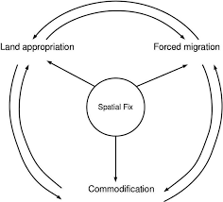
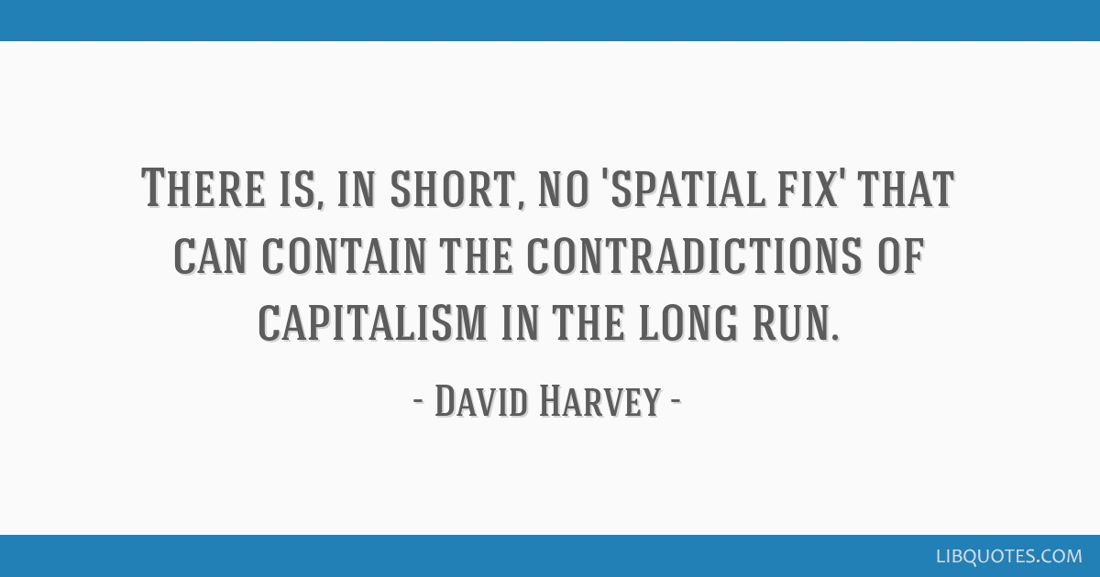

Slide 14
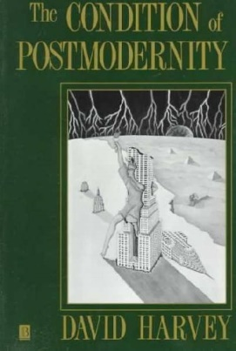
The Condition of Postmodernity: An Enquiry into the Origins of Cultural Change (1989)
  postmodernity within the context of late 20th-century global changes: the rise of neoliberalism, globalization, and technological advancements
  time-space compression phenomenon accelerates the pace of life and reshapes spatial relationships
  the shift from Fordist-Keynesianism, characterized by mass production and state intervention, to a regime of flexible accumulation, which involves more adaptable production processes, labor practices, and market strategies
  deregulation, privatization, and market-oriented neoliberal reforms exacerbate social inequalities and reshape urban and regional development into more spatially unjust forms
  postmodern fragmentation of cultural expressions and identities, driven by consumerism and media saturation, is often an obstacle to a radical change

Slide 15
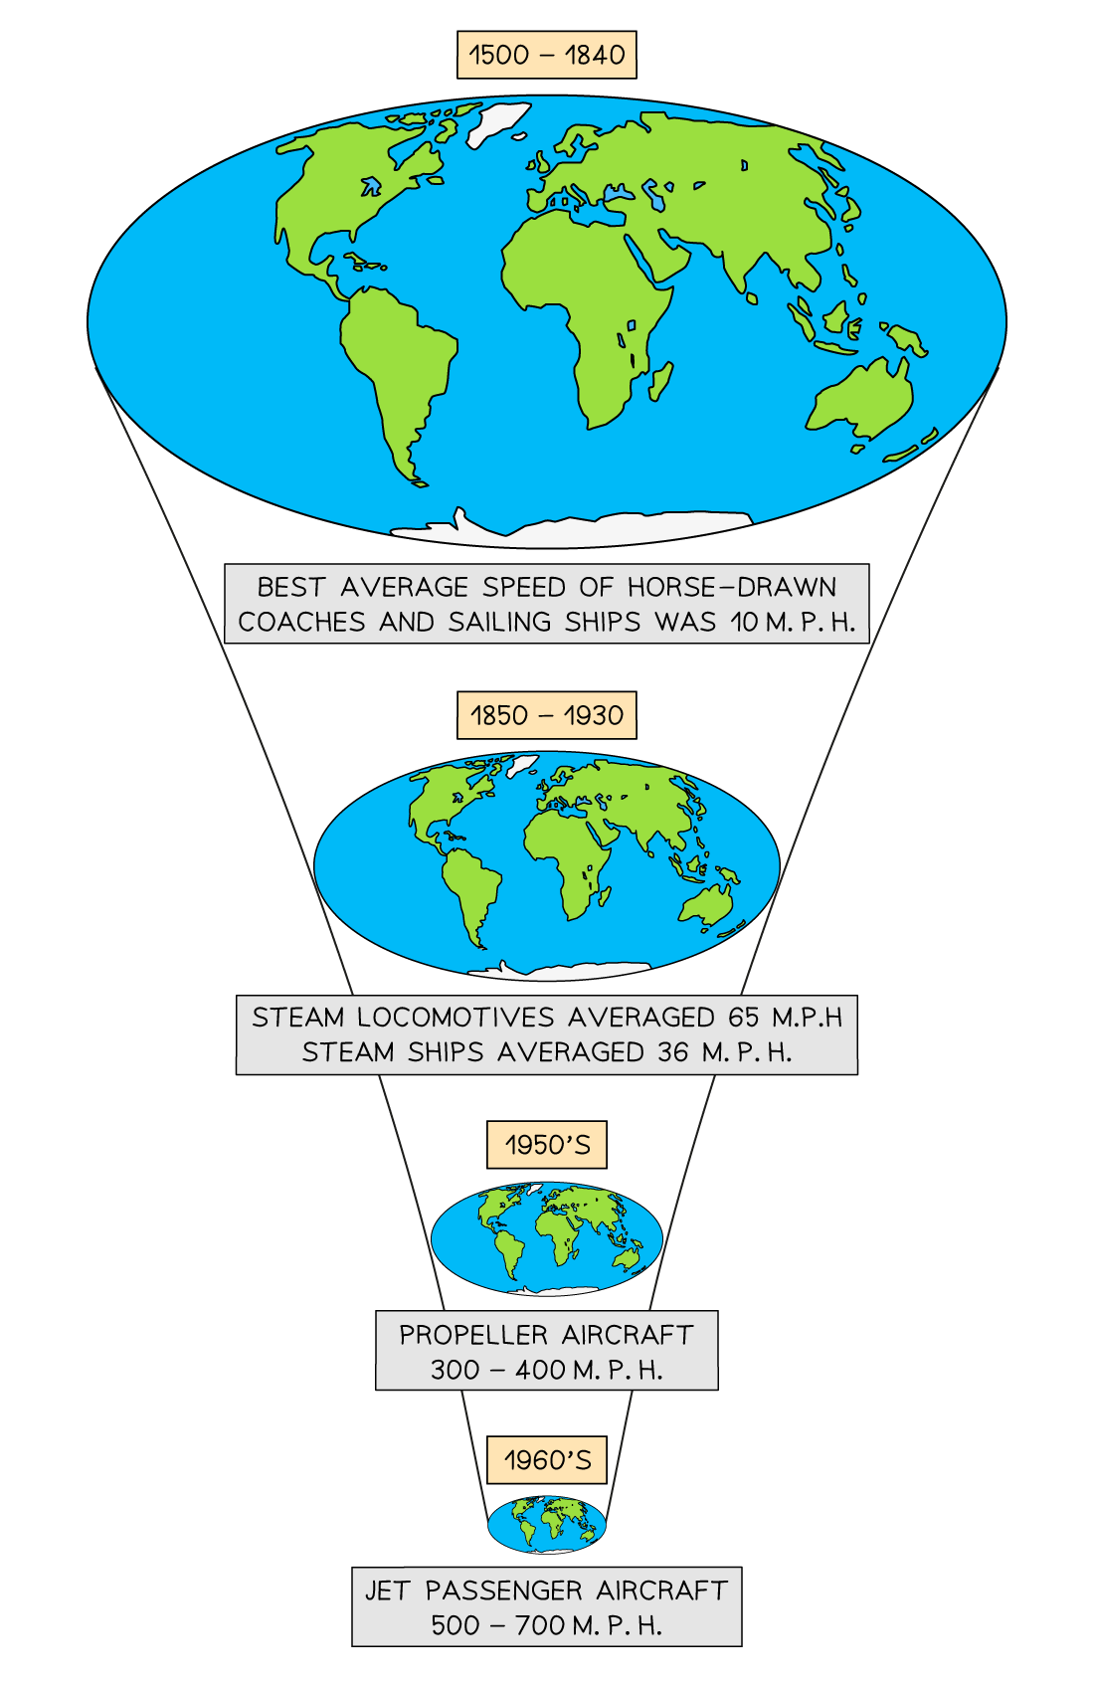

Slide 16
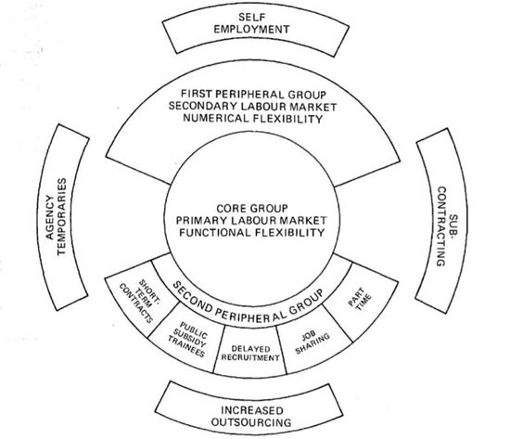

Slide 17


The New Imperialism (2003)
  concept of the „accumulation by dispossession“: privatization, commodification, financialization, and the management and manipulation of crises systematically transfer assets from the public and vulnerable populations to capitalists
  contemporary global capitalism exhibits characteristics of a new imperialism
  globalization under neoliberalism has intensified imperialist practices, as multinational corporations and international institutions like the IMF and World Bank impose policies that benefit the Global North at the expense of the Global South
  the Iraq War as an example of new imperialism because it was driven by the desire to control oil resources and assert geopolitical dominance

Slide 18
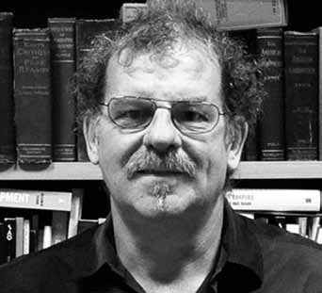
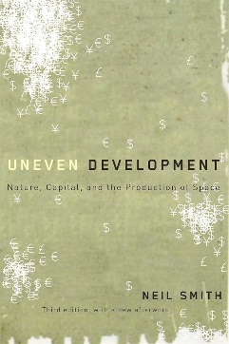
Neil Smith (1954 – 2012)
Economic and urban geographer, student of David Harvey
nature is socially constructed through capitalist processes
  commodification of nature
  differences between first, second, and third nature
  Uneven Development: Nature, Capital and the Production of Space (1984)
Urban gentrification as „creative destruction“
  existing communities are uprooted to make way for new developments that cater to wealthier populations, reinforcing social inequalities

Slide 19
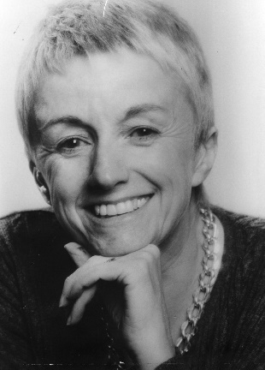
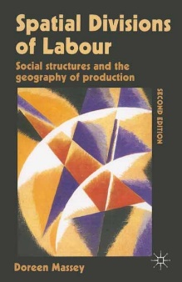
Doreen Massey (1944 – 2016)
Economic geographer, later feminist and poststructuralist geographer
Spatial divisions of labor differentiate regions and spaces and allocate their specific roles in the production process
  highlighting the interconnection of the global and the local
  Spatial Divisions of Labour: Social Structures and the Geography of Production (1984)
The rise of transnational production networks creates new spatial divisions and inequalities, impacting workers in both developed and developing countries
  concept of „power geometry“ for contemporary globalization

Slide 20
Feminist interventions into Marxist geography
Traditional Marxist models often focus predominantly on class struggle while neglecting the role of gender in shaping social relations and economic dynamics
  by considering multiple axes of identity (gender, race, class, and sexuality, …), feminist perspectives deepen the understanding of how economic systems and spatial structures contribute to social inequalities
  the importance of recognizing unpaid labor, such as domestic work and caregiving
  reproductive labor is essential for capitalism to function
Critique of the public/private divide
Neoliberal economic policies exacerbate gender inequalities

Slide 21

Anarchist geography returns
In the 21st century radical geography re-discovers anarchist tradition again
Anti-capitalist and anti-authoritarian
  Not only critiques of neoliberal capitalism but also of the inherently coercive nature of state and corporate authority
Promotion of anti-hierarchical perspectives
  Participatory knowledge creation
  Intersectionality and interconnectedness of struggles

Slide 22
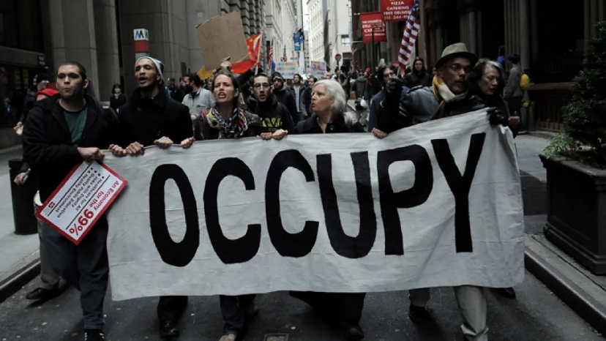
Anarchist geographical horizon
The significance of everyday practices and grassroots movements in shaping spaces of resistance
  encouraging the reappropriation of space for community building and self-organization
Prefigurative politics
  the change must be happening now, even if it is just small steps
  insurrection more useful than (Marxist idea of) revolution

Slide 23


