Slide 1
Eurocentrism and Orientalism: postcolonial critiques and imaginative geographies

Slide 2
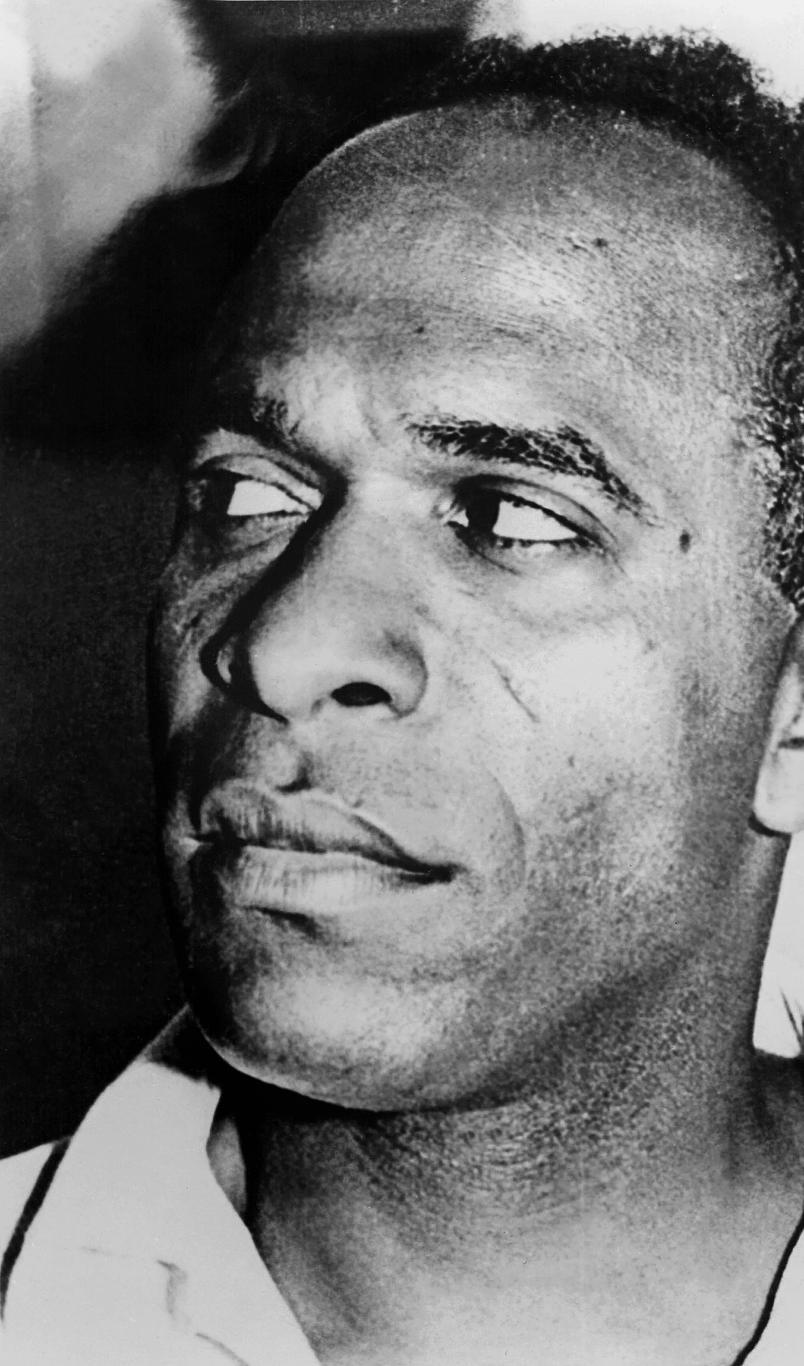
Postcolonial situation and psychoanalysis
Frantz Fanon
  orignally from Martinique, but important in France and northern Africa
  freedom fighter, philosopher, psychiatrist
Postcolonial reworking of then important psychoanalytical concepts
Skin-ego
Black consciousness

Slide 3
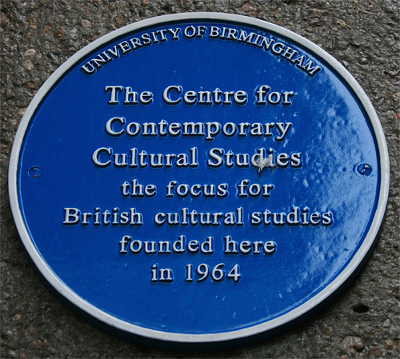
Birmingham school of cultural studies
Beginning in the 1960s: CCCS
Workers‘ culture at first
  Critiques of the idea of the „high culture“
Poststructuralism and Marxism sitting together
Stuart Hall
  Bringing postcolonial theory into it
The imperative of the connection of Marxist critique of global capitalism and the postcolonial cultural critique
Researches of media production and media consumption primarily
David Morley

Slide 4
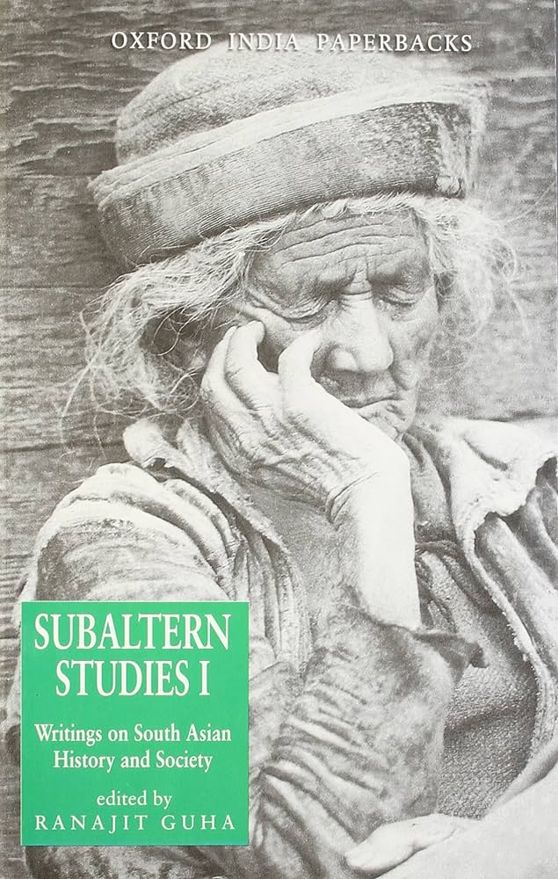
Indian subaltern studies
Studies of Indian peasants and lower classes and castes
Gayatri C. Spivak
  Interest in deconstruction and its usage for postcolonial contexts
Dipesh Chakrabarty
  Critique of Western teleological historical thinking
  Provincializing Europe
Partha Chatterjee
  Interest in postcolonial nationalisms and the influence of the Empire thought on them
David Arnold
  The question of postcolonial thinking about nature

Slide 5

Dependency theory and the uneven development
Samir Amin
  Egyptian Marxist
  Capitalism and its culture = Eurocentrism
  The advocate of „delinking“
James Blaut
  Radical geographer
  The critic of Eurocentric historical sociology
  Revision of the world-history and concepts of Eurocentric diffusionism and the tunnel of time
  „The diagnosis and treatment of a serious malady of the mind.“ (Blaut 1993: 215)

Slide 6
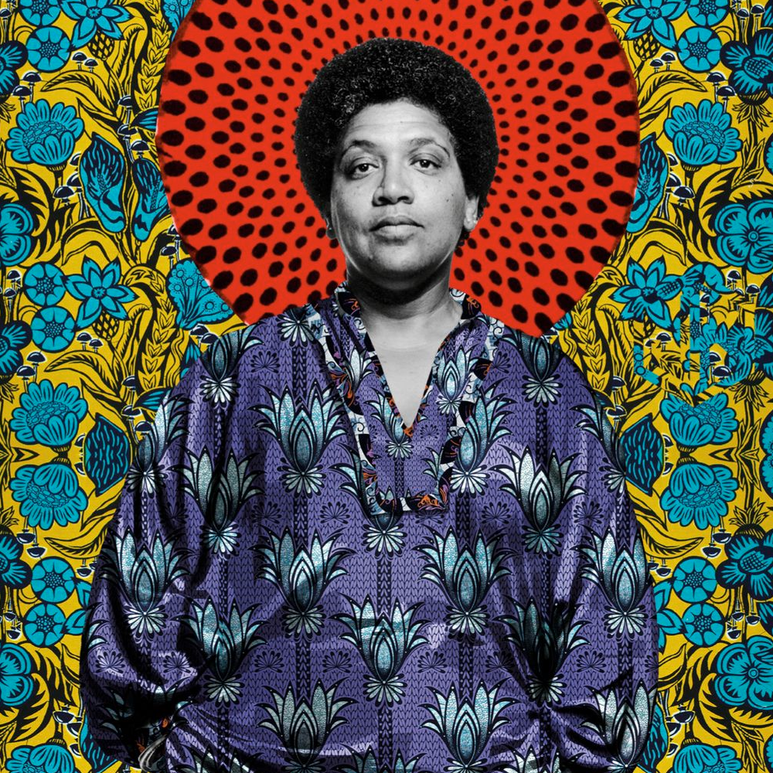
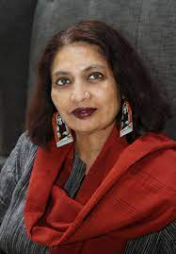
Feminist postcolonialism
Critique of the focus on First World women only
Not only the problem of gender difference but the problem of gender difference vis-à-vis social class, race, ethnicity, caste or sexual difference
Audre Lorde
  „The Master's Tools Will Never Dismantle the Master's House“
  First World women use the tools of patriarchy to opress Third World women
Chandra T. Mohanty
  Double colonization
  Critique of Western feminisms that see non-Western women as a unitary universal category

Slide 7
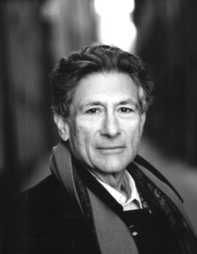
Orientalism
Edward Said
  Interest in occupied Palestine
  Inspiration in Foucault‘s discourse theory
  Contrapuntal reading
Said‘s elaboration are both, textual and material, and both, historical and political
Orientalist imaginative geographies dramatize the distance and difference between what is close to us and what is far away.
Huge influence on human geography (and other social sciences)

Slide 8
What is Orientalism?
According to Said, Orientalism is a form of intellectual domination, rooted in public (and other) discourses, that creates a dichotomy between the "civilized" West and the "exotic" Orient, perpetuating stereotypes and justifying colonial and imperial ambitions
This framework highlights how cultural representations can serve to maintain and enforce unequal power dynamics between Western and non-Western space

Slide 9
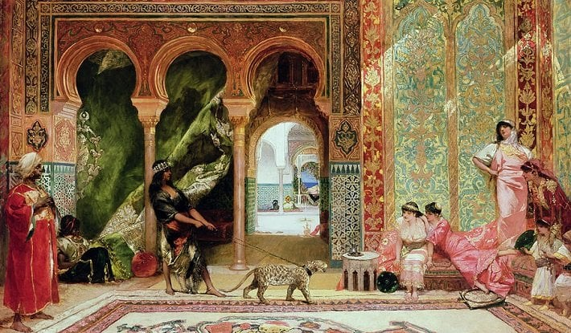
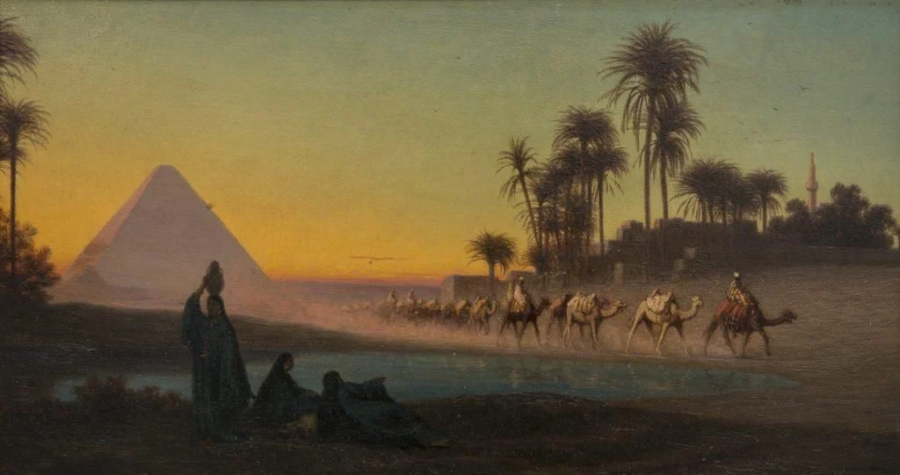

Slide 10
Orientalist imaginative geographies
Imaginative constructions that dramatize the distance and difference between what is close to us and what is far away
They fold distance into difference through a series of spatializations
Fundamental practice for the process of Othering people that are supposed not to belong into “our” community

Slide 11
Characteristic of Core – Charasteric of Periphery
Inventiveness – Imitativeness
Rationality, intellect – Irrationality, emotion, instict
Abstract thought – Concrete thought
Theoretical reasoning – Empirical, practical reasoning
Mind – Body, matter
Discipline – Spontaneity
Adulthood – Childhood
Sanity – Insanity
Science – Sorcery
Progress - Stagnation

Slide 12
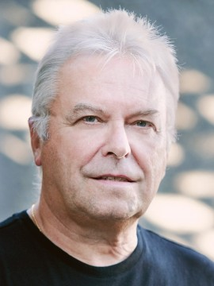
Derek Gregory (born 1951)
One of the most important theorists in geography
Political, cultural, historical geographer
  University of Cambridge
  University of British Columbia
Geographical imaginations and imaginative geographies
  Postmoderm transformation of geography
  Introducing Edward Said‘s postcolonial theory into geography
  Geographies of war and peace
  Elaborations in the topic of Orientalism and war
  Highly relevant today -> Palestine

Slide 13
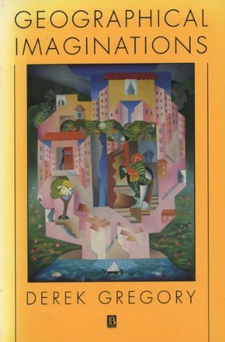
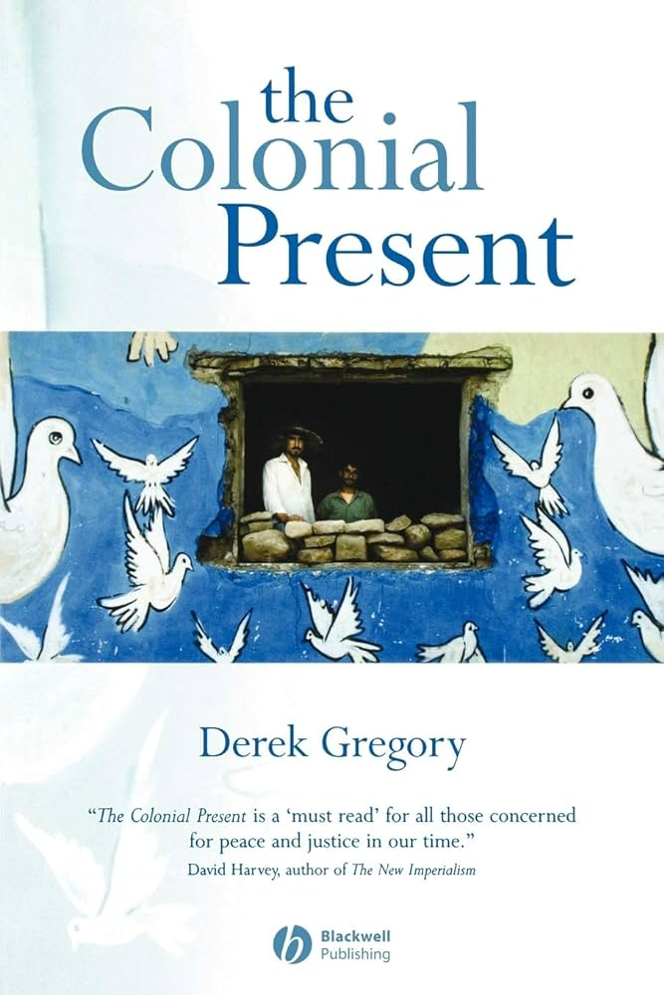

Slide 14
[Imaginative geographies] are ‘imaginative’ not only because that is what they are (they are quite literally fabrications, a word that usefully combines ‘something fictionalized’ with ‘something made’) but also because that is where they reside, concealed in the collective unconscious, where they too often fan the flames of enmity and hatred … [Through them, the] space [of ‘others’] is often seen as the inverse of ‘our’ space: a sort of negative in the photographic sense that they might develop into something like ‘us’, but also the site of absence, because ‘they’ are seen somehow to lack the positive tonalities that distinguish ‘us’. (Gregory, 2004, p. 801)

Slide 15
How does Orientalism work?
Traditionally legitimized by the “common sense”
Discursive, but performative
Drawing on long-term histories of intercultural contact in a political way
Real diverse non-Western people with their lives, biographies, experiences are not important for imaginative geographies
  Steretypization is important
Remaking diachronic global spacetime into stable synchronic spatial segments
Idea of the single timeline of progress and stabilization of Others‘ time in the past
  Justification of economic inequalities
Simon Springer: Orientalist segmentarities and stabilisations are framed not only as a process of self-affirmation but also as a denial of potentially beneficial associations with Others

Slide 16
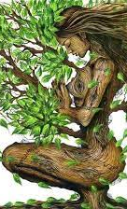
Imaginative geographies of (post)colonial natures
(Post)colonial productions of space -> (post)colonial productions of nature
Western cultural ideology of non-Western nature
  Nature to be dominated and domesticated
  Feminization and pathologization
  Nurturing mother / wild, seductive, unruly siren
Neccesity to be disciplined by (ordered, rational, masculine) culture

Slide 17
World-as-exhibition
Production of „spaces of constructed visibility“
  which are also always „spaces of constructed invisibility“
Modern rational viewing subject being able to dis-cover the „real“ order inside the chaos of the non-modern and the pre-modern
Natures typologized and taxonomized
  Dangerous-safe, detestable-beautiful, unnatural-natural, abnormal-normal, exotic-ordinary, polished-monstrous, intelligible-unintelligible, useless-useful
Then commodified and mathematized
Strange other natures eventually to become familiar in their very strangeness

Slide 18

Visual fantasies and haptic terrors
Moral geography of natures
  Other natures as a paradise
  Other natures as pestiliental and excessive
  Noble savage / ignoble savage
The fantasy of tropical heterotopia
  Tropical sublime
Visuality versus haptic sensuality
„Traders and militiamen constructed a landscape of wildness and savagery so they themselves became wild and savage: the violence of their actions mirrored the violence of their fears.“ (Gregory 2001: 107)

Slide 19

Natures and war
Cartography versus corpography
  Generals in front of battlemaps / soldeirs „down there“ inside dangerous, messy, detrimental (and often destroyed) nature
  It required a „re-mapping“, the improvisation of a corpography rather than a cartography, in which haptics had to be heightened
Interdepence of corporeal death and environmental death
Landscape turning into „anti-landscape“
Soldiers to be reduced to a savage „state of nature“ by non-Western nature
  Survivors doubting their humanity because of the „inhuman“ nature of the battlefield

Slide 20
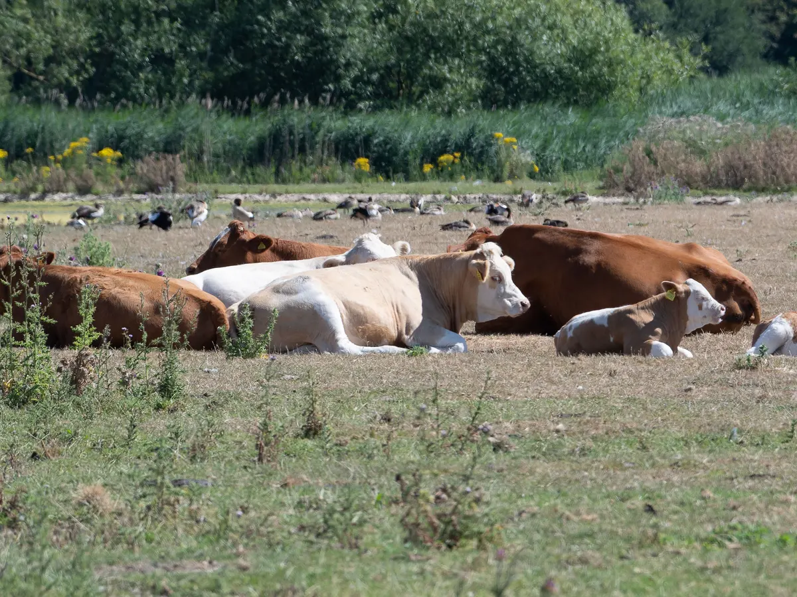
Temperate Europe as the birthplace of progress
Environmental determinisms
Three primordial environmental facts: the shapes of the continents, the distribution of domesticable wild plants and animals, and the geographical barriers inhibiting the diffusion of domesticates
  Europe‘s livestock to be sturdier and healthier than those of nontemperate regions
Natural determinants of plant and animal ecology as somehow determinants of human ecology
Tropical climates as inimical to human activity and cultural progress
  Tropical heat, somehow, impedes human mental and physical activity
  People plagued with diseases
  Tropical agriculture hopelessly unproductive

Slide 21
