Slide 1
Landscape geography and the problem of representation
Pavel Doboš

Slide 2
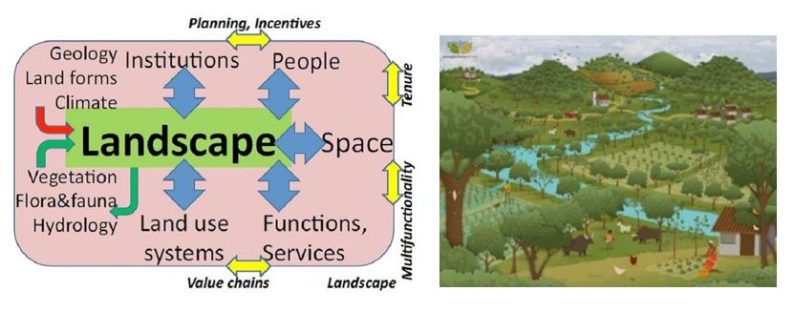
What is landscape?
Much more complicated question than it seems
  Another ambiguous geographical concept
Landscape is tension
  Proximity/distance
  Observation/inhabitation
  Eye/land
  Culture/nature

Slide 3
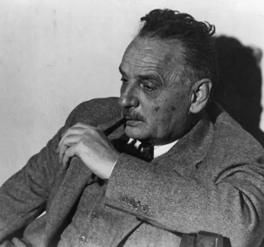
Beginnings of landscape geography
Berkeley School and Carl Sauer
Invention of the concept of „cultural landscape“
  landscape is geography „out there“, away from cities, although influenced by humans
  fashioned from a natural landscape by a cultural group, i.e. culture is the agent, the natural area is the medium, the cultural landscape the result
  against environmental determinism
  the task was to describe the morphology (the shape, form and structure) of a given landscape, and in so doing to reveal the characteristics, trace, distribution and effectivity of the human cultures that had inhabited and moulded it

Slide 4
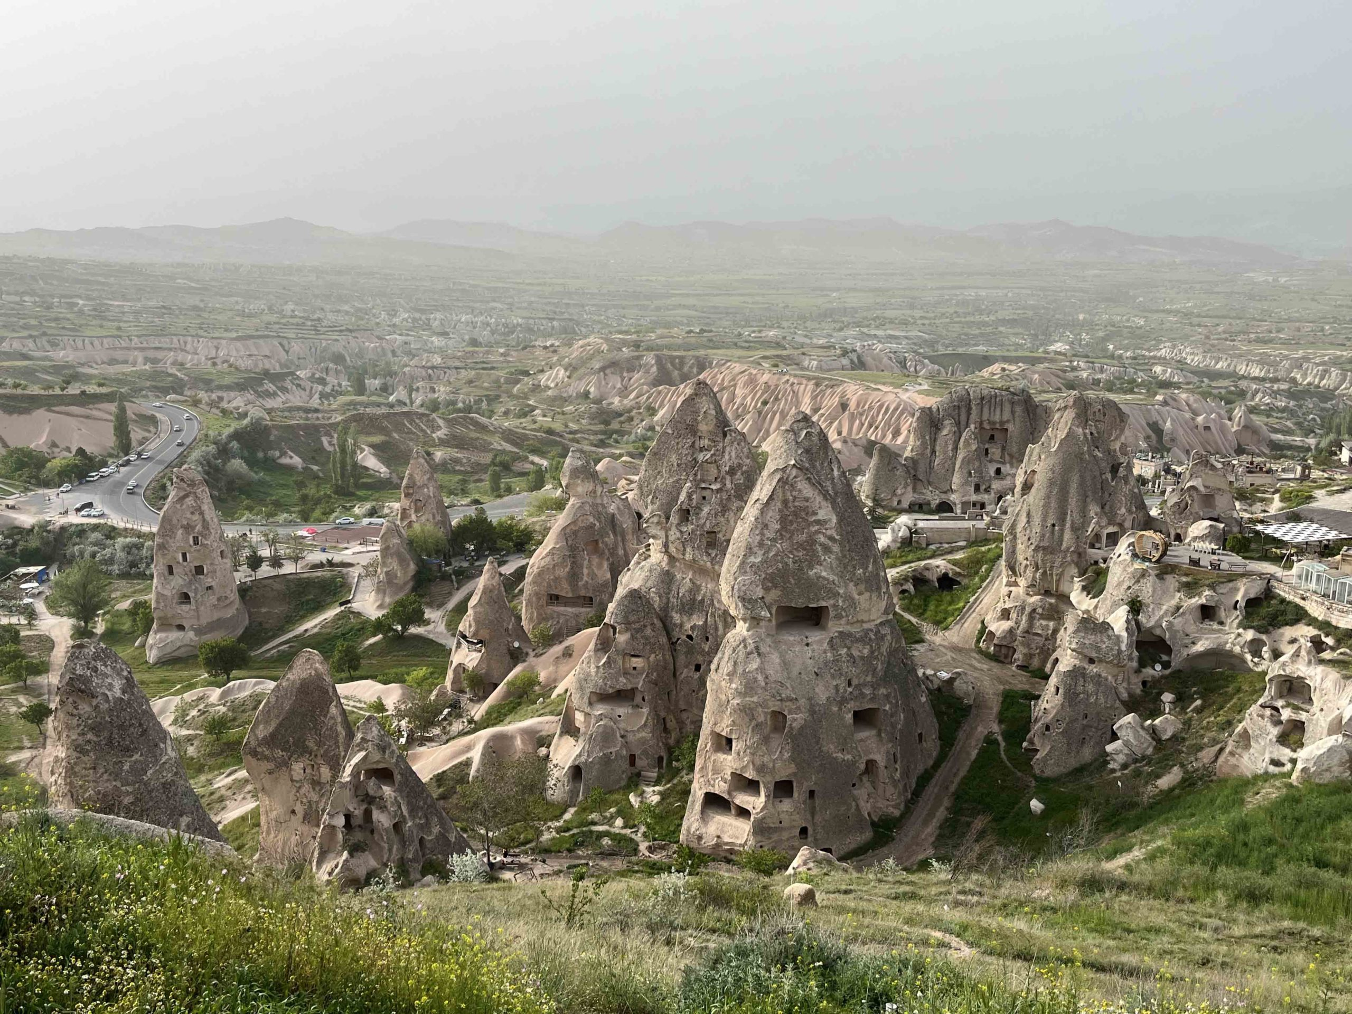

Slide 5
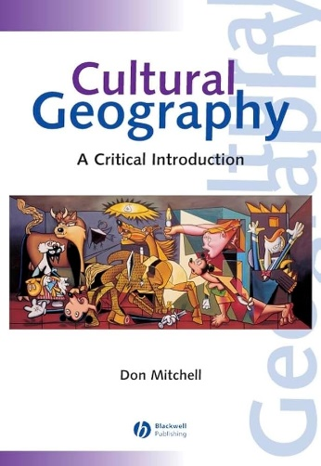
Landscape in „New cultural geography“
Landscape primarily understood in visual terms, as a representation, and is socially constructed
Interest in cultural symbols, meanings and discourses that are represented through landscape
  landscape can be read and deciphered as a text
  these are always imbued with power relations
Landscape ordered via visual practices: linear perspective, geometry

Slide 6
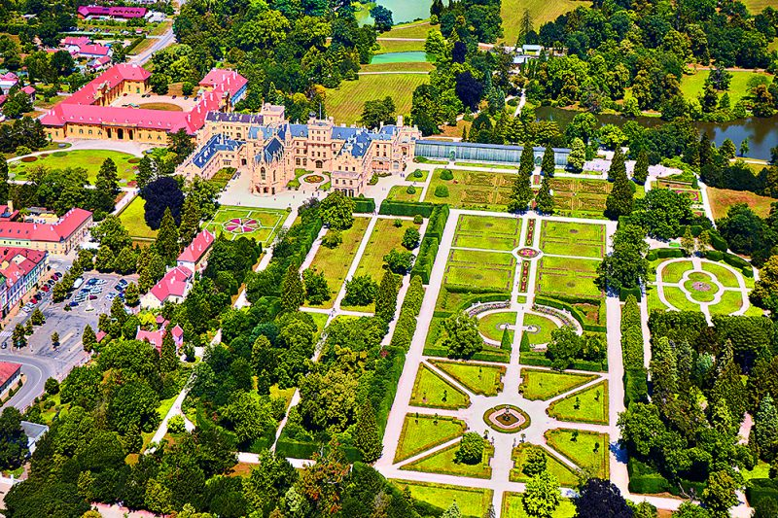

Slide 7
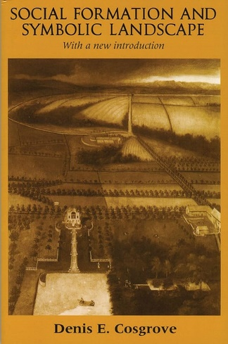
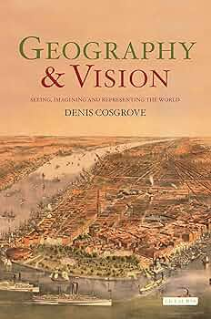
Landscape is thus a way of seeing, a composition and structuring
of the world so that it may be appropriated by a detached individual
spectator to whom an illusion of order and control is offered through
the composition of space according to the certainties of geometry. […] One of the consistent purposes of landscape painting has been
to present an image of order and proportioned control. […] There is
an inherent conservatism in the landscape idea, in its celebration
of property and of an unchanging status quo, in its suppression of
tensions between groups in the landscape. (Cosgrove 1985: 55-8)

Slide 8
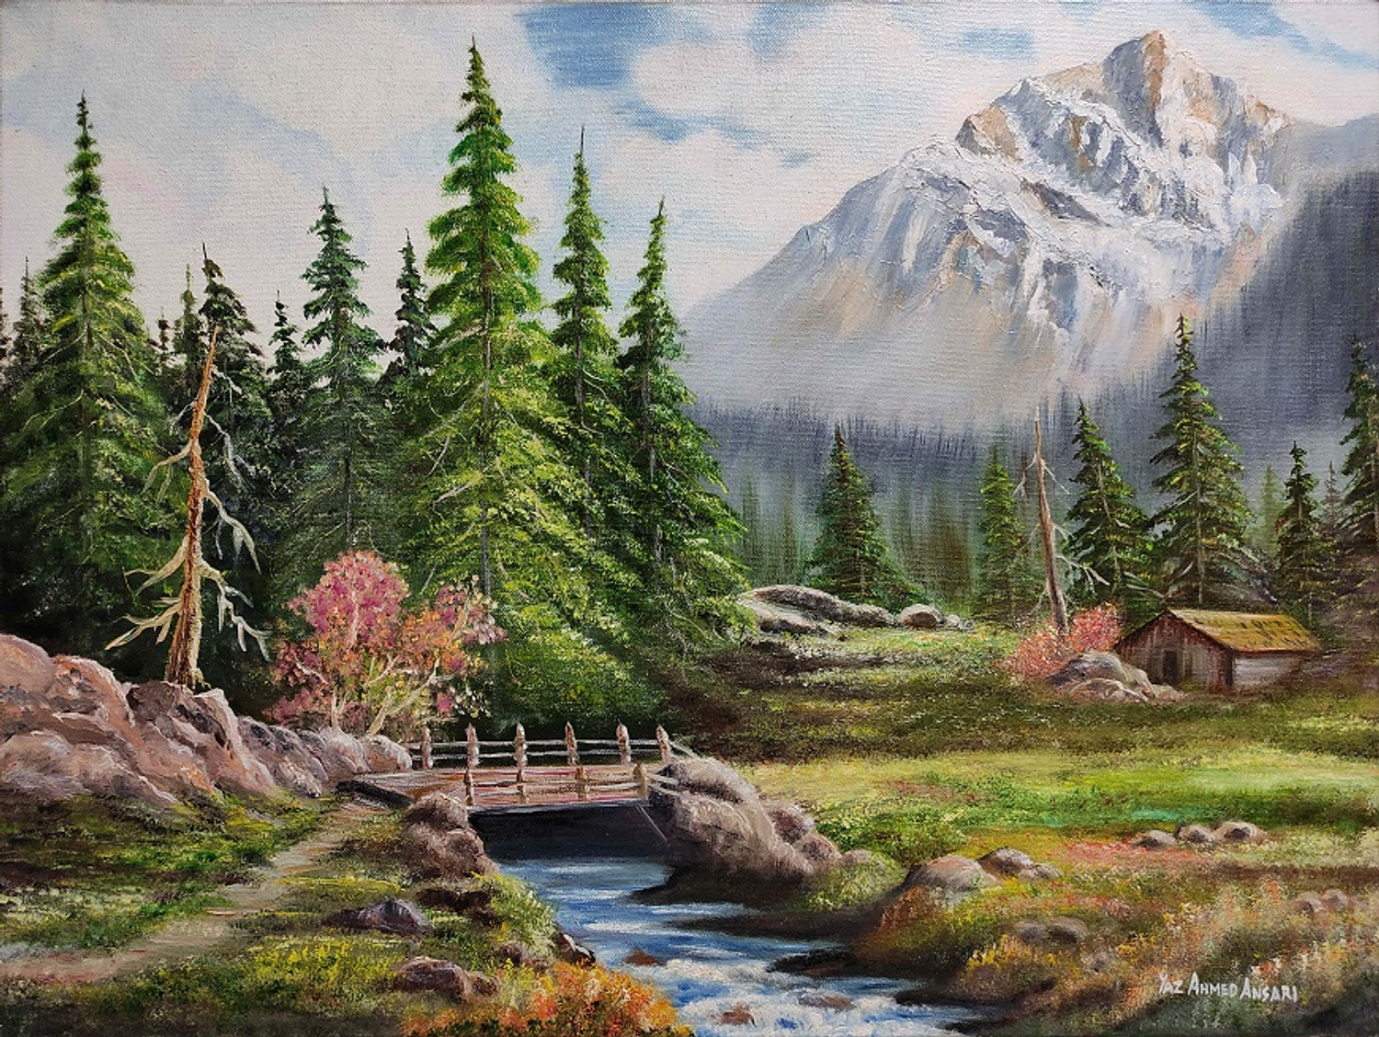

Slide 9
Landscape idea
Landscape is an idea developed by Europeans in the Renaissance period
  an idea of European elite consciousness about how to represent the world, to make it pleasant for the eye
Way of seeing that chimes with elite and aristocratic visions of human society and nature
  such visions are often profoundly distant from the actuality of working and living in landscape, and should be understood as imposing an aesthetic and moral order from afar
  for cultural Marxists landscape is literally a veil

Slide 10
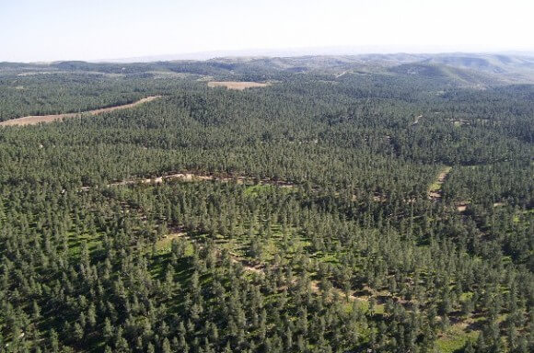

Slide 11
It can be argued that one of the most important roles that landscape plays in the social process is ideological, supporting a set of ideas and values, unquestioned assumptions about the way a society is or should be organised. […] If landscapes are texts which are read, interpreted according to an ingrained cultural framework of interpretation, if they are often read ‘inattentively’ at a practical or nondiscursive level, then they may be inculcating their readers with a set of notions about how the society is organised: and the readers may be largely unaware of this. (Duncan & Duncan 1988: 123)

Slide 12
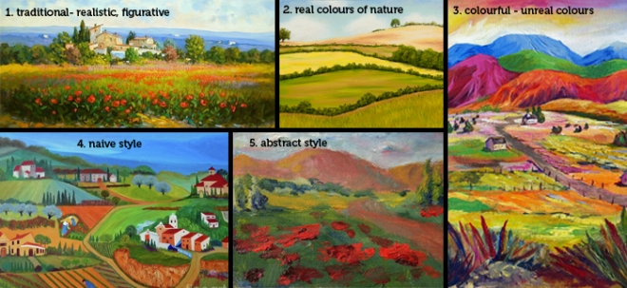
Representations and change
Although landscapes are synchronic representations, they are not static but are constantly changing and evolving
  they reflect the dynamic nature of cultural and social processes
  understanding landscapes requires a historico-geographical perspective, recognizing how they have changed over time

Slide 13
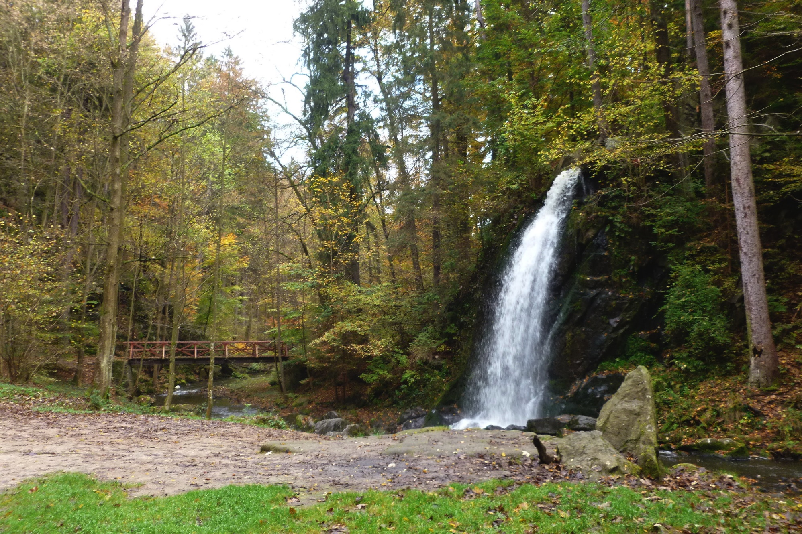

Slide 14
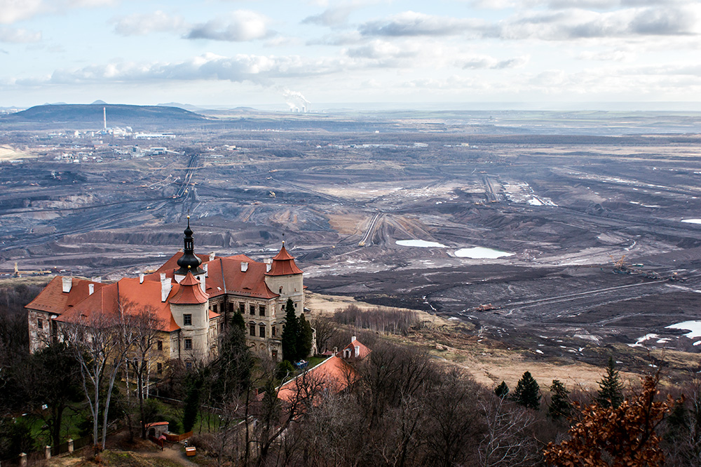

Slide 15
A landscape is a cultural image, a pictorial way of representing, structuring or symbolising surroundings. […] A landscape park is more palpable but no more real, no less imaginary, than a landscape painting or a poem. […] And of course, every study of a landscape further transforms its meaning, depositing yet another layer of cultural representation. […] From a post-modern perspective landscape seems less like a palimpsest whose ‘real’ or ‘authentic’ meanings can somehow be recovered with the correct techniques, theories, or ideologies, than a flickering text displayed on the word-processor screen whose meaning can be created, extended, altered, elaborated and finally obliterated by the merest touch of a button. (Cosgrove & Daniels 1988: 1-8)

Slide 16
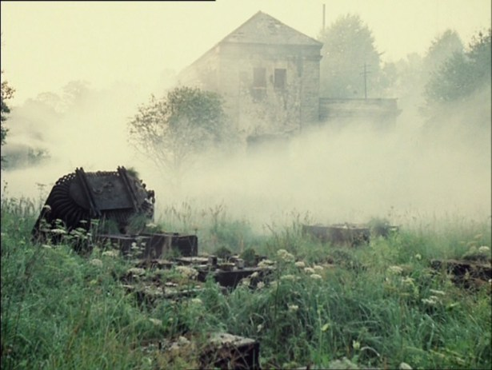

Slide 17
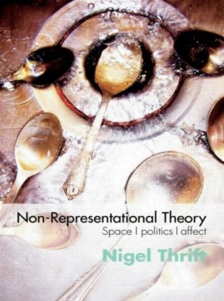
Beyond representation
„New cultural geography“ and its approach to landscape began to be criticized from the position of non-representational theory
  visual, symbolic, discursive landscapes are „dead geographies“
Embodied experiences of individuals within landscapes should be focused on
  sensory and affective engagements with landscapes rather than symbolic meanings
  haptic and tactile geographies

Slide 18
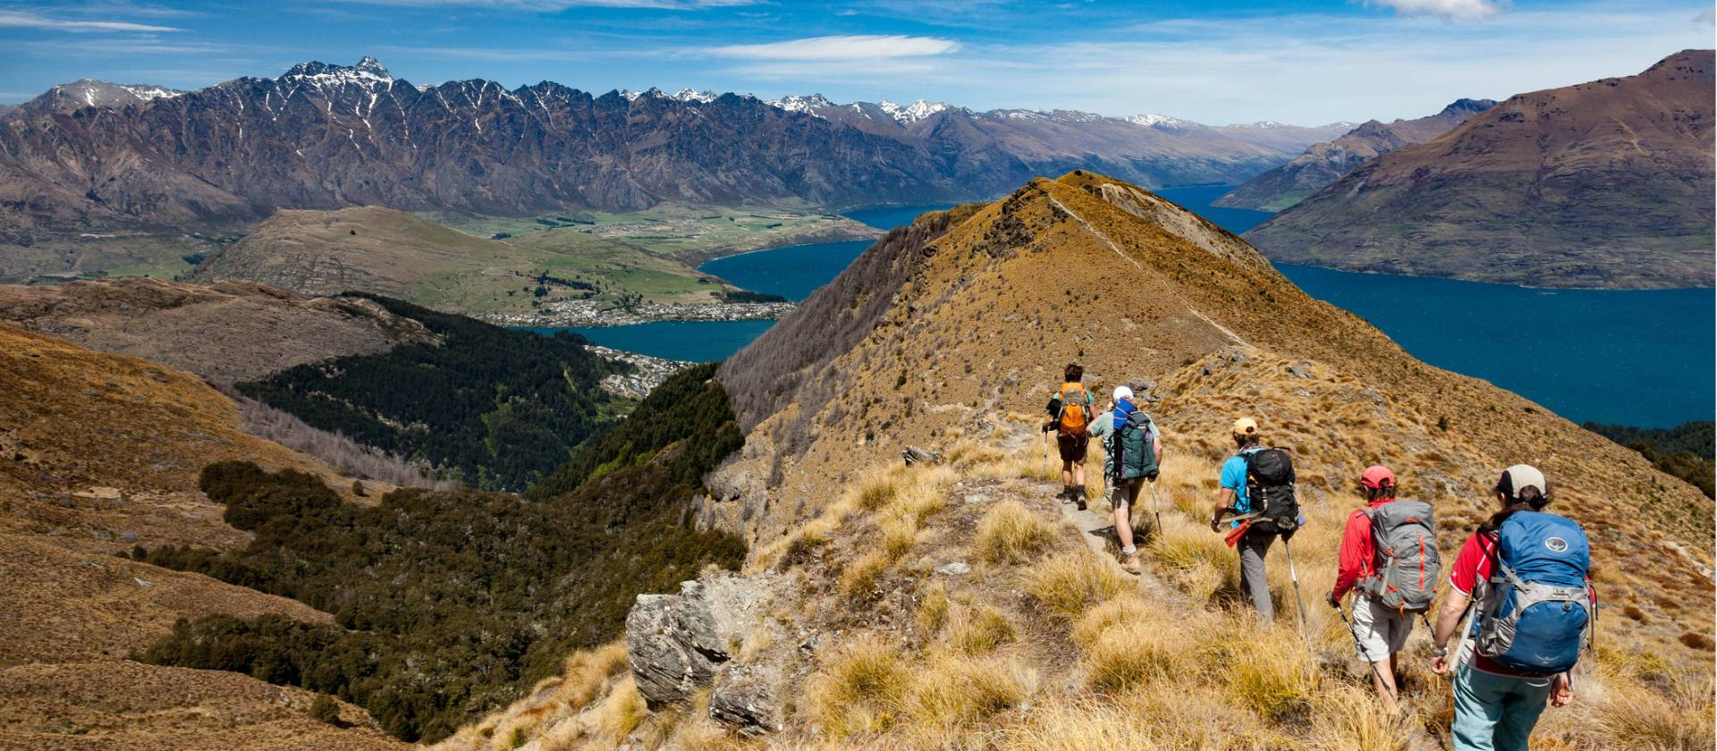

Slide 19
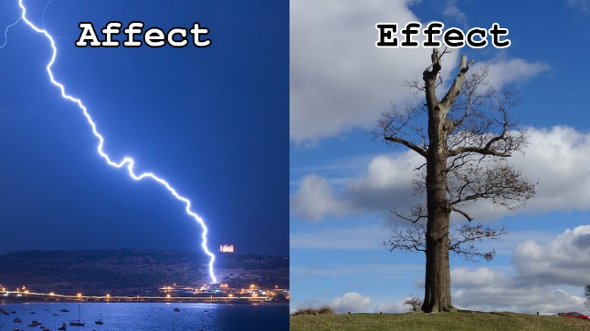
Landscape is not „out there“
Through everyday practices, performances, and actions landscapes are continually created and re-created
  landscapes are experienced and lived
  landscape meanings are generated through practices and performances rather than being pre-given, waiting to be read and deciphered
Affective and emotional engagements with landscapes
  landscapes evoke feelings and emotions, not only persuade viewers in an ideological way

Slide 20
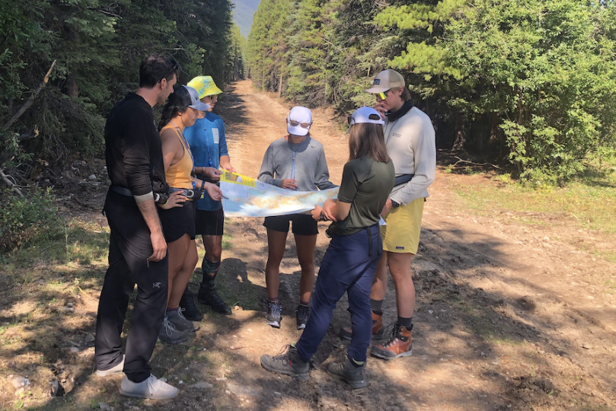

Slide 21
Not views, but events
Landscapes are conceptualized through events that unfold over time, highlighting their processual nature
Potentialities and possibilities are inherent in landscapes, rather than fixed or stable meanings
Non-human elements of landscapes are interacted with, not only observed
  landscapes are assemblages of human and non-human actors

Slide 22
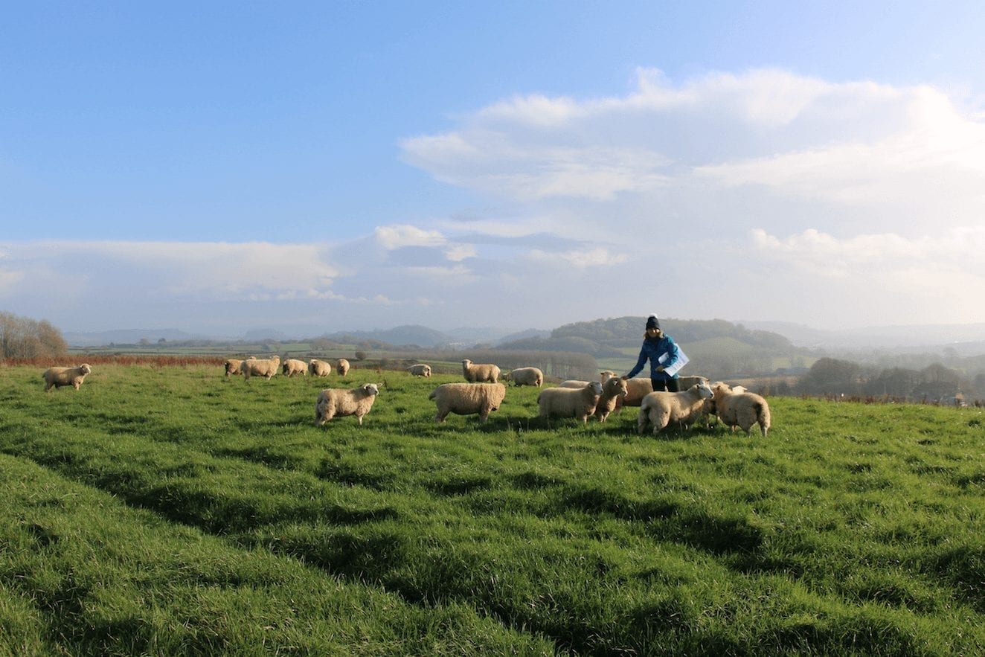

Slide 23
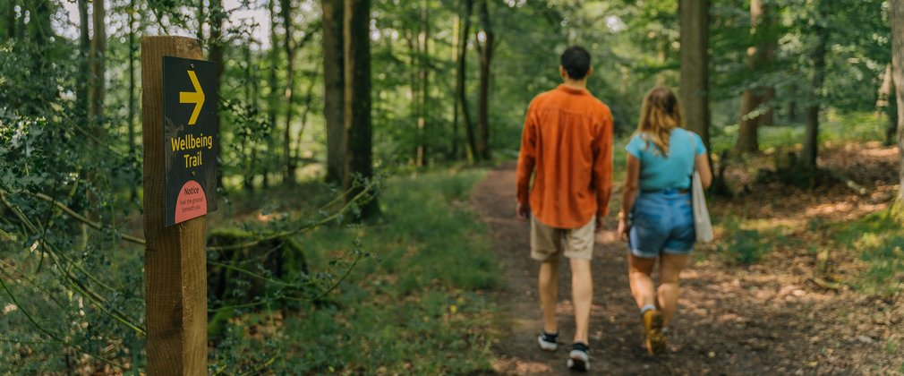
Corporealities in landscapes
Landscape as dwelling in
X
Landscape as endless story of movement and moving through

Slide 24
Landscape is not just a way of seeing, a projection of cultural meaning. Nor, of course, is landscape simply something seen, a mute, external field. Nor, finally, can we speak altogether plausibly of the practice of self and landscape through notions of a phenomenological milieu of dwelling. Taking a first step past constructivist, realist and phenomenological visions, this paper writes its way through what might be termed a post-phenomenological understanding of the formation and undoing of self and landscape in practice. Therein, landscape might best be described in terms of the entwined materialities and sensibilities with which we act and sense. (Wylie 2005: 245)

