Slide 1
Politics of performance and affect: the imperative of being non-representational
Pavel Doboš

Slide 2
Non-representational theory
Origins in the Anglophone geography of the start of 21st century
Critique of representational cultural geography
The aim to make geographies living (again)
Drawing on long histories of „theories of practice“ as well as poststructuralist philosophy
  but less Foucault and more Deleuze

Slide 4
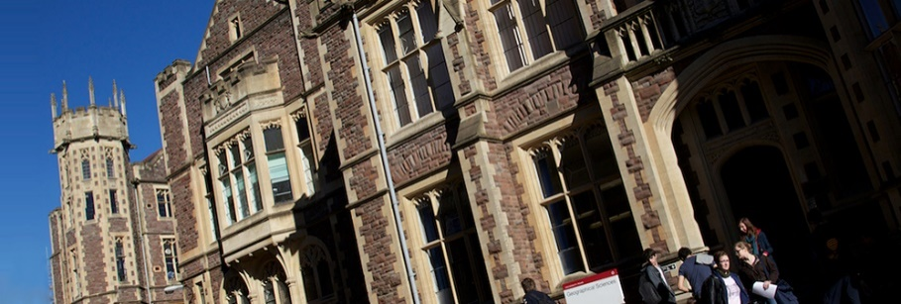
Bristol school of cultural geography
Beginnings in the 1990s with new original kind of geographical thought
  geographer Nigel Thrift coming to Bristol and working there (1987-2003)
New highly theoretical M.Sc. and Ph.D. programmes in „Society and Space“
  students advancing Thrift‘s thought: John Wylie, Mitch Rose, Derek McCormack, J.-D. Dewsbury, Marcus Doel, Paul Harrison, Ben Anderson, …

Slide 5
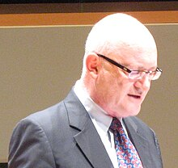
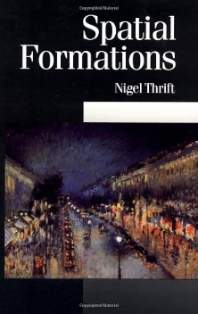

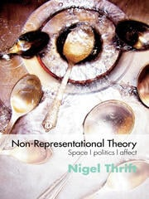
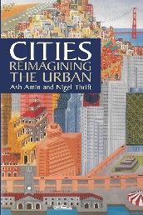
Nigel Thrift (1949 – ?)
Urban, economic and cultural geographer
Originally a Marxist geographer (collaborations with Richard Peet) and an elaborator of time-geography
Then interested in a wide range of geographical issues
  2000: „His main current interests are in the exclusionary geographies written into software, non-representational theory, embodied ‘methodologies’ like dance, and the reworking of political economy.“

Slide 6
New important concepts
A lot: practice, event, affect, performance and performativity, becoming, body and embodiment, subjectification, habit, relations and relationality, matter and materiality, assemblage, haptics and sound, rhythm and refrain, atmosphere, …
  emphasis on different (more animate, vital and living) concepts than in representational cultural geography

Slide 7
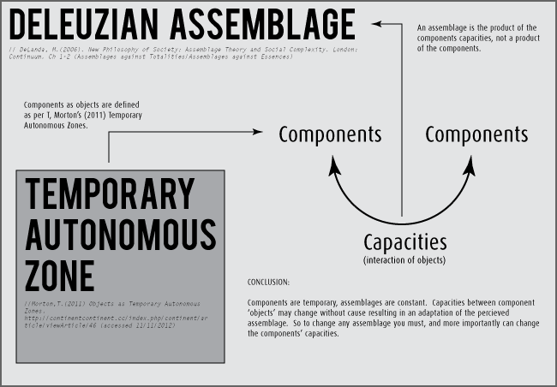
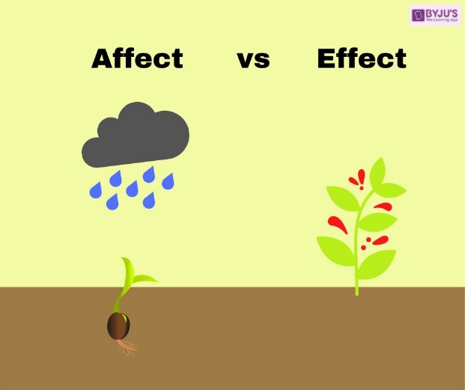
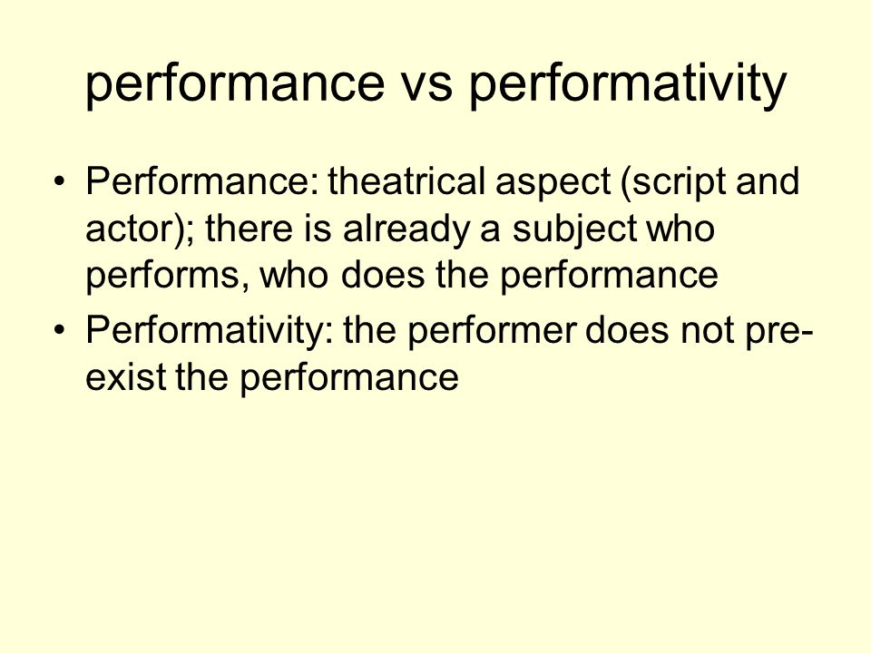

Slide 8
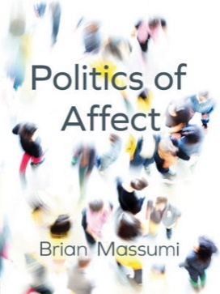
Different view of politics
More focus on micro-politics than macro-politics
Political affects
  power-laden work or instrumentality of things, events or bodies
  politics (as discourse or ideologies) can be interpreted from power-imbued representations – as representational cultural geography does… but how these representations affect us? what are mechanisms of their (emotional or other) working? what effects can they have? what subjects can they bring forth? what difference can they do in the world? how they remake our space of life?
Spaces of political atmospheres
Events of politics

Slide 9
‘It’s not about forgetting representations’ or ‘NRTs look at what representations do’, but also in work which shows how affects, practices, relations, events, and the like unfold in ways which are in some sense contextual or circumstantial. Such contexts or circumstances are not necessarily determinative of how an event, practice, encounter or whatever will unfold and we don’t necessarily know in advance what impact they may or may not have. The key point is that they hold the potential to impact upon the unfolding of social life and there is a politics associated with this. (Simpson 2020: 223)

Slide 10
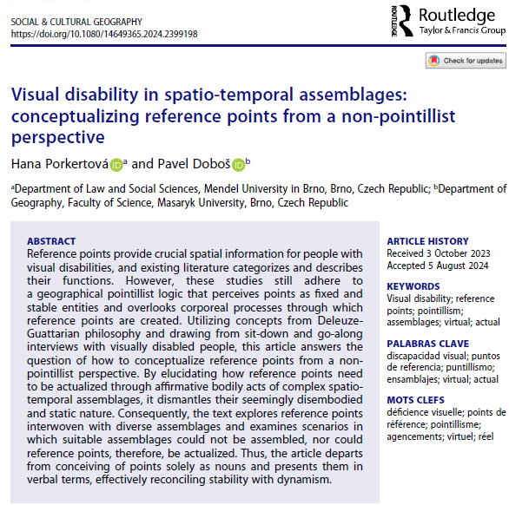

Slide 11
