Slide 1
Geographies of virtual space and the problem of internet communication
Pavel Doboš

Slide 2

Introduction
Virtual space, cyberspace, digital space
  digitized, coded via software, algorithmized
  not a „mirror“ of the real, but part of the real
Subfield of digital geographies

Slide 3
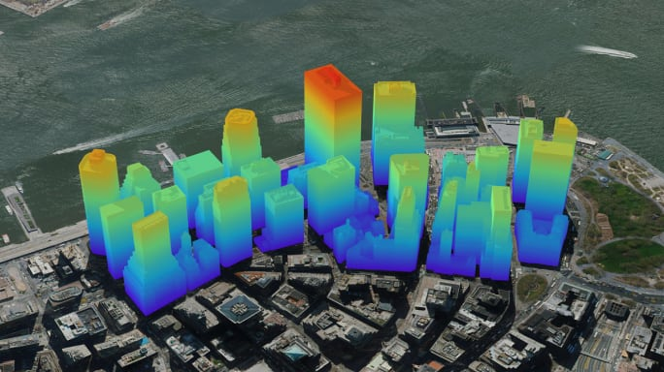
Geographies through the digital
Geographies made through quantitative computational big data
  epistemic rationalities imposed by digitally networked spatial platforms that render the objects and spaces of representation „knowable“ in ways that privilege abstraction and calculability
  visualizations via aerial view preferred (i.e. Google Earth)
Geographic information systems
  GIScience, critical GIS

Slide 4
Geographies produced by the digital
Production of space is transformed with digital media and software
  global economic space, space of flows, space-time compression
  code/space – ontogenesis of certain spaces via software codes and algorithms
Spaces are being increasingly mediated and experienced through digital interfaces
  locative media, geoweb, augmented reality
Smart cities and big data governmentality
  how populations are managed is mediated by information systems and databases

Slide 5

Geographies of the digital
Virtual space/cyberspace geographies
  predominantly visual understanding of space in which various computer-generated environments are accessed via a screen
  spatialities of video games and social media
Geographies of big data production
  data mining and the emergence of data doubles
  unequalities in the production of web content
  problem of algorithmized automatic production of big data
Geographies of Internet communication

Slide 6
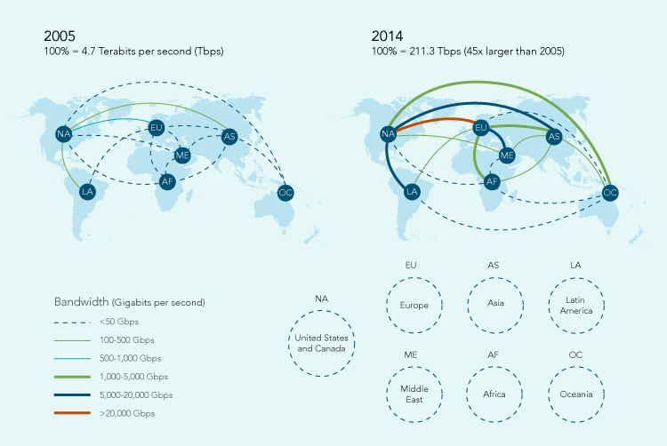
Spaces in communication

Slide 7

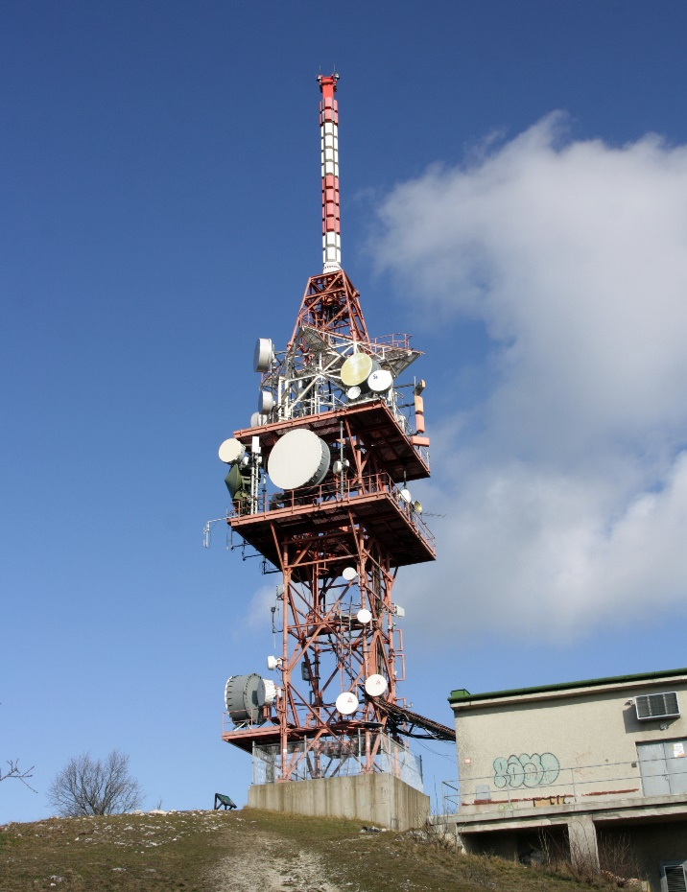
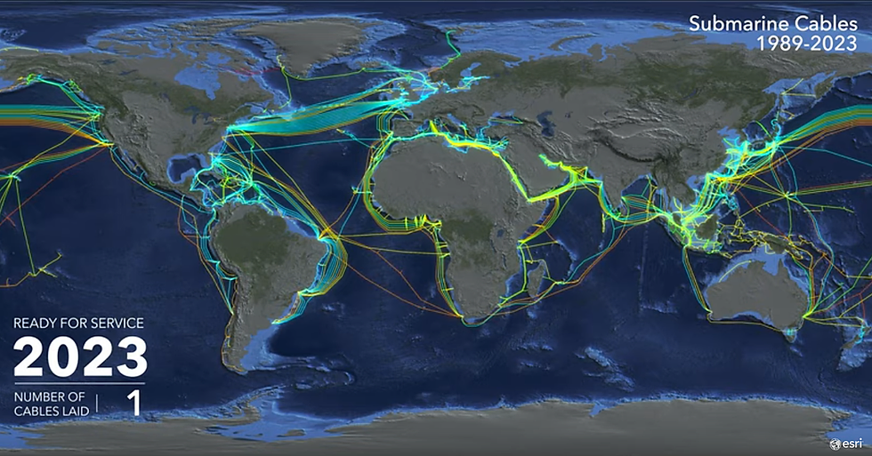
Communication in spaces

Slide 8


Places in communication

Slide 9

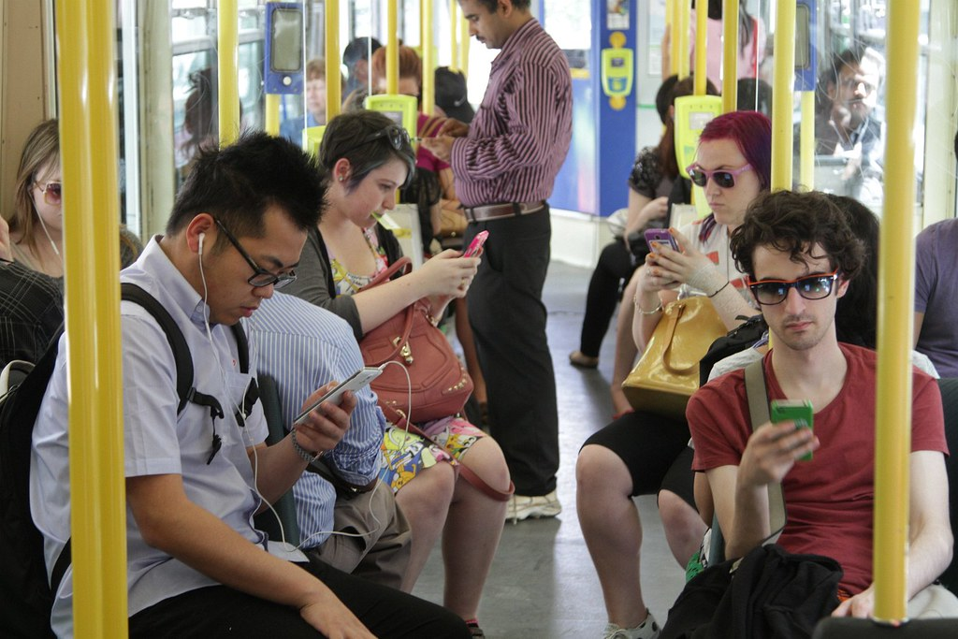

Communication in places

Slide 10
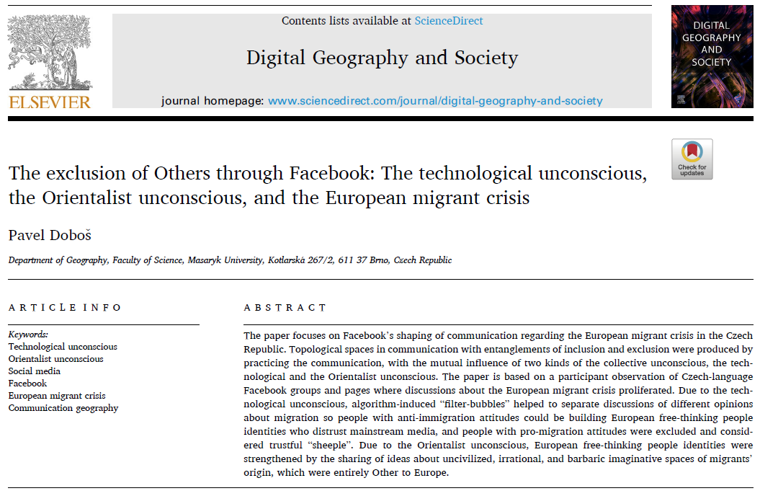

Slide 11
Critical cartographies and the cartographic reason
Pavel Doboš

Slide 12
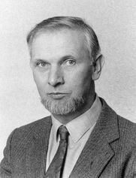
Beginnings of critical cartography
1990s: J. B. Harley
Maps are not purely objective, scientific representations of the world
  rather products of the social and political contexts in which they are created
  tools of power and ideology
  cartographer's choices highly important
  instruments of control, surveillance, colonization, military strategy, administration, …
  maps should be approached critically and deconstructed

Slide 13
Crit. cartography today – 1. approach
Majoritarian maps must be scrutinized and criticized
  all maps are subjective and influenced by the cartographer’s perspective, as well as societal, cultural, and political contexts
  maps can be used to assert authority, enforce boundaries, and marginalize communities
Maps are not merely passive reflections of the world but active agents in its construction
  they are performative
GIS technologies can both challenge and reinforce traditional power dynamics
  critical GIS

Slide 14
Crit. cartography today – 2. approach
New critical maps must be created
Participatory and community Mapping
  democratizing cartography, giving voice to marginalized and indigenous groups
Activism and counter-mapping
  creating alternative maps that challenge dominant narratives and highlight issues of spatial justice
  visualizing social inequalities, environmental problems, …
Ethical considerations
Experiments with alternative visualizations

Slide 15
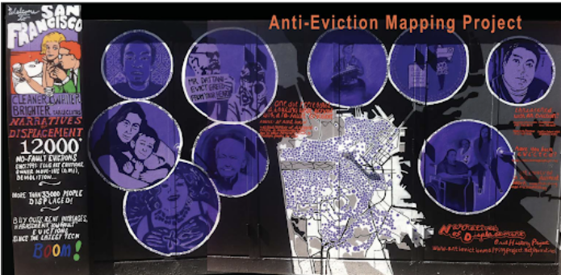

Slide 16
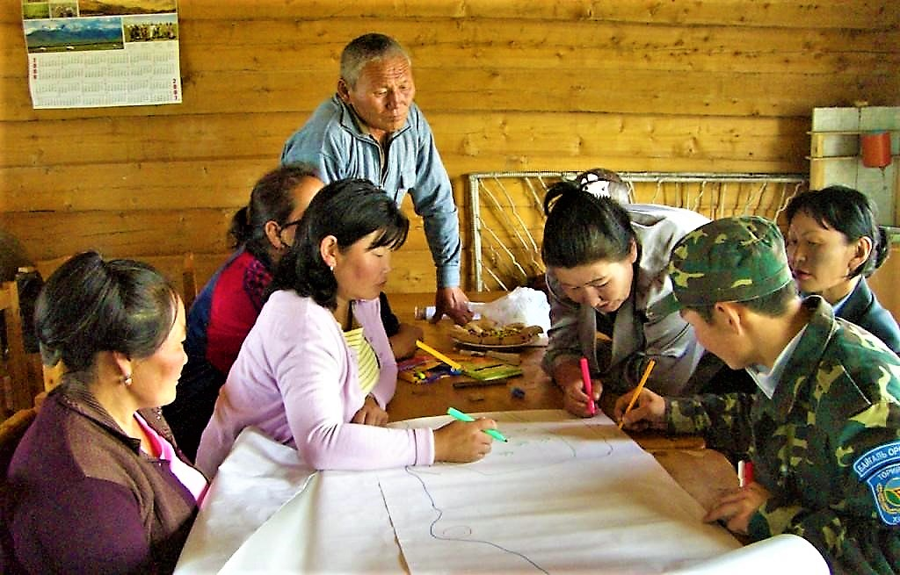

Slide 17
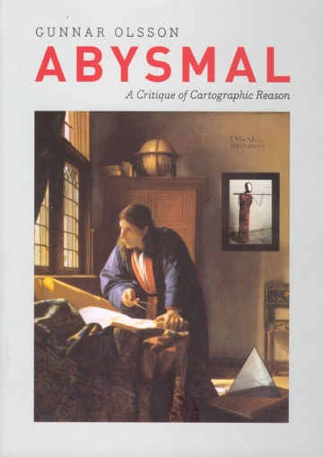
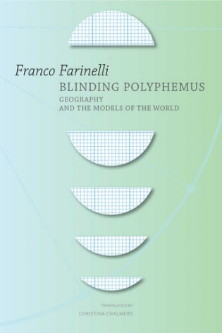
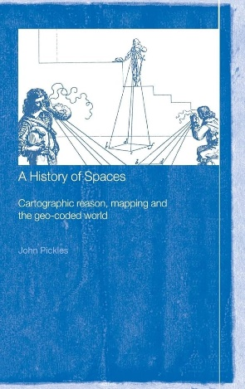
Critique of cartographic reason
Mapping the (practice of) mapping
  Gunnar Olsson, Franco Farinelli, and their successors
Cartography is a rationale for much of Western philosophical thought
  cartography is ocular-centric, accentuates a geometric approach to the world, and is able to structure our thoughts on a canvas. It stabilizes the world in synchrony, persuades us to perceive the world of and through boundaries, and is a utopian practice for world improvement.
Our belief in modern maps is almost religious

Slide 18
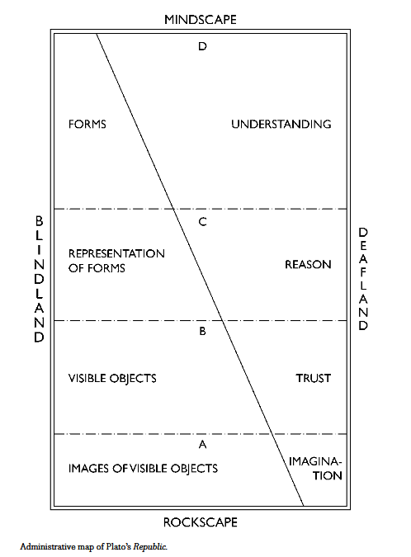

Slide 19
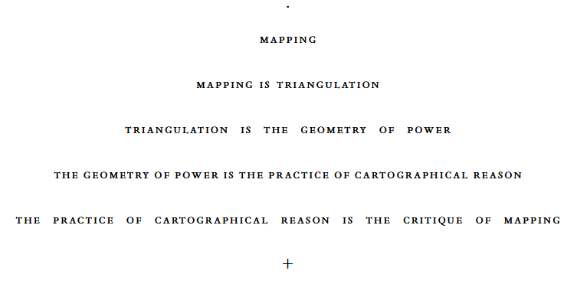

Slide 20
Post-representational cartography
Mapping as a set of practices rather than just the production of stable inert images
  processes, interactions, and performances involved in map-making and map-use
Mapping as embodied and situated knowledge
Mapping as plural and ontogenetical
  maps are not fixed but are constantly evolving through their use and reinterpretation
  maps are relational tools that help to negotiate and produce spatial understandings
  maps have agency
Maps as unstable and mutable objects
  object-oriented cartography

Slide 21
