Slide 1
Not So Short Introduction To
TopSpin
Spring 2016
Karel Kubíček

Slide 2
Data Processing using
TopSpin 3.X

Slide 3
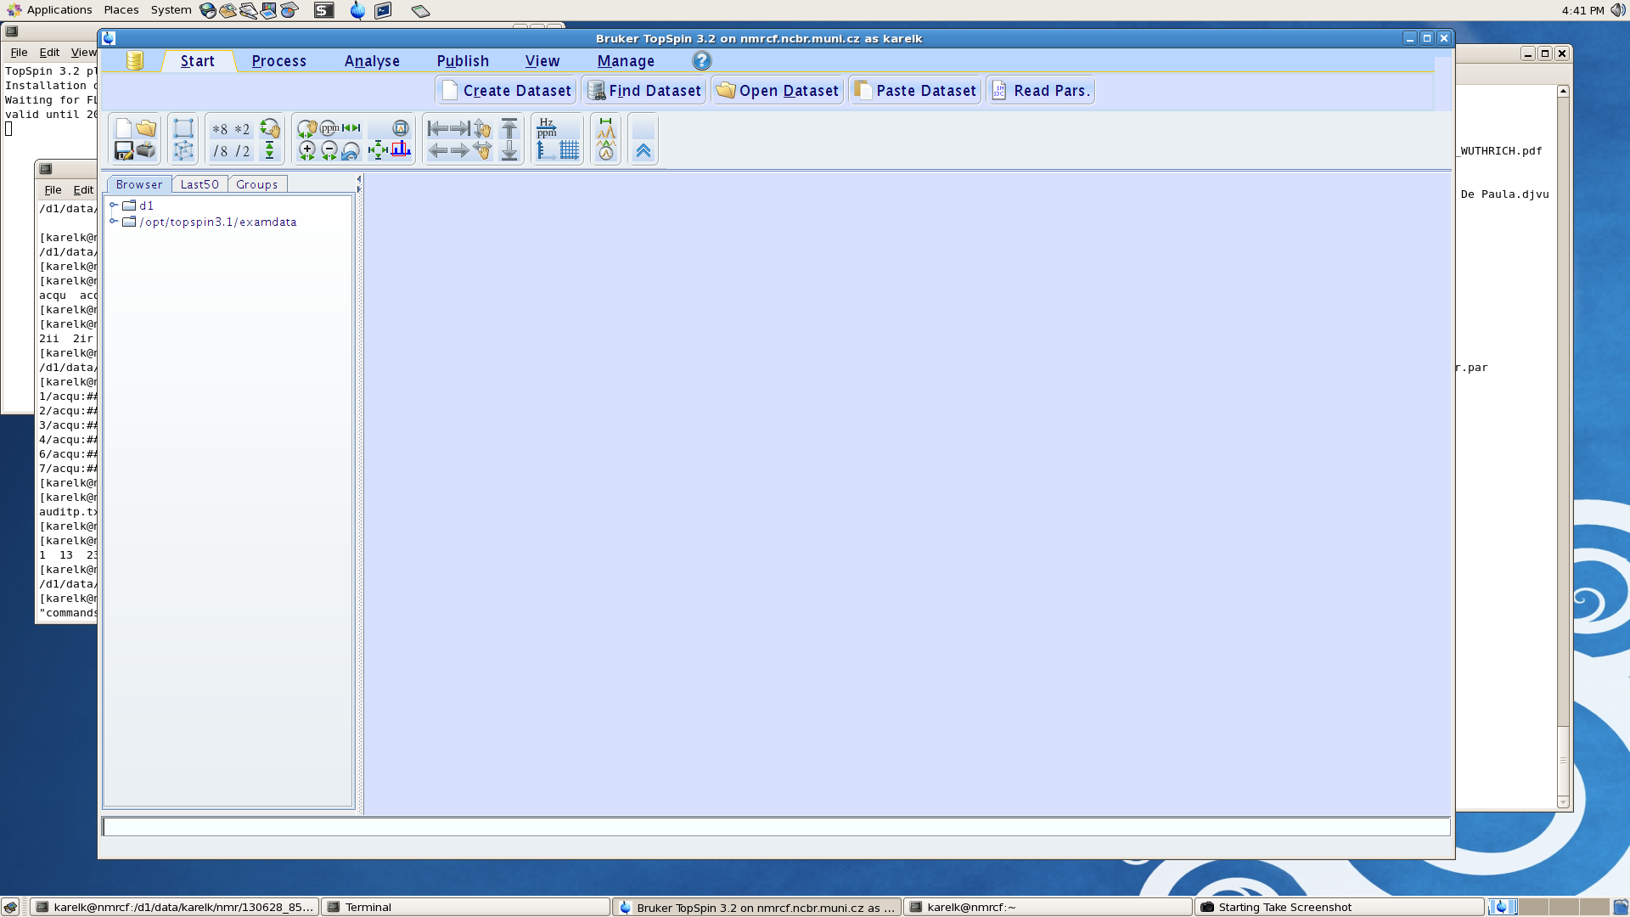
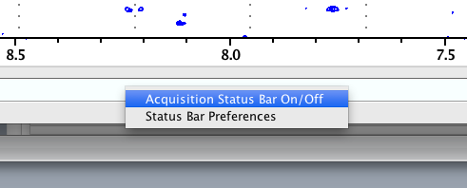
Topspin 3.X – layout description
2
1
1 – Menu/submenu bar
2 – Windows navigator
3 – Toolbar
4 – Browser
5 – Data/window area
6 – Command line
7– Status panel
3
4
5
6
7
Right mouse click in the status bar area toggles it on/off

Slide 4
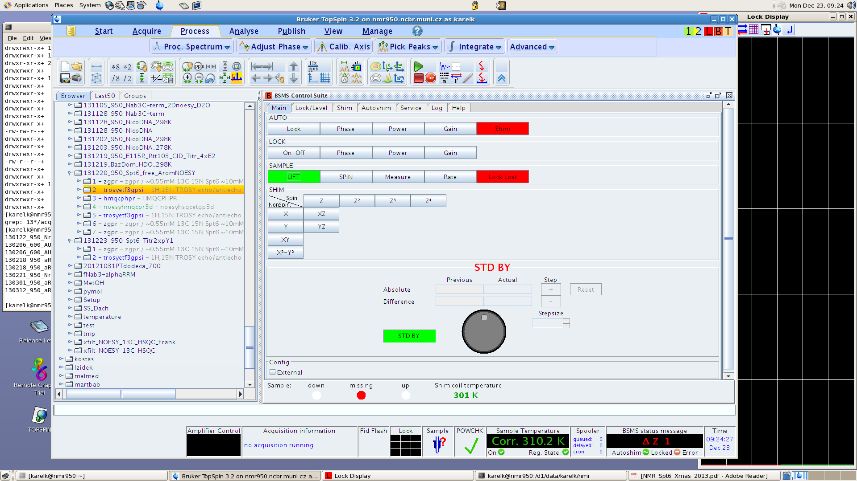

Topspin 3.X – layout description
2
1
1 – Menu bar
2 – Windows navigator
3 – Toolbar
4 – Browser
5 – Data/window area
6 – Command line
7– Status panel
3
4
5
6
7

Slide 5
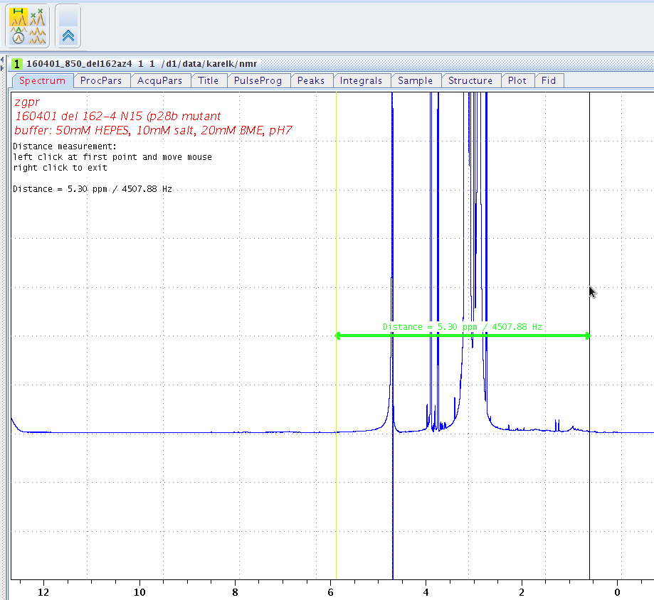

Slide 6
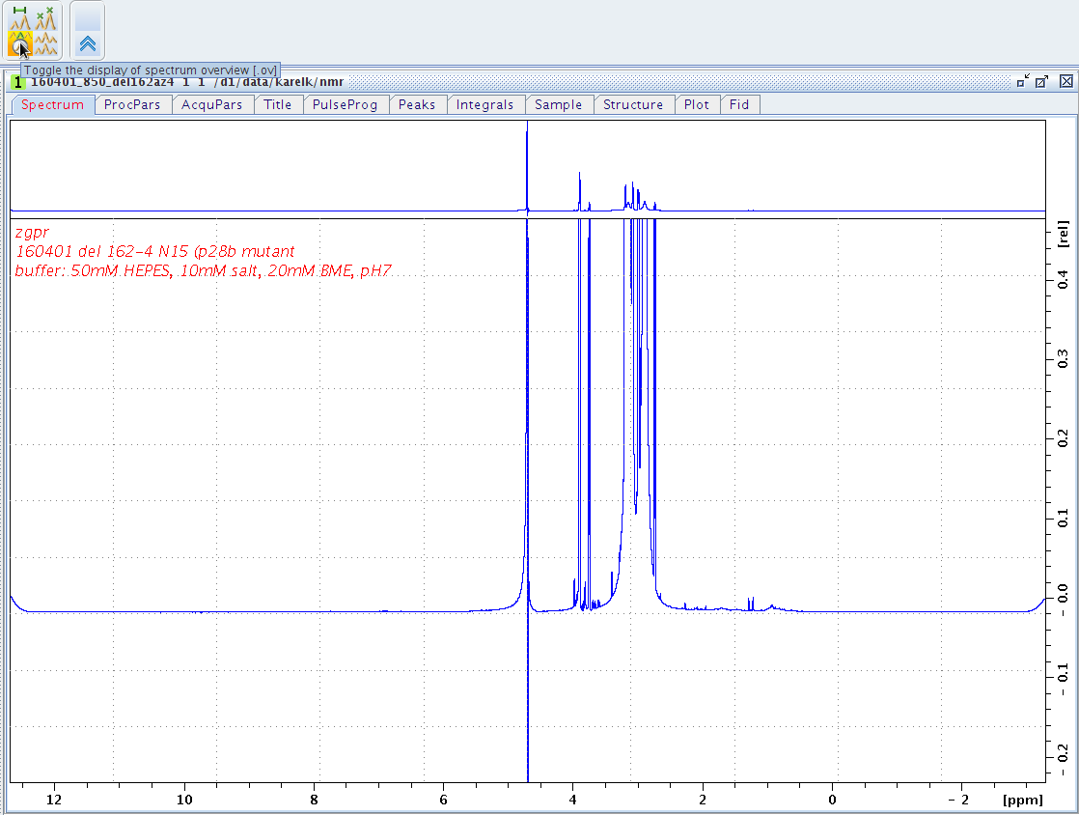

Slide 7
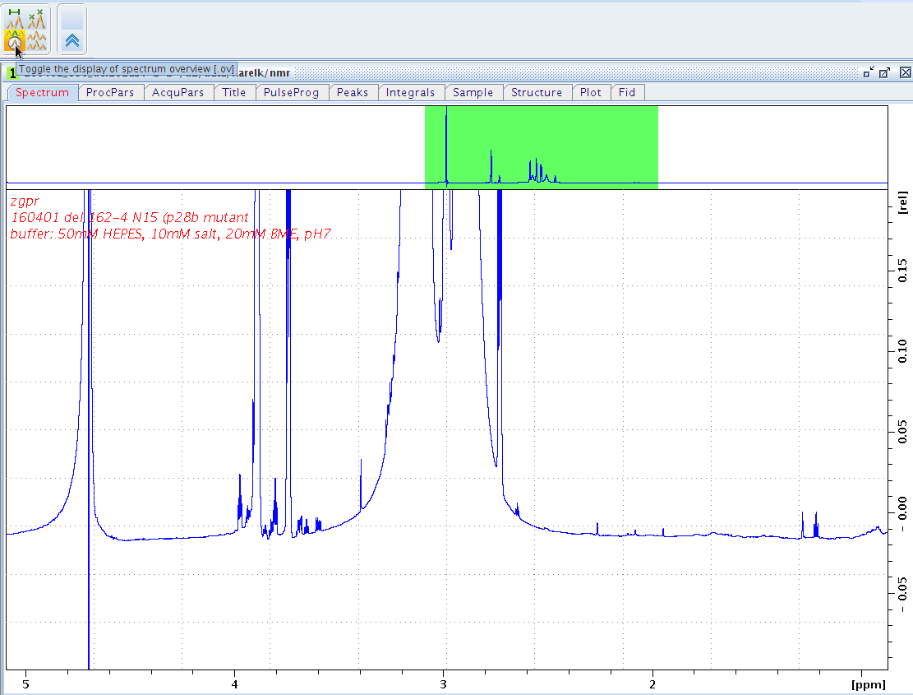

Slide 8
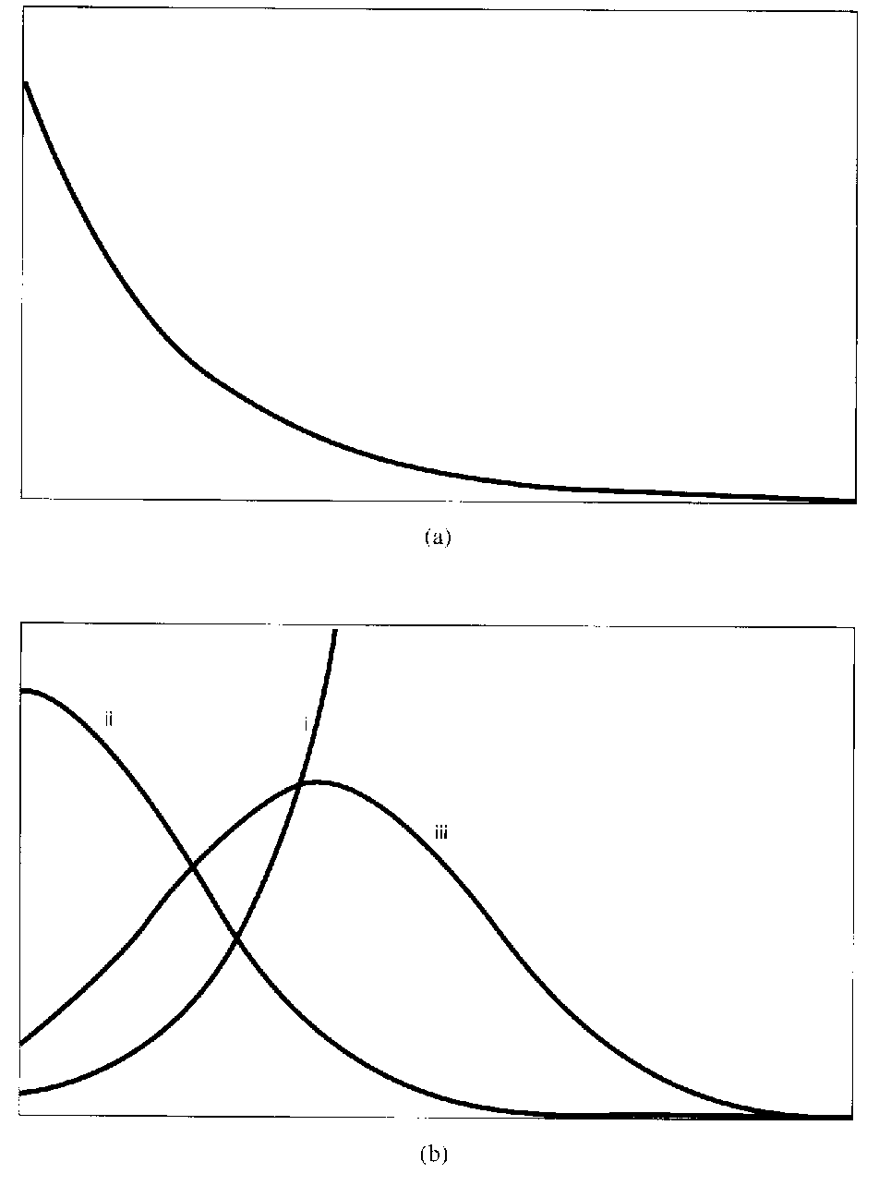
NMR data processing
Window functions:
1) improvement of S/N ratio
2) improvement of resolution

Slide 9
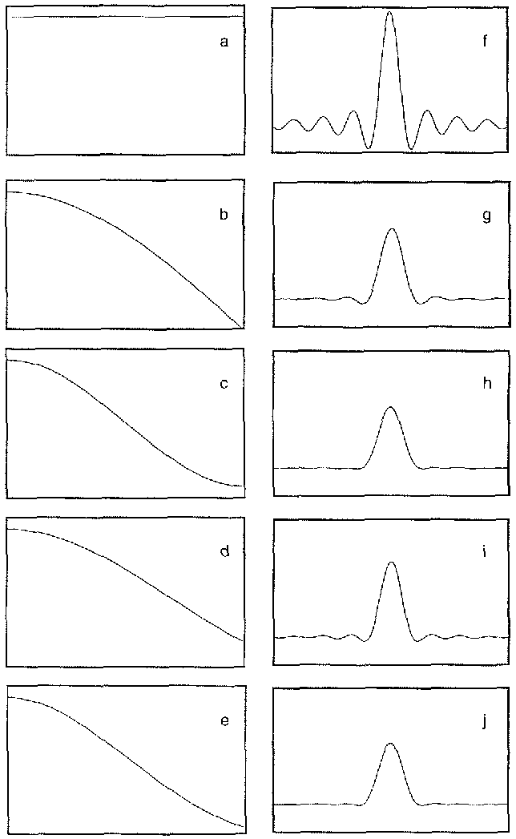
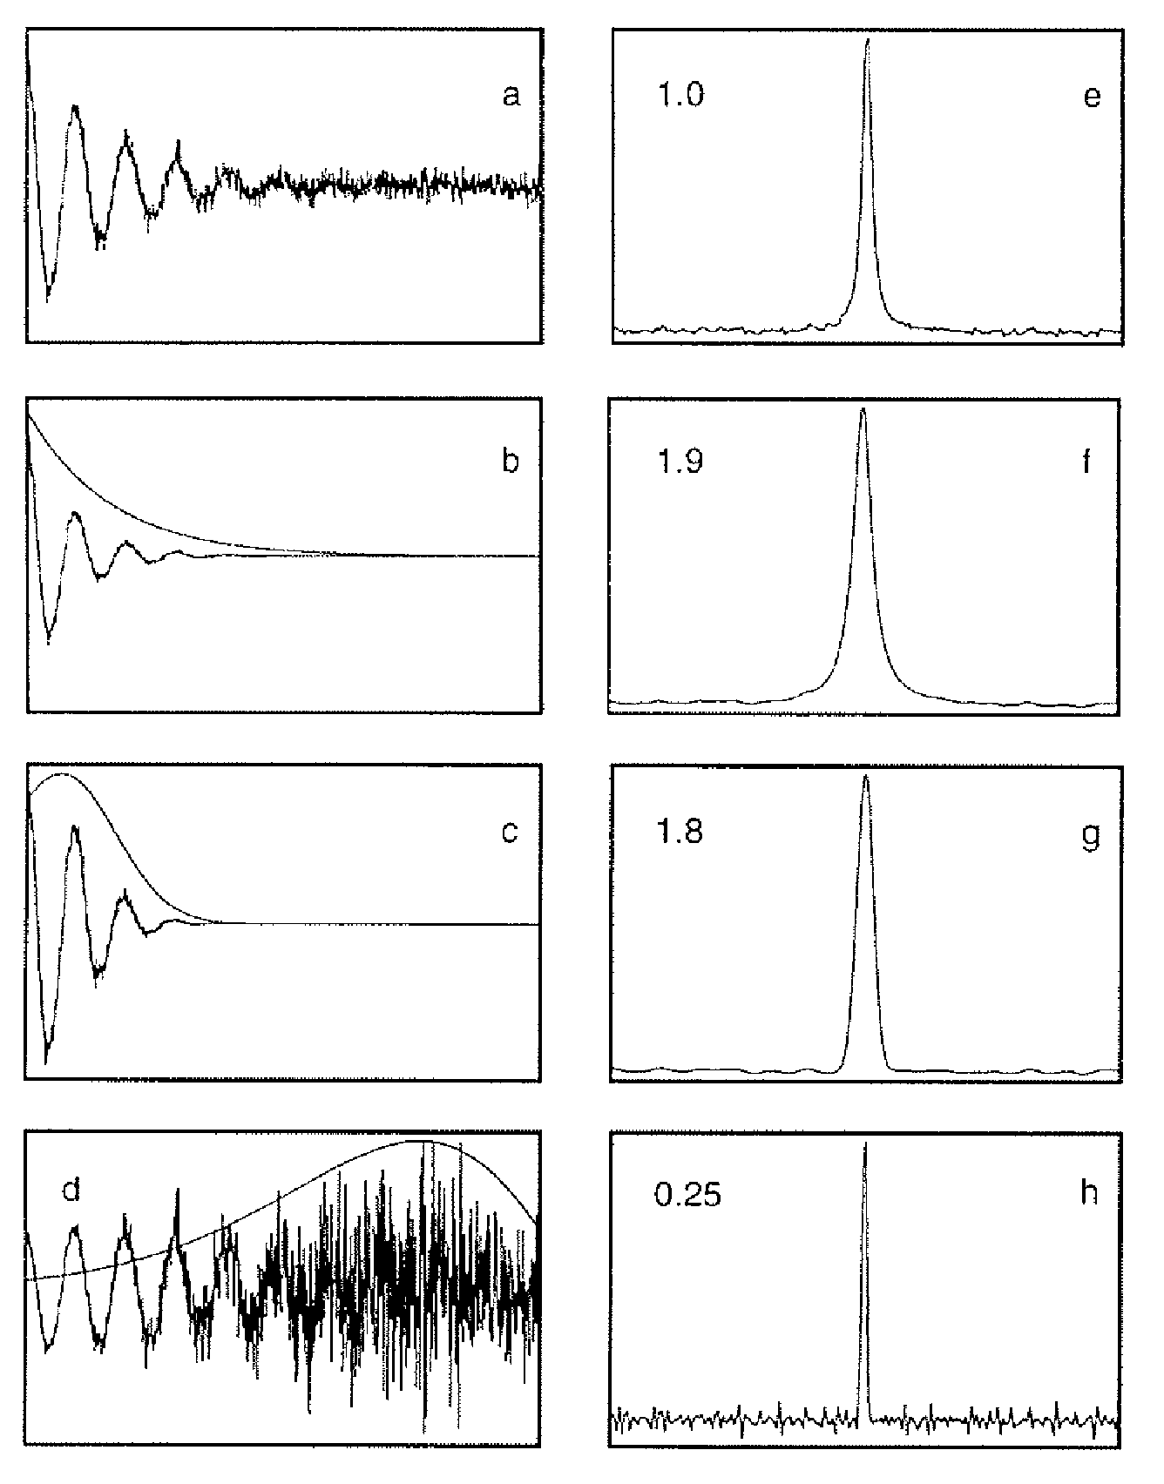
NMR data processing – window functions - apodization
Exp
Lor.-Gauss
Kaiser w. f’tion

Slide 10
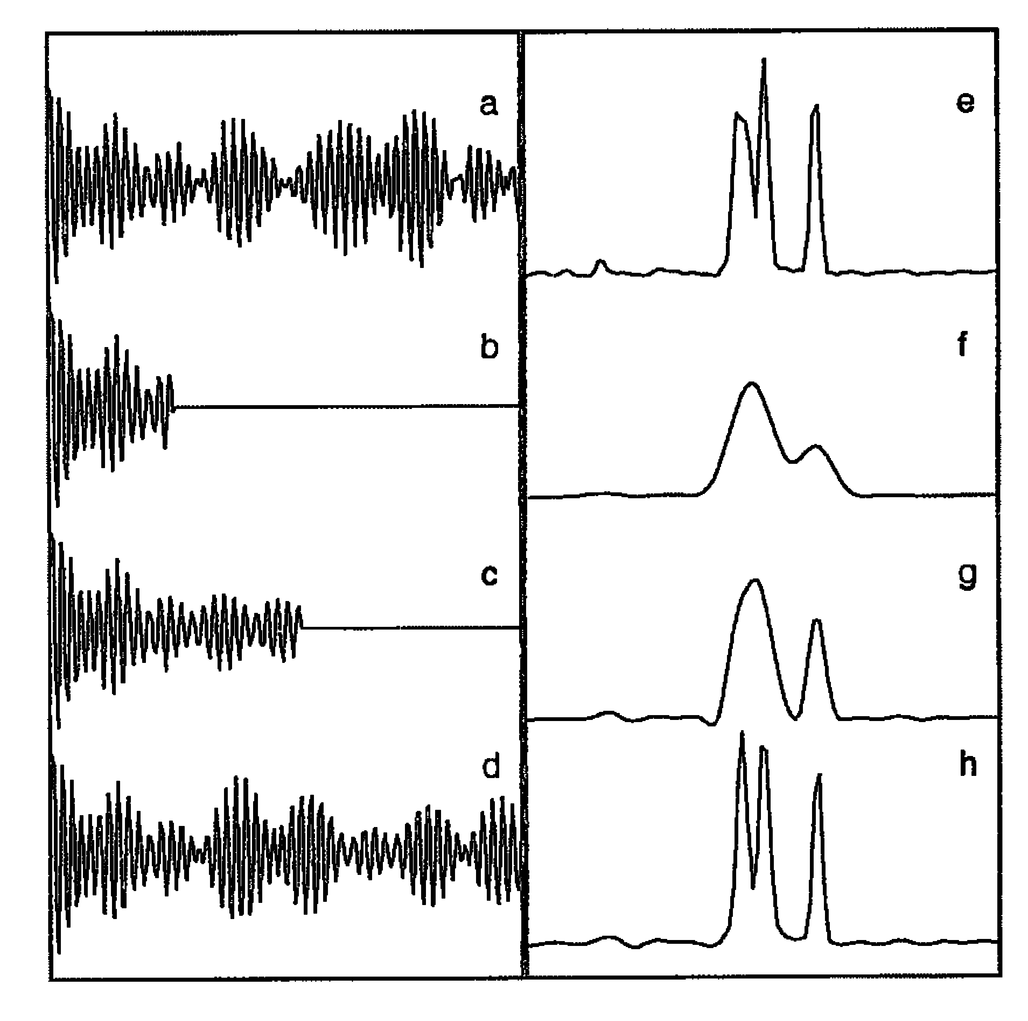
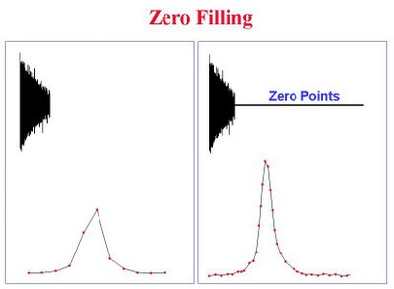
Zpracování NMR dat – Zero Filling, Lineární predikce
Lineární predikce
240 bodů
Zero filling
64 bodů
LP na 128 bodů
LP na 240 bodů

Slide 11
NMR data processing – summary
Solvent suppresion
Window functions
Zero-filling
FT
Transpozition
|nmrPipe -fn POLY -time \
|nmrPipe -fn SP -off 0.33 -end 0.98 -pow 2 -c 1.0 \
|nmrPipe -fn ZF -size 2048 \
|nmrPipe -fn FT -auto \
|nmrPipe -fn PS -p0 -76.0 -p1 0.0 -di \
|nmrPipe -fn EXT -x1 11.0ppm -xn 6.0ppm -sw \
|nmrPipe -fn POLY -ord 3 -auto \
|nmrPipe -fn TP \
F2

Slide 12
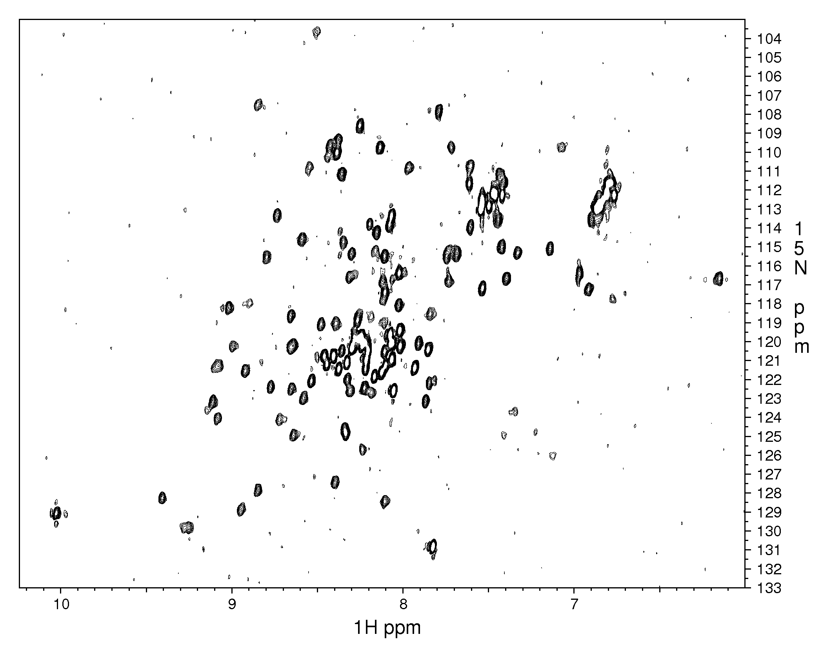
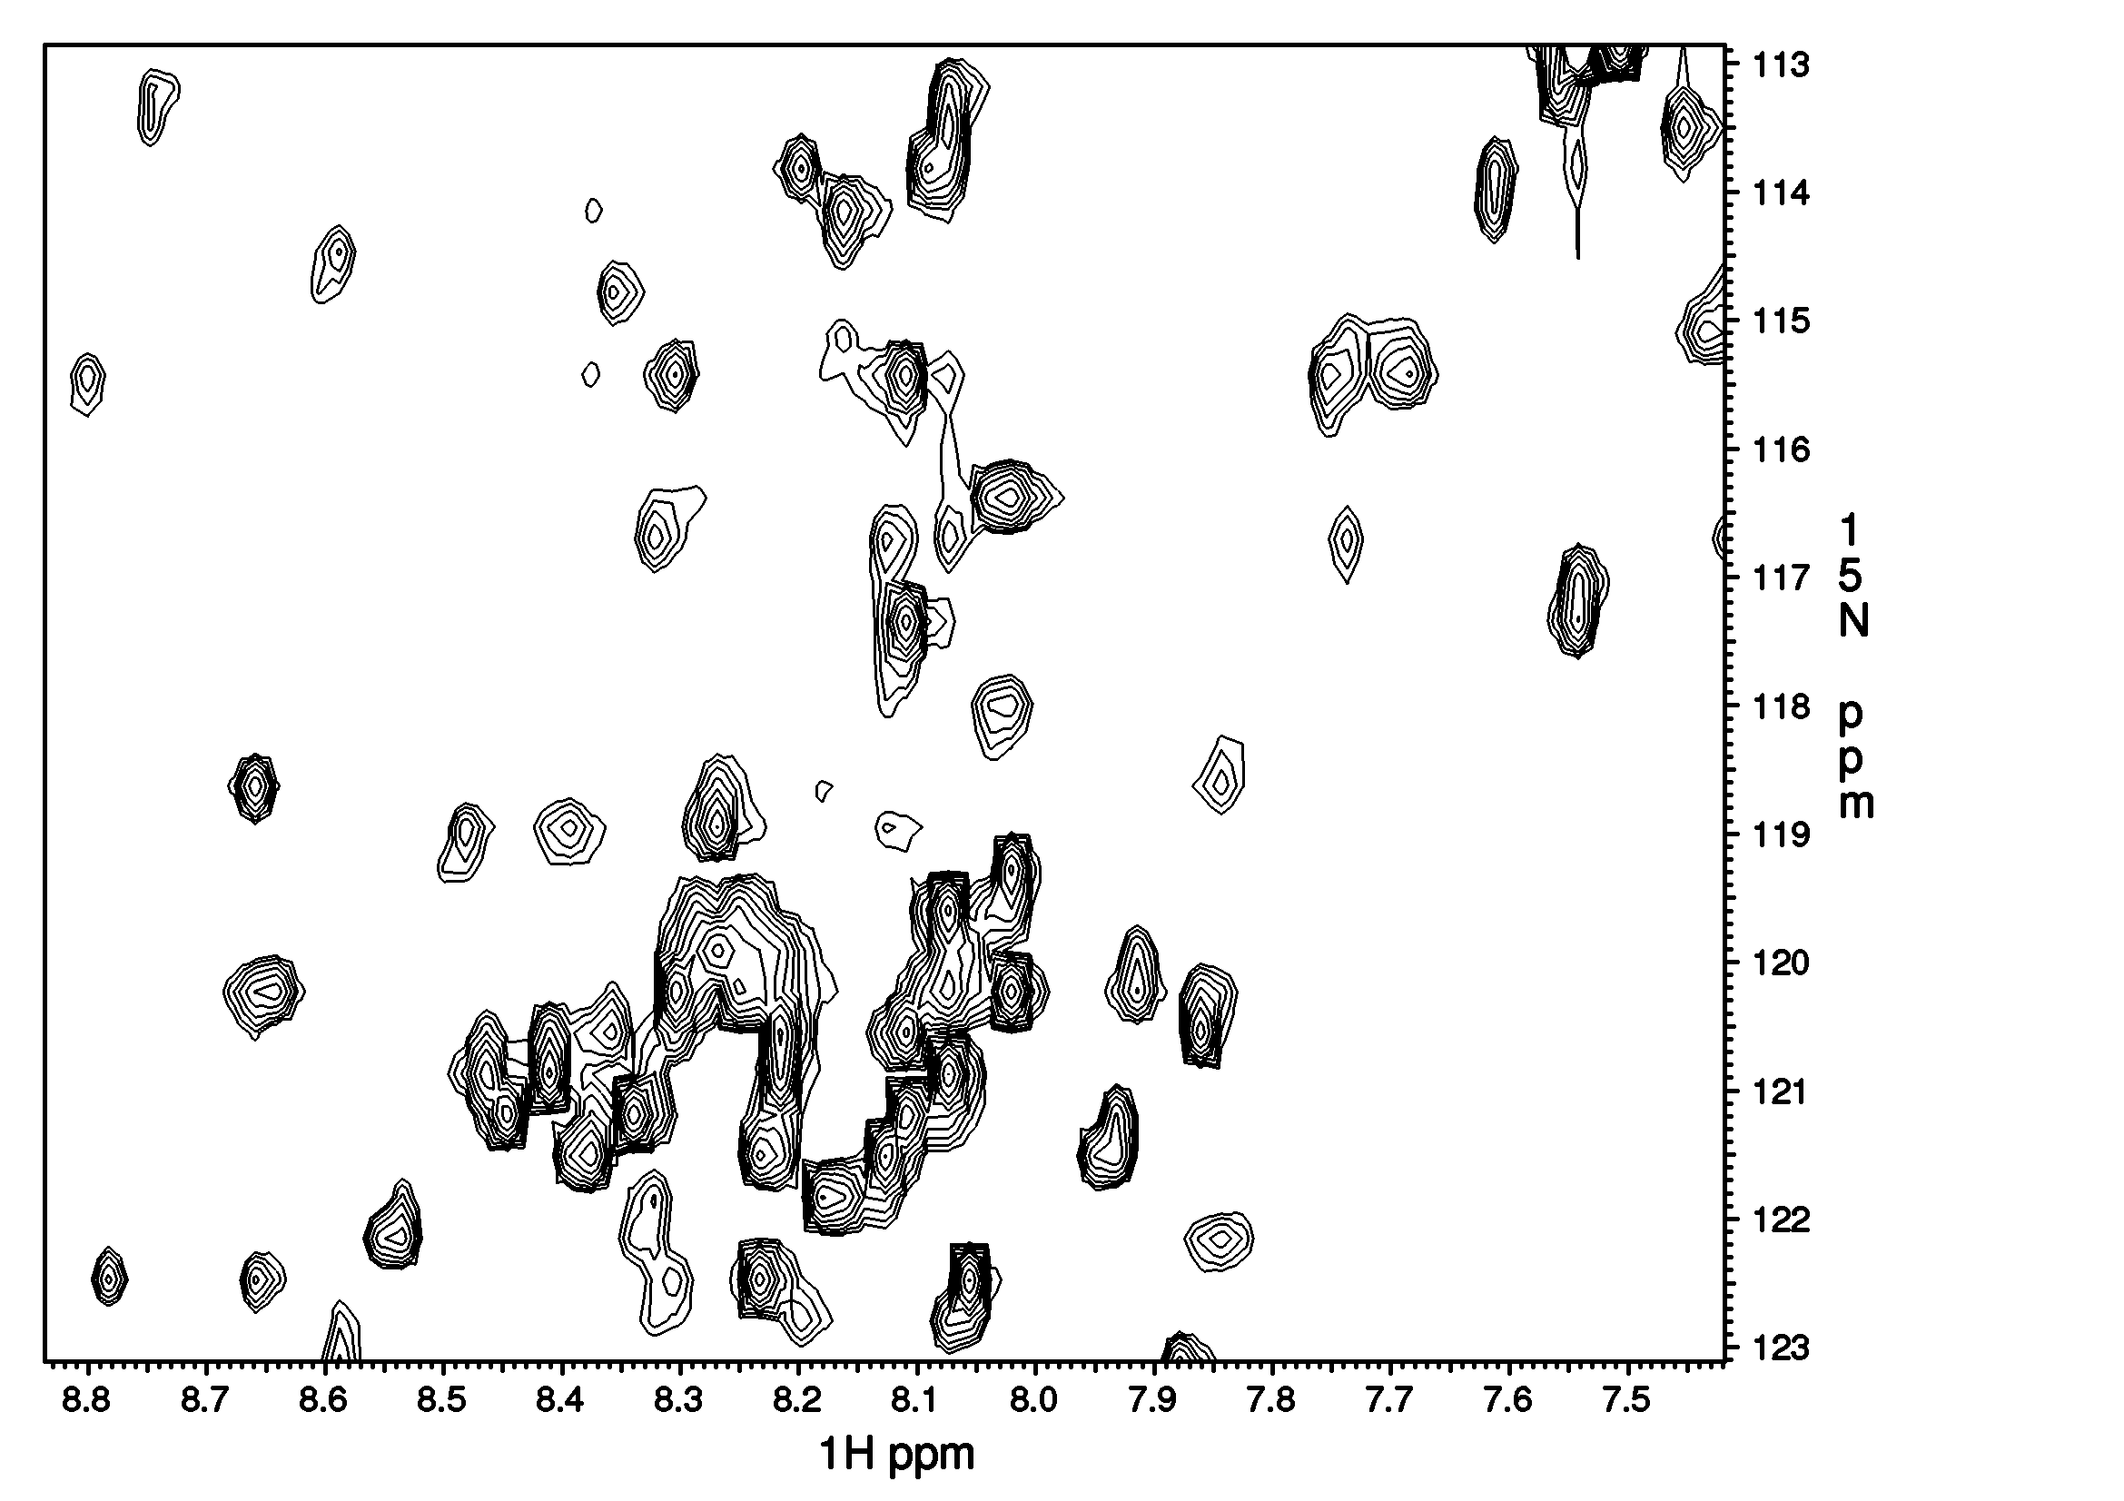
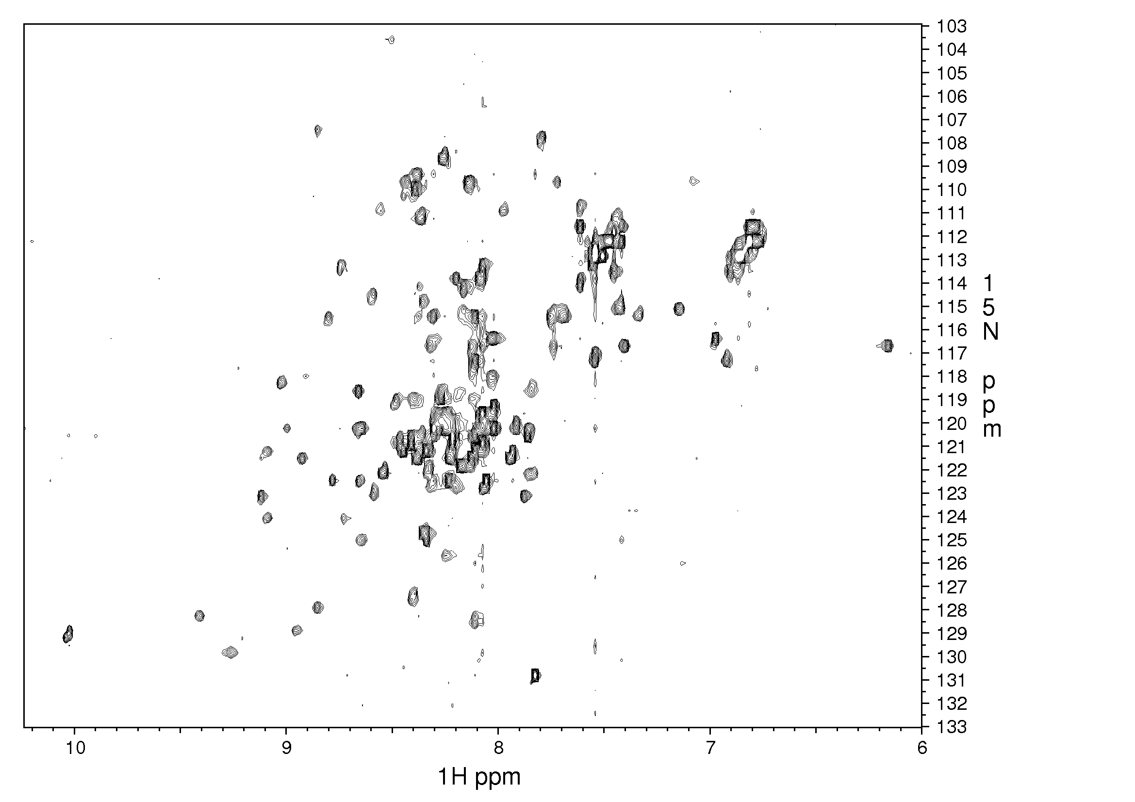
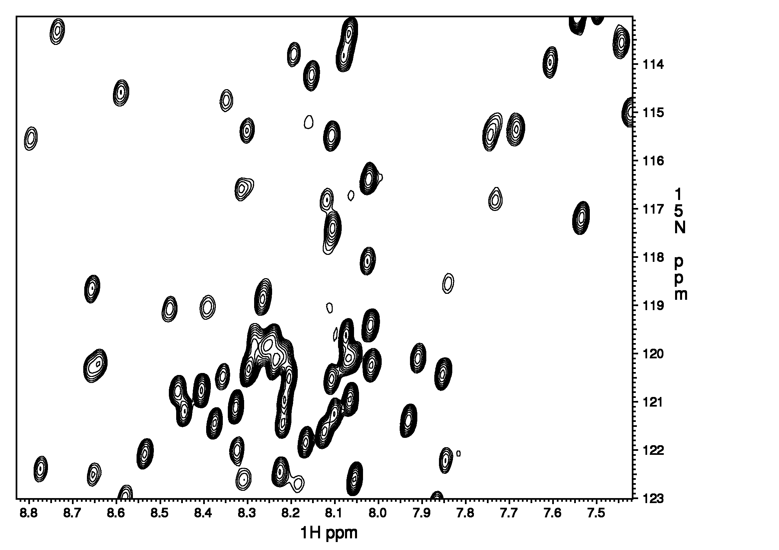

Slide 13
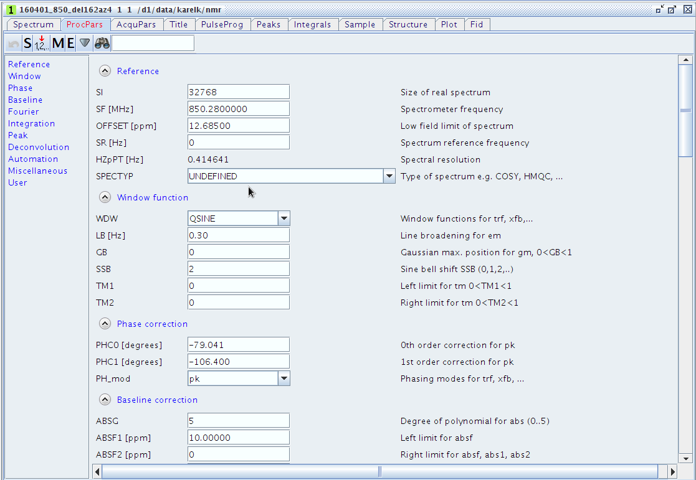

Slide 14
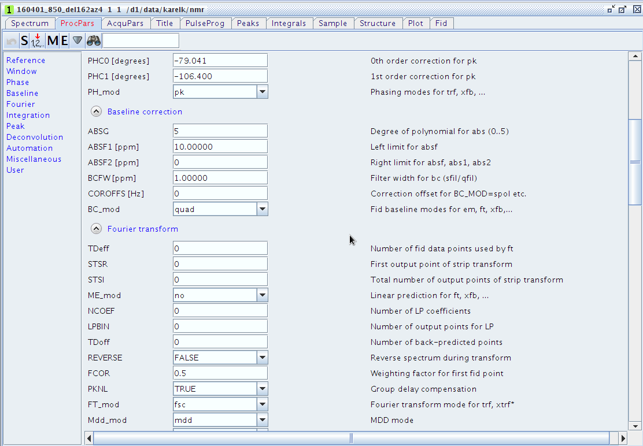

Slide 15
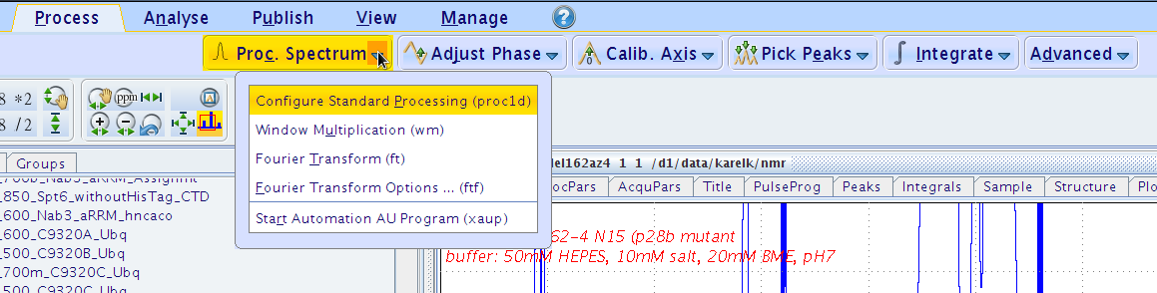

Slide 16
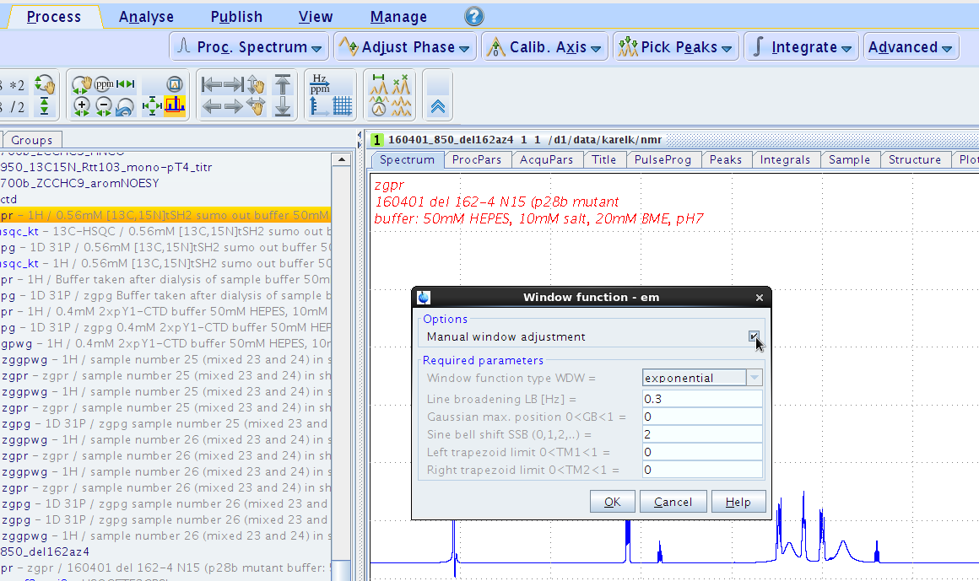

Slide 17
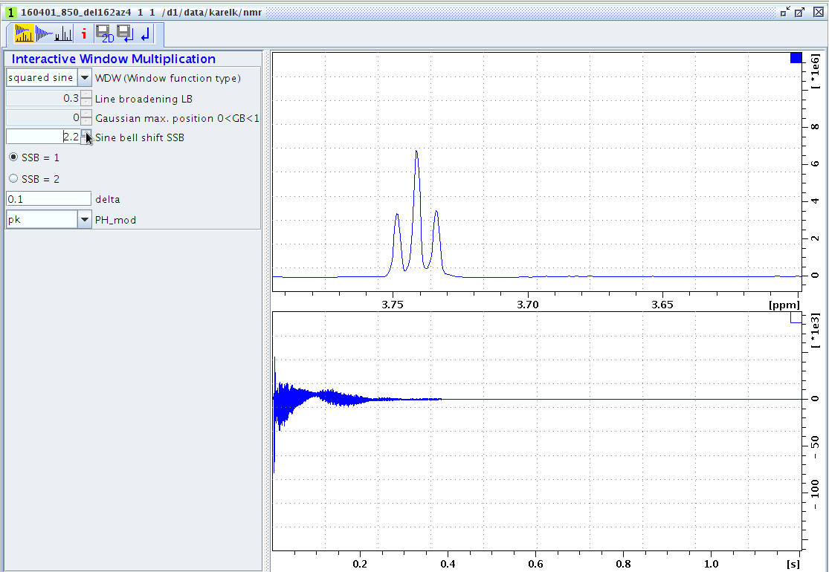
QSIN(t) = sin[(π-PHI)*(t/AQ+PHI)]²
0 < t < AQ and AQ = π / SSB

Slide 18
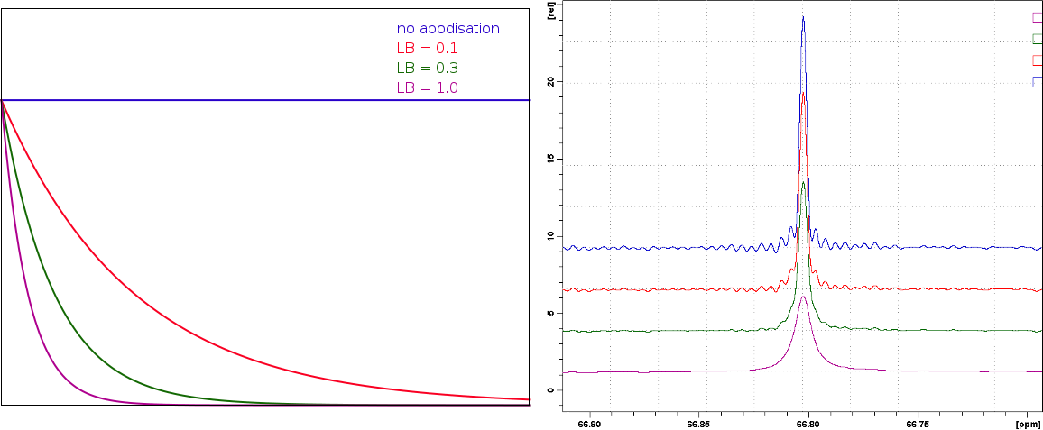
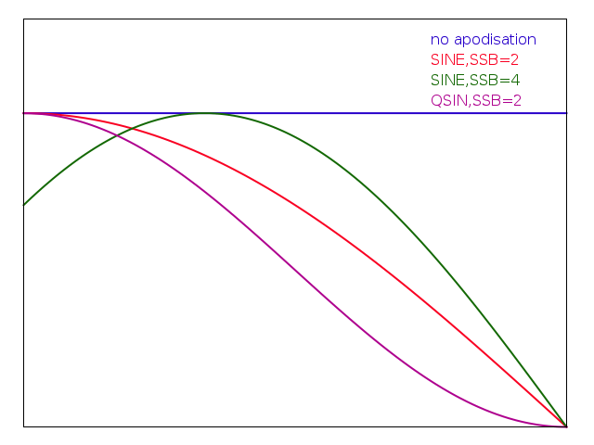
http://sopnmr.blogspot.cz/2016/01/processing-window-functions.html

Slide 19
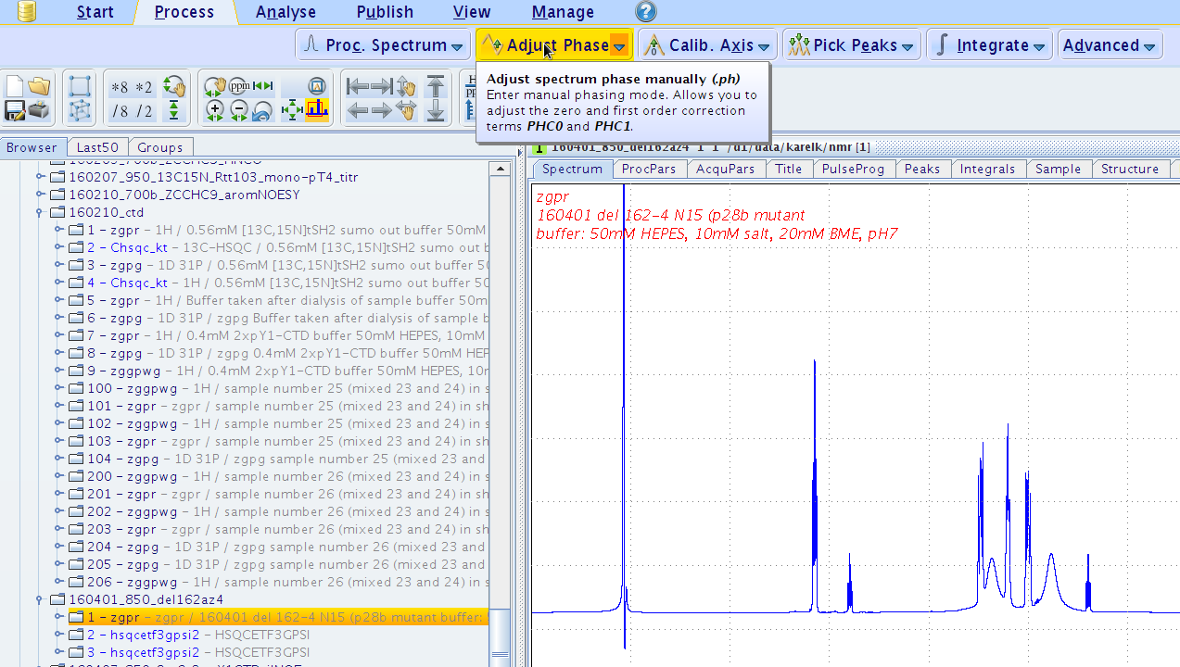

Slide 20
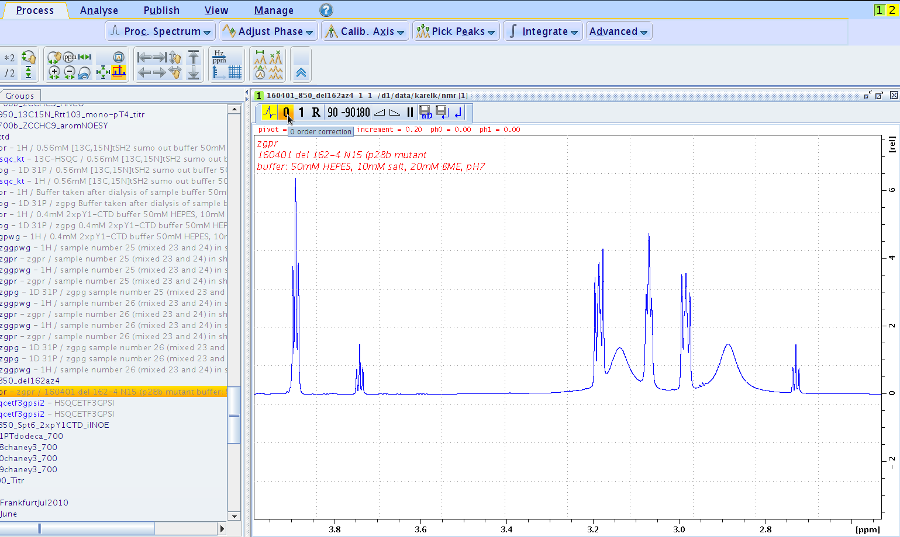

Slide 21
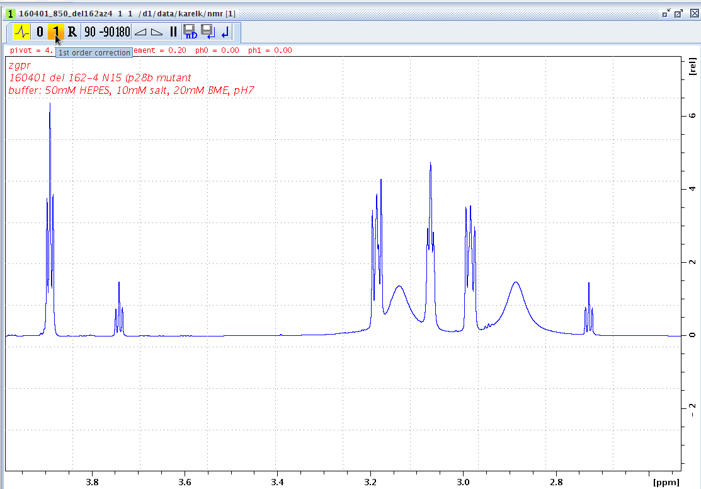

Slide 22
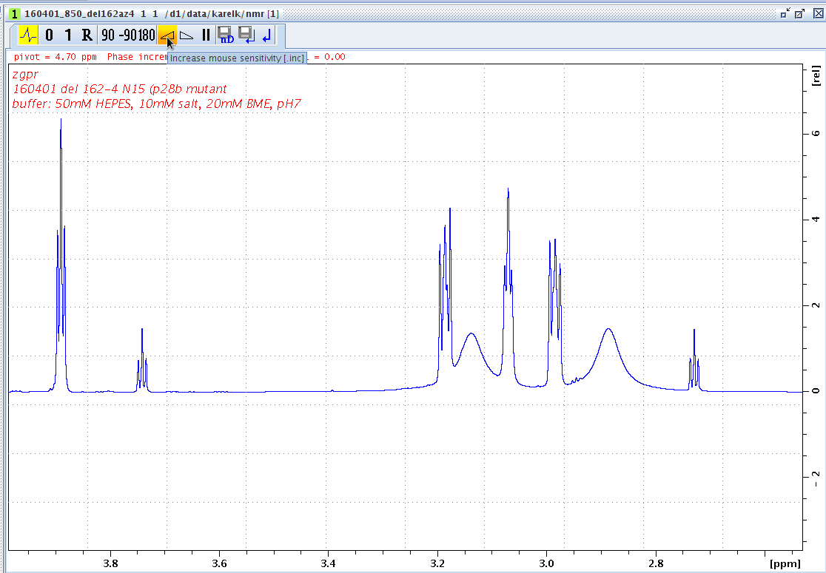

Slide 23
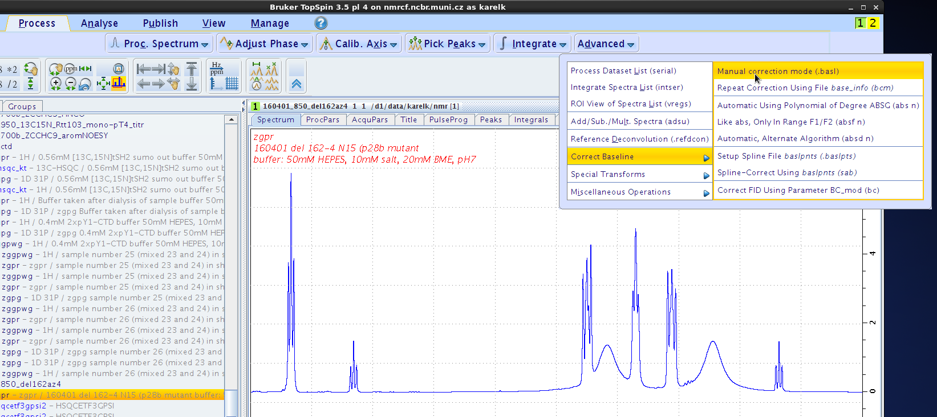

Slide 24
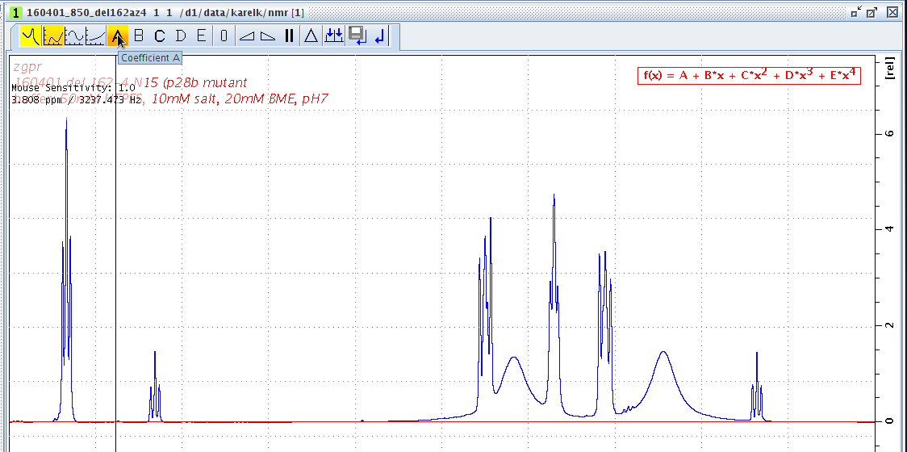

Slide 25
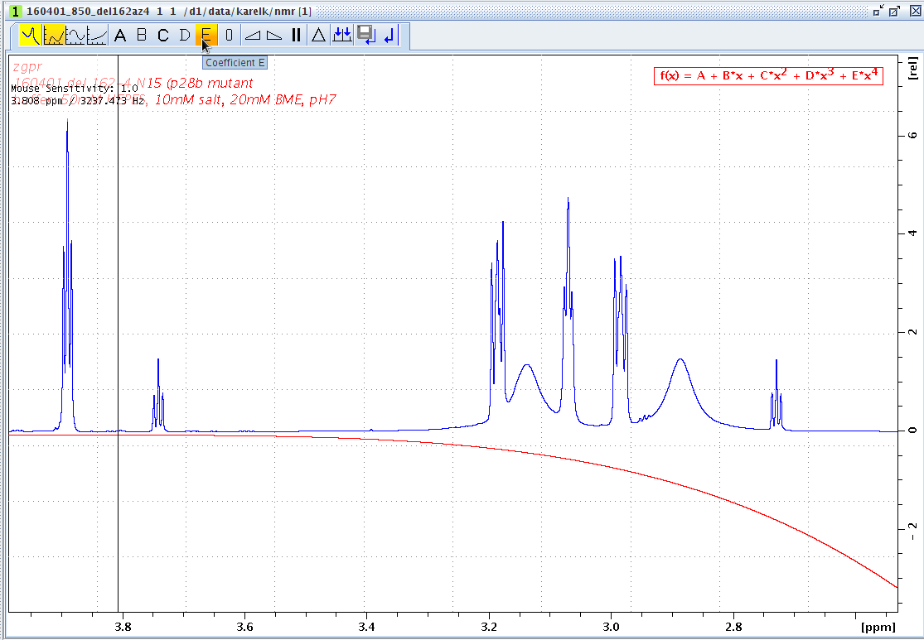

Slide 26
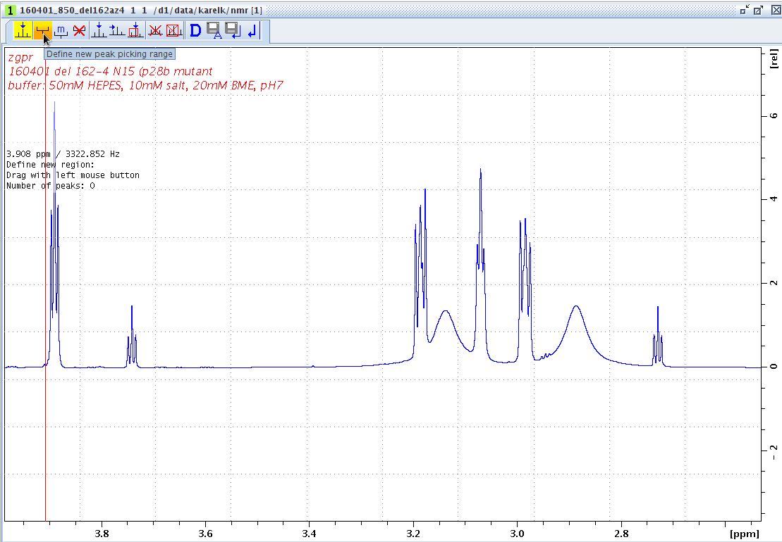

Slide 27
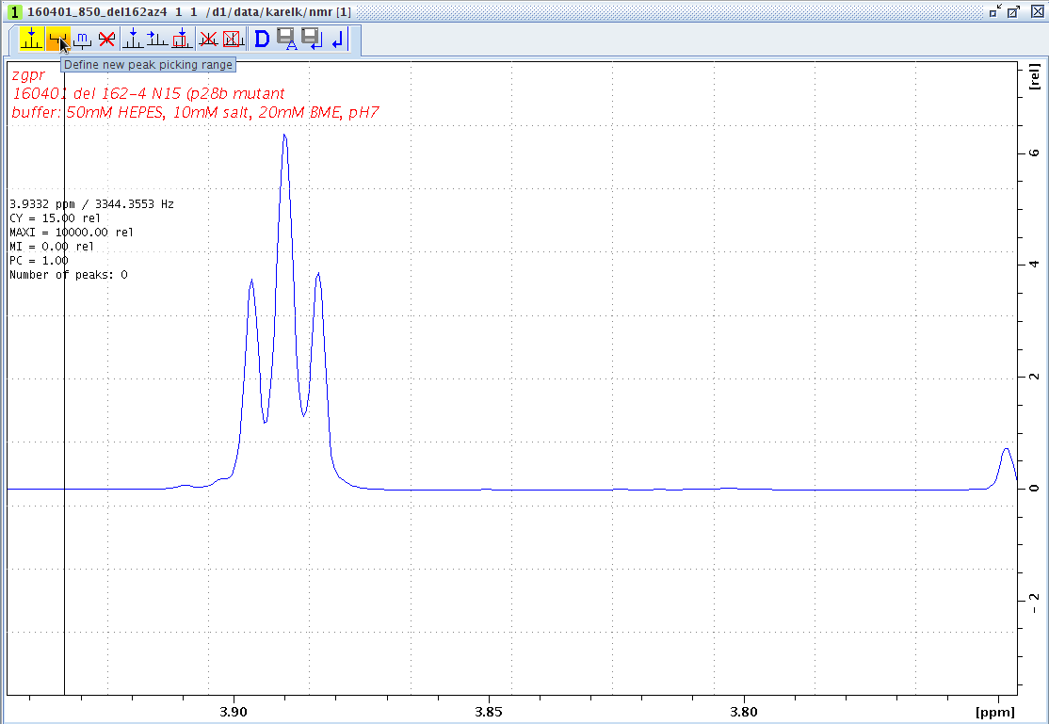

Slide 28
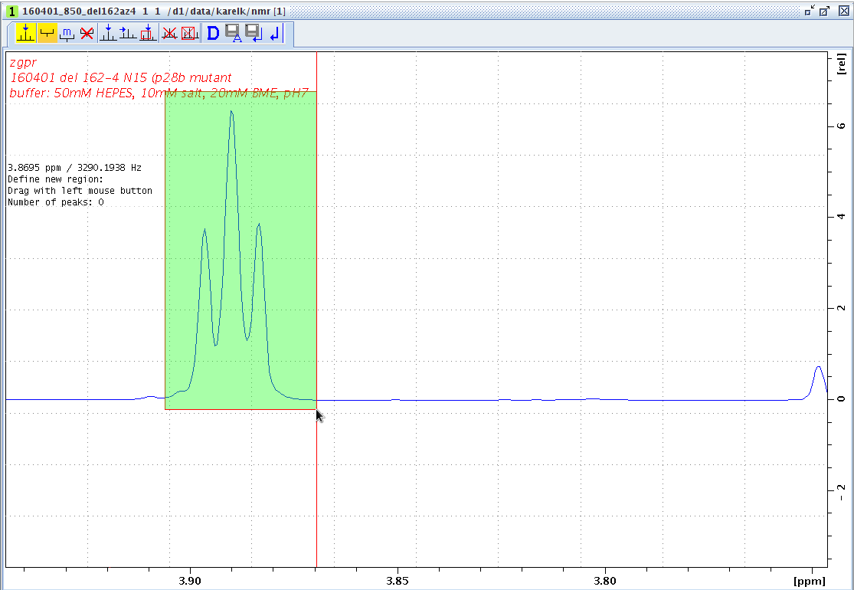

Slide 29
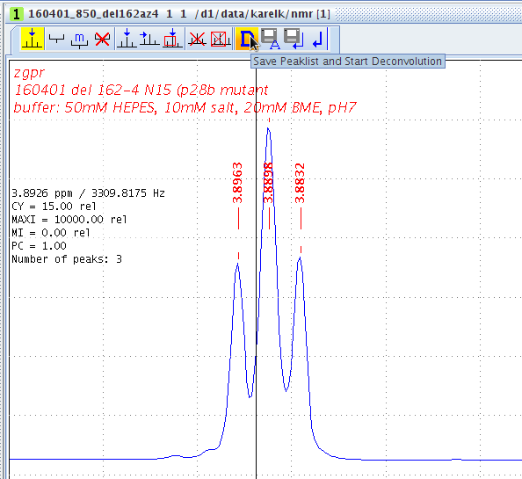

Slide 30
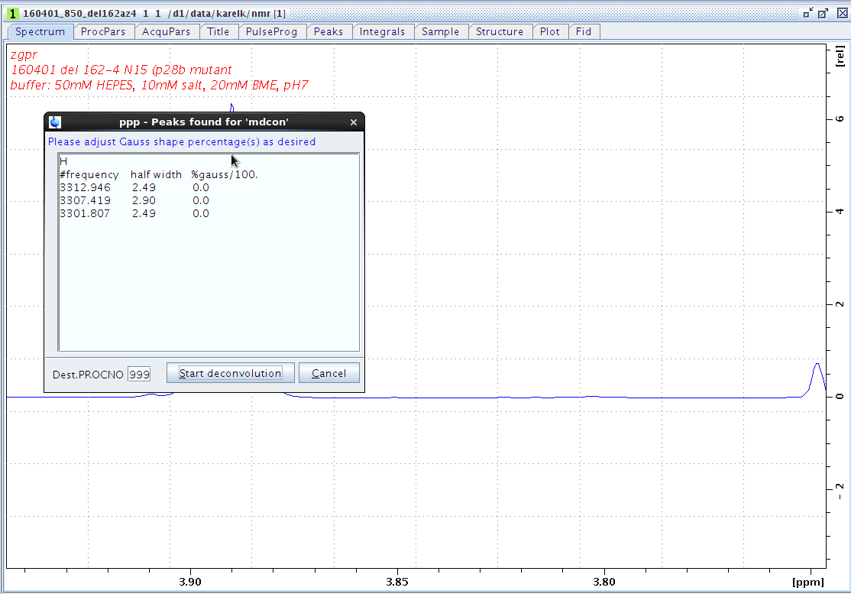

Slide 31
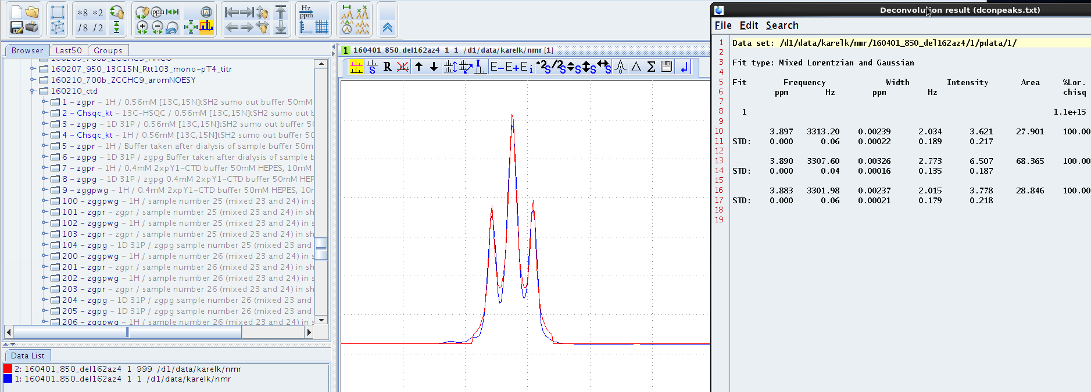

Slide 32
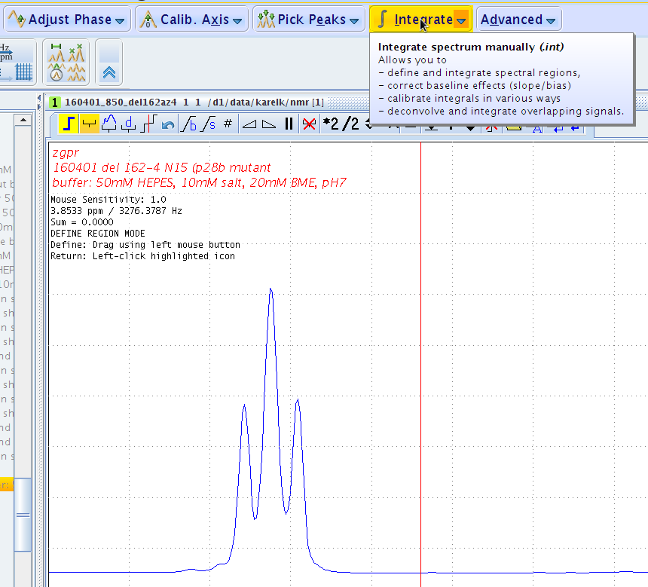

Slide 33
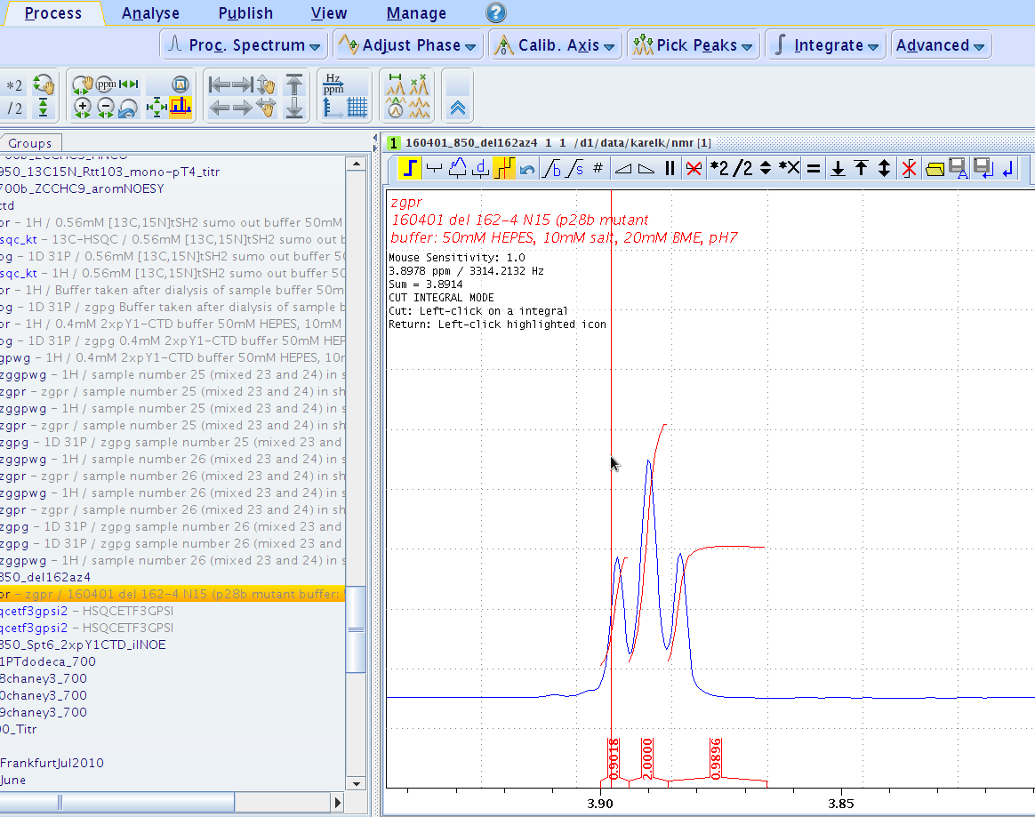

Slide 34
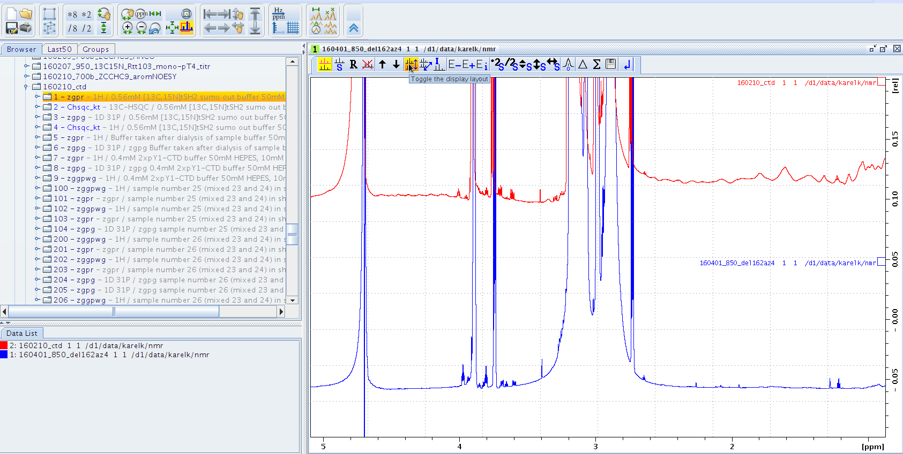

Slide 35
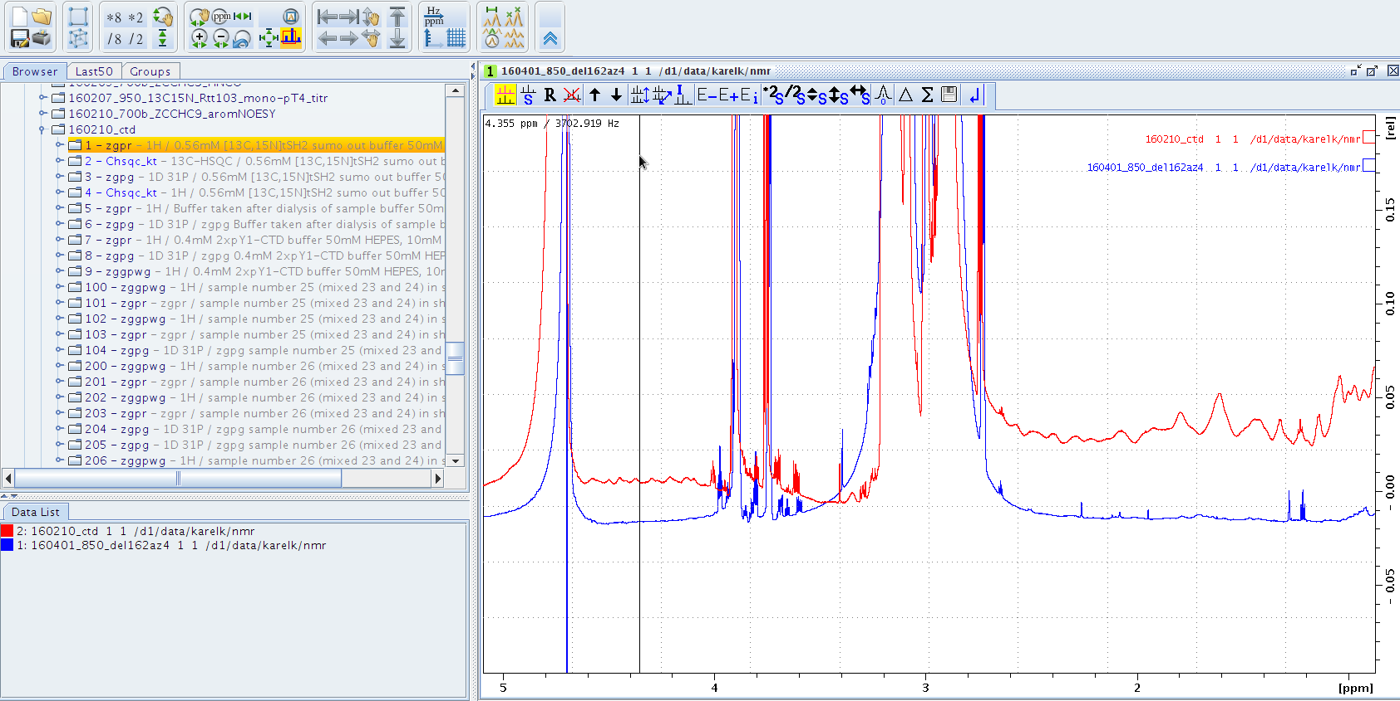

Slide 36
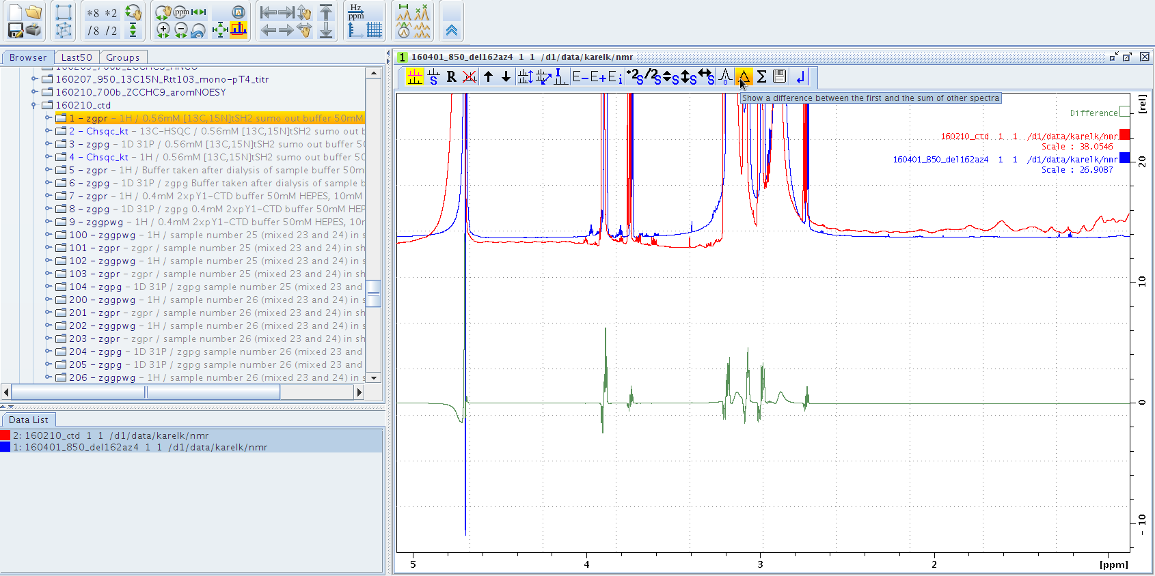

Slide 37
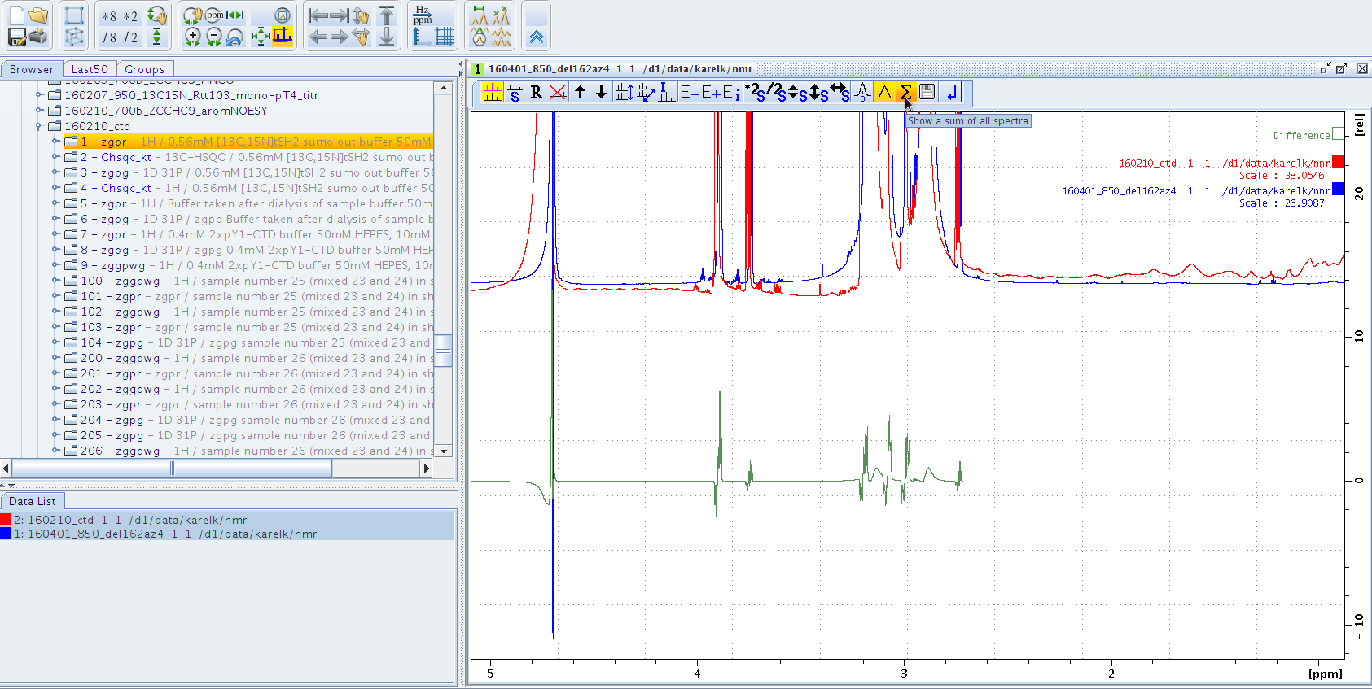

Slide 38
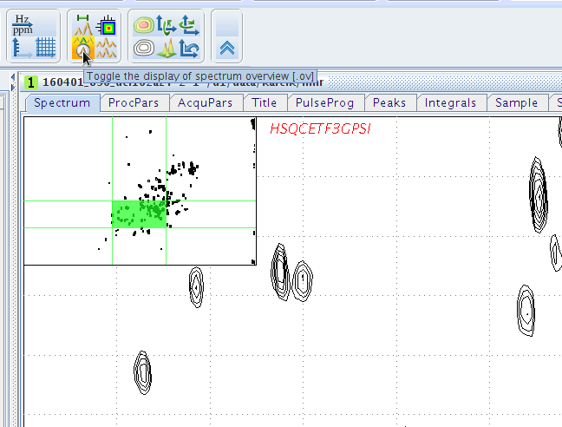

Slide 39
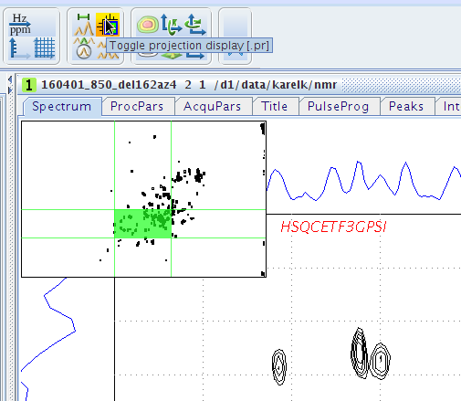

Slide 40
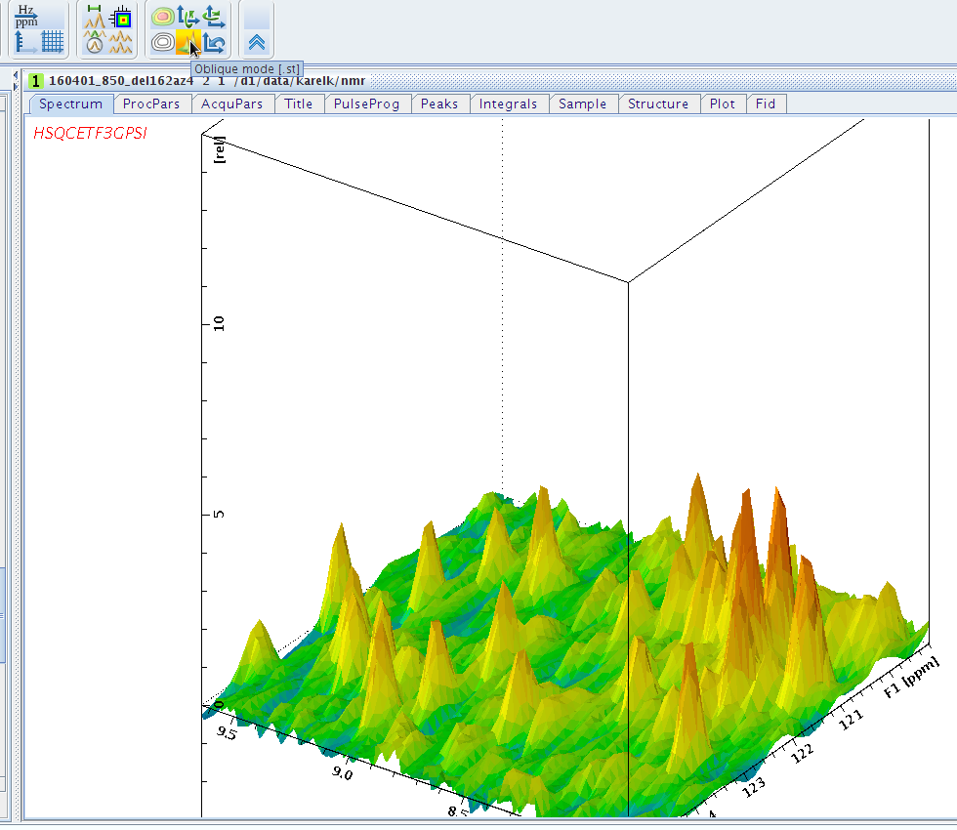

Slide 41
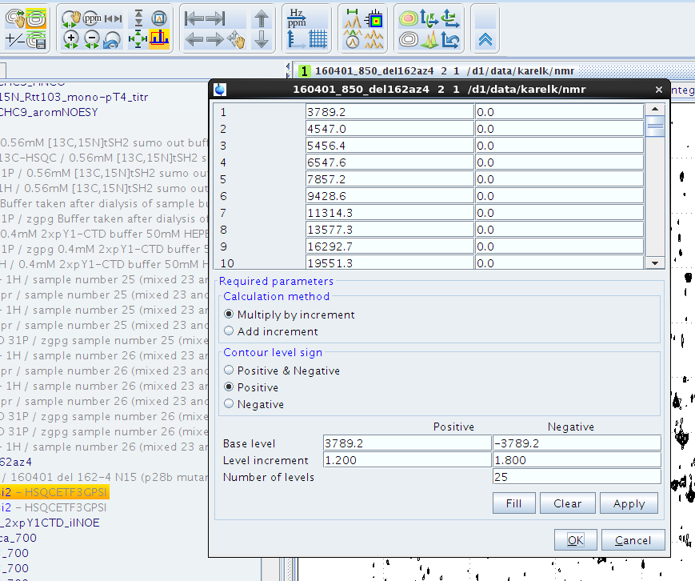

Slide 42
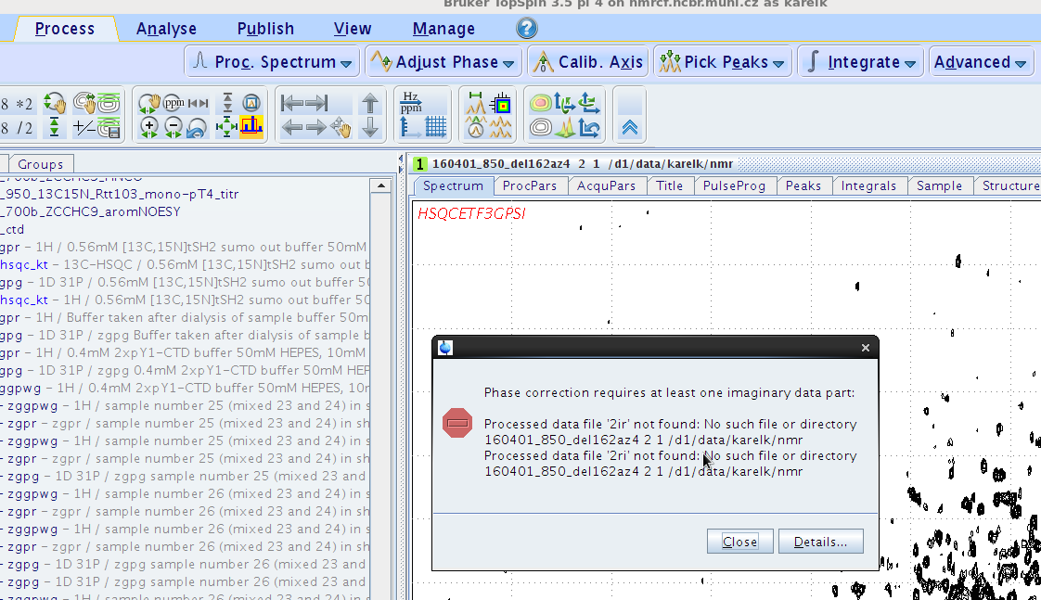

Slide 43
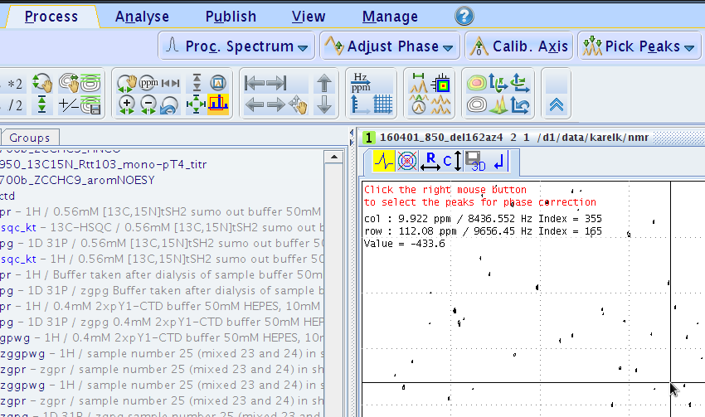

Slide 44
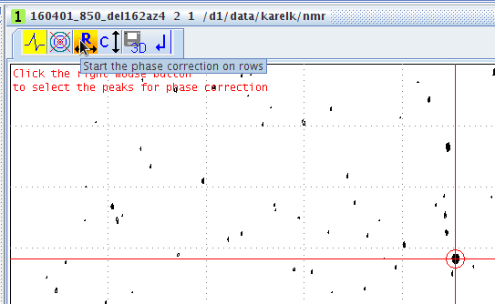

Slide 45
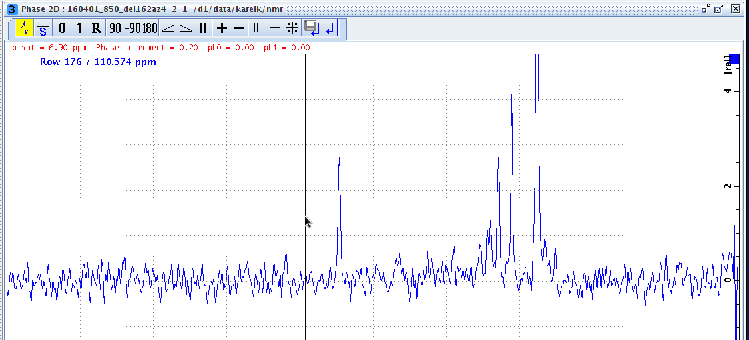

Slide 46
Quick reference:
edp – open Processing tab
qsin – multiply FID with qsin window function
qfp – qsine+ft+phase correction
efp – exponential w. f’tion+ft+phase corr.
1 td – display number of set TD points in F1
1s td – display really acquired # TD pts in F1
1s te – display temperature @ which was experiment measured
fp – Fourier transformation+phase correction
.ph – start phase menu
.md – spectra overlay window
re 1 – go to ExpNo 1 of current dataset
rep 1 – go to ProcNo of current ExpNo
levcalc – calculate contour levels
edlev – edit contour levels
xf1 – process 2D data in F1
xf2 – process 2D data in F2
xfb – process 2D
xfb n – process 2D and remove 2ri, 2ir, 2ii
abs1, abs2 – baseline correction in 2D
ft3d – 3D data processing
ft3d n - process 3D and remove imaginary part
tabs1, tabs2, tabs3 – baseline correction in 3D
ftnd 0 – processing of 3D acquired with NUS
edmac name – create or edit macro name
wrp 2 y – write processed data to ProcNo 2 and if exists, overwrite
rser 1 – extract first FID of an nD experiment
apk – automatic phase correction
show – show active processes
curplot – set up printer
print – print spectrum

