Slide 1
Basics of SAXS in structural analysis (of biomolecules)
Karel Kubíček

Slide 2
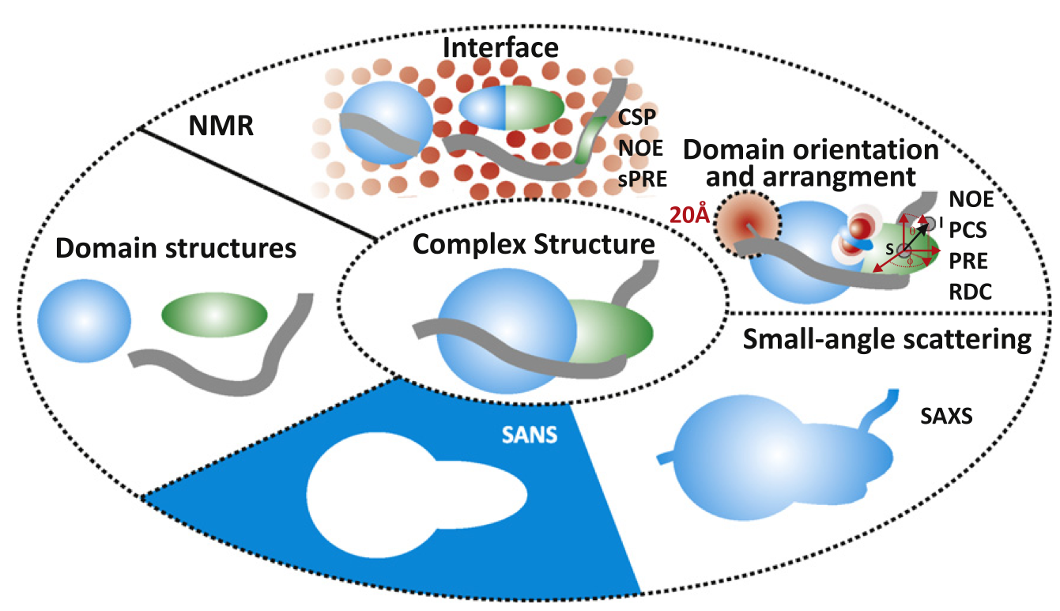
Motivation

Slide 3
Terminology
X-ray – diffraction / scattering
XS - X-ray scattering
SAXS/WAXS - Small/Wide Angle X-ray Scattering
SANS - --------”---------- Neutron ---”---
Otto Kratky (1902, Vienna-1995, Graz)
Günter Porod (1919 near Villach, 1984 Graz)
Dmitri I. Svergun
Scattering
Scattering curve
Guinier plot
PDF (Pair-distribution function)
Bead model
Bead model - / SAXS - envelope

Slide 4
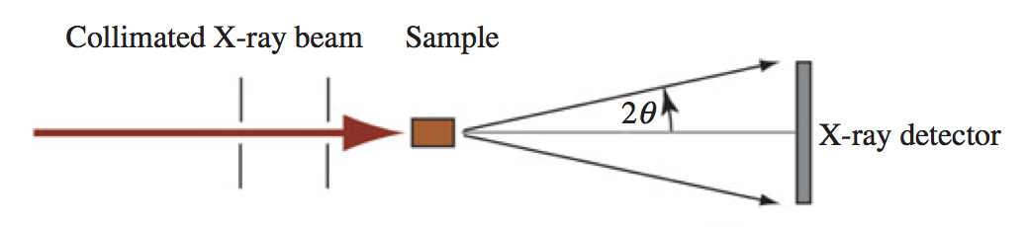
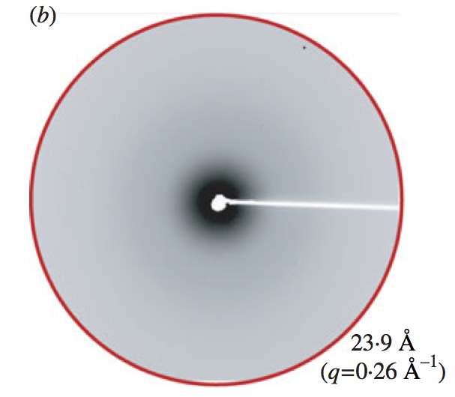
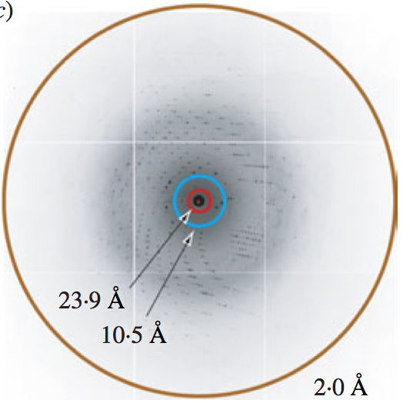
Experimental setup
X-ray
SAXS

Slide 5
Crystalized Sample Sample in Solution
X-ray
SAXS

Slide 6
(very tiny) bit of theory
k
q
q=2k.sinθ => q/2/k=sinθ,
k=2π/λ => q=4π/λ.sinθ
Often q is denoted as s

Slide 7
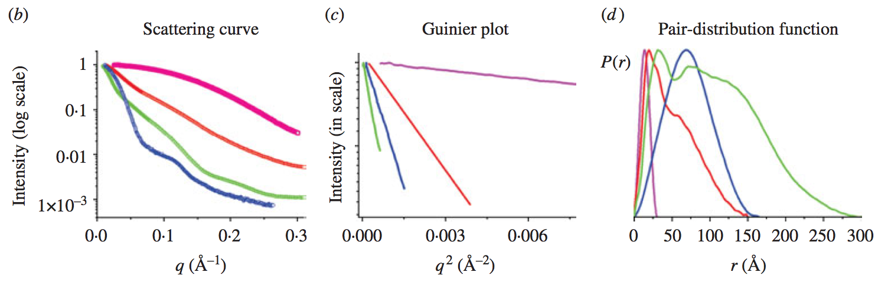
1st step: scattering to scattering curve
=>

Slide 8
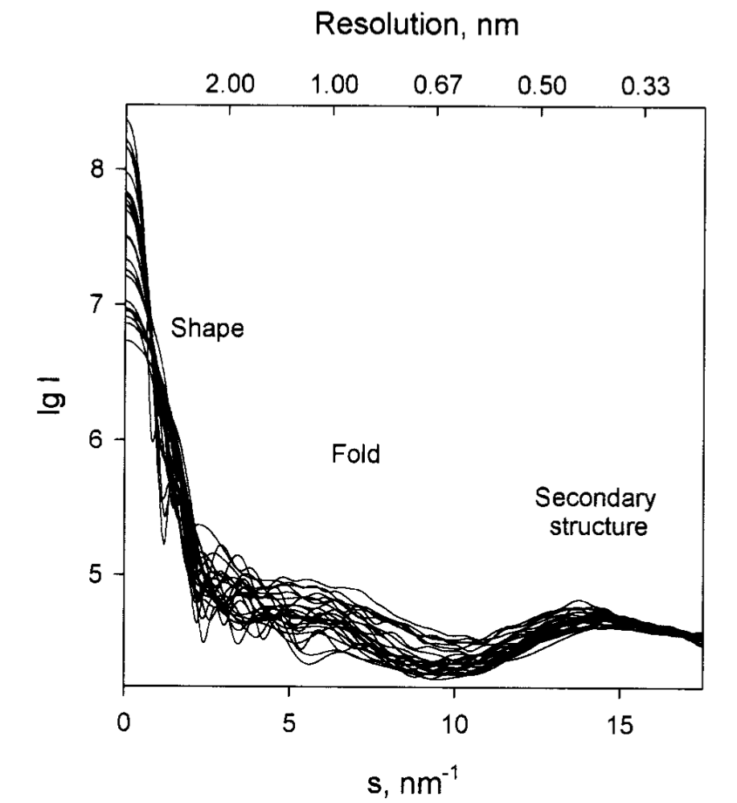
What can we learn from the scattering curve:
Shape of the studied molecule
Fold
Secondary structure

Slide 9
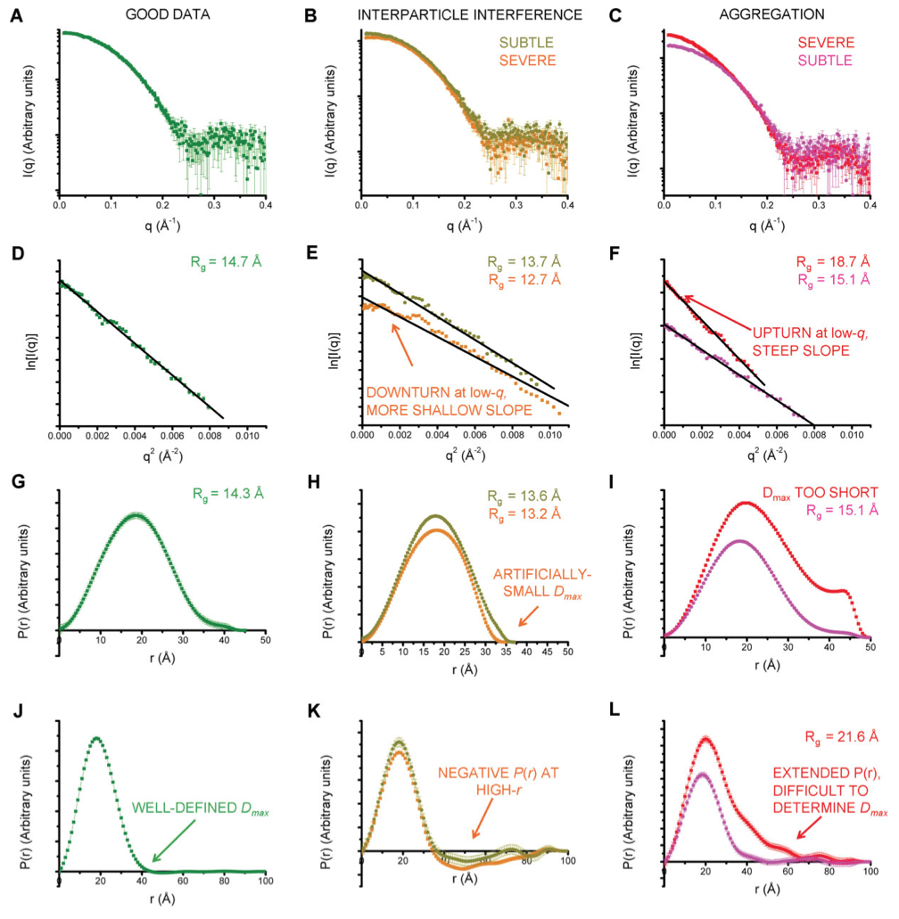
Is it really that easy?

Slide 10
2nd step: Guinier plot & Kratky plot (from the initial region of the scattering curve)

Slide 11
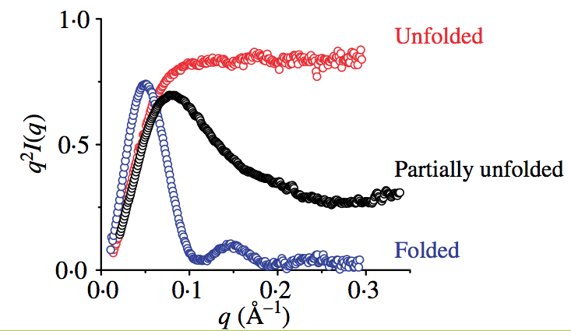
2nd step: Guinier plot & Kratky plot (from the initial region of the scattering curve)

Slide 13
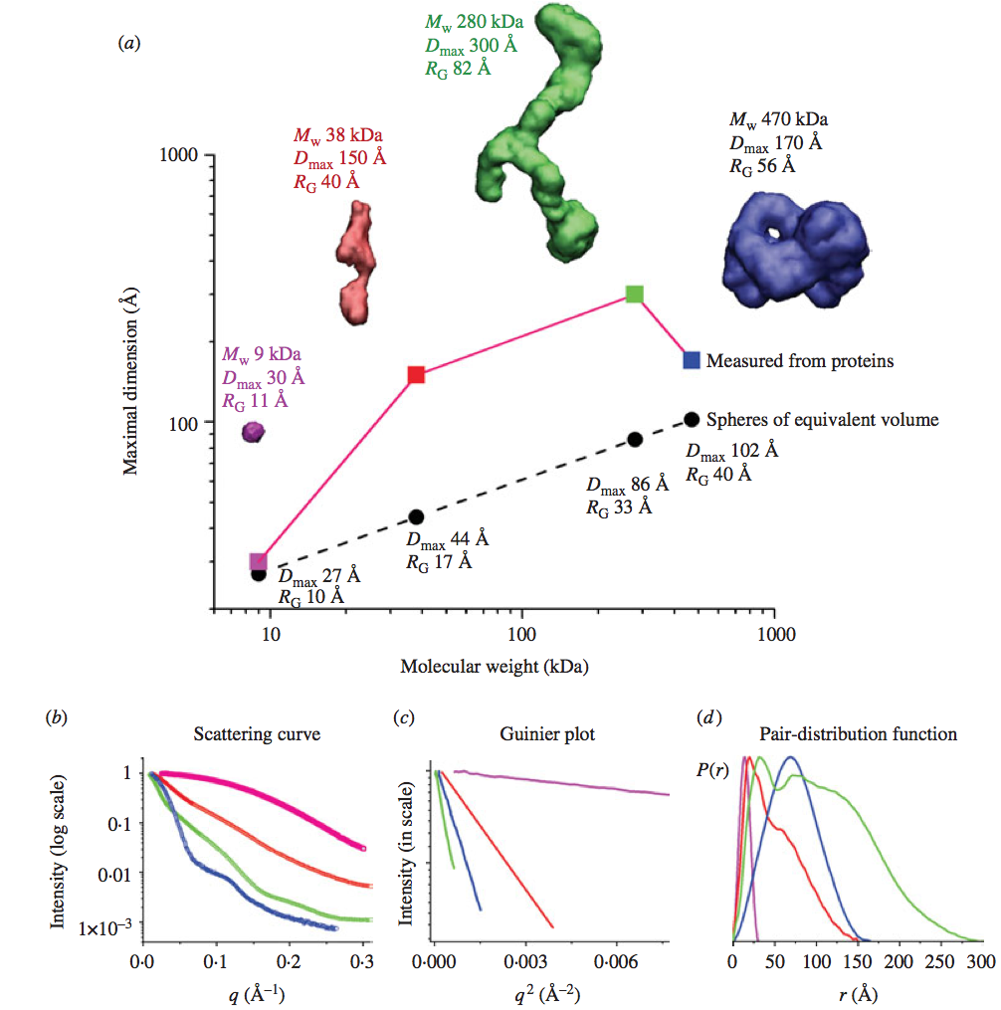
3rd step: PDF Pair-distribution function

Slide 15
All information from the scattering curve together

Slide 16
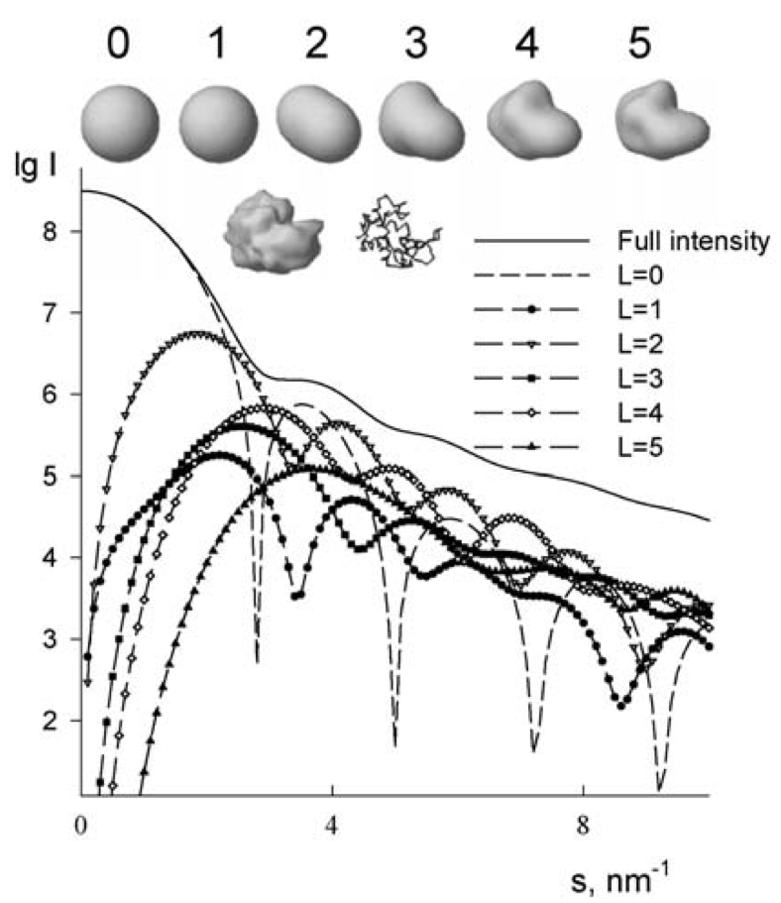
Bead model
Spherical harmonics problem to be solved

Slide 17
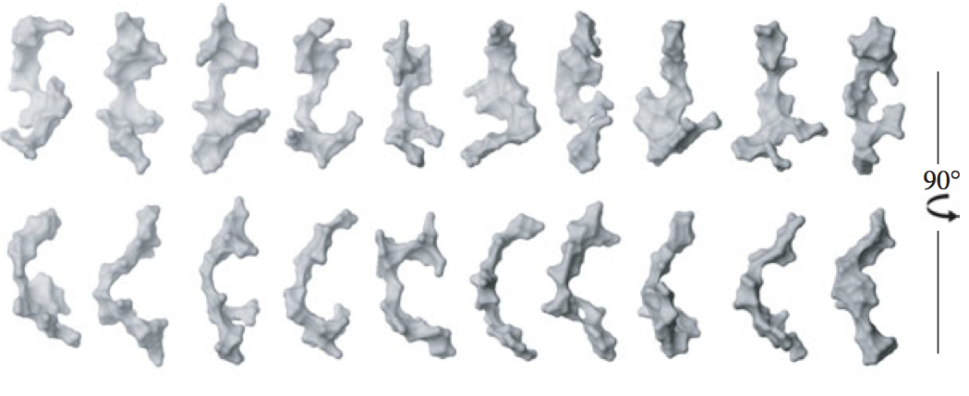
Solutions with similar “goodness” of fit may be obtained

Slide 18
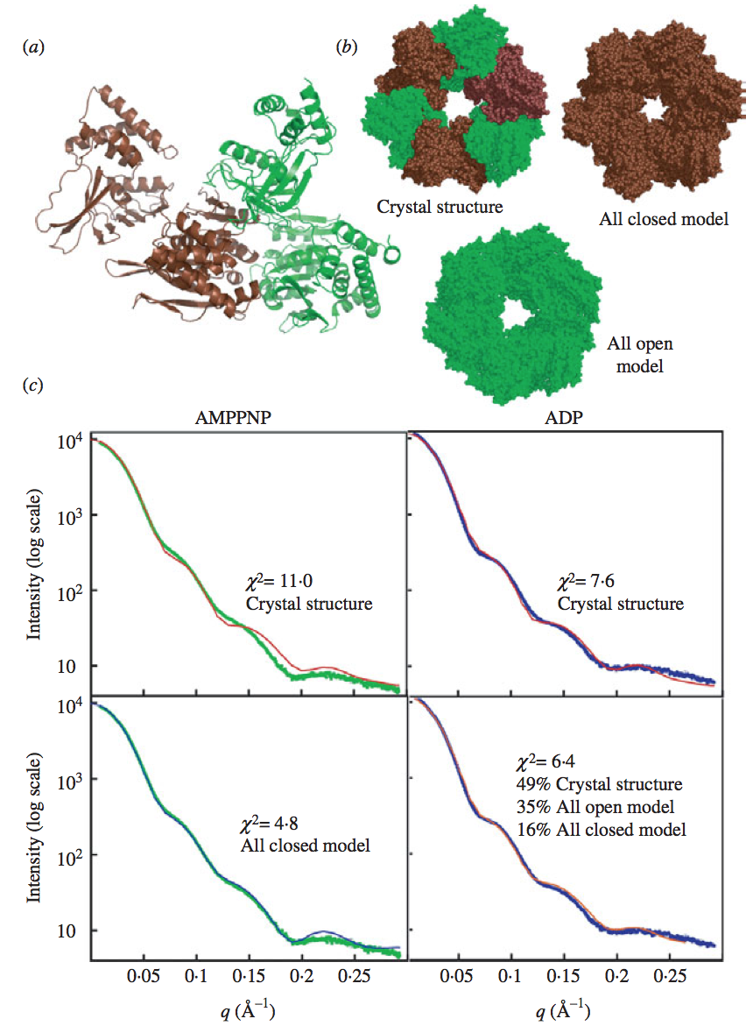

Slide 19
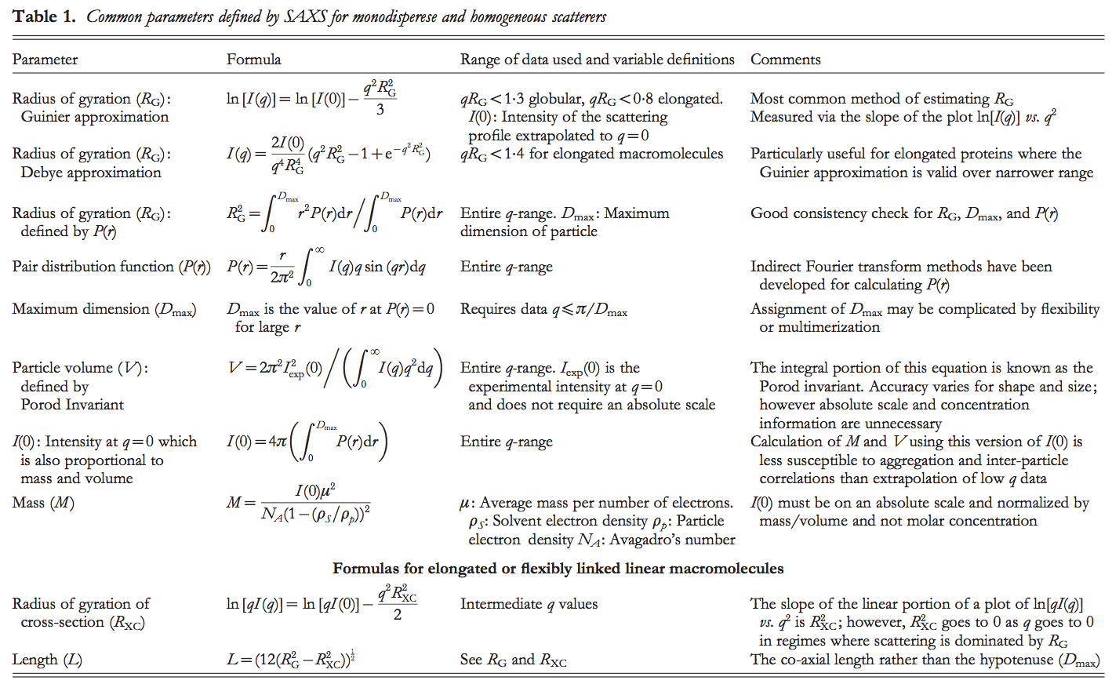
Summary

Slide 20
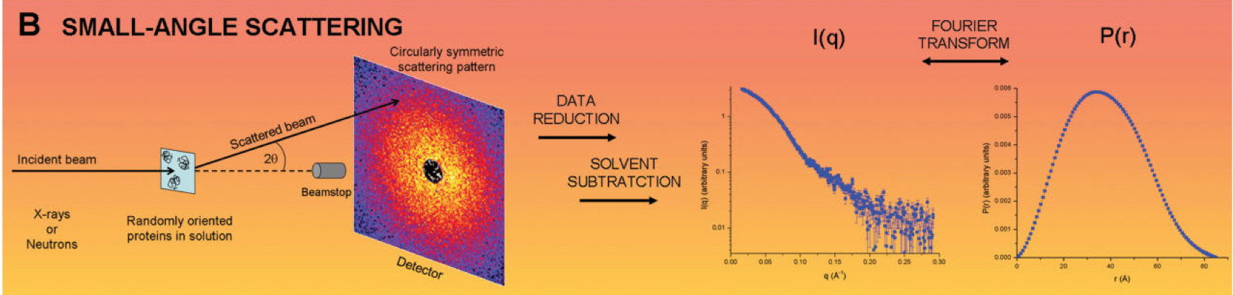
Summary (graphically)

Slide 21
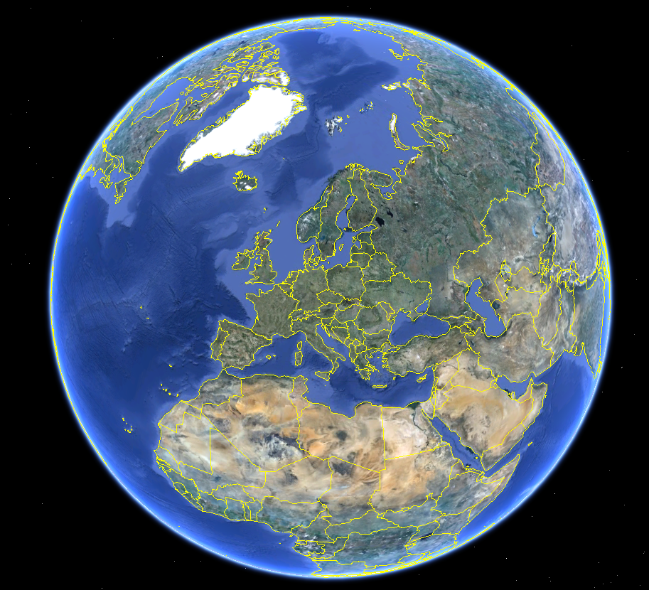
SAXS Hamburg

Slide 22
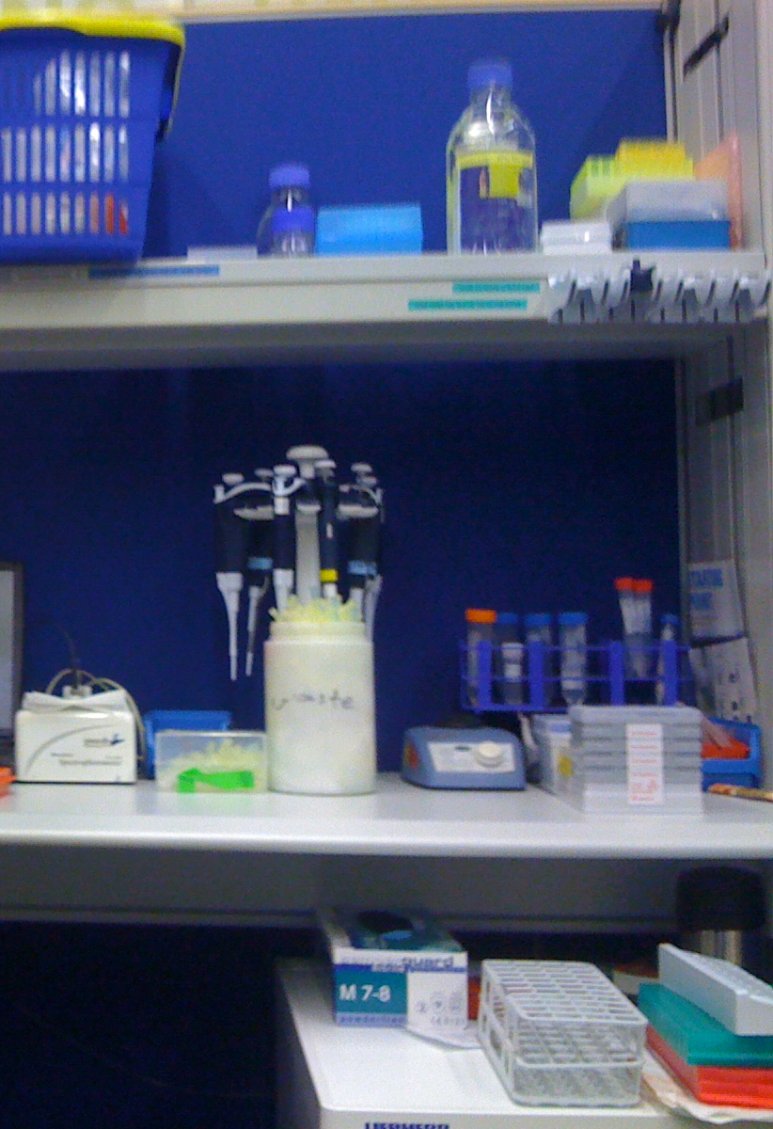
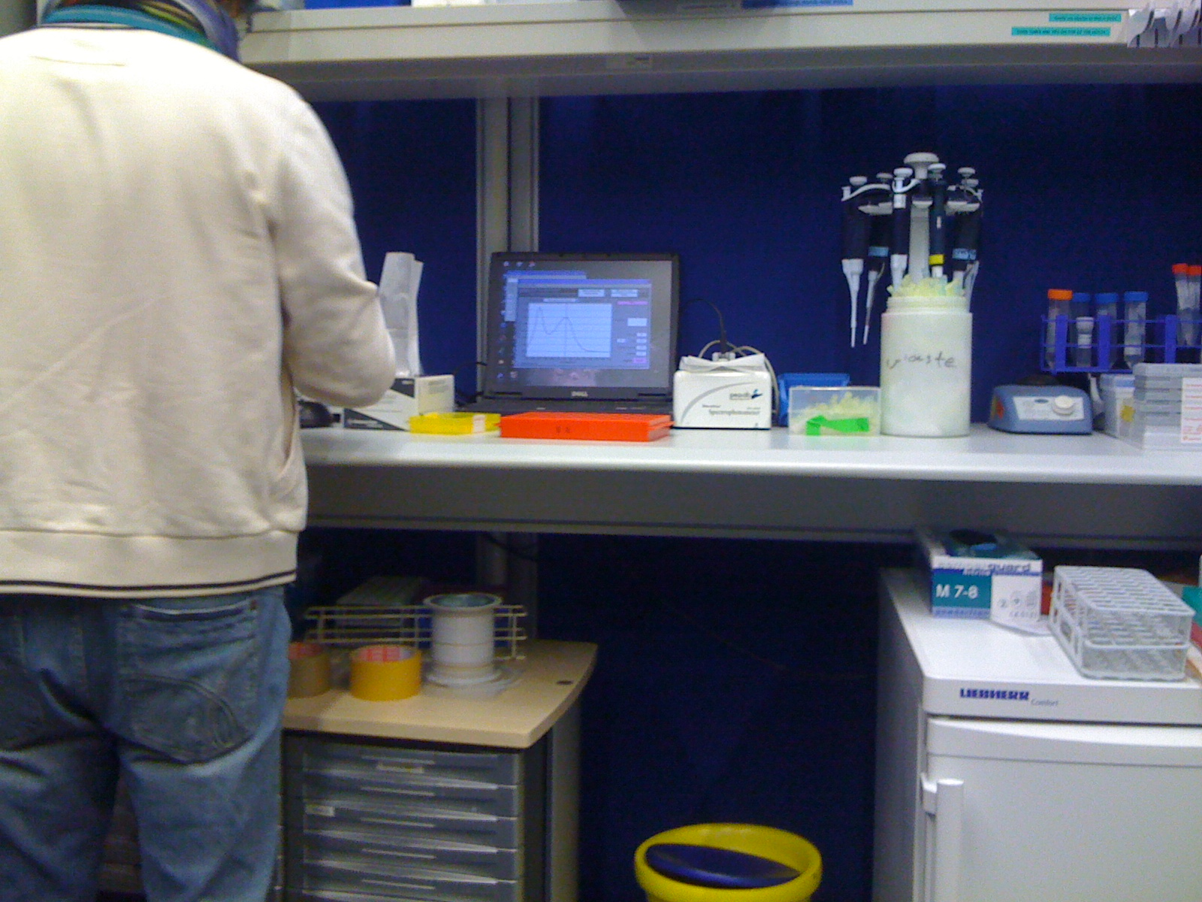

Slide 23
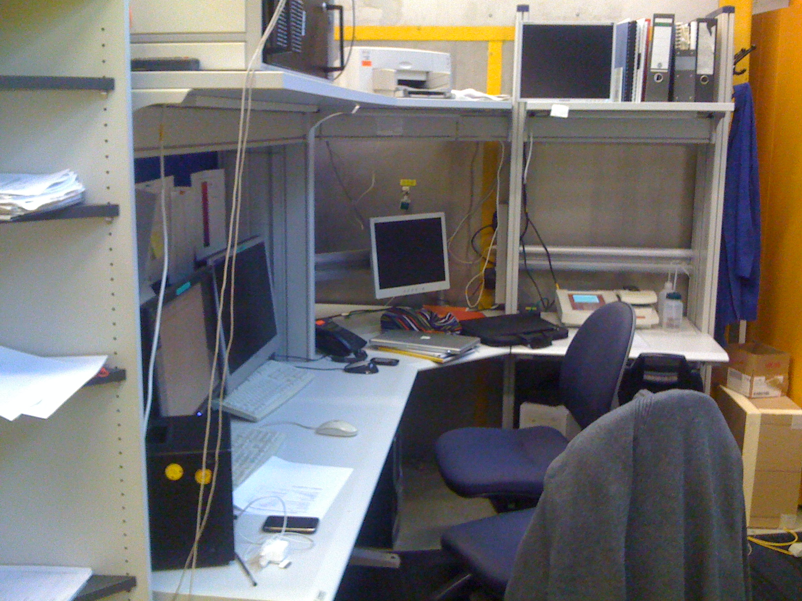
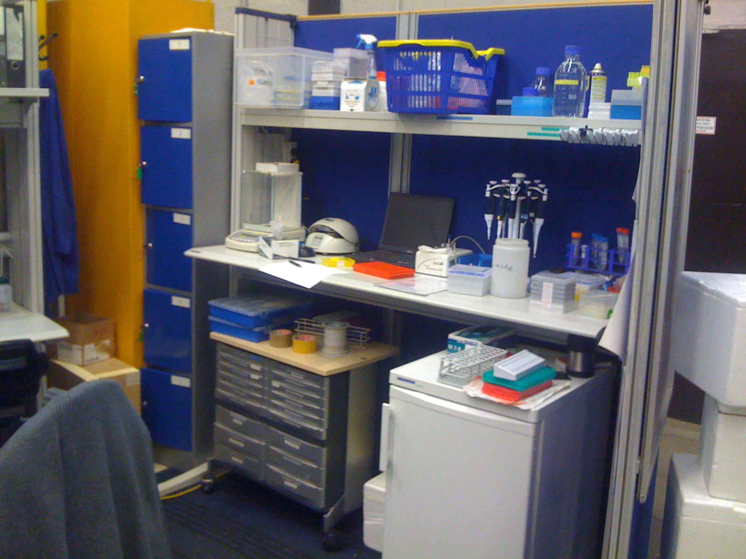
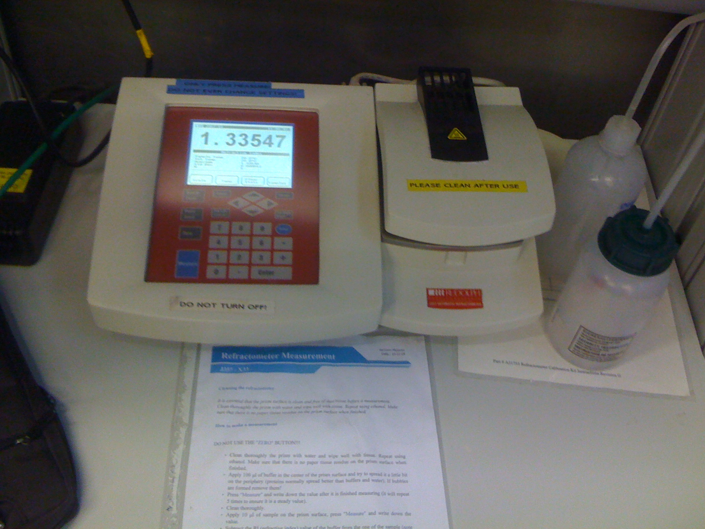
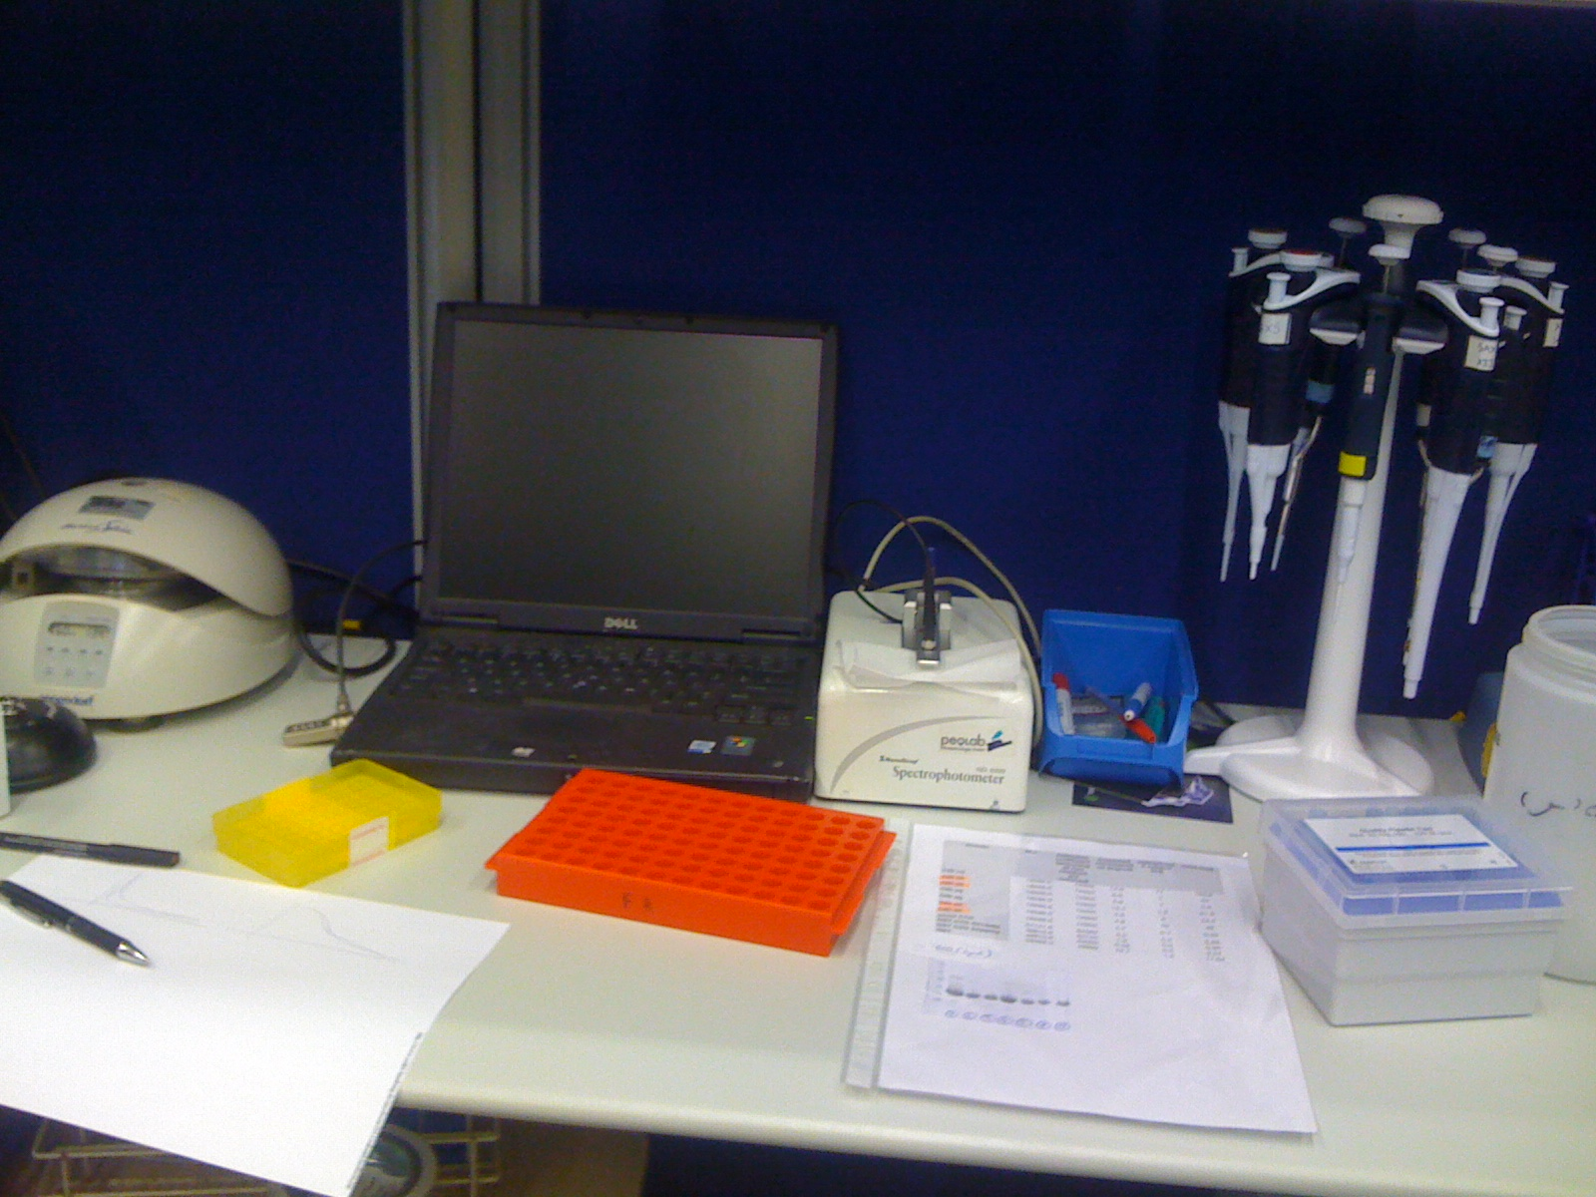

Slide 24
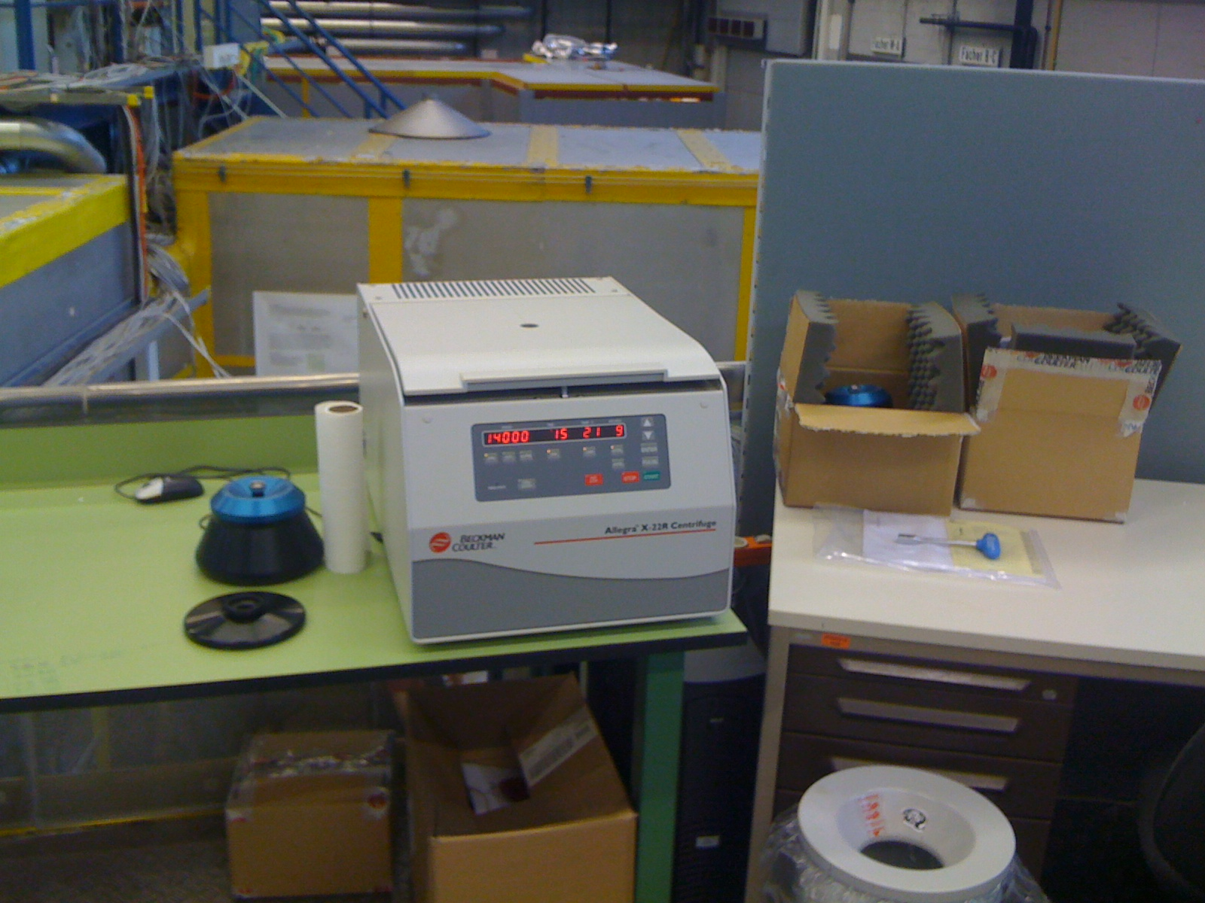
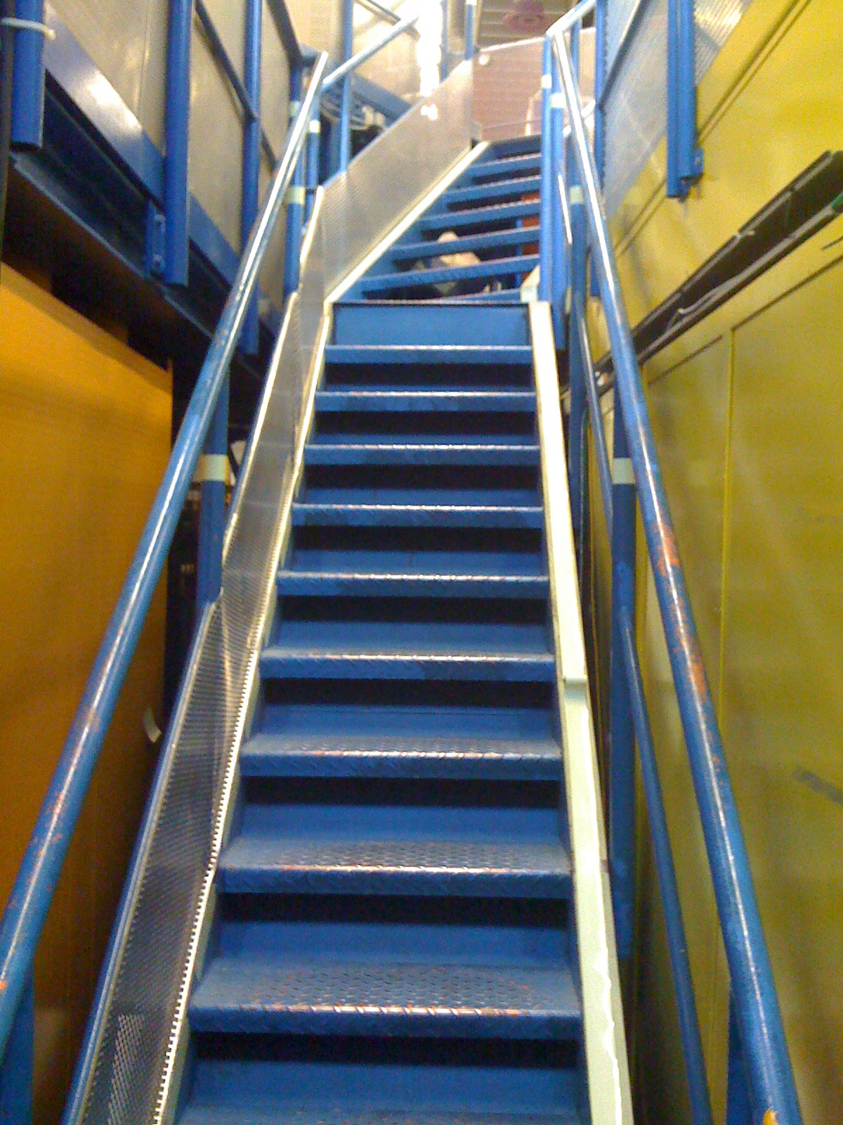
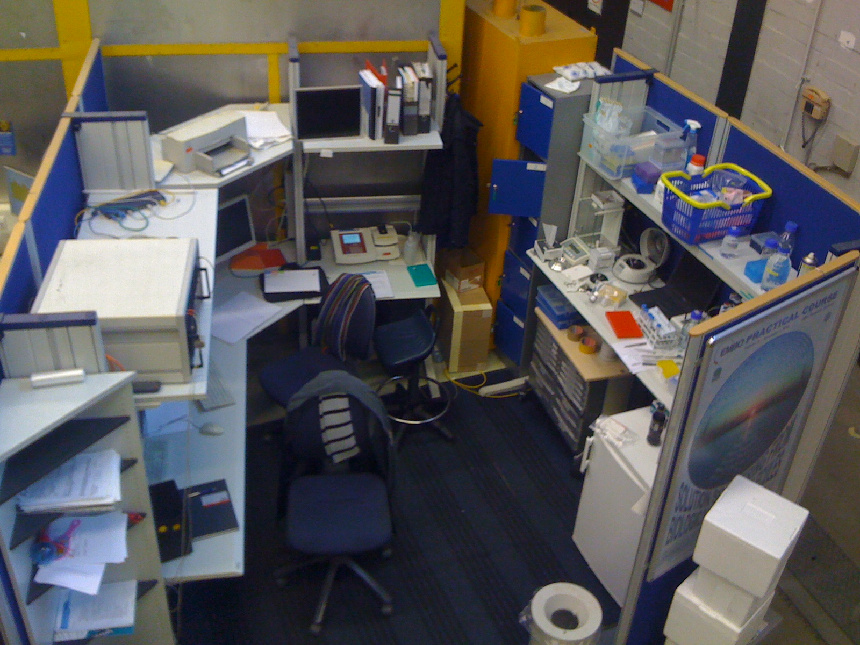

Slide 25
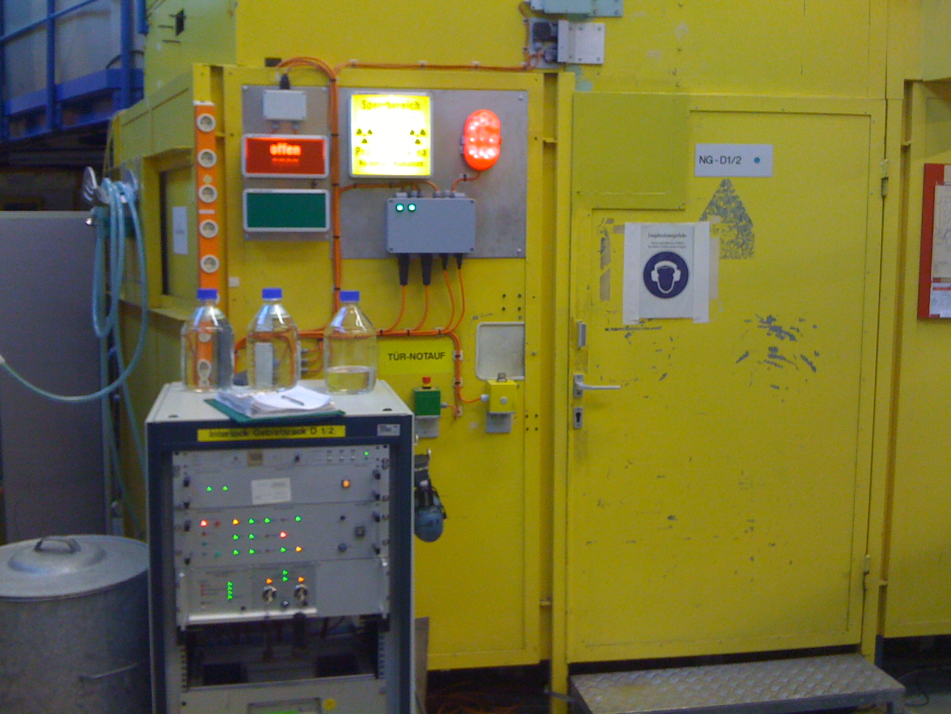

Slide 26
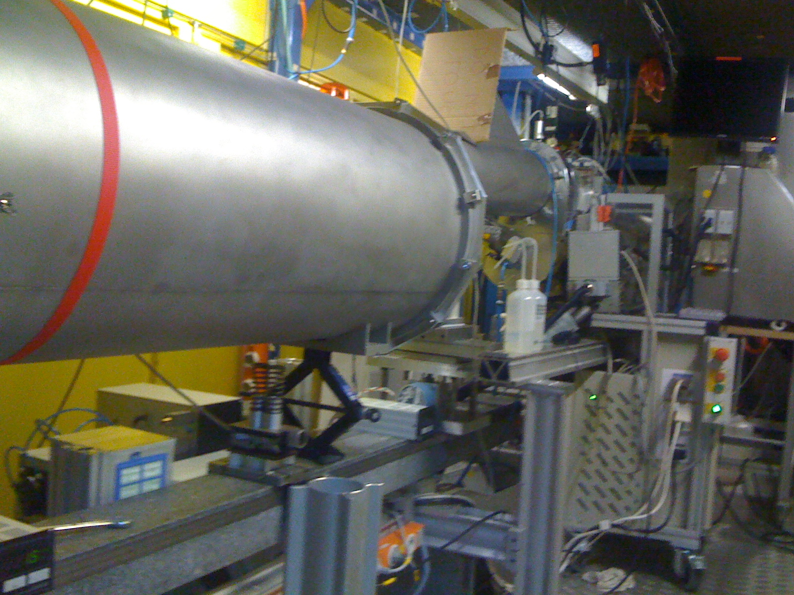

Slide 27
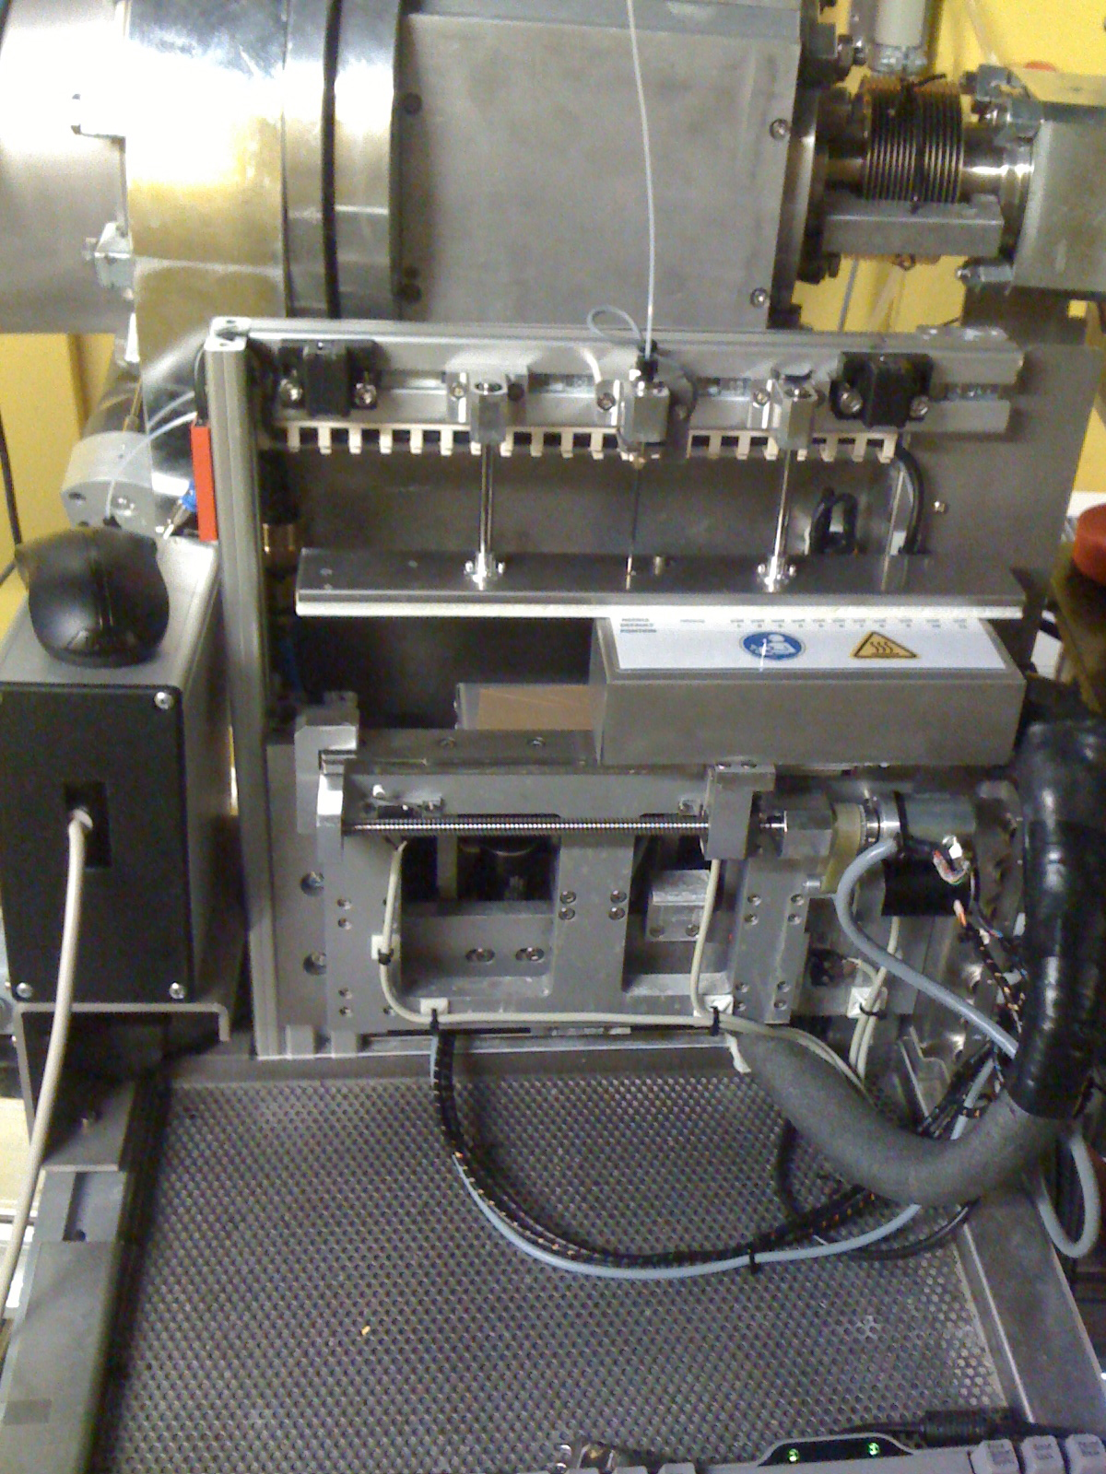

Slide 28
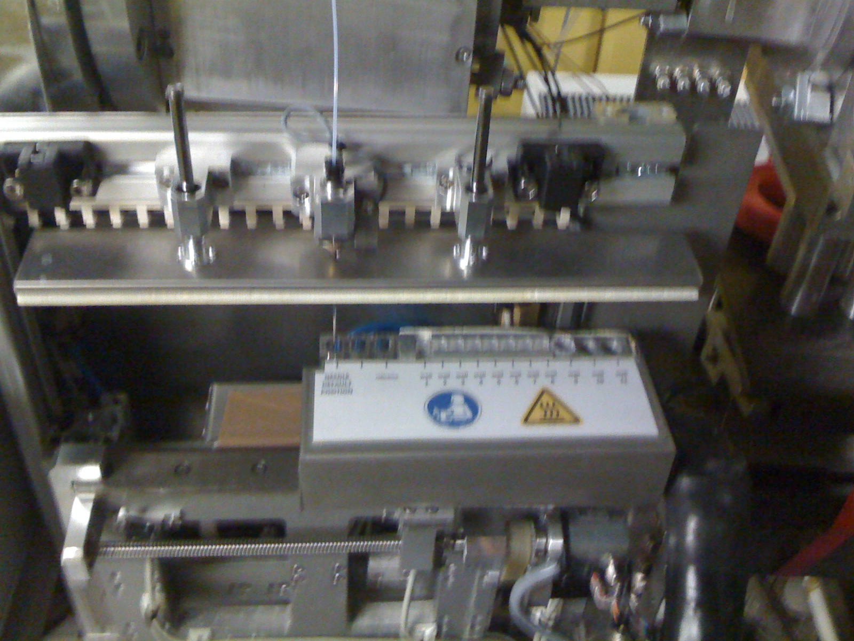

Slide 29
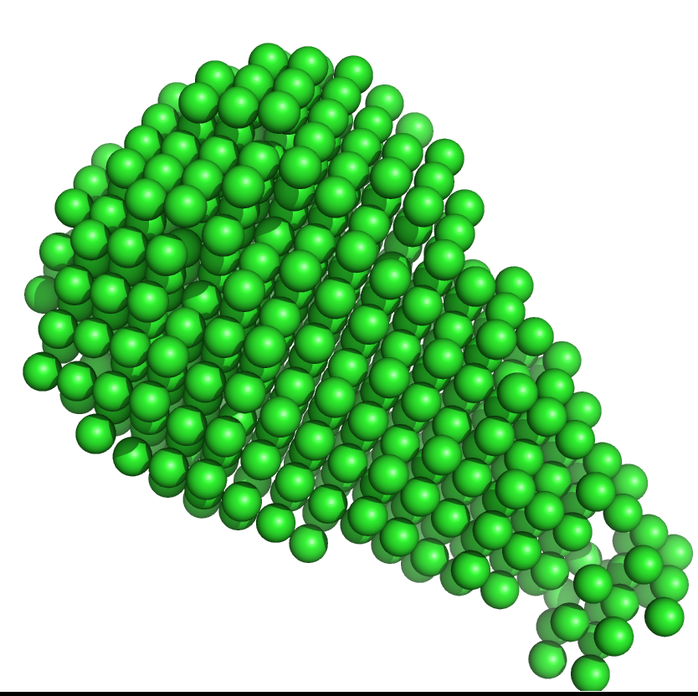
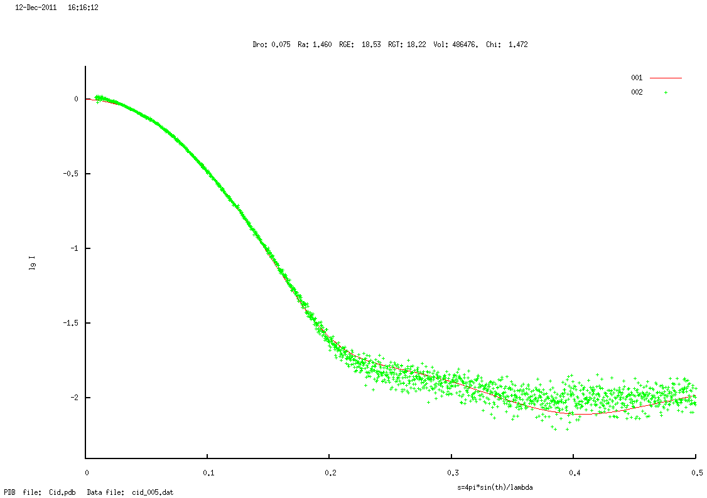
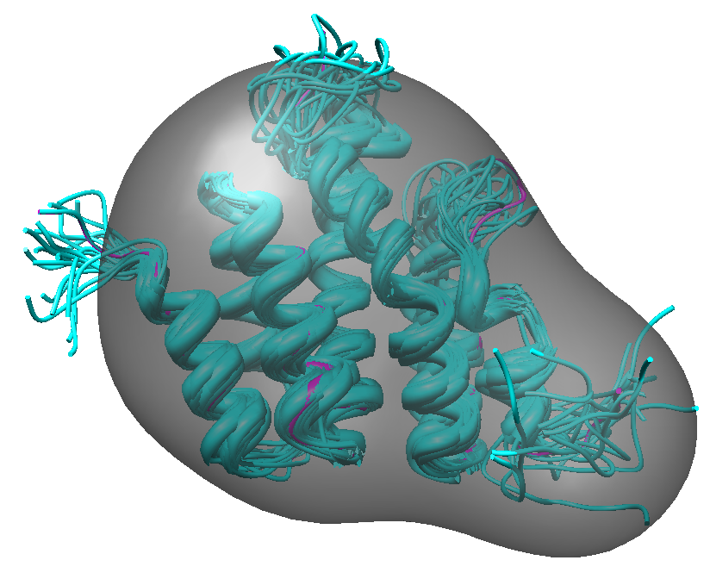
Evaluation of the experimental data

Slide 30
References:
Koch, M.H.J., Vachette, P., Svergun, D.I. Quart Rev Biophys 2003
Jacques, D.A., Trewhella, J. Prot Sci 2010
Svergun, D.I., Petoukhov, M.V., Koch, M.H.J. Biophys J 2001
Wriggers, W. Biophys Rev 2010
Putnam, C.D., Hammel, M., Hura, G.L., Tainer, J.A. Quart Rev Biophys 2007
Madl, T. Gabel, F., Sattler, M. J Struct Biol 2010

Slide 31
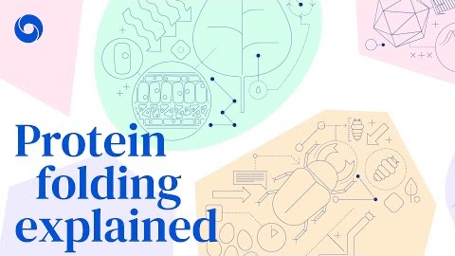
AlphaFold: a solution to a 50-year-old grand challenge in biology
https://deepmind.com/blog/article/alphafold-a-solution-to-a-50-year-old-grand-challenge-in-biology

Slide 32
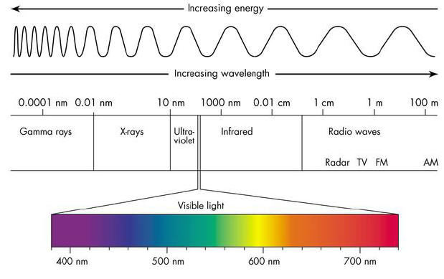
NMR

Slide 33
Confidence in structural features of proteins determined by
X-ray crystallography
(estimates are very rough and strongly depend on the quality of the data)
Structural feature |  |  | Resolution
 | 5 Å | 3 Å | 2.5 Å | 2 Å | 1.5 Å
Chain tracing | - | Fair | Good | Good | Good
Secondary structure | Helices fair | Fair | Good | Good | Good
Sidechain conformations | - | - | Fair | Good | Good
Orientation of peptide planes | - | - | Fair | Good | Good
Protein hydrogen atoms visible | - | - | - | - | Good

Slide 34
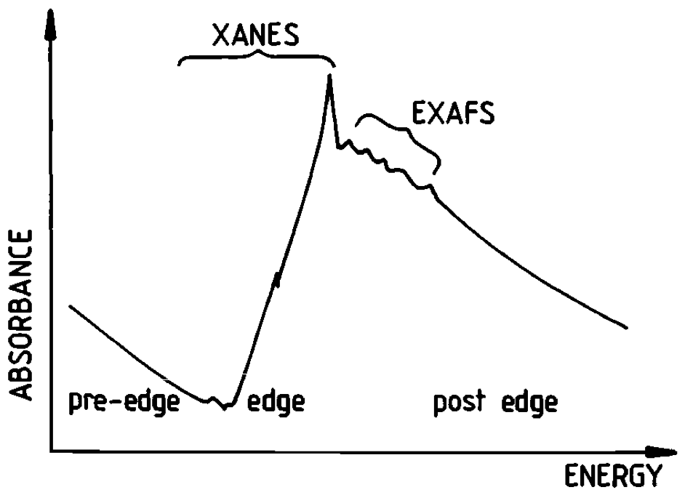
XAS = X-ray Absorption Spectroscopy
XANES = X-ray Absorption Near Edge Structure
EXAFS = Extended X-Ray Absorption Fine Structure

Slide 35
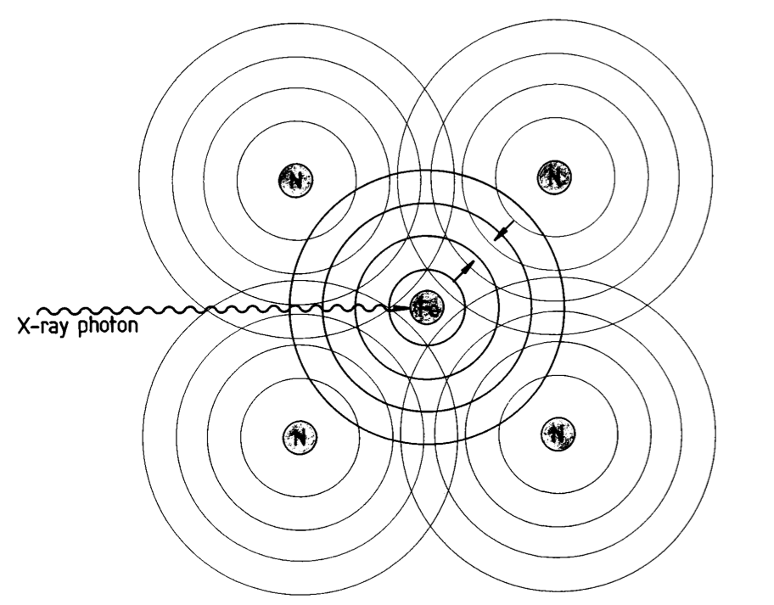

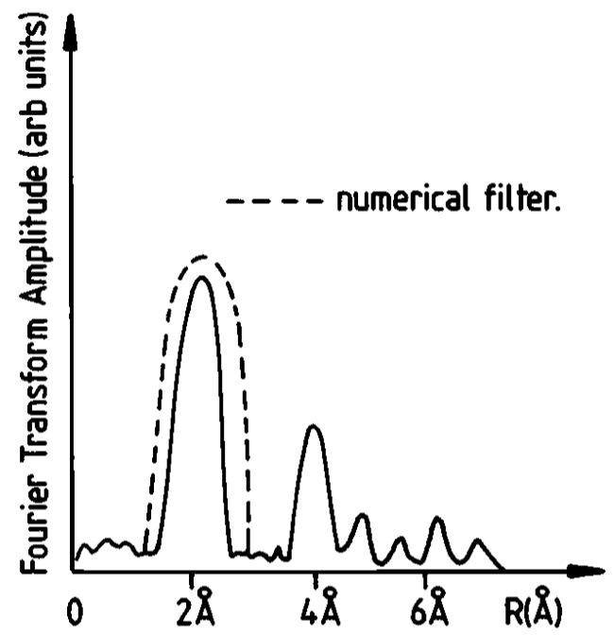
SAXS/EXAFS
N
N
Fe
EXAFS (Extended X-ray Absorption Fine Spectroscopy) poskytuje informace o nejbližších slupkách atomů sousedících s absorbujícím atomem
N
N

Slide 36
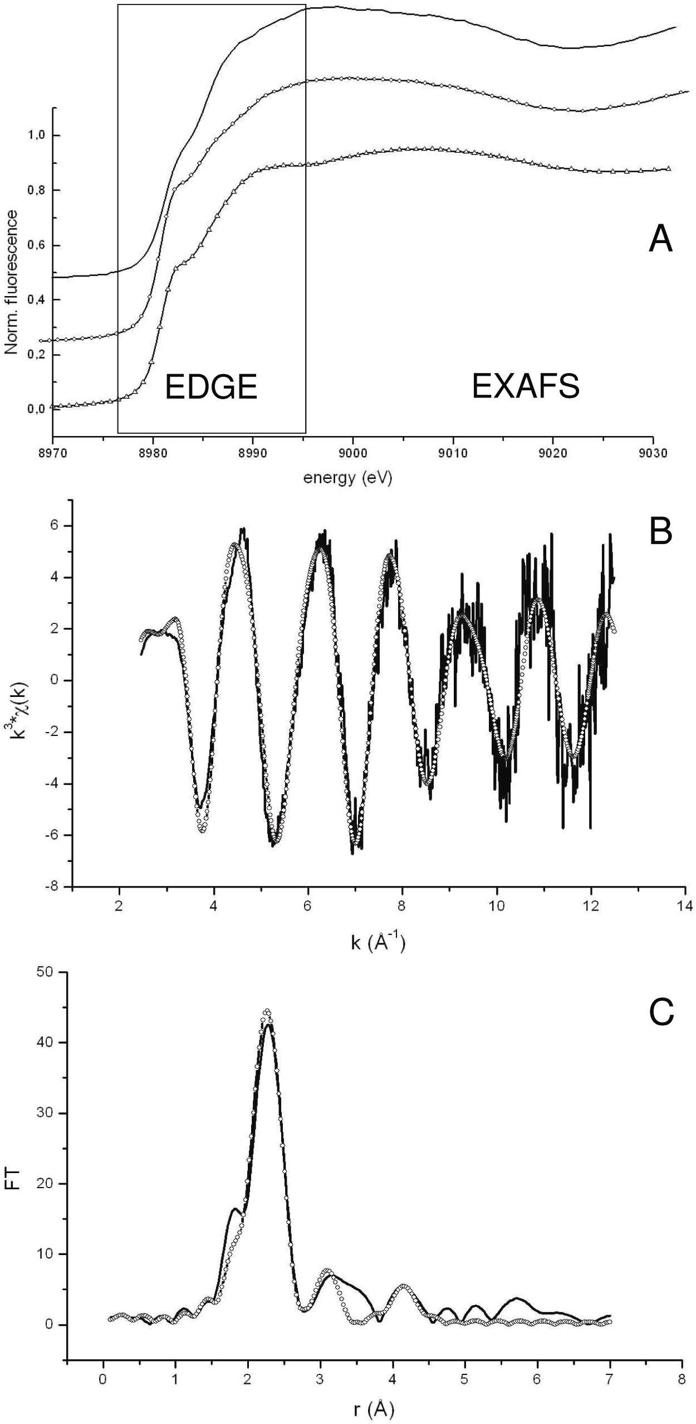
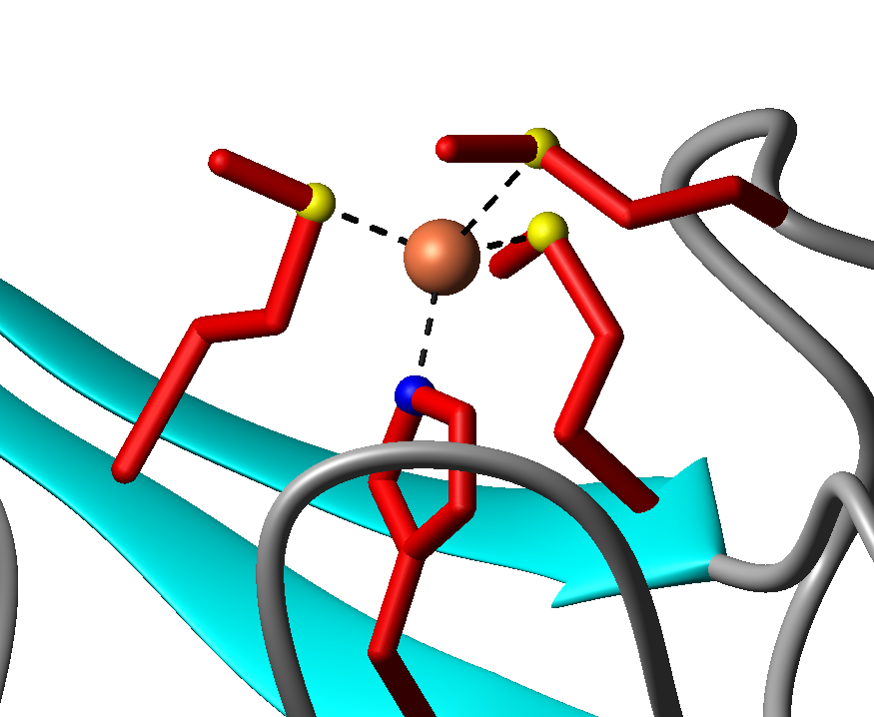
X-Ray Absorption Spectroscopy
Met 110
Met 86
Cu(I)
β4
Met 75
β5’
His 108
Cu(I)DR1885 ΔE=-10.3 eV
Ligand r(Å) 2σ².10³(Å²) R-exafs ε(fit index)
Fit1 (1shell) 2S 2.299 4(1) 0.446 0.49
Fit2 (1shell) 3S 2.301 9(1) 0.403 0.41
Fit3 (2shells) 3S 2.300 8(1) 0.334 0.29
1N§ 1.982 4(1)
Fit4 (2shells) 3S 2.303 8(1) 0.305 0.27
1N* 1.999 7(2)
§ no MS *His, MS

Slide 37
A BLAST search over all non-redundant GenBank genomes
M
H
M
H
M
75
86
108
110

Slide 38
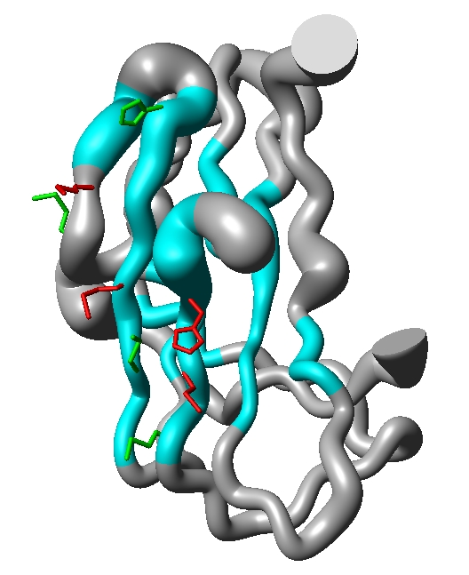
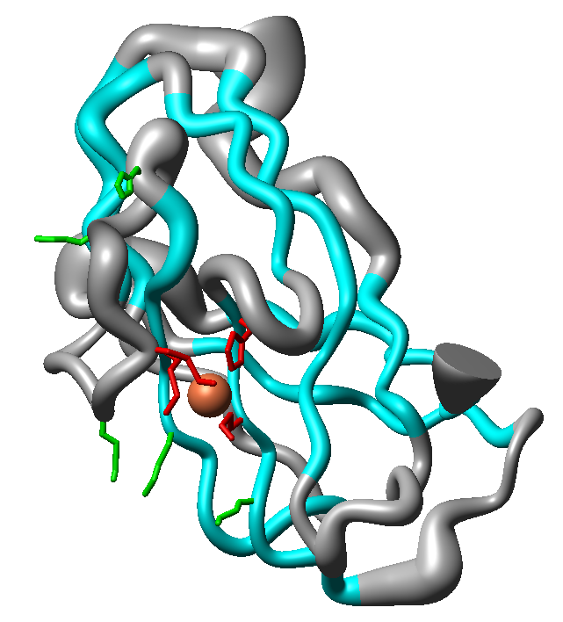
His 79
β5
N
N
β3
β6
Met 83
β2
Met 86
His 108
Met 88
β9
C
C
β8
Met 75
Met 110
β4
β1
Met 73
Apo
Holo
β7
Met 112
Conserved Met&His
Other Met&His residues
cyan – β-sheets
grey – random coil

Slide 39
Rentgenstrukturní analýza
Krystalová mřížka působí na rentgenové záření jako optická mřížka na viditelné světlo. Nastávají ohybové jevy a na stínítku se objevuje difrakční obrazec. Tyto obrazce mohou být matematicky analyzovány, aby se získala informace o rozložení elektronů v molekulách tvořících krystal.

Slide 40
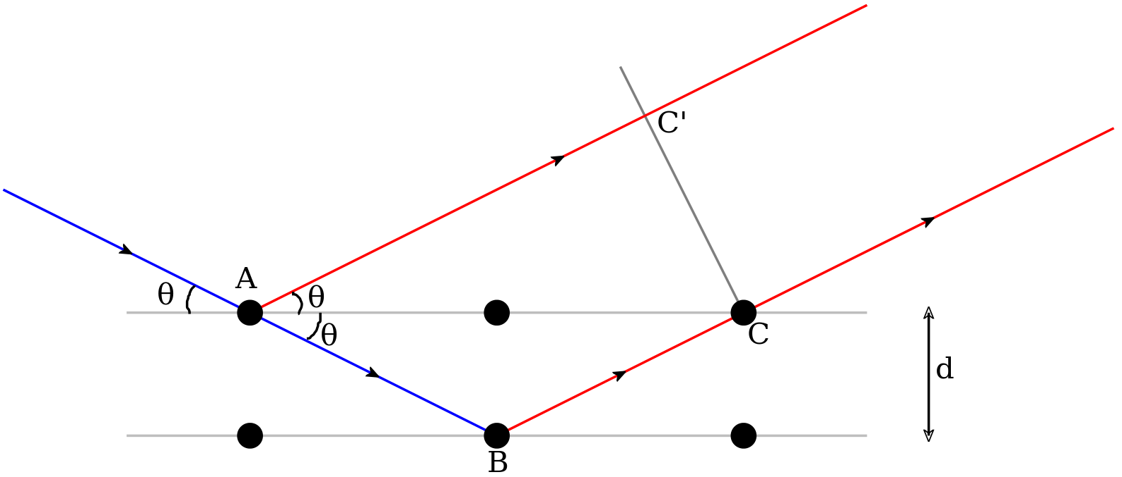
Bragg‘s law
2d sinΘ = nλ

Slide 41
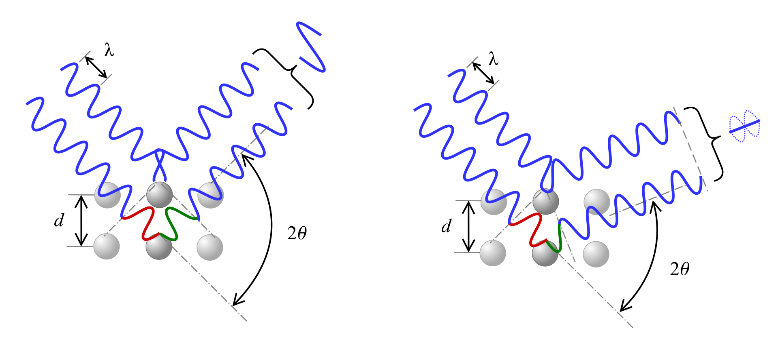
Bragg‘s law
2d sinΘ = nλ

Slide 42
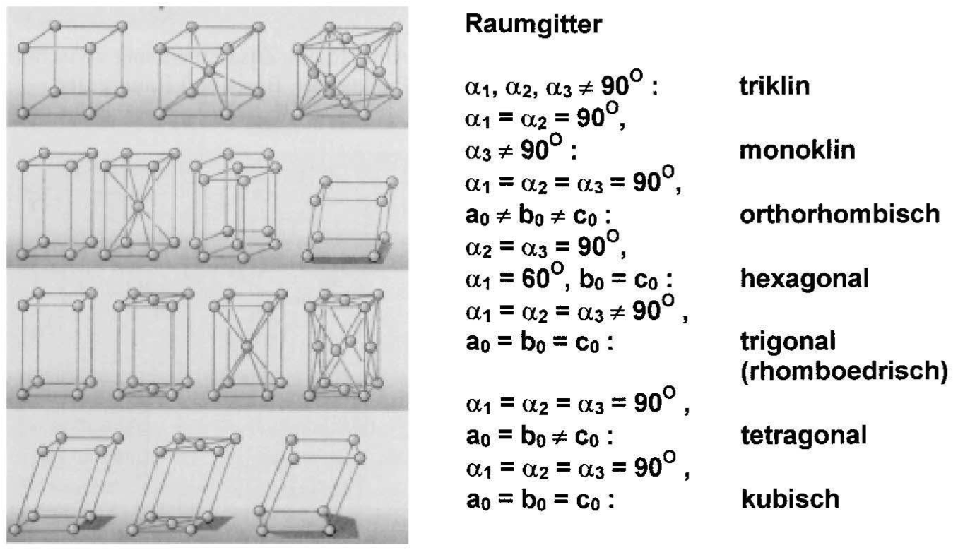
Krystalografická soustava
Trojklonná
Jednoklonná
Kosočtverečná (ortorombická)
Šesterečná
Klencová
Čtverečná
Krychlová

Slide 43
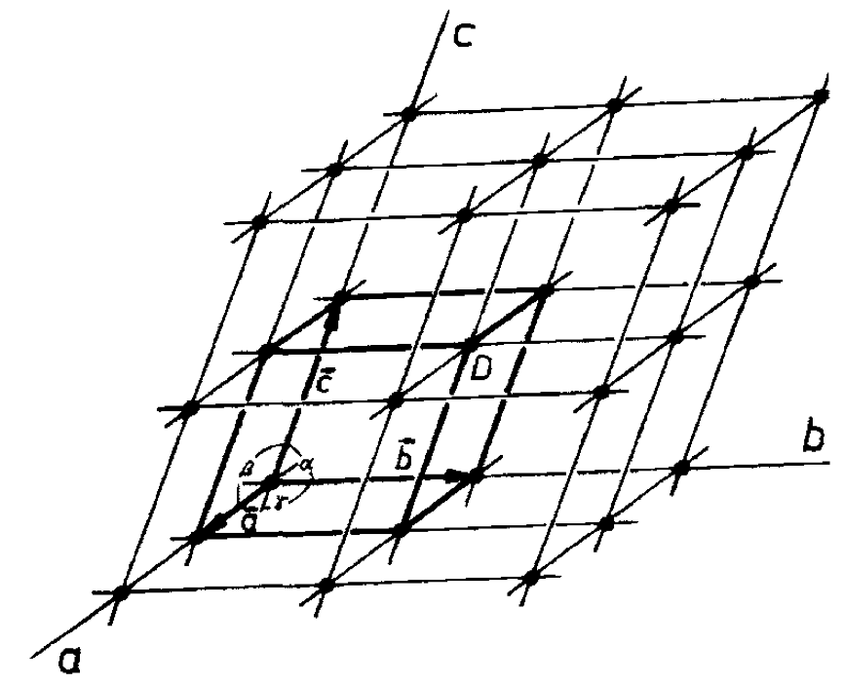
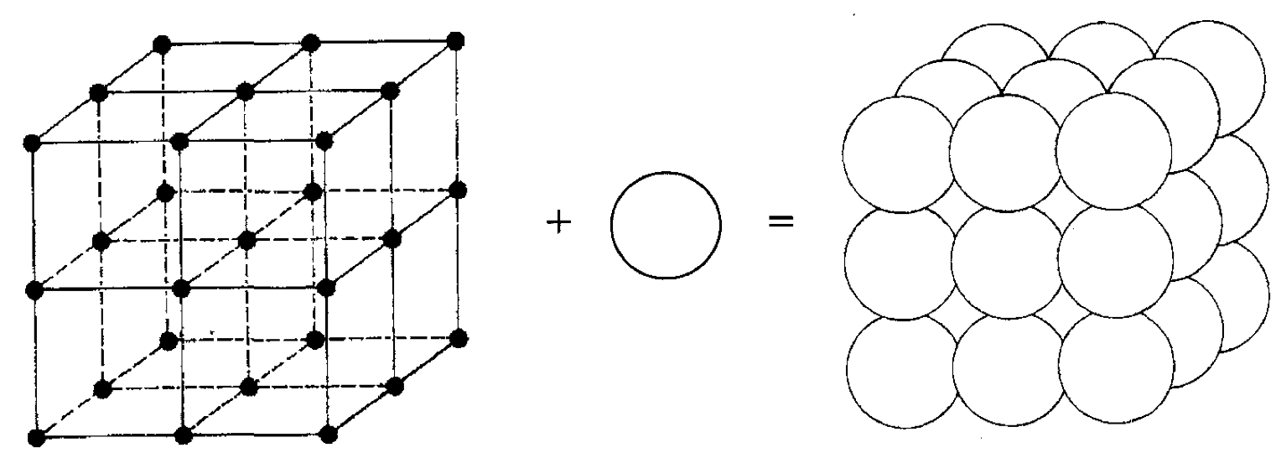

Slide 44
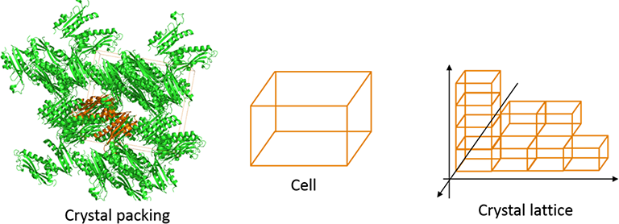
https://www.intechopen.com/books/x-ray-scattering/x-ray-diffraction-in-biology-how-can-we-see-dna-and-proteins-in-three-dimensions-

Slide 45
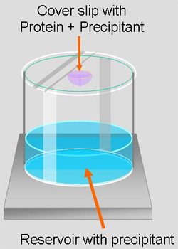
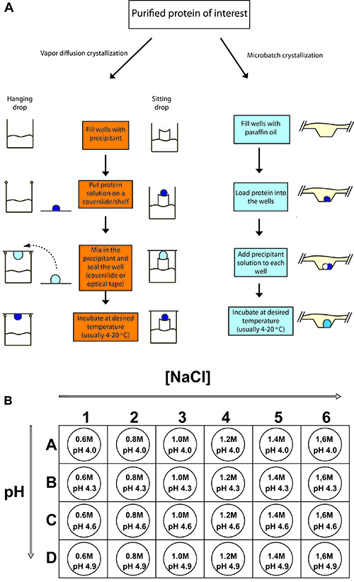

Slide 47
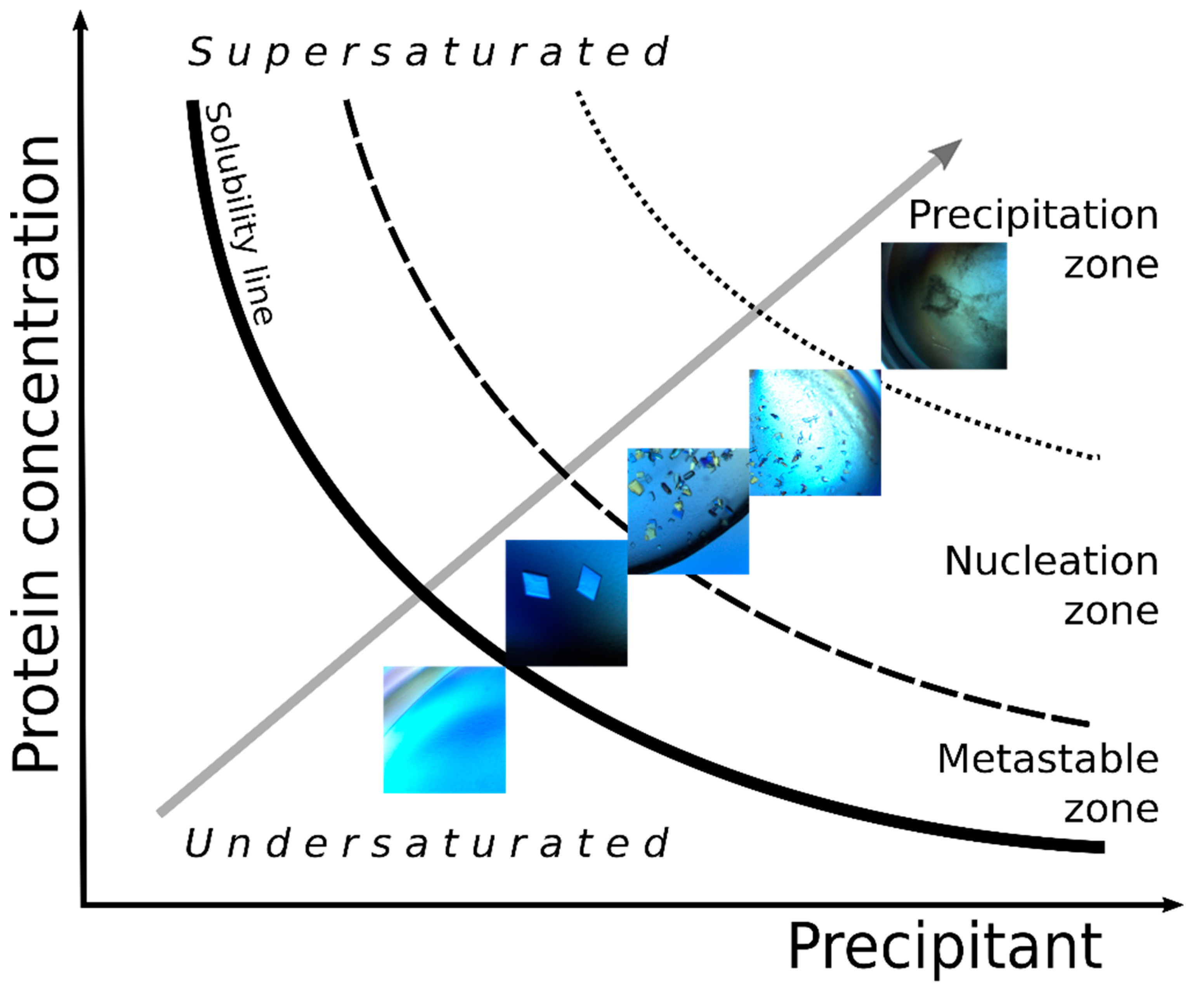
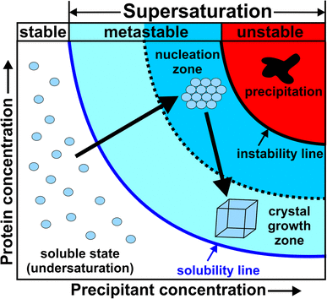
Phase diagram of solubility of a protein in solutions as a function of the concentration of the precipitant.
https://doi.org/10.3390/cryst8110434
http://skuld.bmsc.washington.edu/~merritt/bc530/local_copies/phase_methods_files/vd_xtals.jpg

Slide 48


Slide 49

X-Ray Goniometer
a device that permits the simultaneous recording of the direction of X rays diffracted by a specimen under study and of the position of the specimen at the time of diffraction.
An X-ray goniometer can be an independent device recording the diffraction pattern on photographic film; in this case it is an X-ray camera. The term “X-ray goniometer” is also applied to goniometric devices that are components of X-ray diffractometers and are used for mounting the specimen and detector in positions corresponding to the conditions necessary for the occurrence of X-ray diffraction.
https://encyclopedia2.thefreedictionary.com/X-Ray+Goniometer

Slide 50


Slide 51


https://www.intechopen.com/books/x-ray-scattering/x-ray-diffraction-in-biology-how-can-we-see-dna-and-proteins-in-three-dimensions-

Slide 52




Krystalogram B-DNA získaný v r. 1952 Rosalindou E. Franklinovou, na jehož základě Watson a Crick navrhli dvoušroubovicový model struktury DNA. C. & W. dostali v r.1962 společně s Mauricem Hugh Frederick Wilkinsem NC za fyziologii a medicínu „za jejich objevy týkající se molekulární struktury nukleových kyselin a jejich významu při přenosu informací v živých organizmech“
F
C
W

Slide 53

http://www.udel.edu/chem/fox/MassSpecLecture09.pdf

Slide 54

http://www.udel.edu/chem/fox/MassSpecLecture09.pdf

Slide 55

http://www.udel.edu/chem/fox/MassSpecLecture09.pdf

Slide 56

http://www.udel.edu/chem/fox/MassSpecLecture09.pdf

Slide 57

http://www.udel.edu/chem/fox/MassSpecLecture09.pdf

Slide 58

http://www.udel.edu/chem/fox/MassSpecLecture09.pdf

Slide 59

http://www.udel.edu/chem/fox/MassSpecLecture09.pdf

Slide 60

http://www.udel.edu/chem/fox/MassSpecLecture09.pdf

Slide 61


Slide 62


Slide 63


Slide 64


Slide 65


Slide 66


Slide 67

Amino Acid
Residue Composition
Residue Monoisotopic Mass
Delta Mass
Methionine
C₅H₉NOS
131.0405
0
Methionine Sulfoxide
C₅H₉NO₂S
147.0354
15.9949
Methionine Sulfone
C₅H₉NO₃S
163.0303
31.9898
Sulfur
S
31.9721
-

Slide 68



Slide 69
Mass Spectrometry
ESI - electron spray ionization – high voltage applied to a liquid jet producing highly charged droplets
MALDI - matrix-assisted laser desorption/ionization
- three step process:
        1) sample mix with matrix and deposition on a metal plate,
        2) laser pulse desorbs the sample with matrix,
        3) analyte molecules are ionized and analyzed (TOF – time of flight MS technique)

Slide 70

Quadrupole mass analyzer

Slide 71


Slide 72

HDX MS - Hydrogen Deuterium Exchange with Mass Spec

Slide 73

ARDD - average relative D-uptake difference
Scientific Reports 3, Article number: 1247, 2013

Slide 74

http://www.biopharminternational.com/performing-hydrogendeuterium-exchange-mass-spectrometry

Slide 75

ITC – isothermal titration calorimetry
1760s – Black measured the heat capacity and latent heat of water
1780s – Lavoisier designed an ice calorimeter and used this instrument to measure the metabolic heat produced by a guinea pig confined in the measurement chamber
=> Calorimeter was one of the earliest scientific instruments & first calorimetric experiment was a biologically relevant measurement

Slide 76
Why ITC?
ITC is a quantitative technique
can determine:
  binding affinity (K_{a}),
  enthalpy changes (ΔH),
  binding stoichiometry (n) of the interaction between two or more molecules in solution.
From these initial measurements:
Gibbs energy changes (ΔG)
entropy changes (ΔS)
ΔG = -RTlnK_{a} = ΔH-TΔS

Slide 77



Slide 78



Slide 79




Slide 80

Three possibilities of calorimetric measurement:
temperature change (either adiabatic or isoperibol) [°C/time]
power compensation (often called isothermal) [μcal/time]
heat conduction (Lavoisier design)

Slide 81


Slide 82


Slide 83



Slide 84




Slide 85



Slide 86



The experimental binding isotherm can be characterized
by the unitless value c

