Slide 1
Teachers Self-evaluation of Inclusive Education in Czech Primary Schools
Research project Special Needs of Pupils in the Context of the Framework Educational Programme for Basic Education
Jana Kratochvílová, Jiří Havel
Department of Primary Education
Faculty of Education, Masaryk University

Slide 2
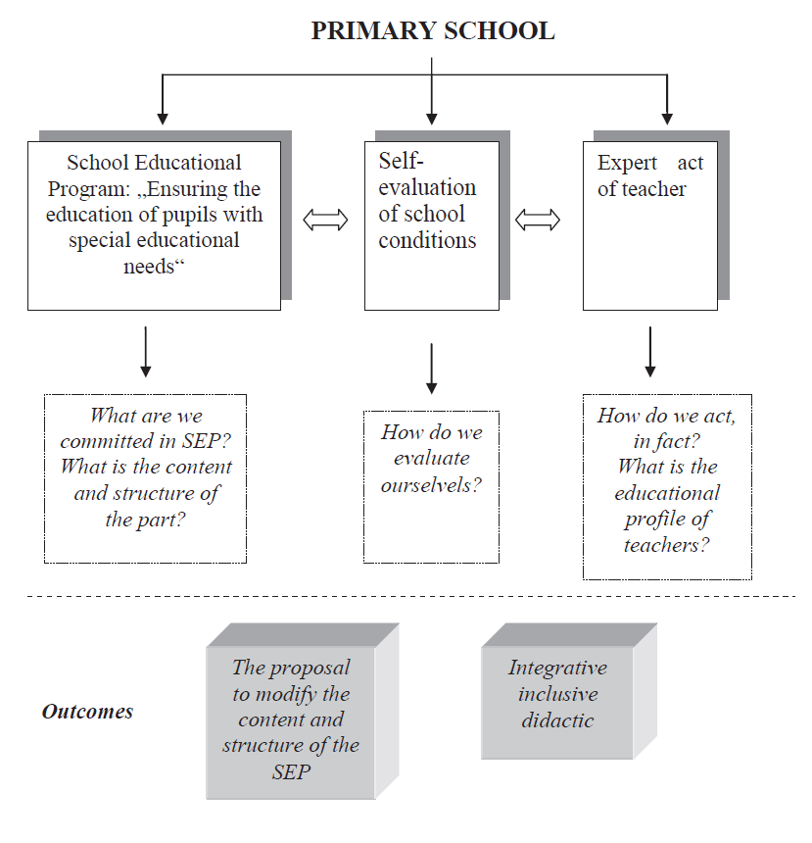

Slide 3

Inclusive education
Process of integrating all children in regular schools in such a way that staff of schools create in collaboration with the community such conditions that support their development in all areas of quality pupil`s life (somatic health, psychological, social, spiritual development and self-development) in maximum extent.

Slide 4
The goal of the research II. phase
To determine:
What conditions teachers create for their pupils in primary schools in education from the point of inclusion?
How they evaluate these conditions themselves and verbalize them?
We have used quantitative and qualitative approach for finding answers to these questions.

Slide 5
Research tool
The Czech version of the questioner Framework for self-evaluation of conditions of education 2007 modified from the British original Index for inclusion (Booth, T. & Ainscow, M. 2002).
Original version of the questionnaire included a total of 45 criteria for evaluation. Each criterion was followed by so-called guidance question (479 in total).
Czech version 2002 included 42 criteria and the guidance questions were greatly reduced in the number 195.

Slide 6
2nd phase
Key issue:
How do teachers evaluate the level of ensuring conditions of an inclusive education in their school? (Quantitative approach)
How do teachers understand the offered indicators of inclusion?
What arguments do teachers choose for defend of their evaluation? (Qualitative approach)
What arguments do teachers use for improving the situation? (Qualitative approach)

Slide 7
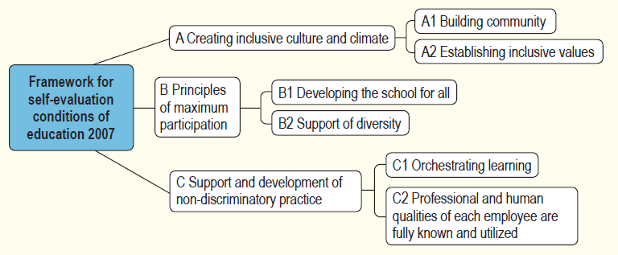
Index for inclusion 2009

Slide 8
Research sample
Eight schools (60 teachers)
Equitable representation of rural or urban schools
The urban schools | The rural schools:
mostly fully organized | 1 fully organized, 3 small schools
217 - 649 students | 45 -165 students
16 - 41 teachers | 3 - ...teachers
wide range of social and cultural background | cultural background much more homogenous

Slide 9
Ranking the schools in order of decreasing average
AVERAGE | 6,7 | 6,6 | 6,5 | 6,2 | 6,2 | 6,0 | 5,9 | 4,7
MODUS | 7 | 7 | 7 | 7 | 7 | 7 | 6 | 5
MEDIÁN | 7 | 7 | 7 | 6 | 7 | 6 | 6 | 5
MAXIMUM | 7 | 7 | 7 | 7 | 7 | 7 | 7 | 7
MINIMUM | 5 | 5 | 3 | 4 | 5 | 4 | 2 | 1
SCHOOL NUMBER | 7 | 1 | 5 | 8 | 3 | 4 | 6 | 2

Slide 10
Qualitative and quantitative approach
Quantitative data at the seven-point scale:
From 1 - not at all,
to 7 – completely.
Qualitative data as content analysis of arguments for sub-criteria:
    It is very important for evaluation the objectivity of the chosen degree.

Slide 11
The best evaluated criteria | AVERAGE
The school tries to accept all pupils from the catchment area | 7,0
The school tries to minimize any discriminatory practices and acts of discrimination | 6,7
All forms of support of optimal development of child are consistent | 6,6
Working with pupils with SEN is based on inclusive principles | 6,6
It is helped to all new pupils to feel comfortable and safe at school | 6,6

Slide 12
All forms of support of optimal development of child are consistent
Inadequate argument: Yes. Acceptable:
Year leadership, consultation of all teachers in the classroom.
Every teacher is actively involved in finding ways to help the child with barriers in learning. They share experiences and results of their observations of the child together.
Class teacher transmits information about pupils to other teachers.

Slide 13
It is helped to all new pupils to feel comfortable and safe at school
The arguments show that schools have a relatively well-developed system of introduction and adaptation of new pupils:
We use social and communicative games to pull-in a new child into the collective of a class or a group work.
Each new pupil has a mentor.
Some schools declare their decision to develop a comprehensive program for new pupils.

Slide 14
The lowest evaluated criteria | AVERAGE
School consult with organizations, which bring together people with handicap, how the school should provide the wheelchair access | 5,1
The access to homework contributes to learning of all pupils | 5,3
Self-evaluation and evaluation support the performance of each pupil | 5,4
Pupils work during lesson together | 5,5
School staff produces or makes available sources (materials) to support learning and active participation of all pupils, teachers and parents | 5,5

Slide 15
The access to homework contributes to learning of all pupils
Generally teachers don't make differentiation and individualization of homeworks. An example of a good argument is:
We differentiate homework, enter optional tasks, use the class library, internet classroom.
Some tasks are awarded on a voluntary basis; sometimes pupils have the opportunity of their choice.

Slide 16
Self-evaluation and evaluation support the performance of each pupil
For this item is characterized a really high dispersion of value between schools:
Pupils regularly evaluate not only the results of their activities, but also the learning process and the causes of success or failure. They are looking for ways to make a change in their own learning.
Regularly used self-evaluation of pupils allows them to reflect their knowledge, skills, level of key competencies. At the end of group work we perform evaluations (writing - a questionnaire, or oral).
Information books are based on weekly and monthly self-evaluation.

Slide 17
Criteria with the largest variance | Variance
Does the school consult with organizations, which associate people with handicap, how the school should provide the wheelchair access? | 4,29
Teachers and assistants for pupils with SEN encourage and promote active learning of each pupil. | 4,19
Does the school create its classroom so the respect of all pupils equally is clear? | 3,45
Self-evaluation and evaluation support the performance of each pupil. | 2,25

Slide 18
Conclusions
Big differences were found in the self-evaluation of school at the quantitative evaluation of indicators:
Average school evaluated the best was 6,7.
The lowest degree by self-evaluation was 4,7.
High values ​​also take other measures of central tendency at median and mode:
The value of mode is 7 in five schools.
Median acquires value 7 in four schools, value 6 in three schools and value 5 in one school.

Slide 19
Conclusions
Teams of teachers for their argumentation often used the irrelevant answers that were too wide, general and unspecified or did not respond to the question.
One school was significantly different by its specific and factual argumentation. This school also excelled in the content analysis of the school curriculum.

Slide 20
Self-reflection of the research tool
From teachers’ feedback, we found that the tool itself is demanding:
To the time of respondents.
To the communication of team and the arguments.
To the formulation of new objectives and actions.
On understanding the importance of some criteria of inclusion and guidance questions of teachers themselves in Czech schools.
Research tool requires revision - reformulation of some partial criteria, its slimming for easier and more objective use in the conditions of the Czech schools.
19 criteria
93 indicators

Slide 22
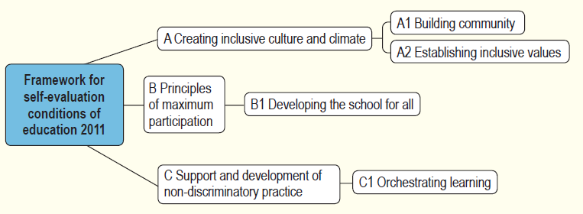
2009
2011

Slide 23
Thank for your attention!
Děkujeme za pozornost!
Cádiz, EERA - ECER
18.–21. 9. 2012

