Slide 1
Teachers Competences at Inclusive Primary Schools in the Czech Republic
Research project Special Needs of Pupils in the Context of the Framework Educational Programme for Basic Education
Jiří Havel, Jana Kratochvílová
Department of Primary Education
Faculty of Education, Masaryk University

Slide 2
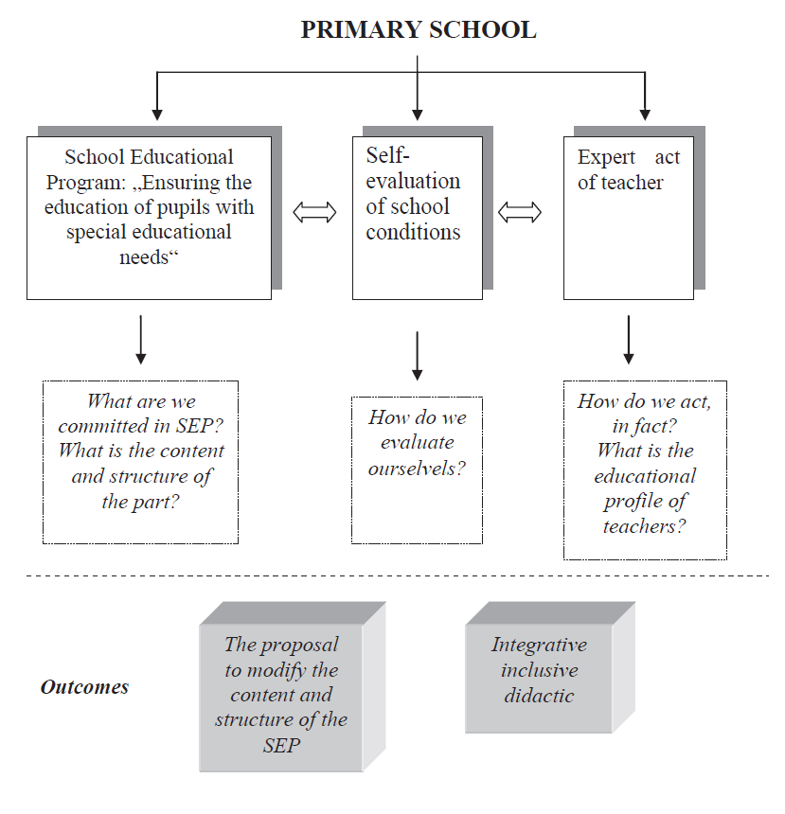

Slide 3

Inclusive education
Process of integrating all children in regular schools in such a way that staff of schools create in collaboration with the community such conditions that support their development in all areas of quality pupil`s life (somatic health, psychological, social, spiritual development and self-development) in maximum extent.

Slide 4
The goal of the research
Humanistic conception of education and schools actually does not permit other than "not to exclude" approach of teacher to children that learn. Most primary school teachers hold this attitude to their pupils although they were not specifically trained in this way.
We therefore wanted to determine whether it is possible to name competencies of teacher who supports inclusive environment
knowledge, skills, attitudes, values.

Slide 5
Research tool
Research technique „5positive features“ (5P).
Three-member team observed common teaching hours of teachers in primary schools that declared as inclusive schools. Each member to take note of 5 positive features, preferably in the context of inclusive education.
The research sample:
    8 primary schools (4 urban and 4 rural),
    about 60 teachers,
    more than 50 pupils with special educational needs.

Slide 6
System of teachers` competencies
A. Teaching and educational competence
(psycho-pedagogical, communicative, diagnostic)
B. Personal competence
(mainly teachers` responsibility for his pedagogical decisions and their consequences, but also his creativity, flexibility, empathy, authenticity and ability to accept ourselves and others)
C. Developing competence
(adaptive, informative, explorative, self-reflective, self-regulated)
(Švec, 1999, p. 22-23)

Slide 7
Findings
The characteristics of competencies of inclusive teacher.
In this presentation we are limited only to list the characteristics of individual competencies teachers who create in-class "inclusive" environment.

Slide 8
Psycho-pedagogical competence:
Focuses on the essentials - requires mastery by all their pupils
Offers various sources of knowledge
Uses a variety of tools and equipment, allowing differentiation in teaching
Offers files of differently exacting instructions and tasks, gives children the option of choice (in class and homework) and uses it in a diagnostic way
Calls for use of diverse opinions and hypothesis
Focuses on descriptions of thought processes and performance
Focuses on the development of cognitive skills
Adapts methodical guidance of lesson according to children
They learn to do the right notations in the exercise book
Focuses children on basic idea and leads them to distinguish the nature of the problem
Emphasizes factual contexts in subject matter, it is bound to actual experience of students
In methods it prefers authentic learning, exploring, researching
Requires reasoning
Uses cooperative activities of students, emphasizes the importance of mutual aid and responsibility, responds adequately to the passivity of children at work in the group
Connects teaching students with their homework, gives a choice variety of tasks
Teaching has tempo and dynamics - there are no idle time and boredom
Changes different methods during teaching
Provides sufficient time to complete the task

Slide 9
Communicative competence:
Acts calm, cool and helpfully
Due to life of each class he sets the rules of conduct
Continually provides feedback
Expresses emphasis on the positive achievements - encourages praise
Positive working with error (not criticizing the whole personality of a student)
It is a partnership between a student and a teacher
Manifests personal approach to individuals - uses the names
Places emphasis on sophisticated communication

Slide 10
Diagnostic competence:
Is interested in the views of pupils
Asks questions about the reasoning processes
Works with pre-conceptions of pupils
Uses diversity of assumptions of individual pupils
Leads pupils to self-knowledge
Assesses individual student progress
Evaluates systematically in relation to the previously communicated goals
Works with the evaluation criteria which are known to pupils
Encourages pupils to achieve their personal maximum
Leads children to self-evaluation

Slide 11
Personality competence:
Supports self-confidence of pupils
Is strict in the requirements
Respects all students equally
Leads things into perspective
Uses examples that are close to pupils` lives
Positively stimulates to a better performance
Implements individual approach to pupils
Differentiates requirements according to pupils ability
Provides space for activity and expression of all pupils
Promotes cooperation (cooperative learning), uses meaningfully group teaching (does not abuse the movement of pupils around the classroom)
Does not earmark anybody

Slide 12
Conclusions
In our sample of schools we have met with only exceptionally non-objective or negative approach to children.
It confirms that in the Czech elementary schools there is an implicitly inclusive environment.
In the further course of the research project our endeavour will be to determine the key attributes of inclusion and subsequently to implement them into the training of future teachers of primary schools.

Slide 13
Thanks for your attention!
Brussels, WCLTA
25.–28. 10. 2012

