Slide 1
DYNAMIC STUDY SUPPORT WITH CONNECTED EXTERNAL SYSTEMS
J.Hrbacek, M. Kucera Masaryk University, Faculty of education/Department of Technical Education and Information Science, Brno, Czech Republic
November 8 - 9, 2012, Stará Lesná, The High Tatras, Slovakia

Slide 2
For a long time, people have been trying to find ways that would lead to more effective teaching. Simultaneously, study and teaching supports have been developing. Current information technology, electronics and microprocessor technology have brought completely new possibilities into creation of study supports. They also allowed a new way of study supports creation and their direct connection with external systems. It is basically about the transition from static to dynamic creation of study supports. Also, the possibility of direct connection of study supports with external systems enables all that was impossible up to now, such as creation of study supports for a target group and the ability to monitor and manage students’ practical activities or responses to these practical activities and modify study supports according to students’ results. This is the prerequisite for the creation of study supports with internal intelligence.

Slide 3
what led to the design concept of dynamic study supports with connected external systems
great expansion of ICT technologies and programs for creating multimedia study supports - this allows the authors to create their own study supports directly, In my opinion, it is extremely important to give authors/teachers maximal flexibility in their didactic approach and to allow them certain originality
teacher should have the opportunity to flexibly adjust study supports to the target group as well as to current needs and his/her way of teaching
potřeba vedení a kontrola činností studenta při praktických činnostech prováděných v rámci samostudia
3

Slide 4
dynamic study supports
a well-prepared study support is the basis
this support is first split into its component fragments (blocks) including the topics, problems and their explanations, explaining and motivating animations, simulations, audio, thematic tasks, examples, etc.
it is important for longer texts to be divided into smaller parts to avoid scrolling the text
for all the blocks the printed form is needed so that a student could print out this study support or just its part
for the creation of a support, a list that defines the sequence of units in the support is used (XML file)
the study support itself consists of presenter that presents the support according to the list
4

Slide 5
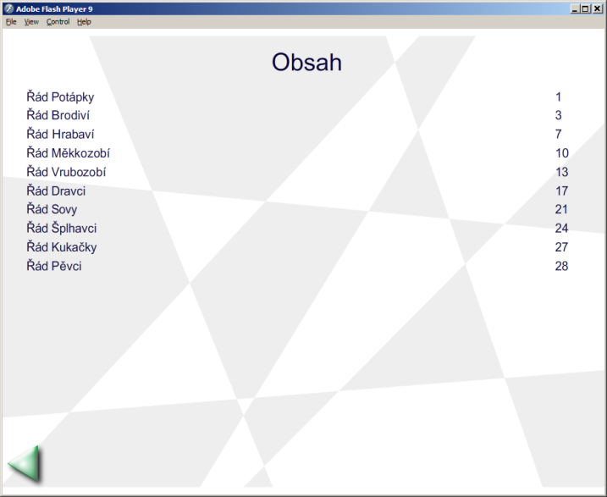
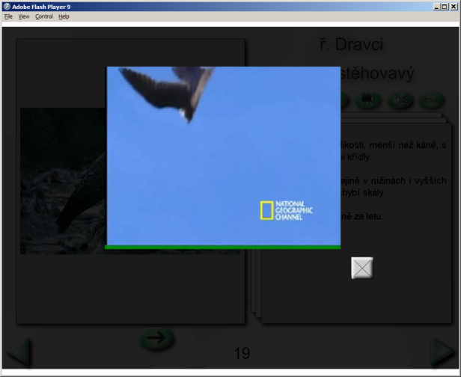
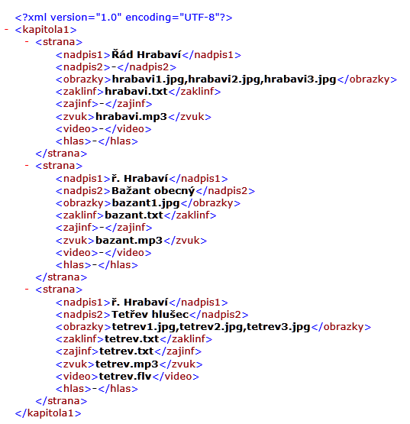
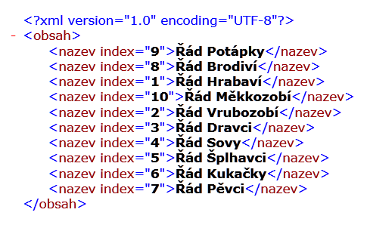
Example of the study support "Encyclopedia of Birds "
5

Slide 6
External systems directly connected width study supports
it allows the study support to control the behaviour of the external system
it allows the study support to control the external system
the study support can thus demonstrate the study matter on the external system, the study support can guide the student through the process of measuring and it can set up the external system and then the student performs measuring using the given values
the mutual communication between the study support and the external system offers the possibility of controlling either the external system from the study support, or controlling the study support from the external system
the implementation of external systems can forbid the student to continue in studying, if he hasn’t completed all the activities that he was supposed to do in his study
6

Slide 7
Connnection of external system with dynamic study support
dynamic study support made in Flash, Visual Basic, etc.
SW connection module – made in Flash (MDM Zinc) or implemented directly to Visual Basic application
7

Slide 8
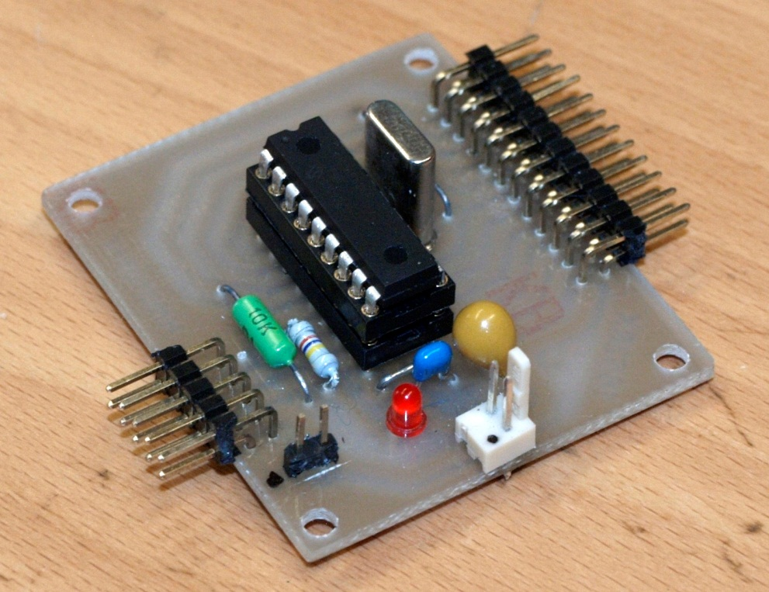
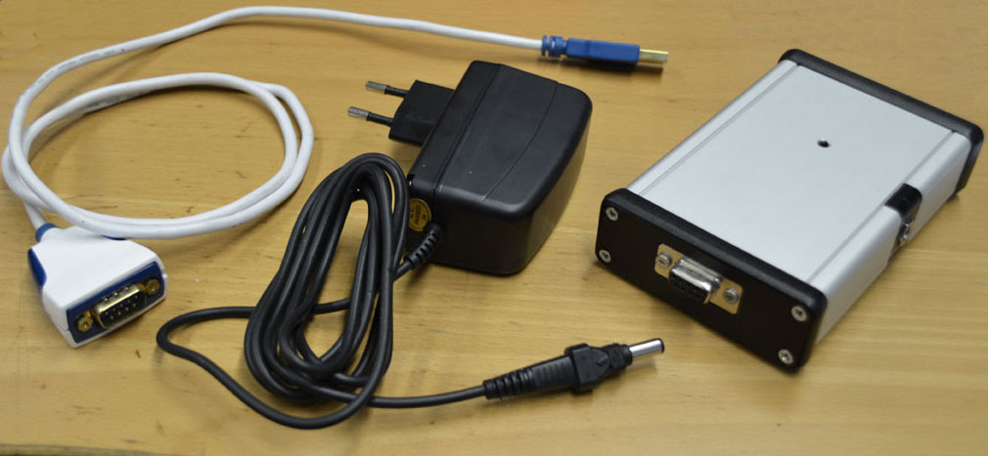
The basic version of the universal connection HW module
from the kit, compact version, ..
8

Slide 9
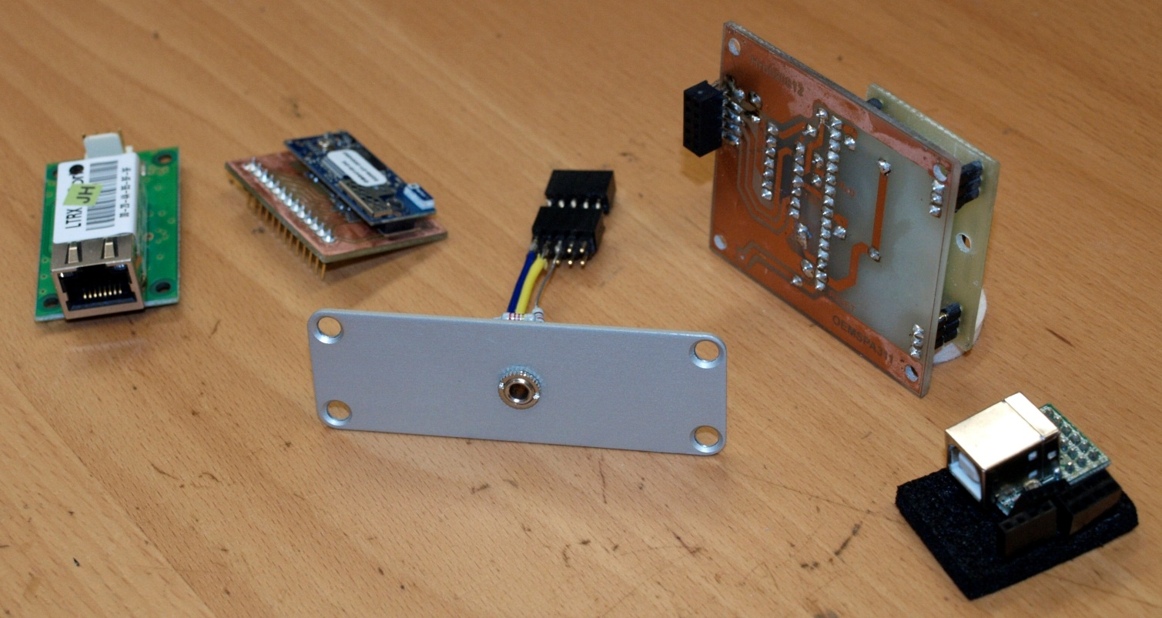
Modules for connection of external systems to PC
for example - TCP/IP, Bluetooth, RS232 TTL or 3.3V, Bluetooth 3.3V, or USB/TTL RS232
9

Slide 10
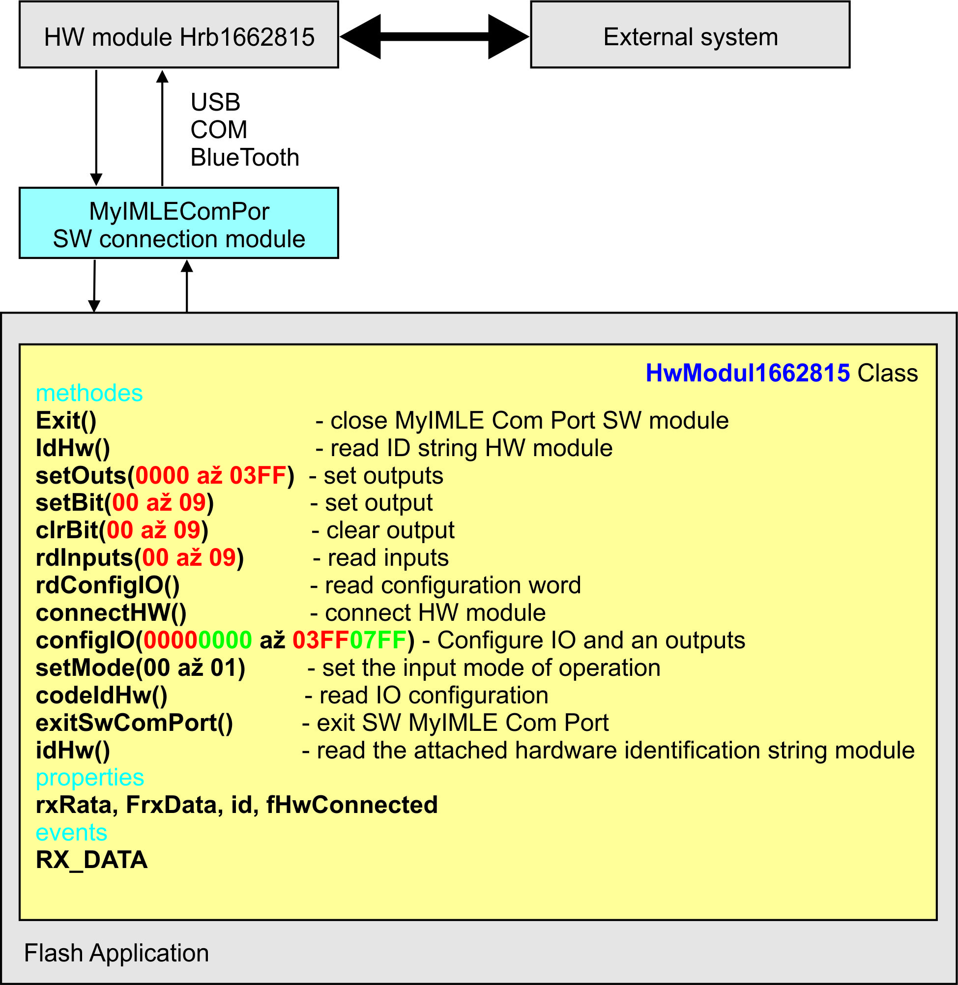
External systems connected with dynamic study supports from user‘s point of view
from the information mentioned above, it may appear that the creation and use of external systems can be very complicated and difficult for common users, but it is not true
methods of the Flash class for the simples HW module - 10 digital Inputs /Outputs and one digital input
10

Slide 11
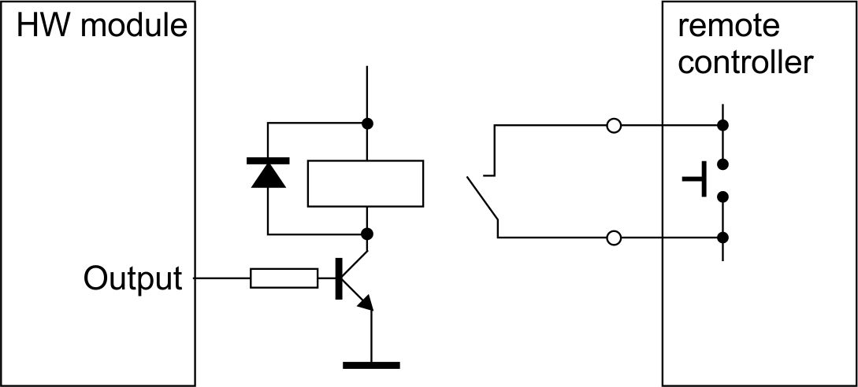
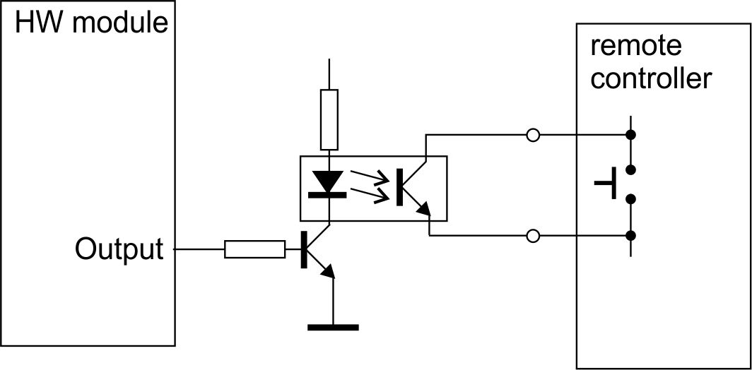
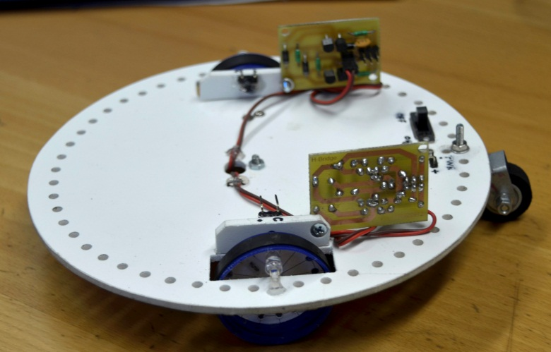
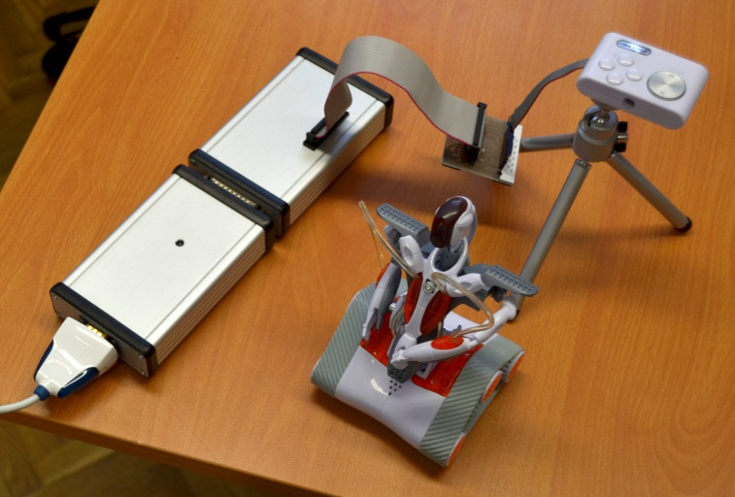
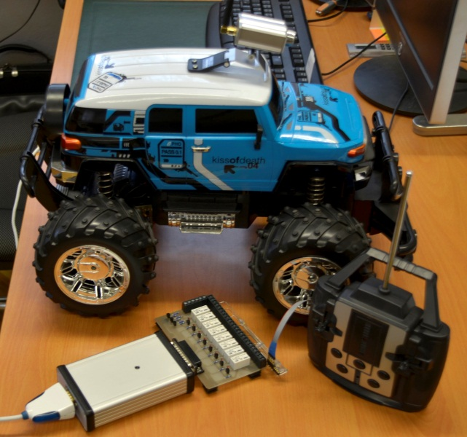
Circuit board relay connected with the remote control of the model is connected to the output of HW module
Examlpe of simple applications
11

Slide 12
Thank you for your attention
12

