Slide 1
Teaching legal communication to undergraduates:
Helping with the first steps
Štěpánka Bilová
Masaryk University Language Centre, Czech Rep.

Slide 2
Masaryk University Language Centre
Department at the Faculty of Law
Legal English - 1st and 2nd year undergraduates
90 minutes per week – 4 semesters

Slide 3
Outline
Activities related to communication (soft skills)
Interviewing a client
pre-interview activity
family law related case
Negotiating
snowball activity
Discussion activity
types of custody
Feedback from students and Lessons learnt

Slide 4
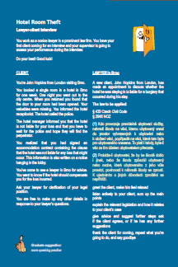
Real life like activities
Motivation – to get involved,
to realize: professional
communication ≠ chatting
Authentic materials
Czech context
Believable scenario
Effective practice

Slide 5
Soft skills: Dealing with clients in a law firm
video
Scene 1: Law firm meeting
There are two new cases in the law firm today – what are they?
Assisting an offender
Being fired for being too attractive
Careless and reckless driving
Landlord X Tenant dispute
Disclosing confidential information
Public urination

Slide 6
Dealing with clients
video
Scene 2: A chance meeting of the client in the corridor
Analyze the situation. Was it a typical meeting? What went on?

Slide 7
Dealing with clients
Scene 3: 1st meeting with the lawyers
The lawyers need to prepare for the first official meeting with the client.
What do they need to prepare?
What ground needs to be covered?
What potential problems can you foresee?

Slide 8
Dealing with clients
video
Scene 3: You are now going to watch the meeting without any sound. Try to figure out how the meeting went.

Slide 9
What could students learn from the activity?
Paying attention to body language/facial expression
Preparing questions and taking notes

Slide 10
CLIENT
You’re John Hopkins from London visiting Brno.
You booked a single room in a hotel in Brno for one week. One night you went out to the city center. When you returned you found out that the door to your room had been opened. Your valuables were missing. You informed the hotel receptionist. The hotel called the police.
The hotel manager informed you that the hotel is not liable for your loss and that you have to wait for the police and hope they will find the perpetrator.
You realized that you had signed an accommodation contract containing the clause that the hotel was not liable for any loss that might occur. This information is also written on a notice hanging in the lobby.
You’ve come to see a lawyer in Brno for advice. You want to know if the hotel should compensate you for the loss incurred.
Ask your lawyer for clarification of your legal position.
You are free to make up any other details in response to your lawyer´s questions.
LAWYER in Brno
A new client, John Hopkins from London, has made an appointment to discuss whether the hotel he was staying in is liable for a burglary that occurred during his stay.
The law to be applied:
§ 2946 NOZ
(1) Kdo provozuje pravidelně ubytovací služby, nahradí škodu na věci, kterou ubytovaný vnesl do prostor vyhrazených k ubytování nebo k uložení věcí, popřípadě na věci, která tam byla pro ubytovaného vnesena. To platí i tehdy, byla-li věc za tím účelem ubytovatelem převzata.
(2) Prokáže-li ubytovatel, že by ke škodě došlo i jinak, nebo že škodu způsobil ubytovaný nebo osoba, která ubytovaného z jeho vůle provází, povinnosti k náhradě škody se zprostí. K ujednáním o jiných důvodech zproštění se nepřihlíží.

Slide 11
Interviewing clients Getting married in the Czech Republic (Family Law)
2 students – a couple to be married in the CR
1 student – a busy lawyer

Slide 12
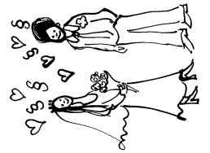
 | Future bride | Prospective bridegroom
Nationality
Name – first and surname
Marital status
Social status (rich?, what job?)
Agree on the following:
Kind of wedding – church, civil
Future country of residence
Future Surname
Prepare any questions you would like to ask your lawyer:

Slide 13
Lawyer – quick preparation
Getting Married: Making it Legal - How to officially get married in the Czech Republic Church or civil wedding? You'll also need to determine whether you'll be having a civil or religious ceremony, as the documents needed for each type of marriage will differ. For civil marriages, you'll take your documents to the Office of Vital Records (matrika) in the Municipal Office (místní úřad), under whose jurisdiction the venue for your ceremony falls. For church ceremonies, go directly to the officiating church authority. For Catholic ceremonies, at least one of the parties must be Catholic. Such weddings also require all the papers used in regular Catholic weddings: baptism certificates, a letter from the bride and/or groom’s parish priest, and a certificate proving completion of a marriage-preparation course. Some Protestant denominations also require a baptism certificate. Jewish ceremonies involve additional religious papers from home, of which the bride and/or groom can receive information from their local rabbinate. Documents you'll need Whether you are a non-EU citizen marrying a Czech national, an EU citizen marrying a Czech national or two non-Czech persons marrying one another, you will need the form “A ….. After the wedding Shortly following the ceremony, a marriage certificate will be mailed to you. Foreigners must report the change in their marital status to the appropriate consular department of their home country's embassy in the Czech Republic. Women who…

Slide 14
Interview + Follow-up
Lawyer – what kind of clients, which advice
Clients – were you satisfied with the lawyer and why
orally or in writing
(lawyer: report, clients: “Facebook posts”)

Slide 15
What could students learn from this role-play?
It depends on the “clients”:
e.g. dealing with difficult clients ☺, coping with the situation when you need to refer to the text when answering the clients’ questions, …

Slide 16
Negotiating
Various kinds
contractual terms
out-of-court settlement (case studies)
reaching a group concensus
(not so much competitive)

Slide 17
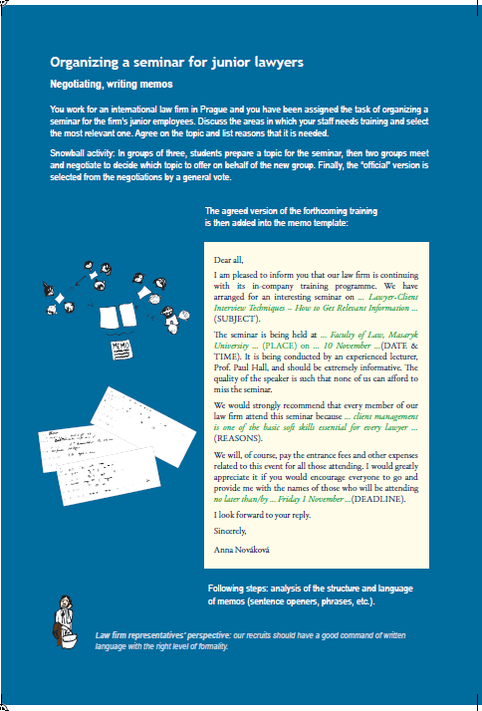
Organizing a seminar for junior lawyers

Slide 18
Organizing a seminar for junior lawyers
You work for an international law firm in Prague and you have been assigned the task of organizing a seminar for the firm employees.
TOPIC: REASONS: WHEN (DATE & TIME): PLACE: ACTION/DEADLINE: ANY OTHER DETAILS:

Slide 19
Organizing a seminar for junior lawyers
Choosing a topic
Why is the topic important? (as many reasons as possible)
Negotiating the topic
New Czech Civil Code
Successful Negotiations
Lawyer-Client Interview Techniques

Slide 20
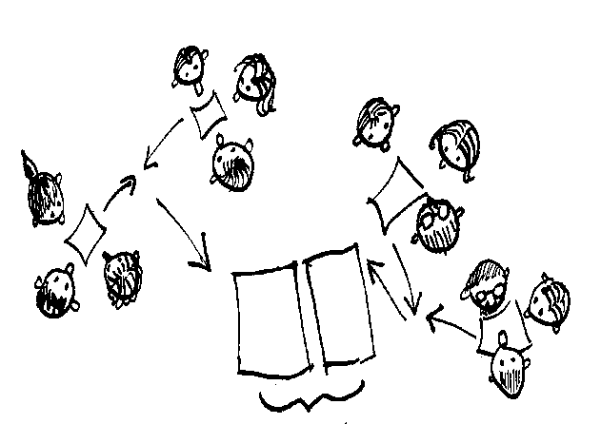
Snowball activity
TOPIC: REASONS:
Each student decides individually
Negotiating in pairs
Negotiating in groups of four (using all your arguments, while listening attentively to the arguments of the other pair)
EXPLAINING REASONS!

Slide 21
Benefits of the activity
Not too competitive
Changing patterns in negotiations
Stress on being able to explain the importance (useful vocabulary: essential, vital, key competences, …)

Slide 22
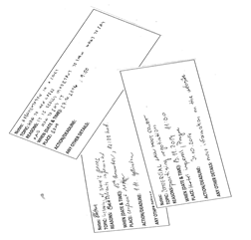
Follow-up
Writing a memo
Dear all, I am pleased to inform you that our law firm is continuing with its in-company training programme. We have arranged for an interesting seminar …(SUBJECT). The seminar is being held at … (PLACE) on … (DATE & TIME). It is being conducted by an experienced lecturer, Prof. Paul Hall, and should be extremely informative. The quality of the speaker is such that none of us can afford to miss the seminar. We would strongly recommend that every member of our law firm attend this seminar because …(REASONS). We will, of course, pay the entrance fees and other expenses related to this event for all those attending. I would greatly appreciate it if you would encourage everyone to go and provide me with the names of those who will be attending no later than/by … (DEADLINE). I look forward to your reply. Sincerely, Anna Nováková

Slide 23
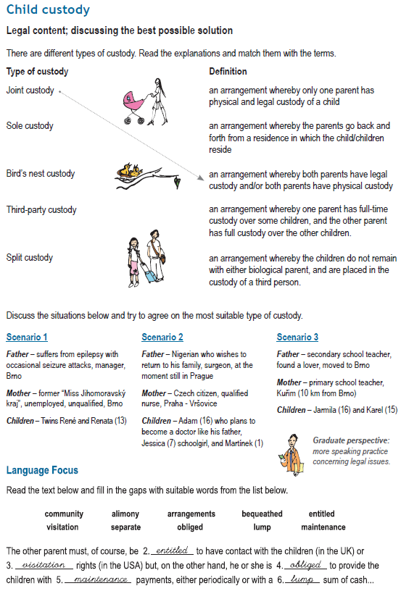
Discussions
Family Law – Child custody
Types of custody
Applying the theory to practice

Slide 24
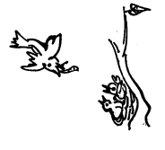
Types of custody
Type of custody | Definition
Joint custody | A. a traditional form of custody, an arrangement whereby only one parent has physical and legal custody of a child
Sole custody | B. an arrangement whereby the parents go back and forth from a residence in which the child/children reside, placing the burden of upheaval and movement on the parents rather than the child/children
Bird's nest custody | C. an arrangement whereby both parents have legal custody and/or both parents have physical custody
Third-party custody | D. an arrangement whereby one parent has full time custody over some children, and the other parent has full-time custody over the other children
Split custody | E. an arrangement whereby the children do not remain with either biological parent, and are placed under the custody of a third person

Slide 25
Scenario 1
Mother secretly drinks, Prague
Father is workoholic – demanding job, well paid, Prague
Children: Eliška (age 6), Jakoubek (age 8)
Scenario 2
Father suffers from epilepsy with occasional seizure attacks, manager, Brno
Mother, former “Miss Jihomoravský kraj”, unemployed, unqualified, Brno
Twins René and Renata (13)
Scenario 3
Father – Nigerian who wishes to return to his family, surgeon, at the moment still Prague
Mother – Czech citizen, qualified nurse, Prague - Vršovice
Children – Adam (16) who plans to become a doctor like his father,
Jessica (7) schoolgirl and Martínek (1)
Scenario 4
Father – unemployed with criminal record, Ostrava
Mother – shop assistant, Ostrava
Children – Alice (10), Jana (9), Josef (7)
Scenario 5
Father – secondary school teacher, found a lover, moved to Brno
Mother – primary school teacher, Kuřim (10 km out of Brno)
Children – Jarmila (16) and Karel (15)

Slide 26
Arriving at a solution
Ss prepare the cases individually
(stating reasons for their decisions, thinking
about the consequences, …)
Discussing in pairs (often bringing their own life experience), any order
Ss should realize there is not always one single right solution

Slide 27
Feedback from students
_
+
Speaking is not necessary. The students
already know how to speak in English.
I’m so happy for all the speaking activities,
I feel much more confident when speaking now.
I would cancel the group work. It didn’t
bring any results, it was a waste of time.
I would love to work more in groups.
I learn so much.
The seminars are very interactive, but the teacher
should realize that students are not interested in interactive work.
I enjoyed all these interactive activities,
It was fun and we learnt a lot.

Slide 28
Feedback from students
_
+

Slide 29
Lessons learnt
Ss can be very creative
Ss themselves are a great resource for teaching material
there is no universal successful activity
motivation, involvement, variety
legal communication X
communication with aspects of law

Slide 30
Aims
Steps towards better professional communication
Be aware of soft skills
Listen actively
Prepare carefully
Express ideas/facts/arguments clearly and politely
Variety of communication tasks

Slide 31
Thank you for your attention.
And co-operation.
Pictures: Barbora Chovancová

