Slide 1
“It was not as bad as I thought it would be”: politeness strategies in students’ self-reflection journals
Petra Trávníková
Masaryk University Language Centre

Slide 2
Outline
Theoretical background
Material analysed
Self-praise and how it is expressed in the corpus

Slide 3
Self-praise
Self-disclosure….. bragging
Definition:
uttering a positive statement about oneself
Speech act through which people positively present their appearance, possession, skills, etc. (Guo and Ren 2020)
face-enhancing act directed at the speaker (Dayter 2013)
growing literature on self-praise, especially in online contexts and some languages (x classical politeness theories)

Slide 4
Theoretical background
Brown and Levinson (1987)- face threatening
Leech (1983) > Maxim of Modesty:
“Minimise the expression of praise of self x maximise the expression of dispraise of self”.
Pomerantz –compliments (hearer x speaker-oriented)
potentially problematic social activity
culture-sensitive character (Chinese modesty- self-denigration principle --Gu 1990)

Slide 5
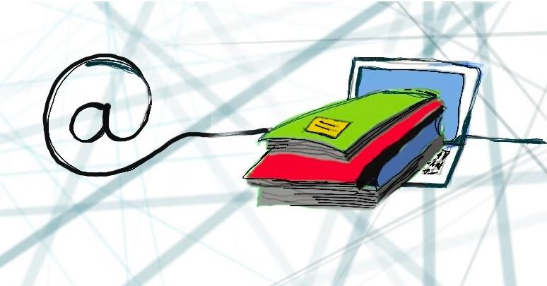
Material under investigation
Self-reflection journals
-the very nature of a diary allows students to search for and express their learning in a personal way, a learning that makes personal meaning and is useful in the student’s own context. (Tang 2002)
-part of portfolio assessment, written continuously
-used in a presentation skills class for Master’s students at FSS MU, C1 level
-form and style: semi-structured, free-writing
- 150 journals over 3 semesters, c. 17,000 words

Slide 6
Good day to you, dear reader! Allow me to introduce myself. My name is … and I am an avid language learner. I enjoy all things foreign, especially food, films and foreign languages. My life has led me to believe that I shall not be afraid to talk to people as long as I have something to say and since English has sort of been my second nature (thanks to my secondary education at an English-Slovak grammar school) for 10 years now, I have become accustomed to speaking my own mind in English. As a bit of a blabbermouth, I found this course very helpful, when it comes to structuring my thoughts and trying to lure the listener in. I am very thankful to have been able to attend this class and will continue to work on my presenting skills. Please, enjoy my little collection of thoughts and feelings on my presentations.

Slide 7
Shop windows of students’ achievements?

Slide 8
I think it was my worst performance. I have selected a great and interesting topic, and I wanted to present my research in the best possible way. My presentation was full of stats and numbers, which I obviously in a stressful situation did not remember, or I was not completely sure, so I was checking my notes too much. When I forget some number, I started to be more nervous than I have ever in this subject was and I was completely lost. I think it should just stop, took a break for a few secs and started the slide or the chapter once again – there was no time limit. I wanted to shine with my research, but even if I have presented it in the best way, after the presenting experience, I am sure it was not a good presentation. As I have said earlier, it was full of numbers and stats, which the audience had no chance to get. I should focus way more on the important facts and cases, not on the numbers. But it was a great experience, and I hope next time I will present my research way better.

Slide 9
3 main pragmatic strategies (Ren, Guo 2020)
explicit SP
modified explicit SP
with a compensation
3. praise from a third party

Slide 10
1. Explicit self-praise
In my opinion, I am a good speaker on a normal level.
Overall, I felt like the teamwork went well.
…other than that, I was satisfied with the way I delivered my topic.
To conclude, I felt good giving the presentation, I felt less nervous than normally.
I think I did well.
X compliments

Slide 11
2. Modified explicit self-praise (Dayter 2013)
SP + disclaimer
SP + a shift of focus (giving credit to sb else)
SP + self-denigration
SP + reference to hard work

Slide 12
SP + disclaimer
Overall, I can say I am content with the mini-presentation of mine, but I see a lot of space for improvement.
I think overall my presentation went well and I felt some progress. Firstly, I finally speak more slowly and more in my words. … However, there are definitely a lot of areas I need to improve.
SP + a shift of focus
The presentation itself went pretty smoothly .. The worst was definitely losing the thread after my dog started to eat right next to my seat since I was sure you have to hear her eating so loudly. However, .. the overall feeling is relatively positive.

Slide 13
c. SP and self-denigration
My topic was my BA thesis, … I enjoyed yapping about it outside school even before the presentation, therefore the biggest challenge for me was cramming all of what I wanted the audience to know into those 20 short slides.
d. SP+ reference to hard work
Overall, it was a good presentation and I said what I wanted to say. Needless to say, how many times I have recorded it. It was fun for decent two evening hours. Props need to be given here to my girlfriend for giving me tips about my pace and wording.

Slide 14
3. Praise from a third party
Teacher
A feedback from the teacher was in a positive way and thanks to it I had pleasant feelings from our work and I was motivated to work on myself more.
Peers (feedback)
… but I am glad I did it. I am glad that others also care about the visual content and liked my presentation from the visual side as well.

Slide 15
Conclusions
Modesty maxim
Ren and Guo 2020: comparison of oneself between past and present
Further research: quantitative analysis, intercultural differences
Pedagogical implications

Slide 16
