Slide 1
Dajare ダジャレ – Its types and cognitive mechanisms for its understanding
Jiří MATELA
Department of Japanese Studies
Masaryk University, Brno

Slide 2
Dajare – Japanese puns… But why puns?
Linguistic humor → semantic processes
Evans (2016): “[…] puns are incredibly complex requiring your brain to perform exquisite gymnastics in putting together carefully choreographed aspects of word sounds and meanings in novel ways.”
PUN – “a humorous use of a word in such a way as to suggest different meanings or applications, or a play on words […], common as jokes in riddles […]”
Dajare (Japanese puns) – minimal humorous (?) texts

Slide 3
Outline of the talk
Brief etymological sketch of dajare
2. Dajare in contemporary Japan and its types
Brief outline of the LCCM Theory
Tentative model of cognitive mechanism related to understanding of dajare
Conclusions

Slide 4
1. Etymological background of dajare in Japan
Evidence of wordplays in gisho 戯書 (as old as Man’yōshū)
Genroku era – spread of haikai no renga (comic linked verse)
Maekuzuke 前句付け – pleasure in search for wordplay, associations etc.
Zappai 雑排 (also kyōhai 狂俳)
Appreciation of share 洒落 – “witticism, jest, refinement, stylish…”
Da- 駄 – “vulgar, poor, low-grade, trivial…”

Slide 5
1. Etymological background of dajare in Japan
Dajare 駄洒落
Also jiguchi 地口 and other names for wordplay
Share – part of a specific popular (sub)culture. With its gradual decay, share becomes cut off from its creative background.
Today many Japanese young people call dajare “oyaji gyagu” (old man’s jokes)

Slide 6
2. Dajare in contemporary Japan and its types
Hobby, internet groups
日本だじゃれ活用協会 (since 2014/09/01)
DajareStation https://dajare.jp/
Owarai bangumi, stand-up comedians
Anonenone (Shimizu K. & Harada N.)
Common informal communication
Parties, celebrations, speeches…
Advertisement
Ōtsuka shōkai 大塚商会 (tanomēru)

Slide 7
Is dajare always a pun, i. e. with humorous effect?

Slide 8
2. Some of dajare types
Segmentation homophony, juxtaposition…:
1）Yoku dekita naiyō desu ga, yoku de kitanai yō desu.
Non-segmentation homophony:
2）Kaeru no ko mo kaeru.
Near-homophony:
3）Toire ni ittoide
4）Futon ga futtonda
5）Dajare wo iu no wa dare ja
Use in riddles, dialogues, use of dialects etc.

Slide 9
3. Brief outline of the LCCM Theory
Lexical Concepts and Cognitive Models Theory
Vyvyan Evans (2009). How Words Mean. Oxford Univ. Press.
Cognitive Linguistics, meaning construction…
Criticism of previous theories of cognitive semantics, such as
Cognitive Grammar (R. Langacker)
Mental Spaces Theory (G. Fauconnier)
…

Slide 10
3. Brief outline of the LCCM Theory
6） 胸に大きなリボンのついたワンピースを着て、赤い口紅を塗っていた。（岩瀬成子『やわらかい扉』1950）
7） 松どもの足もとの地面は、枯れ松葉が茶色く掩い、その上をときどき、赤い蟻が這いまわっていた。（天沢退二郎、1993）
What is the meaning of the word 赤い?
What is the semantic representation of a word like 赤い?

Slide 11
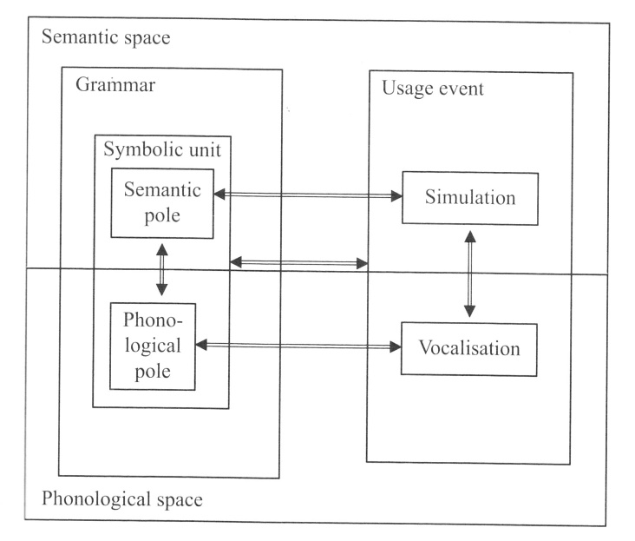
Cognitive Grammar’s semantic representation
Conceptual
Space (?)

Slide 12
LCCM Theory’s semantic representation

Slide 13
4. Tentative model of dajare cognition
Segmentation homophony and near homophony cases
e. g. Fukuoka-shi nai no hitotachi, fuku okashinai?
福岡市内の人たち、服おかしない？
福岡市内…
PHONOL.
FORM 1
LEXICAL
CONCEPT 1
CM 1
AUDITORY
STIMULUS
X
PHONOL.
FORM 2
LEXICAL
CONCEPT 2

Slide 14
4. Tentative model of dajare cognition
Segmentation homophony and near homophony cases
e. g. Fukuoka-shi nai no hitotachi, fuku okashinai?
福岡市内の人たち、服おかしない？
服おかしない
PHONOL.
FORM 3
LEXICAL
CONCEPT 3
CM 2
AUDITORY
STIMULUS
X
PHONOL.
FORM 4
LEXICAL
CONCEPT 4

Slide 15
4. Tentative model of dajare cognition
Non-segmentation homophony cases
e.g. Nigai koi yori, amai koi
苦い濃いより、甘い濃い
濃い・恋
LEXICAL
CONCEPT
濃い
CM 3
AUDITORY
STIMULUS
[koi]
PHONOL.
FORM /koi/
LEXICAL
CONCEPT
恋

Slide 16
5. Conclusions
Need for theory of homophony (and near-homophony) within LCCM Theory (and Cognitive Semantics)
Communicative functions of dajare? (Question of non-humorous effects)
Semantic theory: From special cases (puns, dajare) to “regular” cases – Inspiration in Construction Grammar

Slide 17
ありがとう、蟻が十匹。

