Slide 1
Syphilis causing strains: differences in growth rates and patients infection characteristics
David Šmajs
Laboratory of Bactrerial Genetics and Genomics
Department of Biology
Faculty of Medicine
Masaryk University
Brno, Czech Republic

Slide 2
Science in the LBGG, Masaryk University:
Treponema pallidum infections: syphilis and related diseases
TP genomics, transcriptomics
In vitro TP cultivation
WHO: 2030, yaws eradication
Syphilis vaccine (NIH)
Analysis of clinical samples
Lagomorph syphilis
Yaws in African nonhuman primates
Bacteriocin research: bacterial pathogenicity, virulence factors and related diseases
E. coli core and pangenomes
E. coli probiotics
Bacteriocin evolution
New bacteriocin types and genes
Bacteriocins and colon cancer

Slide 3
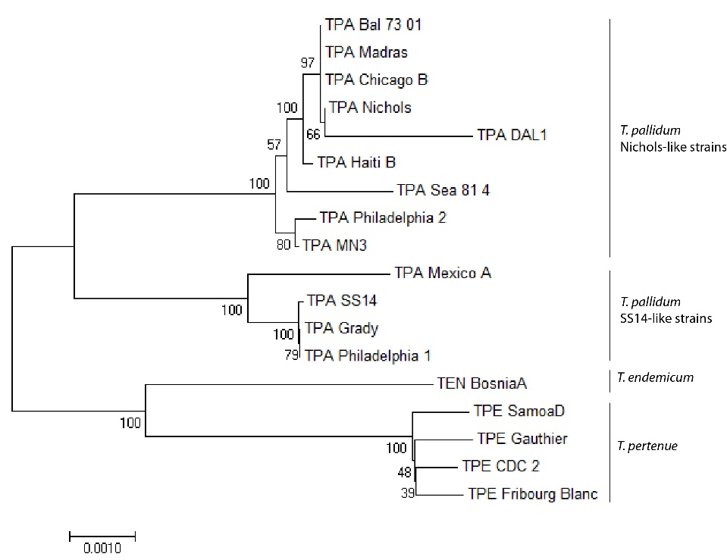
Two groups of syphilis-causing strains
Bad sampling
or separate evolution?
Šmajs et al. 2016
The tree was constructed from alignment of concatenated multiple chromosomal loci of TPA, TPE, and TEN reference strains including the TP0136, TP0304, TP0326, TP0488, TP0515, TP0548, and TP0558 loci. There was a total of 14743 nucleotide positions in the final dataset.

Slide 4
Two groups of syphilis-causing strains
Nichols-like strains:
5.9%
n = 1989
Šmajs et al. 2018
Nichols-like strains:
21.6%
n = 1687
Data since review by Šmajs et al. 2018

Slide 5
Two groups of syphilis-causing strains - why most of the people are infected with SS14-like isolates?
Until 2022, Nichols-like and SS14-like strains were analyzed among 3676 isolates/strains:
Data since review by Šmajs et al. 2018
456 TPA isolates from Australia (Victoria), 26.1% of Nichols-like isolates, Taouk et al. 2022
393 TPA isolates from Queensland, Australia, 9.4% of Nichols-like isolates, Sweeney et al. 2022
n = 849
638 Nichols-like isolates from 4525 isolates: 14.1%

Slide 6
Two groups of syphilis-causing strains
Strain | Place of isolation | Year of isolation | Reference | SS14-like/Nichols-like cluster
Nichols | Washington, D.C., USA | 1912 | Nichols | Nichols
Haiti B* | Côtes-de-Fer, Haiti | 1951 | Turner and Hollander | Nichols
Chicago B | Chicago, USA | 1951 | Turner and Hollander | Nichols
Madras* | Madras, Indie | 1954 | Laboratory diary of R. George (CDC) | Nichols
Bal 73-01 | Baltimore, USA | 1968 | Hardy et al. | Nichols
Sea 81-4 | Seattle, USA | 1980 | Lukehart et al. | Nichols
DAL-1 | Dallas, USA | 1991 | Wendel et al. | Nichols
MN-3 | Minnesota, USA | not known | not known | Nichols
Philadelphia 2 | Philadelphia, USA | not known | not known | Nichols
Mexico A | Mexico | 1953 | Turner and Hollander | SS14
SS14 | Atlanta, USA | 1977 | Stamm et al. | SS14
Grady | Atlanta, USA | 1980s | not known | SS14
Philadelphia 1 | Philadelphia, USA | 1988 | Harper et al. | SS14
Grow Nichols-like strains
better in rabbits?
14d10c | San Francisco, USA | 2017 | Pereira et al. 2016 | Nichols
14d9f | San Francisco, USA | 2017 | Pereira et al. 2016 | SS14
14d9g | San Francisco, USA | 2017 | Pereira et al. 2016 | SS14
Šmajs et al. 2016

Slide 7
Nichols and SS14 strains differ in the ability to grow in vivo
median number of passage days = 23.5
median number of days = 14.5
Philadelphia 1 have 1.48-times longer generation time compared to DAL-1
DAL-1 generation time 30-33.7 hours
Phi 1 generation time 44.4-46.7 hours
The results of multiple passages of TPA DAL-1 (n = 12) and Philadelphia 1 (n = 12) in experimental rabbits showing multiplication of treponemes (defined as a ratio between the number of treponemes per ml after and before experiment) in a log10 scale.

Slide 8
Nichols and SS14 strains differ in the ability to grow in vivo

Slide 9
Nichols and SS14 strains differ in the ability to grow in vivo

Slide 10
Nichols and SS14 strains differ in the ability to grow in rabbits
DAL-1 multiplication appears to be higher with an increased initial inoculation ratio, although this correlation was very weak (R² = 0.156).
DAL-1 strain overgrew Philadelphia 1 by a factor of 14.3× - 320.6×, corresponding to 3.84 - 8.32 TPA generations

Slide 11
Nichols and SS14 strains differ in the ability to grow in vitro
Nichols generation time (28.6 – 30 hours)
SS14-like strains
(36.8 – 44.1 hours)
Edmondson et al., 2018, 2021, 2022

Slide 12
Differences between Nichols-like and SS14-like isolates
Patients characteristics
Nichols-like isolates
SS14-like isolates
Age (years) - CZ
43.21
35.99
p = 0.0074
Unpublished*
Age (years) - France
46 (median)
37.0 (median)
Pospíšilová et al. 2018
Age (years) - Argentina
32 (median)
28.0 (median)
Gallo Vaulet et al. 2017
Age (years) - Argentina
31 (median)
25.0 (median)
p = 0.07
Morando et al. 2022
Sex (w/m)
1/68
51/611
p = 0.0505
Unpublished**
Primary/secondary syphilis***, CZ
2/2
188/45
p = 0.18
CZ, until May 2019
fully and partially typed
Primary/secondary syphilis, France
0/3
53/23
p = 0.033
Pospíšilová et al. 2018
Primary/secondary syphilis, Belgium
0/3
10/2
p = 0.022
Mikalová et al. 2017
Primary/secondary syphilis, Argentina
5/5
23/4
p = 0.041
Gallo Vaulet et al. 2017
Swab/WB
6/4
278/53
p = 0.068
CZ, until May 2019
fully and partially typed
RPR
4.03
3.35
p = 0.16
RPR -/+
3/26
56/276
p = 0.44
VDRL, median titer
128
32
p = 0.09
Morando et al. 2022
Single/multiple primary ulcers
6/0
60/41
p = 0.03
Noda et al. 2019
Nichols-like strains appear to be more frequently isolated from older males, more frequently from patients in the secondary syphilis, from blood samples with higher RPR titres and more frequently from single primary ulcers
*CZ (all samples till May 2019) + database record of fully-typed isolates with known age (FRA, CU, SW)
**All fully-typed isolates from PubMLST database
***In most instances, active syphilis in women and in MSM is usually not diagnosed until the secondary stage. (Baughn and Musher 2005)

Slide 13
Differences between Nichols-like and SS14-like isolates
Nichols-like isolates
SS14-like isolates
Czech Republic
(70.8% of macrolide resistant isolates)
Macrolide sensitivity (29.2%)
23/24
93/373
p = 0.0001
Japan
(86.2% of macrolide resistant isolates)
Kojima et al. 2019
Macrolide sensitivity (13.8%)
4/7
1/29
p < 0.01
Southern Africa
(22.5% of macrolide resistant isolates)
Venter et al. 2021
Macrolide sensitivity (78.5%)
45/49
57/81
p = 0.004
A2059G in Nichols-like isolates: UAB276i (9.24.10), Madagascar, 2003, Chen et al. 2021
9.20.3., Argentina, 2022, Morando et al., submitted

Slide 14
https://pubmlst.org/organisms/treponema-pallidum/
Nichols-like isolates
SS14-like isolates
A2058G
50/154 (32.47%)
639/929 (68.78%)
p<0.0001
A2059G
2/154 (1.30%)
14/929 (1.51%)
No mutation in rrn
71/154 (46.10%)
139/929 (14.96%)
p<0.0001
Undetermined
31/154 (20.13%)
132/929 (14.21%)

Slide 15
Macrolide resistence in Nichols- and SS14-like isolates
100%
A2058G, A2059G
Same mutations, A → G
Similar genome positions
Presence in rrn both operons
Same frequency of spontaneous mutations
Probability of mutations per infected patients: 10⁻³ - 10⁻⁴ for yaws treponemes
Nichols-like isolates
SS14-like isolates
A2058G
639/929 (68.78%)
A2058G fitness cost for Nichols-like isolates
A2058G/A2059G
fitness cost
50/154 (32.47%)
A2058G
2/154 (1.30%)
A2059G
14/929 (1.51%)
0%

Slide 16
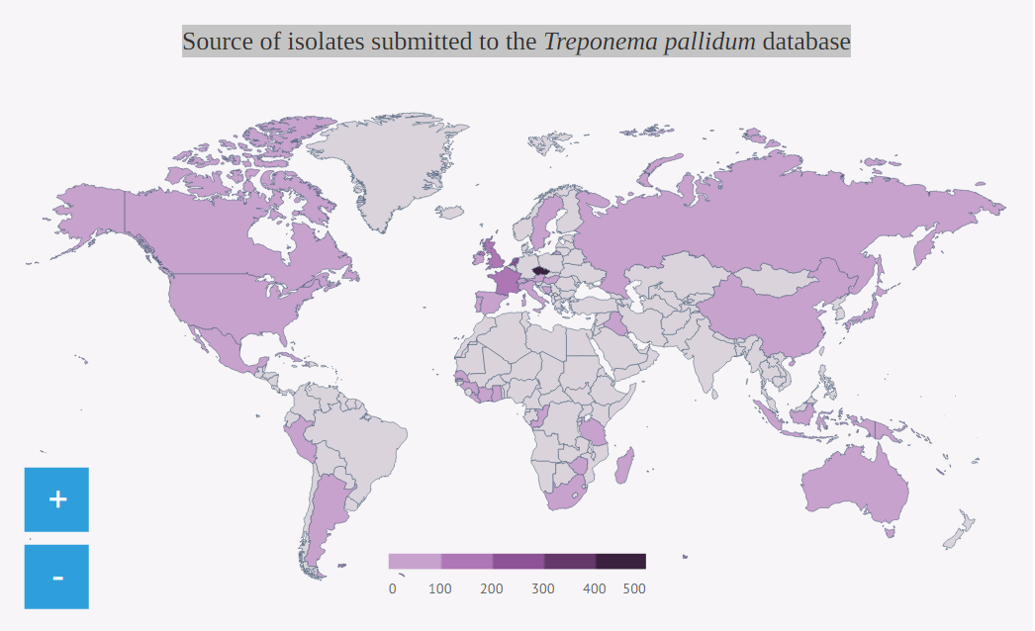
https://pubmlst.org/organisms/treponema-pallidum/
Treponema pallidum | PubMLST

Slide 17
Nichols- and SS14-like isolates: simulation of detected number of allelic profiles
Nichols-like isolates (13AP/89 is.)
Number of allelic profiles
SS14-like isolates
SS14-like isolates (65AP/834 is.)
Number of sampled isolates

Slide 18
Allelic profiles in the Czech population (2004-2021)
33 different allelic profiles
Clades:
87,7 % SS14-like samples (n = 355)
4,4 % Nichols-like samples (n = 18)
7,9 % NA (n = 32)

Slide 19
Clinical samples and examined patients (2004-2021; n = 1,017)
Characteristics |  | PCR N (n=521) | PCR P (n=496) | p value
Gender (M/F) |  | 417/102# | 447/58# | 0,0006*
City (Prague/Brno) |  | 261/256 | 342/154 | <0,0001*
Material (WB/SW) |  | 275/239# | 86/408# | <0,0001*
Age: mean (sd) range |  | 35,4 (12,6) 0-85 | 38,5 (10,74) 0-71 | <0,0001*
Serology (P/N) |  | 339/143# | 467/13# | <0,0001*
Positive serol. | TPPA (P/N) | 306/19# | 439/7# | 0,0018*
 | IGG (P/N) | 303/21# | 414/40# | 0,2794
 | IGM (P/N) | 242/76# | 438/8# | <0,0001*
 | RPR (P/N) | 261/73# | 396/69# | 0,0114*

Slide 20
Allelic profiles associations
Characteristics |  | 1.3.1 (n=137) | 1.1.8 (n=33) | 1.1.1 (n=29) | 1.26.1 (n=24) | 9.7.3 (n=12) | 1.1.3 (n=8) | 1.36.1 (n=6) | Rest (n=26)
Gender (M/F) |  | 128/8#* (0,0042) | 22/11* (0,0003) | 29/0* (0,0336) | 15/9* (0,0005) | 12/0 | 8/0 | 4/2 | 24/2
City (Prague/Brno) |  | 105/32* (0,0354) | 20/13 | 23/6 | 6/18* (0,0001) | 12/0* (0,0209) | 5/3 | 5/1 | 18/8
Material (WB/SW) |  | 3/136 | 1/31# | 1/28 | 0/24 | 2/10* (0,0420) | 0/8 | 0/6 | 14/25
Age: mean (sd) |  | 35,6 (9,6) | 35,3 (14,3) | 32,0 (8,8) | 31,8 (9,4) | 38,7 (11,1) | 34,1 (12,0) | 24,7 (14,3)* (0,0234) | 32,6 (11,3)
Serology (P/N) |  | 131/2# | 32/0# | 23/0 | 24/0 | 11/0# | 8/0 | 6/0 | 26/0
Positive serol. | TPPA (P/N) | 126/0# | 32/0 | 23/0 | 21/2#* (0,0227) | 10/0# | 8/0 | 6/0 | 23/1#
 | IGM (P/N) | 118/11# | 30/1# | 27/1# | 21/3 | 11/0# | 5/2# | 5/0# | 20/6
 | IGG (P/N) | 126/1# | 32/0 | 28/0# | 22/1# | 9/0# | 7/1 | 6/0 | 24/0#
 | RPR (P/N) | 113/18 | 23/9 | 25/4 | 19/5 | 9/2# | 5/3 | 6/0 | 23/3

Slide 21
Summary
1. Diversification of syphilis-causing strains into SS14- and Nichols-like groups
Geographical and population separation of syphilis-infected human societies such as separation of American and European populations before Columbus' journeys
2. Contemporary worldwide predominance of SS14-like strains
Fitness cost for macrolide or other antibiotics
3. Growth in rabbits and rabbit cells
Nichols-like strains grows faster in rabbits

Slide 22
Why are clinical samples of importance?
Improving diagnostics:
existence of serologically negative, but PCR positive samples
discrimination between reinfection vs. relaps of infection
distinguishing of individual subspecies of TP
Adjusting of therapy:
no macrolides!
Identification of interesting samples:
OMPeome, WGS, vaccine development
Epidemiological overview:
Why some variants are so successfull?

Slide 23
Thank you!
David Šmajs
dsmajs@ed.muni.cz
+420 549 497 496

Slide 24
Content of cooperation with other NIVB groups
Druhá strana | Předmět vzájemné spolupráce ve vztahu k cílům a aktivitám výše uvedeným (provést odkaz) EN – 2-3 odrážky Nutná shoda a akceptace navzájem – tj. leadeři skupin si projednají formulaci mezi sebou, zde uvedou platný výsledek.
MU_01_Plevka | The group of Pavel Plevka will perform electron microscopy of treponemal cells undergoing in vitro cultivation.
MU_05_Pantůček | The group of Roman Pantůček will help with genomic analysis of bacteriophages/prophages identified among E. coli isolates.
UK_02_Dřevínek | The group of Pavel Dřevínek will collaborate on microbial analysis of clinical samples.
UPOL_02_Kolář | The group of Milan Kolář will collaborate on analysis of clinical E. coli isolates.
MBU_01_Šebo | The group of Peter Šebo will perform protein analysis of bacterial toxins responsible for adverse effect of E. coli.

Slide 25
Acknowledgements
Petra Matějková, MU
Juraj Bosák, MU
Linda Grillová, MU
Darina Čejková, MU
Markéta Nováková, MU
Lenka Mikalová, MU
Matěj Hrala, MU
Klára Janečková, MU
Pavla Fedrová, MU
Sascha Knauf
Pathology Unit, German Primate Centre
Leibniz Institute for Primate Research
Göttingen
Germany
George M. Weinstock
The Genome Institute,
Washington University School of Medicine, USA
Steven J. Norris
UTMS, Houston, TX
David L. Cox
CDC, Atlanta, GA, USA.
Prof. Justin D. Radolf, Ph.D.
University of Connecticut School of Medicine and Dentistry
Connecticut, USA
Jonathan B. Parr, MD, MPH
Assistant Professor, Division of Infectious Diseases
University of North Carolina at Chapel Hill
Natasha Arora
Evolutionary Genetics and Theoretical Biology IEU
University of Zurich
Zurich
Switzerland

Slide 26
Macrolide resistance
From 496 PCR P
175 N (35,3%)
321 P (64,7%)
86 sensitive (26,8%)
235 resistence (73,2%)
215 A2058G (91,5%)
20 A2059G (8,5%)
 |  | 1.3.1 | 1.1.8 | 1.1.1 | 1.26.1 | 9.7.3 | 1.36.1 | 1.1.3 | Rest
Sensitive (no mutation) |  | 1 | 29 | 11 | 0 | 0 | 6 | 1 | 4
Resistance | A2058G | 106 | 3 | 15 | 17 | 10 | 0 | 0 | 15
 | A2059G | 0 | 0 | 0 | 0 | 0 | 0 | 7 | 0
p value |  | <0,0001* | <0,0001* | 0,023* | 0,015* | 0,122 | <0,0001* | 0,685 | 1,000
Associated with resistence!

Slide 27
Bar chart template

Slide 28
Circular chart template

Slide 29
Here you can put long title, even three or four lines long

Slide 30
Title (max. two lines)

Slide 31
Title

Slide 32
Table template
Column 1 | Column 2
Cell 1

Slide 33
Two contents
Insert visual content on the left side
Insert text on the right side
Or insert text on both sides

Slide 34
Big photo with title

Slide 35
Image description

