Slide 1

Ways of grammar:
Analytical constructions in the acquisition of Italian as an additional language by adult learners with limited literacy
Egle Mocciaro (Masaryk University, Brno)
Adult Second Language Literacy (ASLL)
Language and Literacy Acquisition of Adults
in the Context of Migration,
Multilingualism, and Second Language Learning
March 16–18, 2023 | Friedrich Schiller University Jena, Germany

Slide 2
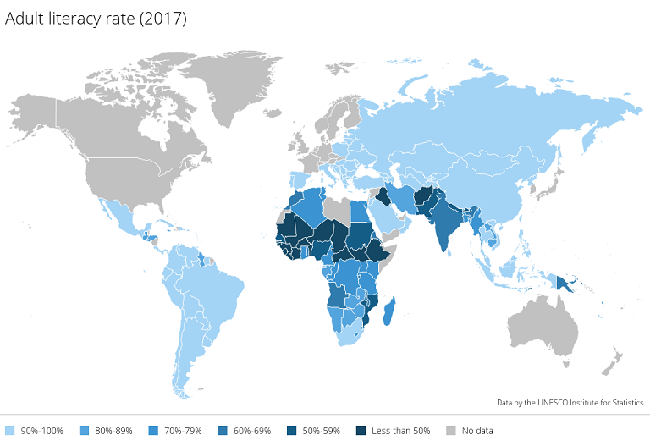
Which learners?
Young people (18-30 years and minors)
Moving from areas of the world with
low rates of schooling and literacy
high rates of territorial multilingualism
Having
low literacy skills (about 30%)
plurilingual repertoires (also from mobility)
polylingualism (set of mobile linguistic resources rather then full competencies)
UNESCO Institute for Statistics, http://uis.unesco.org/en/topic/literacy
Blommaert 2010; Jørgensen 2008; Lüpke & Storch 2013; Mufwene 2008

Slide 3
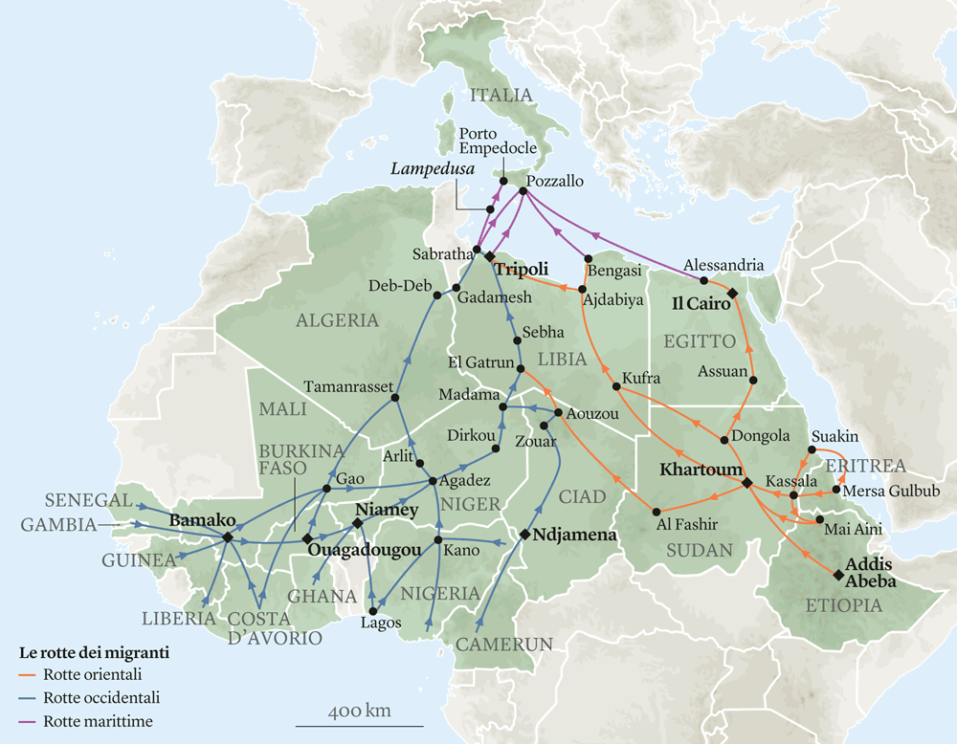
Mobility and learning
Experiencing mobility
Frequently induced («forced migration»)
Made of multi-trajectories (Mediterranean routes)
Interrupted by «immobility» («mobility regime»)
Segregation
Low or no interaction with the local population
Low or no exposure to the local language(s)
Fragmented acquisition of the local language(s)
Internazionale 13/9/2016, https://www.internazionale.it/notizie/2016/09/13/rotte-migranti-africa-italia
D’Agostino 2021: 93 ff; IOM 2019; Schiller & Salazar 2013;

Slide 4
Studies
Need for a research agenda accouning for forced migrants’ acquisition contexts
«[W]e believe that a separate research agenda is useful for the specificities of the living conditions of these learners. Such an agenda must take a holistic approach that considers learners’ experiences, needs and strategies.» (Monsen & Bordal Steien 2022)
Peripherality of research on additional language acquisition in migration contexts
Biased samples and non-representativeness (Andringa & Godfroid 2020; Henrich et al. 2010; Tarone & Bigelow 2005)

Slide 5
Studies
Previous large-scale studies
Low exposure, low-schooling, no attention to literacy (Becker et al. 1977; Clahsen et al. 1983; Klein & Perdue 1992; Perdue 1993; Clahsen et al. 1991)
Naturalistic acquisition, no attention to schooling and literacy (Giacalone Ramat 2003)
Existing studies on the role of literacy and/or schooling
Bigelow & Tarone (2004); Tarone (2010); Tarone & Bigelow (2005, 2007); Tarone et al. (2006, 2009)
Vainikka & Young-Scholten (2007); Vainikka et al. (2017); Young-Scholten & Strom (2006)
(L2s different from English) Julien et al. (2016); Oldenkamp (2013); Sanders et al. (2014); Van de Craats (2011); Janko (2020); Janko et al. (2019); Mocciaro (2020); Tammelin-Laine (2014, 2015); Tammelin-Laine & Martin (2016)

Slide 6
Questions (and methodological choices)
What influence (if any) do sociolinguistic variables, and literacy in particular, have on the development of additional languages in migration context?
On the rate and endstate (Tarone & Bigelow 2009)
On specific patterns along the route (Vainikka et al. 2017; Young-Scholten & Mocciaro 2022)
How to check?
By keeping the variables distinct (literacy vs. schooling vs. exposure)
By reusing existing descriptions focusing on morphosyntax and adopting a functionalist perspective (e.g., Klein & Perdue 1997; Giacalone Ramat 2003)

Slide 7
Data collection: Study 1 (longitudinal)
20 newcomers
3 levels literacy (literacy tests, ItaStra, UniPA, 2017-9)
Early and late literacy
Any language or writing system
Table 1. Levels of literacy; Mocciaro 2020
Cf. Amoruso & Lo Maglio 2018; D’Agostino 2018; D’Agostino & Mocciaro 2021, forthcoming; Mocciaro 2022

Slide 8
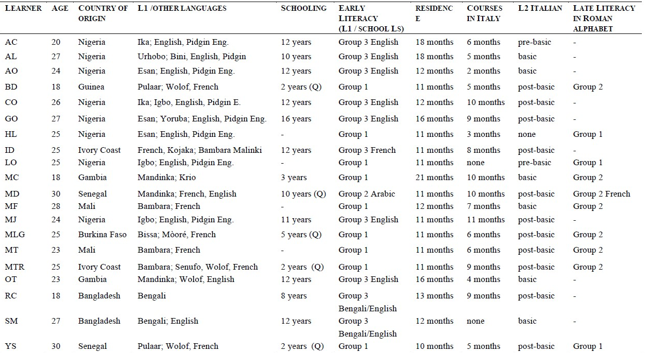
Data collection: Study 1
Table 2. Participants in the study; Mocciaro 2020
(Q = Qur’anic school)

Slide 9
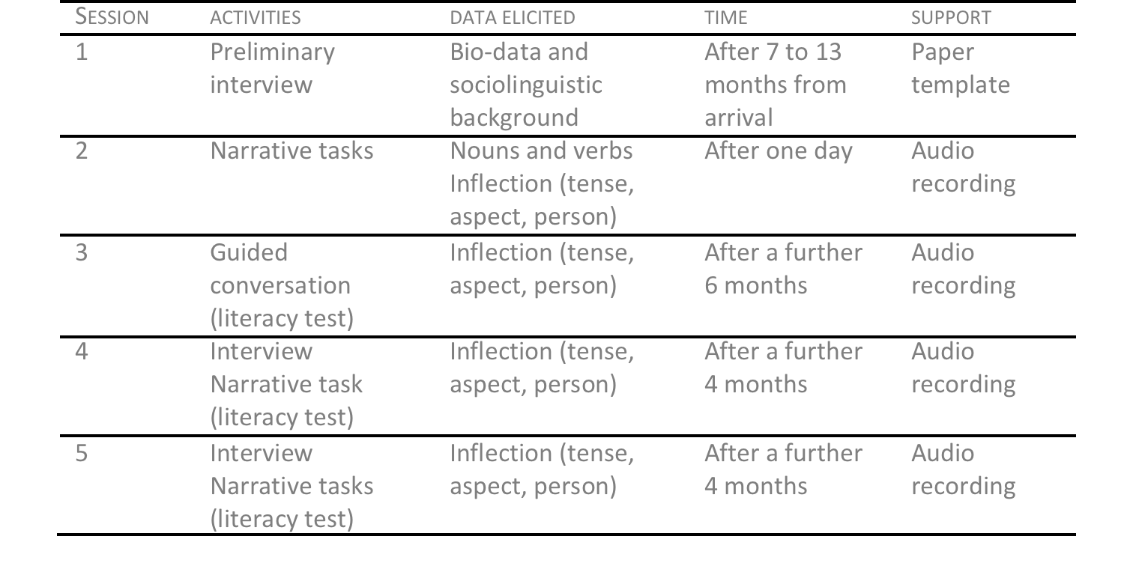
Data collection: Study 1
***no development in literacy from 1 to 5
Table 3. Data collection sessions; Mocciaro 2020

Slide 10
Data collection: Study 2 (cross-sectional)
Newcomers recruited during the new literacy tests at ItaStra, Palermo (2020-2021)
Same criteria as in Study 1
Data analysis = ongoing (sample of 100 learners)

Slide 11
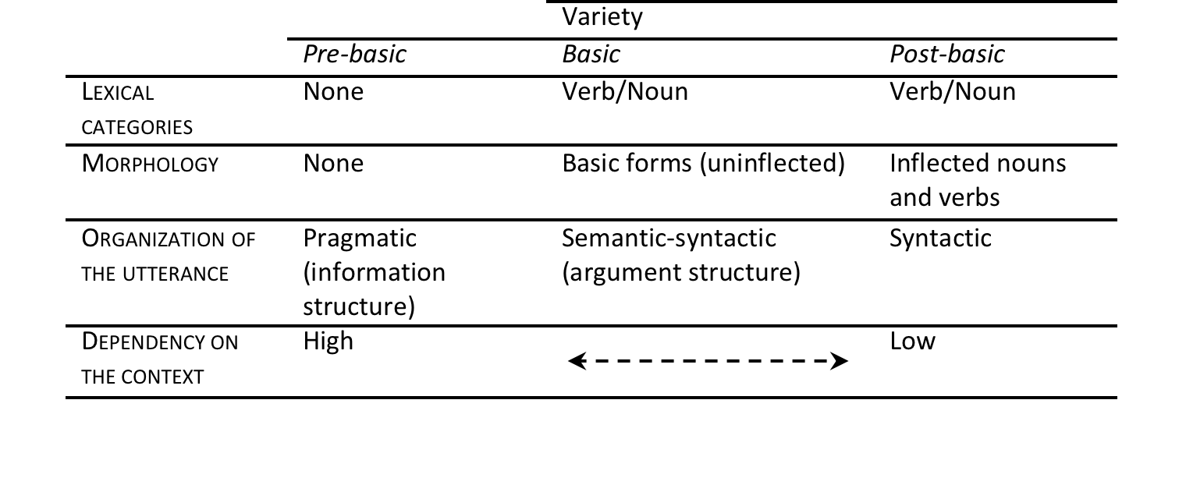
Analytical tools
The Basic variety theory (Klein & Perdue 1997, based on ESF project):
Table 4. Data collection sessions (Mocciaro 2020)

Slide 12
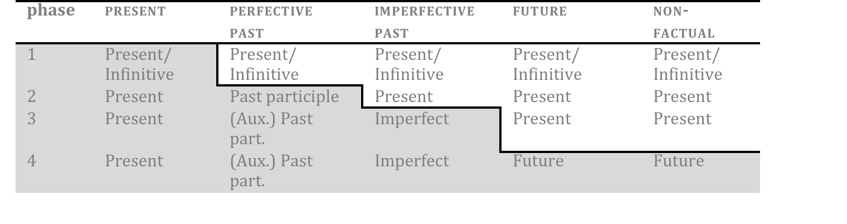
Analytical tools
Implicational sequence
Basic forms  past participle (w/wo auxiliary)  imperfect  future
 conditional  subjunctive
Table 5. Sequence of acquisition of the Italian verb; Banfi & Bernini 2003: 90

Slide 13
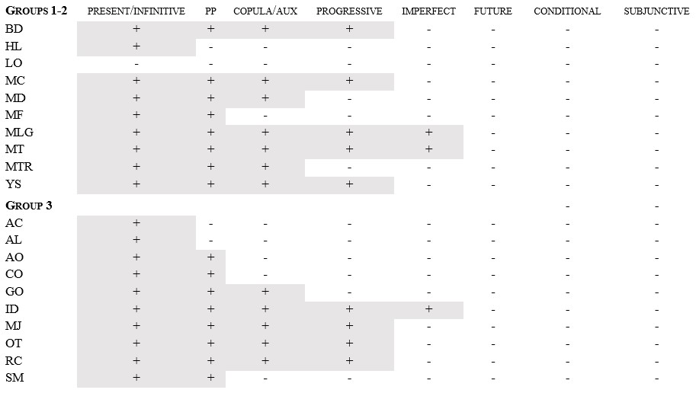
The continuum of morphosyntax
Table 6. The continuum of verbal morphosyntax; Mocciaro 2020

Slide 14
The continuum of morphosyntax
Table 6. The continuum of verbal morphosyntax; Mocciaro 2020

Slide 15
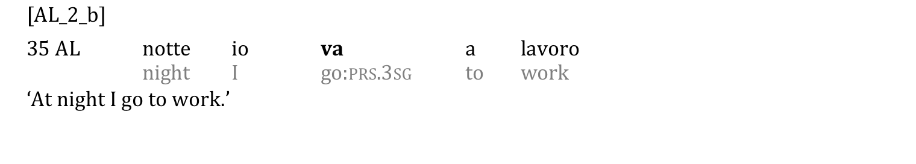
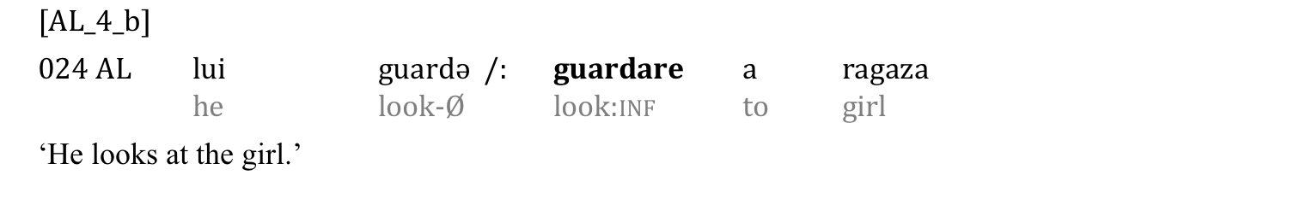
Basic variety
Basic forms (pseudo pres., inf.) → | PP → | Copula/AUX →
V lacks finiteness and is morphologically unanalysable («basic form»)
Temporal, aspectual and person information can be lexicalised (notte, io, lui)
(1)
(2)

Slide 16
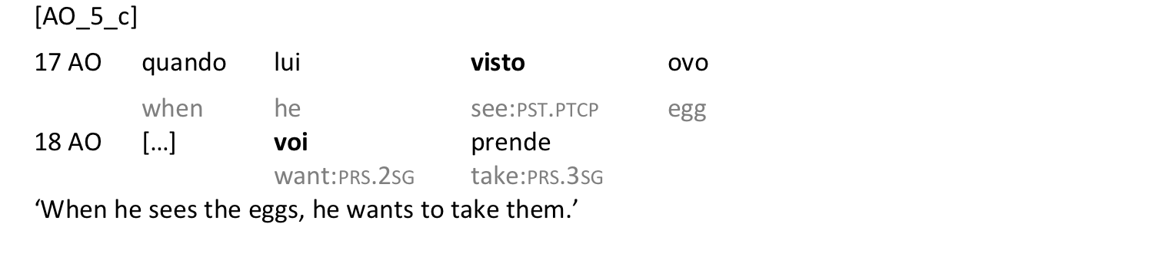
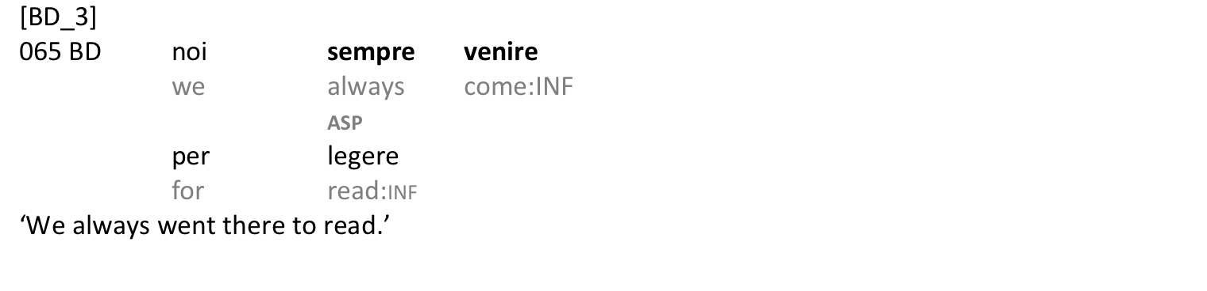
Postbasic continuum
Basic forms (pseudo pres., inf.) → | PP → | Copula/AUX →
Emergence of past participle to express perfective aspect
(5)
(6)

Slide 17
Postbasic continuum
Basic forms (pseudo pres., inf.) → | PP → | Copula/AUX →
Analytical stage → grammaticalisation of auxiliaries (finiteness)
Intermediate stages from non-finite to finite utterances
Analytical stage. Tense and aspect are expressed by auxiliaries or specialised lexical markers; the lexical verb conveys essentially its lexical value
Merging stage. Tense and aspect merge with the lexical content of the verb (more opaque expression of tense and aspect) (Benazzo & Starren 2007: 151)

Slide 18
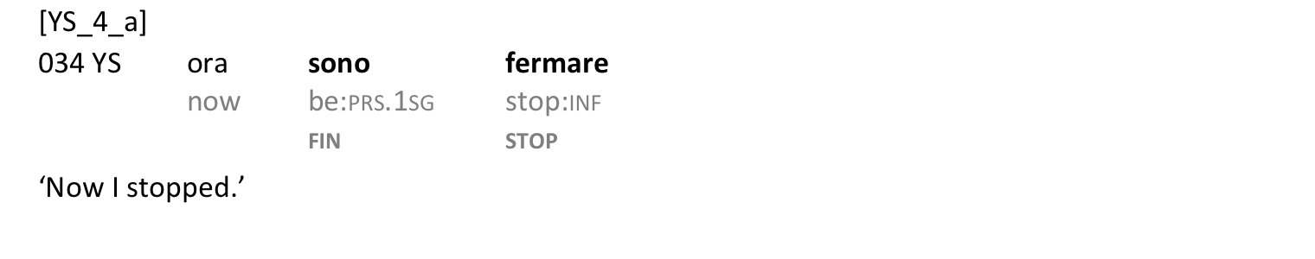

Postbasic continuum: ‘be’-constructions
Basic forms (pseudo pres., inf.) → | PP → | Copula/AUX →
Grammatical meaning and lexical meaning are encoded separately
Temporary strategies before morphology emerges
(7)
(8)
Bernini 1989, 2003; Starren 2001.

Slide 19
Postbasic continuum: ‘do’-constructions
Basic forms (pseudo pres., inf.) → | PP → | Copula/AUX →
«Light V» constructions (e.g., fare ricerca ‘do research’)
Semantically weak V → ACT(-ion/-ivity) + action N as a semantic nucleus (= ‘to research’)
Interlanguage (i.e., non-target) constructions to fill a lexical gap (cf. Giacalone Ramat 1997: 262; Quochi 2007, 2016)
fare dentifriciə ‘to do toothpaste  to brush one’s teeth’ (31 MJ_2_a)
(9)

Slide 20
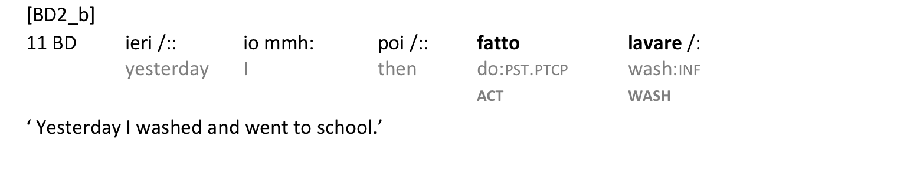
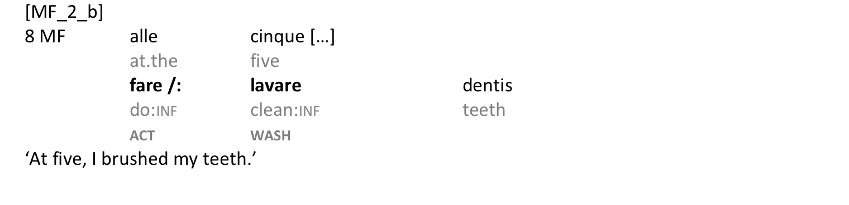
The postbasic continuum: ‘do’-constructions
Basic forms (pseudo pres., inf.) → | PP → | Copula/AUX →
‘Do’ + underspecified Vs → fare makes explicit the predicative value of the uninflected lexical V it governs (and, eventually, TA information)
[do]_{act-}[v]_{pred}
(10)
(11)
Mocciaro 2019, 2020

Slide 21
The continuum of morphosyntax: the role of literacy
Table 6. The continuum of morphosyntax

Slide 22
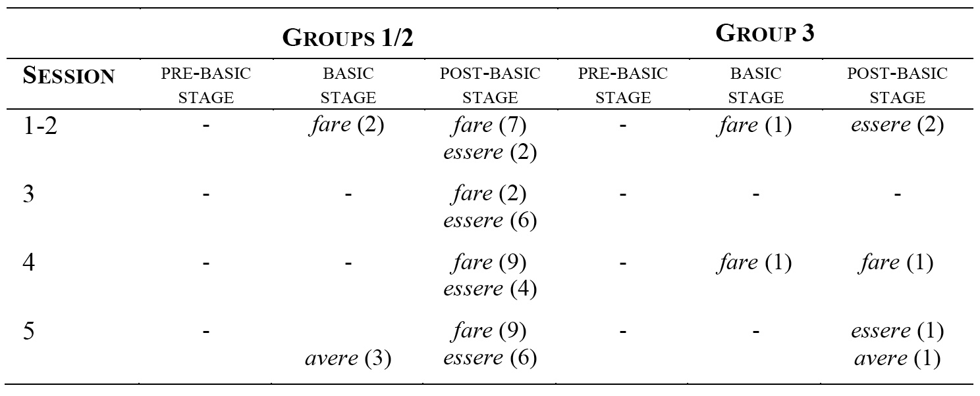
Literacy and non-target constructions
Table 7. The role of literacy: Distribution of Interlanguage constructions

Slide 23
Towards a conclusion: possible causes
Learners with limited literacy lack visual exposure to language
«greater reliance on auditory memory than visual memory» (Vainikka et al. 2017: 248; see Cintrón-Valentín & Ellis 2016; Tarone et al. 2009)
inflectional morphemes are less accessible, as they are low salient
.
at the phonological level (less than a foot, cf. Vainikka et al. 2017: 248)
at the physical level (frequent phenomena of reduction in the actual speech, cf. Savy 1999)
at the contextual level («redundancy», e.g. yesterday I walked; cf. Cintrón-Valentín & Ellis 2016; DeKeyser 2005: 8; Goldschneider & DeKeyser 2001: 52)

Slide 24
Towards a conclusion: possible causes
Learners with limited literacy lack visual exposure to language
This circumstance:
Favours the selection and persistence over time of “heavier” forms, more easily perceived in the input (functional words)
Prompts the emergence of non-target but interlanguage specific morphosyntactic patterns, resulting from overgeneralisation of functional words (cf. Vainikka et al. 2017)
Does not affect the route and the rate of acquisition: it is a pattern long the route (it is the type and amount of exposure that affects the rate - but not the route)

Slide 25
Towards a conclusion: which language(s)?
Back to the context
Characteristic 1. When exposure to the input is good and constinuous, ICs are transient. When exposure is reduced (because of low contact and/or lack of written input), ICs remain stable.
Characteristic 2. Interview force the exclusive use of Italian whereas the actual practice is a «multilingualism at the level of discourse» (D’Agostino 2021):
What role (if any) does Italian play in this puzzle?
Are ICs typical of Italian or are they also found in other pieces of this polyglot repertoire?

Slide 26
Thank you!

Slide 27
References
Amoruso, M. & Lo Maglio, A. 2018. I test e la griglia di valutazione. Una sperimentazione continua. In M. D’Agostino (a c. di), La forza delle lingue, nella migrazione e nella inclusione, 181-183. Palermo: Scuola di Lingua italiana per Stranieri.
Andringa S. & Godfroid S. 2020. Sampling bias and problém of generalizability in applied linguistics. Annual Review of Applied Linguistics 40: 134-142.
Becker, A. et al. 1977. Heidelberger Forschungsprojekt ‘Pidgin-Deutsch Spanischer Und Italienischer Arbeiter in Der Bundesrepublik’. Osnabrück: Universität Osnabrück.
Benazzo, S. & Starren, M. 2007. L’émergence de moyens grammaticaux pour exprimer les relations temporelles en L2. Aile 25: 129-157.
Bernini G. 2003. The copula in learner Italian. Finiteness and verbal inflection. In C. Dimroth & M. Starren (Eds.), Information structure, linguistic structure and the dynamics of language acquisition, 159-185. Amsterdam: John Benjamins.
Bigelow, M. & Tarone, E. 2004. The role of literacy level in second language acquisition: Doesn’t who we study determine what we know? TESOL Quarterly 38(4): 689-700.
Cintrón-Valentín, M. C. & Ellis, N. C. 2016. Salience in second language acquisition: Physical form, learner attention, and instructional focus. Frontiers in Psychology 7(1284). https://www.frontiersin.org/articles/10.3389/fpsyg.2016.01284/full

Slide 28
References
Clahsen, H., Meisel J. & Pienemann, M. 1983. Deutsch als Zweitsprache. Der Spracherwerb ausländischer Arbeiter. Tübingen: Narr.
Clahsen, H., Vainikka, A. & Young-Scholten, M. 1991. Lernbarkeitstheorie und lexikalisches Lernen. Linguistische Berichte 130: 466-477.
D’Agostino, M. 2018. La forza delle lingue. Palermo: Scuola di Lingua italiana per Stranieri. https://www.unipa.it/strutture/scuolaitalianastranieri/Ricerca-/pubblicazioni/collana-strumenti-e-ricerche/
D’Agostino, M. & Mocciaro, E. 2021. Literacy and literacy practices: Plurilingual connected migrants and emerging literacy. Journal of Second Language Writing, 10, https://1016/j.jslw.2021.100792
DeKeyser, R. M. 2005. What makes learning second language grammar difficult? A review of issues. Language Learning 55/1: 1-25.
Ellis N. C. 2003. Constructions, chunking and connectionism. The emergence of second language structure. In C. Doughty & M. Long (Eds), The handbook of second language acquisition, 33-68. Oxford: Blackwell.
Giacalone Ramat, A. (eds.) 2003. Verso l’italiano. Roma: Carocci.
Giacalone Ramat, A. 1997. Progressive periphrases, markedness, and second-language data. In Stig Eliasson & Ernst Häkon Jahr (eds.), Language and its ecology. Essays in memory of Einar Haugen, 261-285. Berlin and New Yourk: Mouton de Gruyter.
Goldschneider, J. M. & DeKeyser, R. M. 2001. Explaining the “natural order of L2 morpheme acquisition” in English: A meta-analysis of multiple determinants. Language Learning 51(1): 1-50.

Slide 29
References
Henrich J., Heine S. J., Norenzayan A. 2010. The weirdest people in the world? Behavioral and Brian Sciences 33(2-3). 61-83.
Janko, E. (2020). The effect of L1 alphabetic print literacy to the acquisition of the L2 oral skills. PhD dissertation, Northumbria University, UK. https://nrl.northumbria.ac.uk/id/eprint/46443/1/janko.eleni_phd%20-%2014029746.pdf
Janko E., Dabrowska E., Street J. 2019. Education and input as predictors of second language attainment in naturalistic contexts. Languages 4(3) (70).
Julien, M., van Hout, R. & van de Craats, I. 2016. Meaning and function of dummy auxiliaries in adult acquisition of Dutch as an additional language. Second Language Research 32(1): 49-73.
Klein, W. & Perdue, C. 1997. The Basic Variety (or: Couldn’t natural languages be much simpler?). Second Language Research 13(4): 301-347.
Klein, W. & Perdue, C. 1992. Utterance structure. Developing grammar again. Amsterdam: John
Benjamins.
Mocciaro E. 2020. The development of L2 Italian morphosyntax in adult learners with limited literacy. Palermo: University of Palermo Press.
Monsen M. & Bordal Steien G. (Eds) 2022. Language learning and forced migration. Bristol: Multilingual Matter.

Slide 30
References
Oldenkamp, L. 2013. The trouble with inflection of adult learners of Dutch. A study on the L1-L2 interplay of morphosyntactic and phonetic-phonological factors. PhD Thesis, Radboud University Nijmegen.
Perdue, C. 1993. Adult language acquisition: Cross-linguistic perspectives. 2 voll. Cambridge: Cambridge University Press.
Quochi, V. 2007. A usage-based approach to light verb constructions in Italian. Development and use. Unpublished PhD Thesis, University of Pisa.
Glick Schiller, N. & Salazar, N. B. 2013. Regimes of Mobility Across the Globe. Journal of Ethnic and Migration Studies 39(2): 183-200.
Starren, M. 2001. The second time: The acquisition of temporality in Dutch and French as a second language. Utrecht: LOT.
Tammelin-Laine T. 2014. Aletaan alusta. Luku-ja kirjoitustaidottomat aikuiset uutta kieltä oppimassa [Let’s start from the beginning. Non-literate adults learning a new language]. Javäskylä: University of Javäskylä.
Tarone E. & Bigelow M. 2005. Impact of literacy in oral language processing: implications for SLA research. Annual Review of Applied Linguistics 25: 77-97.
Tarone E., Bigelow M., Hansen K. 2009. Literacy and second language oracy. Oxford: Oxford University Press.

Slide 31
References
Vainikka A. & Young-Scholten M. 2007. The role of literacy in the development of L2 morphosyntax from an Organic Grammar perspective. In N. Faux (Ed.), Low-educated adult second language and literacy acquisition (LESSLA): Research, policy, and practice. Proceedings of the second annual forum, 123-148. Richmond: The Literacy Institute at Virgina Commonwealth University.
Vainikka A, Young-Scholten M., Ijuin C. Jarad S. 2017. Literacy in the development of L2 English morphosynatx. In M. Sosinski (Ed.), Literacy education and second language learning for adults: Research, policy and practice, 239-250. Granada: Universidad de Granada.
van de Craats I. 2011. A LESLLA corpus: L1 oblstacles in the learning of L2 morphosyntax. In C. Schöneberger, I. Van de Craats, J. Kurvers (Eds.), Low-educated second language and literacy acquisition (LESLLA). Proceedings of the 6th symposium, Cologne 2010, 33-48. Nijmegen: Centre for Language Studies.
Young-Scholten M. & Mocciaro E. 2022. Why and how grammar matters for post-puberty immigrants with limited formal schooling. In L. J. Pentón Herrera (Ed.), English learners with limited or interrupted formal education in primary and secondary classrooms, 321-339. Springer.

