Slide 1

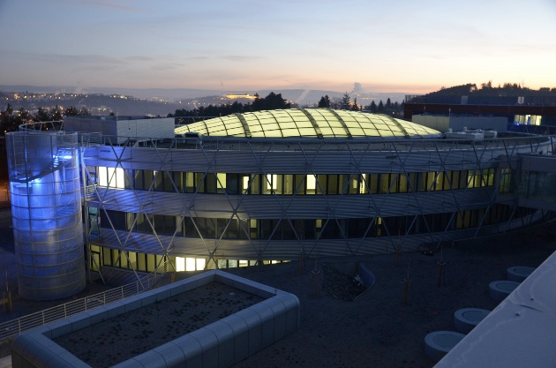


De novo design of peptides
that form transmembrane barrel pores
able to kill antibiotic resistant bacteria
Robert Vácha

Slide 2
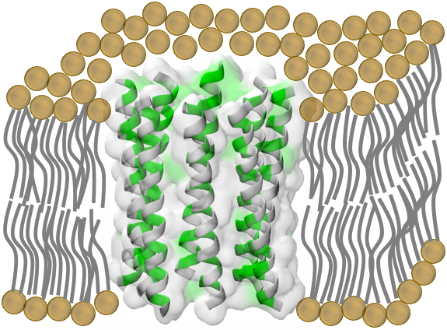
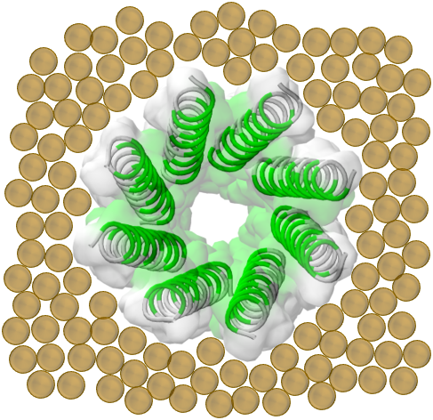
Transmembrane barrel pores (TBP)
Antimicrobial peptides
Chemotherapeutics
Biotechnological applications
Side view
90°
Top view
Lipid heads
Hydrophilic a.a.
Hydrophobic a.a.

Slide 3
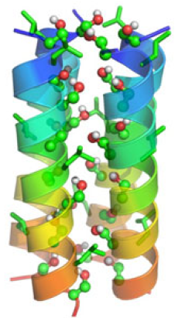
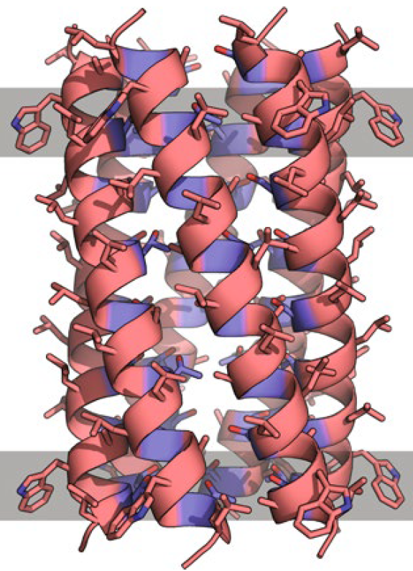
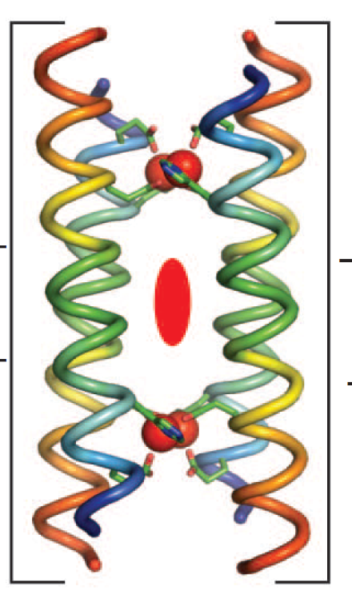
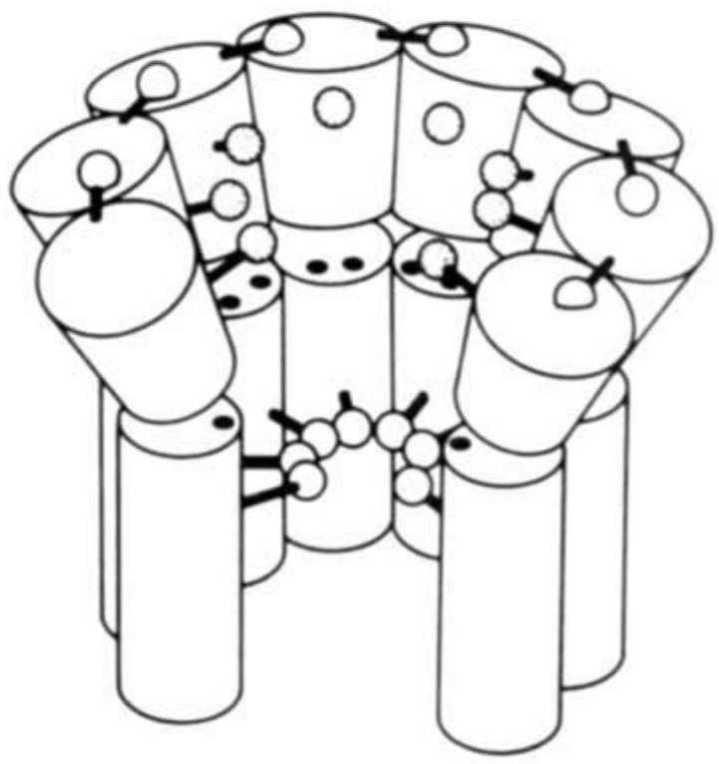
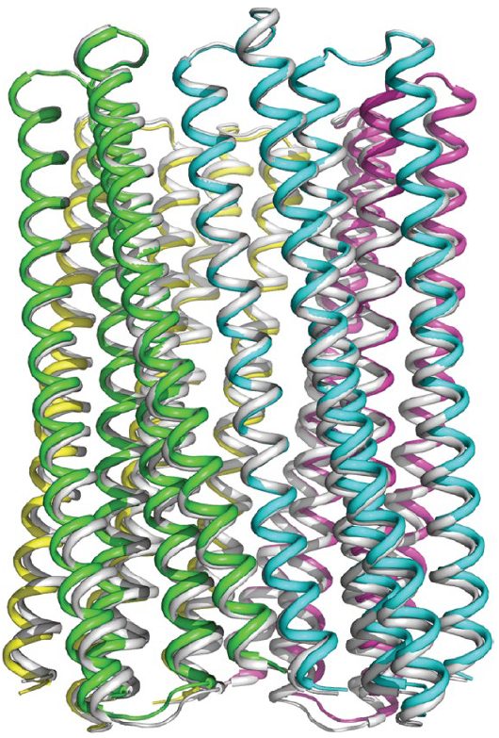
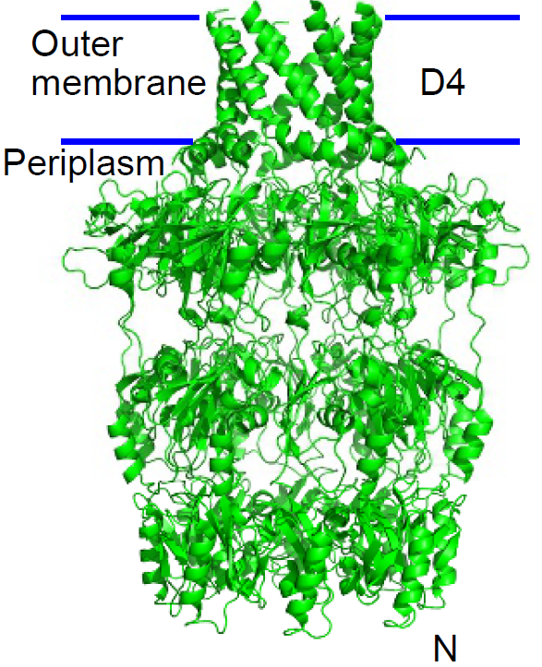
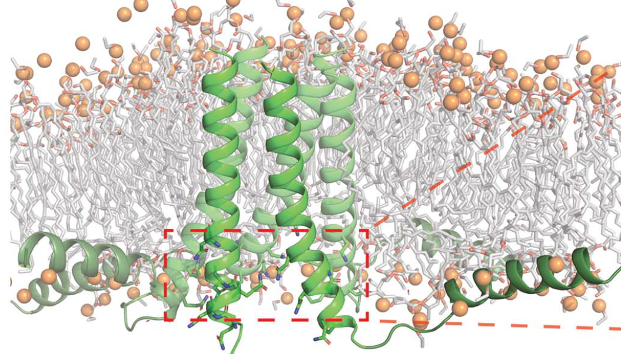
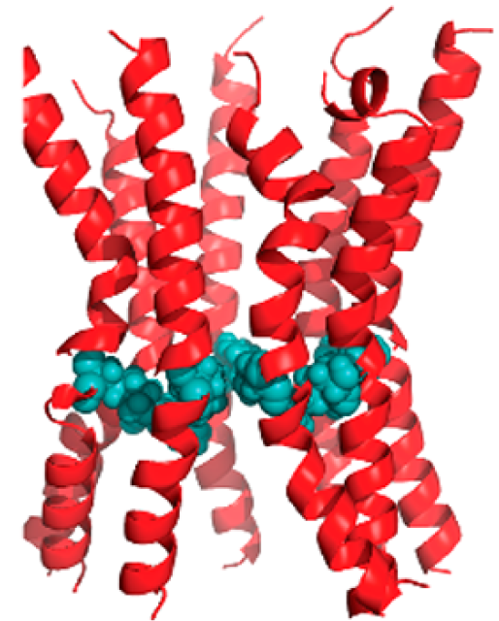
Previous work
1. Ion channels
3. De novo design of double-barrel pore
Voltage-gated alamethicin channel
Fox et al. Nature (1982)
(LSSLLSL)₃ proton channel Lear et al. Science (1988)
Coiled-coil channel
Scott et al. Nat. Chem. (2021)
Zn⁺²/H⁺¹ antiporter
Joh et al. Science (2014)
Helical hairpin large pore
Xu et al. Nature (2020)
2. Redesigned naturally-occurring proteins
Necessary numerous stabilizing interactions
H-bonds between polar residues
Tight-packing of hydrophobic residues
Salt bridges
Stacking of aromatic residues
Termini interactions
Phospholamban
Mravic et al. Science (2019)
PorinACj
Krishnan et al. J. Am. Chem. Soc. (2019)
E. coli Wza
Mahendran et al. Nat. Chem. (2017)

Slide 4

How to design the pore forming peptides
Competing interactions:
  peptide-peptide (structure stabilizing X solubility),
  peptide-membrane (necessary for membrane insertion X destabilizing the structure)
  peptide-water+ions (functional channel)
No design rules, not know role of amino acids = no tuning for applications

Slide 5
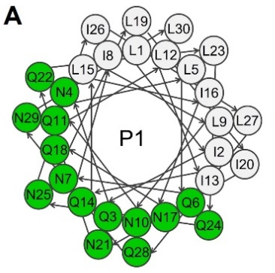
Our focus
Arrangement - antiparallel
Size – octamer
Basic sequence half hydrophilic/half hydrophobic + helix prone residues
LIQNLQNILNQLIQLINQLINQLQNILQNL

Slide 6
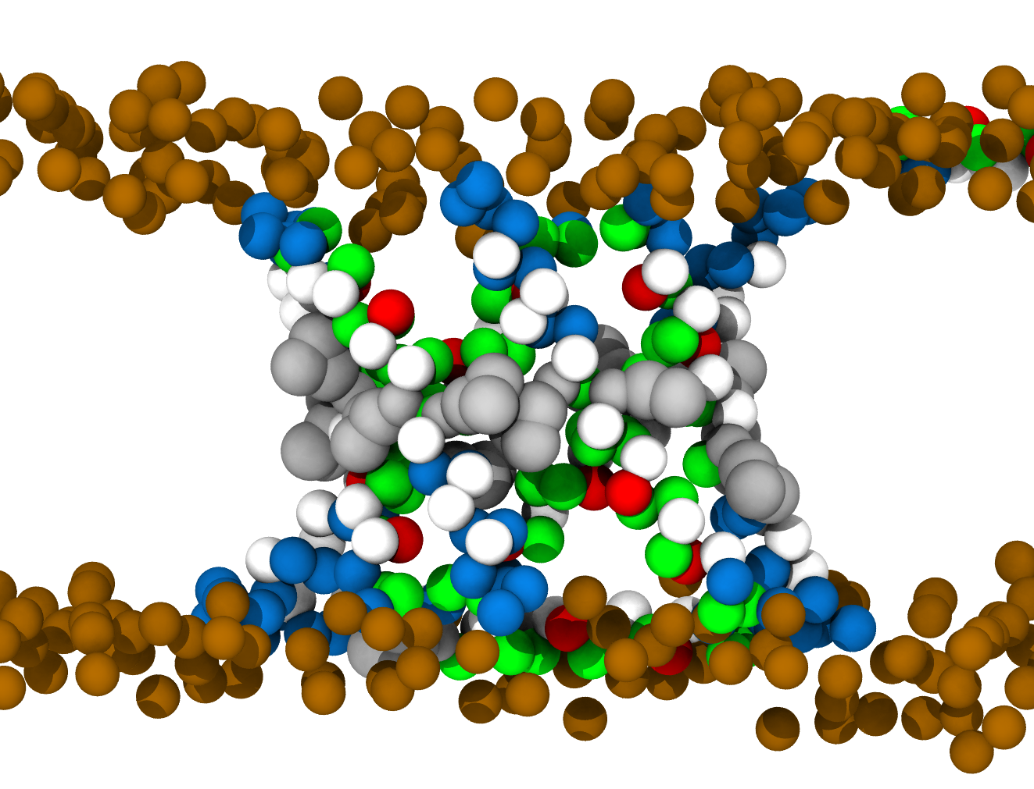
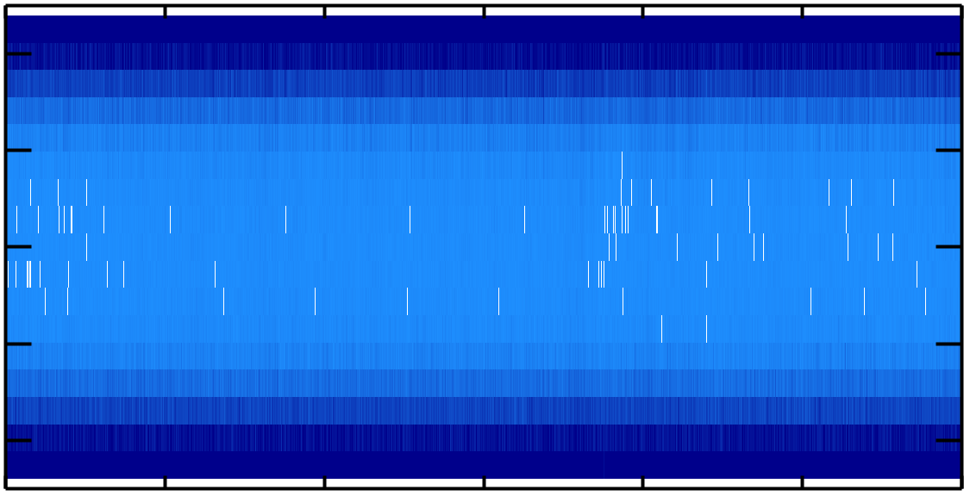
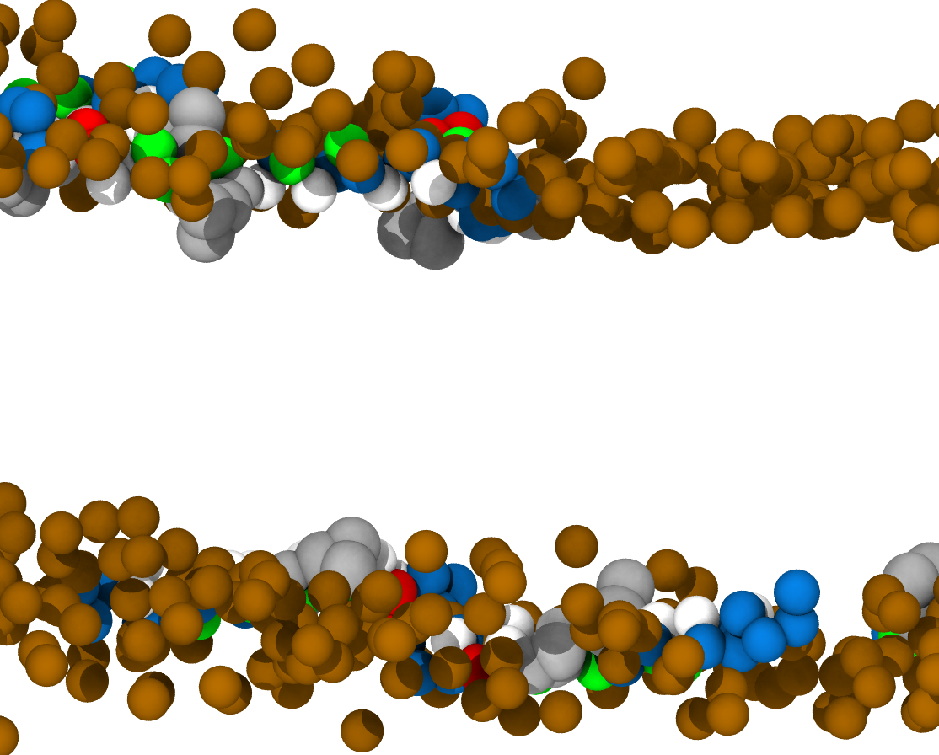
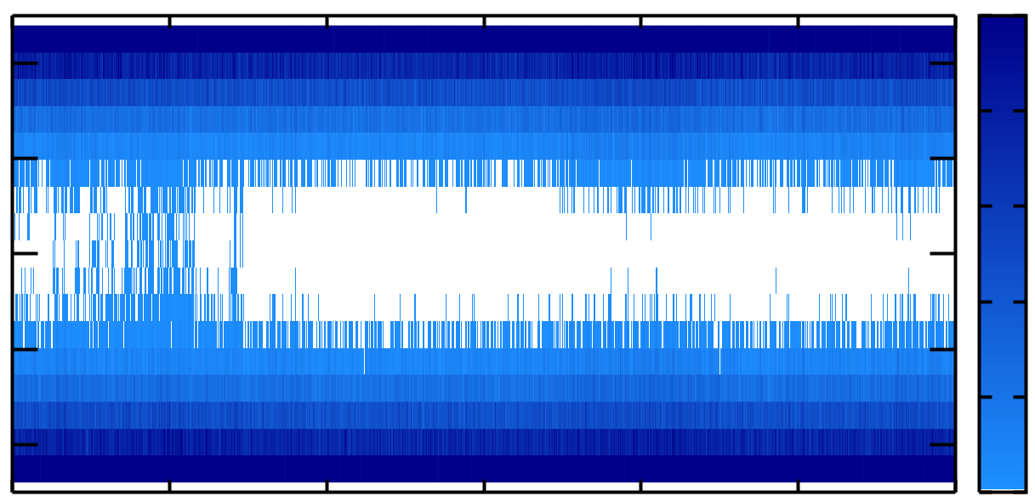
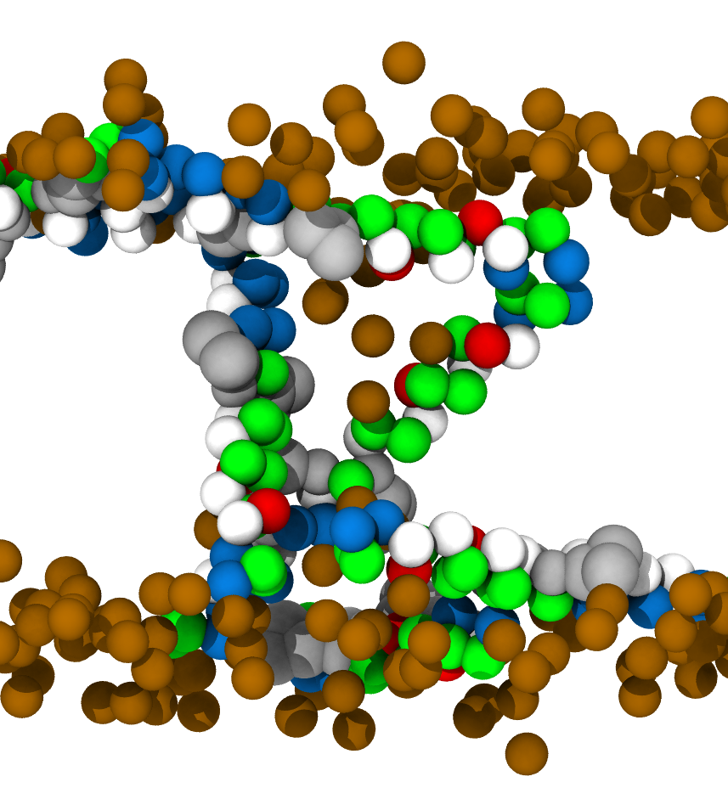
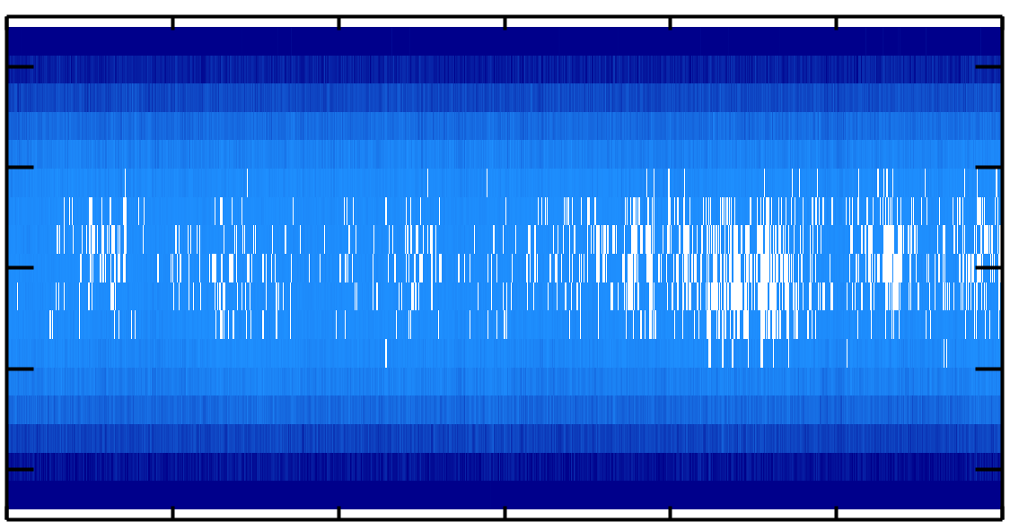
Simulations
2
Octamer
1
0
-1
-2
2
150
1
120
0
90
Distance from membrane center [nm]
60
-1
-2
30
0
2
1
0
-1
-2
48
49
50
51
Simulation runtime [μs]

Slide 7

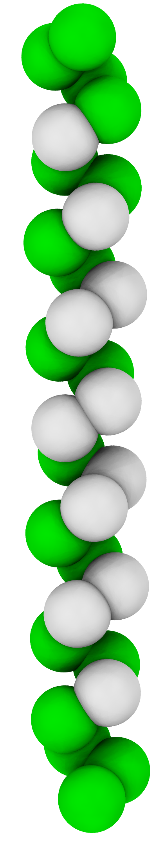
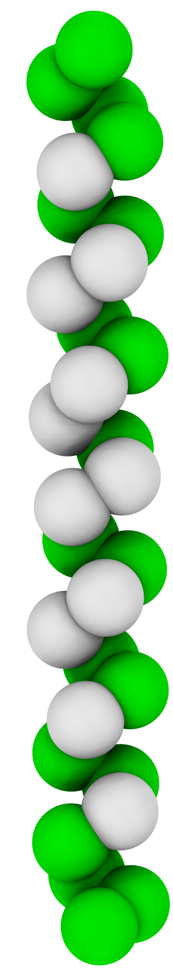
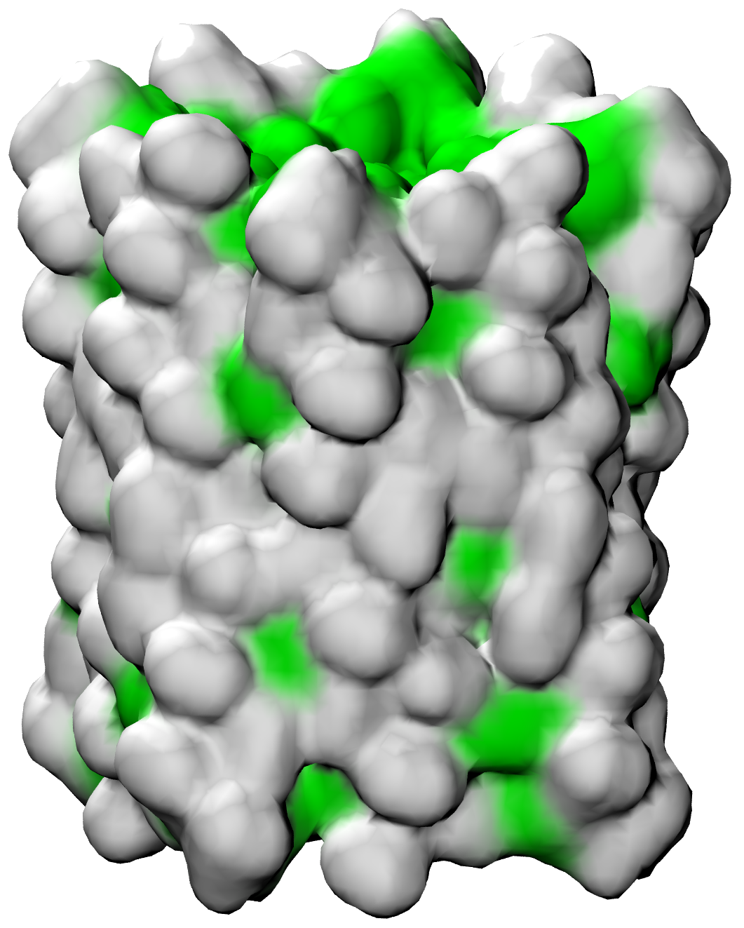
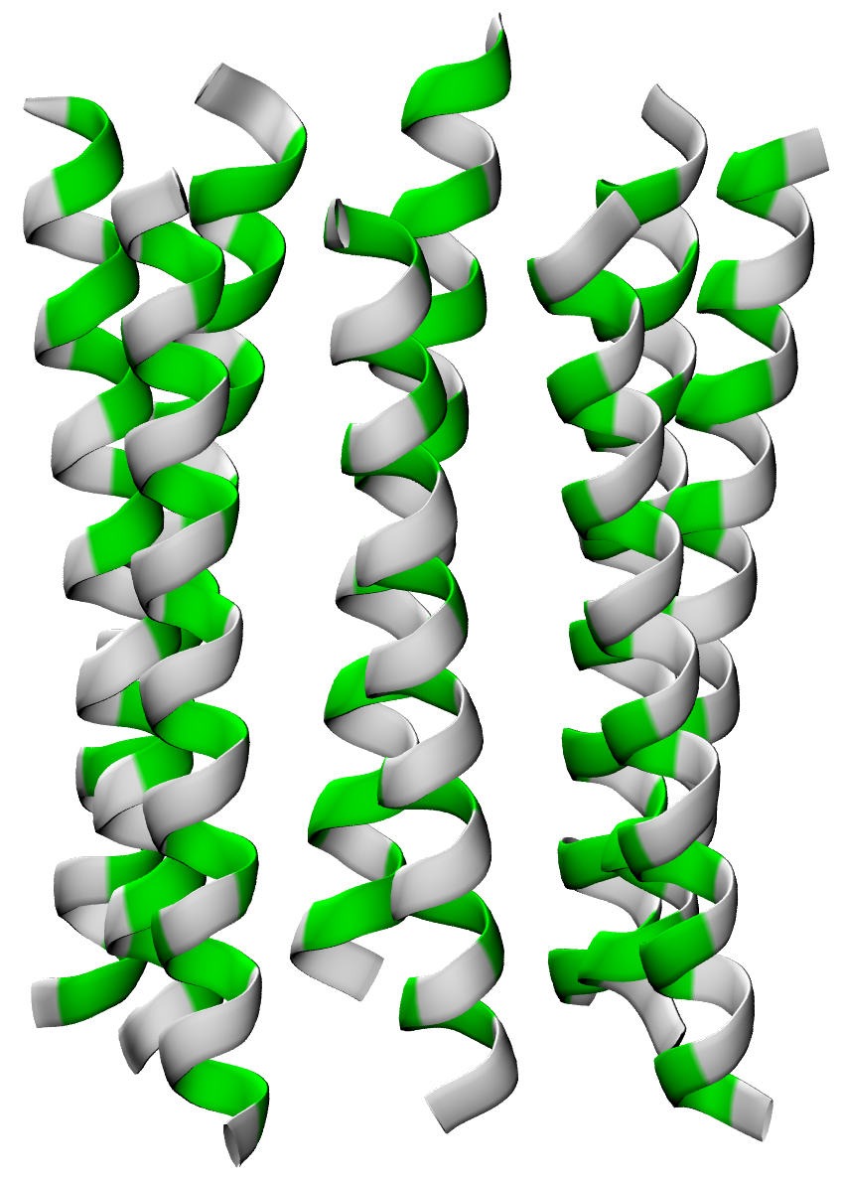
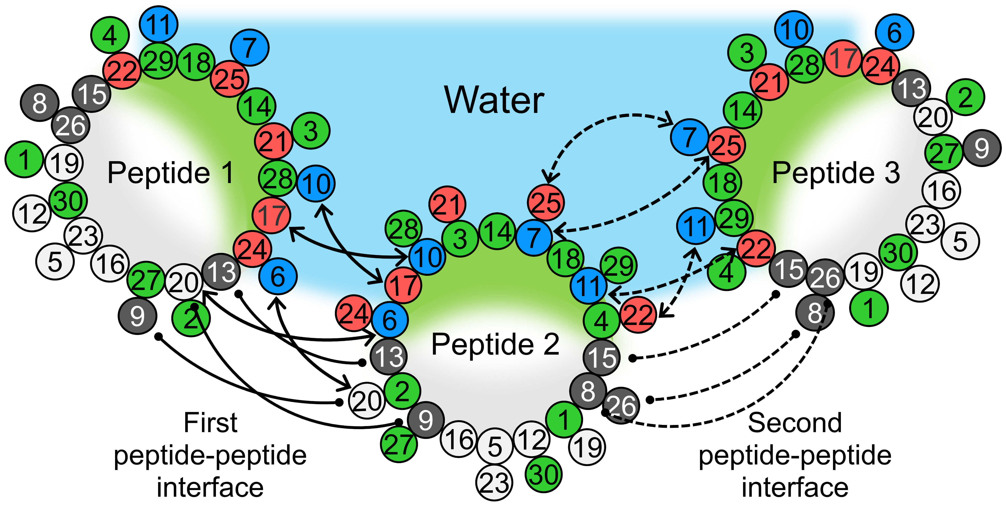

Designed interactions
C
N
C
25
6
7
24
11
21
10
22
30°
20
22 amino acids
17
20
11
17
22
10
7
6
21
24
25
N
C
N
Hydrophobic part – stacking of aromatic residues
Hydrophilic part – salt-bridges

Slide 8
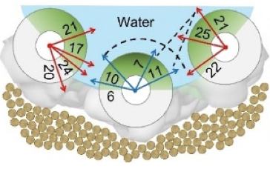
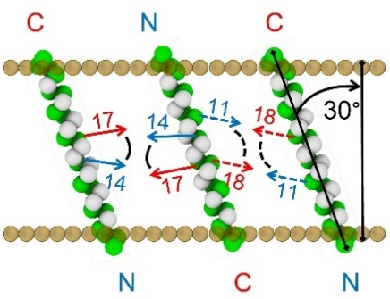
Problems
Rotations
Intramolecular interactions

Slide 9
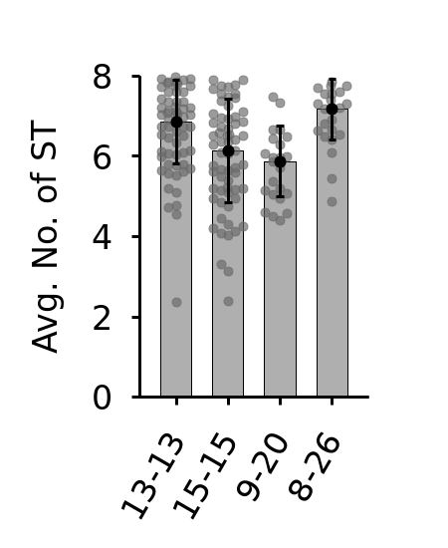
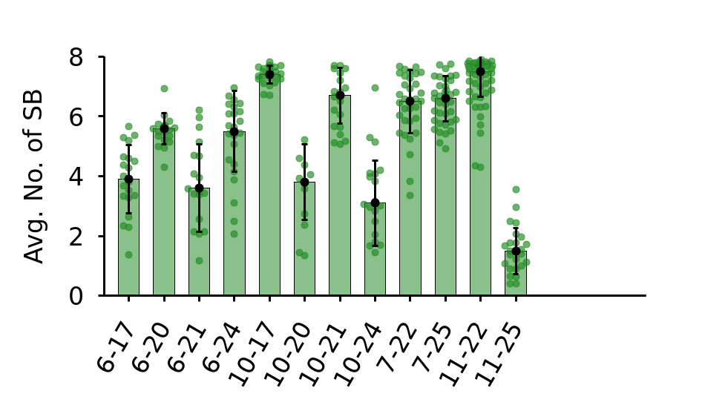
Interaction strength
100
100
75
75
% Stability
% Stability
50
50
25
25
0
0
13-13
15-15
9-20
8-26
6-17
6-20
6-21
6-24
7-22
7-25
10-17
10-20
10-21
11-22
10-24
11-25

Slide 10
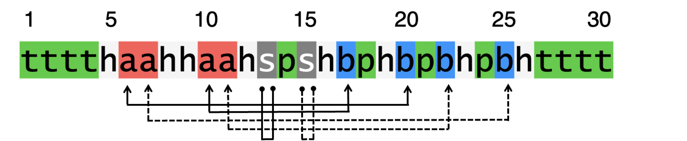
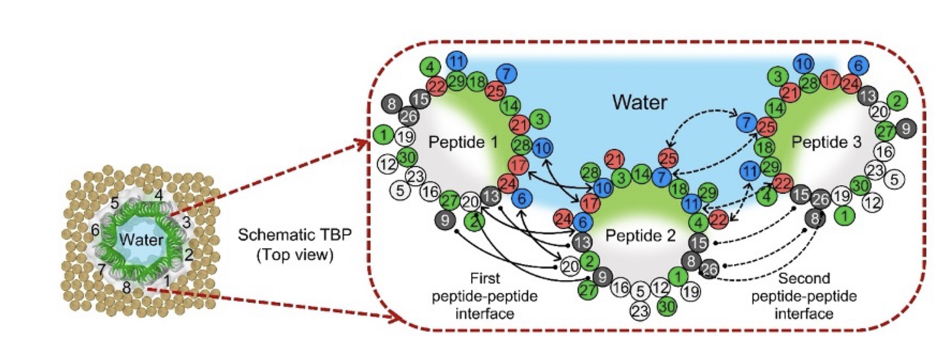
Design
p = polar a.a. (T/Q/S/N)
h = hydrophobic a.a. (A/M/V/L/I)
b = basic a.a. (R/K) forming salt bridges; or p
a = acidic a.a. (D/E) forming salt bridges; or p
s = aromatic a.a. (W/F) forming stackings; or h
t = terminal residues (p or b)

Slide 11
Design

Slide 12
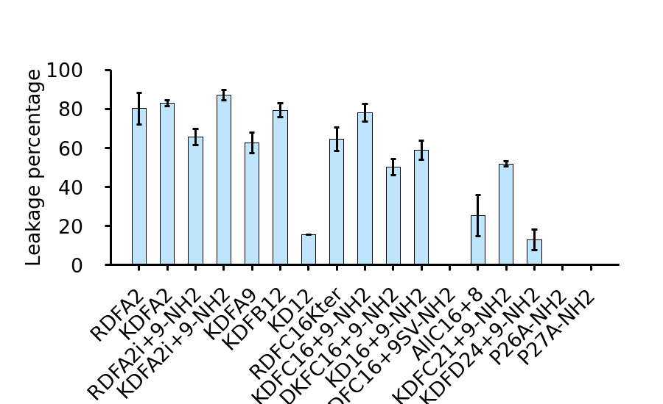
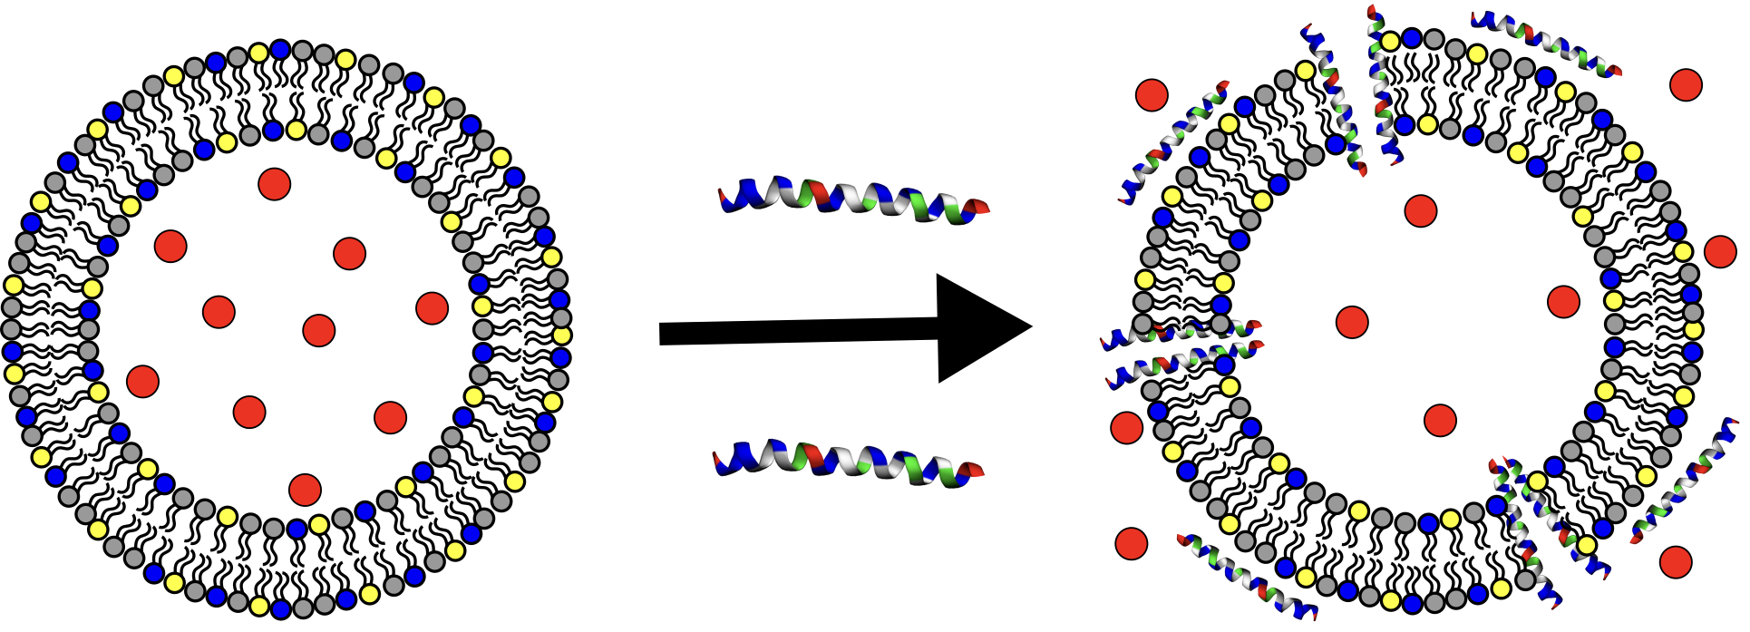
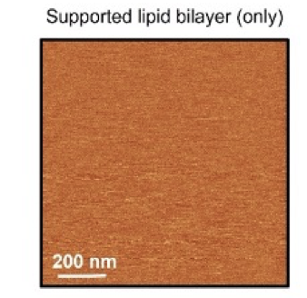
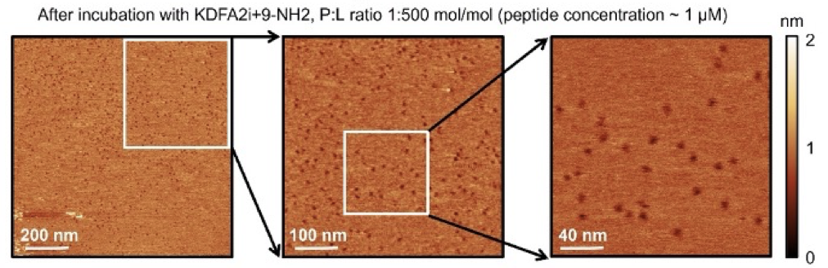
Experimental verification – membrane leakage
Calcein leakage assay
POPC:POPG (1:1 mol:mol)
P:L ratio 1:100 mol/mol
100
80
60
Leakage [%]
40
20
0
KDFA2
KD12
RDFA2
KDFA9
KDFB12
AllC16+8
P28A-NH2
KDFA2i+9-NH2
RDFC16Kter
KD16+9-NH2
P29A-NH2
RDFA2i+9-NH2
KDFC16+9-NH2
DKFC16+9-NH2
KDFC21+9-NH2
KDFC16+9SV-NH2
KDFD24+9-NH2
AFM

Slide 13
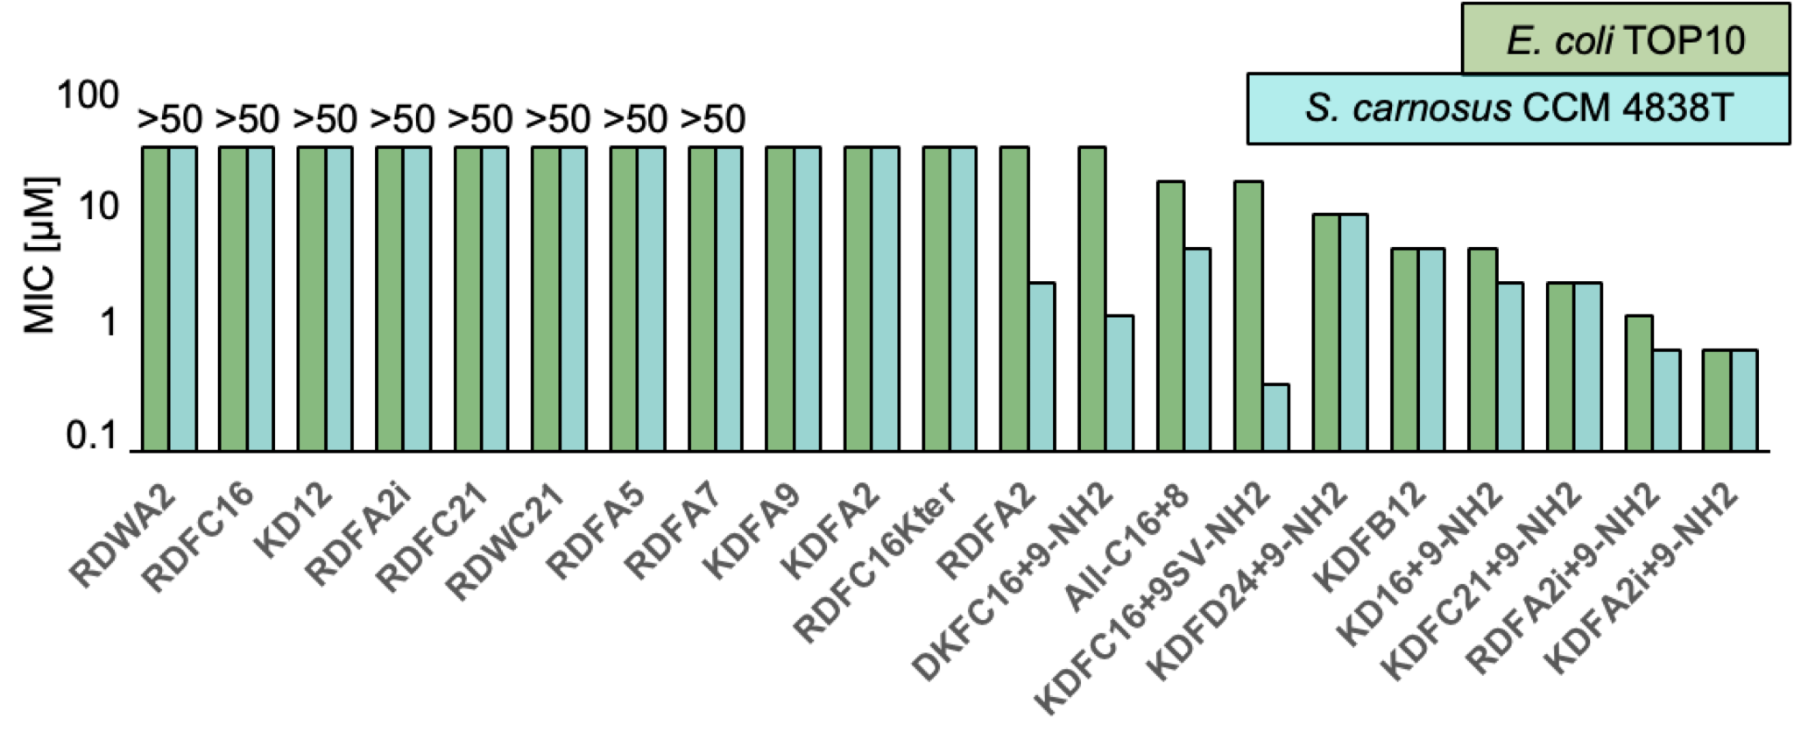
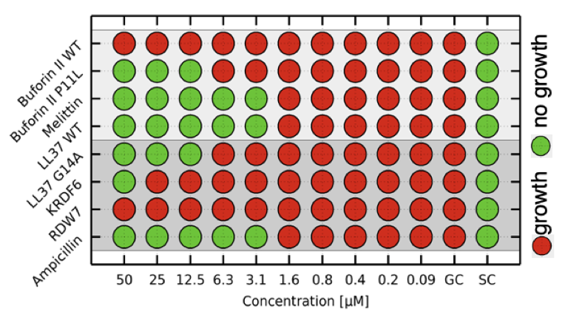
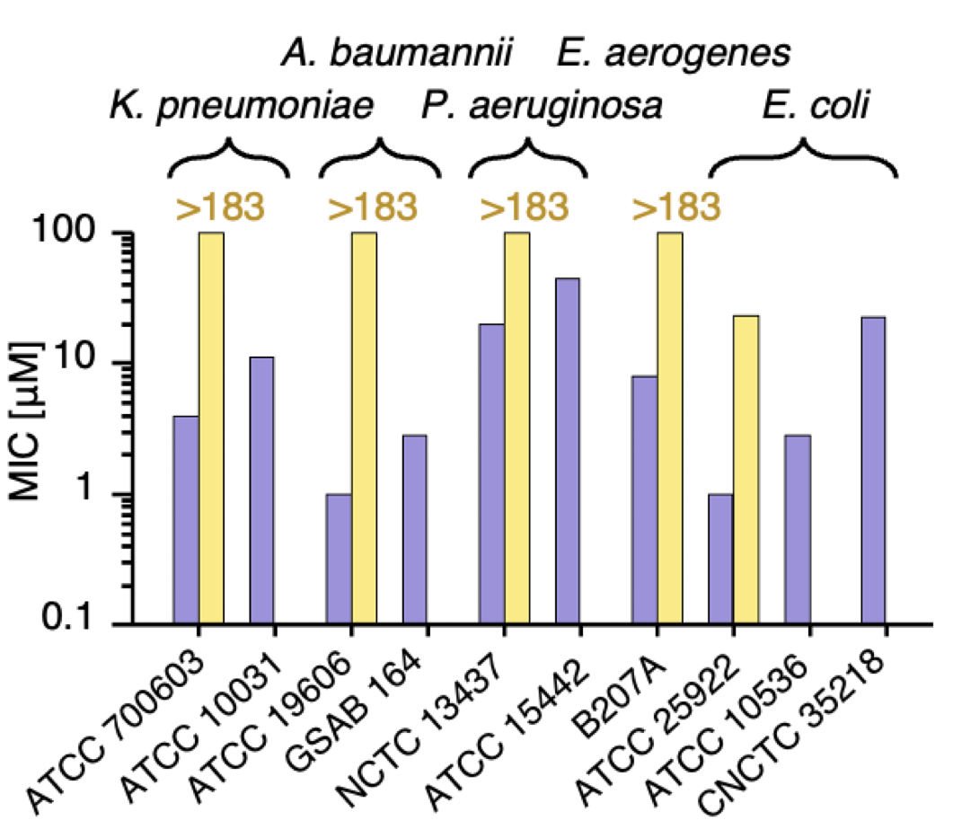
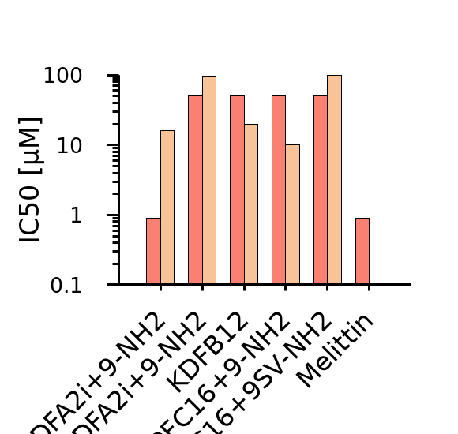
Antibacterial activity
Resistant bacteria - ESKAPE
Toxicity
>150
100
>50
>50
>50
>50
KDFA2i+9-NH2
Ampicillin
10
MIC [μM]
HRBCs
KKKKLKKILKKLFQFINQLDNQLQDIKQNK-NH2
1
HDFs
0.1
KDFB12
Melittin
KDFA2i+9-NH2
RDFA2i+9-NH2
KDFC16+9-NH2
KDFC16+9SV-NH2

Slide 14
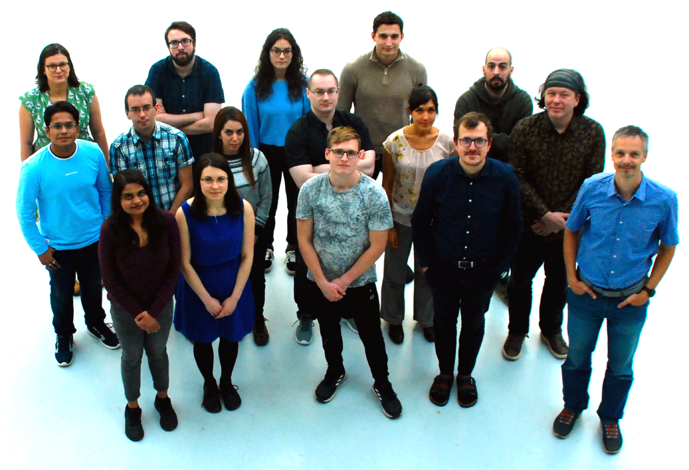








Ladislav Bartoš
Sofia Blasco
Denys Biurikov
Rahul Deb
Martina Drabinová
Francesco L. Falginella
Adelheid Hanáčková
Mehrnoosh Hazrati
Ladislav Hustý
David Kopecký
Ondřej Kroutil
William S. Morton
Peter Pajtinka
Sushmita Pal
Timothee Rivel
Jana Salamonová
Lukáš Sukeník

Slide 15
Summary
4 groups of pore forming peptides (5 design rules and 52 templates)
Known role of each amino acids => tuning for applications
Antimicrobial peptides => kill (multidrug-resistant ESKAPE) bacteria with known mechanism: MIC = 1 μM, IC50 = 50 μM KKKKLKKILKKLFQFINQLDNQLQDIKQNK-NH2

Slide 16
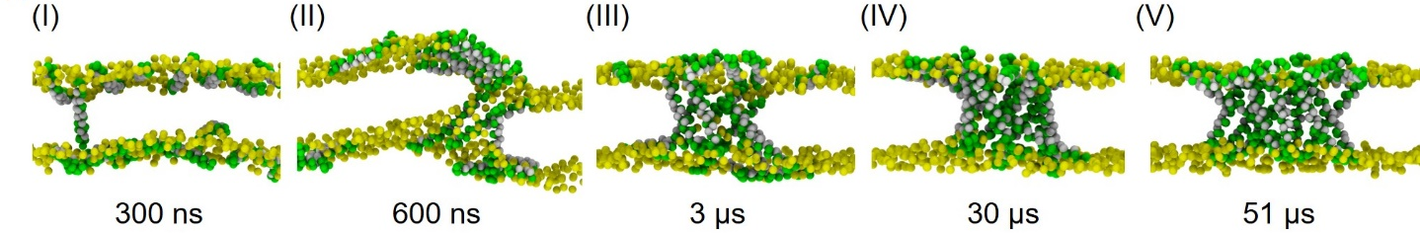
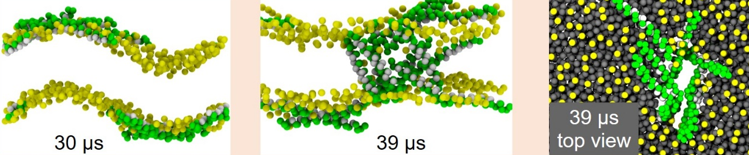
Self-assembly

Slide 17
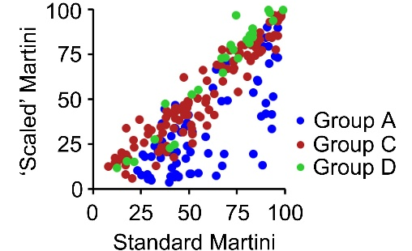
Standard x scaled Martini 2
Pores with scaled Martini are less stable = allows comparison of very strongly stabilized pores; difference only for group A (leas stable pores)
Balance between the peptide interfaces
Stability of aromatic stacking and salt bridge interactions
Martini 2.2 with/without scaled LJ interactions
Javanainen, M. et al. PLOS ONE 12, 2017

Slide 18
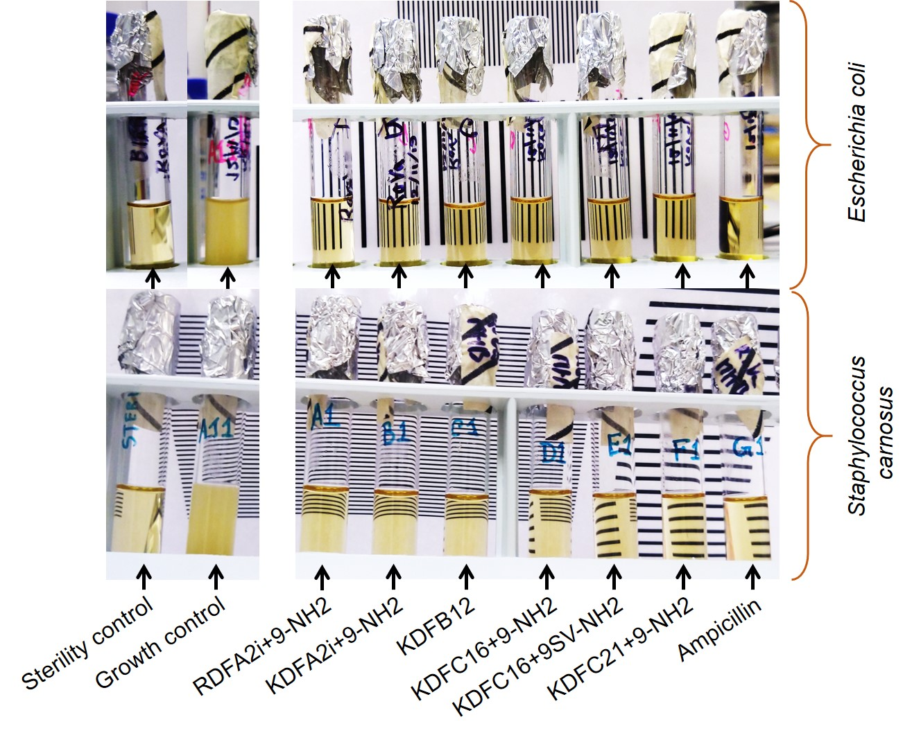
Bactericidal

Slide 19
Design
Group A: One stacking and two salt bridges per interface
Group B: Two stackings and two salt bridges per interface
1
5
10
15
20
25
30
1
5
10
15
20
25
30
tttthbbhhbbhspshaphapahpahtttt
tttthaahhaahspshbphbpbhpbhtttt
tttthbbssbbhhphhaphspahaastttt
tttthaassaahhphhbphspbhbbstttt
Group C: One stacking and four salt bridges per interface
Group D: Two stackings and four salt bridges per interface
1
5
10
15
20
25
30
1
5
10
15
20
25
30
tttthbbhhbbhspshaphaaahaahtttt
tttthaahhaahspshbphbbbhbbhtttt
tttthbbhhbbhspshaphaaahaahtttt
tttthaahhaahspshbphbbbhbbhtttt
p = polar a.a. (T/Q/S/N)
h = hydrophobic a.a. (A/M/V/L/I)
b = basic a.a. (R/K) forming salt bridges; or p
a = acidic a.a. (D/E) forming salt bridges; or p
s = aromatic a.a. (W/F) forming stackings; or h
t = terminal residues (p or b)

Slide 20
Amino acid modifications?
Group A: One stacking and two salt bridges per interface
p = polar a.a. (T/Q/S/N)
h = hydrophobic a.a. (A/M/V/L/I)
b = basic a.a. (R/K) forming salt bridges; or p
a = acidic a.a. (D/E) forming salt bridges; or p
s = aromatic a.a. (W/F) forming stackings; or h
t = terminal residues (p or b)
1
5
10
15
20
25
30
tttthbbhhbbhspshaphapahpahtttt
tttthaahhaahspshbphbpbhpbhtttt
KKKKLKKILKKLFQFIDQLDNDLQDIKKKK
KRKRLKRIVKRAWTFMDSVENDLQEIKRKR
stabilized pores in simulations
cause leakage and
Show antibacterial activity

Slide 21
Negative controls
Same amino acid composition but no preferred interactions (order scrambled):
KQNKLQKAANKFAQAFNQADNQLDNAKKQN-NH2
KQNKLQNFLNQKIQLKNQLFDQLDNIKKQN-NH2
KQNKLQNFANQKAQAKNQAFDQADNAKKQN-NH2
closed pores in simulations
did not cause any leakage and
show no antibacterial activity

