Slide 1
Global and regional level of use of buildings and roads prepared by AI for OSM mapping
By: Milan Fila, Radim Štampach & Benjamin Herfort

Slide 2
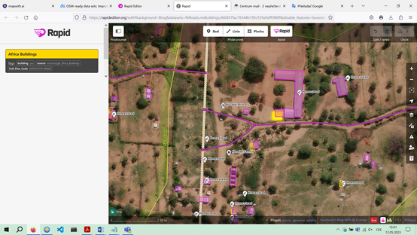
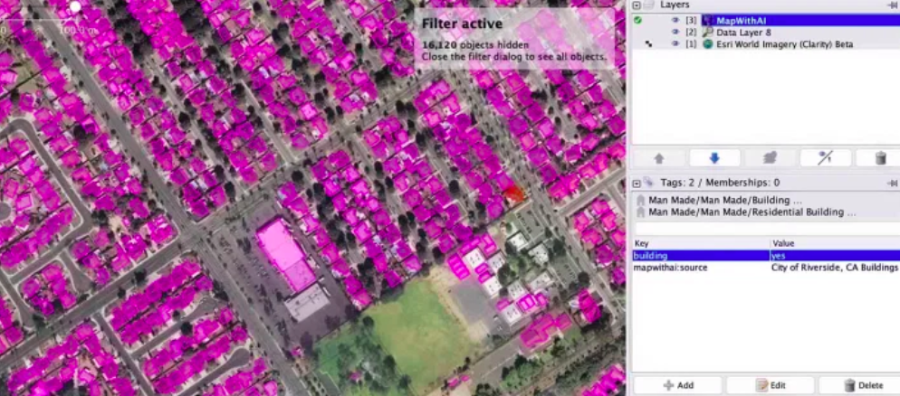
Mapping tools with AI data
RapiD editor
Mapwith.ai plugin for the JOSM editor
HOT – fAIr project
AI buildings – Microsoft, Google in cooperation with ESRI
AI roads – Meta

Slide 3
Motivation
Regions with medium and low HDI → 28% of buildings and 16% of roads in OSM, home to 46% of the global population (2020)
AI-assisted tools → possibility to fill data gaps
Research the actual level of AI-assisted mapping in OSM → global level and differences between countries

Slide 4
Community reactions
Community’s reactions to the AI-assisted mapping are mixed
Turkey-Syria Earthquake in 2023
Using AI data for disaster response
beginners were automatically accepting all AI roads
extra work to validators and experienced mappers
organizers decided not to work with AI data further

Slide 5
Community reactions
July 2023 – Webinar: Perspective on AI assisted OSM mapping (organized by HOT):
AI improves the speed but requires experience for data quality.
AI saves time spent in project delivery for humanitarian response.
AI triggers motivation for participation in OSM mapping.
Carefulness is required especially when using AI in a complex environment – dense areas, informal settlements etc.
Accuracy of AI data is often worse than production of inexperienced mappers. Due to bad quality of training data?
AI predictions are often treated as a source of truth rather than predictions which need to be validated by mappers.
There is a lack of open source models for AI. Models should be opened and offered to the community, not just data.

Slide 6
Research question
What are the differences between AI-assisted and traditional mapping concerning editing behaviour?
Editing pattern of AI and non-AI data
AI-assisted mapping can lead to less community engagement and could undermine the contributor base of OSM in the long run
OSM community attitudes toward imports and automated edits can be negative and cautious
Notes:
Now we can continue with the practical part of our research. We set the research question.
Read the question… → We tried to explore the editing patern of AI and non-AI data.
→ AI-assisted mapping can have a negative effect on OSM communities because mappers are afraid they could be replaced by AI
→ Some of the members from the OSM communities are cautious about imports of huge AI-dataset.

Slide 7
Methodology
All contributions made to OSM during 2021–2023 derived from a combination of the OSHDB developed by the HeiGIT and the OSM changeset database
Three types of operations with objects in OSM: creating, editing (=modifying), and deleting → creating and editing → differences between buildings and roads mapped using AI and buildings and roads in general.
Notes:
Generally, our results were derived from all contributions between 2021 and 2023 from the combination of OpenStreetMap History Database and the OpenStreetMap changeset database.
In OSM there exists 3 types of operations and we worked with the operations creating and editing.
And we tried to explore differences between AI buildings and non-AI buildings and AI roads and non-AI roads.

Slide 8
Methodology
Building definition: building=*
AI building definition: source=microsoft/BuildingFootprints, source=esri/Google_Africa_Buildings
Road definition: tag highway: motorway, motorway_link, trunk, primary, primary_link, secondary, secondary_link, tertiary, tertiary_link, unclassified, residential
AI road definition:
tag hashtags: #nsroadimport, #mapwithai, #MapWithAI
element tags: contain "RapiD"
Notes:
Here we can see how we defined the buildings in general and then the AI buldings.
We selected Microsoft AI buildings and ESRI/Google buildings. In most cases the numbers of ESRI/Google AI buildings were low.
Regarding the road definition we used only the most important types of roads – because they are the backbone of transportation network. So, we used the key highway values...
For AI road definition we used these tag hashtags and element tags that contained RapiD.
We tested some variants of hashtags before – and this returned the best results.

Slide 9
Methodology – global level
Global level:
created AI buildings / created all buildings in 2021–2023
edited AI buildings / edited all buildings in 2021–2023
length of created AI roads / length of created all roads in 2021–2023
length of edited AI roads / length of edited all roads in 2021–2023
Notes:
Here is how we measured the global level of editing and creating of roads and buildings.
We computed:
- ratio of number of created AI buildings on number of all created buildings in each year in 2021-2023
- ratio of number of edited AI buildings on number of all edited buildings in each year in 2021-2023
- ratio of length of created AI roads on length of all created roads in each year in 2021-2023
- ratio of length of edited AI roads on length of all edited roads in each year in 2021-2023

Slide 10
Results – global level
The global level of using AI buildings and AI roads for creating new buildings and roads is generally low – not more than 16%.
For AI buildings – increasing trend (created, edited).
The level of AI buildings and AI roads is higher in the case of creating new objects than in the case of editing existing objects. AI objects are more created than actualised.
 | AI Buildings/Buildings |  | AI Roads/Roads
Year | Created [%] | Edited [%] | Created [%] | Edited [%]
2021 | 5.2 | 0.7 | 14.7 | 8.3
2022 | 12 | 3.2 | 15.1 | 5.7
June 2023 | 14.8 | 4.2 | 7.7 | 3.1
Notes:
We see these numbers and these main results:
The global level of (contributions) AI buildings and roads on all buildings and all roads and is generally low. The highest level was 15 percent, but mostly the numbers were much lower.
On the other hand using of AI buildings have increasing trend in both cases – created and edited.
2) Portion of AI buildings and AI roads is higher in the case of creating new objects than in the case of editing existing objects. It means that AI buildings and AI roads are (after their creation) only rarely actualized. It seems interesting because regular actualisation is being mentioned as one possible indicator of data quality. So, what does it mean about quality of AI buildings and roads...

Slide 11
Methodology – local level
The differences in using AI-assisted mapping between countries.
The absolute numbers of AI buildings and the relative portion of AI buildings in all buildings.
Ohsome API developed by HeiGIT (OSM history)
June 30 2023
Notes:
From the local perspective we tried to explore differences between countries.
Especially, we focused on absolute numbers of AI buildings and the relative portion of AI buildings from the all buildings. We used the web tool Ohsome API developed by HeiGIT (and we were able to walk through the OSM history) and get the numbers of buildings.
And the numbers of buildings are from the date …..

Slide 12
Results – local level – AI buildings
Notes:
The high absolute numbers and relative numbers in the same time are in the USA, Kenya, Turkey and also in Nigeria.

Slide 13
Conclusion
What are the differences between AI-assisted and traditional mapping concerning editing behaviour?
The global level of using AI buildings and AI roads for mapping new objects is less than 16%.
The trend is increasing in case of AI buildings.
AI buildings and roads are less often actualised than created.
AI buildings are significantly used only in countries where Microsoft coordinates AI assisted mapping (USA, Kenya, Nigeria) or where a humanitarian mapping using AI-assisted tools was held by HOT (Turkey).
OSM community has mixed reactions about mapping with AI.
They hope that fAIr project will offer open source AI models.
Notes:
Summary of our results: -The global level of the contributions of AI buildings is less than 20%. Generally low.
-On the other hand the trend of (the level of contributions) AI buildings is increasing.
-AI buildings and roads are less often updated than created.
-AI buildings are significantly used only in countries where Microsoft coordinates AI assisted mapping (USA, Kenya, Nigeria)
or where HOT used AI-asissted tools (Turkey) for humanitarian mapping
-OSM community has mixed reactions about mapping with AI.
They hope that fAIr project will offer open source AI models.

Slide 14
Thank you for your attention!
Milan Fila – fila.milan@mail.muni.cz
Radim Štampach – stampach@mail.muni.cz
Benjamin Herfort – benjamin.herfort@heigit.org
Notes:
Any questions?

