Slide 1
Clash of data cultures: barriers and opportunities in building Digitalia MUNI ARTS infrastructure
Michal Lorenz
Department of Information and Library Studies
Masaryk University, Brno, Czech Republic

Slide 2
Data culture in bussiness
data as a business commodity, a driving force for the development of a companies, data-driven management
digital business strategy based on building the organization’s data ecosystem, i.e. collecting, analysing, exploiting, and sharing data for effective decision-making and business management (Ramaswamy)
linked to the financial value of the data, reduce the culture to mining data for economic purposes.
Ramaswamy, P., 2015. How to create a data culture. Cognizant 2020 Insights [online]. [cit. 2020-03-20]. Available from https://www.cognizant.com/InsightsWhitepapers/how-to-create-a-data-culture-codex1408.pdf.

Slide 3
Data culture in academy
concept of Bowker (2000) – relation to the standards and classification schemes and their local interpretation
Bates: “the different cultural norms, value systems and beliefs that inform, frame and justify people’s practices of data production, processing, distribution or use (data practices), as well as their efforts to govern and shape particular forms of data practices through a variety of social and technical means”
different data cultures of departments are a potential source of conflict in building and using a common research infrastructure
Bowker, G. C., 2000. Biodiversity Datadiversity. Social Studies of Science, 30(5), 643-683.
Bates, J., 2018. Data cultures, power and the city. In Kitchin, R., Lauriault, T. P. and G. McArdle (Eds.) Data
and the City. Abingdon, Oxon: Routledge, 189-200 (p. 191).
Open Access Week, Université Paris Nanterre, 2023

Slide 4
Science friction
data friction – at every interface between data surfaces
between people, organizations, disciplines, substrates, data formats, machines..
crossing of borders cost energy, time, human attention
needs expertise
science friction – interoperability problem between collaborating disciplines
metadata friction – cost of metadata and paradata (description of data collection and processing)
Edwards, P. N., M. S. Mazernik, A. L. Batcheller, G. C. Bowker & Ch. L. Borgman. Science friction: Data, metadata, and collaboration. Social Studies of Science, 41(5), 667-690.
Open Access Week, Université Paris Nanterre, 2023

Slide 5
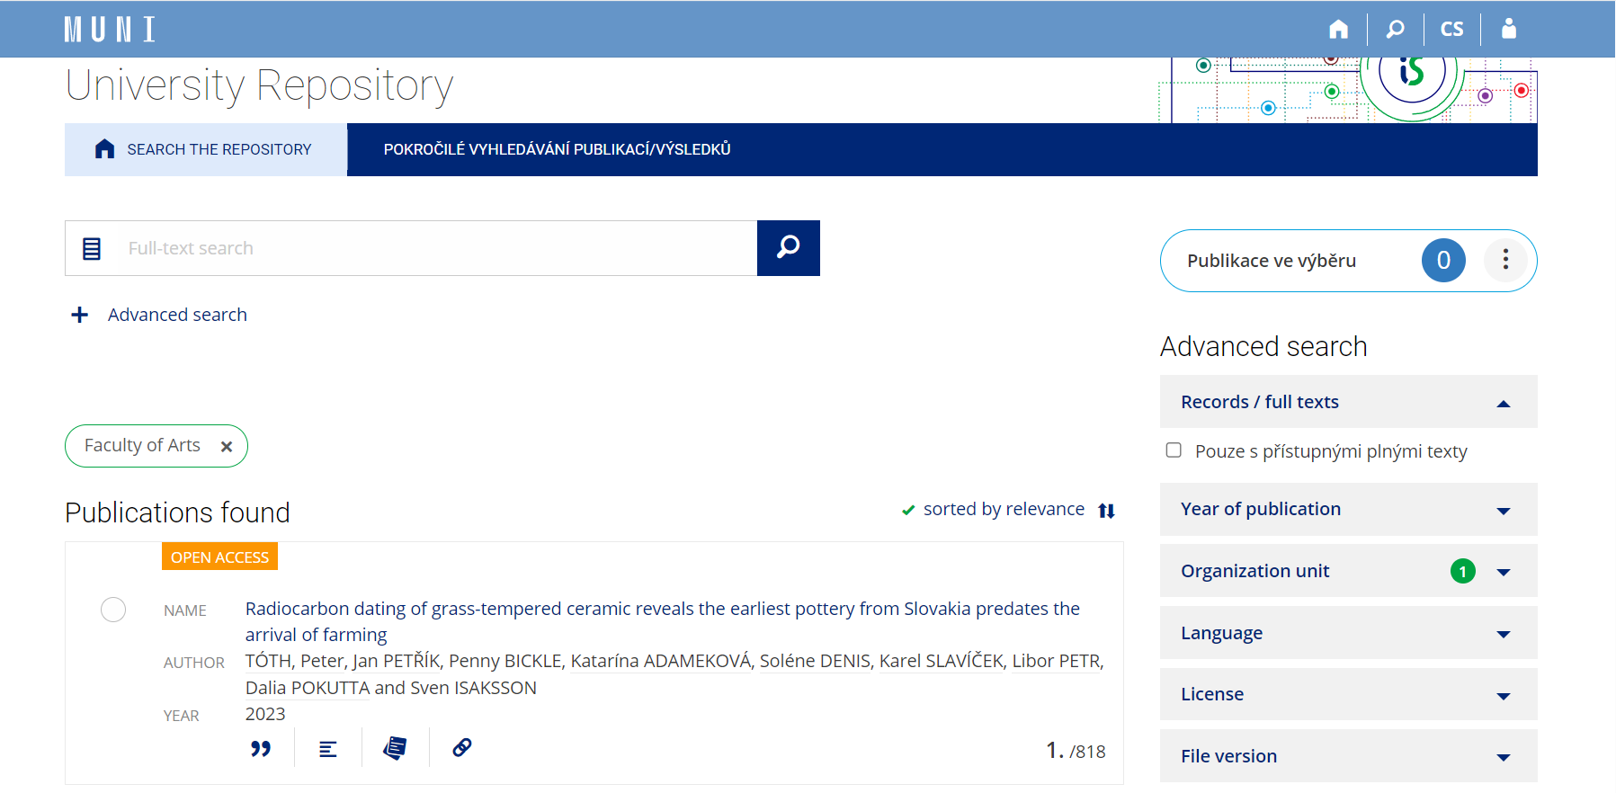
Case of institutional repository of MU
created 2015
self-archiving policy – mandatory downloads of stuff works
strong resistance
Open Access Week, Université Paris Nanterre, 2023

Slide 6
Case of LINDAT-CLARIAH-CZ metacatalog
Heuristic analysis – 5 testers, 70 questions
Results: a total of 33 problems of varying severity identified
critical issues:
illogically arranged menu
impossibility to return to the catalog home page
critical problem: quality of metadata, uniformity of description
low – 15 | middle – 10
serious – 6 | critical – 2
Open Access Week, Université Paris Nanterre, 2023

Slide 7
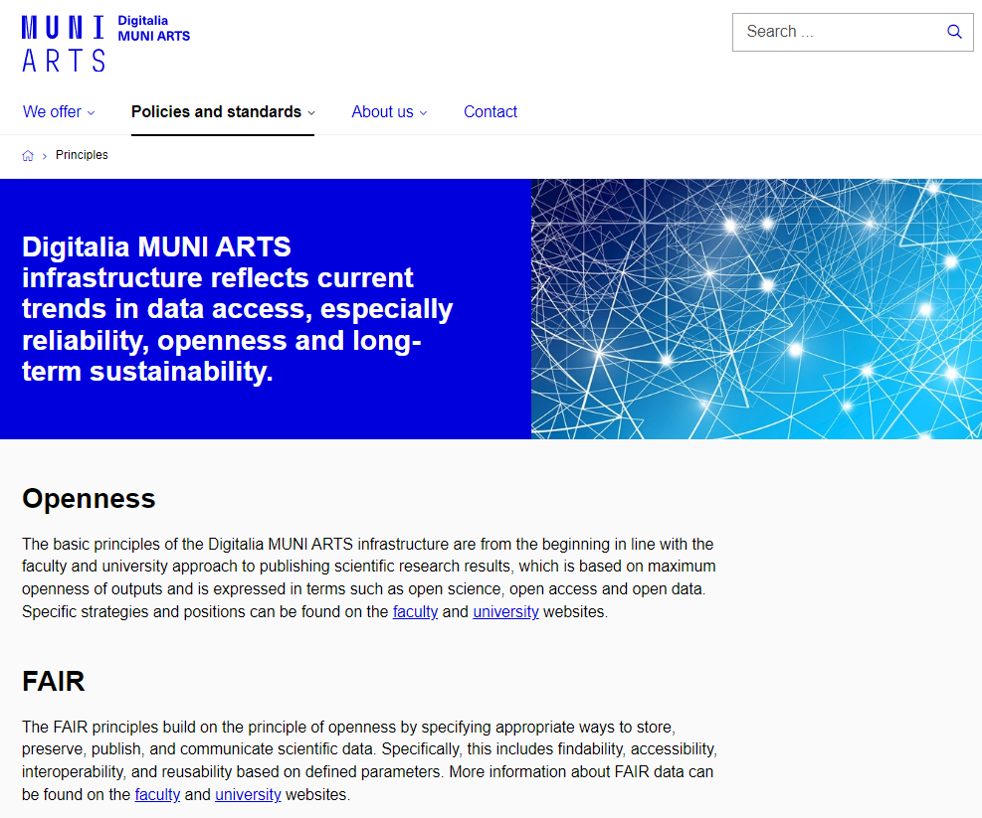
Digitalia MUNI Arts
local node of LINDAT/CLARIAH-CZ national infrastructure
2 FTE, 8 people
Open Access Week, Université Paris Nanterre, 2023

Slide 8
Purpose
to support digital research in the Faculty of Arts of Masaryk University
to ensure access and to preserve research data and research results of academics in the long term
to support research by making available tools
to preparing a virtual research environment supporting scientific collaboration and re-using of research data
Open Access Week, Université Paris Nanterre, 2023

Slide 9
Our goals
to build local node of LINDAT/CLARIAH-CZ infrastructure
to identify all digital research platforms at FA MUNI and gather information about them
What data formats and metadata are produced and collected?
What is the data culture of the workplaces that create them?
What are the needs of the users?

Slide 10
Research platforms according to project stage
LIFECYCLE APPROACH OF A RESEARCH INFRASTRUCTURE
ESFRI. Strategy Report on Research Infrastructures ROADMAP 2021: Public Guide
n=50
Open Access Week, Université Paris Nanterre, 2023

Slide 11
Research platforms and collections at FA MU
according to means of access | In operation project stage only; n = 34

Slide 12
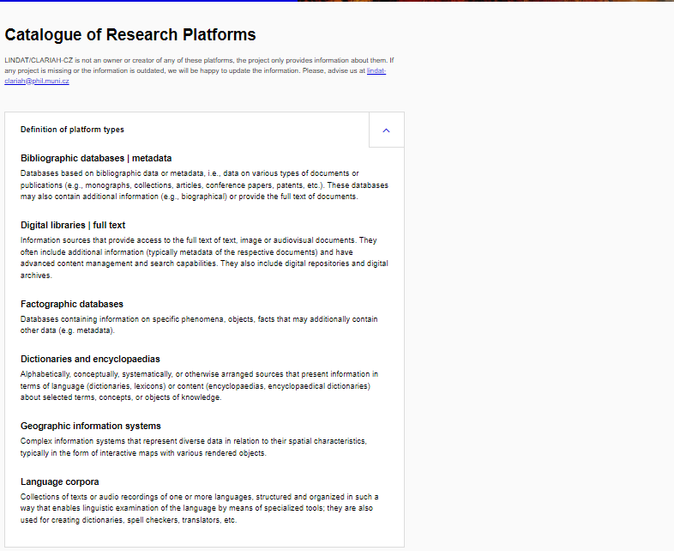
Outcome: Public catalogue
34 active research platforms and collections
Catalogue of platforms at MUNI ARTS | Digital Humanities | MUNI PHIL

Slide 13
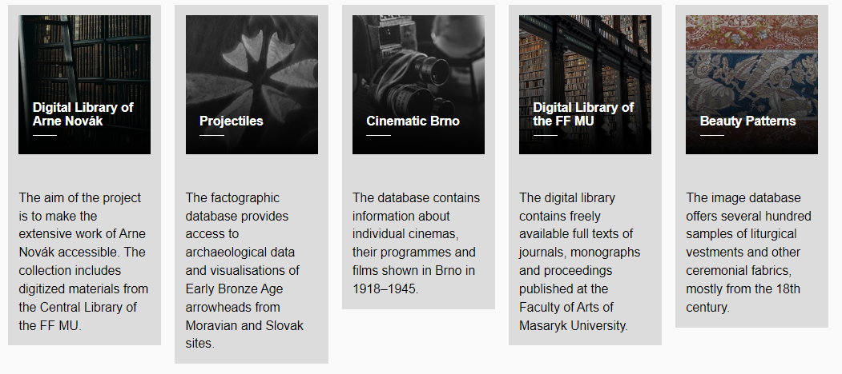
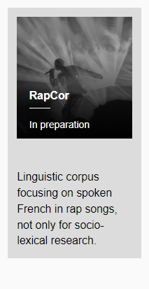
Open Access Week, Université Paris Nanterre, 2023

Slide 14
Clash of Data Cultures
Frictions and barrieres:
access to information
documentation
transparency – e.g. API
long term preservation
value of metadata and paradata
copyright
expectation and misunderstanding: intergation
information architecture
visual representation
concept of open access
concept of data – raw data
concept of user
infrastructural transcontextual syndrome
routines x rapid development
sustainability
power struggles – politics of technology

Slide 15
Opportunities
virtual research environment with analytical model
cloud and grid computing, i.e. 3D models
semantic retrieval (CIDOC CRM - filtering, OWL - retrieving)
inclusivity – support of highly experienced scholars with low data literacy (i.e. Name Tag)
Open Access Week, Université Paris Nanterre, 2023

Slide 16
References
Ramaswamy, P., 2015. How to create a data culture. Cognizant 2020 Insights.
Bowker, G. C., 2000. Biodiversity Datadiversity. Social Studies of Science, 30(5), 643-683.
Bates, J., 2018. Data cultures, power and the city. In Kitchin, R., Lauriault, T. P. and G. McArdle (Eds.) Data and the City. Abingdon: Routledge, 189-200.
Edwards, P. N., M. S. Mazernik, A. L. Batcheller, G. C. Bowker & Ch. L. Borgman. Science friction: Data, metadata, and collaboration. Social Studies of Science, 41(5), 667-690.
ESFRI, 2019. Strategy Report on Research Infrastructures ROADMAP 2021: Public Guide.
Gitelman, L. (Ed.), 2013. “Raw Data” Is an Oxymoron. Cambridge: The MIT Press.
Star, S. L., 1999. The Ethnography of Infrastructure. American Behavioral Scientist, 43(3), 377-391.
Star, S. L & K. Ruhleder, 1994. Steps Towards an Ecology of Infrastructure: Complex Problems in Design and Access for Large-Scale Collaborative Systems. In Proceedings of the 1994 ACM conference on Computer supported cooperative work (CSCW ’94). Association for Computing Machinery, New York, 253–264.

Slide 17
Michal Lorenz
lorenz@mail.muni.cz
Thank you for your attention

