Slide 1
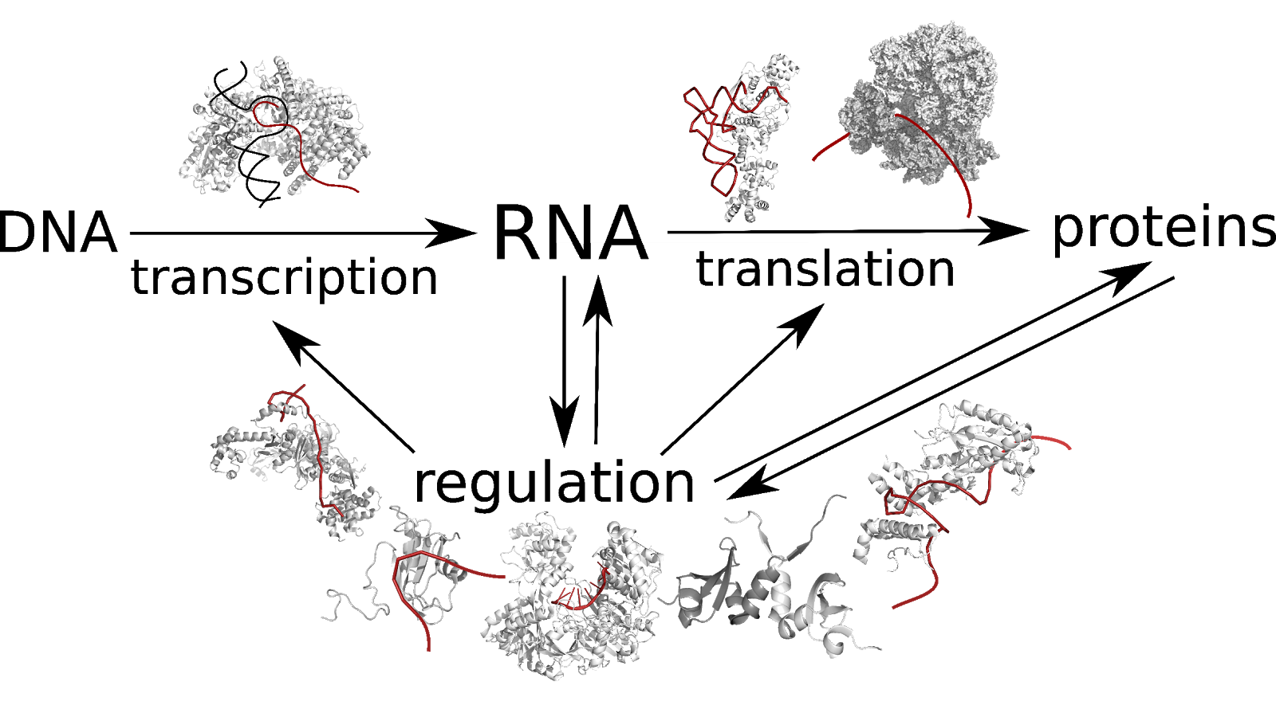
RNA-protein interactions
#of known human RNA binding proteins: 1900+ [2018]
Effect of protein binding on RNA: stability, folding, mediating interactions with other molecules → RNA synthesis, maturation, transport, storage, degradation
→ gene expression, metabolism

Slide 2
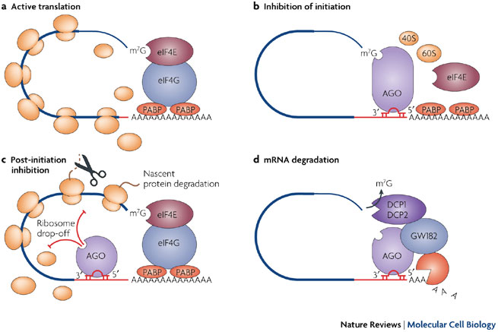

Slide 3
How do they interact?

Slide 4
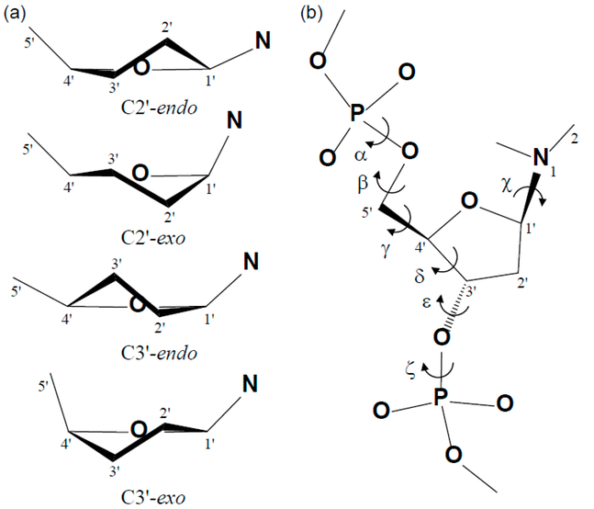
NA vs. proteins
NA: flexible backbone
proteins: 2 backbone torsions

Slide 5
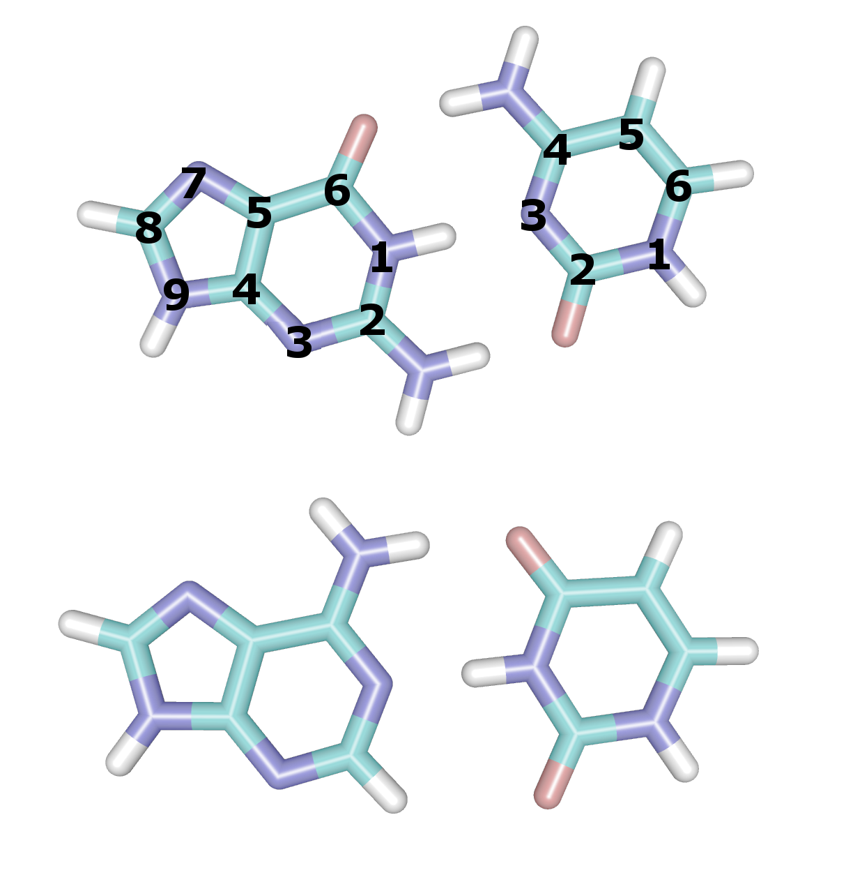
NA vs. proteins

Slide 6
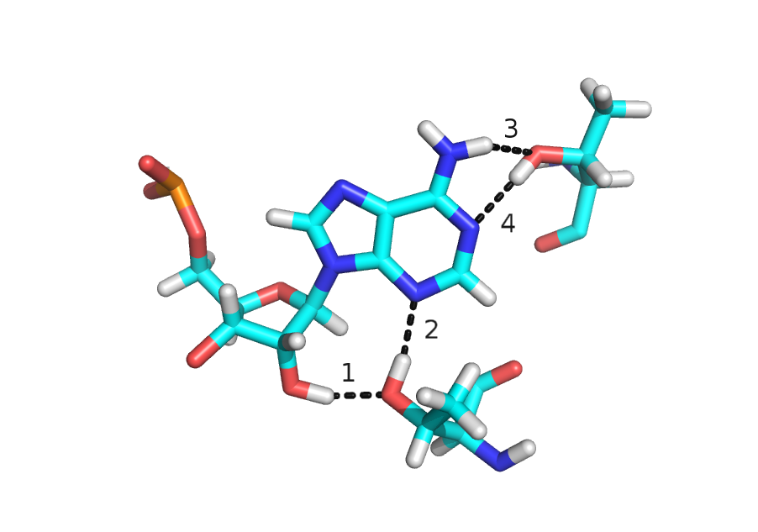
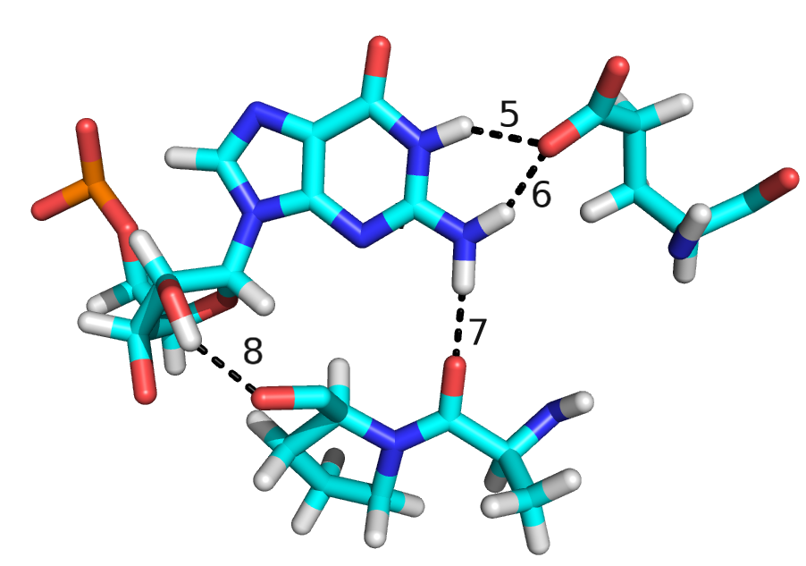
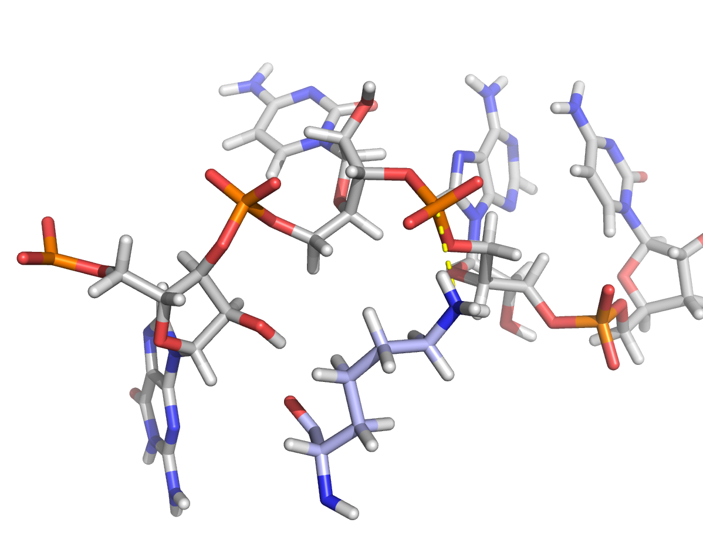
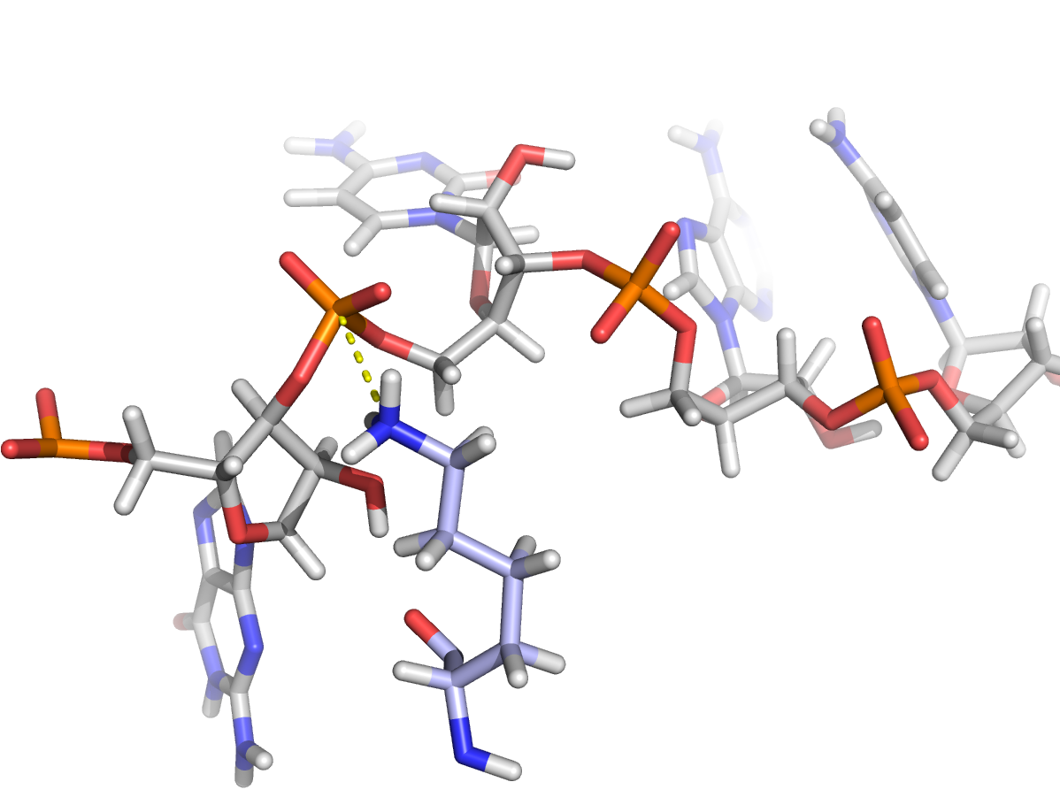

Slide 7
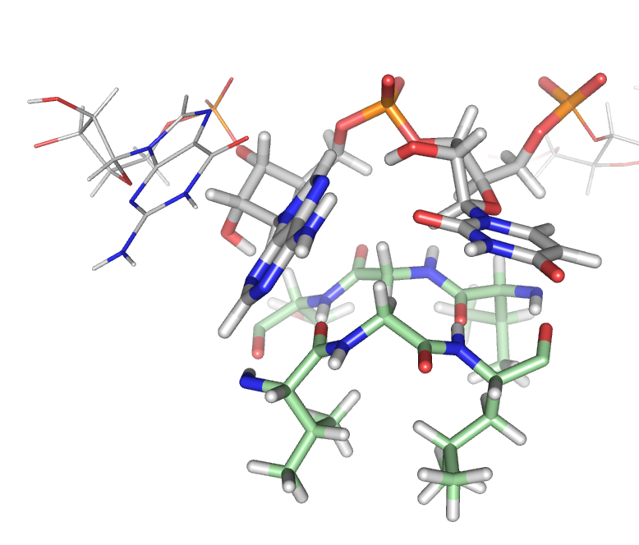
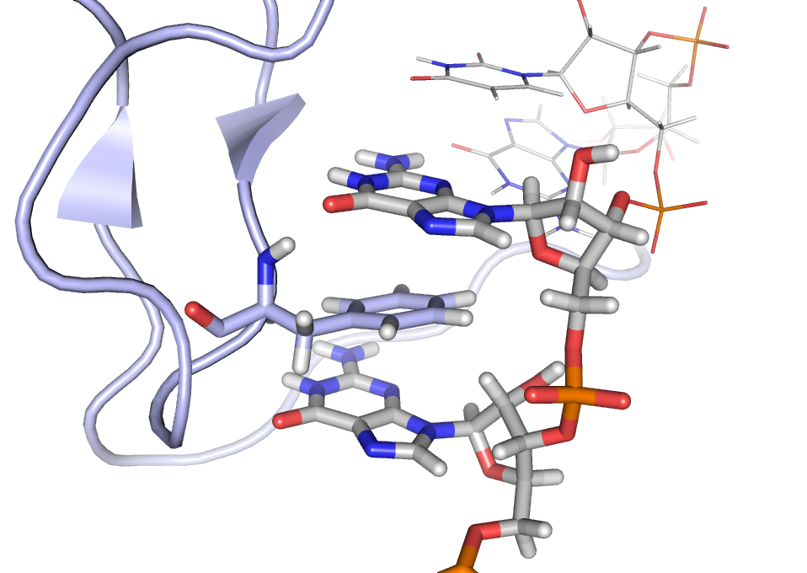

Slide 8
Driving forces for the interaction

Slide 9
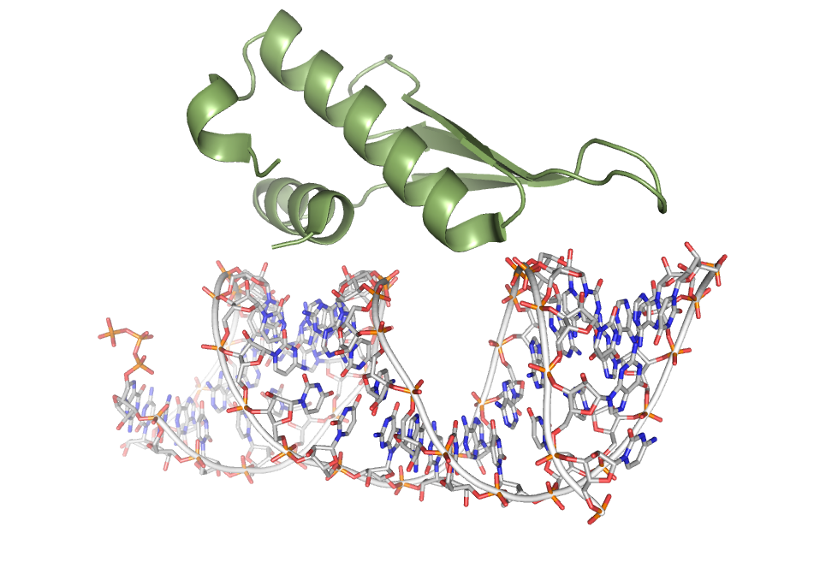
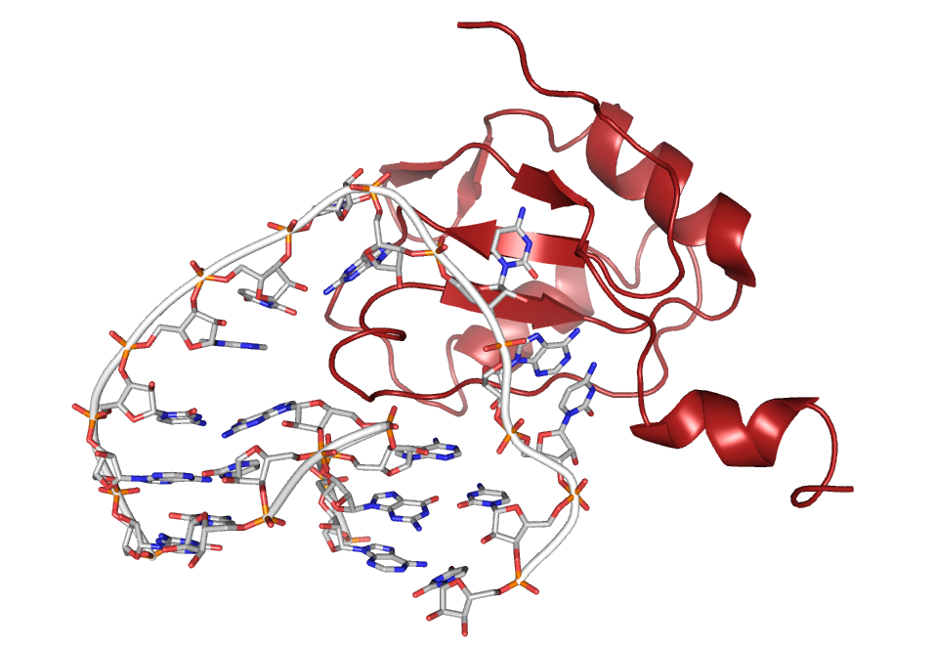
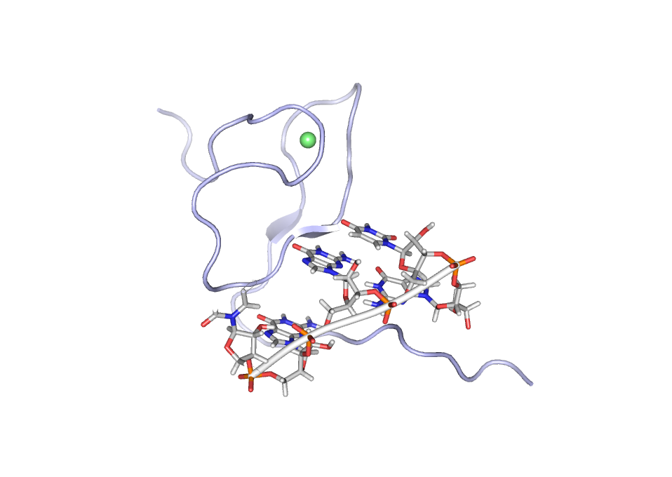
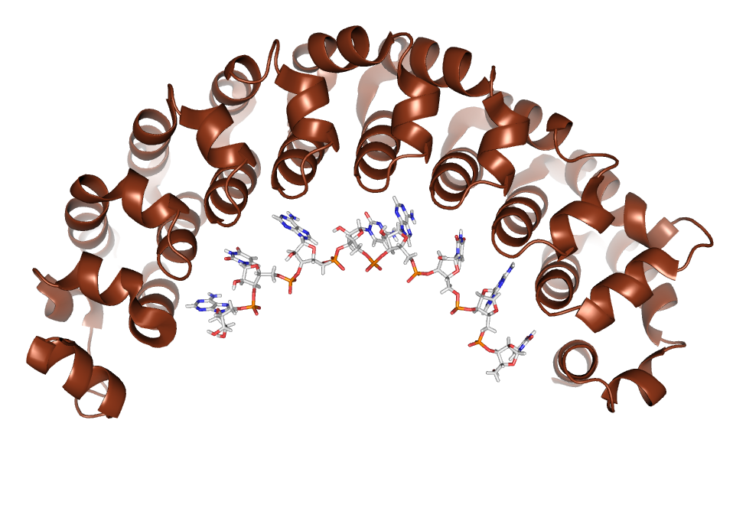
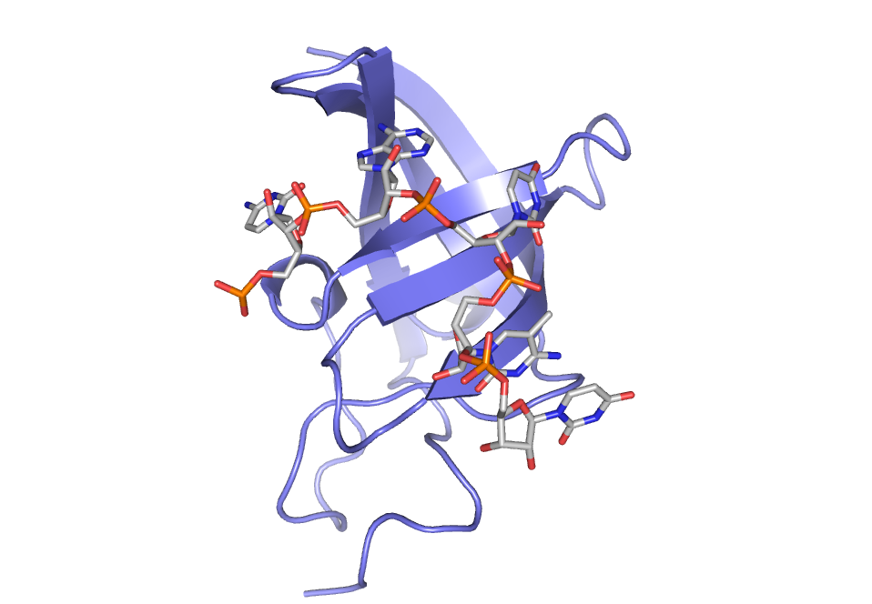
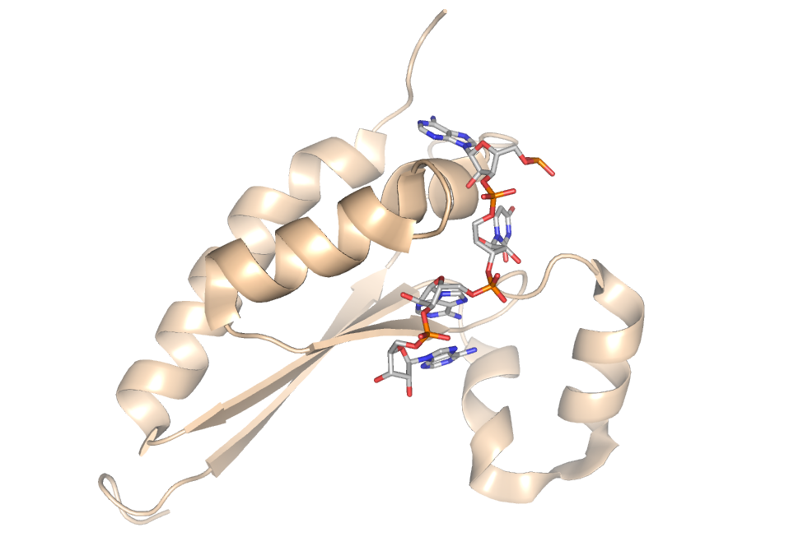
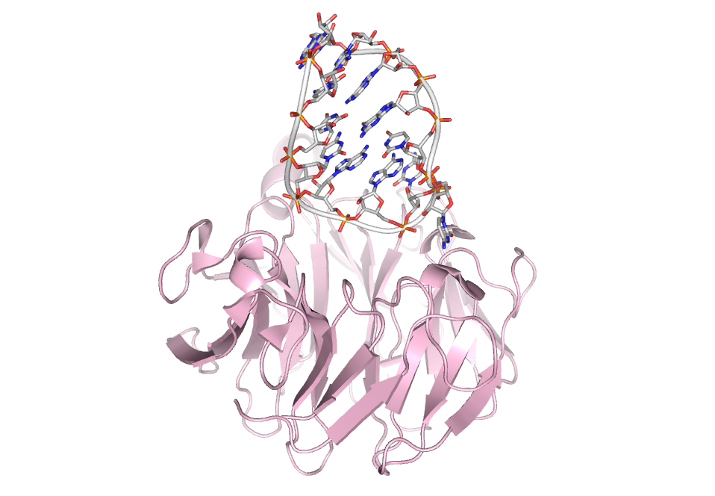
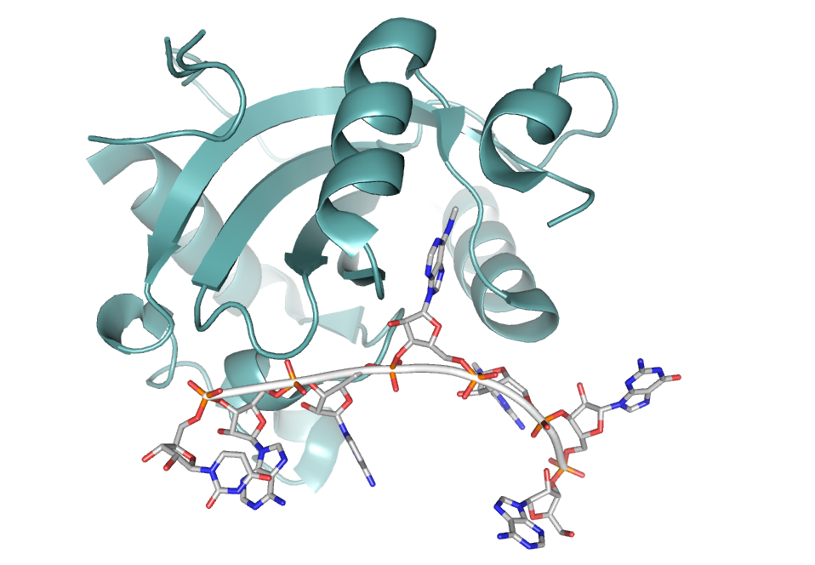
Diversity of protein-RNA binding strategies:
RNA-binding domains

Slide 10
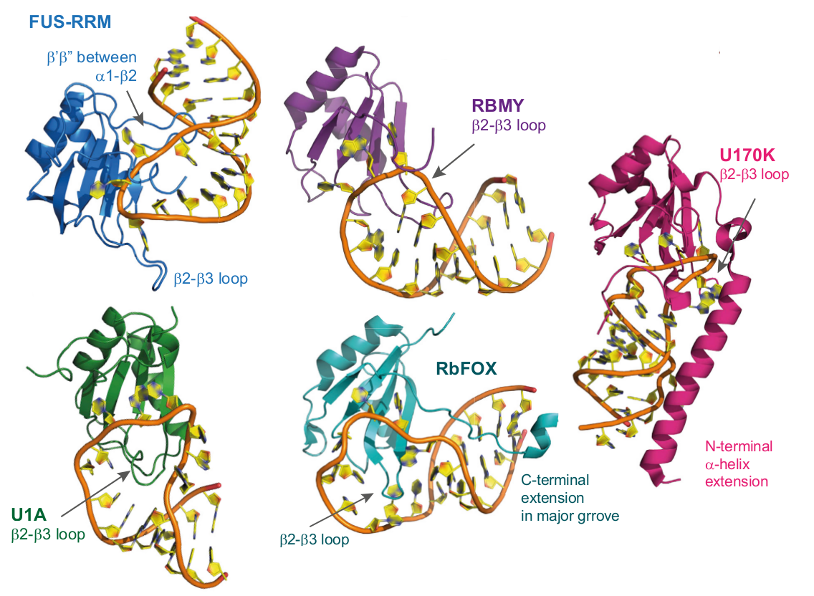
Diversity of protein-RNA binding strategies:
RNA-binding domains
for exaple: RRM
~650 of human proteins have at least one RRM (data from Pfam, Oct 2019)
involved in: RNA editing, pre‐mRNA processing, alternative splicing, mRNA stability and export, pre‐rRNA complex formation, translation regulation, degradation
figure from Loughlin et al., Moll. Cell, 2018

Slide 11
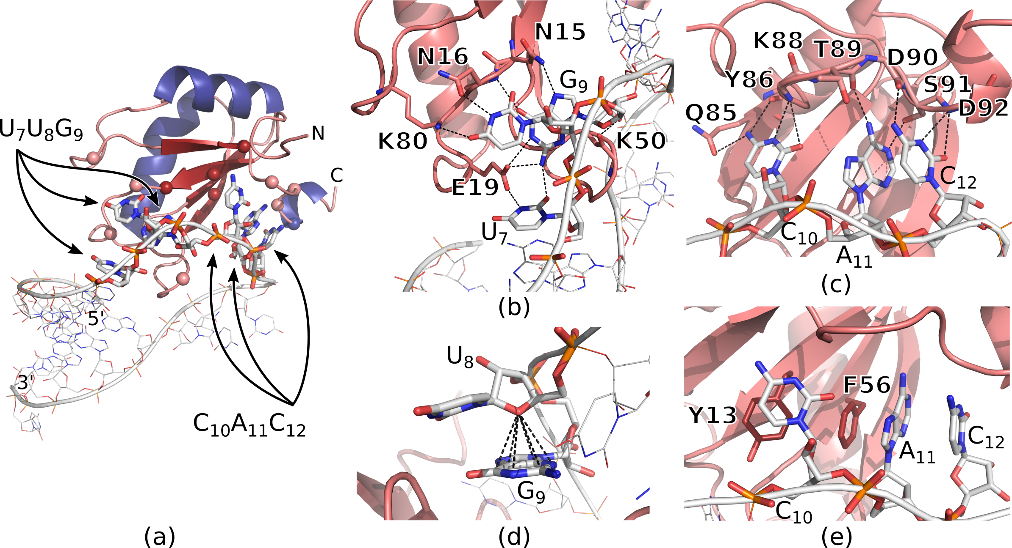
Diversity of protein-RNA binding strategies:
RNA-binding domains
for exaple: RRM
~650 of human proteins have at least one RRM (data from Pfam, Oct 2019)
involved in: RNA editing, pre‐mRNA processing, alternative splicing, mRNA stability and export, pre‐rRNA complex formation, translation regulation, degradation
U1A + U1 snRNA hairpin, figure from Pokorna et al., J. Chem. Theory Comput., 2018

Slide 12
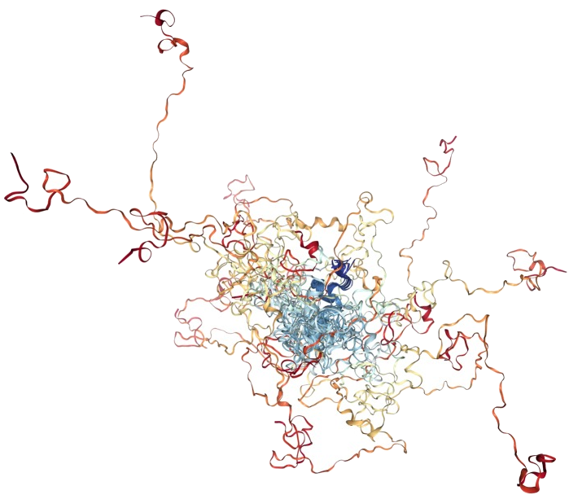
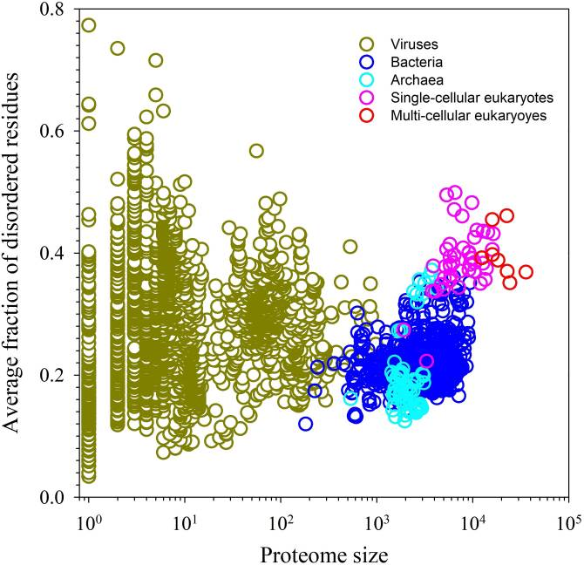
Diversity of protein-RNA binding strategies:
RNA-binding IDRs
IDR = intrinsically disordered region
RNA-binding subunit of the polyadenylation TRAMP complex
figures from Darling and Uversky, Front. Genet., 2018

Slide 13
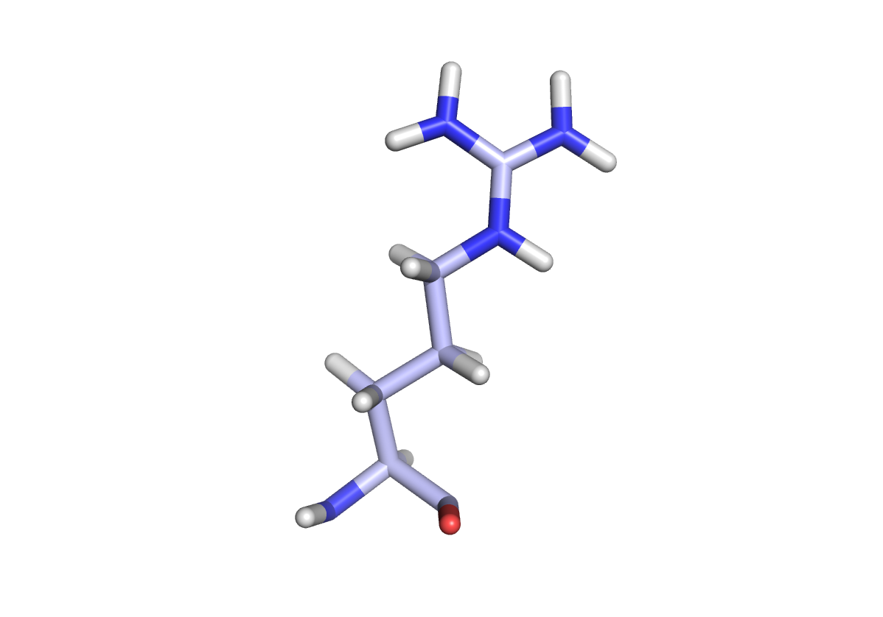
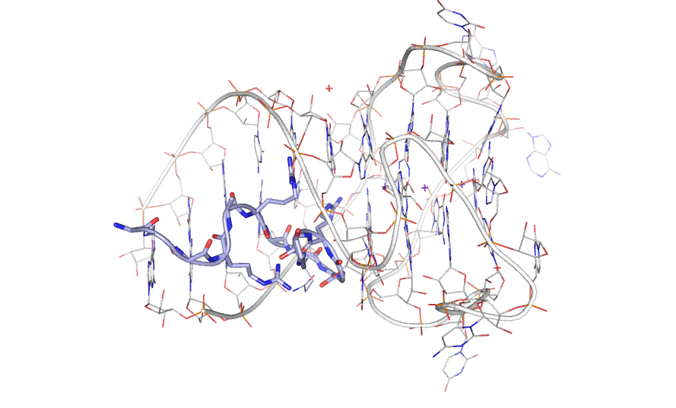
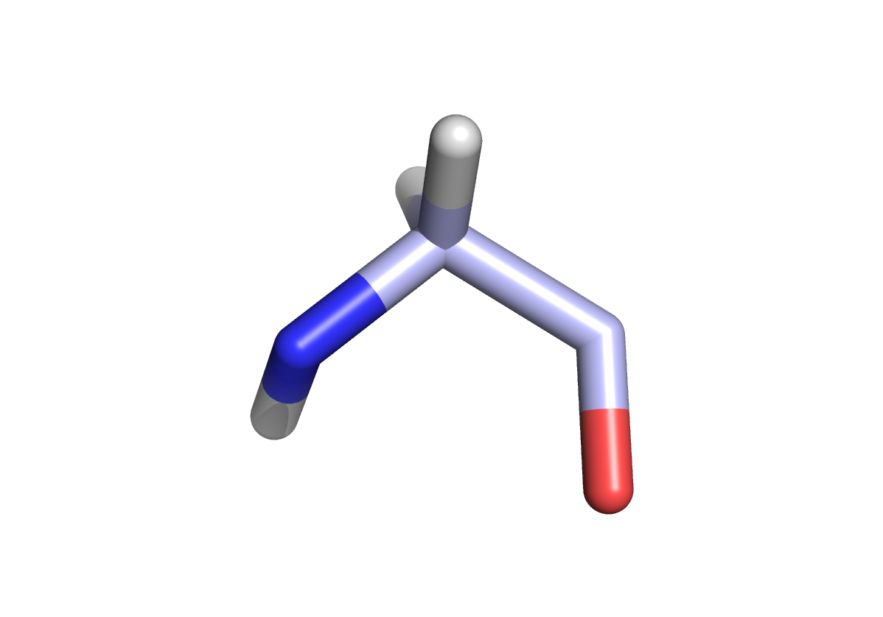
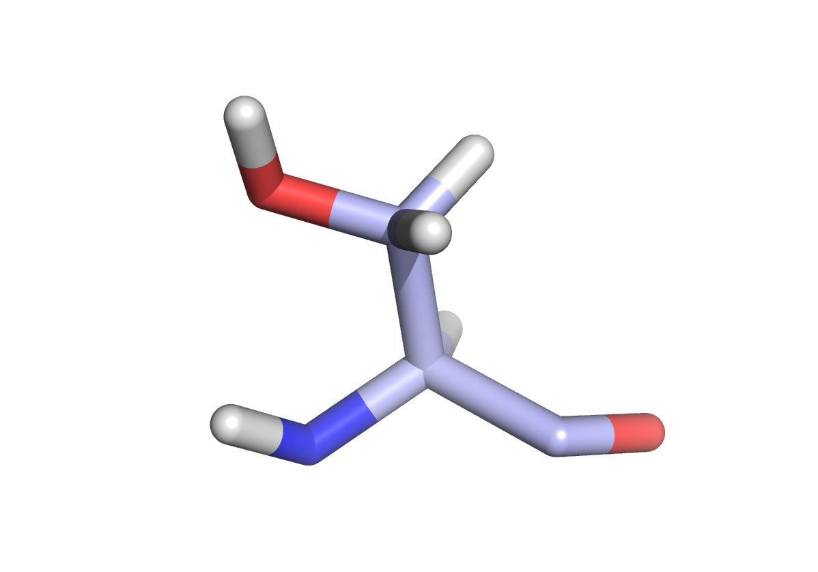
Diversity of protein-RNA binding strategies:
RNA-binding IDRs
IDR = intrinsically disordered region
RGG/RG motif
...RGRSGSGNFGGGRGGGFGGNDNFGRGGNFSGRGGFGGSRGGGGYGG...
+
Fused in sarcoma RGG2 sequence
...ARGDGRRRGGGGRGQGGR...
segment of fragile X mental retardation protein + RNA G-quadruplex, PDB: 5de5
R
G
RS-rich regions
...GPRSPSYGRSRSRSRSRSRSRSRSNSRSRSYSPRRSRGSPRYSPRHSRSRSRT...
S
Serine/arginine-rich splicing factor 1, RS domain sequence

Slide 14
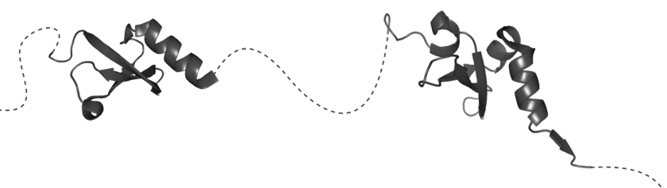
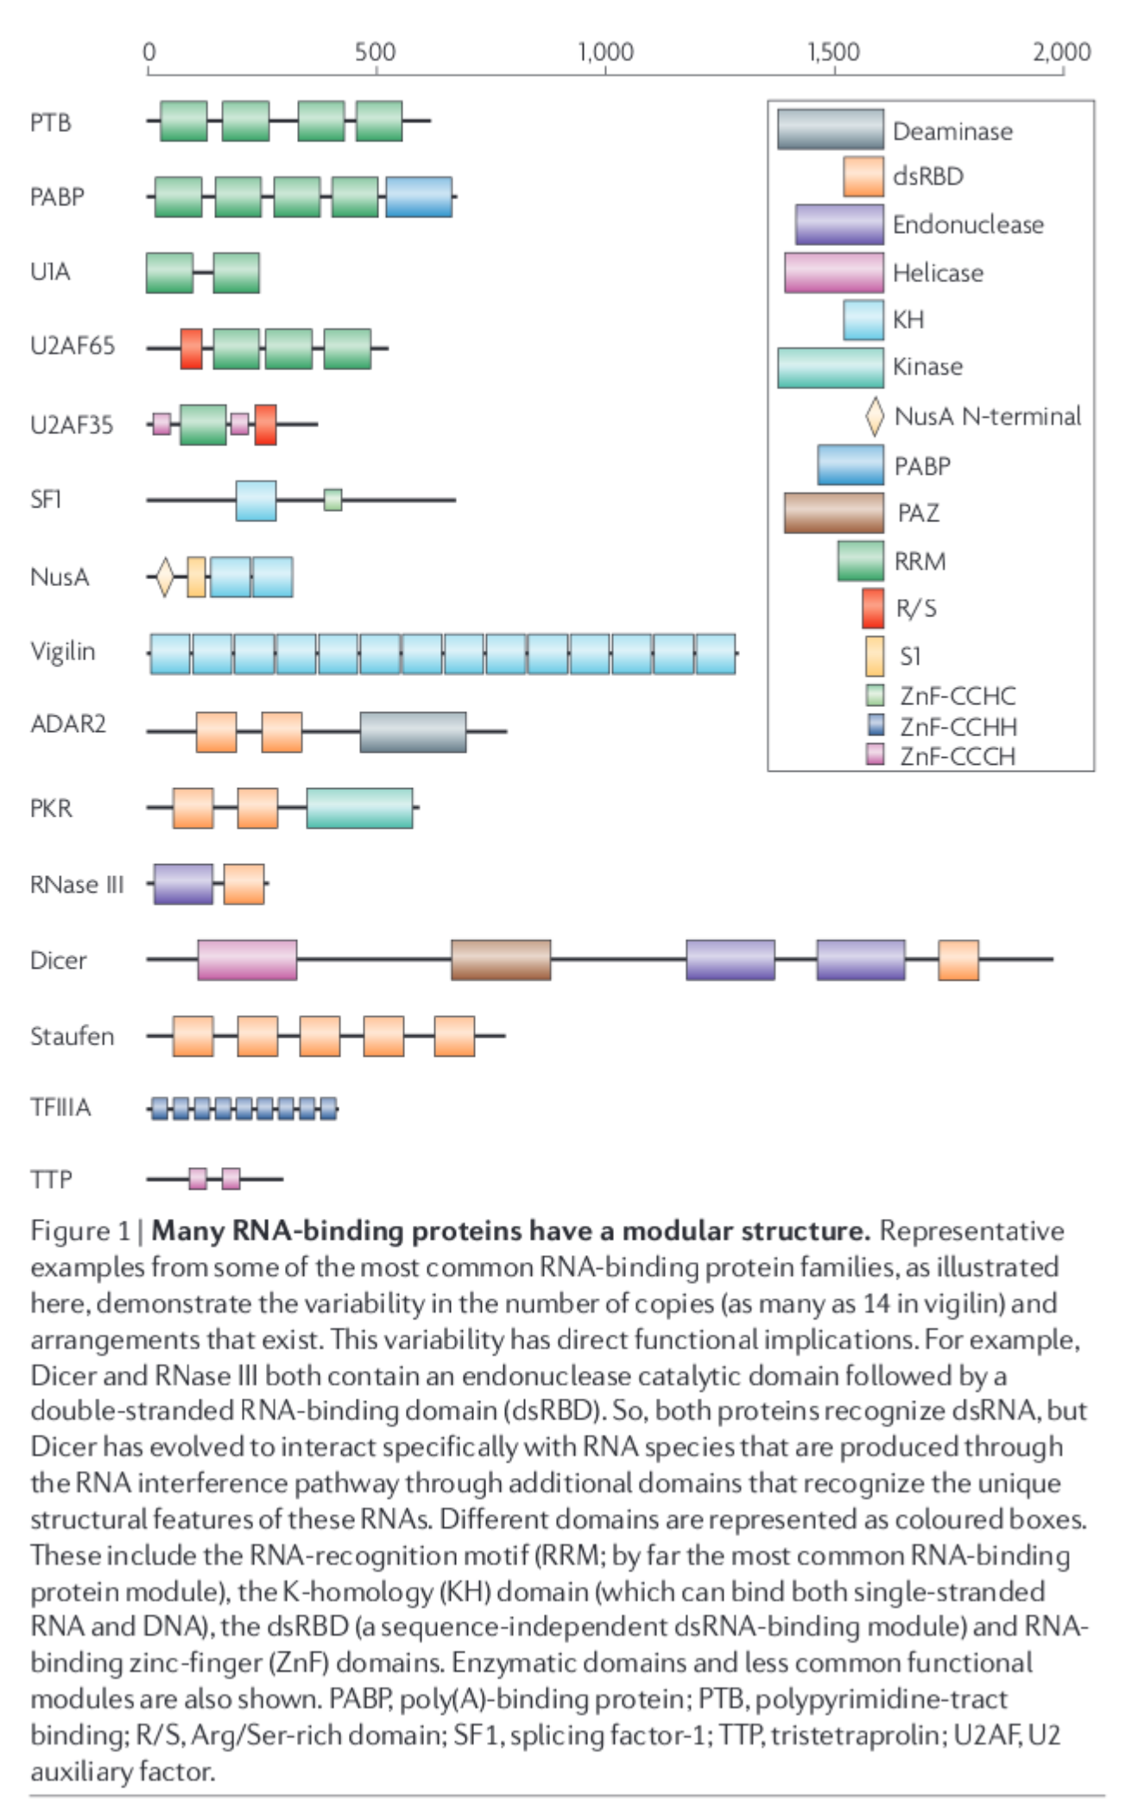
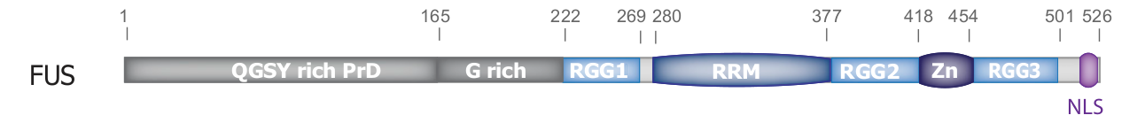
Modularity of RNA-binding proteins
domains, IDRs
→ affinity, specificity
from Lunde et al., Nat. Rev. Mol. Cell Biol., 2007

Slide 15
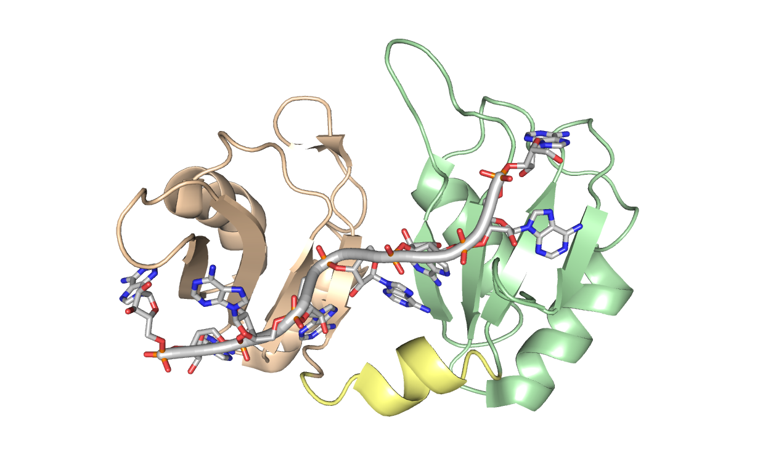
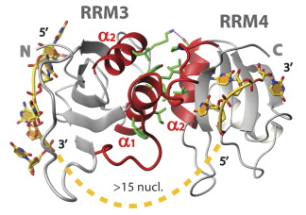
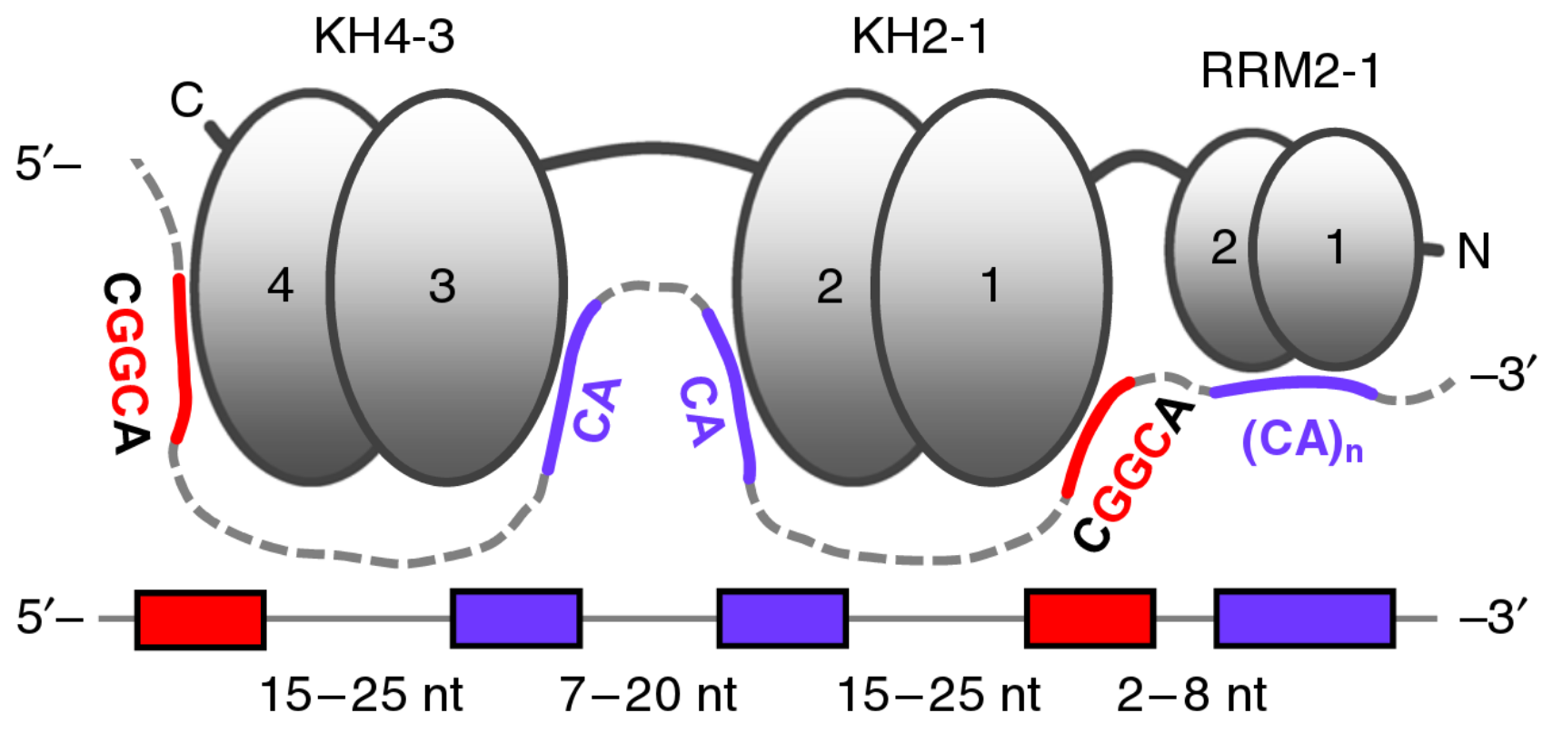
Linkers
polypyrimidine tract binding protein, figure from Clery et al., Curr. Opin. Struct. Biol., 2008
poly(A)-binding protein, PDB: 1cvj

Slide 16
Modularity
insulin-like growth factor 2 mRNA-binding protein 3,figure from Schneider et al., Nat. Commun., 2019

Slide 17
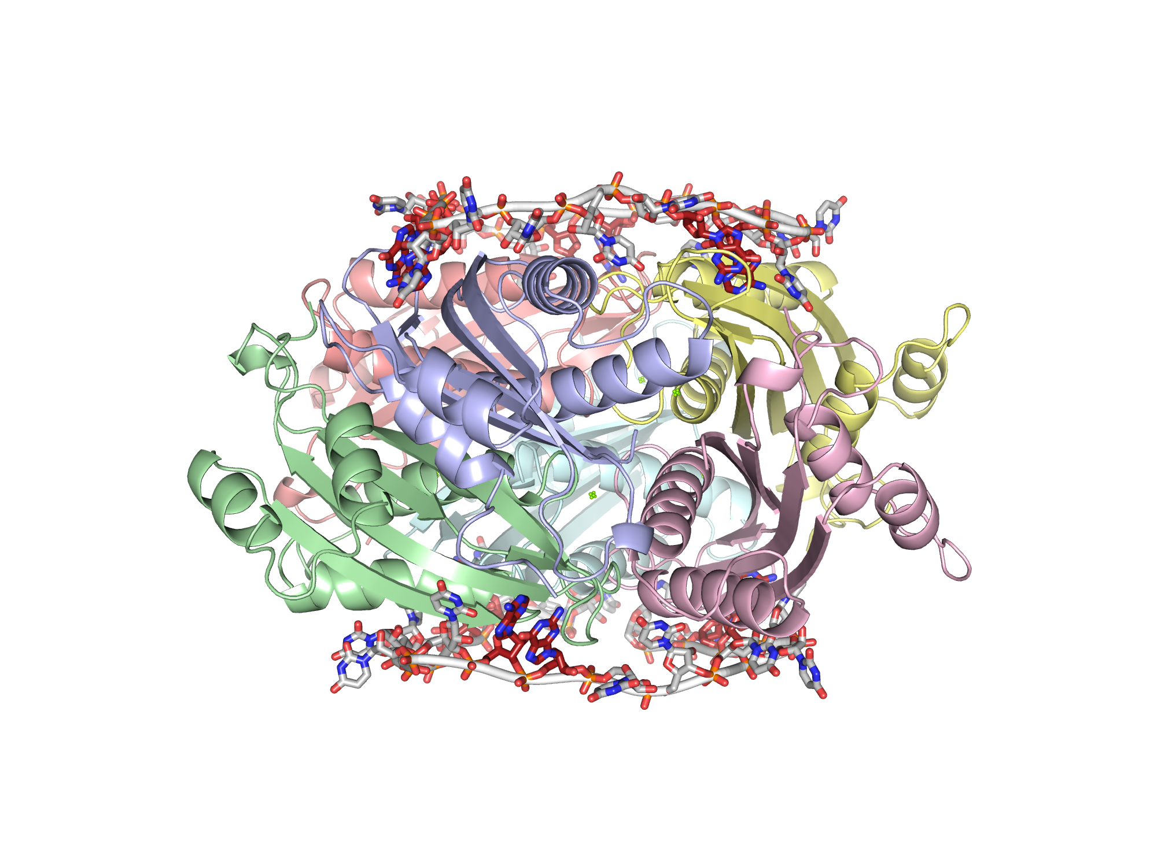
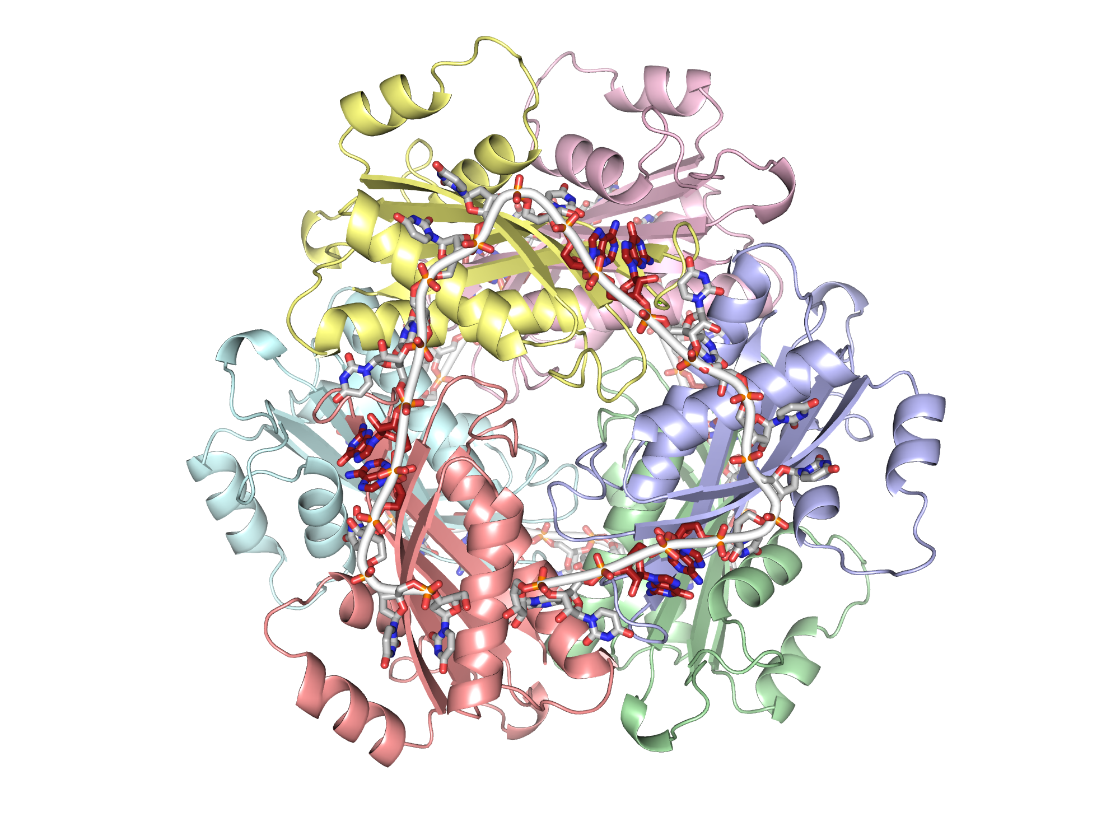
Homomultimers – reading of repetitive motifs
RNA: NNAGNNNNNAGNNNNNAGNN
histidine utilization positive regulatory protein, PDB: 3boy

Slide 18
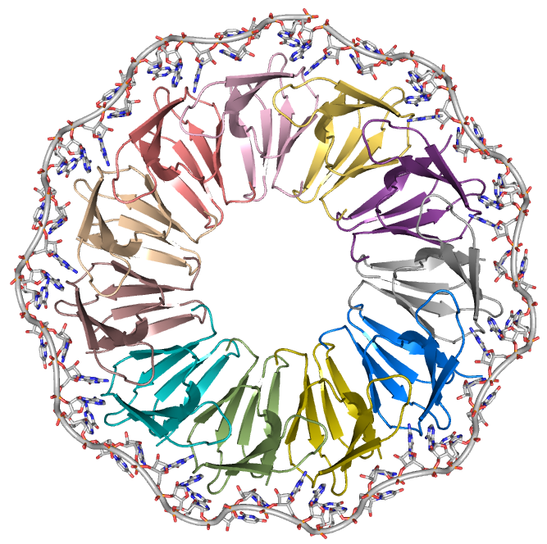
tryptophan RNA-binding attenuation protein, PDB: 1c9s

Slide 19
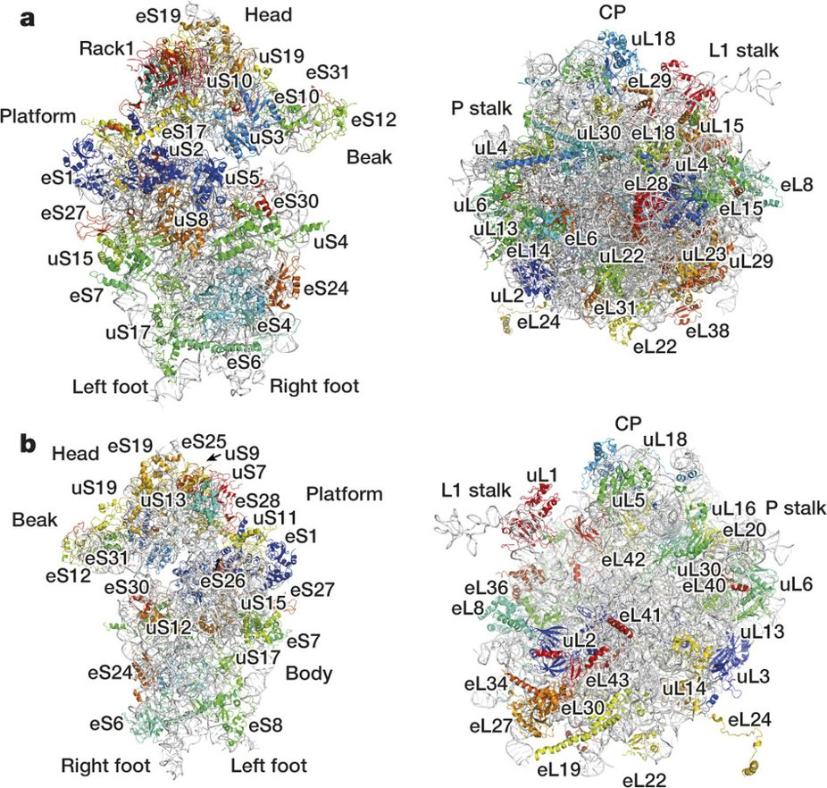
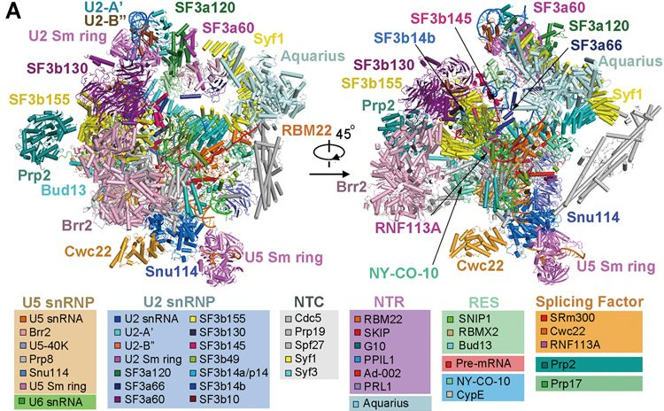
Large RNPs
RNP = ribonucleoprotein
human 80S ribosome, figure from Khatter et al., Nature, 2015
activated spliceosome (B^{act} state), figure from Zhang et al., Nature, 2018

Slide 20
Dynamics of RNA-protein binding

