Slide 1
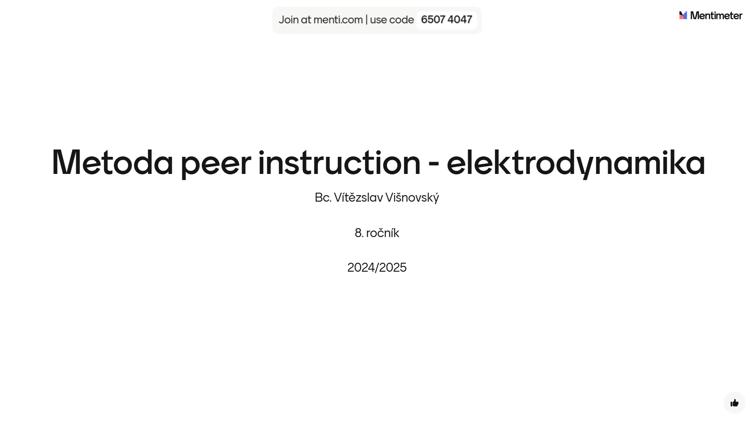

Slide 2
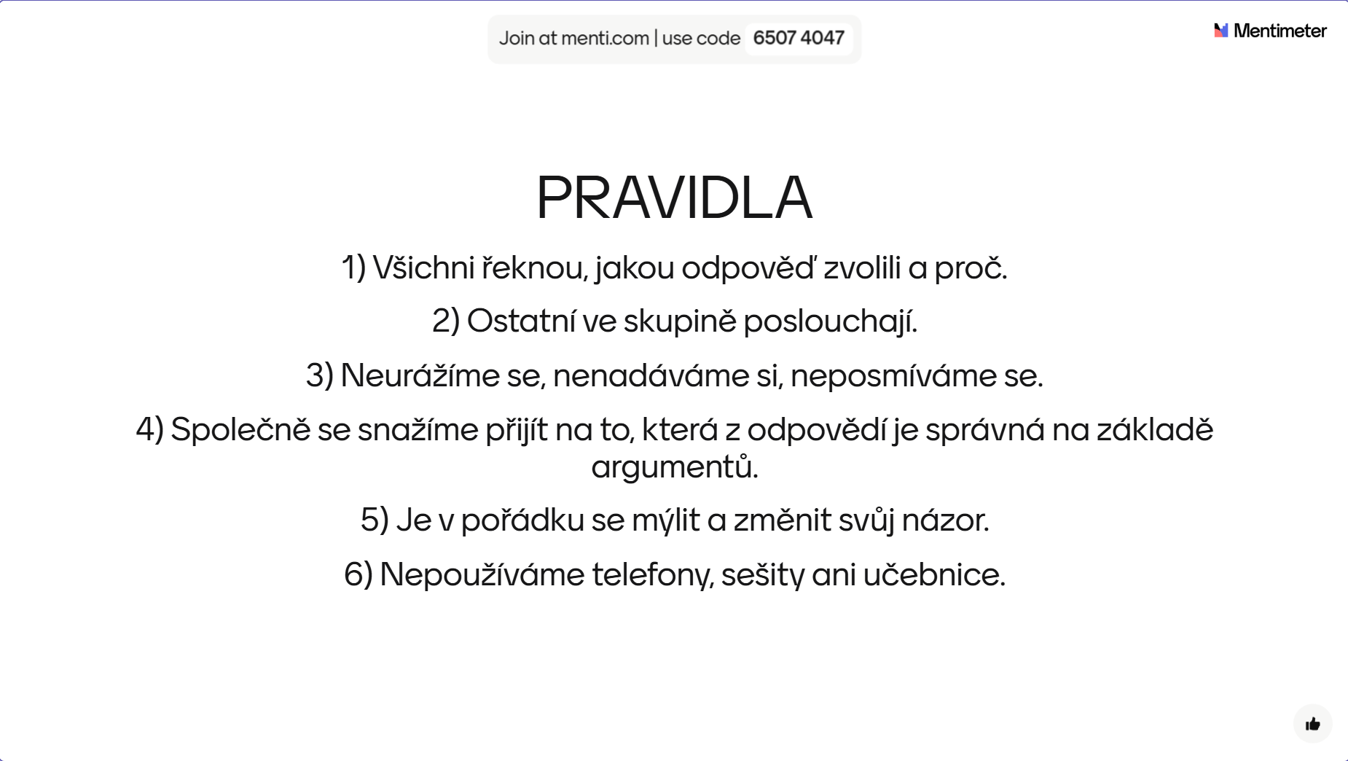

Slide 3
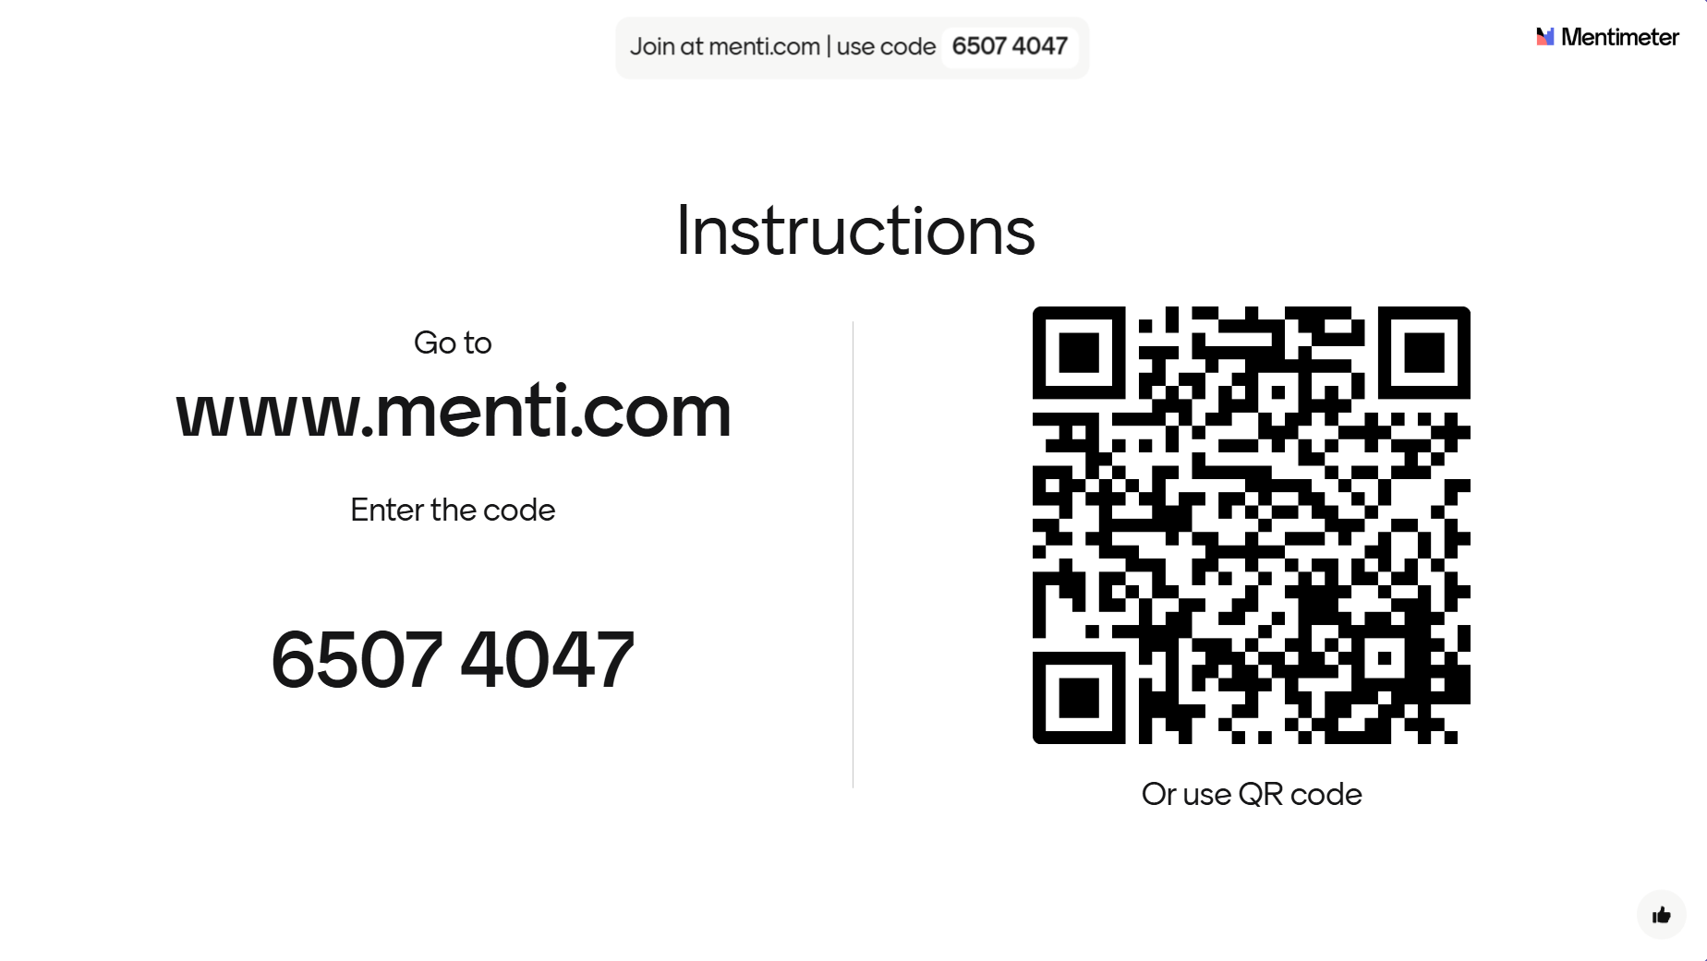

Slide 4
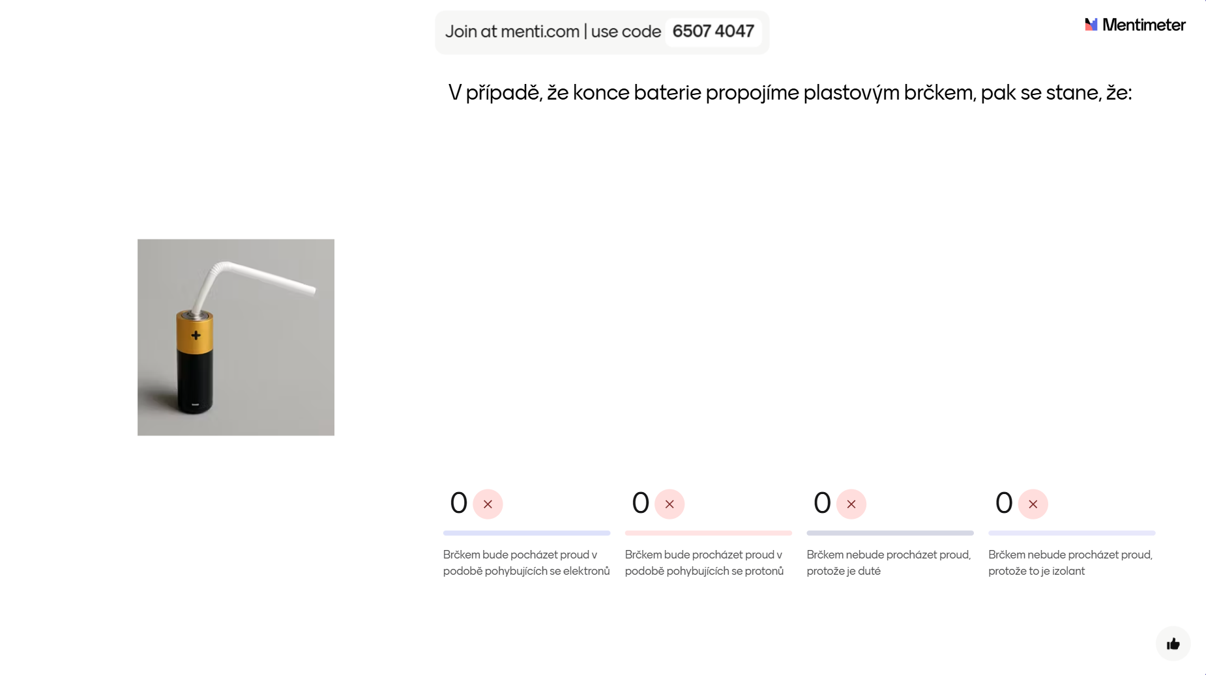

Slide 5
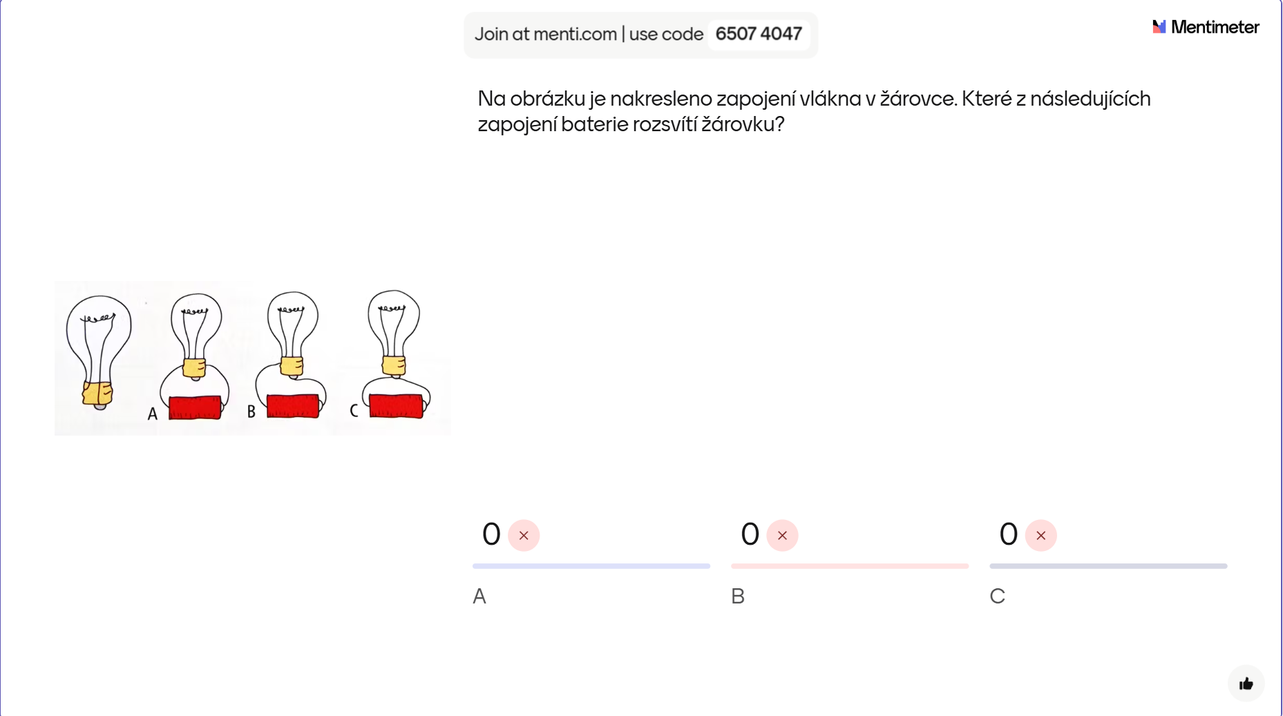

Slide 6
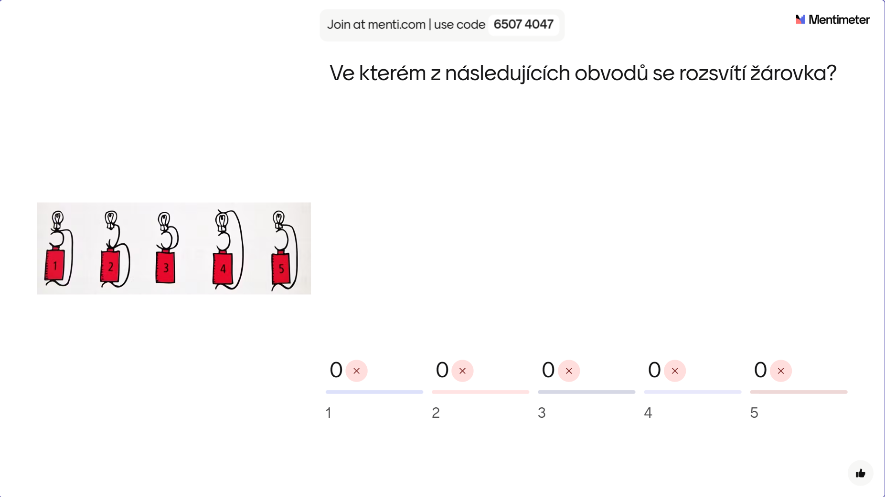

Slide 7
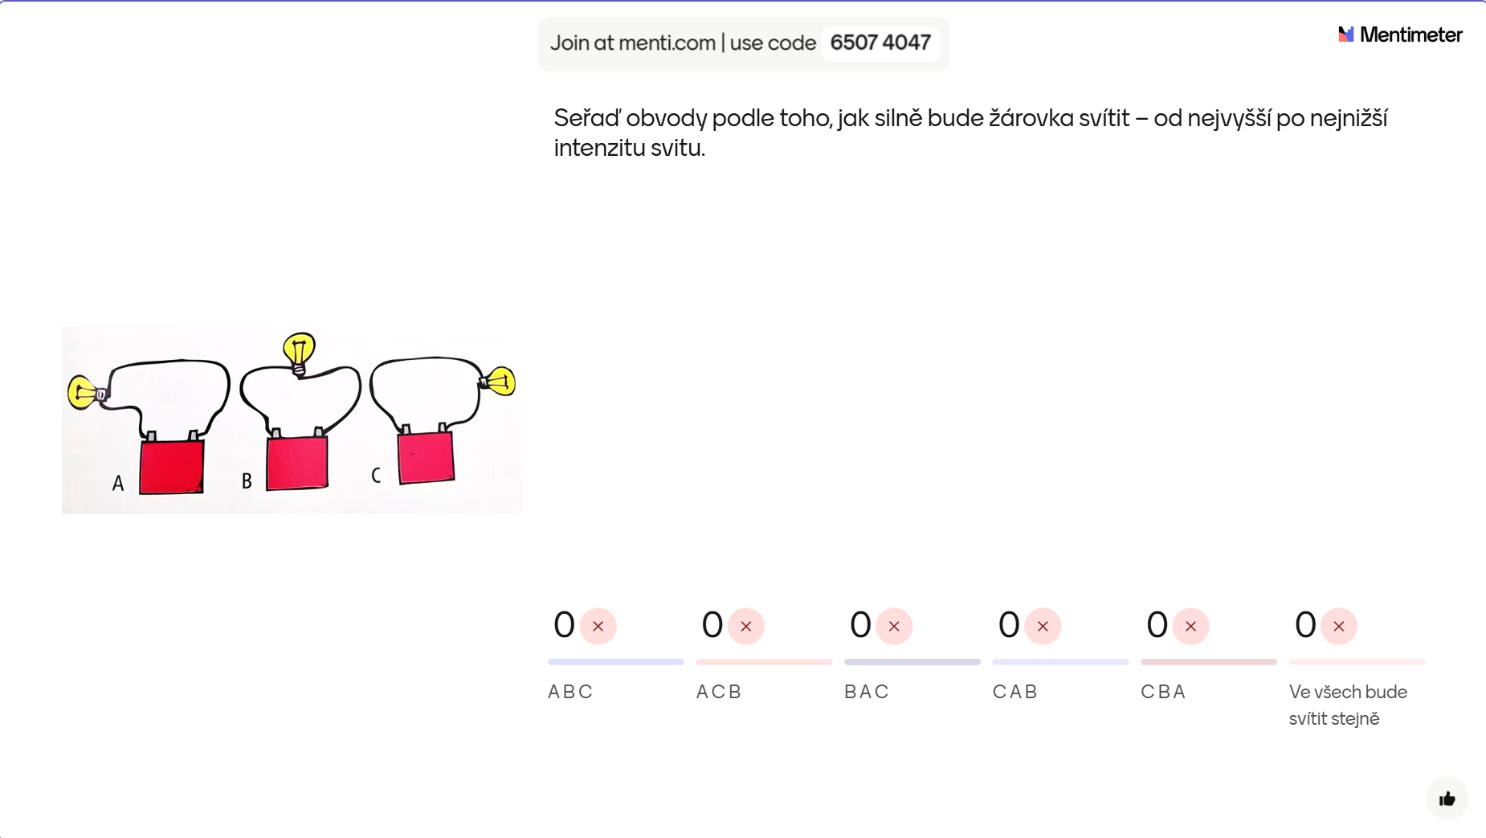

Slide 8
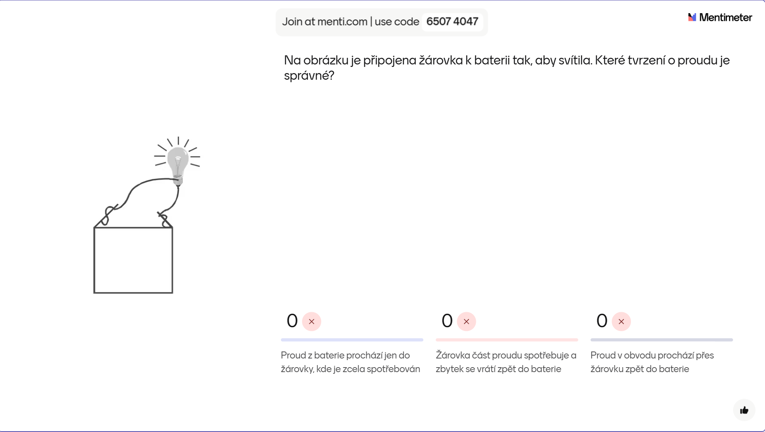

Slide 9
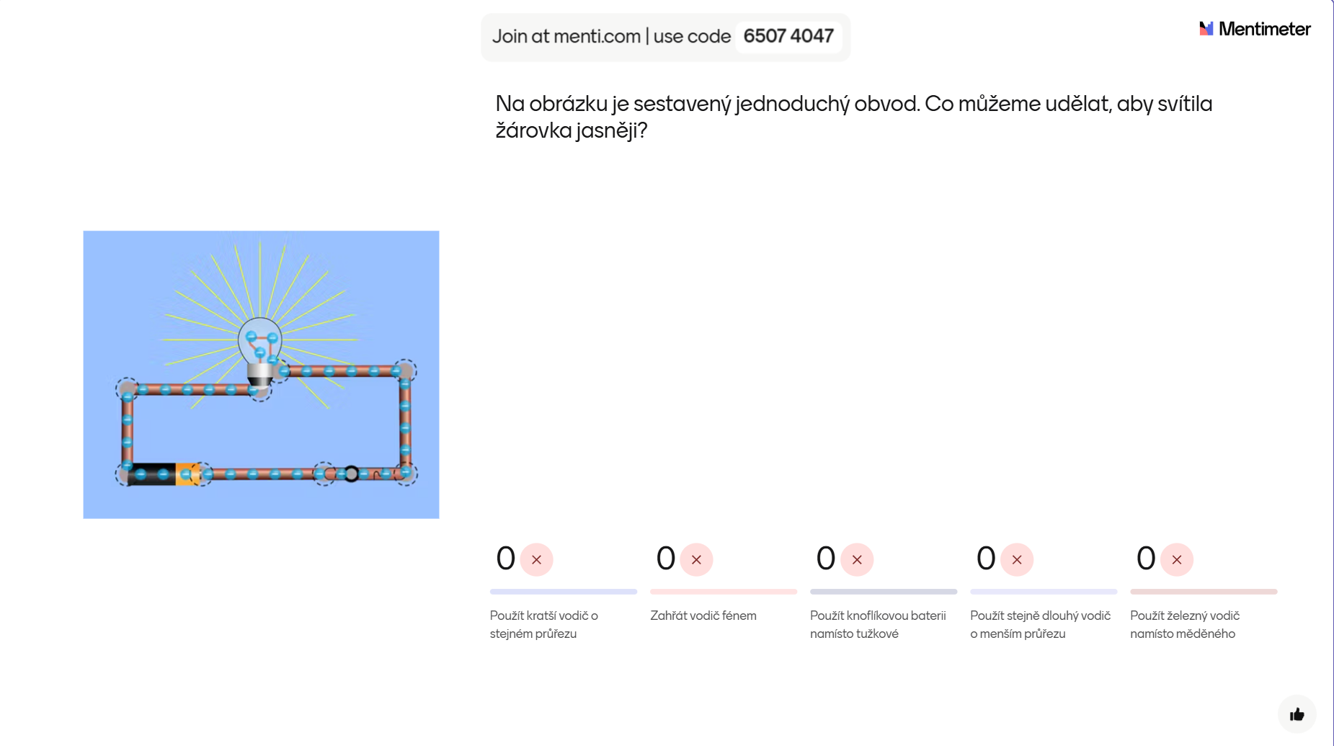

Slide 10
Zdroje
OpenAI. (2025). Běžící muž [Generated image]. DALL·E. https://openai.com/dall-e - slide 4
Hewitt, P. G. (2023). Conceptual Physics, Global Edition (13th edition), PEARSON Education Limited.
– slide 5, 6, 7
Mandíková, D., & Trna, J. (2011). Žákovské prekoncepce ve výuce fyziky. (1st edition). Paido. – slide 8
PhET Interactive Simulations. (2025a, March 26). Stavba obvodu: DC (Version 1.4.0) [Interactive simulation]. University of Colorado Boulder. https://phet.colorado.edu/sims/html/circuit-construction-kit-dc/latest/circuit-construction-kit-dc_all.html?locale=cs – slide 9

